Slide 1
Code optimization
Geert Jan Bex (geertjan.bex@uhasselt.be)
License: this presentation is released under the Creative Commons CC BY 4.0, see https://creativecommons.org/licenses/by/4.0/deed.ast

Slide 2

http://bit.ly/2O0jCDS

Slide 3
Introduction

Slide 4
Moore's law
In the good, old days…
CPU clock frequency increased: performance was free lunch
Problems
Heat dissipation
Power efficiency
However…
"The number of transistors in a dense integrated circuit doubles approximately every two years".

Slide 5
Levels of parallelism
Vectorization
libraries (e.g., MKL)
compiler flags
directives: programmer can/should help
Multiple cores
OpenMP/pthreads
libraries (e.g., MKL)
programmer
Multiple nodes, i.e., distributed computing
MPI/CAF/UPC/Chapel
programmer
GPGPU
CUDA/OpenACC/OpenCL
libraries (e.g., TensorFlow)
programmer
hybrid

Slide 6
Anatomy
Applications
Have one or more processes
Run on one or more compute nodes
Processes
Communicate through message passing (e.g., MPI)
Have one or more threads
Run on single compute node, one or more cores
Threads
Communicate through shared memory (e.g., OpenMP)
Run on single core

Slide 7
Parallel scaling

Slide 8
Dimensions for scaling
Scaling considered in two dimensions
solve same problem faster by using more resources
solve larger problem by using more resources
Strong scaling
Weak scaling

Slide 9
What you hope/expect for…
strong scaling
weak scaling
execution time
nr. processes
Is this going
to happen?
system size
execution time ∼
nr. processes

Slide 10

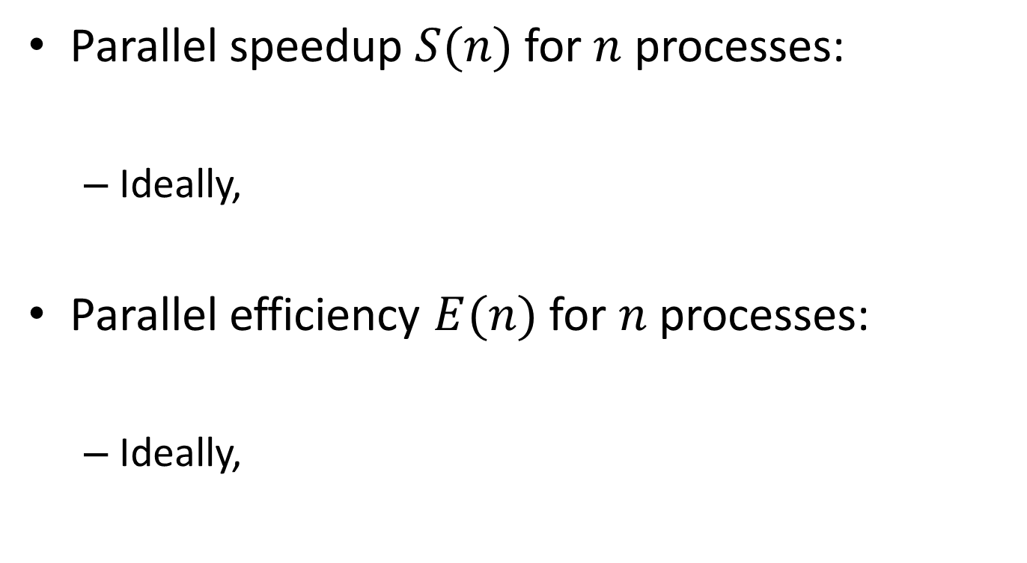



Definitions
Parallel speedup $S(n)$ for $n$ processes:
Ideally,
Parallel efficiency $E(n)$ for $n$ processes:
Ideally,
$$S(n)=\frac{T_{1}}{T_{n}}$$
$$S(n)=n$$
$$E(n)=\frac{T_{1}}{nT_{n}}$$
$$E(n)=1$$

Slide 11
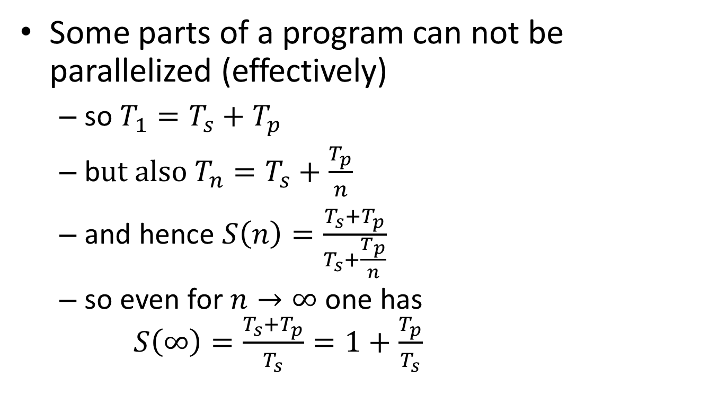
Strong scaling: oops!?!
Some parts of a program can not be parallelized (effectively)
so $T_{1}=T_{s}+T_{p}$
b$ut also T_{n}=T_{s}+\frac{T_{p}}{n}$
and hence $S\left(n\right)=\frac{T_{s}+T_{p}}{T_{s}+\frac{T_{p}}{n}}$
so even for $n→∞$ one has $S\left(∞\right)=\frac{T_{s}+T_{p}}{T_{s}}=1+\frac{T_{p}}{T_{s}}$
Hard limit on speedup due to serial part: Amdahl's law

Slide 12
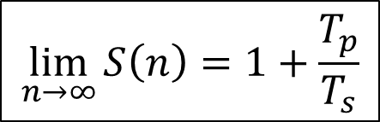

Amdahl's law
speedup
nr. processes
$$\lim_{n→∞}{S\left(n\right)=1+\frac{T_{p}}{T_{s}}}$$
$$\lim_{n→∞}{E\left(n\right)=0}$$

Slide 13
It gets worse…
Overhead!
communication takes time
finite bandwidth
non-zero latency
resource contention
memory subsystem: L3 cache, RAM, QPI
network access
speedup
nr. processes

Slide 14
Picking the sweet spot
sweet spot
speedup
sweet spot
nr. processes
efficiency
nr. processes

Slide 15
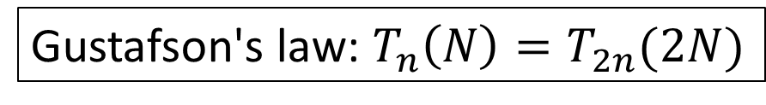
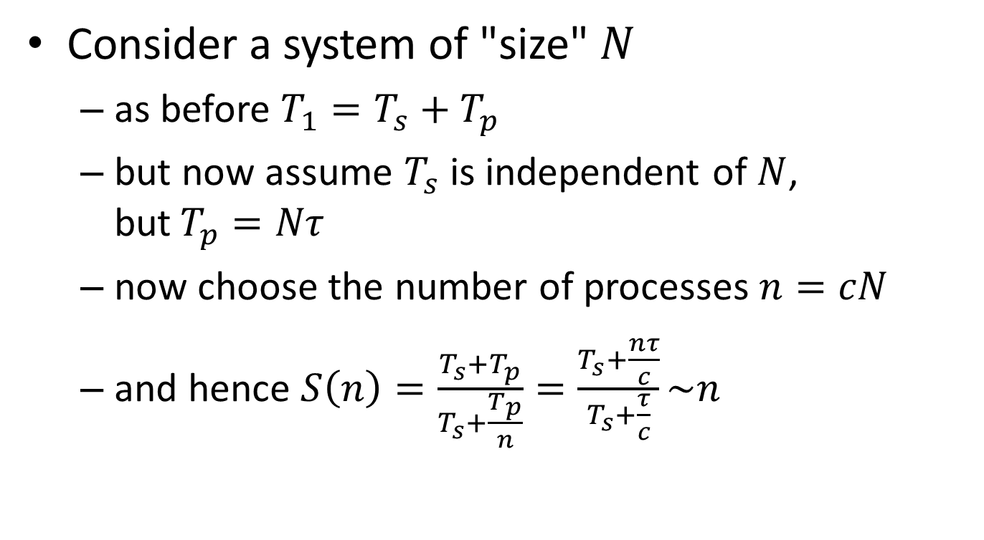
Weak scaling
Consider a system of "size" $N$
as before $T_{1}=T_{s}+T_{p}$
but now assume $T_{s}$ is independent of $N$, but$T_{p}=Nτ$
now choose the number of processes $n=cN$
and hence $S\left(n\right)=\frac{T_{s}+T_{p}}{T_{s}+\frac{T_{p}}{n}}=\frac{T_{s}+\frac{nτ}{c}}{T_{s}+\frac{τ}{c}}\sim n$
Gustafson's law: $T_{n}\left(N\right)=T_{2n}(2N)$
Nice for scientists!

Slide 16
We love Gustafson
Scientist are interested in
studying larger systems/bigger data sets
increasing precision/resolution
more complex phenomena
…

Slide 17
Throughput computing
N independent tasks
Total number of cores n << N
Execution time single task, 1 thread: t₁
Execution time single task, n threads: t_{n}
Multithreading or not?
However: memory?

Slide 18
Computer architecture

Slide 19
Compute node architecture
Socket 0
NUMA node 0
Socket 1
NUMA node 1
L1
L2
L3
L1
L2
L1
L2
L3
L1
L2
DDR3
core0
core5
core10
core15
DDR3
L1
L2
L1
L2
L1
L2
L1
L2
core1
core6
QPI
core11
core16
DDR3
DDR3
L1
L2
L1
L1
L2
L1
L2
L2
L1
L2
core2
core0
QPI
core17
core7
core12
DDR3
L1
L2
L1
L2
L1
L2
L1
L2
DDR3
core3
core8
core13
core18
DDR3
L1
L2
L1
L2
L1
L2
L1
L2
DDR3
core4
core9
core14
core19
IB
I/O

Slide 20
Memory

Slide 21
Memory hierarchy
Bandwidth: 130 GB/s
Data transport takes time!
RAM
size: 64 GB+
latency: 150 cycles
L3 cache
size: 25 MB+
latency: 50 cycles
L2 cache
size: 256 kb
latency: 20 cycles
L1 cache
size: 32 kb data + 32 kb instruction
latency: 5 cycles
QPI incurs 10 % loss
on average: 3 MB/core

Slide 22
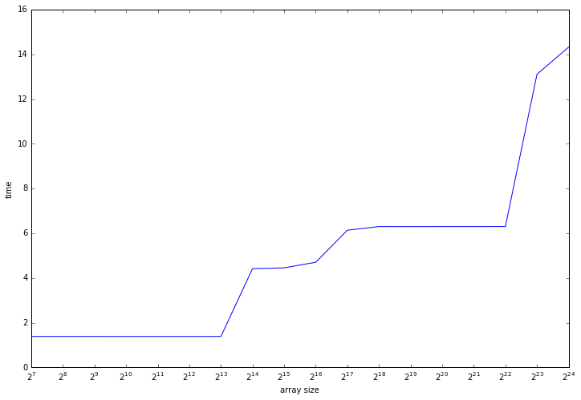
Memory hierarchy timings
L1
L2
L3
16 Mb
256 kb
32 kb

Slide 23
Cache lines
Transport 64 byte at once: RAM → L3 → L2 → L1
cache line
8 double or 16 single precision
Data structure layout is critical!
access to contiguous data
not exploited: effective • memory bandwidth/8 or 16
• cache size/8 or 16
double a[n];
…
for (i = 0; i < n; i++)
f(a[i])
…
a[i-1]
a[i]
a[i+1]
…
a[i+7]
a[i+8]
…
cache line
cache line

Slide 24
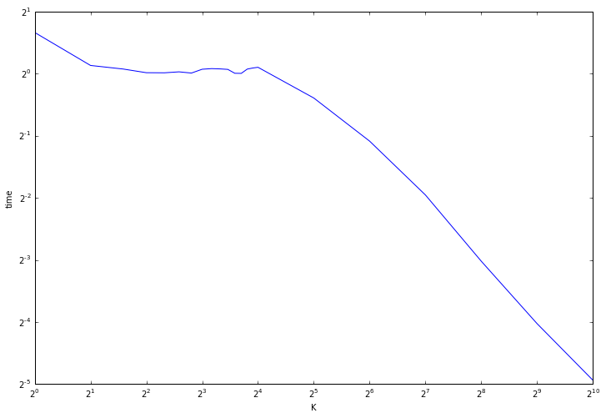
Cache line timings
int a[n];
…
for (i = 0; i < n; i += K)
a[i] *= 3
stride 16
less work, almost equal time!
memory bound,
equal number
of cache lines
to fetch
less work, less cache lines to fetch

Slide 25
Multidimensional arrays
Ordering of 2D/3D/… arrays
by row: C/C++
by column: Fortran, Matlab
…
a_{1,1}
a_{1,2}
a_{1,3}
a_{2,1}
a_{2,2}
a_{2,3}
…
row-major
Access in "wrong" order: performance degradation!
…
a_{1,1}
a_{2,1}
a_{3,1}
a_{1,2}
a_{2,2}
a_{3,2}
…
column-major

Slide 26
AoS versus SoA
Array of Structs versus Struct of Arrays?
struct particle {
double x, y, z, m;
int q;
};
struct particle particles[n];
…
x_{i}
y_{i}
z_{i}
m_{i}
q_{i}
x_{i+1}
…
cache line
May transport useless data: performance degradation
struct particles {
double x[n], y[n], z[n],
m[n];
int q[n];
};
…
x_{i}
x_{i+1}
x_{i+2}
y_{i}
y_{i+1}
…
cache line

Slide 27
Cache associativity: size matters
Lower bits of memory address: slot in cache
L2: 8-way associative, 256 kb
cache line: 64 byte, so 262144/64 = 4096 slots
8-way, so 4096/8 = 512 sets, 8 slots each
when slots are full, eviction from cache, so data 512 × 64 = 32768 bytes apart competes for slots
L1/L2: 8-way associative L3: 20-way associative
Cache evictions limit reuse, reduce performance!
Cache info:
dmidecode –type 7

Slide 28
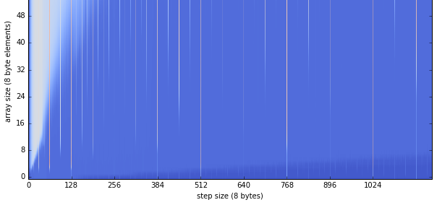
Performance impact
Cache size
Avoid 2D/3D arrays with sizes 2^{n}
Performance drop

Slide 29
CPU

Slide 30
Vectorization
Arithmetic operation done on registers
Vector registers for floating point operands: 256 bit wide
4 double precision
8 single precision
4 concurrent operations
8 concurrent operations
double precision: 4 dp/register × 2.4.10⁹ additions × 14 cores × 2 sockets = 269 GFLOPS
Theoretical peak performance!

Slide 31
(Counter) examples
Can be vectorized
Can not be vectorized
double a[N], b[N], c[N];
for (int i = 0; i < N; i++)
a[i] = a[i] + b[i]*c[i];
All iterations are independent
Loop done in chunks of 4
double a[N], b[N], c[N];
for (int i = 1; i < N; i++)
a[i] = a[i-1] + b[i]*c[i];
Iteration i depends on iteration i - 1

Slide 32
Compiler flags & directives
GCC compiler family
gcc –march=corei7-avx –O3 …
gcc –ftree-vectorize \ –march=corei7-avx –O2 …
for feedback, use -ftree-vectorizer-verbose=2
Intel compiler family
icc –xHost –O2 …
for feedback, use -qopt-report-phase=vec \ -qopt-report=3
Help compiler using, e.g., #pragma omp simd …

Slide 33
Timings for double precision
Number of operations | Dependent | Independent
1 | 1.0 | 1.0
2 | 2.0 | 1.0
4 | 4.0 | 1.0
8 | 8.2 | 2.0
Timings are unit-less relative numbers
Intel compilers 16.x are very smart

Slide 34
AVX2
Haswell, Broadwell CPUs: AVX2 instruction set
Fused multiply/add: a*x + b is single operation
Integer vector registers: 256 bit wide
Extra operations for cryptography
Streaming: 1 addition and 1 multiplication/cycle!
Worth to recompile!

Slide 35
AVX-512
Skylake CPUs: vector registers for floating point operands: 512 bit wide
8 double precision
16 single precision
8 concurrent operations
16 concurrent operations
Even more worth to recompile!

Slide 36
Double promotion
GCC gcc/g++
-Wdouble-promotion
float area(float radius) {
return 3.1425927*radius*radius;
}
Promoted to double
float area(float radius) {
return 3.1425927f*radius*radius;
}
All float

Slide 37
Note of caution
Intel compilers: aggressive optimization
Even at –O2
Reordering of operations/operands
May impact precision
Verify results with -fp-model precise –fp-model source
Potentially severe performance impact!

Slide 38
Math & GCC
GCC more conservative
Less optimized code than Intel compilers
Try –ffast-math, implies
-fno-math-errno
-funsafe-math-optimizations
-ffinite-math-only
-fno-rounding-math
-fno-signaling-nans
-fcx-limited-range
Verify results!!!

Slide 39
Multithreading: false sharing

Slide 40
Cache lines, again
core 0
core 1
cache consistency:
MESI protocol
L1
L1
a[i]
a[i+1]
…
a[i+7]
a[i]
a[i+1]
…
a[i+7]
invalid
L2
L2
a[i]
a[i+1]
…
a[i+7]
a[i]
a[i+1]
…
a[i+7]
invalid
L3
a[i]
a[i+1]
…
a[i+7]
cache trashing
RAM
…
a[i-1]
a[i]
a[i+1]
…
a[i+7]
a[i+8]
…
cache line
modified
shared
exclusive

Slide 41
Bad news and good news
Bad news: performance
degraded by 1.5 to 4
can be hard to spot, e.g., global variables close in memory
Good news: compilers
compilers detect many cases, make variables implicitly thread-private
GCC: -O2 or more
Intel: -O1 or more
However, compiler won't always remedy,
so avoid false sharing!

Slide 42
How to avoid?
Use thread-local variables/copies when possible
Align C global variables at cache boundaries, e.g., int counter_t0 __attribute__((aligned(64))); int counter_t1 __attribute__((aligned(64)));
Align Fortran variables at cache boundaries (Intel only), e.g., integer :: counter_t0, counter_t1 !dir$ attributes align:16 :: counter_t0, counter_t1
Pad C struct to multiples of cache line length, e.g., struct data { double x, y, z; double padding[5]; }; struct data pnts[20] __attribute__((aligned(64)));
For Fortran user defined types, use
SEQUENCE + carefully order members
avoid SEQUENCE, but use compiler flag -align rec16byte
Cost: larger memory footprint!

Slide 43
Performance measures

Slide 44

Machine balance
Memory access
bandwidth
Gwords/s (double precision gigawords per second)
Computation
peak performance
double precision FLOPS/s (FLOating point OPerationS per second)
Machine balance
$$B_{m}=\frac{memory bandwidth}{FLOPS/s}$$

Slide 45


Code balance
Memory access
number of word load and store operations
Computation
number of FLOPS
Code balance
Computational intensity
$$B_{c}=\frac{data transfer}{FLOPS}$$
$$I= 1/{B_{c}}$$

Slide 46

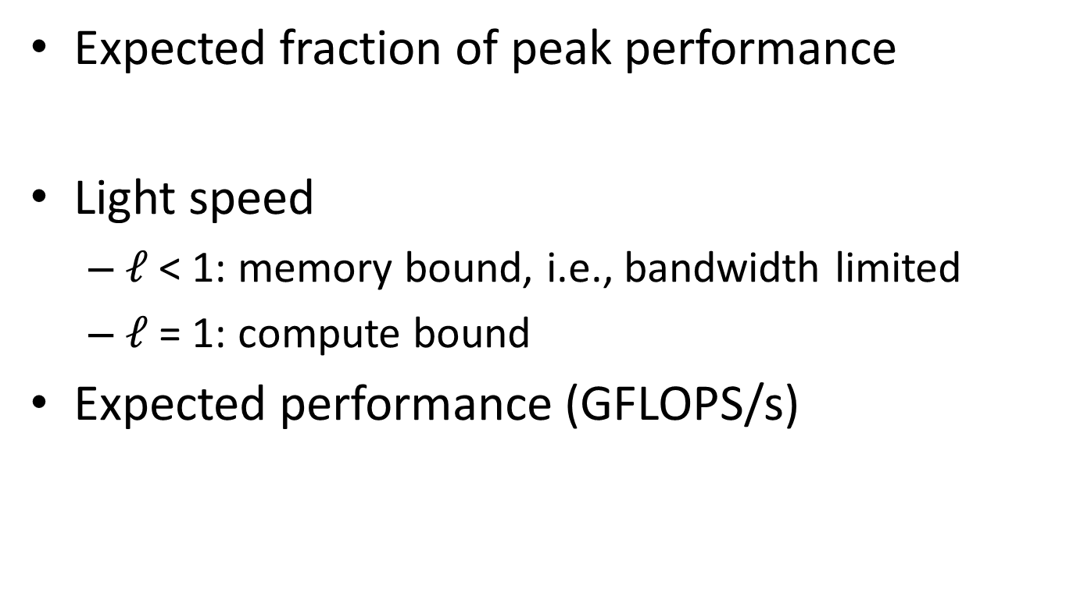
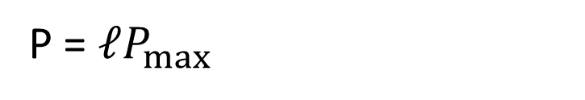
Light speed
Expected fraction of peak performance
Light speed
$ℓ$< 1: memory bound, i.e., bandwidth limited
$ℓ$= 1: compute bound
Expected performance (GFLOPS/s)
$$ℓ= {min⁡(1,B_{m}}/{B_{c}})$$
P = $ℓP_{max}$

Slide 47

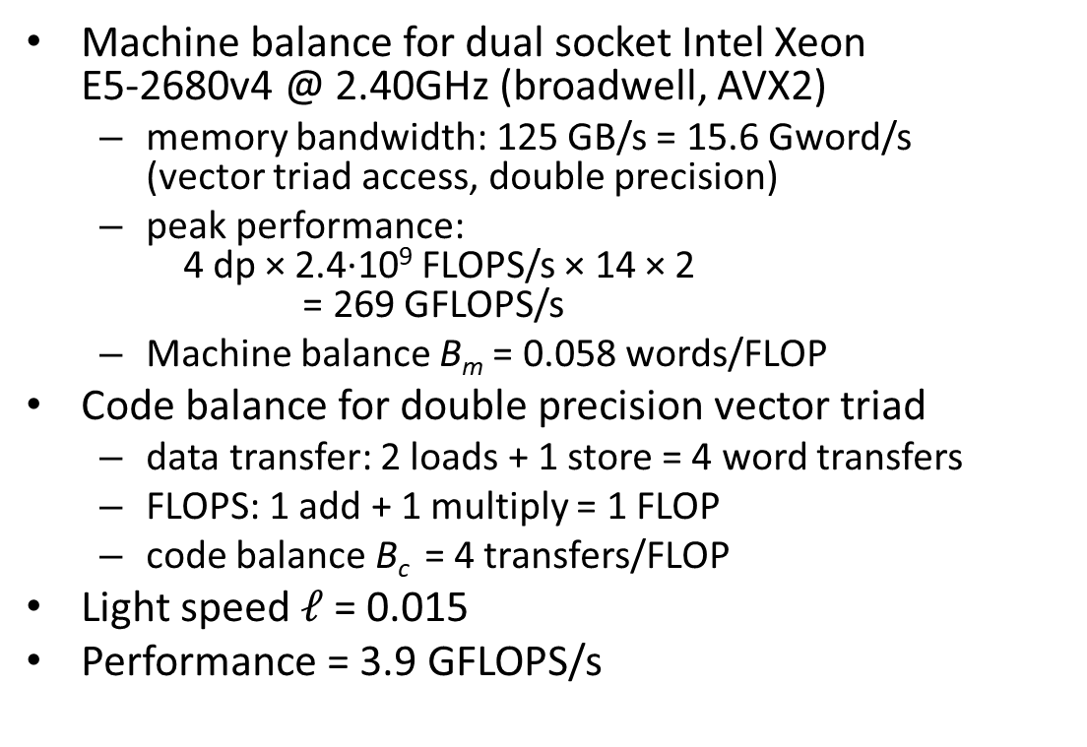

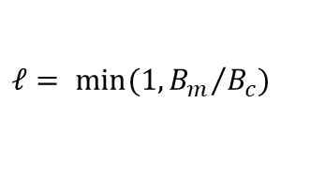

Example
Machine balance for dual socket Intel Xeon E5-2680v4 @ 2.40GHz (broadwell, AVX2)
memory bandwidth: 125 GB/s = 15.6 Gword/s (vector triad access, double precision)
peak performance: 4 dp × 2.4∙10⁹ FLOPS/s × 14 × 2 = 269 GFLOPS/s
Machine balance B_{m} = 0.058 words/FLOP
Code balance for double precision vector triad
data transfer: 2 loads + 1 store = 4 word transfers
FLOPS: 1 add + 1 multiply = 1 FLOP
code balance B_{c} = 4 transfers/FLOP
Light speed $ℓ$= 0.015
Performance = 3.9 GFLOPS/s
$$B_{m}=\frac{memory bandwidth}{FLOPS/s}$$
$$B_{c}=\frac{data transfer}{FLOPS}$$
double a[n], b[n], c[n], s;
…
for (i = 0; i < n; i++)
a[i] = b[i] + s*c[i];
$$ℓ= {min⁡(1,B_{m}}/{B_{c}})$$
P = $ℓP_{max}$

Slide 48
Profiling

Slide 49
gprof with GCC
Compile/link with –g -pg
Run application with representative data/settings
View profile using gprof

Slide 50
Feedback-guided optimization

Slide 51
Philosophy
"The proof of the pudding is in the eating"
Build application with instrumentation
Run application
creates profile
Rebuild application, using profile to guide optimizations
Depends on quality of run: must be representative for general use
CPU/memory architecture
input data/parameters
YMMV: expect < 10 %

Slide 52
GCC compilers
Build with instrumentation
Run as usual
Build using profile
gcc -fprofile-generate -o appl.exe …
gcc -fprofile-use=appl.exe.gcda -o appl.exe …

Slide 53
Intel compilers
Build with instrumentation
Run as usual
Build using profile
icc -prof-gen -prof-dir=./profs -o appl.exe …
icc -prof-use prof-dir=./profs -ipo -o appl.exe …

Slide 54
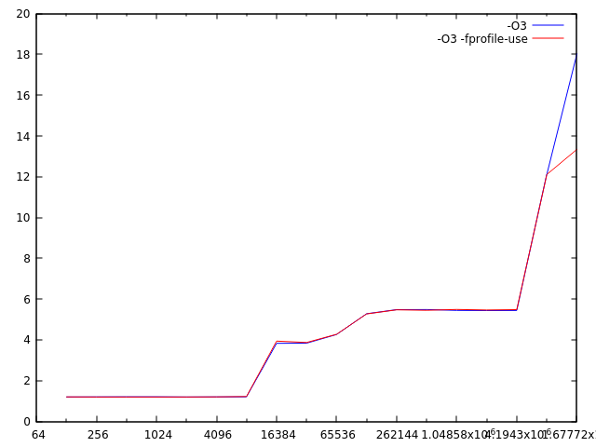
Example
Code illustrating cache hierarchy
improved
pre-fetching

Slide 55
Conclusion

Slide 56
Useful references
Gallery of processor cache effects
Avoiding and Identifying False Sharing Among Threads
Vectorization
A guide to vectorization with Intel C++ compilers
Auto-vectorization with gcc 4.7
Introduction to High Performance Computing for Scientists and Engineers Georg Hager & Gerhard Wellein Chapman & Hall, 2010
Why has CPU frequency ceased to grow?
Compiler Explorer: interactively shows assembler

Slide 57
Appendix

Slide 58
Tools
Profilers
gprof
Scalasca
AllineaForge MAP
Intel vTune
Monitoring
numastat
mpstat
Hardware information
lscpu: CPU information, including cache size and NUMA configuration
lstopo-no-graphics: more detailed cache topology
Intel mlc: provides memory bandwidth & latency info
Use a profiler, it is the law!

Slide 59
Latency
latency
compute time
disk I/O
1000000 cycles
GPGPU
20000 cycles
Infiniband
5000 cycles
OpenMP barrier
1500 cycles
RAM
150 cycles
80 cycles
erf
L3 cache
50 cycles
40 cycles
**
20 cycles
exp
L2 cache
20 cycles
10 cycles
/ or sqrt
5 cycles
+ or *
L1 cache
5 cycles
streaming DP fused multiply/add
Core
1 cycle

Slide 60
Bandwidth
RAM
ivybridge (dual socket, 10 core): 93 GB/s
haswell (dual socket, 12 core): 110 GB/s
broadwell (dual socket, 14 core): 125 GB/s
skylake (dual socket, 18 core): 256 GB/s
QPI
ivybridge: 25 GB/s
haswell: 30 GB/s
broadwell: 30 GB/s
skylake: 80 GB/s
GPGPU RAM (GDDR5@750MHz, K40c): 288.0 GB/s
SATA revision 3: 0.6 GB/s
SATA revision 3.2: 2.0 GB/s
SAS 3: 1.2 GB/s
PCI Express 3.0 (16x): 15.75 GB/s
Infiniband QDR 4x: 4.0 GB/s
Infiniband EDR 4x: 12.5 GB/s
Note: bandwidth depends
on message size!

