Slide 1
Performance measures

Slide 2

Machine balance
Memory access
bandwidth
Gwords/s (double precision gigawords per second)
Computation
peak performance
double precision FLOPS/s (FLOating point OPerationS per second)
Machine balance
$$B_{m}=\frac{memory bandwidth}{FLOPS/s}$$

Slide 3


Code balance
Memory access
number of word load and store operations
Computation
number of FLOPS
Code balance
Computational intensity
$$B_{c}=\frac{data transfer}{FLOPS}$$
$$I= 1/{B_{c}}$$

Slide 4

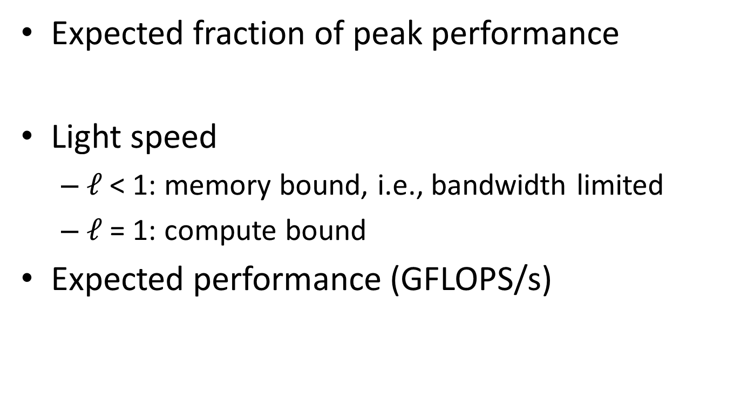
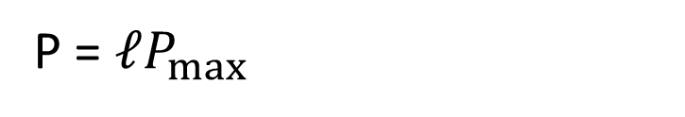
Light speed
Expected fraction of peak performance
Light speed
$ℓ$< 1: memory bound, i.e., bandwidth limited
$ℓ$= 1: compute bound
Expected performance (GFLOPS/s)
$$ℓ= {min⁡(1,B_{m}}/{B_{c}})$$
P = $ℓP_{max}$

Slide 5

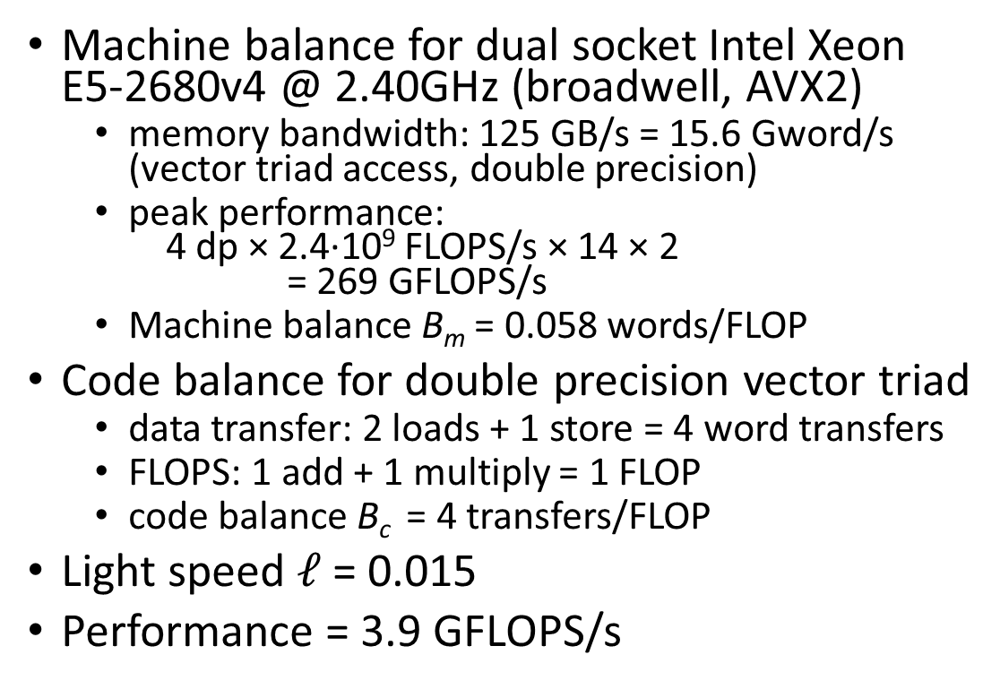

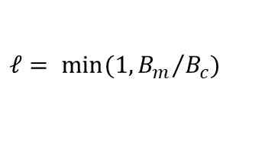

Example
Machine balance for dual socket Intel Xeon E5-2680v4 @ 2.40GHz (broadwell, AVX2)
memory bandwidth: 125 GB/s = 15.6 Gword/s (vector triad access, double precision)
peak performance: 4 dp × 2.4∙10⁹ FLOPS/s × 14 × 2 = 269 GFLOPS/s
Machine balance B_{m} = 0.058 words/FLOP
Code balance for double precision vector triad
data transfer: 2 loads + 1 store = 4 word transfers
FLOPS: 1 add + 1 multiply = 1 FLOP
code balance B_{c} = 4 transfers/FLOP
Light speed $ℓ$= 0.015
Performance = 3.9 GFLOPS/s
$$B_{m}=\frac{memory bandwidth}{FLOPS/s}$$
$$B_{c}=\frac{data transfer}{FLOPS}$$
double a[n], b[n], c[n], s;
…
for (i = 0; i < n; i++)
a[i] = b[i] + s*c[i];
$$ℓ= {min⁡(1,B_{m}}/{B_{c}})$$
P = $ℓP_{max}$

