Slide 1
Profiling with Arm MAP
Geert Jan Bex
(geertjan.bex@uhasselt.be)
License: this presentation is released under the Creative Commons CC BY 4.0, see https://creativecommons.org/licenses/by/4.0/deed.ast

Slide 2
Introduction

Slide 3
Introduction
Arm Forge (https://developer.arm.com/tools-and-software/server-and-hpc/debug-and-profile/arm-forge)
DDT: parallel debugger
MAP: parallel profiler
Commercial product
Floating licence, token based
64 tokens, e.g.,
2 × MAP session of 32 processes
1 × MAP + 1 × DDT session of 32 processes
1 × DDT session of 64 processes
1 × MAP session of 32 processes + 2 × DDT session of 16 processes
…

Slide 4
Supported programming models
Serial applications
Shared memory programming: OpenMP
GPU programming: CUDA
Distributed programming: MPI, UPC
Weapon of choice for MPI (+ OpenMP)
Debugging/profiling at scale: user interface optimized

Slide 5
Alternatives
Debugging
Commercial: RogueWave TotalView
Open source: Eclipse PTP
Profiling
Open source:
Scalasca
Paraver + Extrae

Slide 6
Profiling

Slide 7
Workflow
Concentrate on single node
profile & analyze bottlenecks
memory access?
cache use?
vectorization?
branch prediction?
OpenMP overhead?
Inter-node communication
profile & analyze bottlenecks
granularity of communication/computation?
domain decomposition?
suboptimal MPI calls?

Slide 8
Methodology
MAP uses sampling (call stack)
No instrumentation
Simply compile with -g for details
Overhead is minimal (∼ 5-10 % at most)
Works with many MPI implementations
Intel MPI
OpenMPI
MVAPICH
…

Slide 9
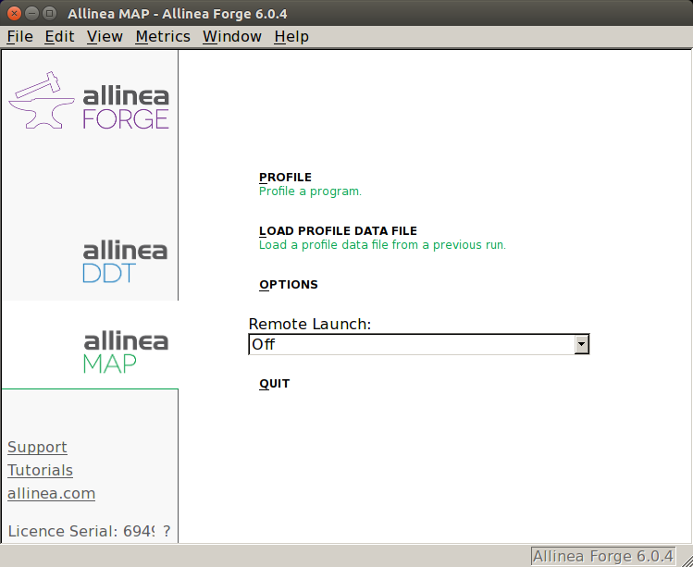
Startup
$ module load AllineaForge
$ map
Start profiling interactively
Load a profile to analyze
```
Start a job to profile interactively

Slide 10
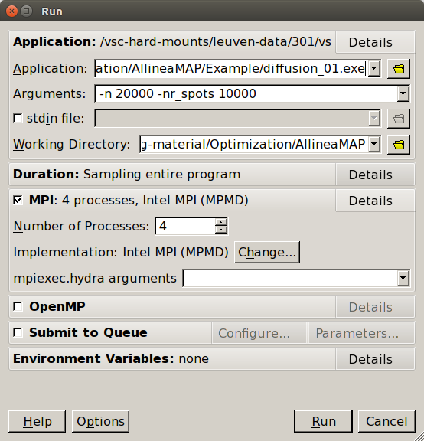
Interactive profiling
Run configuration
Remembers between runs
Choose application
Application arguments
Working directory
Configure MPI/OpenMP
Start run/profiling

Slide 11
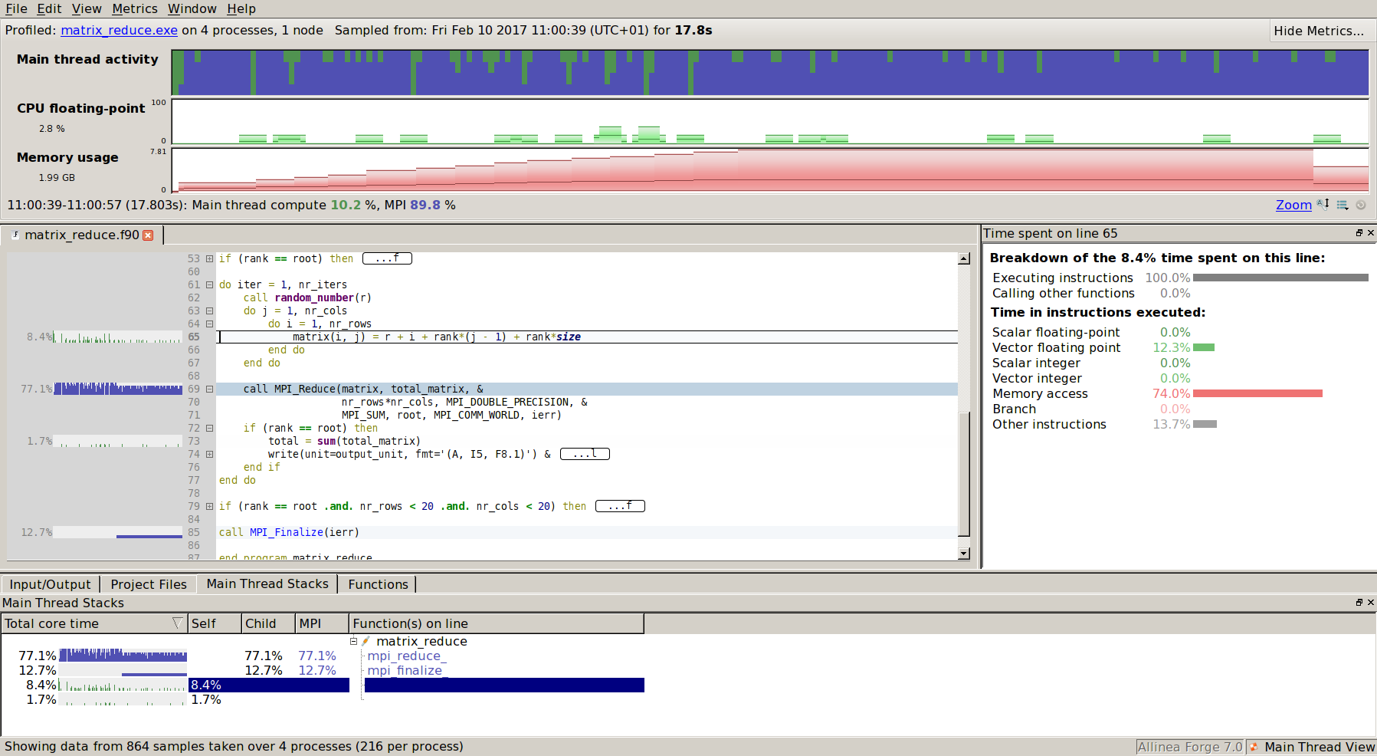

Results
Ask your boss for a large screen

Slide 12
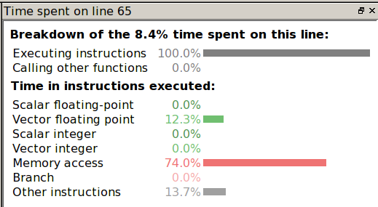


Line breakdown
Vector floating point
Memory access 74 %
No branching

Slide 13
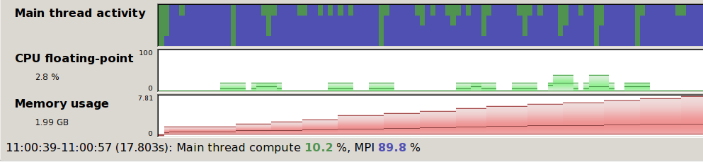
Time line
min, max, mean, s.d. available
Zoom by selecting
All view updated!
processes
time
Very useful to identify run
phases
Can display many metrics
CPU instructions
I/O: disk read/write
MPI
Number calls peer-to-peer & collectives/s
Peer-to-peer & collectives bandwidth
Send & receive bandwidth
Any combination

Slide 14
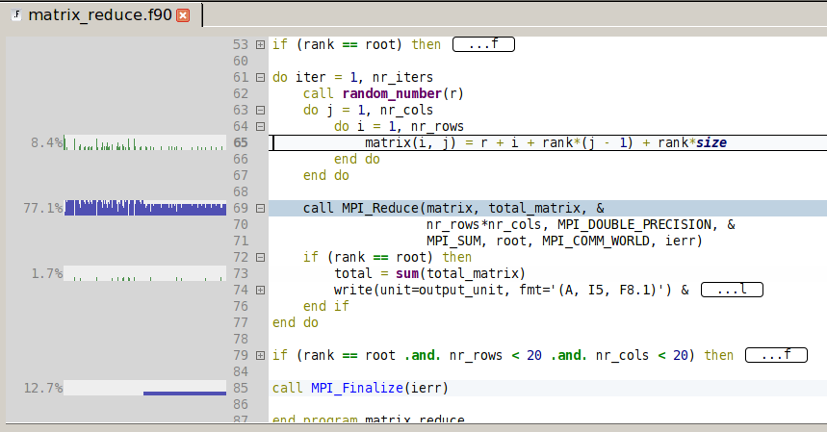
Source code view
Code can be folded
Line based activity
Color coded:
• Communication
• Compute
Easy to navigate through code
Go to function definitions in any file
Requires compile with -g

Slide 15
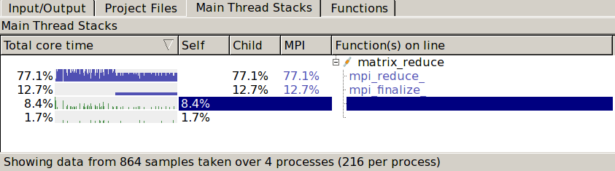
Call stack view
Click to go to code
Ordered by % runtime
Navigate to source code

Slide 16
Round tripping
From within Allinea MAP
Edit code
Rebuild
Profile
Commit in version control system
Switch between MAP and DDT

Slide 17
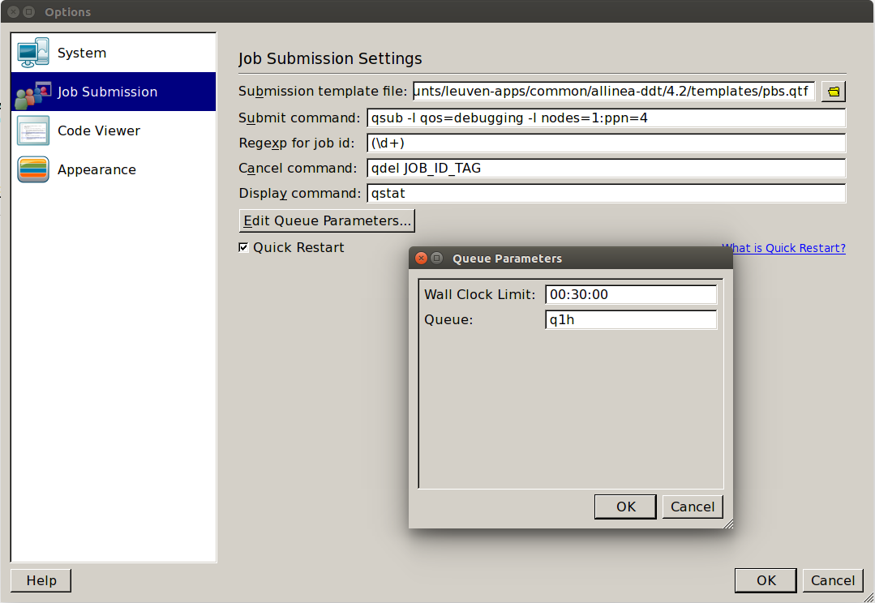
Interactive profiling via job
Job will run on compute nodes

Slide 18
Batch profiling via job
#!/bin/bash –l
#PBS –l nodes=1:ppn=4
#PBS –l walltime=1:00:00
…
map --np 4 --profile --stop-after 3500 \
diffusion.exe 10000 5000 30
Submit job
When done, open profile with MAP

Slide 19
ommunication vs. computation

Slide 20
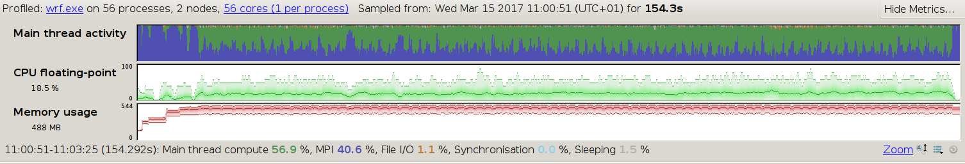
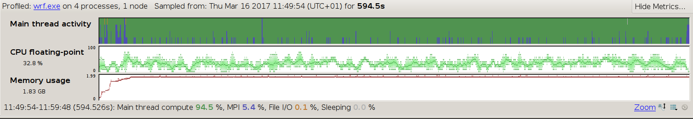
Domain decomposition
resources
walltime
domains too small!
lots of MPI chatter!
load imbalance
resources
walltime

Slide 21
Conclusions

Slide 22
Conclusions
MAP is excellent for applications with many processes/threads
Easy to get an overview
However, works well for serial code too
Timeline is valuable tool
Very easy to use, but correct interpretation requires insight
Drawback: limited to number of tokens
Number of processes
Concurrent sessions
As any tool, not Swiss army knife
Use in combination with other tools, e.g., Intel

