Slide 1


Containers for HPC
Geert Jan Bex (geertjan.bex@uhasselt.be)
License: this presentation is released under the Creative Commons CC BY 4.0, see https://creativecommons.org/licenses/by/4.0/deed.ast

Slide 2

http://bit.ly/32UUdRM

Slide 3


Slide 4
Typographical conventions I
Inline code fragments and file names are rendered as, e.g., hello_world.py
Longer code fragments are rendered as
Data files are rendered as
#!/usr/bin/env python
…
if __name__ == '__main__':
print('hello world!')
case dim temp
1 1 -0.5
2 1 0.0
3 1 0.5
4 2 -0.5
…
fragment not shown

Slide 5





Typographical conventions II
Shell commands are rendered as
Do not type $, it represents your shell prompt!
Good practice:
Bad practice:
(Potential) hazards/bugs:
Performance issue:
Warning:
$ apptainer inspect r_base.sif

Slide 6
Introduction

Slide 7
Introduction
Singularity originally developed by Berkeley Lab, now at Sylabs https://sylabs.io/singularity/
Intended as HPC alternative to
Docker https://www.docker.com/
Shifter https://github.com/NERSC/shifter
Open-source project: name change to Apptainer https://apptainer.org/

Slide 8
Motivation
The good: containers are useful
Some dependency chains are hard to resolve
X11 applications
32-bit applications
Portability of workflow across systems
The bad: containers pose security risks
Escalating privileges
Access to entire file systems
Enter apptainer

Slide 9
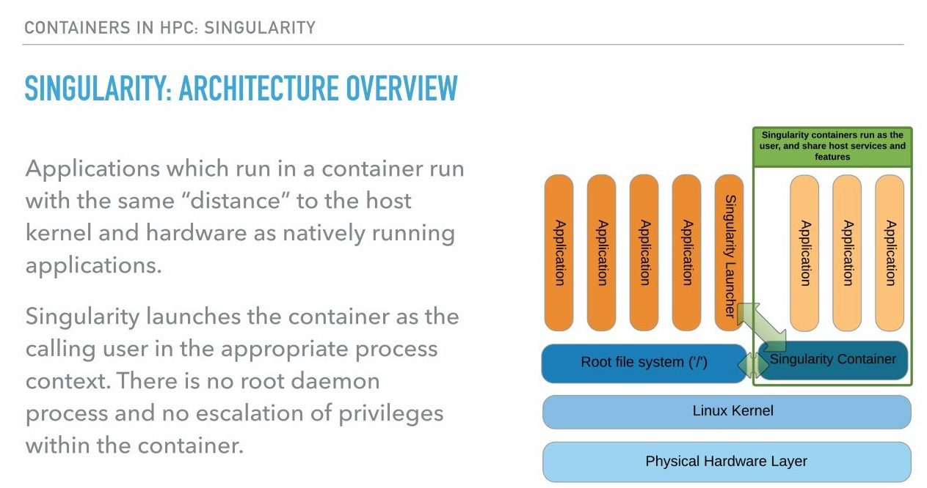
Apptainer architecture

Slide 10
Apptainer image
Single file, contains
OS components
System libraries
Application libraries
Applications
Data (possibly, but normally not)
Creation
On any machine, any (Linux) OS, may require root privileges
Remotely
Deployment
On any (Linux) machine, apptainer installed
No root privileges required

Slide 11
Installing apptainer
Use distribution's package manager
apt
yum
…
Build from source
Note: requires squashfs, fuse

Slide 12
Creating images

Slide 13
Recipe file: bootstrap from distro
Must be installed on host
For, e.g., Ubuntu
focal: 20.04, bionic: 18.04, xenial: 16.04, trusty: 14.04
For, e.g., CentOS
BootStrap: debootstrap
OSVersion: focal
MirrorURL: http://us.archive.ubuntu.com/ubuntu/
BootStrap: yum
OSVersion: 7
MirrorURL: http://mirror.centos.org/centos-7/7/os/$basearch/
Include: yum

Slide 14
Recipe file: bootstrap from docker
For, e.g., Debian
Any public docker container can be used
Docker containers in private repositories can be used
Specify token
BootStrap: docker
From: debian:jessie

Slide 15
Recipe file: preparing install
%setup: commands executed on host
%files: copy files into image when base OS is installed
%setup
mkdir ${APPTAINER_ROOTFS}/sample_data
%files
samples/README.md /sample_data/
samples/*.txt /sample_data/
host file system
Semantics of cp command
image file system

Slide 16
Recipe file: %post
Post bootstrap phase, extra software installation
Through package manager
Download, configure, make, make install
E.g., Ubuntu
E.g., CentOS
%post
sed -i 's/$/ universe/' /etc/apt/sources.list
apt-get update
apt-get -y install grace
%post
yum -y install vim-minimal

Slide 17
Recipe file: applications
%environment: environment variables in image
%runscript: action for apptainer run, e.g.,
Multiple application using %app…, see documentation
%environment
export DATA_DIR=/sample_data
%runscript
/usr/bin/grace

Slide 18
Recipe file: tests & help
%test: action for apptainer test, e.g.,
%help: shown by apptainer run -help
%test
/usr/bin/grace -version
%help
Start grace using: apptainer run grace.sif

Slide 19
Recipe file: meta-info
Provenance of images is important: reproducibility!
%labels: shown by apptainer inspect
Added by apptainer:
Architecture, e.g., amd64
Build date
Bootstrap, .e.g., docker
From, e.g., ubuntu:22.04
%labels
Maintainer Geert Jan Bex
Email geertjan.bex@uhasselt.be
Version 1.0

Slide 20
Recipe file: (almost) complete
BootStrap: debootstrap
OSVersion: xenial
MirrorURL: http://us.archive.ubuntu.com/ubuntu/
…
%post
sed -i 's/$/ universe/' /etc/apt/sources.list
apt-get update
apt-get -y install grace
%runscript
/usr/bin/grace
%test
/usr/bin/grace –version
…

Slide 21
Build image
Build
Creates image
Installs base OS
Installs software specified in %post
Build done
with sudo
with fake root
$ sudo apptainer build grace.sif grace.def
$ apptainer build –-fakeroot grace.sif grace.def

Slide 22
Parametrized recipes
Build-time parameters
Build with
%files
{{ environment }} /environment.yml
$ apptainer build –-fakeroot \
--build-arg environment=env.yml \
grace.sif grace.def
Recipe won't build unless
all arguments defined!
Reproducible builds???

Slide 23
Gotchas on HPC
Can't use sudo → use --fakeroot
Building takes time
Use compute node/batch job
Request enough walltime, e.g., --time 2:00:00!
Build takes memory
Request enough memory, e.g., --mem=16G
Important apptainer directories
Temporary directory
Cache directory

Slide 24
Gotcha temporary directory
Used to build image
Defaults to TMPDIR or /tmp
Can be set in APPTAINER_TMPDIR
Often works on Lustre, sometimes not
Set to local SSD → performance
…
%post
chmod 1777 /tmp
…
recipe.def
Fixes permission issues
…
export APPTAINER_TMPDIR=$VSC_SCRATCH_NODE/$USER/ mkdir -p $APPTAINER_TMPDIR
…
script.slurm

Slide 25
Gotcha: cache directory
Used to cache build artifacts
Across builds
By default: $HOME/.apptainer/cache:
Can grow very large → quota!
Can be set in APPTAINER_CACHEDIR
…
export APPTAINER_CACHEDIR=$VSC_SCRATCH/appt_cache/ mkdir -p $APPTAINER_CACHEDIR
…
script.slurm

Slide 26
Example job script
#!/usr/bin/env -S bash -l
#SBATCH --account=my_credits
#SBATCH --nodes=1 --tasks-per-node=1 --cpus-per-task=4
#SBATCH --time=2:00:00
#SBATCH --mem 16G
export APPTAINER_TMPDIR=$VSC_SCRATCH_NODE/$USER/ mkdir -p $APPTAINER_TMPDIR
export APPTAINER_CACHEDIR=$VSC_SCRATCH/appt_cache/ mkdir -p $APPTAINER_CACHEDIR
apptainer build --fakeroot \
grace.sif \
grace.def
script.slurm

Slide 27
Image types
Types
default: sif
squashfs
compressed
read-only
writable: ext3
sudo build
sandbox: directory
Properties
read-only
sudo: read-write

Slide 28
Multistage builds
Libraries/tools only required during software builds?
Take up space
Increases time to load
Increases memory footprint
Multistage build
Build stage: create temporary image
Deployment stage: copy artefacts from build stage
Don't forget to copy all dependencies,
use ldd to check!

Slide 29
Remote builds
Requires account at Sylabs.io
Build using web browser
https://cloud.sylabs.io/builder
requires Singularity definition file

Slide 30
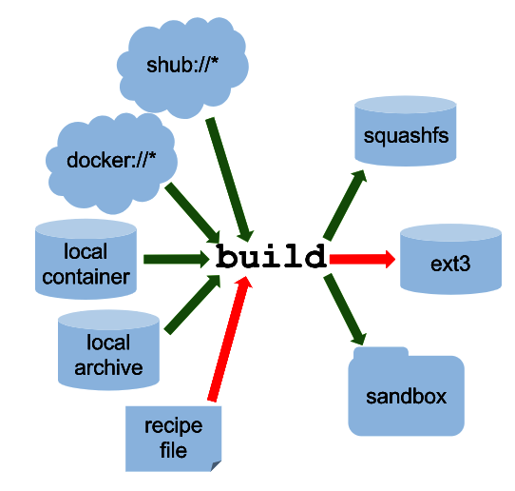
Other options

Slide 31
NVIDIA hpccm

Slide 32
And one more thing…
hpccm (HPC Container Maker)
NVIDIA open source project https://github.com/NVIDIA/hpc-container-maker
Python script defines container
Translated to
Dockerfile
Singularity recipe
Bash install script
High-level description of container

Slide 33
hpccm recipe
import pathlib
# Choose a base image
Stage0 += baseimage(image='ubuntu:20.04')
# Install build tools
Stage0 += apt_get(ospackages=['build-essential', 'make'])
Stage0 += cmake(eula=True)
# Install GNU compilers (upstream)
Stage0 += gnu()
# Copy in some example code
source_dir = pathlib.Path('source-code')
example_dir = '/sample_code'
for file in source_dir.glob('*'):
Stage0 += copy(src=f'{file}', dest=f'{example_dir}/', _mkdir=True)
base OS image
OS packages
building blocks
copy files

Slide 34
hpccm to docker/singularity
Generate a singularity definition file
Generate a Dockerfile
$ hpccm --recipe machine.py \
--format singularity \
> machine.def
$ hpccm --recipe machine.py \
--format docker \
> Dockerfile

Slide 35
hpccm gotchas
Each apt_get triggers apt update
Aggregate all packages single apt_get
Multistage build for apptainer
Name stage 0 in recipe & copy between stages
Specify --singularity-version 3.2 for hpccm
…
Stage0 += baseimage(image='ubuntu:20.04', _as='build')
…
Stage1 += copy(src='/env.tar.gz', dest='/env.tar.gz', _from='build')
…
$ hpccm --recipe machine.py --format singularity \
--singularity-version 3.2 \
> machine.def

Slide 36
hpccm recipe parametrization
Argument name
Default value
Use arguments
Specify arguments
…
env_file = USERARG.get('environment', 'environment.yml')
…
Python variable
$ hpccm --recipe machine.py --format singularity \
--userarg environment=env.yml \
> machine.def

Slide 37
Using images

Slide 38
Run container/execute commands
To execute run script
Bound directories
Home directory
/tmp, /var/tmp
To execute arbitrary command
$ apptainer run grace.sif
$ apptainer exec grace.sif gracebat –data data.dat \ -batch plot.bat
$ apptainer exec grace.sif xmgrace

Slide 39

Integration in workflow
Integration into Slurm job script
Apptainer images can be used in any workflow
Workflow systems may support Apptainer, e.g.,
#!/bin/bash –l
#SBATCH –-nodes=1
#SBATCH –-time=00:30:00
apptainer exec grace.sif gracebat –data data.dat \ -batch plot.bat

Slide 40
Image shell
To execute run shell in image
Defaults to /bin/sh, not /bin/bash!
Take care with .bash_profile and .bashrc, might generated errors
Alternative if Bash is installed
$ apptainer shell development.sif
$ apptainer exec development.sif /bin/bash

Slide 41
Directory bindings
Current working directory
where image is executed if in parent overlay directory
Home directory
bound to user's host home directory
Additional bindings, command line option: -B <host-path>:<img-mount-point>
e.g., -B ~/Data:/mnt/data -B $VSC_DATA
Note: mount point must exist, unless overlays work, e.g., -B /data/analysis
as many as required

Slide 42
Development

Slide 43
Boon for developers
Create image
OS of choice
Required tools
Editor of choice
Compilers/CMake/…
gdb/gprof/ hyperfine/ …
…
Required libraries
Boost/OpenBLAS/…
Configuration
Host home directory
.bashrc/.vimrc/ …
Part of project via git + DVC
Stable, reproducible, per project, shareable, zero-config

Slide 44
Base images
Intel OneAPI https://github.com/intel/oneapi-containers
C/C++/Fortran compilers
SYCL/TBB
MPI
NVIDIA HPC Toolkit https://catalog.ngc.nvidia.com/orgs/nvidia/containers/nvhpc
Add your own requirements!

Slide 45
Multithreaded applications

Slide 46
Example recipe file
BootStrap: debootstrap
OSVersion: xenial
MirrorURL: http://us.archive.ubuntu.com/ubuntu/
%post
sed -i 's/$/ universe/' /etc/apt/sources.list
apt-get update
apt-get -y install build-essential apt-get -y install git
cd /tmp
git clone https://github.com/gjbex/training-material.git
cd training-material/Mpi/HybridPi/
make clean pi_openmp.exe
cp pi_openmp.exe /usr/bin/
cd /tmp
rm -rf training-material/
Build tools
Download, build, install own software

Slide 47
Running OpenMP application
Slurm job script, e.g., scaling test
#!/bin/bash -l
#SBATCH --nodes=1 –ntasks=1 –cpus-per-task=28
#SBATCH --time=00:05:00
for num_threads in 1 2 4 8 16 24 28; do
export OMP_NUM_THREADS=$num_threads
time apptainer exec xenial_openmpi.sif \
pi_openmp.exe 100000000
done
Note: compiler version in image need not be same as on host

Slide 48
Distributed applications

Slide 49
Example recipe file
BootStrap: debootstrap
OSVersion: xenial
MirrorURL: http://us.archive.ubuntu.com/ubuntu/
%post
sed -i 's/$/ universe/' /etc/apt/sources.list
apt-get update
apt-get -y install libmlx4-dev
apt-get -y install libmlx5-dev
apt-get -y install libibverbs-dev
apt-get -y install ibverbs-utils
apt-get -y install libopenmpi-dev
apt-get -y install openmpi-bin
apt-get -y install openmpi-common
apt-get -y install build-essential apt-get -y install git
cd /tmp
git clone https://github.com/gjbex/training-material.git
cd training-material/Mpi/HybridPi/
make clean pi_mpi.exe
cp pi_mpi.exe /usr/bin/
cd /tmp
rm -rf training-material/
Mellanox drivers, IB verbs
Open MPI library and tools
Build tools
Download, build, install own software

Slide 50
Running MPI application
Slurm job script
#!/bin/bash -l
#SBATCH --nodes=2 –ntasks-per-node=36
#SBATCH --time=00:05:00
module load foss/2016a
mpirun -mca orte_tmpdir_base /tmp \
apptainer exec xenial_openmpi.sif pi_mpi.exe 100000000
Note: Open MPI version in image is same as on host

Slide 51
GPU applications

Slide 52
Using GPUs
Do not install
drivers/runtime libraries
in image!
apptainer works well with GPUs
NVIDIA (--nv)
AMD (--rocm)
Will bind drivers/libraries/tools from host
Build image
Run image
$ apptainer build --nv –-fakeroot \
gpu_dev.sif gpu_dev.def
$ apptainer exec --nv gpu_dev.sif /bin/bash

Slide 53
Developing on GPUs
Development libraries required
NVIDIA NGC: container catalog https://catalog.ngc.nvidia.com/containers
NVIDIA HPC SDK
PyTorch, PyTorch Lightning
TensorFlow
RAPIDS/RAPIDS Notebooks
…
AMD Instinct https://instinct.docs.amd.com/projects/container-toolkit/

Slide 54
Services

Slide 55
Server processes
Image runs service, e.g.,
web server
RDBMS
…
Workflow
start service
client(s) interaction
stop service
Processes need to be cleaned up!
Apptainer instances

Slide 56
Define service
#!/bin/sh
### BEGIN INIT INFO
…
### END INIT INFO
DESC="Alpino server"
NAME=alpino
case "$1" in
start)
alpino_server_port=$(cat /conf/port_nr)
nohup /Alpino/bin/Alpino \
-notk -veryfast user_max=20000 server_kind=parse \
server_port="${alpino_server_port}" -init_dict_p \
batch_command=alpino_server \
assume_input_is_tokenized=off \
> /dev/null 2> /dev/null < /dev/null &
;;
stop)
echo “stopping ${NAME} service…”
;;
esac
exit 0
alpino> service alpino start
…
alpino> service alpino stop
alpino.sh

Slide 57
Recipe
Copy service file
…
%files
alpino.sh /etc/init.d/alpino
%post
chmod a+rx /etc/init.d/alpino
mkdir –p /conf
%startscript
service alpino start
…
Set permissions, create mount point
Start service in instance

Slide 58
Run instance(s)
Start instance
Interact with instance…
List running instances
Stop instance
$ apptainer instance.start \
-B conf_01:/conf \
alpino.sif \
alpino_01
Instance name
$ apptainer instance.list
$ apptainer instance.stop \
alpino_01

Slide 59
Messing with images

Slide 60
Modifying images
Not possible directly
Create sandbox, i.e., directory
Execute command in sandbox
Create image from sandbox
$ apptainer build --fakeroot \
./sandbox/ original.sif
$ apptainer shell --writable --fakeroot \ ./sandbox/
apptainer> apt update
apptainer> apt install less
apptainer> exit
$ apptainer build --fakeroot \
new.sif ./sandbox/

Slide 61
Use cases
Experimentation
Debugging
Quick hack
Never put image in production!
Update recipe
Unless under DVC control
Note: this is not reproducible!

Slide 62
Overlays
Clean(er) modifications
Run with overlay
$ mkdir overlay/
$ apptainer shell --overlay overlay/ \
--fakeroot \ r_base.sif apptainer> R
…
> install.packages('Rcpp') > q()
apptainer> exit
Read-only
$ apptainer shell --overlay overlay/:ro \
r_base.sif

Slide 63
Performance & best practices

Slide 64
Apptainer overhead
Startup of image ≈ 0.4 s
Serial code/OpenMP (computing π)
Overhead for walltime ≈ 20 seconds: < 0.85 %
Overhead for walltime ≈ 3 minutes: < 0.70 %
(Almost) independent of number of threads
MPI (computing SVD, matrix product)
PDGESVD: 7 % for 16 processes, 24 % for 64 processes
PDGEMM: < 1 % for 16 processes, 10 % for 64 processes
However, serial GESVD: 10 %
⇒ workflow with many short runtimes: entirely in image

Slide 65
Apptainer performance pitfalls
Using non-optimized libraries/applications
Compilation can/should target specific hardware, e.g., -xHost
Performance loss up to 10-40 %
Crucial for BLAS, propagates to other scientific libraries, e.g., LAPACK, PETSc,…

Slide 66
Bootstrap best practices
Install software in default location, not home directory
Define environment variables in image's %environment
Files should be owned by system account, not user
Don’t mess with /etc/passwd, /etc/group, /etc/shadow

Slide 67
Reproducibility best practices
Do installation via recipe file, not by hand
latest docker tag
May/will be newer version when rebuild
Consider version control of images using DVC
git version control of recipe
≠
reproducibility

Slide 68
Conclusions

Slide 69
Conclusions
Apptainer advantages
Portability
Reproducibility: recipes under version control
Easily create images
Integrate images into existing workflows
No privilege escalation
Create as root
Run as user, no sudo possible
Quite reasonable performance/overhead
Not an excuse to run crappy/suboptimal software!

Slide 70
References
Apptainer documentation https://apptainer.org/docs/
User guide
Admin guide
Apptainer GitHub repository https://github.com/apptainer/apptainer
hpccm https://github.com/NVIDIA/hpc-container-maker
HPCWired article discussing singularity versus Docker/Shifter
DVC (Data Version Control) https://dvc.org/

Slide 71
podman

Slide 72
But I want docker…
podman
Can build containers without sudo
Can run rootless containers
No daemon
Same commands as docker

Slide 73
Create empty image
Initially, empty image
Creation done with sudo
Maximum size (in MiB) of the image
Can be resized later, if necessary
File system created "inside" image
$ sudo apptainer image.create --size 2048 grace.sif
$ sudo apptainer image.expand --size 1024 grace.sif

