Slide 1

GPU programming
Geert Jan Bex
(geertjan.bex@uhasselt.be)
License: this presentation is released under the Creative Commons CC BY 4.0, see https://creativecommons.org/licenses/by/4.0/deed.ast

Slide 2


Slide 3

https://github.com/gjbex/GPU-programming

Slide 4


Typographical conventions
Good practice:
Bad practice:
(Potential) hazards/bugs:
Performance issue:
Performance boost:
Warning:

Slide 5
What do GPUs look like?

Slide 6
Host-device model
Compute node has
1 or more CPUs
Volatile memory: RAM
PCIe bus with
1 or more GPUs
Application
Runs on host
Offloads computations to device(s)
Host
Device(s)

Slide 7
Offload model
Host
…
Device₀
Device₁

Slide 8
Host-device model implications
Data physical location?
Is data (efficiently) accessible?
Data dependencies?
Avoid race conditions
Interconnect latency/bandwidth
Potential performance bottleneck
Hardware details matter… a lot!

Slide 9
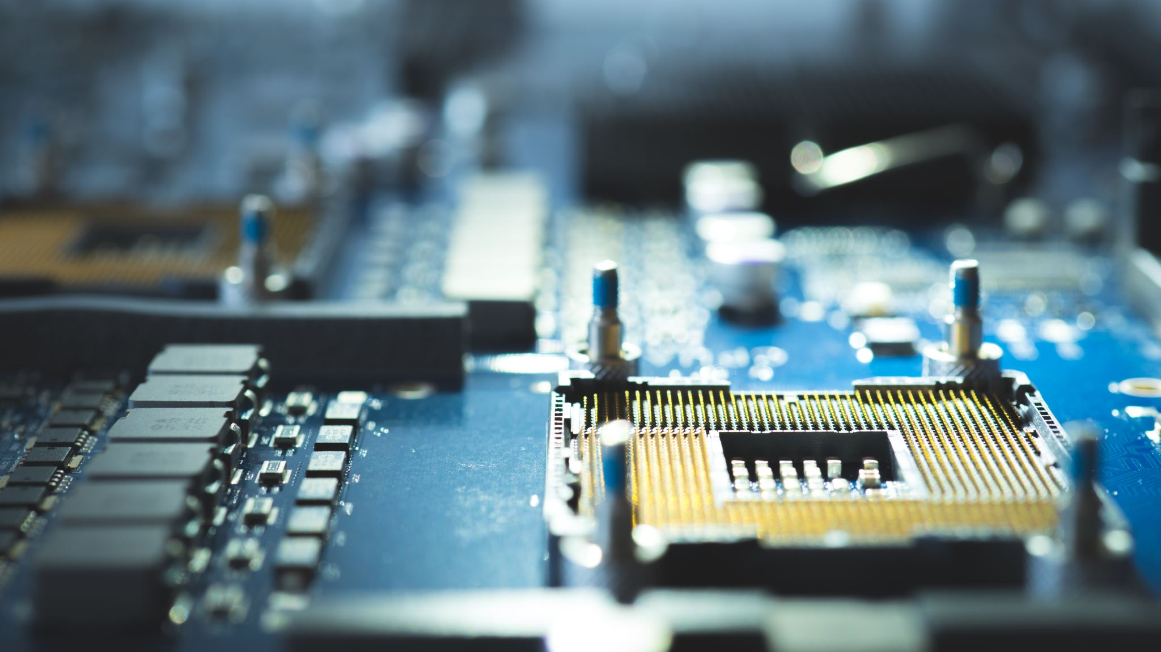
GPU hardware

Slide 10
Terminology crosswalk
Concept | NVIDIA/CUDA | AMD Instinct/HIP
Compute unit | Streaming Multiprocessor (SM) | Compute Unit (CU)
Execution subgroup | Warp, 32 threads | Wavefront, 64 work items
Cooperative thread group (work-group) | Thread block | Work-group/thread block
Work-group local scratchpad | Shared memory | Local Data Share (LDS)
Register resources | Register file | Scalar & vector registers (SGPR/VGPR)
Matrix accelerator | Tensor core | Matrix core/MFMA
Architecture target | Compute capability | GFX target
GPU interconnect | NVLink/NVSwitch | Infinity Fabric/xGMI
Collective library | NCCL | RCCL

Slide 11
Compute unit execution model
SIMT: Single Instruction, Multiple Threads
threads grouped in execution subgroups
Threads in subgroup execute same instruction on different data
Branching
Cheap if threads in subgroup agree
Divergence leads to
Masking of inactive threads
Execution of both paths
Minimize divergence on hot code paths
Code structure
Data layout
Execution subgroups grouped in work-groups
⇒ performance loss

Slide 12
Compute unit
Compute unit
FP pipeline
Scheduder
Instruction schedulers select ready execution subgroups
Simple architecture
No complex per-thread CPU-style execution
Latency hiding: many resident execution subgroups
Pipelines for
Floating point
integer
Matrix acceleration
Load/store units
Register resources (work-item and subgroup state)
Hardware managed local cache
Work-group local software managed scratchpad
INT pipeline
Scheduder
Matrix accelerator
LD/ST
Registers
Scratchpad
Cache

Slide 13
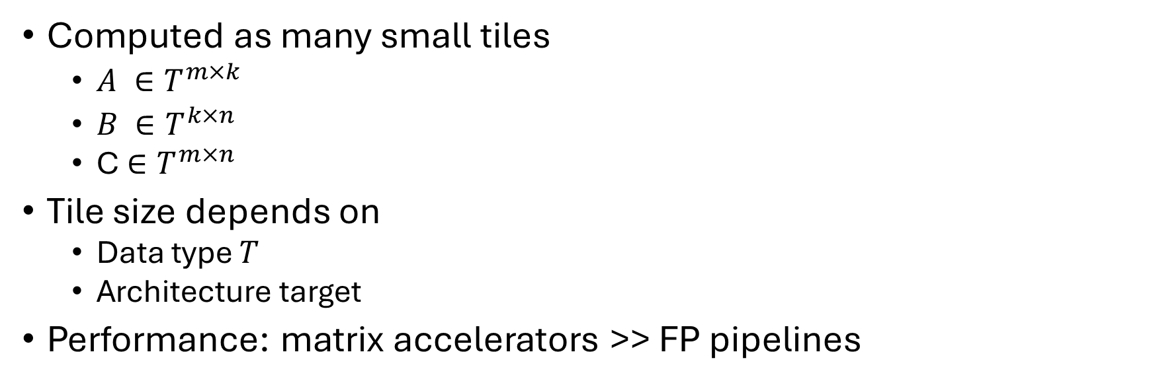
Matrix accelerators
$C+=A∙B$ where $A ∈T^{M×K}$, B$∈T^{K×N},C ∈T^{M×N}$
Computed as many small tiles
$A ∈T^{m×k}$
$B ∈T^{k×n}$
C$∈T^{m×n}$
Tile size depends on
Data type $T$
Architecture target
Performance: matrix accelerators >> FP pipelines

Slide 14
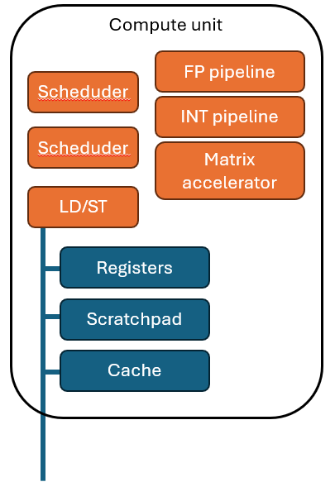
Multiple compute units
GPU
GPU has many compute units
Connected to device memory fabric
Device-level cache(s)
Devide-level memory
…
Cache
Memory
Massive parallelism!

Slide 15
Memory hierarchy
Meory resource | Conceptual scope/role | Managed by
Register resources | Active work item, subgroup state | Compiler and hardware
Work-group local scratchpad | Visible to work-group | Program
Hardware-managed local cashes | Accelerate memory access near CU or CU cluster | Hardware
Device-level cache (L2) | Accessible by all CUs | Hardware
Device-level memory | Accessible to all work-groups | Program/runtime
Latency
Size
Latency hiding through oversubscription
Registers + scratchpad ⇒ resident work-groups, work-items per group

Slide 16
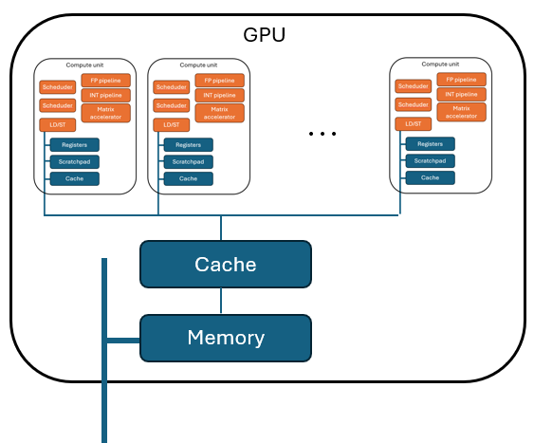
Multiple GPUs/node, multiple nodes
Node
Typically, 4-8 GPUs/node
Connected via GPU interconnect
PCIe connection to host
Nodes connected via high-bandwidth/low-latency network interconnect
…
CPU(s)
Host memory
…

Slide 17
Bandwidth hierarchy
Indicative only: benchmark!
Path | Illustrative peak bandwidth | Relative to GPU device memory
GPU device memory (HBM) | 1.5–8 TB/s | 1 ×
GPU to GPU interconnect | 300–900 GB/s per GPU, one way | ≈ 0.04–0.6 ×
Host memory | 200–500 GB/s per CPU socket | ≈ 0.05–0.2 ×
PCIe | 32 GB/s (Gen4), 64 GB/s (Gen5) one way | ≈ 0.01–0.04 ×
Interconnect network | 12.5–50 GB/s per port, one way | ≈ 0.003–0.03 ×
Minimize data transfers
Host-GPU
GPU-GPU
Node-node

Slide 18

Programming models

Slide 19
How to express GPU work?
Prebuilt operations → mathematical operations
E.g., matrix multiplications, linear solver
Pattern-based programming → parallel patterns & execution policies
E.g., Kokkos: parallel for, reduction, scan
Directive-based programming → annotated loops & data environment
E.g., OpenMP target
Kernel-oriented programming → explicit kernels, launches, memory, dependencies
E.g., CUDA, HIP
More implementation details, more fine-grained control

Slide 20
Data placement
CPU
Host-attached memory
Device-local memory
GPU
Data movement
Making data available
Explicit copy
Run-time managed migration
Coherent direct/remote access
Correctness: producer → dependency/synchronization → consumer
Physical placement
influences performance

Slide 21
Kernels & index spaces
Define 1-, 2-, or 3-dimensional index space
Apply kernel at every point = work-item with index
Index maps work-item to data or work
Runtime maps work-items to available hardware
j
C(i, j) = A(i, j) + B(i, j)
i

Slide 22
Work-items & cooperation
Global index space partitioned into work-groups
Work-groups made up of work-items
Work-items have
Work-group index
Work-group local index
Work-items in work-group can cooperate
Synchronization/barriers
Local scratchpad
j
i
Query device for imits on
work-items/work-group
number of work-groups

Slide 23
Work execution
Many subgroups/work-groups ⇒ latency hiding
Runtime: work-groups → compute units
Work-groups are independent
Assigned work-groups are resident
Constrained by register resources, local scratchpad
Execution subgroups
Ready
Selected
Waiting for data, synchronization, long-latency instruction, pipeline
…
Queued work-groups
Runtime
Compute units

Slide 24
Correctness
Establish happens-before at appropriate scope!!!
Within kernel
Barrier
Collectives
Atomic operations
Between commands
Ordered queues
Events/dependencies
Between host and device
Waits/fences
Overlapping
Data transfers
Computations

Slide 25
Discover, don't assume
Query for
Available devices
Work-group limits
Execution subgroup sizes
Local scratchpad size
Global device memory size

Slide 26
Performance considerations
GPU: optimized for throughput
Enough parallel work?
Many reasonably balanced work-groups
Balance number of work-groups versus resource consumption
How much data movement?
Reuse data
Avoid unnecessary host-device transfers
Memory access efficient?
Optimize data layout for access patterns by execution subgroups/work-groups
Execution serialized?
Minimize divergence in execution subgroups
Minimize contention

Slide 27
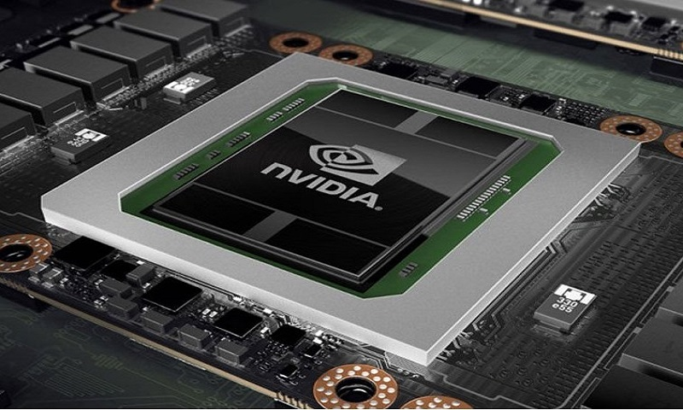
NVIDIA's numbers
This Photo by Unknown Author is licensed under CC BY

Slide 28
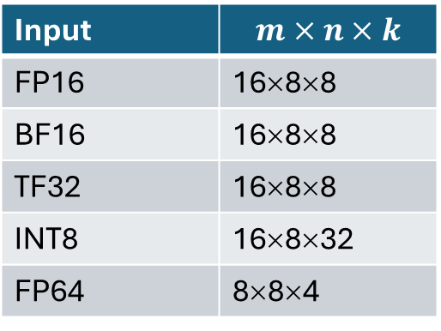
NVIDIA Streaming Multiprocessor (SM)
4 Warp schedulers
Simple architecture
No out-of-order execution
No branch prediction
No sophisticated control flow
Pipelines for
FP32
FP64
INT
Tensor
LD/ST
Memory lanes for pipelines
4-byte registers (thread-private)
Block shared memory/L1 cache
Const/texture cache
Warp-group instructions (NVIDIA H100+)
4 warps participate in tensor instruction
Accommodate larger tensor cores & matrix tiles
Tensor cores, e.g., for NVIDIA A100
Input | $$m×n×k$$
FP16 | 16×8×8
BF16 | 16×8×8
TF32 | 16×8×8
INT8 | 16×8×32
FP64 | 8×8×4

Slide 29
Multiple GPUs/node, multiple nodes
Typically, 4 GPUs/node (A100)
NVLink
Direct connection between all GPUs
12 NVLink link/GPU ⇒ 4 links to each GPU
50 GB/s/link (bi-directional) ⇒ 200 GB/s between GPUs (100 GB/s each way)
PCIe connection to host
NVIDIA Infiniband connects nodes

Slide 30
Bandwidth hierarchy
RAM
RAM
Global GPU memory ≈ 2 TB/s
NVLink ≈ 100 GB/s each way per GPU pair
PCIe ≈ 32 GB/s each way
Host memory ≈ 300 GB/s
HDR Infiniband ≈ 25 GB/s each way per port
CPU
CPU
PCIe
HDR
PCIe
HBM
HBM
HBM
HBM
GPU₀
GPU₁
GPU₀
GPU₁
GPU₂
GPU₃
GPU₂
GPU₃
NVLink
NVLink
HBM
HBM
HBM
HBM

Slide 31

Evolution

Slide 32
NVIDIA memory hierarchy
Level | Scope | Managed by | Typical latency | Size (NVIDIA A100)
Registers | Thread | Compiler | ≈ 1 cycle | 64 K × 4 B per SM
Shared memory | Block | Programmer | ≈ 10-20 cycles | Up to 164 KB, part of 192 KB
L1 cache | SM | Hardware | 30-40 cycles
Const/texture cache | SM | Hardware | ≈ constant | 8 KB
L2 cache | GPU | Hardware | ≈ 200 cycles | 40 MB
Global (HBM) | GPU | Programmer | ≈ 400-800 cycles | 40 or 80 GB
Registers + shared memory ⇒ threads per block
Latency hiding through oversubscription

Slide 33
NVIDIA architecture & compute capability
Model | Architecture | Compute capability | NVLink version | PCIe version | Base frequency (GHz) | Boost frequency (GHz)
P100 | Pascal | 6.0 | 1.0 | 3.0 | 1.33 | 1.48
V100 | Volta | 7.0 | 2.0 | 3.0 | 1.20 | 1.53
A100 | Ampere | 8.0 | 3.0 | 4.0 | 0.77 | 1.41
H100 | Hopper | 9.0 | 4.0 | 5.0 | 1.67 | 1.83
HGX B200 | Blackwell | 10.0 | 5.0 | 6.0+ | 1.80 | 2.00

Slide 34
NVIDIA memory architecture
Level | P100 | V100 | A100 | H100 | HGX B200
Registers | 64 K × 4 B | 64 K × 4 B | 64 K × 4 B | 64 K × 4 B | 64 K × 4 B
Shared memory | 64 KB | 96 KB | 164 KB | 228 KB | 228 KB
L1 cache | 24 KB
L1 + shared | Separate | 128 KB | 192 KB | 256 KB | 256 KB
Const cache | 8 KB | 8 KB | 8 KB | 8 KB | 8 KB
L2 cache | 4 MB | 6 MB | 40 MB | 50 MB | 126 MB
Global | 16 GB | 32 GB | 80 GB | 80 GB | 180 GB
Check cache size assumptions for kernels!

Slide 35
NVIDIA SMs
Model | SMs | Cores per SM | Lanes (TF32/FP64/INT) | Tensor cores per SM | Tensor tile sizes
P100 | 56 | 64 | 64/32/64 | N/A | N/A
V100 | 80 | 64 | 64/32/64 | 8 (mixed FP16/FP32) | 4 × 4 × 4
A100 | 108 | 64 | 64/32/64 | 4 (FP16, BF16, TF32, FP64) | 16 × 8 × 8
H100 | 132 | 128 | 128/64/64 | 4 (FP8, FP16, BF16, TF32, FP64) | 64 × 64 × 16
B200 | 148 | 128 | 128/64/64 | 4 (FP4, FP6, FP8, FP16, BF16, TF32, FP64) | 64 × 64 × 32
32 lanes ⇒ 1 warp instruction/cycle
64 lanes ⇒ 2 warp instructions/cycle
128 lanes ⇒ 4 warp instructions/cycle
E.g., for H100
FP32 peak ≈ 60 TFLOP/s
FP8 tensor peak ≈ 2000 TFLOP/s

Slide 36
NVLink/NVSwitch & PCIe
Model | Links/GPU | GPU-GPU bandwidth (GB/s) each way | PCIe bandwidth (GB/s) each way
P100 | 4 | 20 to 40 (non-uniform) | 16
V100 | 6 | 25 (non-uniform) | 16
A100 | 12 | 100 | 32
H100 | 18 | 150 | 64
B200 | 18 | 900 | 64

Slide 37
Impact on software
More memory ⇒ increase tile size
More L2 cache ⇒ ensure L2 locality
Tensor cores ⇒ exploit mixed precision
More instruction level parallelism ⇒ occupancy can decrease
Overlap memory transfer and computation
Profile!

