Slide 1


Julia: the good, the bad, and the ugly
Geert Jan Bex (geertjan.bex@uhasselt.be)
License: this presentation is released under the Creative Commons CC BY 4.0, see https://creativecommons.org/licenses/by/4.0/deed.ast

Slide 2

https://bit.ly/36wH196

Slide 3


Slide 4


Typographical conventions
Inline code fragments and file names hello_world.py
Longer code fragments
Data files
Terminal output
#!/usr/bin/env julia
…
linear_scale(x, a, b) = a*x + b
Good practice
fragment not shown
case dim temp
1 1 -0.5
…
Bad practice
5 is an integer value

Slide 5

Julia high-level impressions
Influenced by MATLAB
Half-baked mathematical notation
Not object oriented
Multiple dispatch functions
Nice typing system
Opportunities for compiler optimizations
Package system
Environments "built in"
Design decisions are… "interesting"

Slide 6
How to run Julia?
Interactive in shell
Jupyter Notebook
Jupyter Lab
Run script
$ julia
_
_ _ _(_)_ | Documentation: https://docs.julialang.org
(_) | (_) (_) |
_ _ _| |_ __ _ | Type "?" for help, "]?" for Pkg help.
| | | | | | |/ _` | |
| | |_| | | | (_| | | Version 1.8.5 (2023-01-08)
_/ |\__'_|_|_|\__'_| | Official https://julialang.org/ release
|__/ |
julia>
$ Julia
…
julia> using IJulia
Julia> jupyterlab()
$ Julia my_script.jl
$ Julia
…
julia> using IJulia
Julia> notebook()
First time: will offer to install

Slide 7
Expressions

Slide 8
Operators
Assignment: =
Arithmetic
No surprises: +, -, *, /
Power: ^
Integer division: ÷ (\div + tab) or div function
Comparison
Some surprises: ==, != (≠, \ne + tab), <, <= (≤, \le + tab), >, >= (≥, \ge + tab)
Object identity: ===
Logical operators: !, &&, ||
Function composition: ∘ (\circ + tab)
Piping: |>
2x ≡ 2*x but not x y

Slide 9
Naming conventions
Variable names
Can be Unicode, e.g., α (\alpha + tab)
Lower case
Underscore separates "words"
Function names
Can be Unicode, e.g., α (\alpha + tab)
Lower case
Underscore separates "words"
If function modifies arguments, append !
Types
Can be Unicode, e.g., α (\alpha + tab)
Camel case
Don't use Unicode names
in user-facing APIs
Follow naming conventions

Slide 10
Functions & methods

Slide 11
Function definitions
General
Short functions
Lambda functions
function linear_scale(x, a, b)
term = a*x
return term + b
end
function linear_scale(x, a, b)
term = a*x
term + b
end
≡
Result of last expression returned
linear_scale(x, a, b) = a*x + b
(x, a, b) -> a*x + b

Slide 12
Optional and keyword arguments
Optional argument(s)
Keyword arguments
function almost_equal(x, y, delta=1.0e-5)
return abs(x – y) < delta
end
almost_equal(a, b)
almost_equal(a, b, 1.0e-3)
Keyword arguments
function almost_equal(x, y; eps=1.0e-5, abs=1.0e-7)
…
end
almost_equal(a, b)
almost_equal(a, b, abs=1.0e-3)

Slide 13
Multiple dispatch
Function has multiple methods selected on argument type
function show_type(x::Integer)
println("$x is an integer value")
end
function show_type(x::Real)
println("$x is a real value")
end
Only use type annotations
for multiple dispatch
show_type(5)
5 is an integer value
show_type(5.0)
5.0 is a real value

Slide 14
Variable number of arguments
Passed in as Tuple
function are_close(x, δ, values...)
return all(map((y) -> abs(x - y) < δ, values))
end
are_close(0.0, 1.0e-5, 1.23e-7, -0.999e-8)
are_close(0.0, 1.0e-5, 1.23e-7)

Slide 15
Control flow

Slide 16
Conditional statement
function fact(n)
if n < 0
error("fact argument must be positive")
elseif n <= 1
return 1
else
return n*fact(n – 1)
end
end
function fact(n)
n >= 0 || error("fact argument must be positive")
n <= 1 && return 1
return n*fact(n - 1)
end

Slide 17
Repeated evaluation loops
function gcd(a, b)
while a != b
if a > b
a -= b
else
b -= a
end
end
return a
end
Unsurprising:
break
continue
function fact(n)
result = 1
for i in 2:n
result *= i
end
return result
end
Range: <start>:<step>:<end>
Also works on iterables

Slide 18
Error handling
error("fact argument must be positive")
Halts execution
Exceptions
ArgumentError
DomainError
…
throw(DomainError(n, "fact requires positive argument"))
try
println(fact(-1))
catch err
println("don't use $(err.val)")
end
Note: throw()/rethrow() are functions!
Unsurprising: finally clause

Slide 19
Functional operations, iterators & such
Reductions
sum, product, reduce
map
filter
zip
Modules Iterations, Transducers
Pipe operator: |>
map(x -> x^2, 1:10) |> sum

Slide 20
Data types

Slide 21
Basic data types
Integers
Int8, Int16, Int32, Int64, Int128
UInt8, UInt16, UInt32, UInt64, UInt128
Boolean type (8-bit)
Bool
Rational numbers
Rational{int_type}
Floating point numbers
Float16, Float32, Float64
Complex numbers
ComplexF16, ComplexF32, ComplexF64
Character type(32-bit Unicode)
Char
Strings
String
Integer
Real
Number
AbstractFloat
Complex

Slide 22
Literal values
Integer
5 → Int64
UInt8(3) → UInt8
3//5 → Rational{Int64}
Floating point
5.1 → Float64 , -5.1e-9 → Float64
5.1f0 → Float32, -5.1f-9 → Float32
Complex
5.1 + 3.0e-3im → ComplexF64
5.1f0 + 3.0f-3im → ComplexF32
Boolean
true/false
Char
'a', '\n'
String
"abc def"
Type conversion: use type names as functions
String substitution
n = 3
println("2*$n = $(2n)")
2*3 = 6

Slide 23
Data structures
Tuples
Named tuples
Structures
Sets
Dictionaries
Arrays
Vector
Matrix

Slide 24
Vectors, matrices & arrays
Column vector
Row vector
Matrix
Array
v1 = [1.2, 3.4, 5.6]
v2 = [1.2 3.4 5.6]
= 1 × 3 matrix
= horizontal concatenation
A = [
1.2 3.4
5.6 7.8
]
≡
A = [1.2 3.4; 5.6 7.8]
= vertical concatenation
data = Array{Float64}(undef, 3, 5, 7)
= 3 × 5 × 8 array of Float64

Slide 25
Array functions
Construction: zeros, ones, trues, falses, fill, range, rand, randn
Properties: eltype, length, ndims, size, strides, eachindex
fill(3.14, 2, 3)
3.14 3.14 3.14
3.14 3.14 3.14
0.0
0.25
0.5
0.75
1.0
collect(range(0.0, 1.0, length=5))
A = [
1.2 2.3 3.4
4.5 5.6 6.7
]
length(A) == 6
strides(A) == (1, 2)
size(A) == (2, 3)
Not in bytes!
size(A, 1) == 2
eltype(A) == Float64
size(A, 2) == 3
Column-wise storage scheme!
ndims(A) == 2

Slide 26
Array (matrix) operations
Array indexing, 1-based: A[1, 2] = A[2, 1]
Array slicing (copy, no alias): A[2:3, 2:3]
Arithmetic operations
Scalar-array: .+, .-, .*, ./, .^ (≠ MATLAB, numpy)
Array-array element-wise: .+, .-, .*, ./, .^ (sizes must match)
Matrix-matrix multiplication: * (dimensions must match)
Matrix power: ^ (matrix must be square)
Element-wise functions, e.g., sqrt., cos., …
Transpose: transpose, complex conjugate: '
LinearAlgebra module
det, inv, eigen, svd, …
using LinearAlgebra
…
U, s, V = svd(A)
A_new = U*diagm(s)*V'
…

Slide 27
Structures: mutable versus immutable
Constructor
struct Pixel
x::UInt32
y::UInt32
color::String
end
p = Pixel(3, 7, "blue")
println(p.color)
√
p.color = "red"
mutable struct Pixel
x::UInt32
y::UInt32
color::String
end
p = Pixel(3, 7, "blue")
√
println(p.color)
√
p.color = "red"

Slide 28
Type hierarchies
Abstract types, e.g.,
Abstract subtypes of abstract types, e.g.,
Concrete subtypes of abstract types
abstract type AbstractPoint end
abstract type Abstract2DPoint <: AbstractPoint end
Subtyping from single type only!
abstract type Abstract3DPoint <: AbstractPoint end
mutable struct Point2D <: Abstract2DPoint
x::Real
y::Real
end
No subtyping from concrete types!

Slide 29
Accessor methods
get_x(p::AbstractPoint) = p.x
set_x!(p::AbstractPoint, val::Real) = begin p.x = val; end
get_y(p::AbstractPoint) = p.y
set_y!(p::AbstractPoint, val::Real) = begin p.y = val; end
get_z(p::AbstractPoint3D) = p.z
set_z!(p::AbstractPoint3D, val::Real) = begin p.z = val; end
Do not access fields in structures, defines accessor methods

Slide 30
Methods on types
Multiple dispatch
function distance(p1::Abstract2DPoint, p2::Abstract2DPoint)
x1 = get_x(p1); y1 = get_y(p1)
x2 = get_x(p2); y2 = get_y(p2)
return sqrt((x1 – x2)^2 + (y1 – y2)^2)
end
function distance(p1::Abstract3DPoint, p2::Abstract3DPoint)
x1 = get_x(p1); y1 = get_y(p1); z1 = get_z(p1)
x2 = get_x(p2); y2 = get_y(p2); z2 = get_z(p2)
return sqrt((x1 – x2)^2 + (y1 – y2)^2 + (z1 – z2)^2)
end

Slide 31
Traits
Traits are "properties" of types, e.g., color
Default behavior: types are not colored
Action on trait
abstract type ColoredStyle end
struct IsColored <: ColoredStyle end
struct IsNotColored <: ColoredStyle end
ColoredStyle(::Type) = IsNotColored()
get_color(obj::T) where {T} = get_color(ColoredStyle(T), obj)
get_color(::IsNotColored, obj) = error("$(typeof(obj)) is not colored")
get_color(::IsColored, obj) = obj.color

Slide 32
Applying traits
Pixel again
Paint
mutable struct Pixel
…
color::String
end
pixel = Pixel(3, 7, "blue")
println(get_color(pixel))
blue
point = Point2D(3.1, 7.5)
println(get_color(point))
Not in type relation
ColoredStyle(::Type{<:Pixel}) = IsColored()
Point2D is not colored
struct Paint
color::String
end
Share trait
paint = Paint("yellow")
println(get_color(paint))
yellow
ColoredStyle(::Type{<:Paint}) = IsColored()

Slide 33
Parametric types
Abstract or concrete type
Creating objects
Multiple dispatch on abstract parameterized types
struct Pixel{CoordT, ColorT}
x::CoordT
y::CoordT
color::ColorT
end
pixel1 = Pixel{UInt16, String}(UInt16(123), UInt16(2047), "blue")
pixel2 = Pixel{Float64, UInt8}(12.3, -3.4, UInt8(245))

Slide 34
I/O

Slide 35
Text I/O
Standard streams
stdin
stdout/stderr
File streams
open("my_file.txt", "w") do file
for x in 0.0:0.1:10.0
println(file, "$x $(sqrt(x))")
end
end
open method will close
file automatically
using Printf
…
@printf "%.1f %.5f\n", 0.1, sqrt(0.1)
…
open("my_file.txt", "r") do file
for line in eachline(file)
…
end
end

Slide 36
Binary I/O
open("my_file.dat", "w") do file
for x in 0.0:0.1:10.0
write(file, sqrt(x))
end
end
open("my_file.dat", "r") do file
while !eof(file)
value = read(file, Float64)
…
end
end

Slide 37
I/O modules
Delimited text files: DelimitedFiles
Output formatting: Printf
HDF5 files: HDF5

Slide 38
Code organization

Slide 39
Modules
Modules are namespaces
module MyFunctions
export fact
function fact(n)
…
end
function gcd(a, b)
…
end
end
…
using MyFunctions
println(fact(3))
println(MyFunctions.gcd(14, 35))
…
Exported
my_script.jl
using MyFunctions: fact
Not exported
Don’t polute
namespace
using MyFunctions: fact as fac
MyFunctions.jl
import MyFunctions: fact
Add methods to fact function

Slide 40

Packages
Minimal package Gcd
Get into package manager by pressing ]
Get out of package manager by pressing Ctrl-C
pkg> generate Gcd
name = "Gcd"
uuid = "6101a580-870c-4971-a759-bb25a2f00590"
authors = ["Geert Jan Bex <geertjan.bex@uhasselt.be>"]
version = "0.1.0"
Project.toml
Ensure project parent directory is in JULIA_LOAD_PATH

Slide 41
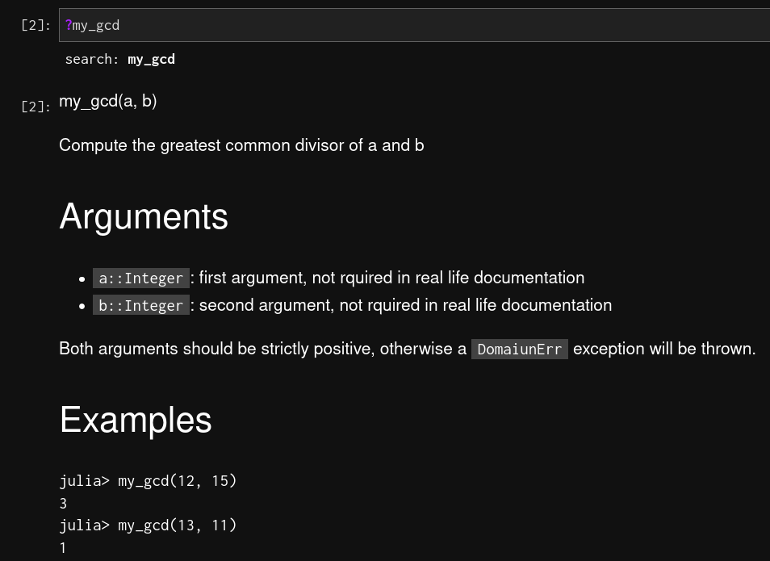
Documentation
Functions & methods
"""
my_gcd(a, b)
Compute the greatest common divisor of a and b
# Arguments
`a::Integer`: first argument, not
required in real life documentation
…
Both arguments should be strictly positive, otherwise a `DomaiunErr` exception will be thrown.
# Examples
```julia-repl
julia> my_gcd(12, 15)
3
julia> my_gcd(13, 11)
1
```
"""
function my_gcd(a::Integer, b::Integer)

Slide 42
Ecosystem

Slide 43
Standard library
Pkg: package & environment handling
Printf: text formatting
DelimitedFiles: delimited text I/O
Iterations: lazy iterators

Slide 44
Third party libraries
BenchmarkTools: benchmark Julia expressions
StructArrays: convert array of structs into struct of arrays
Gadfly: plotting library
DataFrames: data frames
ArgParse: handling command line arguments

Slide 45
In closing

Slide 46
Conclusions
Good?
Bad?
Ugly?
Up to you!

Slide 47
References
Julia documentation https://docs.julialang.org/
Hands on design patterns and best practices with Julia Tom Kwong, 2020, Packt>

Slide 48
Software
Google Colab template https://colab.research.google.com/github/ageron/julia_notebooks/blob/master/Julia_Colab_Notebook_Template.ipynb

