Slide 1


MLOps on HPC
Geert Jan Bex
(geertjan.bex@uhasselt.be)
License: this presentation is released under the Creative Commons CC BY 4.0, see https://creativecommons.org/licenses/by/4.0/deed.ast

Slide 2
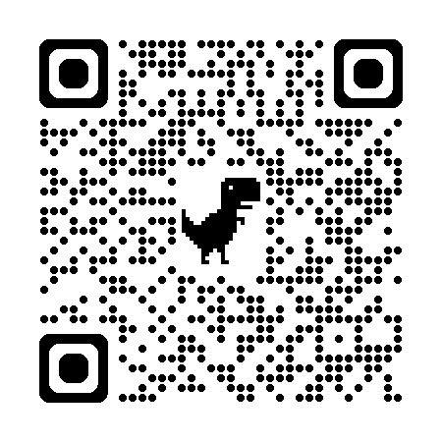
https://bit.ly/4737qM1

Slide 3


Slide 4
Typographical conventions I
Inline code fragments and file names are rendered as, e.g., hello_world.py
Longer code fragments are rendered as
Data files are rendered as
#!/usr/bin/env python
…
if __name__ == '__main__':
print('hello world!')
case dim temp
1 1 -0.5
2 1 0.0
3 1 0.5
4 2 -0.5
…
fragment not shown

Slide 5





Typographical conventions II
Shell commands are rendered as
Do not type $, it represents your shell prompt!
Good practice:
Bad practice:
(Potential) hazards/bugs:
Performance issue:
Warning:
$ python –m doctest data_parsing.py

Slide 6
Introduction

Slide 7

Motivation
Machine learning
Increasingly important in many domains
Not trivial to reproduce
Requires flexibility to experiment
MLOps

Slide 8



Many options
MLFlow
ZenML
DVC

Slide 9
Data Version Control

Slide 10
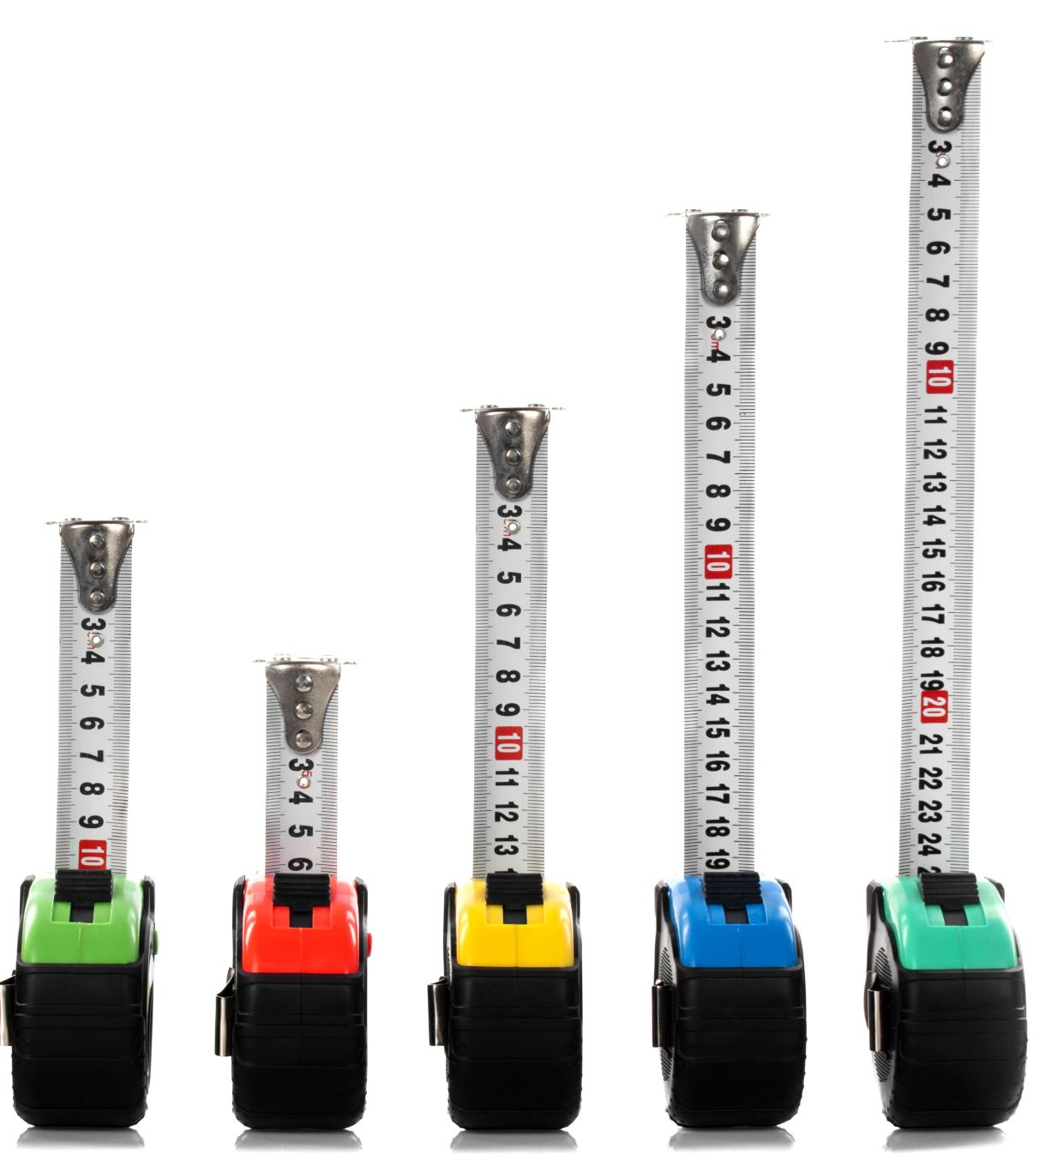
DVC advantages
Interoperates with git
Similar to git
Git + DVC = standalone
Features
Data versioning
Model versioning
Pipelines
Compare experiments

Slide 11
Repository setup for DVC
Set up git repository in ml_project
Initialize DVC
Configure remote for DVC
$ mkdir ml_project
$ cd ml_project
$ git init
$ dvc init
$ git commit -m 'Initialize DVC'
$ dvc remote add -d local_storage ../dvc_data
$ git add .dvc/config
$ git commit -m 'Add remote storage for DVC'

Slide 12
DVC remote storage options
Data not in git repository
Too large
Bad match with git
DVC
Meta-data in git repository
Data in remote storage
Remote storage
Local directory
SSH & SFTP
HTTP/WebDAV
Cloud (S3, Azure Blob Storage, GCP, Google Drive, ...)
Good choice for HPC

Slide 13
DVC remotes examples
Directory in $VSC_DATA, only for HPC access
Directory in $VSC_DATA, accessible via SFTP
Cloud access, see documentation https://dvc.org/doc/user-guide/data-management/cloud-versioning
$ dvc remote add -d local_storage $VSC_DATA/dvc_data
$ dvc remote add -d vsc \
ssh://vsc30000@login.hpc.kuleuven.be:/data/leuven/300/vsc30000/dvc_data

Slide 14
DVC data versioning
Add data to DVC
Data can be
Textual (CSV, JSON, YAML,...)
Binary (HDF5, JPEG, HuggingFace dataset,...)
Convenient auto staging (optional)
$ dvc add data/data.csv
$ git add data/data.csv.dvc
$ git commit -m 'Add data set'
$ dvc config core.autostage true

Slide 15
Interacting with DVC remote
Like git
Push changes to remote
Pull changes from remote
$ dvc push
$ dvc pull

Slide 16
Modifying data
Change data
No change for git
Change for DVC
Check status, e.g.,
Add changes
$ dvc status
data/data.csv.dvc:
changed outs:
modified: data/data.csv
$ dvc add data/data.csv
$ git commit -m 'Modify data'
$ dvc push

Slide 17
Check out previous versions
Find commit ID with git log
Check out commit, e.g., 17262ab
Go back to current version
$ git log --oneline
Scripts also revert!!!
$ git checkout 17262ab
$ dvc checkout
Building workspace index |2.00 [00:00, 94.3entry/s]
Comparing indexes |3.00 [00:00, 2.10kentry/s]
Applying changes |1.00 [00:00, 225file/s]
M data/data.csv
Don't forget dvc checkout!!!
$ git switch -
$ dvc checkout
…

Slide 18
Check out only older data sets
Find commit ID with git log
Create a new branch & restore commit, e.g., 17262ab
When done, switch branches & clean up
$ git log --oneline -- data/data.csv.dvc
$ git switch -C experiment
$ git restore --source=17262ab data/data.csv.dvc
$ git commit -a -m 'Use old data set'
$ dvc checkout
…
Don't forget dvc checkout!!!
$ git switch -
$ git branch -D experiment
$ dvc checkout
…

Slide 20
File fragments and annotations
#!/usr/bin/env -S bash -l
#SBATCH --account=<your_account>
#SBATCH --cluster=<your_cluster>
#SBATCH --time=00:02:00
…
# first clean up your environment
module purge &> /dev/null
# load only the modules you need
module load R-bundle-CRAN/2023.12-foss-2023a
…
jobscript.slurm
Reduces side effects
Reduces side effects

