Slide 1


MLOps on HPC
Geert Jan Bex
(geertjan.bex@uhasselt.be)
License: this presentation is released under the Creative Commons CC BY 4.0, see https://creativecommons.org/licenses/by/4.0/deed.ast

Slide 2
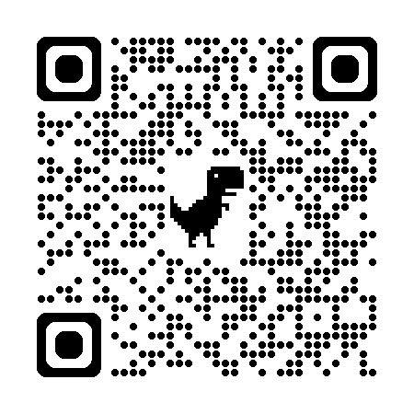
https://bit.ly/4737qM1

Slide 3


Slide 4
Typographical conventions I
Inline code fragments and file names are rendered as, e.g., hello_world.py
Longer code fragments are rendered as
Data files are rendered as
#!/usr/bin/env python
…
if __name__ == '__main__':
print('hello world!')
case dim temp
1 1 -0.5
2 1 0.0
3 1 0.5
4 2 -0.5
…
fragment not shown

Slide 5





Typographical conventions II
Shell commands are rendered as
Do not type $, it represents your shell prompt!
Good practice:
Bad practice:
(Potential) hazards/bugs:
Performance issue:
Warning:
$ python –m doctest data_parsing.py

Slide 6
Introduction

Slide 7

Motivation
Machine learning
Increasingly important in many domains
Not trivial to reproduce
Requires flexibility to experiment
However, not limited to ML!
Any type of experiments
MLOps
ExpOps

Slide 8



Many options
MLFlow
ZenML
DVC

Slide 9
Data Version Control

Slide 10
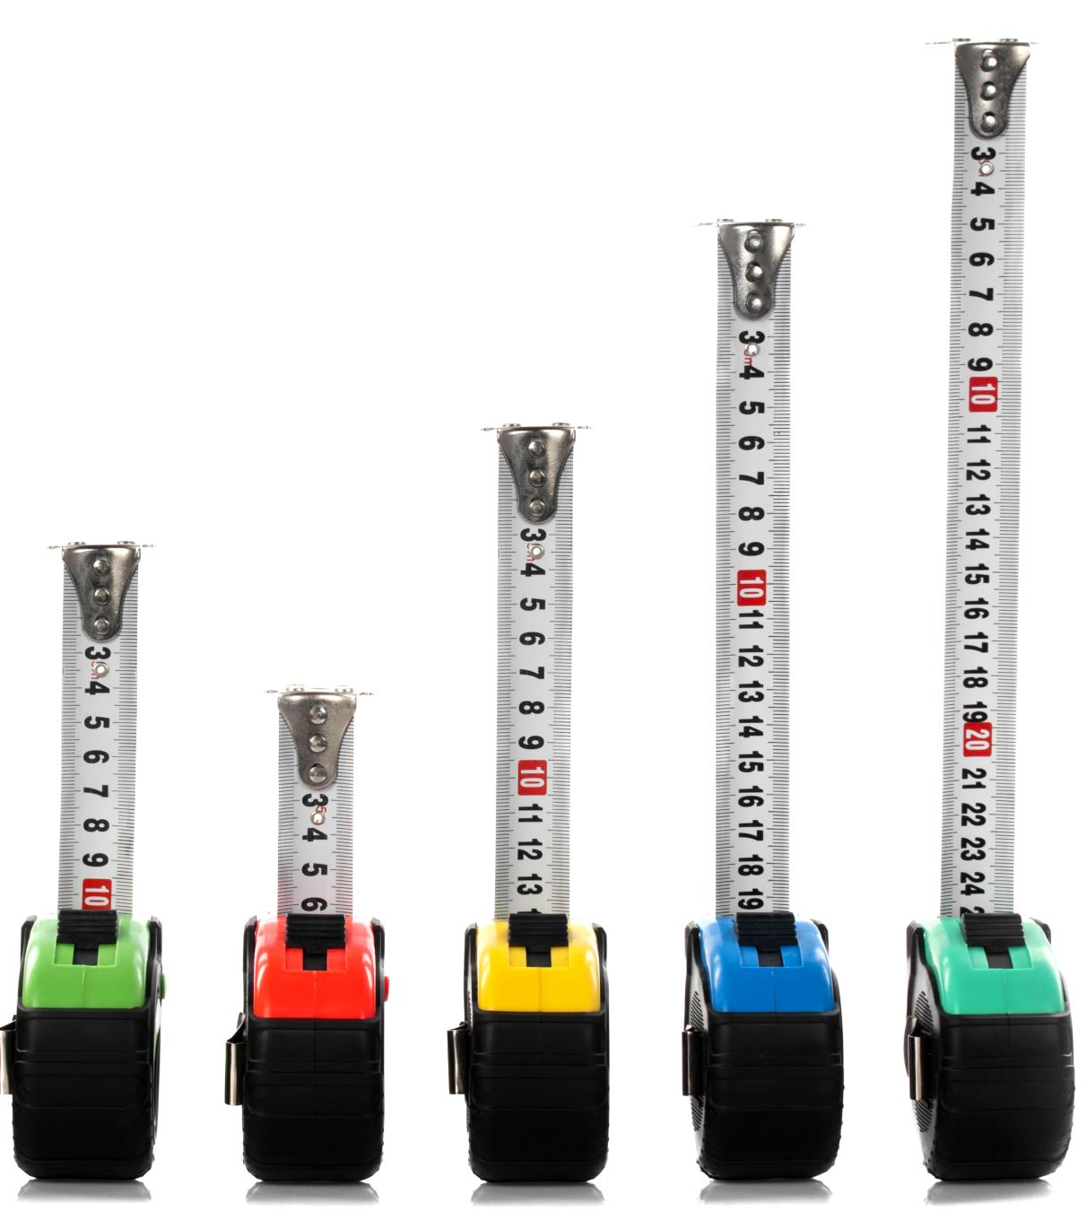
DVC advantages
Interoperates with git
Like git
Git + DVC = standalone
Supports remote data storage
Features
Data versioning
Data pipelines
Experiment management
Model registry (requires DVC Studio)

Slide 11
Repository setup for DVC
Set up git repository in ml_project
Initialize DVC
Configure remote for DVC
$ mkdir ml_project
$ cd ml_project
$ git init
$ dvc init
$ git commit -m 'Initialize DVC'
$ dvc remote add -d local_storage ../dvc_data
$ git add .dvc/config
$ git commit -m 'Add remote storage for DVC'

Slide 12
DVC remote storage options
Data not in git repository
Too large
Bad match with git, i.e., binary files
DVC
Meta-data in git repository
Data in remote storage
Remote storage
Local directory
SSH & SFTP
HTTP/WebDAV
Cloud (S3, Azure Blob Storage, GCP, Google Drive, ...)
Good choice for HPC

Slide 13
DVC remotes examples
Directory in $VSC_DATA, only for HPC access
Directory in $VSC_DATA, accessible via SFTP
Cloud access, see documentation https://dvc.org/doc/user-guide/data-management/cloud-versioning
$ dvc remote add -d local_storage $VSC_DATA/dvc_data
$ dvc remote add -d vsc \
ssh://vsc30000@login.hpc.kuleuven.be:/data/leuven/300/vsc30000/dvc_data

Slide 14
Data Version Control
Data versioning

Slide 15
DVC data versioning
Created by dvc add
Add data to DVC
Data can be
Textual (CSV, JSON, YAML, …)
Binary (HDF5, JPEG, HuggingFace dataset, …)
Convenient auto staging (optional)
$ dvc add data/data.csv
$ git add data/data.csv.dvc
$ git commit -m 'Add data set'
Version of data == commit of .dvc file
$ dvc config core.autostage true
$ git add .dvc/config
$ git commit -m 'Switch on DVC auto-staging'

Slide 16
Interacting with DVC remote
Like git
Push changes to remote
Pull changes from remote
$ dvc push
Data is cached locally in .dvc/cache
$ dvc pull

Slide 17
Modifying data
Change data
No change for git
Change for DVC
Check status, e.g.,
Add changes
$ dvc status
data/data.csv.dvc:
changed outs:
modified: data/data.csv
$ dvc add data/data.csv
$ git commit -m 'Modify data'
$ dvc push

Slide 18
Check out previous versions
Find commit ID with git log
Check out commit, e.g., 17262ab
Go back to current version
$ git log --oneline
Everything revert!!!
$ git checkout 17262ab
$ dvc checkout
Building workspace index |2.00 [00:00, 94.3entry/s]
Comparing indexes |3.00 [00:00, 2.10kentry/s]
Applying changes |1.00 [00:00, 225file/s]
M data/data.csv
Don't forget dvc checkout!!!
$ git switch -
$ dvc checkout
…

Slide 19
Check out only previous versions of data sets
Find commit ID with git log
Create a new branch & restore commit, e.g., 17262ab
When done, switch branches & clean up
$ git log --oneline -- data/data.csv.dvc
$ git switch -C experiment
$ git restore --source=17262ab data/data.csv.dvc
$ git commit -a -m 'Use old data set'
$ dvc checkout
…
Don't forget dvc checkout!!!
$ git switch -
$ git branch -D experiment
$ dvc checkout
…

Slide 20
Importing data
Reuse data
List files in git repository
Recursively list files
Import data set from git repository
Copy files from git repository
$ dvc list git@github.com:gjbex/ml_project.git
Note: performs git clone under the hood
$ dvc list -T git@github.com:gjbex/ml_project.git
$ dvc import git@github.com:gjbex/ml_project.git data/preprocessed
$ dvc import git@github.com:gjbex/ml_project.git params.yaml

Slide 21
Data Version Control
Data pipelines

Slide 22
Data pipelines
Pipelines are built from stages
Stage has
Dependencies
Parameters (optional)
Metrics (optional)
Output(s)
Action (Python/R/Bash/… script)
Pipeline is directed acyclic graph (DAG) of stages
Stages are cached, only run on changes

Slide 23
Add stage
Name of stage
Data dependency
Code dependencies
$ dvc stage add --name split_data \
--deps data/data.csv \
--deps src/split_data.py --deps src/utils.py \
--params split_data.test_size,split_data.random_state \
--outs data/split_data/train.csv \
--outs data/split_data/test.csv \
python src/split_data.py \
--data data/data.csv \
--params params.yaml \
--output data/split_data/
$ git commit -m 'Add split_ddata stage'
Parameters
Output files
Command to execute
Version control stages
dvc add creates dvc.yaml file

Slide 24
Parameters
params.yaml
split_data:
test_size: 0.3
random_state: 1234
train_model:
penalty: "l1"
C: 0.5
solver: "liblinear"
Default params.yaml
Can be
YAML/JSON
Stage-specific
Use in scripts
Specify random state → reproducibility
split_data.py
import yaml
…
with open(args.params) as file:
params = yaml.safe_load(file)
…
train, test = split_train_test(…, params['split_data'][random_state'], …)

Slide 25
Add next stage
Name of stage
Data dependency
= output of split_data
stage
dvc stage add --name train_preprocessor \
--deps data/split_data/train.csv \
--deps src/train_preprocessor.py --deps src/utils.py \
--outs ./preprocessor.pkl \
python src/train_preprocessor.py \
--data data/split_data/train.csv \
--output preprocessor.pkl
git commit -m 'Add train_preprocessor stage'
Code dependencies
Output files
Command to execute
Version control stages
dvc add updates dvc.yaml file
To modify existing stage, use: dvc add --force …
To remove stage, use: dvc remove …

Slide 26
Metrics
Name of stage
Data dependency
= output of preprocess_train
and train_model stage
dvc stage add --name compute_metrics_train \
--deps data/preprocessed/train.csv \
--deps model.pkl \
--deps src/compute_metrics.py --deps src/utils.py \
--metrics metrics/train.yaml \
python src/compute_metrics.py \
--data data/preprocessed/train.csv \
--model model.pkl \
--output metrics/train.yaml
git commit -m 'Add compute_metrics_train stage'
Code dependencies
Metric file
Command to execute

Slide 27
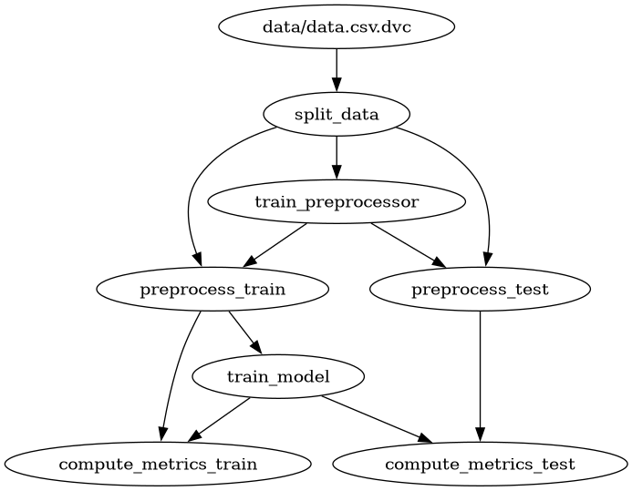
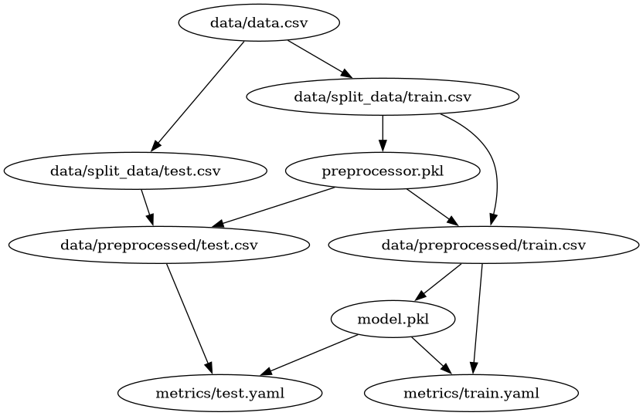
Visualizing pipeline
List stages
ASCII-art visualization of stages
ASCII visualization of data files
Rendering with dot
$ dvc stage list
$ dvc dag
$ dvc dag --outs
$ dvc dag --dot | \ dot -Tpng -o pipeline.png

Slide 28
Run pipeline
Only print commands, don't execute
Run only required stages
Run all stages
Produces/updates dvc.lock file: version control
Check pipeline status
$ dvc repro --dry
$ dvc status split_data:
changed deps:
modified: data/data.csv
data/data.csv.dvc:
changed outs:
modified: data/data.csv
$ dvc repro
$ dvc repro --force
$ git commit -m 'Run pipeline'

Slide 29
Viewing & comparing metrics
View metrics of most recent run
Compare metrics with last commit
$ dvc metrics show
Path accuracy f1_score precision recall
metrics/train.yaml 0.84286 0.8932 0.82143 0.97872
metrics/test.yaml 0.86667 0.9 0.81818 1.0
$ dvc metrics diff
Path Metric HEAD workspace Change
metrics/test.yaml accuracy 0.8 0.86667 0.06667
metrics/test.yaml f1_score 0.85714 0.9 0.04286
metrics/test.yaml precision 0.75 0.81818 0.06818
metrics/train.yaml accuracy 0.82857 0.84286 0.01429
metrics/train.yaml f1_score 0.88679 0.8932 0.00641
metrics/train.yaml precision 0.79661 0.82143 0.02482
metrics/train.yaml recall 1.0 0.97872 -0.02128

Slide 30
Comparing arbitrary runs
Compare metrics of commits
$ dvc metrics diff 070869d 785ea1b
Path Metric 070869d 785ea1b Change
metrics/test.yaml accuracy 0.63333 0.8 0.16667
metrics/test.yaml f1_score 0.76596 0.85714 0.09119
metrics/test.yaml precision 0.62069 0.75 0.12931
metrics/train.yaml accuracy 0.77143 0.82857 0.05714
metrics/train.yaml f1_score 0.85455 0.88679 0.03225
metrics/train.yaml precision 0.74603 0.79661 0.05058
Use --all to see all metrics

Slide 31
Comparing parameters
Compare parameters with last commit
Compare parameters of commits
$ dvc params diff
Path Param HEAD workspace
params.yaml train_model.C 1.0 1.5
$ dvc params diff 070869d 785ea1b
Path Param 070869d 785ea1b
params.yaml train_model.C 0.5 1.0
Use --all to see all parameters

Slide 32

What about R?
Nothing R specific
Reading YAML files
This is not a problem you need to solve
library(yaml)
config <- yaml.load_file("params.yaml")
print(config$split_data$random_state)

Slide 33
Data Version Control
Experiment management

Slide 34
Experiment management
DVCLive Python module
Log experiments
Parameter values
Time step
Metric values
Images/plots/artifacts
Report generation
Compare experiments
Share via GitHub/DVC Studio

Slide 35
DVCLive basics
import dvclive
with dvclive.Live(report='html') as live:
param = 5.0
live.log_param('param', param)
system = init_system(param)
for t in range(1, max_t):
evolve(system)
metric = compute_metric(system)
live.log_metric('metric', metric)
live.next_step()
save(system, 'system.pkl') live.log_artifact('system.pkl', type='model')
param = 5.0
system = init_system(param)
for t in range(1, max_t):
evolve(system)
metric = compute_metric(system)
print(t, metric)
save(system, 'system.pkl')

Slide 36
Run experiment
Run Python script as usual
Creates
dvc.yaml: location of parameters/metrics/plots
dvclive/
metrics.json: metrics of last time step
params.yaml: parameter values
plots/metrics/
TSV file per metric, value for each time step
report.html
Pushes git experiment ref to remote for sharing

Slide 37
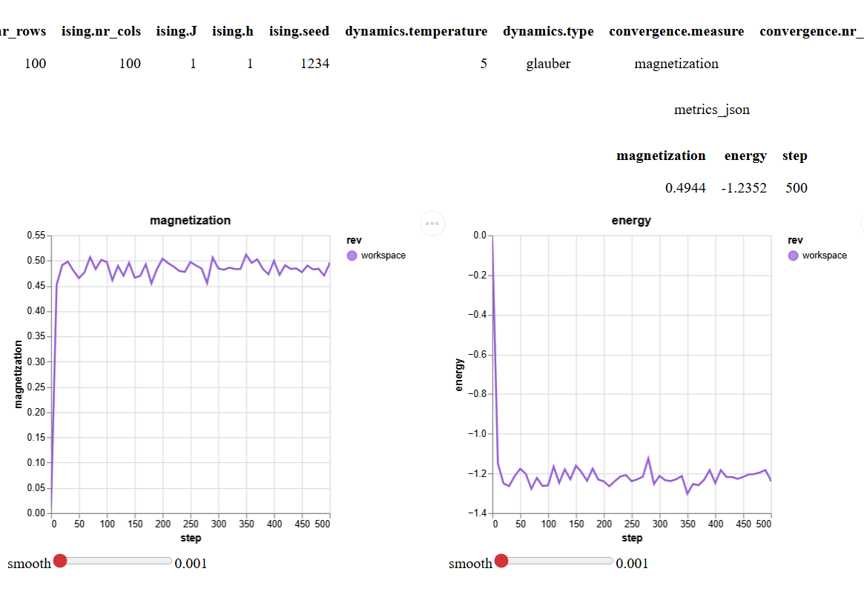

HTML report
Parameter values
Metric values
Plots based on TSV files, interactive
On WSL2 use --open

Slide 38
Experiment management
List experiments at HEAD
List all experiments
Save workspace as experiment
Rename experiment
Rename experiment
$ dvc exp ls
$ dvc exp ls -A
$ dvc exp save --name 'high_temp'
$ dvc exp rename rival-slew high_temp
$ dvc exp remove high_temp

Slide 39
Experiment parameters & metrics
Show experiments
Many measures/parameters very wide output
LESS='-S' prevents wrapping
Use --json
Use --csv --no-pager and csvkit to select columns (csvcut) and format (csvlook)
$ LESS='-S' dvc exp show --only-changed --md
| Experiment | Created | magnetization | energy | ising.h |
|--------------------------|-----------|-----------------|----------|-----------|
| workspace | - | 0.9734 | -2.3871 | 0.5 |
| main | 11:23 AM | 0.4944 | -1.2352 | 1 |
| ├── 44fcecf [rival-slew] | 11:39 AM | 0.9734 | -2.3871 | 0.5 |

Slide 40
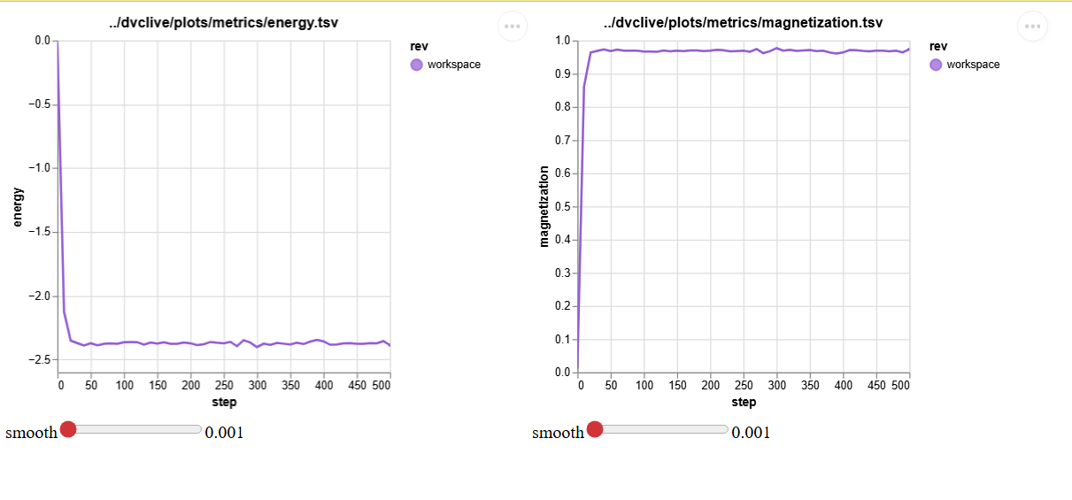
Experiment plots
If you have a browser, use --open
$ dvc plots show high_temp
Plots based on TSV files, interactive
HTML file

Slide 41
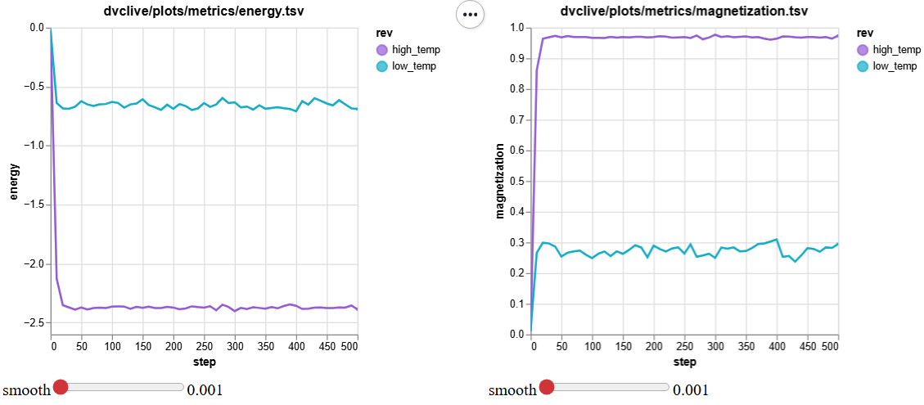
Comparing experiments
Parameters/final metrics
Evolution
$ dvc exp diff high_temp low_temp
Path Metric high_temp low_temp Change
dvclive/metrics.json energy -2.3871 -0.6899 1.6972
dvclive/metrics.json magnetization 0.9734 0.295 -0.6784
Path Param high_temp low_temp Change
dvclive/params.yaml dynamics.temperature 2.0 5.0 3.0
$ dvc plots diff high_temp low_temp
If you have a browser, use --open
HTML file

Slide 42
Sharing experiments
Push experiments to GitHub
Pull experiments to GitHub
$ dvc exp push origin
Name of git remote,
no default
$ dvc exp pull origin
Don’t forget to dvc push/pull, git push/pull is not enough!

Slide 43
What about R?
library(reticulate)
dvclive <- import("dvclive")
live <- dvclive$Live(report='html')
arguments <- commandArgs(…)
delta <- as.numeric(arguments[1])
live$log_param("delta", delta)
score <- 0.0
live$log_metric("score", score)
live$next_step()
for(step in 1:100) {
score <- score + delta
live$log_metric("score", score)
live$next_step()
}
live$end()
Easy: use reticulate to use Python dvclive
arguments <- commandArgs(…)
delta <- as.numeric(arguments[1])
score <- 0.0
for(step in 1:100) {
score <- score + delta
}
Don’t forget to call live$end()!

Slide 44
Data Version Control
Experiment management & pipelines

Slide 45

Pipelines & DVCLive
Experiment == stage
Uses DVCLive
Keep track of
Dependencies
Parameters
Metrics
Outputs

Slide 46
Experiments in pipelines
Add stage as usual
Contains DVCLive experiment management
Parameters read from params.yaml
Run experiment
Run experiment with specific parameter value
Prepare workspace for specific experiment, e.g., high_a
$ dvc exp run
Modifies params.yaml
$ dvc exp run --set-param a=2.0
$ dvc exp apply high_a

Slide 47
Queues & parameter sweeps
Add experiment to queue
Queue parameter sweep
Run queued experiment sequentially
$ dvc exp run --queue
$ dvc exp run --queue -set-param 'a=3.0,4.0,5.0'
$ dvc exp run --run-all

Slide 48
Queue status & management
Check status
Show logs
Remove queued/completed task
$ dvc queue status
Task Name Created Status
db756f8 found-impi 02:24 PM Queued
6c431db fuzzy-sash 02:24 PM Queued
96f84ca regal-coho 02:24 PM Queued
20cacaa muley-tams 02:17 PM Success
cf70af4 dopey-vang 02:17 PM Success
097310c umber-wind 02:17 PM Success
$ dvc queue logs dopey-vang
$ dvc queue remove dopey-vang

Slide 49
Queue control
Run all tasks in queue, 2 workers
Stop all workers
Stop & kill all workers
Kill specific running task
$ dvc queue start --jobs 2
Don’t oversubscribe!
$ dvc queue stop
$ dvc queue stop --kill
$ dvc queue kill leaky-wasp

Slide 50
Conclusions

Slide 51
Take-aways
Git + DVC = standalone
Light weight
Promotes reproducibility
Experiments
Workflows
Facilitates data/experiment/model sharing
Requires
Discipline using version control

Slide 52
References
Git documentation https://git-scm.com/doc
DVC documentation https://dvc.org/doc

