Slide 1

Machine learning with Python
Geert Jan Bex (geertjan.bex@uhasselt.be)
License: this presentation is released under the Creative Commons CC BY 4.0, see https://creativecommons.org/licenses/by/4.0/deed.ast

Slide 2
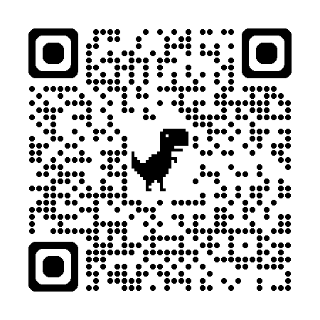
https://bit.ly/40h3frb

Slide 3


Slide 4

Introduction
Machine learning is making great strides
Large, good data sets
Compute power
Progress in algorithms
Many interesting applications
commericial
scientific
Links with artificial intelligence
However, AI ≠ machine learning

Slide 5
Machine learning tasks
Supervised learning
regression: predict numerical values
classification: predict categorical values, i.e., labels
Unsupervised learning
clustering: group data according to "distance"
association: find frequent co-occurrences
link prediction: discover relationships in data
data reduction: project features to fewer features
Reinforcement learning

Slide 6
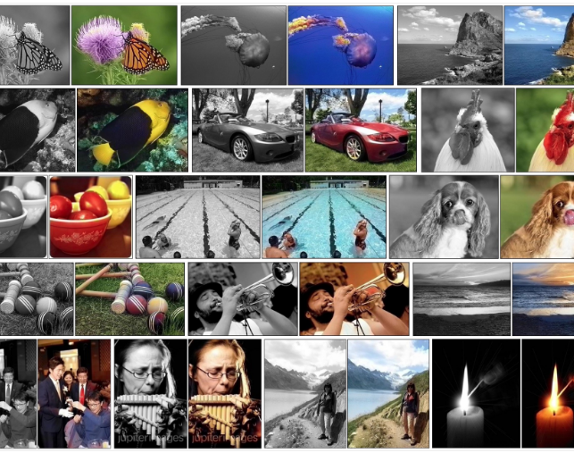
Regression
Colorize B&W images automatically
https://tinyclouds.org/colorize/

Slide 7
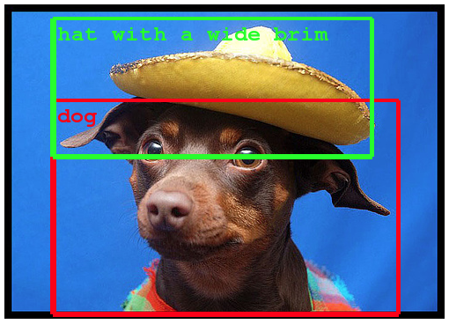
Classification
Object recognition
https://ai.googleblog.com/2014/09/building-deeper-understanding-of-images.html

Slide 8
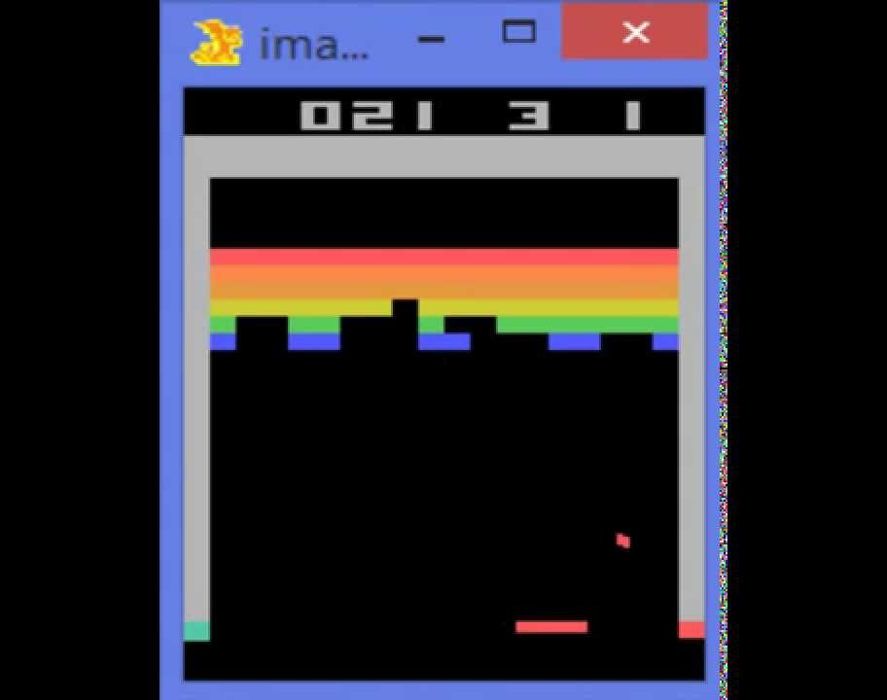
Reinforcement learning
Learning to play Break Out
https://www.youtube.com/watch?v=V1eYniJ0Rnk

Slide 9
Clustering
Crime prediction using k-means clustering
http://www.grdjournals.com/uploads/article/GRDJE/V02/I05/0176/GRDJEV02I050176.pdf

Slide 10
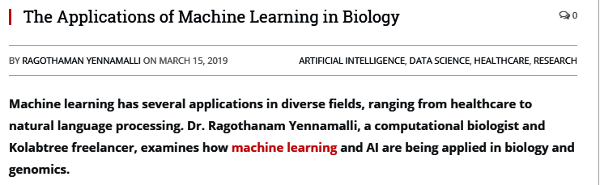
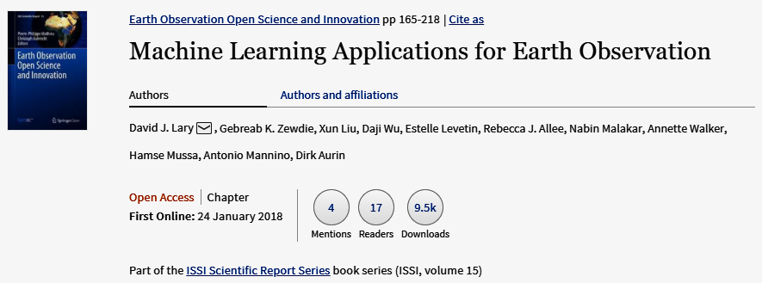
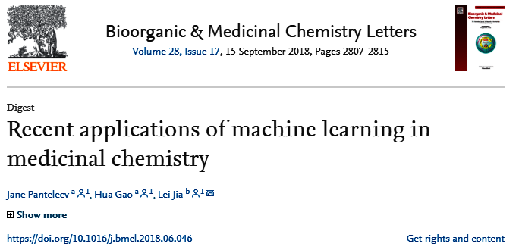
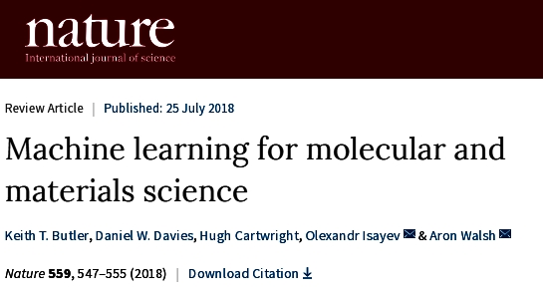
Applications in science

Slide 11
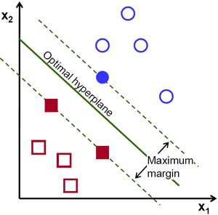
Machine learning algorithms
Regression: Ridge regression, Support Vector Machines, Random Forest, Multilayer Neural Networks, Deep Neural Networks, ...
Classification: Naive Base, Support Vector Machines, Random Forest, Multilayer Neural Networks, Deep Neural Networks, ...
Clustering: k-Means, Hierarchical Clustering, ...

Slide 12

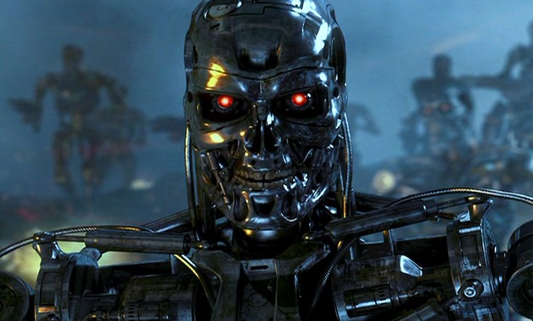
Issues
Many machine learning/AI projects fail (Gartner claims 85 %)
Ethics, e.g., Amazon has/had sub-par employees fired by an AI automatically

Slide 13

Reasons for failure
Asking the wrong question
Trying to solve the wrong problem
Not having enough data
Not having the right data
Having too much data
Hiring the wrong people
Using the wrong tools
Not having the right model
Not having the right yardstick
Notes:
https://www.kdnuggets.com/2018/07/why-machine-learning-project-fail.html

Slide 14
Frameworks
Programming languages
Python
R
C++
...
Many libraries
scikit-learn
PyTorch
TensorFlow
Keras
…
Fast-evolving ecosystem!
classic machine learning
deep learning frameworks

Slide 15

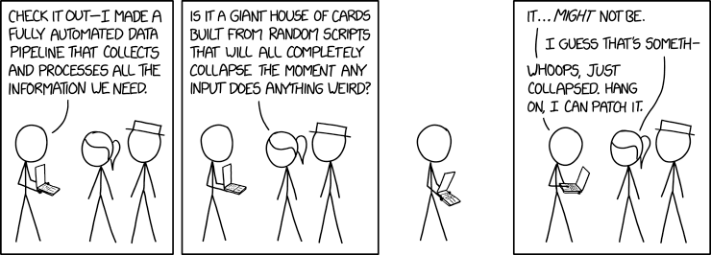

Data pipelines
Data ingestion
CSV/JSON/XML/H5 files, RDBMS, NoSQL, HTTP,...
Data cleaning
outliers/invalid values? → filter
missing values? → impute
Data transformation
scaling/normalization
Must be done systematically

Slide 16
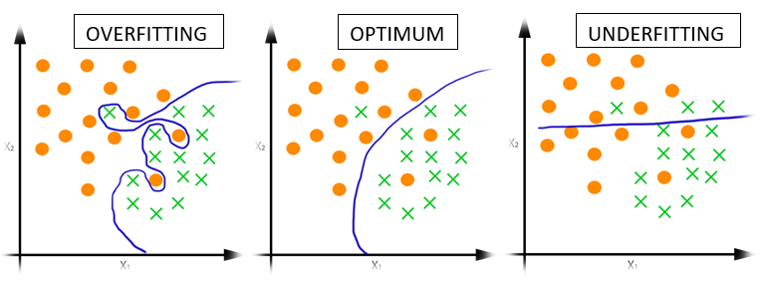
Supervised learning: methodology
Select model, e.g., random forest, (deep) neural network, ...
Train model, i.e., determine parameters
Data: input + output
training data → determine model parameters
validation data → yardstick to avoid overfitting
Test model
Data: input + output
testing data → final scoring of the model
Production
Data: input → predict output
Experiment with underfitting and overfitting:
010_underfitting_overfitting.ipynb

Slide 17
scikit-learn
https://github.com/gjbex/Python-for-machine-learning/tree/master/source-code/scikit-learn

Slide 18
scikit-learn
Nice end-to-end framework
data exploration (+ pandas + holoviews)
data preprocessing (+ pandas)
cleaning/missing values
normalization
training
testing
application
"Classic" machine learning only
https://scikit-learn.org/stable/

Slide 19
Machine learning tasks
Supervised learning
regression: predict numerical values
classification: predict categorical values, i.e., labels
Unsupervised learning
clustering: group data according to "distance"

Slide 20
Data set
training: 2015 test: 2016
World happiness index 2015 & 2016 (http://worldhappiness.report/)
Happiness score for country based on
economic factors (GDP)
family situation (social network)
health care (life expectancy)
freedom
trust (government corruption)
generosity
dystopia residual
Geographical region, e.g.,
Western Europe, Southern Asia,…
don't touch!
quantitative data
categorical data

Slide 21
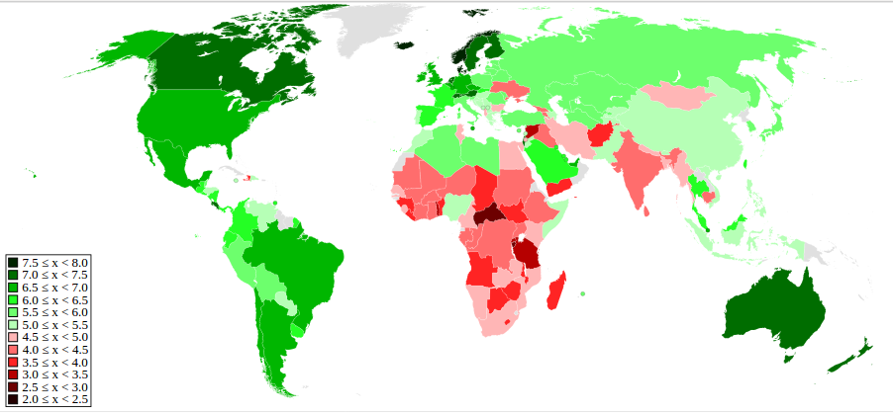
World happiness
https://en.wikipedia.org/wiki/World_Happiness_Report

Slide 22
Task 1
Given
economy
family
health
freedom
trust
generosity
dystopia residual
region
Predict happiness score
Regression

Slide 23
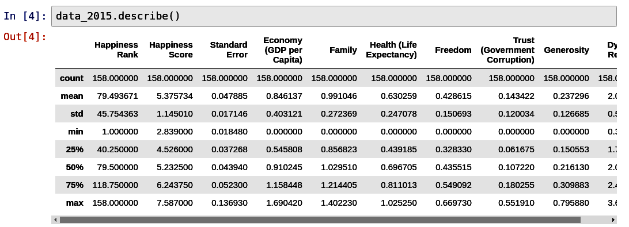
Let's peek…
Rescaling

Slide 24
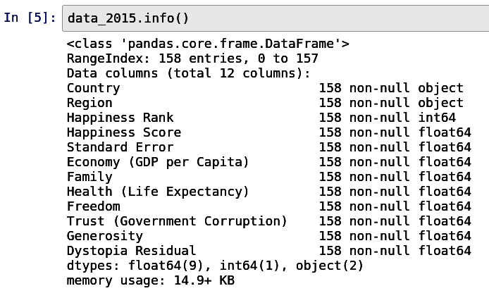
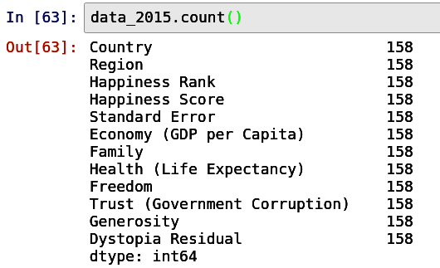
Missing values?
No NaNs, otherwise, use Imputer

Slide 25
Extracting data
Part of machine learning pipeline
fit + transform
Extracting columns from pandas data frame
Transform data
scale numerical features to [0, 1]
one-hot encoding for regions

Slide 26
Numerical attributes pipeline
Extract, then scale
from sklearn.compose import ColumnTransformer
from sklearn.preprocessing import MinMaxScaler
num_attr_names = data_2015.columns[5:13]
num_attrs_transformer = ColumnTransformer([
('minimax', MinMaxScaler(), num_attr_names)
])
name of operation
operation constructor
column names

Slide 27
Categorical attribute pipeline
Extract, then create one-hot attributes
Country | Region
Belgium | Western Europe
Canada | North America
Germany | Western Europe
… | …
Country | Western Europe | Northren America | …
Belgium | 1 | 0 | …
Canada | 0 | 1 | …
Germany | 1 | 0 | …
… | … | … | …
from sklearn.preprocessing import OneHotEncoder
region_transformer = ColumnTransformer([
('one_hot_encoder', OneHotEncoder(categories='auto'),
['Region'])
])

Slide 28
Combining pipelines & execution
Both pipelines must be executed, results combined
Run data through pipeline
from sklearn.pipeline import FeatureUnion
preparation_pipeline = FeatureUnion(transformer_list=[
('region_attr', region_attr_transformer),
('num_attrs', num_attrs_transformer),
])
train_data = preparation_pipeline.fit_transform(data_2015)
Ready to start training!
numpy array

Slide 29
Training & prediction
Create learning algorithm
Train
Predict
from sklearn.linear_model import Ridge
ridge_regr = Ridge(alpha=0.5, fit_intercept=False)
hyperparameters
X = train_data
Y = np.array(data_2015['Happiness Score'])
ridge_regr.fit(X, Y);
???
Y_ridge_regr = ridge_regr.predict(X)

Slide 30
Score & errors
Score
Better: cross validation
ridge_regr.score(X, Y)
0.9984
scores = cross_val_score(
ridge_regr, X, Y, scoring='neg_mean_squared_error',
cv=10
)
10-fold
0.1954, 0.0215, 0.0579, 0.0478, 0.0551, 0.0649, 0.0591, 0.0451, 0.0729, 0.0803
np.sqrt(-scores)

Slide 31
Fine tuning
Define hyper parameter search space
Define grid searcher
Search
Best hyper parameters
grid_params = [
{'alpha': [0.0005, 0.001, 0.005, 0.01, 0.05, 0.1, 0.5], 'fit_intercept': [True, False]},
]
grid_search = GridSearchCV(ridge_regr, grid_params, cv=10,
scoring='neg_mean_squared_error')
grid_search.fit(X, Y)
grid_search.best_params_
{'alpha': 0.0005, 'fit_intercept': True}

Slide 32
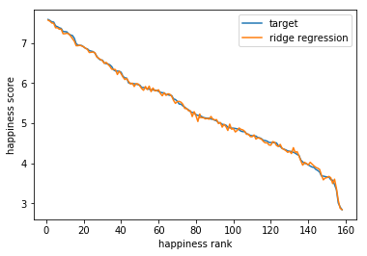
Training result

Slide 33
Testing the model
Use pipeline
Predict
Score
test_data = preparation_pipeline.transform(data_2016)
Note: only transform, no fit_transform!
Y_test = ridge_regr.predict(X_test)
ridge_regr.score(X_test, Y_test)
0.9950

Slide 34
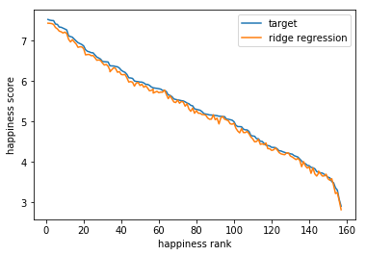
Test result

Slide 35
Task 2
Given
economy
family
health
freedom
trust
generosity
dystopia residual
Predict whether country in Western Europe
Classification

Slide 36
Data preparation
Numerical pipeline is same as in task 1
select from pandas DataFrame
scale
Add column for class
True if in Western Europe, False otherwise
prepared_data = num_attrs_pipeline.fit_transform(data_2015)
data_2015['Western Europe'] = (data_2015['Region'] ==
'Western Europe')

Slide 37
Training & scoring
Create learning algorithm
Train
Scoring
from sklearn.naive_bayes import GaussianNB
nb = GaussianNB()
attributes: approx. Gaussian distr.
nb.fit(prepared_data, data_2015['Western Europe'])
nb.score(prepared_data, data_2015['Western Europe'])
0.9367
Seems reasonable

Slide 38
Testing the model
Use pipeline
Predict
Score
test_data = num_attrs_pipeline.transform(data_2016)
Note: only transform, no fit_transform!
Y_test = nb.predict(test_data)
nb.score(test_data, Y_test)
0.8662
Not so good

Slide 39
Actually…
Compute confusion matrix
confusion_matrix(data_2016['Western Europe'],
nb.predict(test_data))
false positives
array([[132, 4],
[ 17, 4]])
false negatives
Massive exit from Western Europe: 17 countries just left!

Slide 40
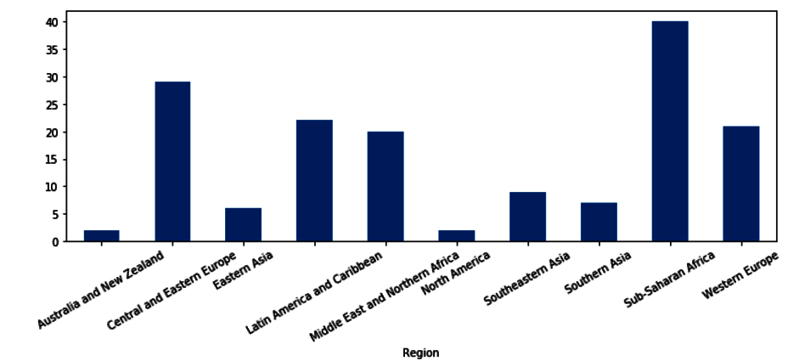
Data set properties
small class, many detractors

Slide 41
Task 3
Given
economy
family
health
freedom
trust
generosity
dystopia residual
Find countries that are "close"
Clustering

Slide 42
k-means algorithm
Start with k means, i.e., seed points
Repeat
Assign data points to nearest mean value
Update by recomputing mean values
Stop when no more change

Slide 43
Data preparation & Training
Data preprocessing same as task 2
Create learning algorithm
Train
Add cluster label to data set
from sklearn.cluster import KMeans
k_means = KMeans(n_clusters=3)
How many clusters?
k_means.fit(prepared_data)
data_2015['Cluster'] = 0
for i in range(3):
data_2015.loc[clusterer.labels_ == i, 'Cluster'] = i

Slide 44
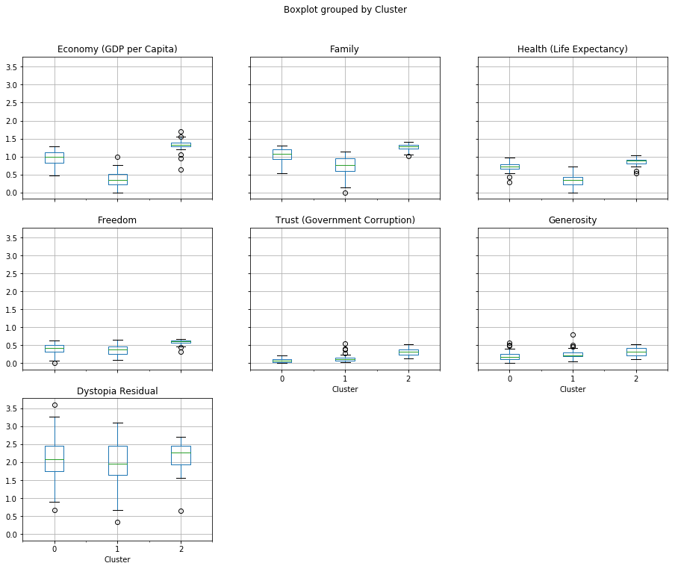
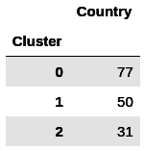
Examine clusters
data_2015.boxplot(by='Cluster', column=num_attr_names)
data_2015.loc[:, ('Cluster', 'Country')].groupby('Cluster').count()

Slide 45
And the winners are…
Switzerland
Iceland
Denmark
Norway
Canada
Finland
Netherlands
Sweden
New Zealand
Australia
Austria
United States
Luxembourg
Ireland
Belgium
United Arab Emirates
United Kingdom
Oman
Singapore
Germany
Qatar
France
Uruguay
Saudi Arabia
Malta
Kuwait
Uzbekistan
Japan
Bahrain
Turkmenistan
Hong Kong

Slide 46
Keras
https://github.com/gjbex/Python-for-machine-learning/tree/master/source-code/keras

Slide 47


Keras
High-level framework for deep learning
TensorFlow backend
Layer types
dense
convolutional
pooling
embedding
recurrent
activation
…
https://keras.io/

Slide 48
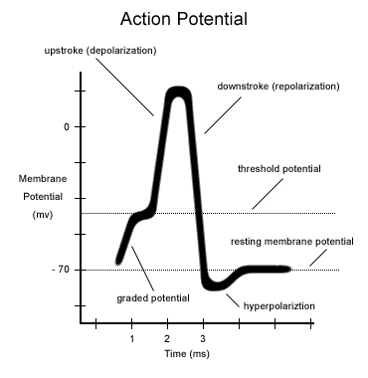
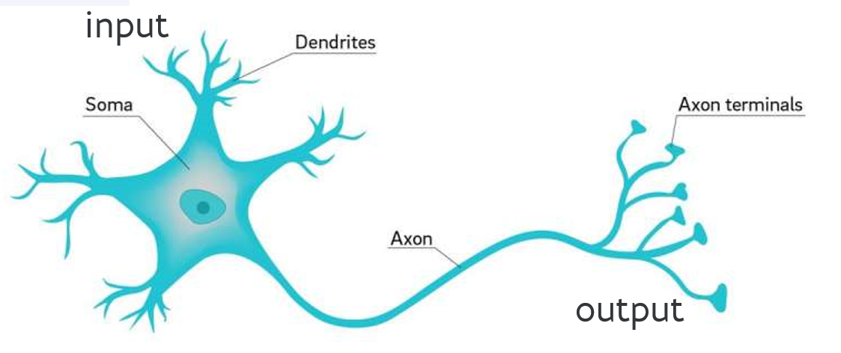
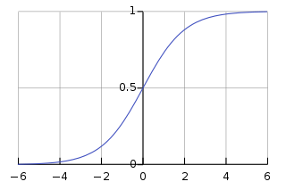











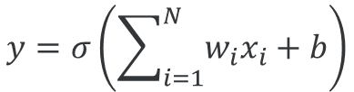


From neurons to ANNs
inspiration
$$x_{1}$$
$$w_{1}$$
$$x_{2}$$
$$w_{2}$$
$$y=σ\left(\sum_{i=1}^{N}{w_{i}x_{i}+b}\right)$$
$$σ\left(x\right)$$
$$y$$
$$w_{3}$$
activation function
$$x_{3}$$
$$b$$
...
$$+1$$
$$x$$
$$w_{N}$$
$$x_{N}$$

Slide 49
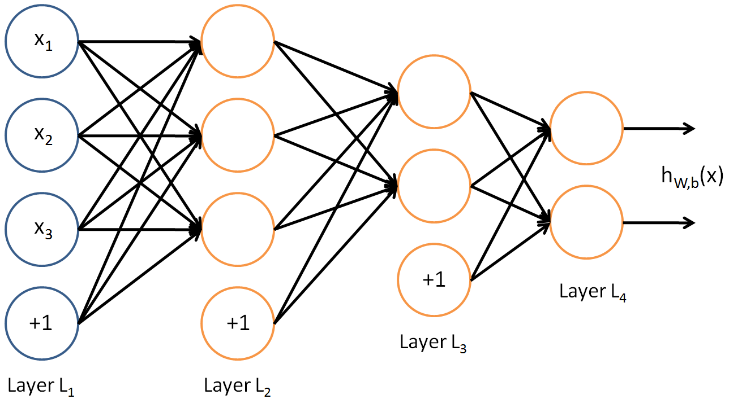
Multilayer network
How to determine weights?

Slide 50
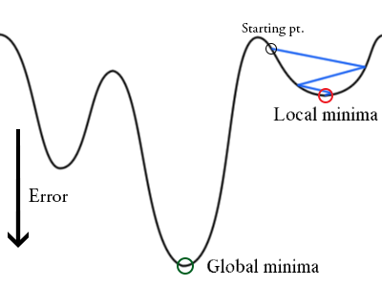
Training: backpropagation
Initialize weights "randomly"
For all training epochs
for all input-output in training set
using input, compute output (forward)
compare computed output with training output (loss function)
adapt weights (backward) to improve output
if accuracy is good enough, stop

Slide 51
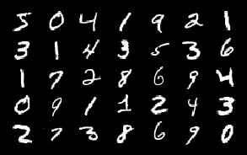
Task: handwritten digit recognition
Input data
grayscale image
Output data
digit 0, 1, ..., 9
Training examples
Test examples
Explore the data: 020_mnist_data_exploration.ipynb

Slide 52

First approach
Data preprocessing
Input data as 1D array
output data as array with one-hot encoding
Model: multilayer perceptron
784 inputs
dense hidden layer with 512 units
ReLU activation function
dense layer with 512 units
ReLU activation function
dense layer with 10 units
SoftMax activation function
array([ 0.0, 0.0,..., 0.951, 0.533,..., 0.0, 0.0], dtype=float32)
5
array([ 0, 0, 0, 0, 0, 1, 0, 0, 0, 0], dtype=uint8)
Activation functions: 030_activation_functions.ipynb
Multilayer perceptron: 040_mnist_mlp.ipynb

Slide 53
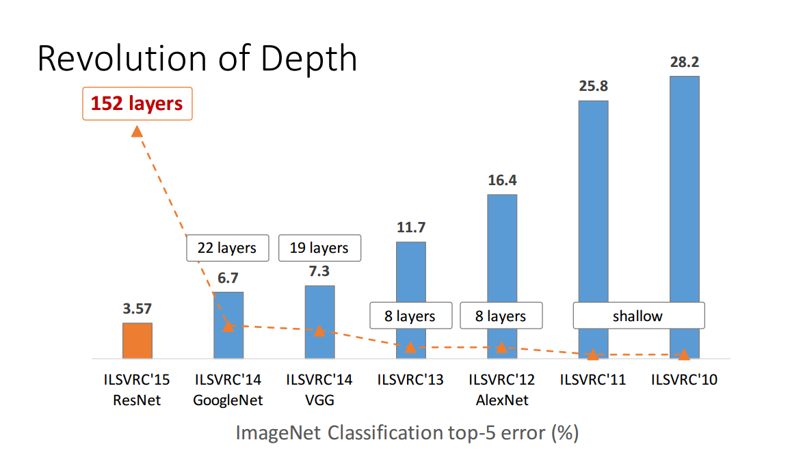
Deep neural networks
Many layers
Features are learned, not given
Low-level features combined into high-level features
Special types of layers
convolutional
drop-out
recurrent
...

Slide 54

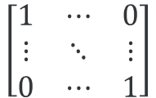
Convolutional neural networks
$$\left[\begin{matrix}1 & ⋯ & 0 \\ ⋮ & ⋱ & ⋮ \\ 0 & ⋯ & 1\end{matrix}\right]$$
⊗

Slide 55

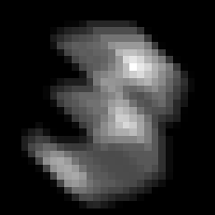


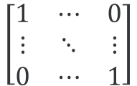
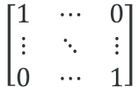
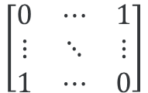
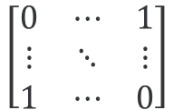
Convolution examples
$$\left[\begin{matrix}1 & ⋯ & 0 \\ ⋮ & ⋱ & ⋮ \\ 0 & ⋯ & 1\end{matrix}\right]$$
$$\left[\begin{matrix}1 & ⋯ & 0 \\ ⋮ & ⋱ & ⋮ \\ 0 & ⋯ & 1\end{matrix}\right]$$
$$\left[\begin{matrix}0 & ⋯ & 1 \\ ⋮ & ⋱ & ⋮ \\ 1 & ⋯ & 0\end{matrix}\right]$$
$$\left[\begin{matrix}0 & ⋯ & 1 \\ ⋮ & ⋱ & ⋮ \\ 1 & ⋯ & 0\end{matrix}\right]$$
Convolution: 050_convolution.ipynb

Slide 56
Second approach
Data preprocessing
Input data as 2D array
output data as array with one-hot encoding
Model: convolutional neural network (CNN)
28 × 28 inputs
CNN layer with 32 filters 3 × 3
ReLU activation function
flatten layer
dense layer with 10 units
SoftMax activation function
array([[ 0.0, 0.0,..., 0.951, 0.533,..., 0.0, 0.0]], dtype=float32)
5
array([ 0, 0, 0, 0, 0, 1, 0, 0, 0, 0], dtype=uint8)
Convolutional neural network: 060_mnist_cnn.ipynb

Slide 57


Task: sentiment classification
Input data
movie review (English)
Output data
Training examples
Test examples
<start> this film was just brilliant casting location
scenery story direction everyone's really suited the part
they played and you could just imagine being there Robert
redford's is an amazing actor and now the same being director
norman's father came from the same scottish island as myself
so i loved the fact there was a real connection with this
film the witty remarks throughout the film were great it was
just brilliant so much that i bought the film as soon as it
…
/
Explore the data: 070_imdb_data_exploration.ipynb

Slide 58
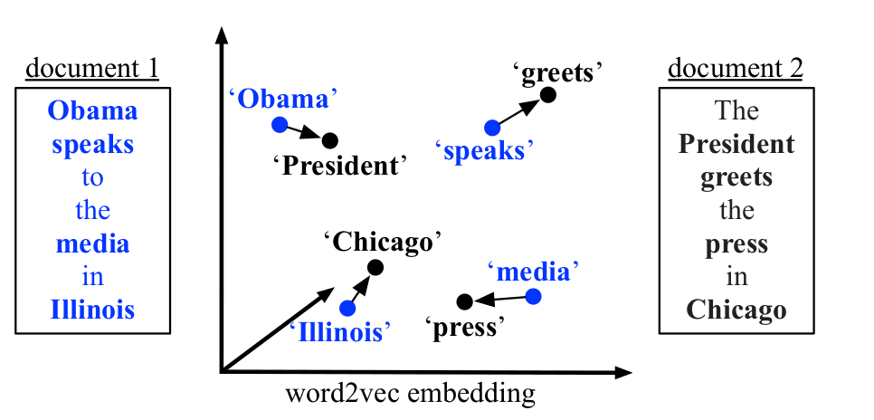
Word embedding
Represent words as one-hot vectors length = vocabulary size
Word embeddings
dense vector
vector distance ≈ semantic distance
Training
use context
discover relations with surrounding words
Issues:
unwieldy
no semantics

Slide 59
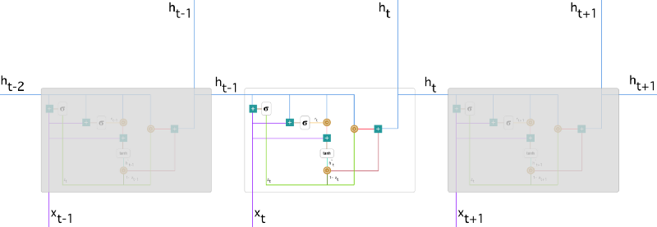
How to remember?
Manage history, network learns
what to remember
what to forget
Long-term correlations!
Use, e.g.,
LSTM (Long Short-Term Memory
GRU (Gated Recurrent Unit)
Deal with variable length input and/or output

Slide 60
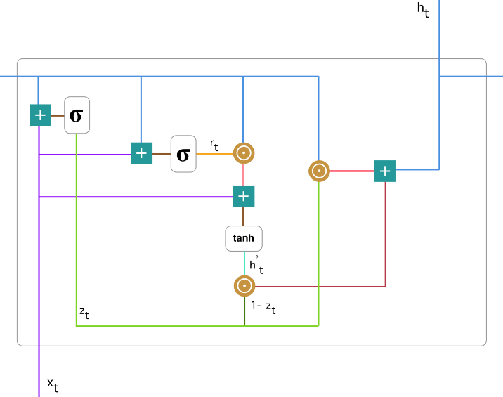




Gated Recurrent Unit (GRU)
Update gate
Reset gate
Current memory content
Final memory/output
$$z_{t}=σ\left(W_{z}x_{t}+U_{z}h_{t−1}\right)$$
$$r_{t}=σ\left(W_{r}x_{t}+U_{r}h_{t−1}\right)$$
$${h′}_{t}=tanh\left(Wx_{t}+r_{t}⊙Uh_{t−1}\right)$$
$h_{t}=z_{t}⊙h_{t−1}+\left(1−z_{t}\right)$ $⊙{h′}_{t}$

Slide 61
Approach
Data preprocessing
Input data as padded array
output data as 0 or 1
Model: recurrent neural network (GRU)
100 inputs
embedding layer, 5,000 words, 64 element representation length
GRU layer, 64 units
dropout layer, rate = 0.5
dense layer, 1 output
sigmoid activation function
Recurrent neural network: 080_imdb_rnn.pynb

Slide 62



Caveat
InspiroBot (http://inspirobot.me/)
"I am an artificial intelligence dedicated to generating unlimited amounts of unique inspirational quotes for endless enrichment of pointless human existence".

Slide 63
Conclusions
scikit-learn
easy to use
consistent, elegant API
restricted to classic machine learning
Keras
very versatile
offers access to TensorFlow backend for low-level
Consider using pre-trained networks
Success depends on understanding algorithms!
Success also depends on understanding data & domain!
Many things to explore

Slide 64
Further reading
Hands-on machine learning with scikit-learn & TensorFlow Aurélien Géron O'Reilly, 2017
Excellent keras tutorial https://github.com/leriomaggio/deep-learning-keras-tensorflow

