Slide 1
Shared memory programming in C++ with Threading Building Blocks
Geert Jan Bex email: geertjan.bex@uhasselt.be

Slide 2
Introduction & motivation

Slide 3
Why shared memory programming?
All CPUs have multiple cores
Cores have vector registers
Accelerators
GPGPUs
FPGAs
...
Various levels of parallelism

Slide 4
Options for C++?
pthreads
disadvantages: programming model not really suited for scientic programming
C++ threads
advantages: part of C++ standard
disadvantages: programming model not really suited for scientic programming
OpenMP
advantages: de facto standard in scientific computing; standard supported by "all" compilers; standard for C and Fortran
disadvantages: multilevel parallelization is tricky
Threading Building Blocks (TBB)
advantages: multilevel parallelism is easier; integrates well with modern C++
disadvantages: no standard, C++ only

Slide 5
Whence TBB?
History
1995-2006: MIT Cilk
2006-2009: Cilk++
2009-...: Intel Cilk Plus
2006-...: Intel Threading Building Blocks
optimized for Intel hardware
2016-...: Threading building blocks open source
https://www.threadingbuildingblocks.org/

Slide 6
What is TBB?
Algorithms
parallel_for, parallel_reduce, parallel_scan, parallel_do, pipeline
Tasks & flow graphs
Concurrent containers
concurrent_queue, concurrent_vector, concurrent_hash_map
Mutual exclusion
Atomic operations
Memory allocation

Slide 7
Where to find info?
TBB website: https://www.threadingbuildingblocks.org/
Documentation: see website
Books:
Intel Threading Building Blocks: outfitting C++ for multi-core parallelism James Reinders, 2010, O'Reilly
Pro TBB: C++ parallel programming with Threading Building Blocks Michael Voss, Rafael Asenjo, James Reinders, 2019, Apress Open
Slides https://github.com/gjbex/training-material/blob/master/CPlusPlus/Tbb/tbb.pptx
Sample code https://github.com/gjbex/training-material/tree/master/CPlusPlus/Tbb

Slide 8
C++ refresher

Slide 9
C++ prerequisites
Iterators
Classes/structs defining operator()
Lambda functions
Placement new

Slide 10
Iterators
#include <algorithm>
#include <iostream>
#include <vector>
int main() {
std::vector<int> v;
for (int i = 0; i < 10; ++i)
v.push_back(i);
for (auto it = v.cbegin(); it != v.cend(); ++it)
std::cout << *it << " ";
std::cout << std::endl;
for (auto it = v.begin(); it != v.end(); ++it)
*it = (*it)*(*it);
…
return 0;
}
Iterators over C++ STL containers, e.g.,
cbegin: iterator to first element
cend: iterator to last element
it: iterator pointing to current value (const)
non-const iterators: begin/end
0
1
2
3
…
8
9
…
v.cbegin()
it
v.cend()

Slide 11


Classes/structs defining operator()
#include <iostream>
class QuadraticFunction {
private:
double a_, b_, c_;
public:
QuadraticFunction(double a, double b, double c) :
a_ {a}, b_ {b}, c_ {c} {}
double operator()(const double x) {return (a_*x + b_)*x + c_; }
};
int main() {
QuadraticFunction f1(1.0, 0.0, -1.0);
QuadraticFunction f2(-1.0, 3.0, 0.0);
for (double x = -3.0; x <= 3.0; x += 0.2)
std::cout << x << " " << f1(x) << " " << f2(x) << "\n";
return 0;
}
$f_{1}$: x $→ x^{2}−1$
$f_{2}$: x $→ {−x}^{2}+3x$

Slide 12
Lambda functions
#include <algorithm>
#include <iostream>
#include <vector>
int main() {
std::vector<double> v {0.5, 0.75, 1.0, 1.5, 3.5};
std::for_each(v.begin(), v.end(),
[] (double& x) { x *= x; });
for (auto x: v)
std::cout << x << " ";
std::cout << std::endl;
return 0;
}
std::for_each modifies container element in-place
Here, x → x²
Lambda function = unnamed function, used once
Return type: often deduced
General form: [ … ] ( … ) -> return_type { … }
context
arguments
function body

Slide 13
Lambda functions & context
#include <algorithm>
#include <iostream>
#include <vector>
int main() {
std::vector<double> x_vals;
for (double x = -3.0; x <= 3.0; x += 0.2)
x_vals.push_back(x);
double a {-11.0};
double b {3.0};
double c {1.5};
std::vector<double> y_vals;
std::transform(x_vals.begin(), x_vals.end(),
std::back_inserter(y_vals),
[&a, &b, &c] (double& x) {
return (a*x + b)*x + c;});
for (std::size_t i = 0; i < x_vals.size(); ++i)
std::cout << x_vals[i] << " " << y_vals[i] << "\n";
return 0;
}
[]: nothing
[=]: everything in scope by value (copy)
[&]: everything in scope by reference
[=var]: variable var by value (copy)
[&var]: variable var by reference

Slide 14
Placement new
#include <cmath>
#include <iostream>
struct Point {
double x, y;
Point() {…}
};
int main() {
Point* p_ptr = (Point*) malloc(sizeof(Point));
double dist {0.0};
for (long i = 0; i < i_max; ++i) {
Point* p = new(p_ptr) Point();
dist += std::sqrt(p->x*p->x + p->y*p->y);
}
free(p_ptr);
return 0;
}
Create new object in pre-allocated memory location
E.g., custom memory allocator

Slide 15
TBB algorithms

Slide 16
parallel_for: simplest form
#include <algorithm>
#include <iostream>
#include <numeric>
#include <tbb/tbb.h>
#include <valarray>
int main() {
std::valarray<int> data(10000);
std::iota(std::begin(data), std::end(data), 0);
std::for_each(std::begin(data), std::end(data),
[] (int& i) { i = i*i; });
tbb::parallel_for(0ul, data.size(),
[&data] (std::size_t i) { data[i] = data[i]*data[i]; });
std::cout << data.sum() << std::endl;
return 0;
}
work automatically divided over thread pool

Slide 17
parallel_for: more control
…
int main() {
…
std::size_t grain_size {1000};
tbb::parallel_for(tbb::blocked_range<std::size_t>(0ul, data.size(), grain_size),
[&data] (const tbb:blocked_range<std::size_t>& range) {
for (std::size_t i = range.begin(); i < range.end(); ++i)
data[i] = data[i]*data[i]; });
…
return 0;
}
blocked ranges divided over thread pool, rule of thumb: 10,000 cycles per blocked range
0
…
999
1000
…
1999
2000
…
9999
first range
second range
last range

Slide 18
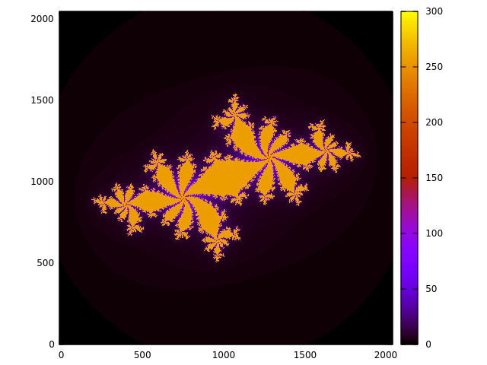
parallel_for: Julia sets
#include <complex>
…
const std::complex<double> c(-0.62772, - 0.42193);
for (double x = -1.8; x < 1.8; x += 0.001)
for (double y = -1.8; y < 1.8; y += 0.001) {
std::complex<double> z(x, y);
while (std::abs(z) < 2.0 && n++ < max_n)
z = z*z + c;
std::cout << x << " " << y << " " << n << std::endl;
}
16384 × 16384 array

Slide 19
parallel_reduce: simplest form
#include <iostream>
#include <numeric>
#include <tbb/tbb.h>
#include <valarray>
int main() {
std::size_t grain_size {1000};
std::valarray<int> data(10000);
std::iota(std::begin(data), std::end(data), 0);
int sum = tbb::parallel_reduce(
tbb::blocked_range<std::size_t>(0ul, data.size(), grain_size), 0,
[&data] (const tbb::blocked_range<std::size_t>& range, int init) {
for (std::size_t i = range.begin(); i < range.end(); ++i)
init += data[i];
return init;
},
[] (int x, int y) { return x + y; }
);
…
return 0;
}
reduction of blocked_range
reduction of blocked_range results

Slide 20
parallel_reduce: class
class Stats {
private:
Vector* const data_;
const std::size_t n_;
double sum_, sum2_;
public:
Stats(Vector* data) : data_ {data}, n_ {data->size()}, sum_ {0.0}, sum2_ {0.0} {}
Stats(Stats& stats, tbb::split) : Stats(stats.data_) {}
void operator()(const tbb::blocked_range<std::size_t>& r) {
for (auto i = r.begin(); i != r.end(); ++i) {
double val = (*data_)[i];
sum_ += val;
sum2_ += val*val; }
}
void join(const Stats& stats) {
sum_ += stats.sum_;
sum2_ += stats.sum2_;
}
double mean() const { return sum_/n_; }
double stddev() const {…};
};
…
Vector data = …;
Stats stats(&data);
tbb::blocked_range<std::size_t> ranges(
0ul, data.size(), grain_size
);
tbb::parallel_reduce(ranges, stats);
std::cout << stats.mean();
…

Slide 21
parallel_do
Create processing class
overloads operator() to process single item
optionally add new items to process (using tbb::parallel_do_feeder)
Create STL std::vector with initial items
Call tbb::parallel_do with
begin of iterator for initial items to process
end of iterator for items to process
processing class instance
Note: items in the vector can be computed, no dependencies on other items

Slide 22
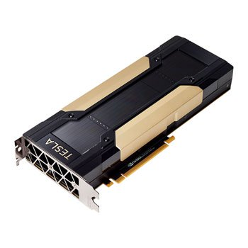


no pipeline
GPU₀
CPU₂
GPU₂
CPU₁
GPU₁
CPU₀
GPU₀
CPU₀
Both GPU and CPU are idle half of the time

Slide 23
pipeline
GPU₀
GPU₂
GPU₁
GPU₀
CPU₂
CPU₁
CPU₀
Pipeline start-up → pipeline full → pipeline wind-down

Slide 24
TBB tasks

Slide 25


Task spawning
$$fib\left(n\right)=fib\left(n−1\right)+fib(n−2)$$
$$fib\left(0\right)=fib\left(1\right)=1$$
class FibTask : public tbb::task {
private:
long n_;
long* result_;
public:
FibTask(long n, long* result) : n_ {n}, result_ {result} {}
tbb::task* execute() {
if (n_ < 2) {
*result_ = 1;
} else {
long result_n_1;
long result_n_2;
tbb::task_list list;
list.push_back(*new(allocate_child()) FibTask(n_ - 1, &result_n_1));
list.push_back(*new(allocate_child()) FibTask(n_ - 2, &result_n_2));
set_ref_count(3);
spawn_and_wait_for_all(list);
*result_ = result_n_1 + result_n_2;
}
return nullptr;
}
};
…
auto task = new(tbb::task::allocate_root()) FibTask(n, &result);
tbb::task::spawn_root_and_wait(*task);
…
However, task granularity!

Slide 26
Task spawning: granularity
class FibTask : public tbb::task {
private:
long n_;
long* result_;
public:
FibTask(long n, long* result) : n_ {n}, result_ {result} {}
tbb::task* execute() {
if (n_ < 10) {
*result_ = sequential_fib(n_);
} else {
…
}
}
};

Slide 27
Task spawning: timings
n = 50

Slide 28
Tree traversal
54,899,183 nodes
dual Intel Xeon skylake
2 × 18 cores

Slide 29
Flow graphs

Slide 30
TBB scheduler

Slide 31
TBB task scheduler
thread pool
task queue
when thread is done, it steals work
Load balancing: thread on busy core will poll less often for work
t_{i}
t_{j}
0
1
2
3

Slide 32
Conclusions

Slide 33
Conclusions
Advantages
Interesting programming model
Integrates nicely with modern C++
Works with any compiler
Nice for heterogeneous hardware
Disadvantages
Thread affinity?
Code base critically depends on TBB

