Slide 1
Modeling and programming
G. J. Bex
geertjan.bex@uhasselt.be

Slide 2
What is programming?
Real world
Model
Implementation
def volume(object):
…
Minimize discrepancies: real world ↔ model ↔ implementation

Slide 3
Models

Slide 4
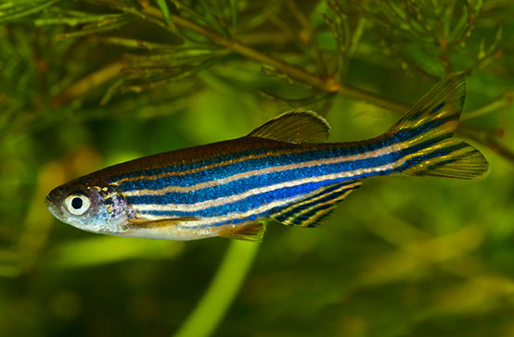
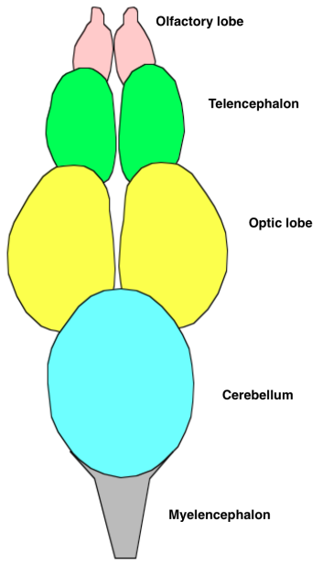
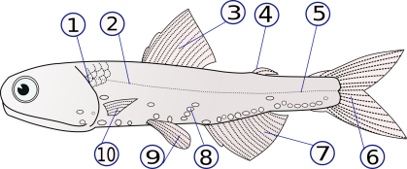
Modeling an organism
AACGATTAC…
DNA molecule
danio rerio
anatomic model
…
brain model

Slide 5
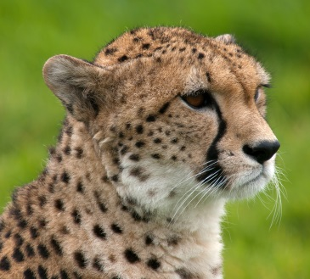
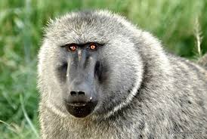
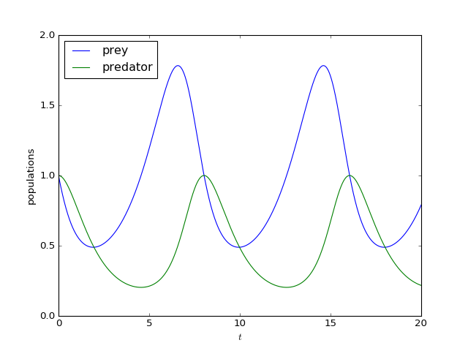
Modeling an ecosystem
Lotka-Volterra equations

Slide 6
Algorithms

Slide 7
Algorithm
High level formal model of a task
can have subtasks
can have alternatives, depending on circumstances, outcomes of subtasks
subtasks may have to be repeated multiple times
Task: transforms input into output
i.e., changes state of the world
Analogies
recipe
laboratory protocol/workflow description

Slide 8

Muhammad ibn Musa al-Khwarizmi
Persian mathematician, astronomer, geographer, c. 780 - c. 850
Khiva, Uzbekistan

Slide 9
Example 1: sorting spaghetti
Given: bunch of spaghetti strands
Task: sort strands according to increasing length
Result: strands laid out on table, in order
Algorithm:
Take spaghetti in left hand
Put left hand on table so that each stalk touches table
Pick largest strand with right hand, put it at end of table
Pick largest starnd, put it next to first
Repeat 4 until until left hand empty
Is it correct?
And, is it complete?

Slide 10
Sorting spaghetti

Slide 11
Example 2: sort list of numbers
Given: 3, 7, 4, 7, 1, 5
Task: sort list, numbers in increasing order
Result: 1, 3, 4, 5, 7, 7
Algorithm?
Go through list, take out smallest number, append to new list
Repeat 1 until original list is empty
Is it efficient?

Slide 12
Efficiency
How many steps does it take? Let's count…
step 0: [3, 7, 4, 7, 1, 5], []
step 1: [3, 7, 4, 7, 5], [1] 6 comparisons
step 2: [7, 4, 7, 5], [1, 3] 5 comparisons
step 3: [7, 7, 5], [1, 3, 4] 4 comparisons
step 4: [7, 7], [1, 3, 4, 5] 3 comparisons
step 5: [7], [1, 3, 4, 5, 7] 2 comparisons
step 6: [], [1, 3, 4, 5, 7, 7] 1 comparison
21 comparisons
length of list N: N(N + 1)/2 steps

Slide 13
Can we do better?
Length of list N: N(N + 1)/2 steps
Yes, obviously, think of spaghetti sort!
However, with lists of numbers: N log₂ N (quicksort algorithm)
So what?
N = 16: 136 vs. 64 factor of 2
N = 256: 32,896 vs. 2,048 factor of 16
N = 4096: 8,390,656 vs. 49,152 factor of 170
…

Slide 14
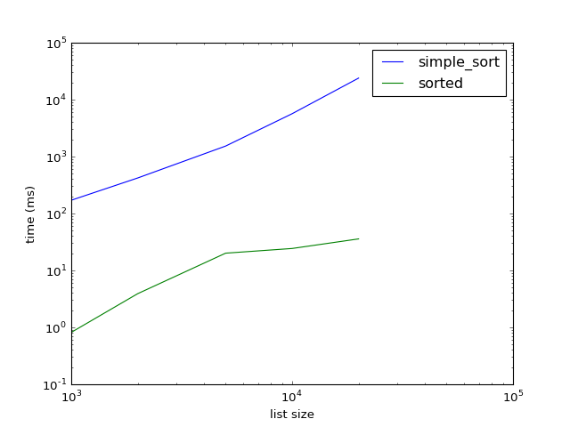
Comparison
simple_sort versus sorted (Tim sort)

Slide 15
Example 3: counting nucleotides
Given: AGGTACCACCTTGAAACAAT
Task: count number of A, C, G, T
Result: 8 As, 5 Cs, 3 Gs, 4 Ts
Algorithm:
start with 0 As, 0 Cs, 0 Gs, 0 Ts
for each symbol in DNA sequence
if symbol is A, add 1 to As
if symbol is C, add 1 to Cs
if symbol is G, add 1 to Gs
if symbol is T, add 1 to Ts
How does it scale?
Is it fail-safe?

Slide 16
Example 4: Fibonacci numbers
Given: positive integer number n, e.g., 5
Task: compute Fibonacci number for n
Result: f_{n}, e.g., 8 for n = 5
Algorithm:
if n is 0 or 1, return 1
return f_{n-1} + f_{n-2} i.e., go to 1 for f_{n-1} go to 1 for f_{n-2} add results

Slide 17
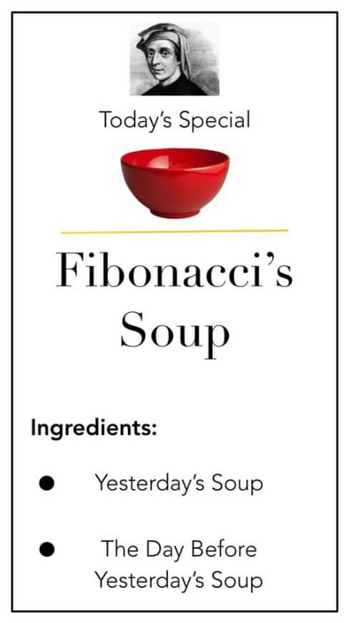

Slide 18
How many calls/computations?
15 function calls
f₅
f₄
+
f₃
f₃
f₂
f₂
+
f₁
+
f₂
+
f₁
f₁
+
f₀
f₁
+
f₀
f₁
+
f₀

Slide 19
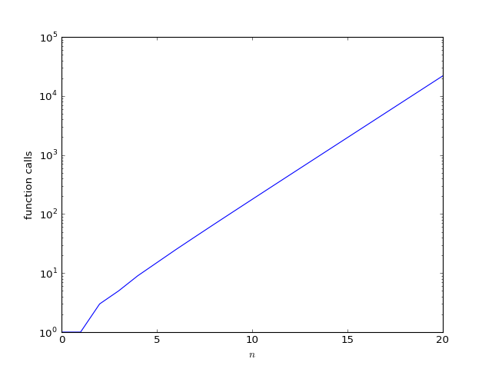
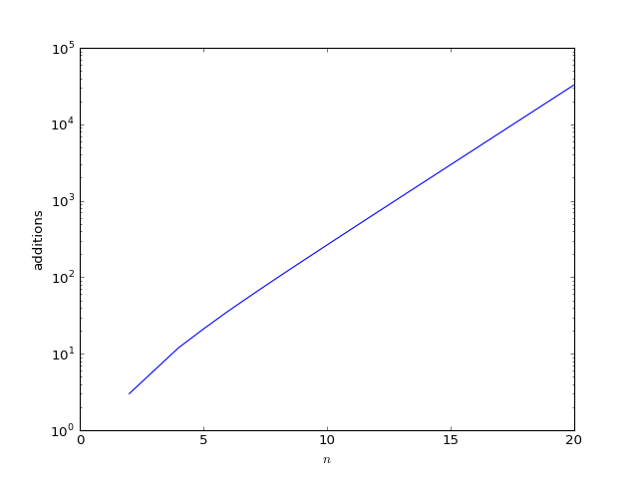
Fibonacci: scaling
Note: y-axis is logarithmic!
Oops?!? Can we do better?

Slide 20
Yes, we can!
Start with: f_{prev} = 1, f_{curr} = 1, i =2
While i ≤ n temp = f_{prev} f_{prev} = f_{curr} f_{curr} = f_{curr} + temp i = i + 1
Result: f_{curr}
E.g., for n = 5:
start: f_{prev} = 1, f_{curr} = 1, i = 2
i = 2: f_{prev} = 1, f_{curr} = 2
i = 3: f_{prev} = 2, f_{curr} = 3
i = 4: f_{prev} = 3, f_{curr} = 5
i = 5: f_{prev} = 5, f_{curr} = 8
result: 8

Slide 21
Implementation

Slide 22
Programming
Translate algorithm into code
algorithm
given: DNA sequence
start with 0 As, 0 Cs, 0 Gs, 0 Ts
for each symbol in DNA sequence
if symbol is A, add 1 to As
if symbol is C, add 1 to Cs
if symbol is G, add 1 to Gs
if symbol is T, add 1 to Ts
result: values of As, Cs, Gs, Ts
Python
def count_nucl(dna):
a, c, g, t = [0]*4
for nucl in dna:
if nucl == 'A':
a += 1
elif nucl == 'C':
c += 1
elif nucl == 'G':
g += 1
elif nucl == 'T':
t += 1
return a, c, g, t
C
Nucl_count count_nucl(char dna[]) {
…
}

Slide 23
What is a program?
input
output
01010001
10101011
00101001
10101000
…
11100110
00010100
00000010
…
program
1
4
25
10101010
10100010
10101100
11110111
01101000
…
1
2
5
input = [1, 2, 5]
output = []
for i in input:
output.append(i**2)

Slide 24


Von Neumann architecture
x == 3
y == -1
01100110
memory
17*x + y
for …: …
control unit
arithmetic/logic unit
01100110+1101101
if …: …
input
output
mathematical model for computer

Slide 25
Programming language
Data types
integer numbers: int
floating point numbers: float
complex numbers: complex
boolean values: bool
strings: str
lists: list
…
Control statements
variable assignment: a = …
conditional statement: if …: …
iteration statements: for …: …, while …: …
functions: def count(dna): …
Many more types
More control structures

Slide 26
Numbers
Integers
type name: int
constants, e.g., -7, 0, 12
Floating point numbers (aka real numbers)
type name: float
constants, e.g., -3.5, 0.13, 3.14e-3, -5.17e5
Complex numbers
type name: complex
constants, e.g., 1 + 3.1j, -1.2e-5 - 3.12e2j, 0 + 0j

Slide 27
Strings
Sequences of characters
Type name: str
Constants
'alpha'
'Albert Einstein'
'3.14' (string representation of number)
'Don\'t bother'
'' (empty string)
"Don't bother"
"Don\"t bother"

Slide 28
Booleans
Truth values
Type name: bool
Constants
True
False

Slide 29
Lists
Ordered sequence
Type name: list
Constants
[1, 3, 5, 1, 3] (list can have duplicate elements)
[0.2, -7.1, 1.2e2]
['a', 'c', 'abc']
[1, 'abc', 3.7] (list items can have different types)
[[1, 2], [3, 4], [5, 6]] (list of lists)
[] (empty list)

Slide 30
Variables
Names for memory locations
store in memory
retrieve from memory
update in memory = retrieve + store
7
5
store
n = 5
retrieve
retrieve
print(n)
store
n = n + 2
n = 7

Slide 31
Multiple variables
For int, float, complex, bool, str
store in memory
assignment
update in memory
5
store
7
a = 5
5
retrieve
store
store
b = a
b = 5
Note: memory location a not modified
b = 7

Slide 32
Multiple variables
For list, numpy types, …
store in memory
assignment
update in memory
1 5
1 a
store
a = [1, 'a']
store
b = a
Note: a and b refer to same memory location
b[1] = 5

Slide 33
Multiple variables
For object assignment
store in memory
assignment
update in memory
1 a
1 a
store
a = [1, 'a']
a 1
store
b = a
a and b refer to same list
b = ['a', 1]
b refers to new, a to old list

Slide 34
Objects versus values
Value identity
Object identity
a = 'abc'
b = 'abc'
c = [1, 'a']
d = [1, 'a']
a == b → True
c == d → True
a is b → True
c is d → False
e = [1, 'a']
f = e
c is d → True

Slide 35
Conditional statement
If condition is true, do something
If condition is true, do something, else do something else
condition
a = …
b = …
if a > b:
print(a)
a = …
b = …
if a > b:
print(a)
else:
print(b)

Slide 36
Conditions
For int, float, str, list: <, <=, >, >=, ==, !=
However for float: ==, != ???
What does it mean for list?
For str, list: in
e.g., 'word' in 'three words', 5 in [1, 3, 7]
Combining conditions: and, or, not
e.g., 0 <= a and a <= 10, 5 not in [1, 3, 7]

Slide 37
Iterative statements
for loops
iterate over each elements of list, …
while loops
Iterate while a condition is true
data = [1, 3, 9]
for element in data:
print(element)
data = [1, 3, 9]
i = 0
while (data[i] < 5 and
i < len(data):
print(data[i])
i = i + 1

Slide 38
User functions
function name
argument(s)
function declaration
def fac(n):
'''computes number of permuations for
given n'''
result = 1
for i in range(2, n+1):
result *= i
return result
documentation
function body = sequence of statements
return value

Slide 39
Syntax versus semantics
syntax: form, grammar
correct: The dog is barking.
incorrect: The dog barking.
semantics: meaning, interpretation
correct: The dog barked.
incorrect: The dog spoke.
Except in fairy tales!

Slide 40
Exercises

Slide 41
Exercises
Implement the following in a Python notebook
algorithm 2
algorithm 3
algorithm 4
recursive version
iterative version
Time the execution of the recursive and iterative versions of the Fibonacci function for n = 5, 10, 15, 20, 25, 30, 35 and plot the results

