Slide 1
Python for data science
Geert Jan Bex
(geertjan.bex@uhasselt.be)
License: this presentation is released under the Creative Commons CC BY 4.0, see https://creativecommons.org/licenses/by/4.0/deed.ast

Slide 2

http://bit.ly/2O8Zpex

Slide 3


Slide 4
Typographical conventions
Inline code fragments and file names are rendered as, e.g., hello_world.py
Longer code fragments are rendered as
Data files are rendered as
#!/usr/bin/env python
…
if __name__ == '__main__':
print('hello world!')
case dim temp
1 1 -0.5
2 1 0.0
3 1 0.5
4 2 -0.5
…
fragment not shown

Slide 5
Motivation
Python is well-suited for data science
terse, interpreted language, prototyping, fast development
Jupyter notebooks
easy to access information
text-based information: regular expressions, CSV
web-based information: beautiful soup
relational databases: SQLalchemy
…
easy to represent information: pandas
easy to visualize information: seaborn, holoviews
go-to language for machine learning: keras, TensorFlow, PyTorch,…

Slide 6
Pandas
https://github.com/gjbex/Python-for-data-science/tree/master/source-code/pandas

Slide 7
What is it?
Library for data science
defines datastructures
Series (1D)
DataFrame (2D)
defines algorithms
selection
pivot tables
defines utilities
visualization, e.g., scatter_matrix
Backed by numpy
Nice to experiment with data, jupyter notebooks
convention
import pandas as pd
R dataframes
for Python

Slide 8
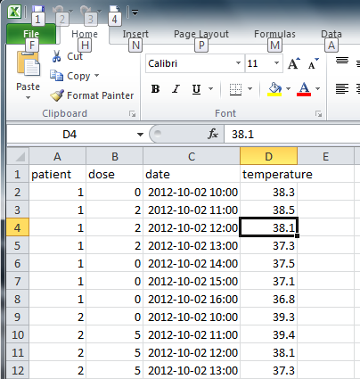
Example data
Microsoft Excel spreadsheet

Slide 9
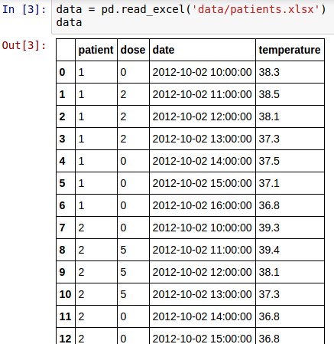
Read dataframe
Create DataFrame from Excel file
Also tabular data, CSV, HDF5, SQL query, HTML page,…
Show in notebook

Slide 10
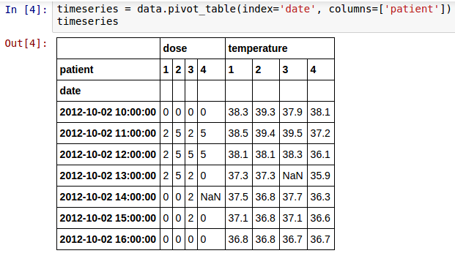
Transform dataframe
Patient data as columns, date as index: pivot table
missing value

Slide 11
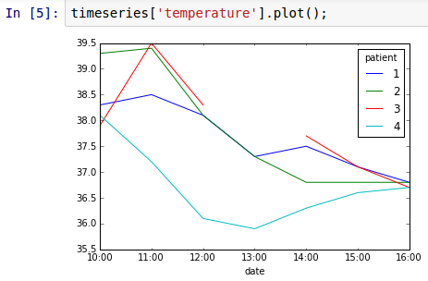
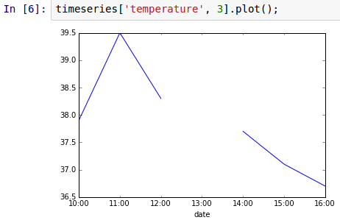
Plot data
missing value

Slide 12
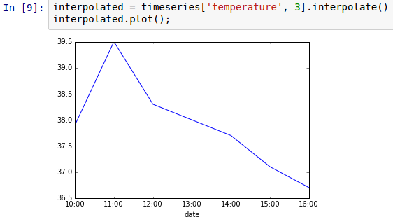
Missing data: NaNs
Can be filled with 0, other value, or interpolated
interpolated value

Slide 13
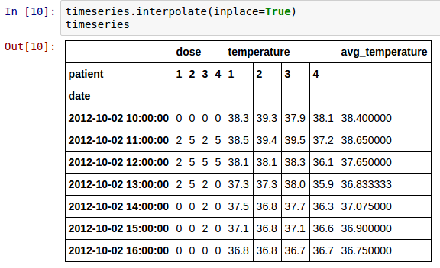
In-place changes
Changes produce new DataFrame
good to experiment
bad for performance/memory usage
Use in place

Slide 14
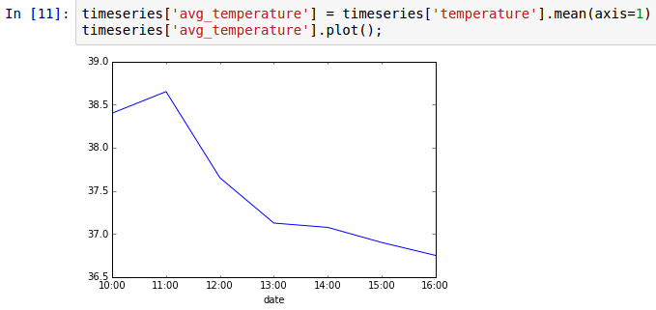
Statistics & adding columns
Compute average temperature and add as column
add column
compute statistics

Slide 15
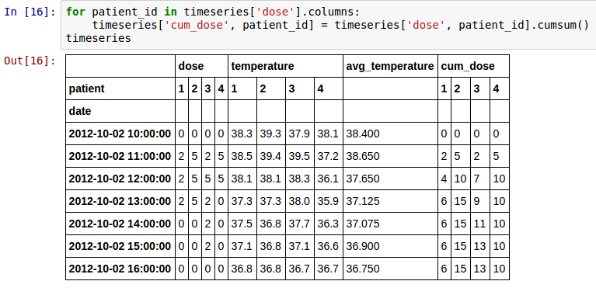
Cumulative sum
compute sums
Dose is better expressed cumulatively
modify column

Slide 16
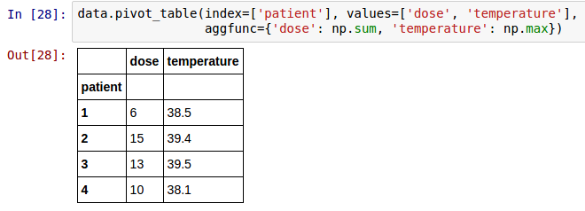
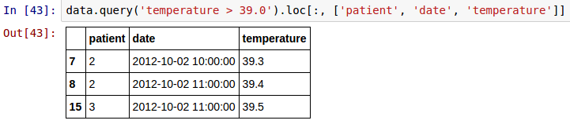
More pivot & query
pivot_table and query are powerful!
What is total dose versus maximum temperature for each patient?
Which patients had temperature > 39, and when?

Slide 17
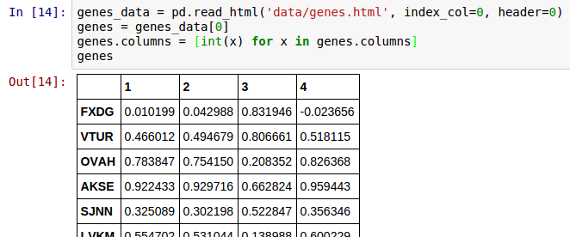
Reading HTML tables
column names
index column
read_html produces list of DataFrame, one per HTML table on page
Column names are str by default, converted to int for consistency with running example

Slide 18
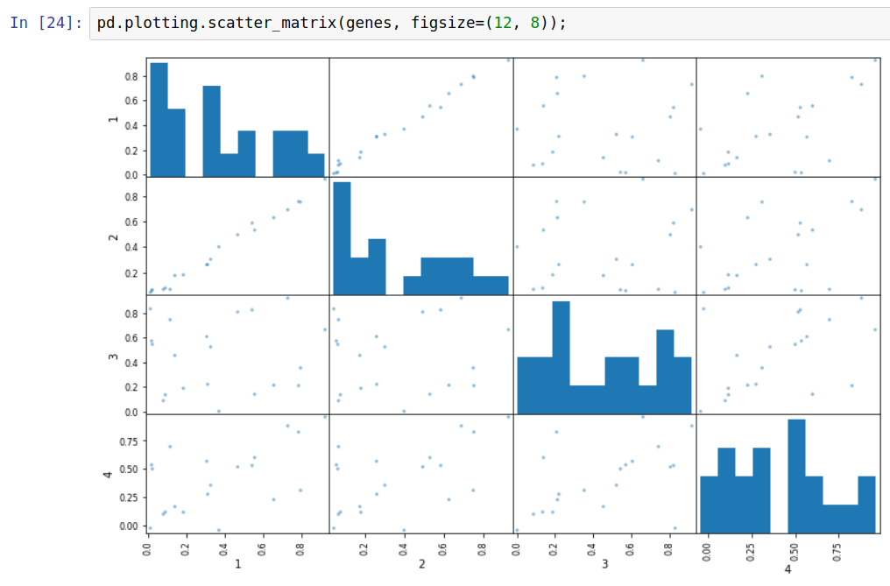
Scatter matrix

Slide 19
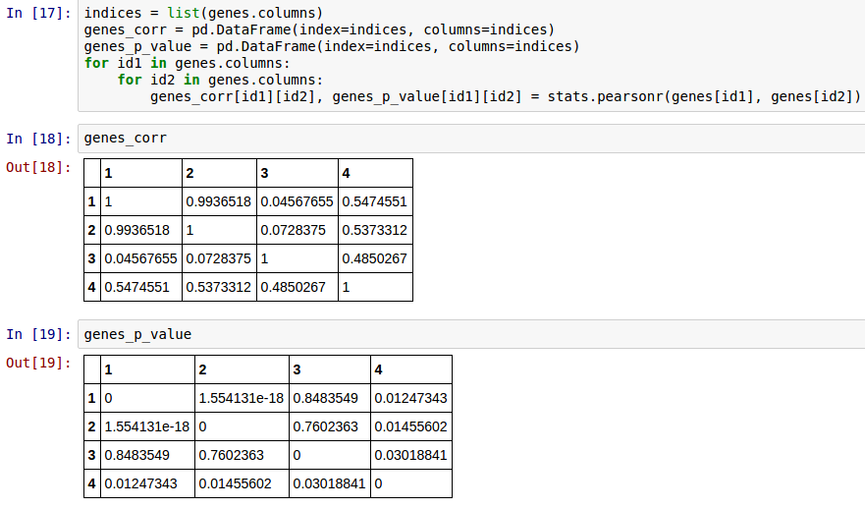
Computing correlations
Creating DataFrames by hand
Note: import scipy.stats as stats

Slide 20
HoloViews
https://github.com/gjbex/Python-for-data-science/tree/master/source-code-/holoviews

Slide 21
What is it?
Library for exploratory data visualization
Easy to create overlays
Parameter exploration
GridSpace
HoloMap
Interfaces with numpy, pandas
Nice to experiment with/explore data, jupyter notebooks
Very simple for complex things
convention
import holoviews as hv

Slide 22

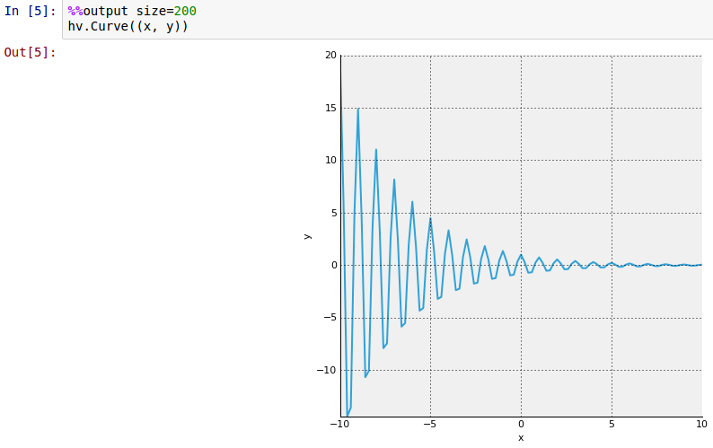
Trivial example
Plotting numpy arrays
plot tuple of x and y values

Slide 23
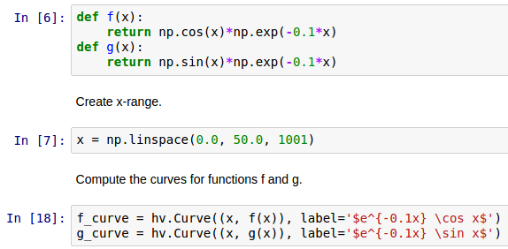
Combining plots
Create data & two plots
create two plots not yet displayed
label plots using LaTeX

Slide 24
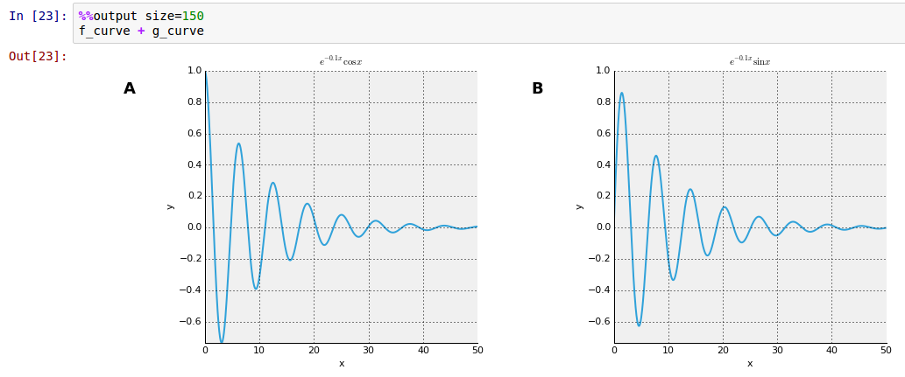
Side by side
combine plots side by side

Slide 25
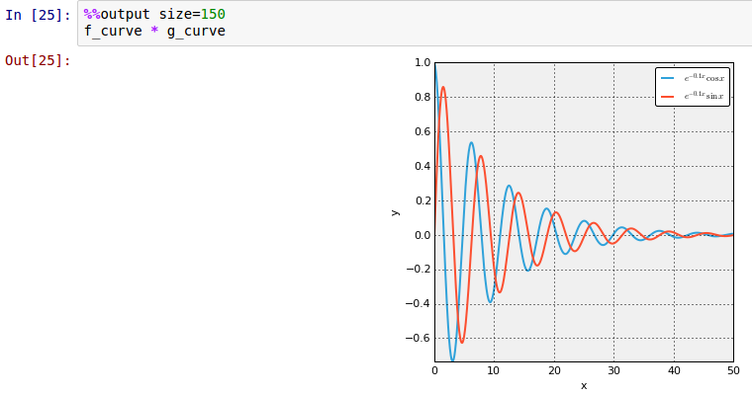
Overlay
combine plots by overlaying

Slide 26
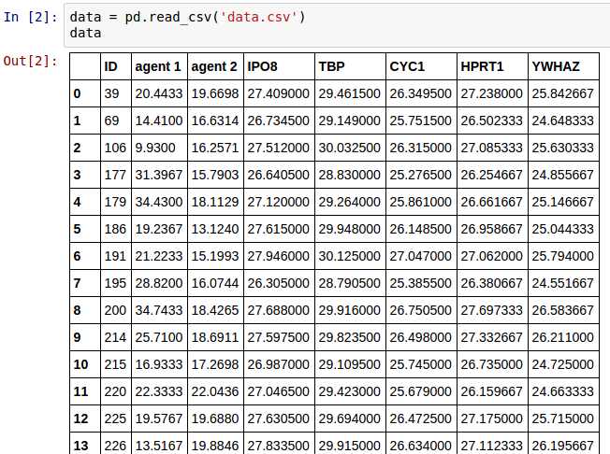
pandas & HoloViews
Read data

Slide 27
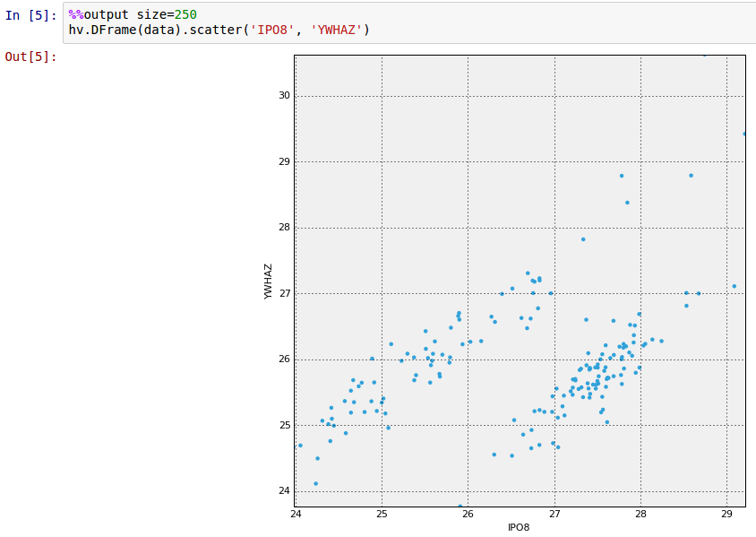
Plotting DataFrame
"bridge" between pandas & HoloViews

Slide 28
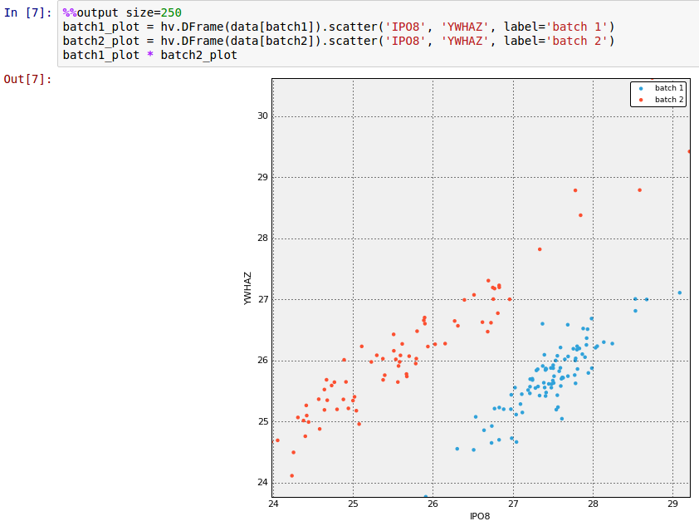
More overlays

Slide 29
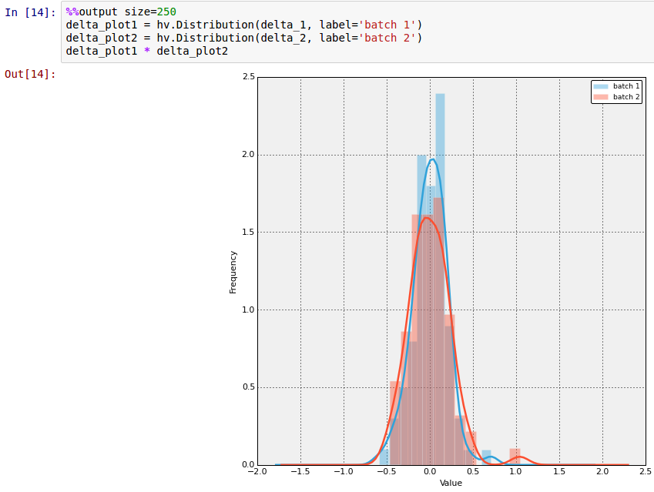
Plotting distributions

Slide 30
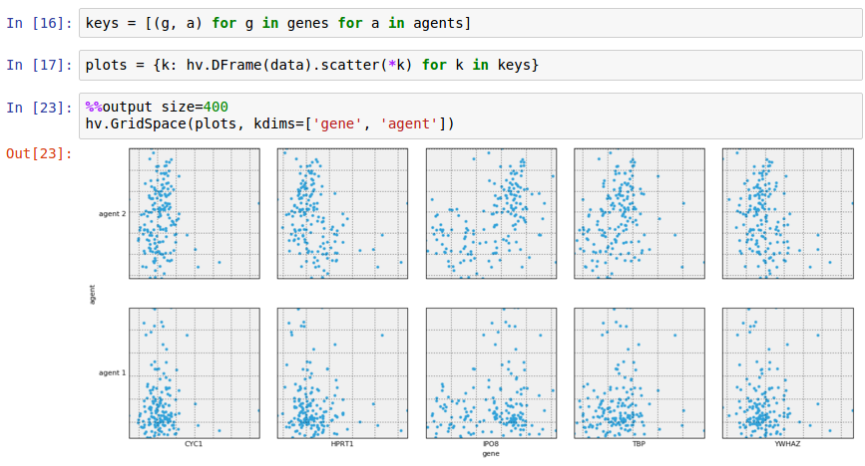
GridSpace
create key pairs,
gene, agent
create plots,
one per key pair

Slide 31
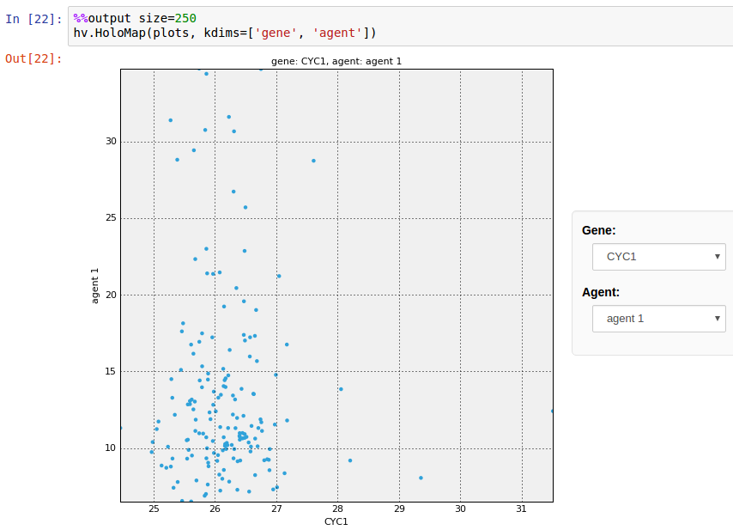
HoloMap
select parameters to plot from menus

Slide 32
Manipulating strings: Python regular expressions
https://github.com/gjbex/Python-for-data-science/tree/master/source-code/regexes

Slide 33
Regular expressions: definition
Regular expression = description of a language ≡ set of strings
Language can be
Finite
Infinite
Remember, set of all strings is infinite, countable
Chomsky hierarchy
regular languages ⊂ context-free languages ⊂ context-sensitive languages ⊂ recursively enumerable languages
Python regular expressions can express more than regular languages

Slide 34
Regular expressions: expressive power
Never parse HTML or XML with regular expressions!!!
HTML & XML are context-free languages
Even if you think you can, don't, there be dragons
Can you write a regular expression to match all regular expressions?
No: the language of regular expressions is context-free
Can you parse English using a regular expression
No: English is a little bit context-sensitive

Slide 35
Regular expressions: examples I
DNA: [ACGT]+
[ACGT] = one out of {A, C, G, T}
expr+ = one or more repetitions of expr
language = {A, C, G, T, AA, AC,…,GAATTCAA,…}
DNA containing AAT: [ACGT]*AAT[ACGT]*
expr₁ expr₂ = expr₁ followed by expr₂
expr* = zero or more repetitions of expr
language = {AAT, AAAT, CAAT,…, AATA, CGTAATGGAT,…}
DNA containing AAT or TAT: [ACGT]*(AAT|TAT)[ACGT]*
expr₁ | expr₂ = either expr₁, or expr₂
language = {AAT, TAT, AAAT, ATAT, CAAT,.., CAATGTATGT,..}
DNA containing AA or AACC: [ACGT]*AA(CC)?[ACGT]*
expr? = zero or one of expr
language = {AA, AACC, AAA, CAA, CAACC,…, AGATAACCTTA}

Slide 36
Regular expressions: examples II
Belgian phone number: 0[1-9]\d?/[1-9]\d{5,6}
[c₁-c₂] = any character from c₁ to c₂
\d = [0-9]
expr{m,n} = m to n repetitions of expr
All strings, including empty string: .*
. = any character
Email address: \w+(?:\.\w+)?@\w+(?:\.\w+)+
\w = [A-Za-z0-9_]
expr+ = one or more repetions of expr
\. = character '.'
(?: expr) = grouped expr
Don't use this in practice!!!
Similar to brackets in math expressions

Slide 37
Regular expressions: characters
Characters that have to be escaped
tab : \t
new line : \n
carriage return : \r
\ : \\
brackets : \(, \), \[, \], \{, \}
operators : \+, \-, \*, \?
. (dot) : \.
All other characters literal

Slide 38
Regular expressions: character classes
x = {'x'}
[xyz] = {'x', 'y', 'z'}
[x-z] = {c | 'x' ≤ c ≤ 'z'}
[^xyz] = {any} \ {'x', 'y', 'z'}
\w = {'A',…,'Z', 'a',…,'z', '0',…,'9', '_'}
\W = {any} \ {'A',…,'Z', 'a',…,'z', '0',…,'9', '_'}
\d = {'0',…,'9'}
\D = {any} \ {'0',…,'9'}
\s = {' ', '\t', '\f', '\r', '\n', '\v'} (white space)
\S = {any} \ {' ', '\t', '\f', '\r', '\n', '\v'}
. = {any} \ {'\n'}
Note: strings are Unicode, so, e.g., \d matches numerals in any script, not only Arabic numerals

Slide 39
Regular expressions: operators
Concatenation: expr₁ expr₂ (implicit)
Choice: expr₁ | expr₂ = either expr₁, or expr₂
Repetition:
expr{n} = exactly n repetitions of expr
expr{m,n} = minimum m, maximum n repetitions of expr where m ≤ n
expr{,n} = minimum zero, maximum n repetitions of expr
expr{m,} = minimum m repetitions of expr
expr? = zero or one occurrence of expr
expr* = zero or more repetitions of expr
expr+ = one or more repetitions of expr
Longest match semantics

Slide 40
Greedy vs. non-greedy operators
Consider string '<var name="x">15</var>'
<.+> will match substring …
Use non-greedy operator
<.+?> will match substring '<var name="x">'
expr<op>? = operator <op> with shortest match semantics (i.e., non- greedy) applied to expr
Alternative: <[^>]+>
'<var name="x">15</var>'
Longest match semantics!

Slide 41
Why not parse XML with REs?
Task: match start tag in
'<var name="x">15</var>' <.+?> will match substring '<var name="x">'
'<var name="a->b">15</var>' <.+?> will match substring '<var name="a->'
√
Oops!
Use a parser for context free language, or, better still, use Python's xml.dom, xml.sax, …

Slide 42
Regular expressions: examples III
String of digits only: ^\d+$
^: matches empty string at start of string, or after new line
$: matches empty string at end of string, or before new line
Year in 20th or 21st century: \b(?:19|20)\d{2}\b
\b: matches empty string at "word" boundary
Words starting, but not ending with 'py': \bpy\B
\B: matches empty string in "word"

Slide 43
Regular expressions: anchors
All anchors match empty string
At start of string: \A
At end of string: \Z
At start of string, or after newline: ^
At end of string, or before newline: $
Before or after alphanumeric sequence: \b
Within alphanumeric sequence: \B

Slide 44
Regular expressions: matching
Import re module!!!
re.match(pattern, s)
Matches pattern from start of string s
Returns match object, or None if no match
re.search(pattern, s)
Matches pattern anywhere in string s
Returns match object, or None if no match
>>> print(re.match(r'<.+>', '<abc>') is not None)
True
>>> print(re.match(r'<.+>', 'data: <abc>') is not None)
False
Use raw Python strings, i.e., r'…' for regular expressions
>>> print(re.search(r'<.+>', 'data: <abc>') is not None)
True

Slide 45
Raw strings
Yet more strings: raw string, e.g., 'hello\n+world!' versus 'hello\\n+world!' versus r'hello\n+world!'
>>> print('hello\n+world!') hello +world!
>>> print('hello\\n+world!') hello\n+world!
>>> print(r'hello\n+world!') hello\n+world!
'\' is just a regular character in a raw string, very convenient for regular expressions!

Slide 46
Ignoring case
Ignoring case
E.g., match DNA, [AaCcGgTt]+:
cumbersome, error prone, hard to read!
Better: use original pattern [ACGT]+, but match while ignoring case, i.e., using re.IGNORECASE (or re.I) modifier re.match(r'[ACGT]+', s, re.IGNORECASE) or re.match(r'[ACGT]+', s, re.I)

Slide 47
More readable regular expressions
Sophisticated regular expressions are hard to read r'0[1-9]\d?/[1-9]\d{5,6}'
Reformat as r'''0 # area codes always # start with 0 [1-9]\d? # area codes: 1-2 # digits / # separator [1-9]\d{5,6} # 6 or 7 digits for # number'''
Use re.VERBOSE (or re.X) modifier

Slide 48
Regular expression performance
Regular expression may be evaluated many times
Don't use for line in sys.stdin: if re.match(r'0[1-9]\d?/[1-9]\d{5,6}', line): …
Do use regex = re.compile(r'0[1-9]\d?/[1-9]\d{5,6}') for line in sys.stdin: if regex.match(line): …
regex is compiled regular expression object, reused many times
Substantial performance benefit!

Slide 49
Regular expressions: extracting I
Part(s) of regular expressions can be captured
Example: regular expression begin (\w+) if matched against
string 'begin data', substring 'data' is captured
String 'begin block', substring 'block' is captured
Use match object returned by re.match or re.search
group 1
group 2
>>> m = re.match(r'(begin|end) (\w+)', 'begin data')
>>> print('{1} {0}s here'.format(m.group(1), m.group(2)))
data begins here

Slide 50
Capturing vs. grouping
Don't confuse grouping and capturing
(?:…): syntactic grouping for operator priority
(…): capturing, use partial match later
Capturing instead of grouping will work, but is slower

Slide 51
Named groups
More robust to name groups
Even better
However, regular expression harder to read?
>>> m = re.match(r'(?P<event>begin|end) (?P<name>\w+)',
'begin data')
>>> print('{1} {0}s here'.format(m.group('event'),
m.group('name')))
data begins here
>>> m = re.match(r'(?P<event>begin|end) (?P<name>\w+)',
'begin data')
>>> print(f'{m.group('name')} {m.group('event')}s here')
data begins here

Slide 52
Finding repetitions
Match sequences that code for leucine (codons UUA, UUG, CUA, CUC, CUG, CUU): (?:[ACGU]{3})* # any codons (?:UU[AG]|CU[ACGU]) # leucine
Match sequences that code for leucine twice with the exact same codon, at most 5 codons apart (?:[ACGU]{3})* # any codons (UU[AG]|CU[ACGU]) # first leucine (?:[ACGU]{3}){,5}? # codons \1 # second leucine
Repetition of capture 1
Note: non-greedy match operator!

Slide 53
Regular expressions: extracting II
Extract all words from a text 'This is a short text. It has words, but also punctuation, and even numbers like 12 and 7.'
Pattern for word: [A-Za-z]+
re.findall(pattern, s) returns list of all matches of pattern in s
>>> s = 'This is a short text. It has words,...'
>>> m = re.findall(r'[A-Za-z]+', s)
>>> print(m)
['This', 'is', 'a', 'short', 'text', 'It', 'has', 'words']

Slide 54
Regular expressions: extracting III
Splitting a string on a delimiter 'a ; list; of ; words '
Pattern for delimiter: \s*;\s*
re.split(pattern, s) splits string s
>>> s = 'a ; list; of ; words '
>>> parts = re.split(r'\s*;\s*', s.strip())
>>> print(parts)
['a', 'list', 'of', 'words']
or
>>> parts = map(lambda x: x.strip(), s.split(';'))
>>> print(list(parts))
['a', 'list', 'of', 'words']

Slide 55
Regular expressions: substitution
Values should be quoted 17,13.3,AGCGT,-1.4 '17','13.3','AGCGT','-1.4'
Pattern for values ([^,]+), replace by '\1'
re.sub(pattern, repl, s) replaces all occurrences of pattern in s by repl
Corresponds to
group(1)
>>> s = '17,13.3,AGCGT,-1.4'
>>> result = re.sub(r'([^,]+)', r"'\1'", s)
>>> print(result)
'17','13.3','AGCGT','-1.4'

Slide 56
Named group substitution
More robust
>>> s = '17,13.3,AGCGT,-1.4'
>>> result = re.sub(r'(?P<item>[^,]+)', r"'(?P=item)'", s)
>>> print(result)
'17','13.3','AGCGT','-1.4'

Slide 57
Further reading: regular expressions
Regular expression how-to http://docs.python.org/3/howto/regex.html
You should learn regex https://blog.patricktriest.com/you-should-learn-regex/

Slide 58
Relational databases: Python DB API & SQLAlchemy ORM
https://github.com/gjbex/Python-for-data-science/tree/master/source-code/db-access

Slide 59
Accessing relational databases
Relational databases:
great to store structured data, table-oriented
can be accessed easily via command line, programming language, GUI
can be queried using SQL
examples: MySQL, PostgreSQL, Oracle, DB2, SQLite3,…
Using DB from Python via standard interface
Support for sqlite3 built-in, ok for simple applications
For non-trivial stuff, use SQLAlchemy
Object-relational mapping (ORM)
Connectors to many RDBMS

Slide 60
SQL
Create table to store data
Store data
Query data
Modify data
CREATE TABLE IF NOT EXISTS weather (
city_name TEXT NOT NULL,
date TEXT NOT NULL,
temperature REAL NOT NULL);
INSERT INTO weather (city_name, date, temperature)
VALUES ('London', '2012-03-14', 13.2);
SELECT city_name, AVG(temperature) FROM weather
WHERE date BETWEEN '2012-01-01' AND '2012-01-31' GROUP BY city_name;
UPDATE weather SET city_name = 'St. Petersburg'
WHERE city_name = 'Leningrad';

Slide 61
Python DB access: inserting data
Connect to a database & create cursor
Insert data tuples
import sqlite3
conn = sqlite3.connect('weather-db')
cursor = conn.cursor()
for data in generate_data(nr_cities, start, end):
cursor.execute('''INSERT INTO weather
(city_name, date, temperature)
VALUES (?, ?, ?)''',
data)
conn.commit()
cursor.close()
tuple

Slide 62
Python DB access: querying
Compute average temperature for period per city
conn = sqlite3.connect('weather-db')
conn.row_factory = sqlite3.Row
cursor = conn.cursor()
cursor.execute(
'''SELECT city_name, AVG(temperature) AS 'temperature'
FROM weather WHERE date BETWEEN ? AND ?
GROUP BY city_name''',
(start, end))
for row in cursor:
print(f"{row['city_name']}\t{row['temperature']}")
cursor.close()

Slide 63
SQLAlchemy: ORM
Define classes/tables
from sqlalchemy import (Column, ForeignKey, UniqueConstraint,
Integer, String, DateTime, Float)
from sqlalchemy.ext.declarative import declarative_base
from sqlalchemy.orm import relationship
Base = declarative_base()
class City(Base):
__tablename__ = 'cities'
city_id = Column(Integer, primary_key=True)
name = Column(String(100), nullable=False, unique=True)
class ≡ table
object attributes
column properties
class attribute ≡ column definition

Slide 64
SQLAlchemy: relationships
Define relationship
table constraint
class Measurement(Base):
__tablename__ = 'measurements'
__table_args__ = (
UniqueConstraint('time', 'city_id'),
)
measurement_id = Column(Integer, primary_key=True)
time = Column(DateTime, nullable=False)
temperature = Column(Float, nullable=False)
city_id = Column(Integer, ForeignKey('cities.city_id'))
city = relationship(City)
column properties
relationship for ORM queries

Slide 65
SQLAlchemy: create tables
To interact, create engine
Creating tables ≡ setting metadata
from sqlalchemy import create_engine
…
engine = create_engine('sqlite:///{0}'.format(db_name))
Base.metadata.create_all(engine)
That's it!

Slide 66
SQLAlchemy: inserts
Create engine, session
Create and add objects
…
from sqlalchemy.orm import sessionmaker
…
engine = create_engine('sqlite:///{0}'.format(db_name))
Base.metadata.bind = engine
DBSession = sessionmaker(bind=engine)
db_session = DBSession()
…
…
for city_name in ['New York', 'Leningrad', 'Paris']:
city = City(name=city_name)
db_session.add(city)
db_session.commit()

Slide 67
SQLAlchemy: inserting relationships
Use objects to express relationships
…
for city in city_list:
temperature = measure_temperature(city)
date = determine_date()
measurement = Measurement(time=date, temperature=temperature,
city=city)
db_session.add(measurement)
db_session.commit()
…
use actual object

Slide 68
SQLAlchemy: queries
Queries as method calls
Natural join query
…
city_list = db_session.query(City).all()
class ≡ table
join on relationship
…
measurements = db_session.query(Measurement) \
.join('city') \
.filter(City.name == city_name,
s_date <= Measurement.time,
Measurement.time <= e_date) \
.all()
Note: class attributes!!!
SELECT * FROM … WHERE …

Slide 69
SQLAlchemy: updates
Modify object attribute(s) ≡ update
…
leningrad = db_session.query(City) \
.filter(City.name == 'Leningrad') \
.one()
leningrad.name = 'Saint Petersburg'
db_session.commit()
don't forget commit!

Slide 70
SQLAlchemy: just classes
Classes representing tables can have methods
class Measurement(Base):
…
def __str__(self):
fmt_str = '{city:s}: {time:s}\n\tT = {temp:.1f} C'
return fmt_str.format(city=str(self.city),
time=str(self.time),
temp=self.temperature)
…

Slide 71
Pitfalls
ORM "hides" database interaction
Easy to be inefficient
Object creation takes time
Can consume a lot of memory
Still necessary to understand
Relational model
How RDBMS works

Slide 72
Further reading: relational databases
Introduction to relational database design https://www3.ntu.edu.sg/home/ehchua/programming/sql/Relational_Database_Design.html

Slide 73
Web scraping: gathering data from the web
https://github.com/gjbex/Python-for-data-science/tree/master/source-code/web-scraping

Slide 74
Introduction
Caveat: web scraping code is brittle, typically not robust against
page layout changes (unless proper use of CSS)
page content changes
site redesign
Many frameworks available, here Beautiful Soup
However, for tables only, consider pandas
Use site APIs (e.g., REST interface) whenever available!

Slide 75
Beautiful Soup
Open web page using urllib
Cook soup out of opened page
Eat soup
import urllib
…
page = urllib.request.urlopen(page_url)
Note: urllib2 for Python 2.x
from bs4 import BeautifulSoup
…
soup = BeautifulSoup(page, "html5lib")
print('looking at {0}'.format(soup.title.string))
Assumes page has a title element

Slide 76
Finding stuff
First element with tag, e.g., a
All element with tag, e.g., a
Element content, e.g., a
Element attribute, e.g., href in a
print('looking at {0}'.format(soup.a))
for a in soup.find_all('a'):
print('a element: {0}'.format(a))
for a in soup.find_all('a'):
print('link text: {0}'.format(a.string))
for a in soup.find_all('a'):
print('link url: {0}'.format(a.get('href')))

Slide 77
Graphical Information Systems data processing
https://github.com/gjbex/Python-for-data-science/tree/master/source-code/gis

Slide 78
Introduction
Graphical Information System (GIS), e.g.,
ArcGIS
QGIS
Many data formats, e.g.,
shape files
GeoJSON
GeoTIFF
Python & GIS
I/O library: Fiona, gdal
visualization: Folium
data processing/modeling: Shapely, GeoPandas
Can be scripted with Python

Slide 79
World Happiness Index
Data
World Happiness information: CSV file
relevant columns: Country, Happiness Score
data on 157 countries
country names, borders,… : GeoJSON
import pandas as pd
happiness_data = pd.read_csv(happiness_filename)

Slide 80
Folium visualization
import folium
Create world map
Add chloropleth
longitude
lattitude
world = folium.Map(
location=[0.0, 0.0],
tiles='Mapbox Bright',
zoom_start=2)
shows entire world
world.choropleth(
name='world happiness',
data=happiness_data,
columns=['Country', 'Happiness Score'],
geo_data=str(country_geo_filename),
key_on='properties.name',
fill_color='YlGn', fill_opacity=0.7,
line_opacity=0.2,
legend_name='Happiness Score')
pandas
GeoJSON

Slide 81
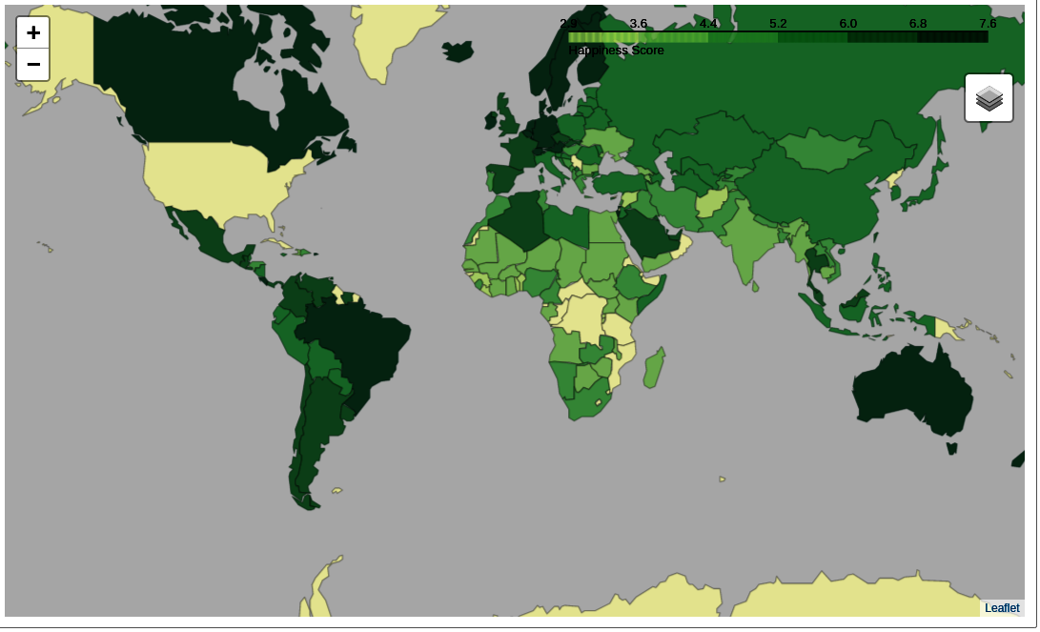
Folium in Jupyter Notebook
Missing data?

Slide 82
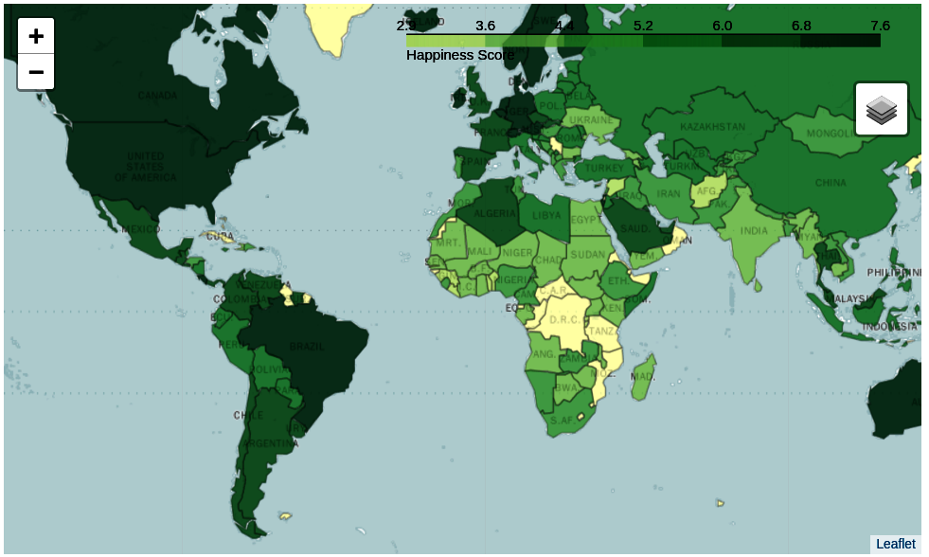
Data linkage issue
In World Happiness Index: United States
In GeoJSON file: United States of America
Fix: change names, e.g.,
happiness_data.at[12, 'Country'] = 'United States of America'

Slide 83




Shapely: geometric objects
Point: 2D or 3D
MultiPoint: collection of Point
LineString: sequence of Point
MultiLineString: multiple LineString
LinearRing: closed LineString
should not cross
Polygon: LinearRing as outer boundary, optionally multiple LinearRing as "holes"
should not touch in more than one point
MultiPolygon: multiple Polygon
should not touch in more than one point

Slide 84
Shapely: object examples
LineString
LinearRing
Polygon
line = LineString([(0.0, 0.0), (1.0, 1.0), (2.0, 0.5)])
outer = LinearRing([(3.0, 2.0), (3.0, 5.0), (6.0, 5.0),
(6.0, 2.0)])
inner1 = LinearRing([(3.5, 2.5), (3.5, 4.5), (4.5, 4.5),
(4.5, 2.5)])
inner2 = LinearRing([(5.0, 2.5), (5.0, 4.5), (5.5, 4.5), (5.5, 2.5)])
polygon = Polygon(outer, [inner1, inner2])

Slide 85
Shapely: predicates
a.within(b) ≡ b.contains(a)
a.intersects(b) ≡ not a.disjoint(b)
a.crosses(b)
a.almostequals(b, decimal=3)
a.is_valid
Shapely lets you create invalid objects
line.is_ring

Slide 86
Shapely: spatial analysis
a.intersection(b)
a.union(b)
a.difference(b)
a.symmetric_difference(b)
a.boundary: one dimension less
a.centroid: "mean" position
Set theoretic operations
a ≡ a.intersection(b).union(a.symmetric_difference(b))
a.symmetric_difference(b) ≡ a.difference(b).union(b.difference(a))
Note: use cascading_union for performance

Slide 87



Shapely: buffer
Point: 0D, LineString: 1D
buffer operation → 2D
line1 = LineString([(0.0, 1.0), (1.0, 0.5), (2.0, 1.5)])
line2 = LineString([(1.0, 0.5), (0.0, 2.0), ((-1.5, 1.0))])
multi_line = MultiLineString([line1, line2]
buff1 = multi_line.buffer(0.1)
buff2 = multi_line.buffer(0.1, cap_style=CAP_STYLE.flat, join_style=JOIN_STYLE.mitre)

Slide 88

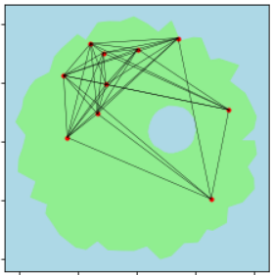
Shapely: example
Create island
create coast as LinearRing
create lake contour as LinearRing
check whether lake.within(coast)
create island as Polygon, coast as boundary, lake as hole
Create cities
create city position as Point
extend proportional to size city = city.buffer(population)
retain if city.within(island)
Create roads
create road as LineString between cities
retain if road.within(island)

Slide 89
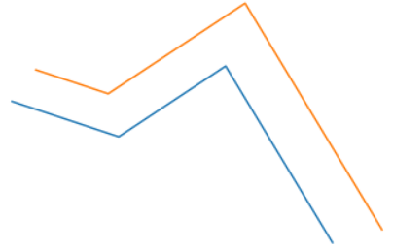
Shapely: other constructions
shape.convex_hull: shape → Polygon
shape.envelope: shape → Polygon
rectangle, sides parallel to axes
shape.minimum_rotated_rectangle: shape → Polygon
line.parallel_offset(…): line → LineString
parallel = line.parallel_offset(0.5, 'left', join_style=JOIN_STYLE.mitre)

Slide 90
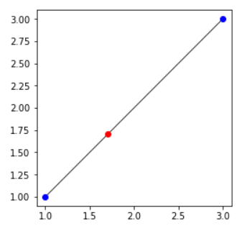
Shapely: interpolation
Compute point at given distance from point along a line
point1 = Point((1.0, 1.0))
point2 = Point((3.0, 3.0))
line = LineString([point1, point2])
point3 = line.interpolate(1.0)
point1.distance(point3)
→ 1.0
d = 1.0

Slide 91
GeoPandas: shape files & GeoJSON
import geopandas as gpd
%matplotlib inline
Read GeoJSON
Coordinate reference system
gdf = gdp.read_file(geo_json_filename)
print(gdf.info())
<class 'geopandas.geodataframe.GeoDataFrame'>
RangeIndex: 180 entries, 0 to 179
Data columns (total 3 columns):
id 180 non-null object
name 180 non-null object
geometry 180 non-null object
dtypes: object(3)
memory usage: 4.3+ KB
gdf.crs

Slide 92
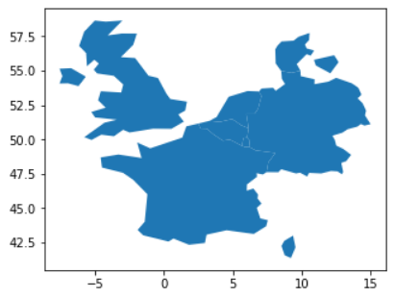
GeoPandas: selection
longitude range
Spatial selection
Visualization
latitude range
western_europe = gdf.cx[0:10, 50:55]
id
BEL Belgium
DEU Germany
DNK Denmark
FRA France
GBR United Kingdom
LUX Luxembourg
NLD Netherlands
Name: name, dtype: object
Based on intersection
print(western_europe['name'])
western_europe.plot()

Slide 93
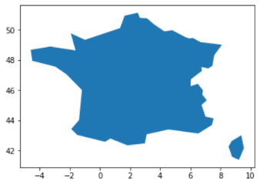
GeoPandas operations
Shapely operations, e.g., buffer(…), boundary, rotate(…)
GeoSeries/GeoDataFrame → GeoSeries
unary_union: GeoDataFrame/GeoSeries → Polygon/MultiPolygon
Overlay operations: overlay(…)
union, intersection, difference, symmetric_difference
southern_europe = gdf.cx[-10:20, 40:45]
intersection = gpd.overlay(western_europe, southern_europe, how='intersection')

Slide 94
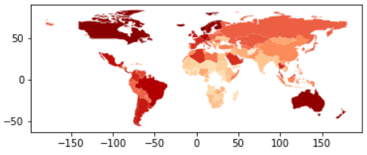
GeoPandas merge
Merging dataframes
consistent column names
df = pd.read_csv(csv_filename)
df.rename(columns={'Country': 'name'})
df_merged = gdf.merge(df, on='name')
df_merged.plot(column='Happiness Score', cmap='OrRd')
merge on country name
Cholopleth plot
by happiness score

Slide 95

GeoPandas dissolve
Aggregate GIS information based attributes
world = df_merged[['name', 'Region', 'geometry']]
regions = world.dissolve(by='Region')
western_Europe_shape = regions.at['Western Europe', 'geometry']

Slide 96
GeoTIFF
Raster data, e.g., satellite imagery
TIFF image file
1 or more raster bands
meta-data in tags
coordinate reference system
geotransform
I/O: GDAL library with Python wrapper

Slide 97
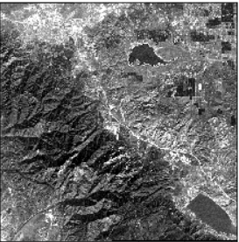
Reading GeoTIFF
Open & read GeoTIFF
Number raster bands: data.RasterCount
Raster band as numpy array
Projection: data.GetProjection()
Geo-transform: data.GetGeoTransform()
import gdal
data = gdal.Open(file_name)
count from 1!
raster_band = data.GetRasterBand(1).ReadAsArray()

Slide 98
Writing GeoTIFF
Create file
Set projection/geo-transform
Write numpy array data
Flush cache
driver = gdal.GetDriverByName('GTIFF')
new_data = driver.Create(new_file_name,
data.RasterXSize, data.RasterYSize,
1, gdal.GDT_Byte)
nr. of bands
many types, e.g.,
GDT_Float32
GDT_Int16
new_data.SetProjection(data.GetProjection())
new_data.SetGeoTransform(data.GetGeoTransform())
new_data.GetRasterBand(1).WriteArray(new_raster_band)
new_data.Flush()

Slide 99
GeoTIFF geo-transformation
Geo-transformation: pixels → coordinates

Slide 100
Further reading
Folium manual http://python-visualization.github.io/folium/docs-master/
Shapely manual https://shapely.readthedocs.io/en/latest/
GeoPandas manual http://geopandas.org/index.html
GIS & Python introduction https://macwright.org/2012/10/31/gis-with-python-shapely-fiona.html
Fiona manual http://toblerity.org/fiona/index.html
Editing/displaying GeoJSON http://geojson.io/
GIS data sources http://gisgeography.com/best-free-gis-data-sources-raster-vector/

