Slide 1

Python on GPUs
Geert Jan Bex
(geertjan.bex@uhasselt.be)
License: this presentation is released under the Creative Commons CC BY 4.0, see https://creativecommons.org/licenses/by/4.0/deed.ast

Slide 2

https://gjbex.github.io/Python-on-GPUs/

Slide 3


Slide 4
Typographical conventions I
Inline code fragments and file names are rendered as, e.g., hello_world.py
Longer code fragments are rendered as
Data files are rendered as
#!/usr/bin/env python
…
if __name__ == '__main__':
print('hello world!')
case dim temp
1 1 -0.5
2 1 0.0
3 1 0.5
4 2 -0.5
…
fragment not shown

Slide 5


Typographical conventions II
Shell commands are rendered as
Do not type $, it represents your shell prompt!
Good practice:
Bad practice:
(Potential) hazards/bugs:
Performance issue:
Performance boost:
Warning:
$ python –m doctest data_parsing.py

Slide 6
What do GPUs look like?

Slide 7
Host-device model
Compute node has
1 or more CPUs
Volatile memory: RAM
PCIe bus with
1 or more GPUs
Application
Runs on host
Offloads computations to device(s)
Host
Device(s)

Slide 8
Offload model
Host
…
Device₀
Device₁

Slide 9
Host-device model implications
Explicit data transfer between host and device
Explicit synchronization
Avoid race conditions
Interconnect latency/bandwidth
Potential performance bottleneck
Hardware details matter… a lot!

Slide 10
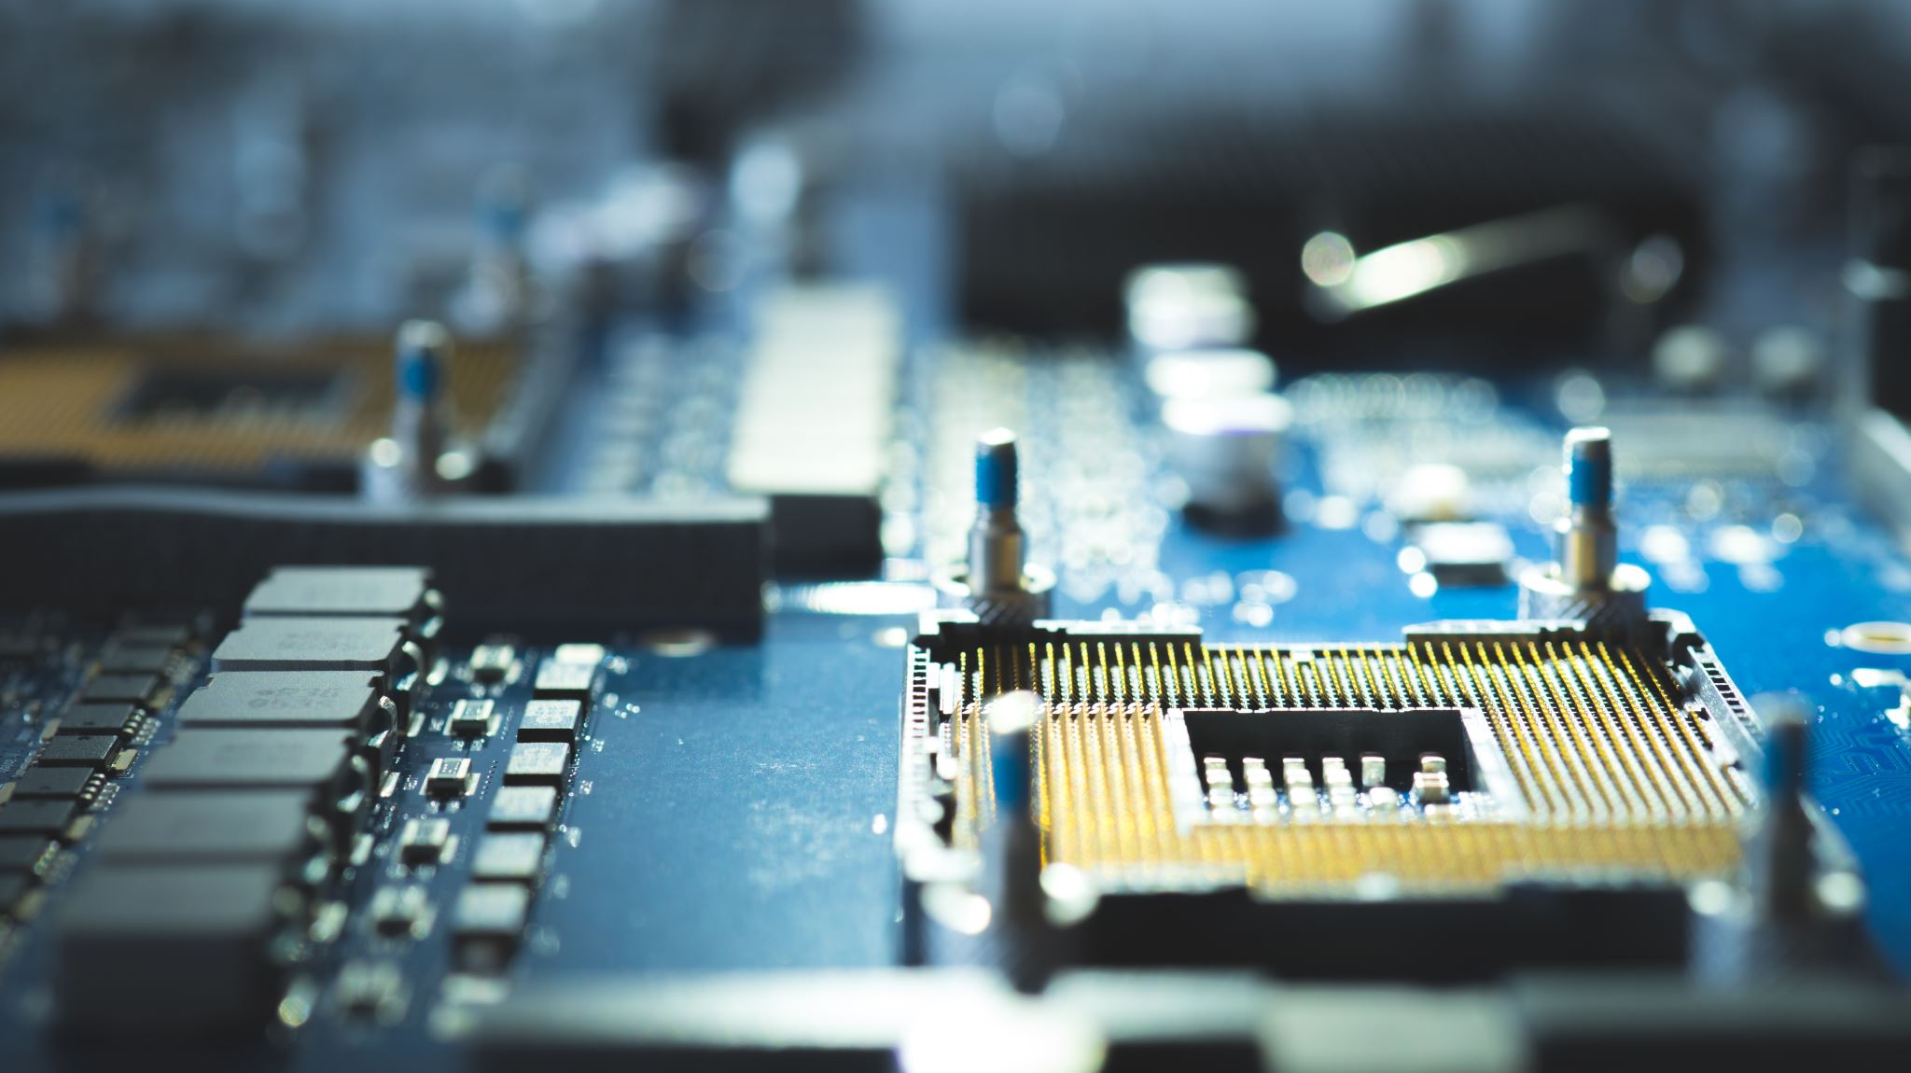
GPU hardware

Slide 11
GPU Streaming Multiprocessor (SM)
4 Warp schedulers
Simple architecture
No out-of-order execution
No branch prediction
No sophisticated control flow
Pipelines for
FP32
FP64
INT
Tensor
LD/ST
Memory lanes for pipelines
4-byte registers (thread-private)
Block shared memory/L1 cache
Const/texture cache
Warp
=
32 threads, all execute same instruction

Slide 12
GPU hardware execution model
SIMT: Single Instruction, Multiple Threads
32 threads grouped in warps (NVIDIA)/wavefronts (AMD)
Threads in warp execute same instruction on different data
Warp-group instructions (H100+)
4 warps participate in tensor instruction
Accommodate larger tensor cores & matrix tiles

Slide 13
Branching on GPUs
Cheap if threads agree
Divergence leads to
Masking of inactive threads
Execution of both paths
Try to avoid branching
Code structure
Data layout
⇒ performance loss
13

Slide 14
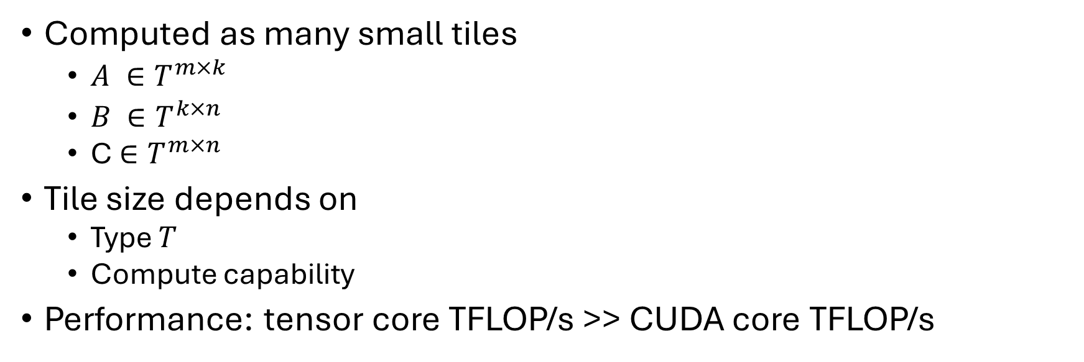
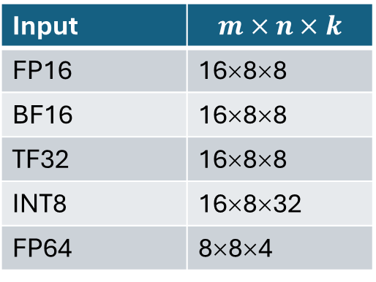
Tensor cores
$C+=A∙B$ where $A ∈T^{M×K}$, B$∈T^{K×N},C ∈T^{M×N}$
Computed as many small tiles
$A ∈T^{m×k}$
$B ∈T^{k×n}$
C$∈T^{m×n}$
Tile size depends on
Type $T$
Compute capability
Performance: tensor core TFLOP/s >> CUDA core TFLOP/s
E.g., for A100
Input | $$m×n×k$$
FP16 | 16×8×8
BF16 | 16×8×8
TF32 | 16×8×8
INT8 | 16×8×32
FP64 | 8×8×4

Slide 15
Multiple SMs
GPU has many Streaming Multiprocessors
E.g., A100: 108
Share
L2 cache
Global (GPU) memory
32 threads/warp × 4 warp instructions/SM × number SMs for, e.g., A100 = 13,824 instructions/cycle
Massive parallelism!

Slide 16
GPU memory hierarchy
Level | Scope | Managed by | Typical latency | Size (NVIDIA A100)
Registers | Thread | Compiler | ≈ 1 cycle | 256K × 4b per SM
Shared memory | Block | Programmer | ≈ 10-20 cycles | Up to 164 Kb, part of 192 Kb
L1 cache | SM | Hardware | 30-40 cycles
Const/texture cache | SM | Hardware | ≈ constant | 8 Kb
L2 cache | GPU | Hardware | ≈ 200 cycles | 40 Mb
Global (HBM) | GPU | Programmer | ≈ 400-800 cycles | 40 or 80 Gb
Regusters + shared memory ⇒ threads per block
Latency hiding through oversubscription

Slide 17
Multiple GPUs/node, multiple nodes
Typically, 4 GPUs/node (A100)
NVLink
Direct connection between all GPUs
12 NVLink lanes/GPU ⇒ 4 lanes to each GPU
50 Gb/lane (bi-directional) ⇒ 200 Gb between GPUs
PCIe connection to host
Infiniband connects nodes

Slide 18
Bandwidth hierarchy
RAM
RAM
Global GPU memory ≈ 2 Tb/s
NVLink ≈ 200 Gb/s
PCIe ≈ 32 Gb/s
Host memory ≈ 300 Gb/s
Infiniband (HDR) ≈ 25 Gb/s
CPU
CPU
PCIe
HDR
PCIe
HBM
HBM
HBM
HBM
GPU₀
GPU₁
GPU₀
GPU₁
GPU₂
GPU₃
GPU₂
GPU₃
NVLink
NVLink
HBM
HBM
HBM
HBM

Slide 19

Programming model

Slide 20
Programming GPUs
CUDA on NVIDIA/HIP on AMD
C/C++/Fortran + OpenMP 5.x
C/C++/Fortran + OpenACC
SYCL
C++ + Kokkos
…

Slide 21
Memory management
Explicit memory management
Memory allocation/deallocation
Host versus device addresses
Explicit copy
Host → device
Device → host
Device → device
Explicit synchronization
Unified memory management
Memory allocation/deallocation
Single address space
Implicit data migration (page fault/page copy)
Explicit synchronization
More control, potentially better performance

Slide 22
Kernels
Functions compiled for device
Operate on data in device memory
Launched from host, run on device
Configuration in 1D, 2D, 3D
Threads per block
Blocks per grid

Slide 23
Threads, blocks & grid
Warp is 32 threads, warp-group is 4 × 32 threads
Threads per block: x-dimension × y-dimension × z-dimension ≤ 1024
x-dimension ≤ 1,024
y-dimension ≤ 1,024
z-dimension ≤ 64
Blocks per grid
x-dimension ≤ 2³¹ - 1
y-dimension ≤ 65,535
z-dimension ≤ 65,535
Kernel can get
Thread indices, thread dimensions
Block indices, block dimension
⇒ differentiate work/thread

Slide 24
Streaming Multiprocessors & blocks
All threads in block execute on same SM
Can be synchronized
Can use shared memory
Multiple blocks assigned to SM
Depends on registers, shared memory/L1 cache availability
Threads grouped in warps
At most 32 warps
4 warp schedulers ⇒ 4 warp instructions/cycle
Need not belong to same block
Picked from ready warps
Stalled warps: waiting for
Memory
Synchronization
Long-latency instructions
Many threads/blocks ⇒ latency hiding

Slide 25
Synchronization
Overlapping
Data transfers
Computations
Memory copy can be asynchronous
Kernel execution can be asynchronous
Synchronization levels
Warp: implicit lockstep
Block: explicit sync statement
Cluster (H100+): cluster boundaries
Grid: cooperative group kernel (all blocks must fit on GPU)
GPU: kernel boundaries
⇒ Explicit synchronization to avoid race conditions!!!

Slide 26
Inquiry functions & configuration
Compute capability
Hardware limits
Number of devices
Maximum number of threads/block & dimension
Memory/cache sizes
…

Slide 27
Performance considerations
Avoid warp divergence (beware of branching)!
Ensure threads have enough work
Increase arithmetic intensity
Number of threads/block ⇔ registers/shared memory
Ensure sufficient occupancy
Exploit data locality (shared memory/L2 cache)
Minimize host-device memory transfers and synchronization
Memory access matters ⇒ data access coalescing
Accommodate 128-byte memory transactions
Warp should access consecutive addresses ⇒ grid-trided loops to distribute work
Data should be aligned
Data layout ⇔ thread access pattern (e.g., SoA vs. AoS)
Note: opposite of CPU multithreading wisdom!

Slide 28

Evolution

Slide 29
Architecture & compute capability
Model | Architecture | Compute capability | NVLink version | PCIe version | Base frequency (GHz) | Boost frequency (GHz)
P100 | Pascal | 6.0 | 1.0 | 3.0 | 1.33 | 1.48
V100 | Volta | 7.0 | 2.0 | 3.0 | 1.20 | 1.53
A100 | Ampere | 8.0 | 3.0 | 4.0 | 0.77 | 1.41
H100 | Hopper | 9.0 | 4.0 | 5.0 | 1.67 | 1.83
HGX B200 | Blackwell | 10.0 | 5.0 | 6.0+ | 1.80 | 2.00

Slide 30
NVIDIA memory architecture
Level | P100 | V100 | A100 | H100 | HGX B200
Registers | 64K × 4b | 64K × 4b | 256K × 4b | 256K × 4b | 256K × 4b
Shared memory | 64Kb | 96Kb | 164Kb | 228Kb | 256Kb
L1 cache | 24Kb
L1 + shared | Separate | 128Kb | 192Kb | 256Kb | 256-288Kb
Const cache | 8Kb | 8Kb | 8Kb | 8Kb | 8Kb
L2 cache | 4Mb | 6Mb | 40Mb | 50Mb | 192Mb
Global | 16Gb | 32Gb | 80Gb | 80Gb | 180Gb
Check cache size assumptions for kernels!

Slide 31
NVIDIA SMs
Model | SMs | Cores per SM | Lanes (TF32/FP64/INT) | Tensor cores per SM | Tensor tile sizes
P100 | 56 | 64 | 64/32/64 | N/A | N/A
V100 | 80 | 64 | 64/32/64 | 8 (mixed FP16/FP32) | 4 × 4 × 4
A100 | 108 | 64 | 64/32/64 | 4 (FP16, BF16, TF32, FP64) | 16 × 8 × 8
H100 | 132 | 128 | 128/64/64 | 4 (FP8, FP16, BF16, TF32, FP64) | 64 × 64 × 16
B200 | 192 | 128 | 128/64/64 | 4 (FP4, FP6, FP8, FP16, BF16, TF32, FP64) | 64 × 64 × 32
32 lanes ⇒ 1 warp instruction/cycle
64 lanes ⇒ 2 warp instructions/cycle
128 lanes ⇒ 4 warp instructions/cycle
E.g., for H100
FP32 peak ≈ 60 TFLOP/s
FP8 tensor peak ≈ 2000 TFLOP/s

Slide 32
NVLink & PCIe
Model | Links/GPU | GPU-GPU bandwidth (Gb/s) | PCIe bandwidth (Gb/s)
P100 | 4 | 40 to 80 (non-uniform) | 32
V100 | 6 | 50 (non-uniform) | 32
A100 | 12 | 200 | 64
H100 | 18 | 300 | 128
B200 | 18 | 600 | 128

Slide 33
Impact on software
More memory ⇒ increase tile size
More L2 cache ⇒ ensure L2 locality
Tensor cores ⇒ exploit mixed precision
More instruction level parallelism ⇒ occupancy can decrease
Overlap memory transfer and computation
Profile!

