Slide 1
Firing cannons
Geert Jan Bex
geertjan.bex@uhasselt.be

Slide 2

Problem setting
y
h
α
d
x

Slide 3
Equations of motion
Position:
Velocity:
Initial conditions:
Equations of motion:

Slide 4
Iterative scheme
Discrete time steps:
⇒
with

Slide 5
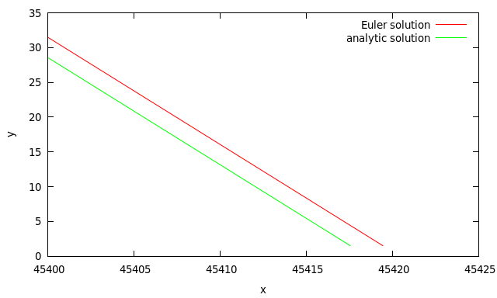
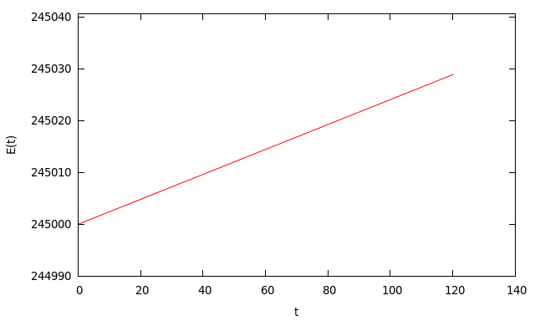
Oops?!?
Not quite correct, let's check energy

Slide 6
Energy
Total energy
Discrete time steps

Slide 7
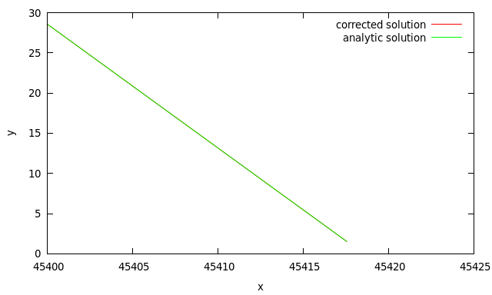
Correction
Simple (in this case)

Slide 8
It's a drag…
Adding air drag
with

Slide 9
Correcting for air density
Air density varies with altitude
Corrected air drag
with

Slide 10
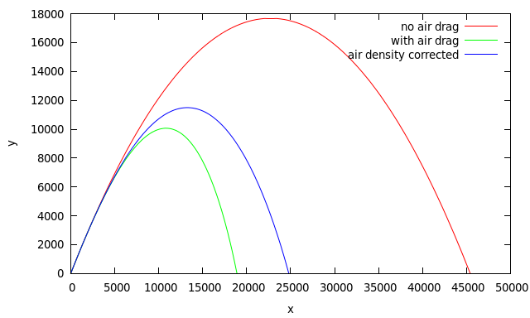
Comparing

Slide 11
Range
Find the maximum range of the cannon
at which angle should it be fired?
Find the maximum altitude of the shell
at which angle should it be fired?

