Slide 1
Charged particles
Geert Jan Bex
geertjan.bex@uhasselt.be

Slide 2
Problem setting
Charged particles
protons,
electrons,
each has
position in 2D
velocity in 2D
Initial position, velocity for particles
Dynamics?

Slide 3
Equations of motion
For particle , i.e., differential equations

Slide 4
How to initialize?
Assume equilibrium: use equipartition theorem! For each degree of freedom:
For the kinetic energy for particles in 2D:

Slide 5
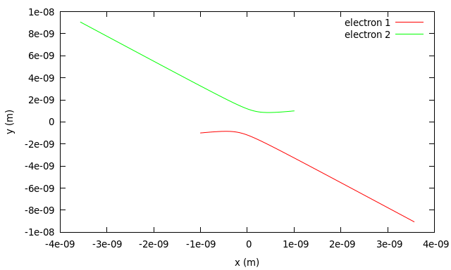
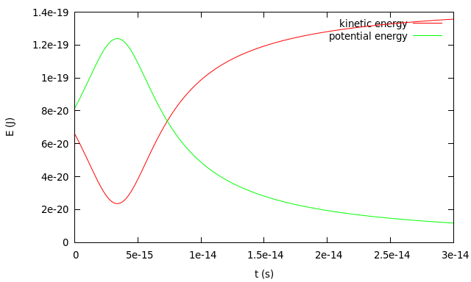
Two electrons
initial positions

Slide 6
Check
Conservation of linear momentum
Conservation of angular momentum
Conservation of total energy

Slide 7
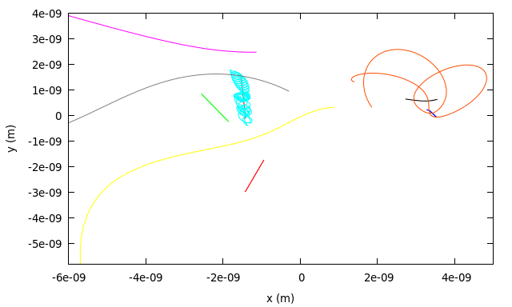
10 particles trajectories

Slide 8
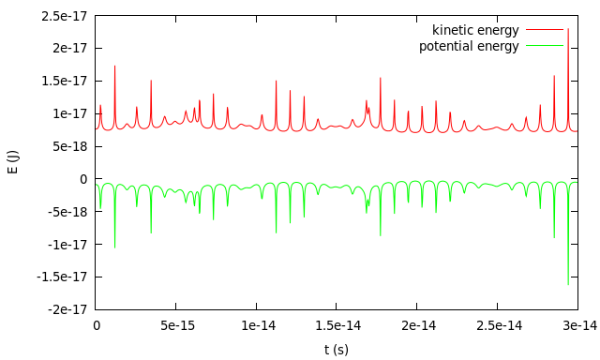
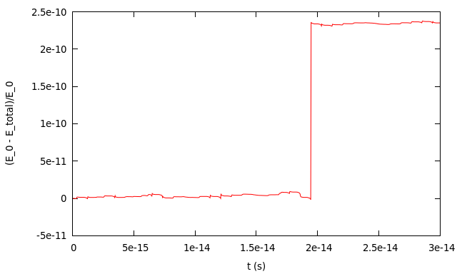
10 particles energy

Slide 9
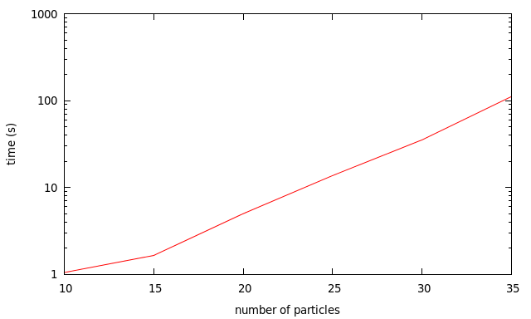
More particles
Scaling?

