Slide 1
Power spectrums
Geert Jan Bex
geertjan.bex@uhasselt.be

Slide 2
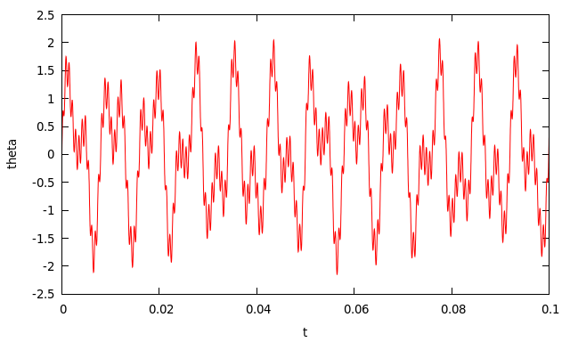
Signals
Consider
Signal measured for 1 second, sampled at 2¹⁶ Hz

Slide 3
Analysis
Compute power spectrum
Use Fourier transform: time domain to frequency domain
But, measurements are discrete: use DFT (Discrete Fourier Transform)
For performance, use FFT (Fast Fourier Transform)
where

Slide 4
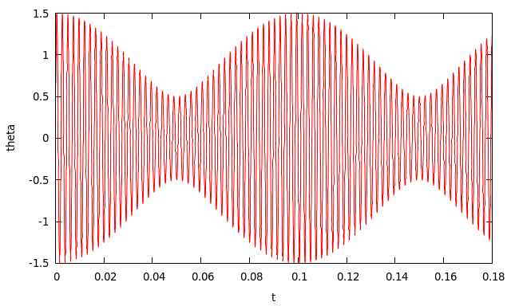
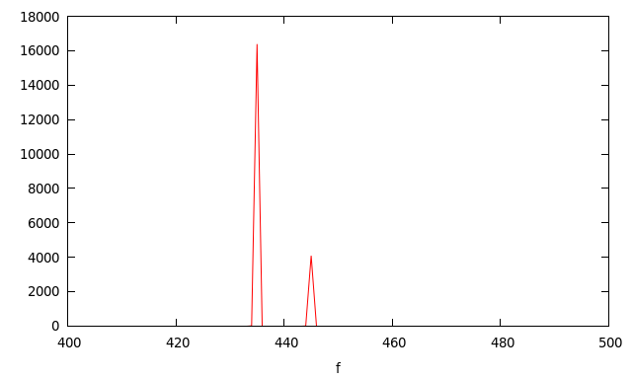
Example
Signal
Power spectrum
Sum of two periodic signals at frequencies 435 and 445 Hz and relative amplitudes 1:0.5

Slide 5
Exercise
Write C program to compute power spectrum
use GSL FFT
Analyze signals
http://alpha.uhasselt.be/~gjb/signal1.txt
http://alpha.uhasselt.be/~gjb/signal2.txt

