Slide 1
Julia set
Geert Jan Bex
geertjan.bex@uhasselt.be

Slide 2
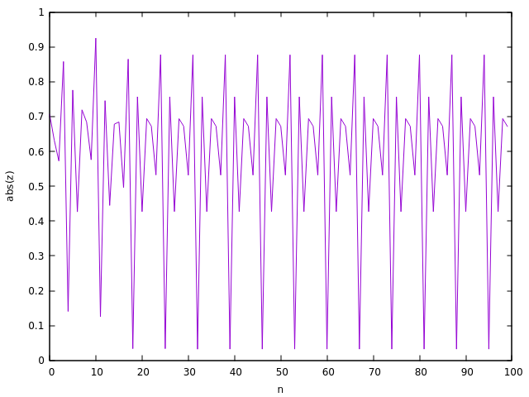
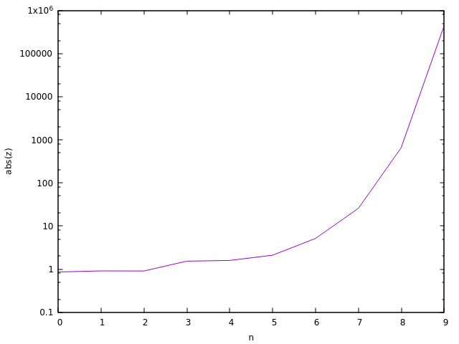
Function behavior
Function to iterate
where

Slide 3
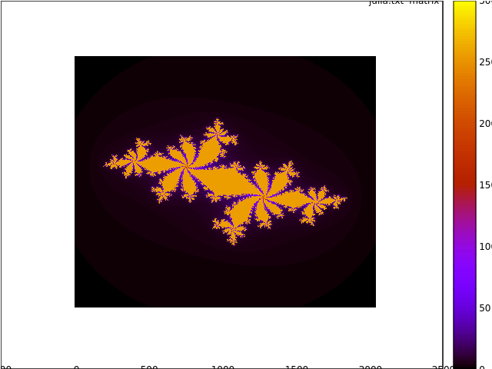
Julia set
Number of iterations n such that
Consider
Create heatmap
many iterations
fewiterations

