Slide 1
Tree_2k spatial data structure
Geert Jan Bex
geertjan.bex@uhasselt.be

Slide 2
Problem setting
Consider
N points p_{i} in 2D, 3D,…,kD, given extent
Find all points at Euclidean distance less than given radius r around p_{q}
Many queries
E.g., in 2D

Slide 3
Naïve solution
Algorithm
for each point p_{i}
compute Euclidean distance d(p_{i}, p_{q})
if d(p_{i}, p_{q}) < r, p_{i} in result
Complexity: O(N)
Too expensive in, e.g., many body simulations
Better: in 2D, use quad-tree; In 3D, use octo-tree; In kD, use 2^{k}-tree
Expensive for large N

Slide 4
Tree building algorithm
E.g., 2D initialization
initialize tree with one empty region
for each p_{i} in region
add it to region
if region has subregions, add to appropriate subregion
else if region is "full", split region into 4 new subregions
else add it to bucket

Slide 5
Illustration of building tree
bucket size 2

Slide 6
What's the point?
Pun intended…
Queries are fast!
Only few distances to calculate: fast!

Slide 7
Query algorithm
initialize empty region list
start at top region
in region
if query cannot return points in region, stop
else if region is leaf, add node to region list
else query each subregion
initialize empty point list
for each region in region list
compute distance to query point for each point, if less than radius, add point to point list

Slide 8
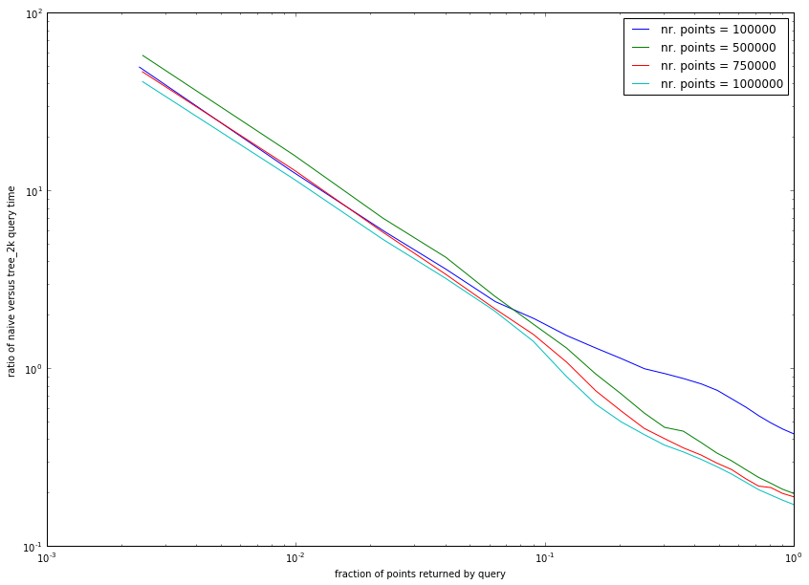
How much faster?
Depends on
number of points
number of results
ratio of naïve versus tree_2k query time
Can be a factor of 100!
10 %
fraction of points returned by query

Slide 9
Free lunch?
There ain't such thing as a free lunch!
Memory overhead!
For 10⁶ points in 2D: factor of 1.8
54.3 GB
includes
tree (3.2×10⁵ nodes of which 2.4 × 10⁵ leaf nodes)
coordinates of each point
address for additional data for each point

Slide 10
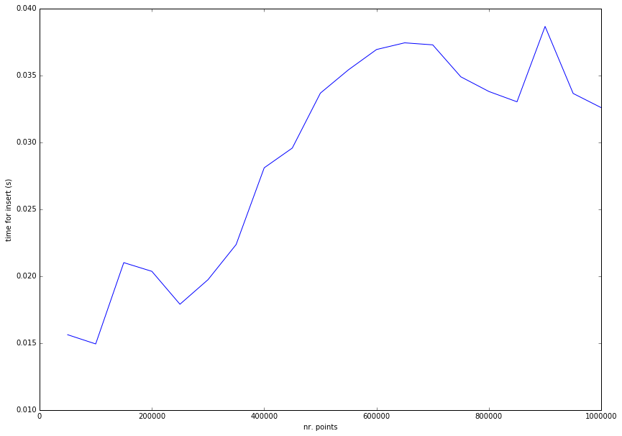
Cover charge
Construction of tree takes time
time for inserts (s)
number of points

Slide 11
Tradeoffs
Execution time vs. memory overhead
Number of queries vs. time to build tree
Number of expected results vs. query method
Bucket size vs. query time
Bucket size vs. memory overhead
Subtle considerations:
know your problem, know your algorithms!

Slide 12
Room for improvement
What about removing points?
again, tradeoff between memory and compute time
Is the data structure optimal?
many allocations, but easily avoided (how?)

