Slide 1
Computational physics
Geert Jan Bex
geertjan.bex@uhasselt.be

Slide 2
PROGRAMMING IN C:
FILE I/O & COMMAND LINE ARGUMENTS
K&R, Chapter 7 & 5, File I/O & command line arguments

Slide 3


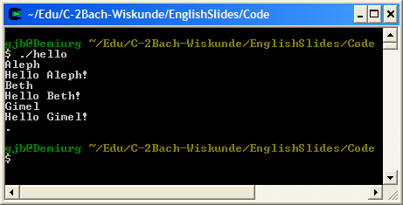
Input/output
stdin
stdout
application
stderr
#include <stdio.h>
#include <stdlib.h>
int isQuit(char str[]);
int main(void) {
for (;;) {
char str[80];
scanf("%s", str);
if (isQuit(str))
break;
printf("hello %s!\n", str);
}
return EXIT_SUCCESS;
}
stdin
stdout

Slide 4
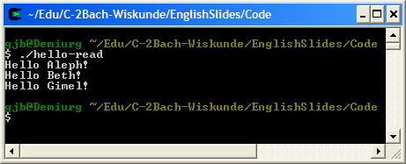
File I/O: reading
stdout
application
stderr
#include <stdio.h>
#include <stdlib.h>
int main(void) {
FILE *names = fopen("names.txt", "r");
if (names == NULL) { /* panic! */ }
while (!feof(names) {
char str[80];
if (fscanf(names, "%s", str) == 1)
printf("hello %s!\n", str);
}
fclose(names);
return EXIT_SUCCESS;
}
name of
file to open
mode:
r for reading
always
check!
fopen before
reading
names.txt
Aleph
Beth
Gimel
be polite:
always
fclose what
you've
fopened

Slide 5
File I/O: writing
application
#include <stdio.h>
#include <stdlib.h>
int main(void) {
FILE *names = fopen(“persons.txt", "r");
if (names == NULL) { /* panic! */ }
FILE *greetings = fopen("greetings.txt", "w");
if (greetings == NULL) { /* panic! */ }
while (!feof(names) {
char str[80];
if (fscanf(names, "%s", str) == 1)
fprintf(greetings, "hello %s!\n", str);
}
fclose(greetings);
fclose(names);
return EXIT_SUCCESS;
}
mode:
w for writing
always
check!
persons.txt
fopen before
writing
Aleph
Beth
Gimel
greetings.txt
Hello Aleph!
Hello Beth!
Hello Gimel!
always
fclose:
output
stream is
not flushed!

Slide 6
File I/O: tidbits
fclose what you fopen
I/O modes:
  r: open file for reading, fails if file doesn't exist
  w: open file for writing, if file exists, original contents is lost, otherwise, create it
  a: open file for writing, if file exists, append to it, otherwise, create it
FILE *: file pointer, predefined:
  stdin: keyboard
  stdout: terminal, intended for normal output
  stderr: terminal, intended for warnings, error
  messages, diagnostics
printf(formatStr,…) ≡ fprintf(stdout, formatStr,…)
scanf(formatStr,…) ≡ fscanf(stdin, formatStr, …)

Slide 7
Format strings
format code
%d: int
%ld: long
%u: unsigned
%lu: unsigned long
%c: char
%s: char *
%lf: double
%le: double
%lg: double
%p: pointer
%%: literal '%'
output
upto first '\0'
e.g., 30431.3454
e.g., 3.04313454e4
e.g., 30.4313454e3
input
upto first whitespace!!!
whitespace: ' ', '\t', '\r', '\n'
width w:
%wd
%0wd
%-wd
precision d:
%.de
%w.de
printf("%5d", 3)
printf("%05d", 3)
printf("%-5d", 3)
printf("%5d", 100000)
3
printf("%.2f", 3.5)
printf("%5.2f", 3.5)
3.50
00003
3.50
3
100000
works for all output
works for e, f, g

Slide 8
Other file I/O function
int fgetc(FILE *fp)
  read a char from fp
char *fgets(char *s, int n, FILE *fp)
  read a string from fp of at most n-1 chars, end it with '\0' or until a '\n' is encountered, return string or NULL on error
int fputc(int c, FILE *fp)
  put char c in fp
int fputs(const char *s, FILE *fp)
  put string s in fp
int ungetc(int c, FILE *fp)
  put char c back into fp after it has been read
int fflush(FILE *fp)
  ensure that output stream fp is written to file
declared in stdio.h

Slide 9
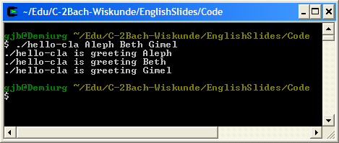
Command line arguments
application name
command line arguments
argv[0]
argv[1]
argv[2]
argv[3]
#include <stdio.h>
#include <stdlib.h>
int main(int argc, char *argv[]) {
unsigned i;
for (i = 1; i < argc; i++)
printf("%s is greeting %s\n", argv[0], argv[i]);
return EXIT_SUCCESS;
}
argc: number of arguments + 1
argv: array of char pointers
argv[0] holds
application name

Slide 10
Command line arguments 2
argv[0]
argv[1]
argv[2]
argv[3]
#include <stdio.h>
#include <stdlib.h>
int main(int argc, char *argv[]) {
unsigned i;
for (i = 1; i < argc; i++)
printf("%s is greeting %s\n", argv[0], argv[i]);
return EXIT_SUCCESS;
}
h
e
l
l
o
-
c
l
a
\0
argc:
4
argv:
G
i
m
e
l
\0
B
e
t
h
\0
A
l
e
p
h
\0

Slide 11
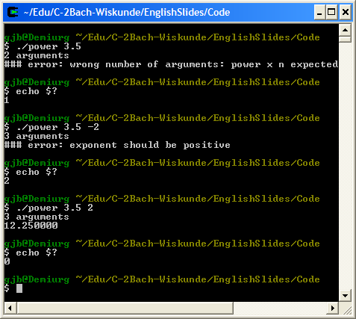
Exit status
void reportError(char str[]);
int main(int argc, char *argv[]) {
printf(“%d arguments\n”, argc);
if (argc != 3) {
reportError("wrong number of arguments: power x n expected");
exit(1);
}
double x = atof(argv[1]);
int n = atoi(argv[2]);
printf("%lf\n", power(x, n));
return EXIT_SUCCESS;
}
double power(double x, int n) {
if (n < 0) {
reportError("exponent should be positive");
exit(2);
} else {
unsigned i;
double p = 1.0;
for (i = 1; i <= n; i++)
p *= x;
return p;
}
}
declared in stdlib.h

Slide 12
String conversions
int main(int argc, char *argv[]) {
if (argc != 3) {
reportError("wrong number of arguments: power x n expected");
exit(1);
}
double x = atof(argv[1]);
int n = atoi(argv[2]);
printf("%lf\n", power(x, n));
return EXIT_SUCCESS;
}
string to int
  int atoi(char *str)
string to double
  float atof(char *str)
string to long
  long atol(char *str)
declared in stdlib.h

