Slide 1

Scientific Python
Geert Jan Bex
(geertjan.bex@uhasselt.be)
License: this presentation is released under the Creative Commons CC BY 4.0,
see https://creativecommons.org/licenses/by/4.0/deed.ast

Slide 2

http://bit.ly/36VXTEZ

Slide 3


Slide 4
Typographical conventions
Inline code fragments and file names are rendered as, e.g., hello_world.py
Longer code fragments are rendered as
Data files are rendered as
#!/usr/bin/env python
…
if __name__ == '__main__':
print('hello world!')
case dim temp
1 1 -0.5
2 1 0.0
3 1 0.5
4 2 -0.5
…
fragment
not shown

Slide 5
numpy
https://github.com/gjbex/Scientific-Python/tree/master/source-code/matrices
https://github.com/gjbex/Scientific-Python/tree/master/source-code/numpy

Slide 6
Out of the box
Python is interpreted
  Python is slow
  Python is really slow
Okay for one-offs, prototypes, short runtimes
Not okay for computationally intensive tasks!
Don't use vanilla Python for computations!!!

Slide 7
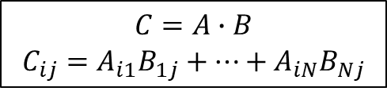
Python performance
def init_matrix(n):
m = []
for i in range(n):
m.append([])
for j in range(n):
m[i].append(random.random())
return m
def matmul(a, b, c):
n = len(a)
for i in range(n):
for j in range(n):
c[i][j] = 0.0
for k in range(n):
c[i][j] += a[i][k]*b[k][j]
500 × 500 matrices
Represent matrix as list of lists
Python: 0.09 s
C: 0.014 s
Naïve!
Fortran: 0.012 s
$$C=A∙B$$
$$C_{ij}=A_{i1}B_{1j}+⋯+A_{iN}B_{Nj}$$
Python: 32 s
C: 0.49 s
Fortran: 0.11 s

Slide 8
Libraries for numeric computation
numpy
  Fast arrays
  Matrix operations (BLAS-like)
  Linear algebra
  Fast Fourier Transform
  Mathematical functions defined on arrays
  Pseudo-random number generation to initialize arrays
  Simple statistics
…

Slide 9
Python using numpy
500 × 500 matrices
import numpy as np
def init_matrix(n, rng):
return rng.uniform(0.0, 1.0, (n, n))
def matmul(a, b):
return a @ b
numpy: 0.011 s
numpy: 0.077 s
Language/library | Execution time matrix multiplication (s)
Python | 32
C | 0.49
Fortran | 0.11
Python/numpy | 0.077
Fortran/BLAS | 0.060
415 ×

Slide 10
Creating array I
convention
import numpy as np
create 3-element array, all 0.0
v1 = np.zeros(3)
v2 = np.ones(3)
v3 = np.empty(3)
create 3-element array, all 1.0
create 3-element "empty" array
initialize elements later
create 2 × 3 array, all elements 0.0
a = np.zeros((2, 3))
b = np.ones((2, 3))
c = np.eye(2)
d = np.empty((2, 3))
create 2 × 3 array, all elements 1.0
create 2 × 2 identity array
create 2 × 3 "empty" array
initialize elements later
Default type: np.float64 ≡ double precision

Slide 11
Creating arrays II
f = np.array([[3.1, 4.2, -1.1], [-0.3, 1.3, 13.1]])
create 2 × 3 array from a Python
list of lists
g = np.zeros_like(f)
create 2 × 3 array with shape
and dtype of f
f = np.genfromtxt('matrix.txt')
create 2 × 3 array
from text file
1.2 2.3 3.4
4.5 5.6 6.7

Slide 12
Creating arrays III
e = np.arange(-1.0, 1.0, 0.25)
create 8-element array, first element -1.0,
last element less than 1.0, step 0.25
[ -1. -0.75 -0.5 -0.25 0. 0.25 0.5 0.75 ]
f = np.linspace(-1.0, 1.0, 9)
create 9-element array, first element -1.0,
last element 1.0, determine step
[ -1. -0.75 -0.5 -0.25 0. 0.25 0.5 0.75 1. ]

Slide 13
Random numbers
Create random number generator (RNG)
Reproducibility: seed RNG
Create arrays
rng = .default_rng()
rng = .default_rng(seed=1234)
create 2 × 3 array, elements x
randomly drawn from uniform
distribution such that x ∈ [-1.0, 1.0[
e = rng.uniform(-1.0, 1.0, (2, 3))
create 5 × 4 array, elements x
randomly drawn from normal
distribution with mean 1.0 and
standard deviation 0.1
e = rng.normal(loc=1.0, scale=0.1, (5, 4))

Slide 14
Numpy data types
Integers
np.int8, np.int16, np.int32, np.int64
np.uint<n> for unsigned integers
Floating point numbers
np.float16, np.float32, np.float64, np.float128
Complex numbers
np.complex64, np.complex128, np.complex256
Boolean values: bool
Characters/strings: np.character
Not quad-precision,
not portable
v = np.zeros(3, dtype=np.int8)

Slide 15
Accessing array elements
a = np.zeros((2, 3))
nr. bytes to
next row
Array dimensions, strides
Assigning to a specific element
Using an element's value
a.shape == (2, 3)
a.strides == (24, 8)
nr. bytes to
next column
a[1, 0] = 5.0
$$\left(\begin{matrix}0.0 & 0.0 & 0.0 \\ 5.0 & 0.0 & 0.0\end{matrix}\right)$$
5.0
q = a[1, 0] + a[1, 2]
Note:
Implicit conversion of
tuple for indexing
0-based indexing

Slide 16
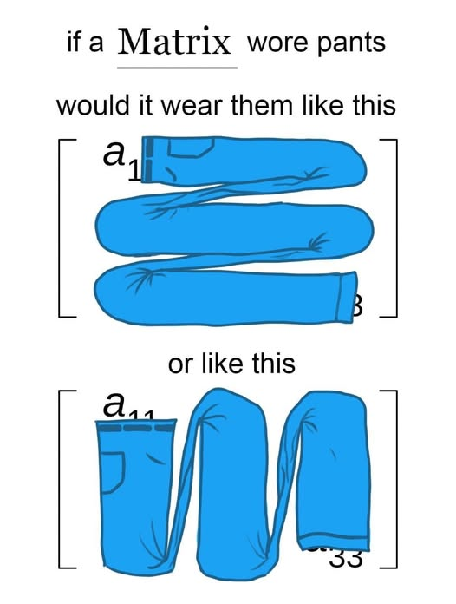



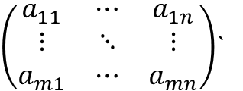

















Memory layout
$\left(\begin{matrix}a_{11} & ⋯ & a_{1n} \\ ⋮ & ⋱ & ⋮ \\ a_{m1} & ⋯ & a_{mn}\end{matrix}\right)$`
$$a_{11}$$
$$…$$
$$a_{1n}$$
$$a_{21}$$
$$…$$
$$a_{2n}$$
$$…$$
$$a_{m1}$$
$$…$$
$$a_{mn}$$
row 1
row 2
row m
$$a_{11}$$
$$…$$
$$a_{m1}$$
$$a_{12}$$
$$…$$
$$a_{m2}$$
$$…$$
$$a_{1n}$$
$$…$$
$$a_{mn}$$
column 1
column 2
column n
Access elements contiguously!

Slide 17
Accessing subarrays: slicing
[[ 1 2 3 4 5 ]
[ 6 7 8 9 10 ]
[ 11 12 13 14 15 ]
[ 16 17 18 19 20 ]]
a = np.arange(1, 21).reshape(4, 5)
Second column
Third row
2D subarray
a[:, 1]
[ 2 7 12 17 ]
result: 1D array
a[2, :]
[ 11 12 13 14 15 ]
[[ 1 2 3 4 5 ]
[ 6 1 0 9 10 ]
[ 11 0 1 14 15 ]
[ 16 17 18 19 20 ]]
a[1:3, 1:3] = np.eye(2)
cfr. list slicing, but…
array slicing does not copy!

Slide 18
Views versus copies
Reshape: different view on same data
Some operations return copies;
check documentation carefully;
also see
https://github.com/gjbex/Scientific-Python/blob/master/source-code/numpy/views.ipynb
a = np.array([[1.0, 3.0],
[4.0, 5.0]])
[[ 1. 3.]
[ 4. 5.]]
b = a.reshape(-1)
[ 1. 3. 4. 5.]
a[0, 0] = 13.0
[[ 13. 3.]
[ 4. 5.]]
a
b
[ 13. 3. 4. 5.]

Slide 19
Fancy indexing
a = np.arange(1, 10, dtype=np.int8).reshape(3, 3)
[[ 1 2 3 ]
[ 4 5 6 ]
[ 7 8 9 ]]
Conditional indexing
Conditional assignment
a[a % 2 == 1] = 0
[[ 0 2 0 ]
[ 4 0 6 ]
[ 0 8 0 ]]
3 × 3 Boolean array
np.where(a > 0, 1, -1)
[[ -1 1 -1 ]
[ 1 -1 1 ]
[ -1 1 -1 ]]
3 × 3 Boolean array

Slide 20
Operations on arrays
Scalar-array operations: +, -, *, /, //, **
Element-wise operations: +, -, *, /, //, **
Matrix product
Broadcasting, see
https://github.com/gjbex/Scientific-Python/blob/master/source-code/numpy/broadcast.ipynb
a = np.array([[1.0, 3.0], [4.0, 5.0]])
print(3.0 + a)
[[ 4. 6. ]
[ 7. 8. ]]
a = np.array([[1.0, 3.0], [4.0, 5.0]])
b = np.array([[2.0, 3.0], [1.0, 0.5]])
print(a*b)
[[ 2. 9. ]
[ 4. 2.5 ]]
print(a @ b)
[[ 5. 4.5 ]
[ 13. 14.5 ]]

Slide 21
Functions operating on arrays
a = np.empty((500, 500))
b = rng.uniform(0.0, 1.0, (500, 500))
Avoid
Use
Other functions: np.sin, …, np.sinh, …, np.exp,…
for i in range(500):
for j in range(500):
a[i, j] = math.sqrt(b[i, j])
140 μs
21 ×
a = np.sqrt(b)
6.5 μs

Slide 22
Aggregation functions
[[ 0 1 2 3 4 5
6 7 8 9 10 11
12 13 14 15 16 17
18 19 20 21 22 23 ]]
a = np.arrange(24).reshape(4, -1)
Sum of columns
Sum of rows
Sum of all elements
a.sum(axis=0)
[ 36 40 44 48 52 56 ]
a.sum(axis=1)
[ 15 51 87 123 ]
a.sum()
276

Slide 23
Some linear algebra
a = np.array([[1.0, 3.0], [4.0, 5.0]])
numpy has some linear algebra operations
  matrix power
  matrix inverse
  determinant
  eigenvalues
[[ 85. 129.]
[ 172. 257.]]
np.linalg.matrix_power(a, 3)
[[-0.71428571 0.42857143]
[ 0.57142857 -0.14285714]]
np.linalg.inv(a)
np.linalg.det(a)
-7.0
np.linalg.eigvals(a)
[-1. 7.]

Slide 24
numpy data I/O revisited
All functions are equal, but…
some are more equal than others
Reading text file with 10⁷ 64-bit floats
  np.genfromtxt(…): 12 seconds
  np.fromfile(…, sep='\n'): 6 seconds
  np.loadtxt(…): 2 seconds
Reading binary file with 10⁷ 64-bit floats
  np.load(…): 19 milliseconds
  np.fromfile(…): 16 milliseconds
HDF5 file with 10⁷ 64-bit floats
  h5_file['data'][:]: 32 milliseconds
6 ×
100 ×
Not all data formats are equal: HDF5 to the rescue

Slide 25
Matrices
Matlab-like initialization
Overloaded * and ** operators
Result is always matrix (2D)
[[ 1. 3. ]
[ 4. 5. ]]
a = np.matrix('1.0 3.0; 4.0 5.0')
Don't use,
confusing
a = np.matrix([[1.0, 3.0], [4.0, 5.0]])
b = np.matrix([[2.0, 3.0], [1.0, 0.5]])
print(a*b)
print(a**3)
[[ 5. 4.5 ]
[ 13. 14.5 ]]
[[ 85. 129. ]
[ 172. 257. ]]
a = np.matrix('1.0, 3.0')
b = np.matrix('2.0; 4.0')
print(a*b)
[[ 14. ]]

Slide 26
References
numpy for MATLAB users
http://mathesaurus.sourceforge.net/matlab-numpy.html

Slide 27
scipy
https://github.com/gjbex/Scientific-Python/tree/master/source-code/numpy
https://github.com/gjbex/Scientific-Python/tree/master/source-code/birdsong

Slide 28
Libraries for numeric computation
…
scipy
  Dense/sparse linear algebra
  Solving ordinary differential equations
  Numerical integration
  Optimization
  Interpolation
  Signal processing
  Statistics
  Special mathematical functions
  Mathematical & physical constants
…
convention
import scipy as sp

Slide 29
Singular Value Decomposition
Should be fast when built against
good BLAS/Lapack library
Computing SVD
Note: s is not a 2D-array, it is a 1D-array
Let's check
a = np.array([[7.3, 5.7], [-1.2, 5.3]])
u, s, v = sp.linalg.svd(a)
S = np.diag(s)
A = u @ S @ v
delta = A - a
[[ 8.88178420e-16, 0.00000000e+00],
[ 4.44089210e-16, 0.00000000e+00]]

Slide 30
Linear regression
x,y
0.000e+00,1.206e+00
5.263e-02,1.207e+00
…
data.csv
Reading data
Linear regression
data = np.genfromtxt('data.csv',
dtype=[np.float64, np.float64],
delimiter=',', names=True)
slp, intc, r, _, _ = sp.stats.linregress(data['x'],
data['y'])

Slide 31
Optimization: function definitions
$$f\left(x, y\right)={\left(x^{2}+y^{2}\right)}^{2}−{2x}^{2}−{2y}^{2}+0.1x$$
Minimize
Define function
Define gradient
def f(X):
x, y = X
return (x**2 + y**2)**2 - 2*x**2 - 2*y**2 + 0.1*x
def grad_f(X):
x, y = X
f_x = 4*(x**2 + y**2)*x - 4*x + 0.1
f_y = 4*(x**2 + y**2)*y - 4*y
return np.array([f_x, f_y])

Slide 32
Optimization
Compute minimum
Many methods
  Powell
  Conjugate gradient
  BFGS
  Newton conjugate gradient
  …
x0 = np.array([1.0, 0.01])
xopt = scipy.optimize.fmin_cg(f, x0, fprime=grad_f,
disp=False)

Slide 33
Ordinary differential equations
Rewrite higher order differential equation to set of first order equations
def func(t, y, g, l, q, F_D, Omega_D):
theta, omega = y[0], y[1]
return [
omega,
-(g/l)*theta - q*omega + F_D*np.sin(Omega_D*t)
]
y[0] ≡ θ
y[1] ≡ ω

Slide 34

Jacobian for equations
For some methods, convergence improves by specifying Jacobian
$$\left[\begin{matrix}\frac{∂f_{1}}{∂θ} & \frac{∂f_{1}}{∂ω} \\ \frac{∂f_{2}}{∂θ} & \frac{∂f_{2}}{∂ω}\end{matrix}\right]$$
def jac(t, y, g, l, q, F_D, Omega_D):
return [
[0.0, 1.0],
[-g/l, -q]
]

Slide 35
Integrate ODEs
Integrate from t0 to t_max in steps delta_t
from scipy.integrate import solve_ivp
…
solution = solve_ivp(
func,
t_span=(t0, t_max),
y0=(theta0, omega0),
t_eval=np.arange(t0, t_max, delta_t),
args=(g, l, q, F_D, Omega_D),
method="RK45",
)
if not solution.success:
…
…
integration method
RKF(4, 5)

Slide 36
Signal processing
Remove noise from sound file (WAV)
  Read WAV file
  Perform FFT to compute frequency spectrum
…
from scipy.io import wavfile
…
sample_rate, signal = wavfile.read(wav_file_name)
…
n = len(signal)
freq = sample_rate*np.arange(n)/n
Y = sp.fft.fft(signal)/n

Slide 37

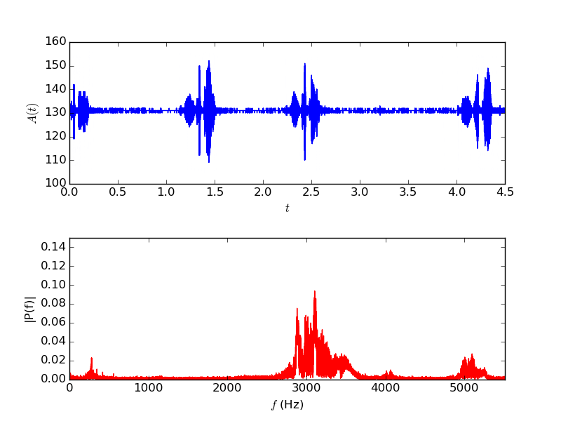
Original signal

Slide 38
Create highpass filter
Create IIR digital filter
fraction of Nyquist frequency
order of the filter
minimum attenuation
…
b, a = sp.signal.iirfilter(17, cutoff,
rs=min_attenuation,
btype='highpass',
analog=False,
ftype='cheby2')
…
filter type
IIR filter type
Notes:
The Nyquist frequency is half of the sampling rate of a discrete signal processing system.
Infinite impulse response (IIR) is a property applying to many linear time-invariant systems. Common examples of linear time-invariant systems are most electronic and digital filters. Systems with this property are known as IIR systems or IIR filters, and are distinguished by having an impulse response which does not become exactly zero past a certain point, but continues indefinitely. This is in contrast to a finite impulse response in which the impulse response h(t) does become exactly zero at times t > T for some finite T, thus being of finite duration.

Slide 39
Filter signal
Apply filter
Write signal to WAV file
…
base = np.uint8(np.mean(signal))
filtered_signal = sp.signal.filtfilt(b, a, signal)
wav_signal = base + np.array(filtered_signal,
dtype=np.uint8)
…
…
wavfile.write(filtered_wav_file_name, sample_rate,
wav_signal)
…

Slide 40
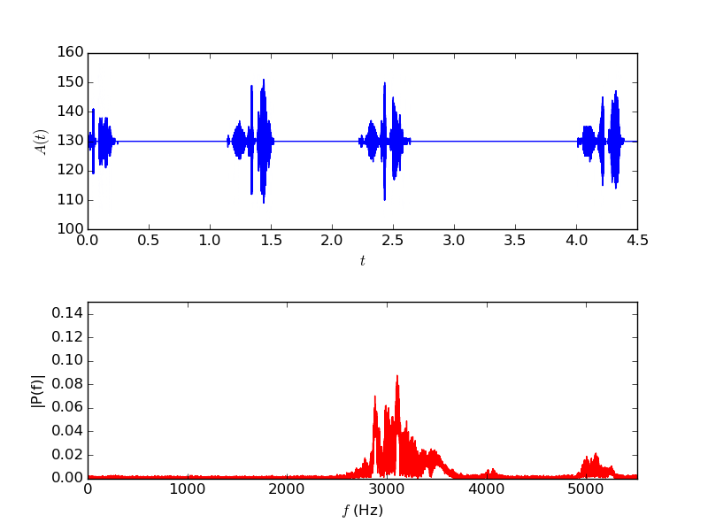
Filtered signal

Slide 41
Matplotlib
https://github.com/gjbex/Scientific-Python/tree/master/source-code/matplotlib

Slide 42
And some matplotlib…
Rich Python plotting library
  scatter plot
  line plot
  bar plot/histogram
  heatmap
  3D surface plot
Highly customizable plots
  LaTeX labels/annotation
Plot to screen, various file formats
Lots of features, this barely scratches the surface.
Convention: import matplotlib.pyplot as plt

Slide 43
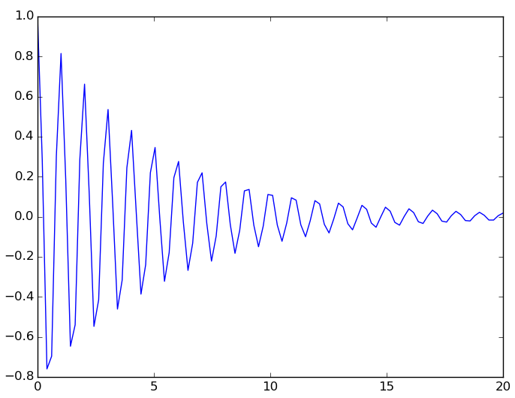
Simple line plot
Data: lists or numpy arrays
Add plot
Show plot
Save plot
x = np.linspace(0.0, 20.0, 500)
y = np.exp(-mu*x)*np.cos(2.0*np.pi*x)
plt.plot(x, y)
plt.show()
plt.savefig(file_name)

Slide 44
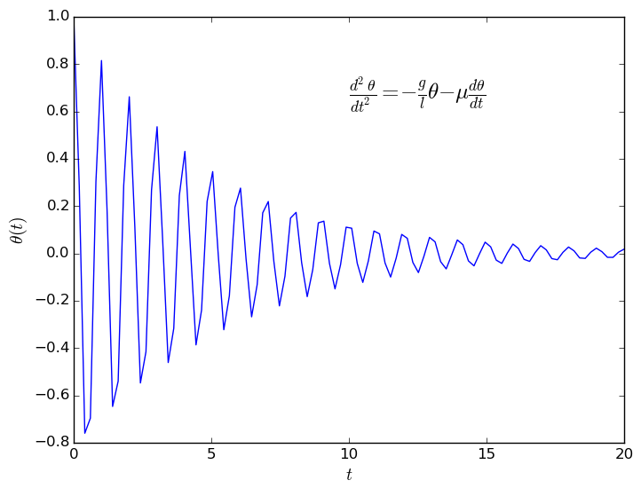
Axis labels, annotation
Add label for x and y axis
Add annotation
construct plot
≡
gradually enrich plt
plt.xlabel(r'$t$', fontsize=14)
plt.ylabel(r'$\theta(t)$', fontsize=14)
eq = (r'$\frac{d^2 \theta}{dt^2} = ' +
r'- \frac{g}{l} \theta ' +
r'- \mu \frac{d\theta}{dt}$')
plt.text(10.0, 0.65, eq, fontsize=18)
LaTeX notation, rendered

Slide 45
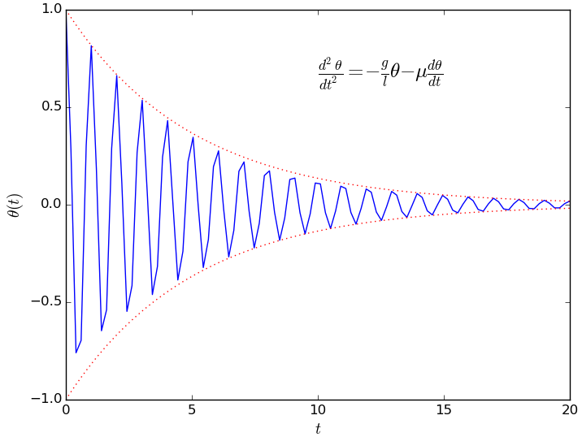
Multiple functions on line plot
Data
Add to plot, line style, color
y_plus = np.exp(-mu*x)
y_min = -np.exp(-mu*x)
plt.plot(x, y_plus,
':', alpha=0.8,
color='red',
linewidth=0.9)
plt.plot(x, y_min,
':', alpha=0.8,
color='red',
linewidth=0.9)
line type

Slide 46
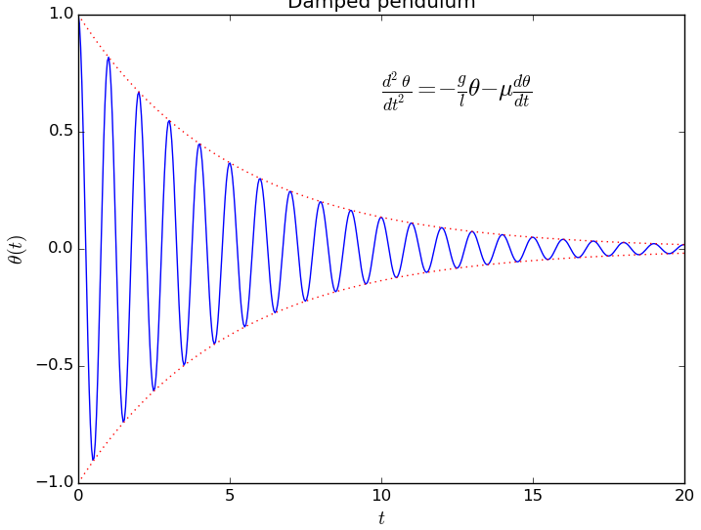
Complete line plot

Slide 47
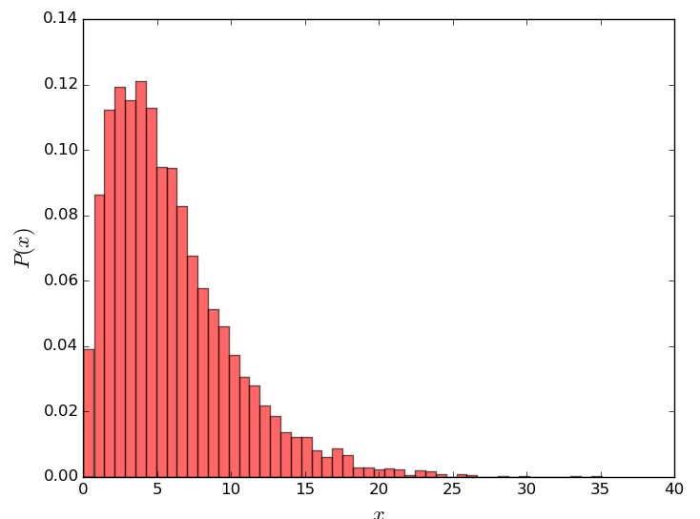
Histogram
13.3146868758
9.66243828428
6.44936354431
2.81183151337
9.55644862073
…
Data:
Plot histogram
values = np.loadtxt('data.txt')
bins = 50
data.txt
plt.hist(values, bins, density=True,
color='red', alpha=0.6)
plt.xlabel('$x$', fontsize=16)
plt.ylabel('$P(x)$', fontsize=16)

Slide 48
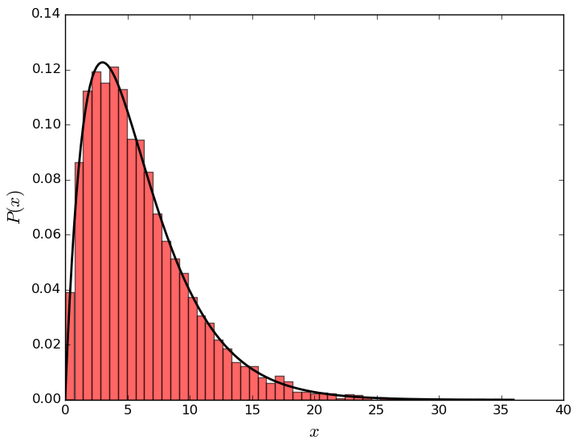
Line plot on histogram
Data:
Reminder
x = np.linspace(floor(np.min(values)),
ceil(np.max(values)),
200)
y = sp.stats.gamma.pdf(x, 2, scale=3.0)
plt.plot(x, y, linewidth=2.0,
color='black')
import numpy as np
import scipy as sp
import matploblib.pyplot as plt

Slide 49
Heat map data
Function to plot
Data
def f(x, y, x0=0.0, freq=1.0, beta=0.5):
r = np.sqrt((x - x0)**2 + y**2)
return np.exp(-beta*r)*np.cos(2.0*np.pi*freq*r)
x = np.linspace(x_min, x_max, points)
y = np.linspace(y_min, y_max, points)
X, Y = np.meshgrid(x, y)
z = f(X, Y, x0=x0_1, freq=f_1) + f(X, Y, x0=x0_2, freq=f_2)

Slide 50
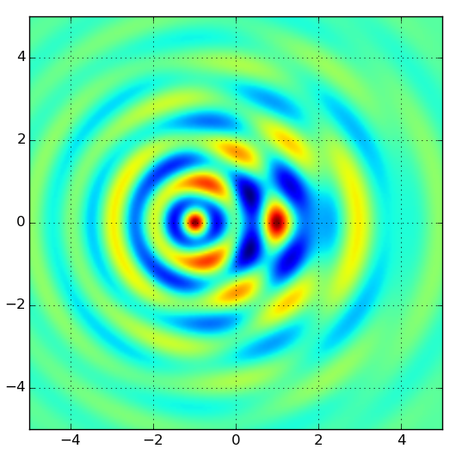
Heat map plot
Plot map
plt.imshow(z, extent=[x_min, x_max, y_min, y_max])
plt.grid(True)
Explore color maps,
helps interpret data!
Brewer schemes

Slide 51
3D surface plot I
Importing extra modules
Plot
Import matplotlib.pyplot as plt
figure,axes = plt.subplots(subplot_kw={'projection': '3d'})
axes.set(
xlim=(x_min, x_max),
ylim=(y_min, y_max),
zlim=(z_min, z_max),
)
surface = axes.plot_surface(
X, Y, z,
cmap='coolwarm', linewidth=0
)
figure.colorbar(surface, ax=axes)

Slide 52
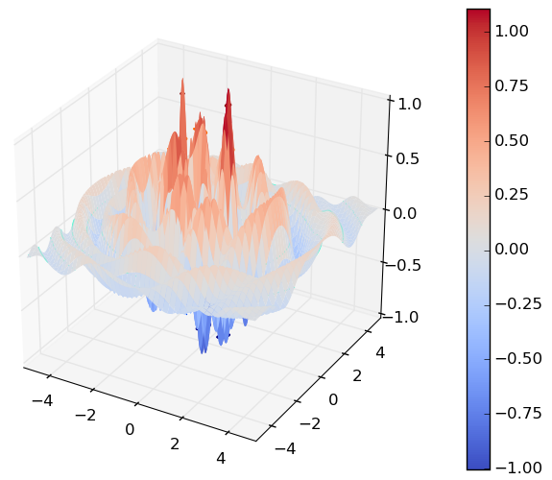
3D surface plot II

Slide 53
References
ColorBrewer 2.0: advice on choosing appropriate color maps
http://colorbrewer2.org/
Coblis: color blindness simulator
https://www.color-blindness.com/coblis-color-blindness-simulator/
Overview of data visualization types & libraries for Python
https://python-graph-gallery.com/

Slide 54
Sympy
https://github.com/gjbex/Scientific-Python/tree/master/source-code/sympy

Slide 55
Introduction
sympy: library for computer algebra
  symbolic computations
Features
  linear algebra
    vectors, matrices, tensors
    solving linear sets of equations
    eigenvalues/eigenvectors, SVD
    …
  calculus
    computing derivatives, series expansions
    limits
    integrals (indeterminate/determinate)
  …

Slide 56
Defining symbols
import sympy
Defining multiple symbols
Symbol with assumptions
  real
  rational
  integer
  positive/negative
Matrices
a, b, c, x = sympy.symbols('a b c x')
y = sympy.Symbol('y', positive=True)
A = sympy.Matrix([[x**2, x*y], [-x*y, y**2]])

Slide 57
Solving equations
Solve
Solve
sympy.solve(a*x**2 + b*x + c, x)
[ (-b + sqrt(-4*a*c + b**2))/(2*a),
-(b + sqrt(-4*a*c + b**2))/(2*a) ]
A = sympy.Matrix([[a, b], [c, d]])
X = sympy.Matrix([x, y])
B = sympy.Matrix([1, 0])
sympy.solve(A*X - B, X)
{ x: d/(a*d - b*c),
y: -c/(a*d - b*c) }

Slide 58
Eigenvalues, eigenvectors
multiplicity
eigen = A.eigenvects()
[(a/2 + d/2 - sqrt(a**2 - 2*a*d + 4*b*c + d**2)/2, 1, [Matrix([
[-b/(a/2 - d/2 + sqrt(a**2 - 2*a*d + 4*b*c + d**2)/2)],
[ 1]])]),
(a/2 + d/2 + sqrt(a**2 - 2*a*d + 4*b*c + d**2)/2, 1, [Matrix([
[-b/(a/2 - d/2 - sqrt(a**2 - 2*a*d + 4*b*c + d**2)/2)],
[ 1]])])]
v1, v2 = eigen[0][2][0], eigen[1][2][0]
sympy.simplify(v1.T*v2)
Matrix([[(-b + c)/c]])
if A is symmetric, eigenvectors are orthogonal

Slide 59
Derivatives
Define function
Derivative with respect to x
Derivative with respect to x and y
def f(x, y):
return a*x**2 + b*x*y + c*y**2 + d
sympy.diff(f(x, y), x)
2*a*x + b*y
sympy.diff(f(x, y), x, y)
b

Slide 60
Integration
Indefinite integral
Definite integral
Multiple integrals
sympy.integrate(f(x, y), x)
a*x**3/3 + b*x**2*y/2 + x*(c*y**2 + d)
from sympy import exp, sqrt, pi, oo
sympy.integrate(exp(-x**2/2)/sqrt(2*pi),
(x, -oo, oo))
1
sympy.integrate(f(x, y), (x, 0, 1), (y, 0, 2))
2*a/3 + b + 8*c/3 + 2*d

Slide 61
Limits and series expansion
Limit
Series expansion
sympy.limit(sin(x)/x, x, 0)
1
sympy.series(sin(x)/x, x, 0, n=6)
1 - x**2/6 + x**4/120 + O(x**6)
Use .removeO()
when not required
Use .taylor_term()
to get term of specific order

Slide 62
Expression representation
sympy expression = tree
from sympy import Add, Mul, Pow
Add(Mul(a, Pow(x, 2)), Mul(b, x), c)
Add
Mul
Mul
Symbol('c')
Symbol('a')
Pow
Symbol('b')
Symbol('x')
Symbol('x')
Integer(2)

Slide 63
Parts of expressions
Pow
Taking expression apart
Operator
Operands
expr = 1/(a*x + b)
Integer(-1)
Add
expr.func
Symbol('b')
Mul
sympy.core.power.Pow
Symbol('a')
Symbol('x')
expr.args
expr.args[0].args[0]
(a*x + b, -1)
b

Slide 64
Expression manipulation
Substitution
Factor, expand
Simplify
expr = x**2 + 2*a*x + y**2
expr.subs(y, a)
a**2 + 2*a*x + x**2
(x**2 + 2*x*y + y**2).factor()
((x + y)**2).expand()
(x + y)**2
x**2 + 2*x*y + y**2
x, y = symbols('x y', positive=True)
(log(x) + log(y)).simplify()
log(x*y)

Slide 65
Further reading
Sympy: symbolic computing in Python
A. Muerer, C.P. Smith, M. Paprocki et al.
PeerJ.CompSci

Slide 66
HDF5:
PyTables & h5py
https://github.com/gjbex/Scientific-Python/tree/master/source-code/hdf5

Slide 67
HDF5: what is it?
System, OS,
programming language
independent way of
storing data
Hierarchical Data Format
Abstract data model
  File
  Group
  Dataset
  Data type
  Attribute
Storage model
File system
Directory
File
Metadata
Documentation, comments
in data file itself, self contained

Slide 68
HDF5 data
Data stored in dataset as n-dimensional arrays
  Dataspace describes layout of data (rank,dimensions)
  Datatype describes single data element
    Atomic
      Integer, float
      String, time
      Opaque
    Composite
      Compound
      Enumeration
      Array
      Variable length
  Partial read/writes, hyperslab selection
Data layout & type description part of
HDF5 file:
  self-documenting
  discovery!

Slide 69
HDF5 storage
Filtering
  Compression
  Error detection
Datasets can be extended
Storage drivers
  Single file
  Multiple files
  Multiple files on parallel file system
  Memory

Slide 70
HDF5: how to use it?
C/C++
Fortran 90
Java
Python
  PyTables, h5py
HDF5 file can be read by program in any language
Not so easy in C/C++/Fortran, fairly trivial in Python

Slide 71
h5py: importing modules
To work with HDF5 files
  import h5py
  if necessary (almost certainly), import numpy
…
import h5py
import numpy as np
…

Slide 72
h5py: open & close HDF5 file
file name
Create new HDF5 file (w for write)
Open HDF5 file for modification (a for append)
Open HDF5 file for reading (r for read)
Close file
Preferred alternative
h5file = h5py.File('data.h5', mode='w')
h5file = h5py.File('data.h5', mode='a')
h5file = h5py.File('data.h5', mode='r')
h5file.close()
with h5py.File('data.h5', 'w', '…') as h5file:
…

Slide 73
h5py: creating a group
group name
Groups start in root
Creating a subgroup
input_group = h5file.create_group('input')
field_group = input_group.create_group('fields')
≡
field_group = h5file.create_group('/input/fields')

Slide 74
h5py: adding a dataset
Use numpy arrays
Add it to HDF5 file
magn_field = lambda x, y: x**2 + 2*x*y
X, Y = np.meshgrid(np.linspace(-1.0, 1.0, x_dim),
np.linspace(-1.0, 1.0, y_dim))
field_values = magn_field(X, Y)
array location in hierarchy
dataset name
field = field_group.create_dataset('magnetic',
field_values.shape,
field_values.dtype)
field[:, :] = field_values[:, :]
h5file.flush()
dataspace

Slide 75
h5py: adding an 2D array
Create numpy array
Add array
position_values = rng.normal(scale=10.0, size=(20, 2))
positions = h5file.create_dataset('/coords/positions'
position_values.shape,
dtype=np.float32)
Positions[:, :] = position_values[:, :]
h5file.flush()

Slide 76
h5py: annotations
Adding a unit annotation to array
Adding annotation to a group
attrs behave mostly like Python dictionaries, to set, get, remove an annotation
  iterator over attribute names:
field_group.magnetic.attrs['units'] = 'mT'
field_group.attrs['warning'] = 'do not modify'
field_group.attrs.keys()

Slide 77
h5py: reading an array
Read entire dataset, i.e., array
Read slice
Read non-consecutive data
magn_field = h5file['input/fields/magnetic']
print(np.average(magn_field))
pos = h5file['/coords/positions'][3:7, :]
read x- and y-coordinates
of 4 particles
indices = [2, 4, 6]
pos = h5file['/c0ords/positions'][indices, :]
read x- and y-coordinates
of 3rd, 5th, and 7th particle
Hyperslabs!

Slide 78
HDF5 command line utilities
h5dump
  Print a textual representation of HDF5 file
h5ls
  Explore structure of HDF5 file
h5copy
  Copy data set from one HDF5 file to another
h5mkgrp
  Create a group in an HDF5 file
h5cc/h5c++/h5fc
  Compile wrappers
  With -showconfig shows library features

Slide 79
PyTables: importing modules
To work with HDF5 files
  import tables
  if necessary (usually not, unless when using compounds), import specific functions, classes
  if necessary (almost certainly), import numpy
Fairly slow, nice implementation
…
import tables
from tables import Int32Col, Float64Col
import numpy as np
…

Slide 80
PyTables: open & close HDF5 file
file name
Create new HDF5 file (w for write)
Open HDF5 file for modification (a for append)
Open HDF5 file for reading (r for read)
Close file
Preferred alternative
h5file = tables.open_file('data.h5', mode='w',
'simulation input and results')
title
h5file = tables.open_file('data.h5', mode='a')
h5file = tables.open_file('data.h5', mode='r')
h5file.close()
with tables.open_file('data.h5', 'w', '…') as h5file:
…

Slide 81
PyTables: creating a group
group location in hierarchy
group name
Groups start in root
Creating a subgroup
input_group = h5file.create_group(h5file.root, 'input',
'input data')
≡
comment
input_group = h5file.create_group('/', 'input',
'input data')
field_group = h5file.create_group(input_group, 'fields',
'various fields')
≡
field_group = h5file.create_group('/input', 'fields',
'various fields')

Slide 82
PyTables: adding an array
Use numpy arrays
Add it to HDF5 file
magn_field = lambda x, y: x**2 + 2*x*y
X, Y = np.meshgrid(np.linspace(-1.0, 1.0, x_dim),
np.linspace(-1.0, 1.0, y_dim))
field = magn_field(X, Y)
array location in hierarchy
array name
h5file.create_array(field_group, 'magnetic', field,
'static magnetic field')
h5file.flush()
comment
array

Slide 83
PyTables: adding an 2D array
Create numpy array
Add array
positions = rng.normal(scale=10.0, size=(20, 2))
h5file.create_array('/coords', 'positions', positions,
'particle positions', createparents=True)
h5file.flush()

Slide 84
PyTables: reading an array
Read entire dataset, i.e., array
Read slice
Read non-consecutive data
magn_field = h5file.root.input.fields.magnetic
print(np.average(magn_field))
pos = h5file.root.coords.positions[3:7, :]
read x- and y-coordinates
of 4 particles
indices = [2, 4, 6]
pos = h5file.root.coords.positions[indices, :]
read x- and y-coordinates
of 3rd, 5th, and 7th particle
Hyperslabs!

Slide 85
PyTables: annotations
Adding a unit annotation to array
Adding annotation to a group
attrs, _v_attrs behave mostly like Python dictionaries, to set, get, remove an annotation
  list of attributes:
field_group.magnetic.attrs['units'] = 'mT'
field_group._v_attrs['warning'] = 'do not modify'
field_group._f_list('user')

Slide 86
PyTables: objects & tables
Define class
Create table
from tables import IsDescription, Int32Col, Float64Col
class Particle(IsDescription):
particle_id = Int32Col()
mass = Float64Col()
x_pos = Float64Col()
y_pos = Float64Col()
x_vel = Float64Col()
y_vel = Float64Col()
initial_state = h5file.create_table(
'/', 'particles', Particle, 'initial state of particles'
)

Slide 87
PyTables: populate table
Add new particles
particle = h5file.root.particles.row
for particle_id in range(100):
particle['particle_id'] = particle_id
particle['mass'] = random.gauss(0.0, 1.0)
particle['x_pos'] = random.gauss(0.0, 1.0)
particle['y_pos'] = random.gauss(0.0, 1.0)
particle['x_vel'] = random.gauss(0.0, 1.0)
particle['y_vel'] = random.gauss(0.0, 1.0)
particle.append()
h5file.flush()
append particles one by one, unlimited (except by disk space)

Slide 88
PyTables: reading a table
Compute center of mass
x, y = 0.0, 0.0
mass = 0.0
for particle in h5file.root.particles:
mass += particle['mass']
x += particle['mass']*particle['x_pos']
y += particle['mass']*particle['y_pos']
x /= mass
y /= mass

Slide 89
Bokeh
https://github.com/gjbex/Scientific-Python/tree/master/source-code/bokeh

Slide 90
What is it?
Plot library
  Easy to use
  Integrates with Pandas
  Interactive demos in jupyter notebooks
  Export to HTML pages, interactive plots using Javascript
  Reasonable support LaTeX labels
More oriented towards information visualization

Slide 91
Simple plot
import required
functions
from bokeh.plotting import figure, output_file, show
…
x = np.linspace(0.0, 20.0, 500)
y = np.exp(-mu*x)*np.cos(2.0*np.pi*x)
y_plus = np.exp(-mu*x)
y_min = -np.exp(-mu*x)
…
output_file('plot.html', title='damped pendulum')
fig = figure(title='damped pendulum',
x_axis_label='t', y_axis_label='theta')
fig.line(x, y)
fig.line(x, y_min, line_color='red',
line_width=0.6,
line_dash=(2, 2))
fig.line(x, y_plus, line_color='red',
line_width=0.6,
line_dash=(2, 2))
show(fig)
set output file
create figure
plot data
create file

Slide 92
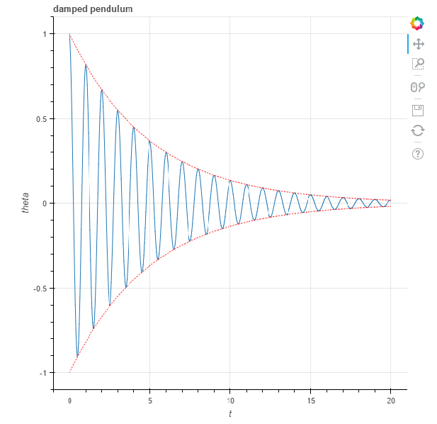
HTML file
pan tool
box zoom
wheel zoom
save image
reset
Interactive in web browser!

Slide 93
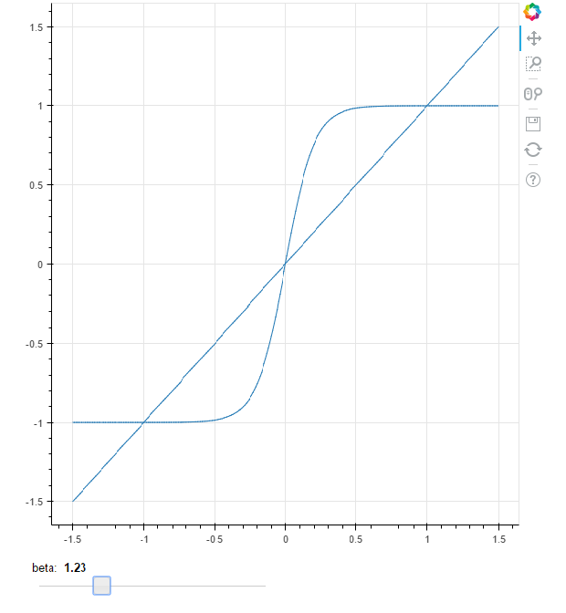
HTML file with widget
Required: callback function
• modifies data
• triggers update
• involves Javascript tinkering
interactive slider

Slide 94
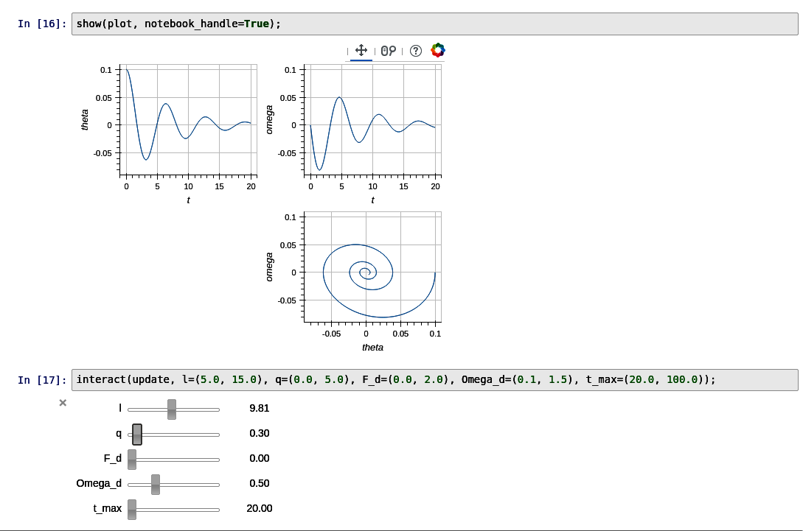
Linked figures
linked figures for
• panning, zooming
• interactive settings

Slide 95
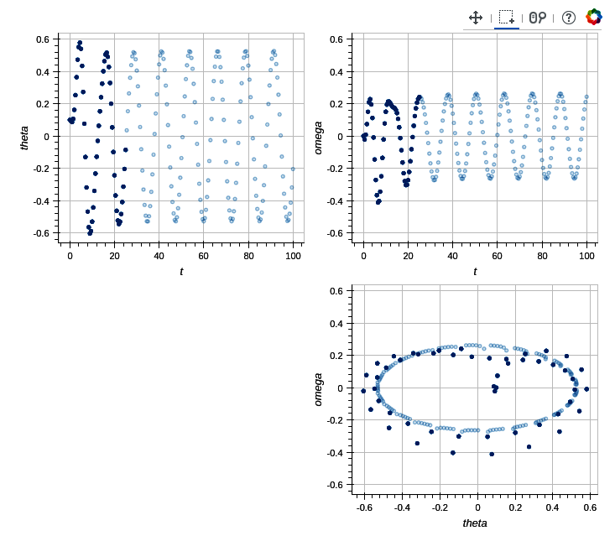
Linked brushing
consistent selection

Slide 96
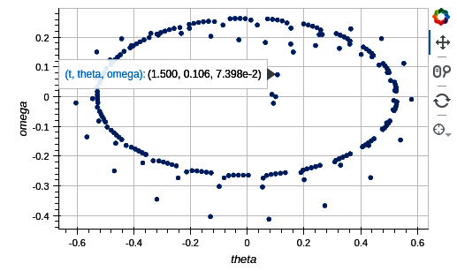
Hover tool
hover for details
Any information can be added

Slide 97
Image & video processing
https://github.com/gjbex/Scientific-Python/tree/master/source-code/image-processing

Slide 98
Image & video processing
Use dedicated software, e.g., GIMP, OpenShot
  use Python for plugins
  use Python for scripting
Image processing
  pillow: basic image processing (successor to PIL)
  scikit-image: more sophisticated algorithms
  OpenCV: comparable to scikit-image
Video processing
  OpenCV: many useful algorithms

Slide 99
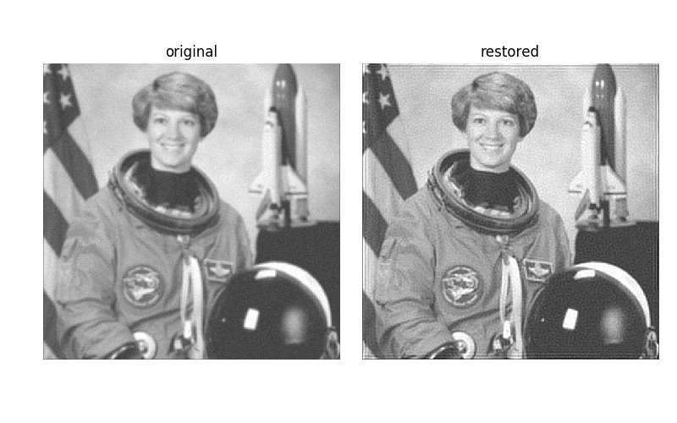
Image restoration
Define point spread function
Perform deconvolution
point_spread_f = np.ones((5, 5))/25.0
from skimage.restoration import unsupervised_wiener
…
denoised, _ = unsupervised_wiener(img, point_spread_f)
3D numpy array, RGB
For image I/O:
skimage.io

Slide 100
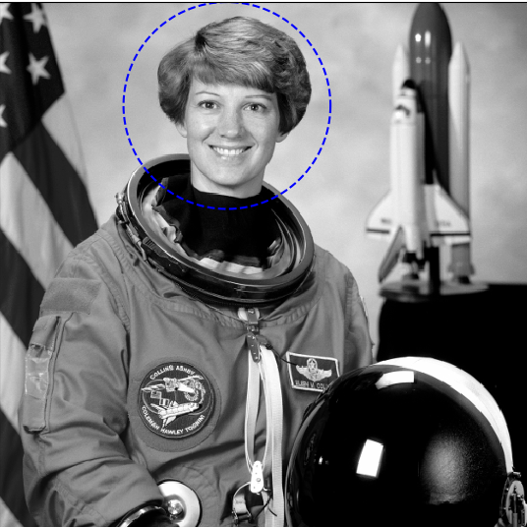
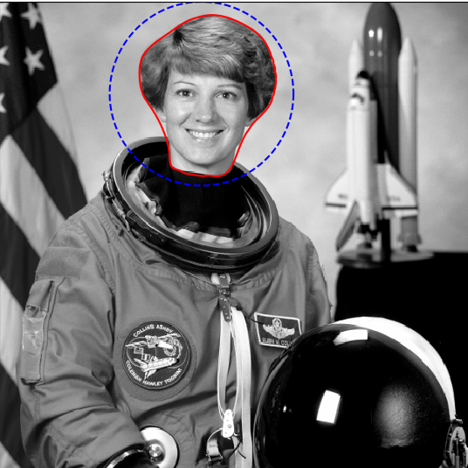
Segmentation
Define initial contour
Compute snake
theta = np.linspace(0, 2*np.pi, n)
x = x0 + radius*np.cos(theta)
y = y0 + radius*np.sin(theta)
initial_snake = np.array([x, y]).T
from skimage.segmentation import active_contour
snake = active_contour(smoothed_image, initial_snake,
alpha=alpha, beta=beta,
gamma=gamma)
from skimage.filters import Gaussian
smoothed_image = gaussian(image, 3)

Slide 101
Capturing video
Capture from camera, show in window
import cv2
capture = cv2.VideoCapture(0)
while True:
status, frame = capture.read()
if not status:
# oops
…
cv2.imshow('frame', frame)
if cv2.waitKey(1) & 0xFF == ord('q'):
break
cv2.destroyAllWindows()
capture.release()
device number
3D numpy array, BGR
quit on 'q'

Slide 102
Reading/writing video
Reading from my_video.avi
Writing to my_video.avi
capture = cv2.VideoCapture('my_video.avi')
video encoding
fourcc = cv2.VideoWriter_fourcc(*'XVID')
writer = cv2.VideoWriter('my_video.avi', fourcc,
frames_per_second,
(width, height))
for frame in frames:
writer.write(frame)
writer.release()

Slide 103
Follow the ball: setup
Hue histogram of ROI (region of interest)
status, frame = capture.read()
track_window = (x, y, width, height)
hsv_frame = cv2.cvtColor(frame, cv2.COLOR_BGR2HSV)
mask = cv2.inRange(hsv_frame,
np.array((min_hue, 50, 50)),
np.array((max_hue, 255, 255)))
roi_hist = cv2.calcHist([hsv_frame], [0],
mask, [max_hue], [0, max_hue])
cv2.normalize(roi_hist, roi_hist, 0, 255,
cv2.NORM_MINMAX)
only histogram
for hue on ROI
HSV = Hue, Saturation, Value
determines color

Slide 104

Follow the ball
Read frames and update track window
termin_cond = (cv2.TERM_CRITERIA_EPS |
cv2.TERM_CRITERIA_COUNT,
iterations, pixels)
while True:
status, frame = capture.read()
hsv = cv2.cvtColor(frame, cv2.COLOR_BGR2HSV)
back_proj = cv2.calcBackProject([hsv], [0], roi_hist,
[0, max_hue], 1)
status, track_window = cv2.meanShift(back_proj,
track_window,
termin_cond)

Slide 105
Further reading
Success depends on
understanding algorithms!
Many things to explore
Check out
  https://scikit-image.org/docs/stable/
  https://docs.opencv.org/4.x/d6/d00/tutorial_py_root.html

