Slide 1


Scientific Python
Geert Jan Bex
(geertjan.bex@uhasselt.be)
License: this presentation is released under the Creative Commons CC BY 4.0, see https://creativecommons.org/licenses/by/4.0/deed.ast

Slide 2

http://bit.ly/36VXTEZ

Slide 3


Slide 4
Typographical conventions I
Shell commands are rendered as
Do not type $, it represents your shell prompt!
Python shell commands are rendered as
Do not type >>>, it represents the prompt!
iPython interpreter is rendered as
$ python –m doctest data_parsing.py
>>> names = 'bob alice carol'.split()
In[3]: names = 'bob alice carol'.split()

Slide 5
Typographical conventions II
Inline code fragments and file names are rendered as, e.g., hello_world.py
Longer code fragments are rendered as
Data files are rendered as
#!/usr/bin/env python
…
if __name__ == '__main__':
print('hello world!')
case dim temp
1 1 -0.5
2 1 0.0
3 1 0.5
4 2 -0.5
…
fragment not shown

Slide 6
numpy
https://github.com/gjbex/Scientific-Python/tree/master/source-code/matrices
https://github.com/gjbex/Scientific-Python/tree/master/source-code/numpy

Slide 7
Out of the box
Python is interpreted
Python is slow
Python is really slow
Okay for one-offs, prototypes, short runtimes
Not okay for computationally intensive tasks!
Don't use vanilla Python for computations!!!

Slide 8
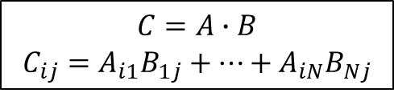
Python performance
def init_matrix(n): m = [] for i in range(n): m.append([]) for j in range(n):
m[i].append(random.random()) return m
def matmul(a, b, c): n = len(a) for i in range(n): for j in range(n):
c[i][j] = 0.0 for k in range(n): c[i][j] += a[i][k]*b[k][j]
500 × 500 matrices
Represent matrix as list of lists
Python: 0.09 s
C: 0.014 s
Naïve!
Fortran: 0.012 s
$$C=A∙B$$
$$C_{ij}=A_{i1}B_{1j}+⋯+A_{iN}B_{Nj}$$
Python: 32 s
C: 0.49 s
Fortran: 0.11 s

Slide 9
Libraries for numeric computation
numpy
Fast arrays
Matrix operations (BLAS-like)
Linear algebra
Fast Fourier Transform
Mathematical functions defined on arrays
Pseudo-random number generation to initialize arrays
Simple statistics
…

Slide 10
Python using numpy
500 × 500 matrices
import numpy as np
def init_matrix(n): return np.random.uniform(0.0, 1.0, (n, n))
def matmul(a, b): return a @ b
numpy: 0.011 s
numpy: 0.077 s
Language/library | Execution time matrix multiplication (s)
Python | 32
C | 0.49
Fortran | 0.11
Python/numpy | 0.077
Fortran/BLAS | 0.060
415 ×

Slide 11
Creating array I
convention
import numpy as np
create 3-element array, all 0.0
v1 = np.zeros(3)
v2 = np.ones(3)
v3 = np.empty(3)
create 3-element array, all 1.0
create 3-element "empty" array initialize elements later
create 2 × 3 array, all elements 0.0
a = np.zeros((2, 3))
b = np.ones((2, 3))
c = np.eye(2)
d = np.empty((2, 3))
create 2 × 3 array, all elements 1.0
create 2 × 2 identity array
create 2 × 3 "empty" array initialize elements later
Default type: np.float ≡ double precision

Slide 12
Creating arrays II
e = np.random.uniform(0.0, 1.0, (2, 3))
create 2 × 3 array, elements x randomly drawn from uniform distribution such that x ∈ [0.0, 1.0[
f = np.array([[3.1, 4.2, -1.1], [-0.3, 1.3, 13.1]])
create 2 × 3 array from a Python list of lists
f = np.genfromtxt('matrix.txt')
create 2 × 3 array from text file
1.2 2.3 3.4
4.5 5.6 6.7

Slide 13
Creating arrays III
e = np.arange(-1.0, 1.0, 0.25)
create 8-element array, first element -1.0,
last element less than 1.0, step 0.25
[ -1. -0.75 -0.5 -0.25 0. 0.25 0.5 0.75 ]
f = np.linspace(-1.0, 1.0, 9)
create 9-element array, first element -1.0,
last element 1.0, determine step
[ -1. -0.75 -0.5 -0.25 0. 0.25 0.5 0.75 1. ]

Slide 14
Numpy data types
Integers np.int8, np.int16, np.int32, np.int64 default for np.int: np.int32 on 32-bit, np.int64 on 64-bit architecture (np.uint<n> for unsigned integers)
Floating point numbers np.float16, np.float32, np.float64, np.float128 default for np.float: np.float64, i.e., double precision
Complex numbers np.complex64, np.complex128, np.complex256 default for np.complex: np.complex128, i.e., double precision
Boolean values: np.bool
Characters/strings: np.character
v = np.zeros(3, dtype=np.int8)

Slide 15
Accessing array elements
a = np.zeros((2, 3))
nr. bytes to next row
Array dimensions, strides
Assigning to a specific element
Using an element's value
a.shape == (2, 3)
a.strides == (24, 8)
nr. bytes to next column
a[1, 0] = 5.0
$$\left(\begin{matrix}0.0 & 0.0 & 0.0 \\ 5.0 & 0.0 & 0.0\end{matrix}\right)$$
5.0
q = a[1, 0] + a[1, 2]
Note:
Implicit conversion of tuple for indexing
0-based indexing

Slide 16
Accessing subarrays: slicing
[[ 1 2 3 4 5 ]
[ 6 7 8 9 10 ]
[ 11 12 13 14 15 ]
[ 16 17 18 19 20 ]]
a = np.arange(1, 21).reshape(4, 5)
Second column
Third row
2D subarray
a[:, 1]
[ 2 7 12 17 ]
result: 1D array
a[2, :]
[ 11 12 13 14 15 ]
[[ 1 2 3 4 5 ]
[ 6 1 0 9 10 ]
[ 11 0 1 14 15 ]
[ 16 17 18 19 20 ]]
a[1:3, 1:3] = np.eye(2)
cfr. list slicing, but…
array slicing does not copy!

Slide 17
Fancy indexing
a = np.arange(1, 10, dtype=np.int).reshape(3, 3)
[[ 1 2 3 ]
[ 4 5 6 ] [ 7 8 9 ]]
Conditional indexing
Conditional assignment
a[a % 2 == 1] = 0
[[ 0 2 0 ]
[ 4 0 6 ] [ 0 8 0 ]]
3 × 3 Boolean array
np.where(a > 0, 1, -1)
[[ -1 1 -1 ]
[ 1 -1 1 ] [ -1 1 -1 ]]
3 × 3 Boolean array

Slide 18
Operations on arrays
Scalar-array operations: +, -, *, /, //, **
Element-wise operations: +, -, *, /, //, **
Matrix product
Python 3.5 style
a = np.array([[1.0, 3.0], [4.0, 5.0]])
print(3.0 + a)
[[ 4. 6. ]
[ 7. 8. ]]
a = np.array([[1.0, 3.0], [4.0, 5.0]])
b = np.array([[2.0, 3.0], [1.0, 0.5]])
print(a*b)
[[ 2. 9. ]
[ 4. 2.5 ]]
print(np.dot(a, b))
[[ 5. 4.5 ]
[ 13. 14.5 ]]
print(a @ b)

Slide 19
Functions operating on arrays
a = np.empty((500, 500))
b = np.random.uniform(0.0, 1.0, (500, 500))
Avoid
Use
Other functions: np.sin, …, np.sinh, …, np.exp, np.trace, np.transpose,…
for i in range(500):
for j in range(500):
a[i, j] = math.sqrt(b[i, j])
140 μs
21 ×
a = np.sqrt(b)
6.5 μs

Slide 20
Some linear algebra
a = np.array([[1.0, 3.0], [4.0, 5.0]])
numpy has some linear algebra operations
matrix power
matrix inverse
determinant
eigen values
[[ 85. 129.]
[ 172. 257.]]
np.linalg.matrix_power(a, 3)
[[-0.71428571 0.42857143]
[ 0.57142857 -0.14285714]]
np.linalg.inv(a)
np.linalg.det(a)
-7.0
np.linalg.eigvals(a)
[-1. 7.]

Slide 21
References versus copies
Reshape: different view on same data
Some operations return copies, check documentation carefully
a = np.array([[1.0, 3.0],
[4.0, 5.0]])
[[ 1. 3.]
[ 4. 5.]]
b = a.reshape((a.size, ))
[ 1. 3. 4. 5.]
a[0, 0] = 13.0
[[ 13. 3.]
[ 4. 5.]]
a
b
[ 13. 3. 4. 5.]

Slide 22
numpy data I/O revisited
All functions are equal, but…
some are more equal than others
Reading text file with 10⁷ 64-bit floats
np.genfromtxt(…): 12 seconds
np.fromfile(…, sep='\n'): 6 seconds
np.loadtxt(…): 2 seconds
Reading binary file with 10⁷ 64-bit floats
np.load(…): 19 milliseconds
np.fromfile(…): 16 milliseconds
HDF5 file with 10⁷ 64-bit floats
h5_file['data'][:]: 32 milliseconds
6 ×
1000 ×
Not all data formats are equal: HDF5 to the rescue

Slide 23
Matrices
Matlab-like initialization
Overloaded * and ** operators
Result is always matrix (2D)
[[ 1. 3. ]
[ 4. 5. ]]
a = np.matrix('1.0 3.0; 4.0 5.0')
Don't use,
confusing
a = np.matrix([[1.0, 3.0], [4.0, 5.0]])
b = np.matrix([[2.0, 3.0], [1.0, 0.5]])
print(a*b)
print(a**3)
[[ 5. 4.5 ]
[ 13. 14.5 ]]
[[ 85. 129. ]
[ 172. 257. ]]
a = np.matrix('1.0, 3.0')
b = np.matrix('2.0; 4.0')
print(a*b)
[[ 14. ]]

Slide 24
References
numpy for MATLAB users http://mathesaurus.sourceforge.net/matlab-numpy.html

Slide 25
scipy
https://github.com/gjbex/Scientific-Python/tree/master/source-code/numpy
https://github.com/gjbex/Scientific-Python/tree/master/source-code/birdsong

Slide 26
Libraries for numeric computation
…
scipy
Dense/sparse linear algebra
Solving ordinary differential equations
Numerical integration
Optimization
Interpolation
Signal processing
Statistics
Special mathematical functions
Mathematical & physical constants
…
convention
import scipy as sp
import subpackages as needed
import scipy.linalg

Slide 27
Singular Value Decomposition
Should be fast when built against good BLAS/Lapack library
Computing SVD
Note: s is not a 2D-array, it is a 1D-array
Let's check
import scipy.linalg
a = np.array([[7.3, 5.7], [-1.2, 5.3]])
u, s, v = sp.linalg.svd(a)
S = np.diag(s)
A = u @ S @ v
delta = A - a
[[ 8.88178420e-16, 0.00000000e+00],
[ 4.44089210e-16, 0.00000000e+00]]

Slide 28
Linear regression
x,y
0.000e+00,1.206e+00
5.263e-02,1.207e+00
…
data.csv
Reading data
Linear regression
data = np.genfromtxt('data.csv', dtype=[np.float64, np.float64],
delimiter=',', names=True)
import scipy as sp import scipy.stats
slp, intc, r, _, _ = sp.stats.linregress(data['x'],
data['y'])

Slide 29
Optimization: function definitions
$$f\left(x, y\right)={\left(x^{2}+y^{2}\right)}^{2}−{2x}^{2}−{2y}^{2}+0.1x$$
Minimize
Define function
Define gradient
def f(X):
x, y = X
return (x**2 + y**2)**2 - 2*x**2 - 2*y**2 + 0.1*x
def grad_f(X):
x, y = X
f_x = 4*(x**2 + y**2)*x - 4*x + 0.1
f_y = 4*(x**2 + y**2)*y - 4*y
return np.array([f_x, f_y])

Slide 30
Optimization
Compute minimum
Many methods
Powell
Conjugate gradient
BFGS
Newton conjugate gradient
…
import scipy.optimize
x0 = np.array([1.0, 0.01])
xopt = scipy.optimize.fmin_cg(f, x0, fprime=grad_f, disp=False)

Slide 31
Ordinary differential equations
Rewrite higher order differential equation to set of first order equations
def func(t, y, g, l, q, F_D, Omega_D):
theta, omega = y[0], y[1]
return [
omega,
-(g/l)*theta - q*omega + F_D*np.sin(Omega_D*t)
]
y[0] ≡ θ
y[1] ≡ ω

Slide 32

Jacobian for equations
For many methods, convergence improves by specifying Jacobian
$$\left[\begin{matrix}\frac{∂f_{1}}{∂θ} & \frac{∂f_{1}}{∂ω} \\ \frac{∂f_{2}}{∂θ} & \frac{∂f_{2}}{∂ω}\end{matrix}\right]$$
def jac(t, y, g, l, q, F_D, Omega_D):
return [
[0.0, 1.0],
[-g/l, -q]
]

Slide 33
Integrate ODEs
Integrate from t0 to t_max in steps delta_t
integration method RKF(4, 5)
from scipy.integrate import ode
…
ode_sys = ode(func, jac).set_integrator('dopri5')
ode_sys.set_initial_value([theta0, omega0], t0)
ode_sys.set_f_params(g, l, q, F_D, Omega_D)
ode_sys.set_jac_params(g, l, q, F_D, Omega_D)
while ode_sys.successful() and ode_sys.t < t_max:
ode_sys.integrate(ode_sys.t + delta_t)
print(ode_sys.t, ode_sys.y[0], ode_sys.y[1])

Slide 34
Signal processing
Remove noise from sound file (WAV)
Read WAV file
Perform FFT to compute frequency spectrum
…
from scipy.io import wavfile
…
sample_rate, signal = wavfile.read(wav_file_name)
…
n = len(signal)
freq = sample_rate*np.arange(n)/n
Y = sp.fft(signal)/n

Slide 35

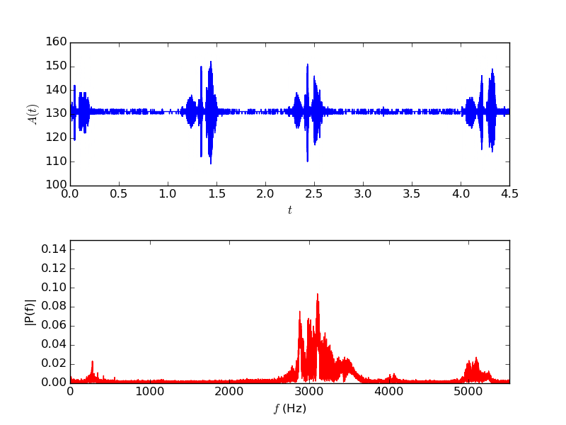
Original signal

Slide 36
Create highpass filter
Import signal processing package
Create IIR digital filter
…
import scipy.signal
…
fraction of Nyquist frequency
order of the filter
minimum attenuation
…
b, a = sp.signal.iirfilter(17, cutoff,
rs=min_attenuation,
btype='highpass',
analog=False,
ftype='cheby2')
…
filter type
IIR filter type
Notes:
The Nyquist frequency is half of the sampling rate of a discrete signal processing system.
Infinite impulse response (IIR) is a property applying to many linear time-invariant systems. Common examples of linear time-invariant systems are most electronic and digital filters. Systems with this property are known as IIR systems or IIR filters, and are distinguished by having an impulse response which does not become exactly zero past a certain point, but continues indefinitely. This is in contrast to a finite impulse response in which the impulse response h(t) does become exactly zero at times t > T for some finite T, thus being of finite duration.

Slide 37
Filter signal
Apply filter
Write signal to WAV file
…
base = np.uint8(np.mean(signal))
filtered_signal = sp.signal.filtfilt(b, a, signal)
wav_signal = base + np.array(filtered_signal, dtype=np.uint8)
…
…
wavfile.write(filtered_wav_file_name, sample_rate, wav_signal)
…

Slide 38
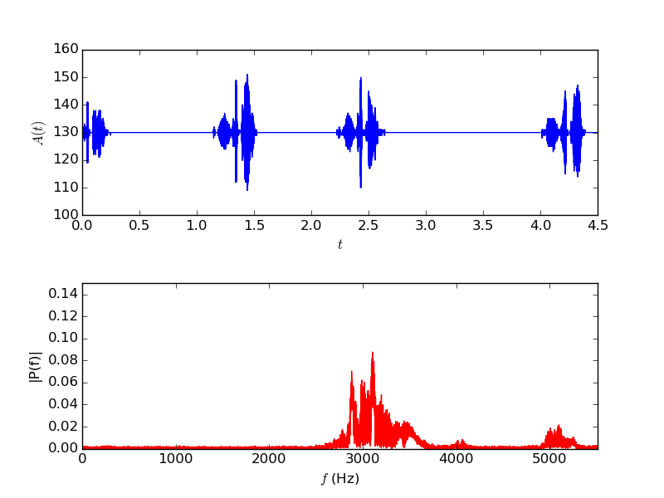
Filtered signal

Slide 39
Matplotlib
https://github.com/gjbex/Scientific-Python/tree/master/source-code/matplotlib

Slide 40
And some matplotlib…
Rich Python plotting library
scatter plot
line plot
bar plot/histogram
heatmap
3D surface plot
Highly customizable plots
LaTeX labels/annotation
Plot to screen, various file formats
Lots of features, this barely scratches the surface.
Convention: import matplotlib.pyplot as plt

Slide 41
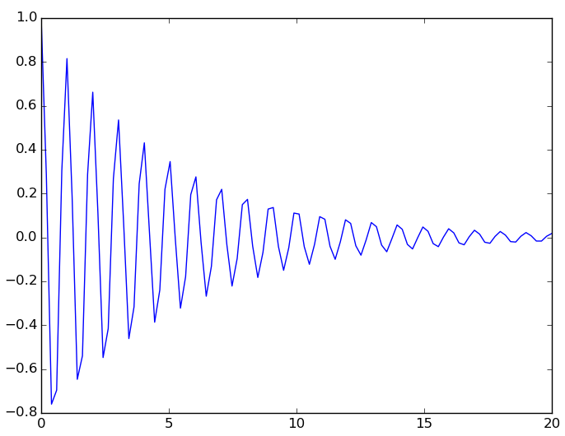
Simple line plot
Data: lists or numpy arrays
Add plot
Show plot
Save plot
x = np.linspace(0.0, 20.0, 500)
y = np.exp(-mu*x)*np.cos(2.0*np.pi*x)
plt.plot(x, y)
plt.show()
plt.savefig(file_name)

Slide 42
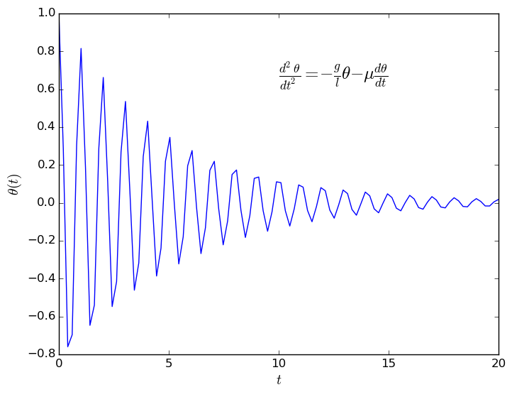
Axis labels, annotation
Add label for x and y axis
Add annotation
construct plot
≡
gradually enrich plt
plt.xlabel(r'$t$', fontsize=14)
plt.ylabel(r'$\theta(t)$', fontsize=14)
eq = (r'$\frac{d^2 \theta}{dt^2} = ' +
r'- \frac{g}{l} \theta ' +
r'- \mu \frac{d\theta}{dt}$')
plt.text(10.0, 0.65, eq, fontsize=18)
LaTeX notation, rendered

Slide 43
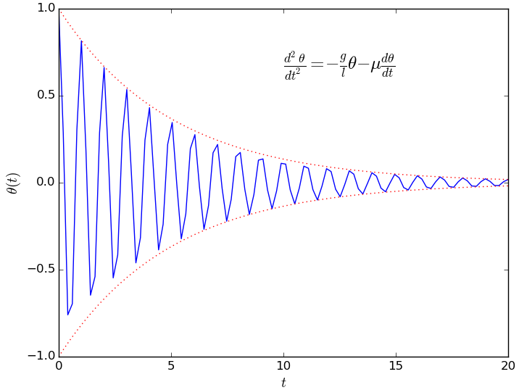
Multiple functions on line plot
Data
Add to plot, line style, color
y_plus = np.exp(-mu*x)
y_min = -np.exp(-mu*x)
plt.plot(x, y_plus,
':', alpha=0.8,
color='red',
linewidth=0.9)
plt.plot(x, y_min,
':', alpha=0.8,
color='red',
linewidth=0.9)
line type

Slide 44
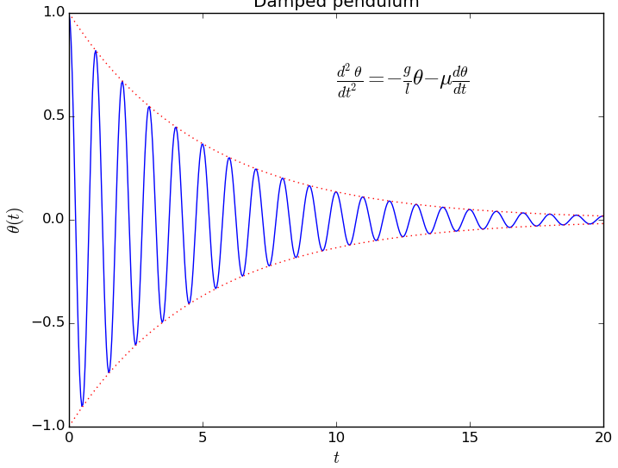
Complete line plot

Slide 45
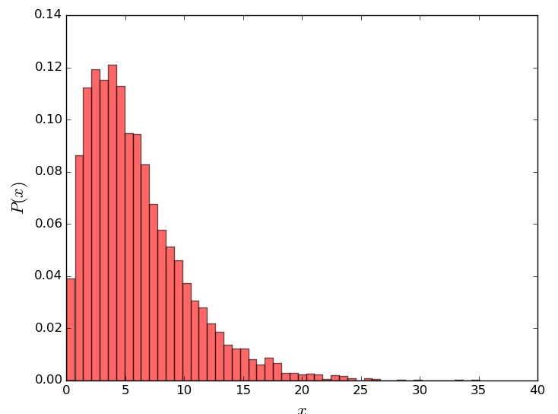
Histogram
13.3146868758
9.66243828428
6.44936354431
2.81183151337
9.55644862073
…
Data:
Plot histogram
values = np.loadtxt('data.txt')
bins = 50
data.txt
plt.hist(values, bins, normed=1,
color='red', alpha=0.6)
plt.xlabel('$x$', fontsize=16)
plt.ylabel('$P(x)$', fontsize=16)

Slide 46
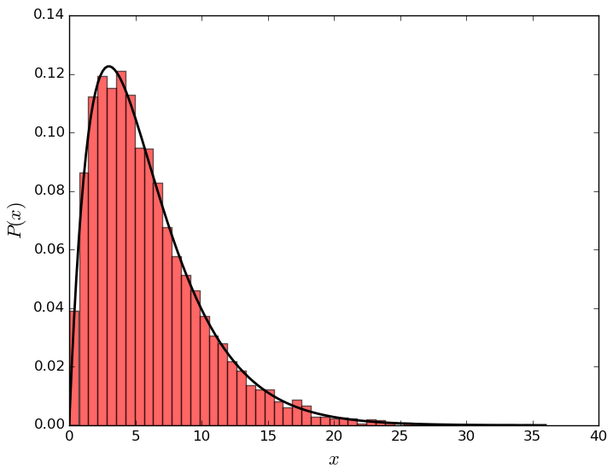
Line plot on histogram
Data:
Reminder
x = np.linspace(floor(np.min(values)), ceil(np.max(values)),
200)
y = sp.stats.gamma.pdf(x, 2, scale=3.0)
plt.plot(x, y, linewidth=2.0,
color='black')
import numpy as np
import scipy as sp
import scipy.stats
import matploblib.pyplot as plt

Slide 47
Heat map data
Function to plot
Data
def f(x, y, x0=0.0, freq=1.0, beta=0.5):
r = np.sqrt((x - x0)**2 + y**2)
return np.exp(-beta*r)*np.cos(2.0*np.pi*freq*r)
x = np.linspace(x_min, x_max, points)
y = np.linspace(y_min, y_max, points)
X, Y = np.meshgrid(x, y)
z = f(X, Y, x0=x0_1, freq=f_1) + f(X, Y, x0=x0_2, freq=f_2)

Slide 48
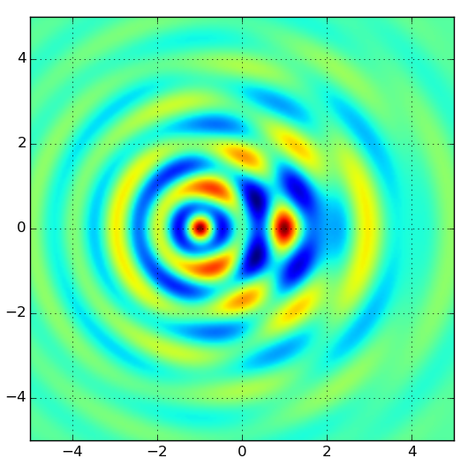
Heat map plot
Plot map
plt.imshow(z, extent=[x_min, x_max, y_min, y_max])
plt.grid(True)
Explore color maps, helps interpret data!
Brewer schemes

Slide 49
3D surface plot I
Importing extra modules
Plot
from mpl_toolkits.mplot3d import Axes3D
from matplotlib import cm
figure = plt.figure()
axes = figure.gca(projection='3d')
axes.set_xlim(x_min, x_max)
axes.set_ylim(y_min, y_max)
axes.set_zlim(z_min, z_max)
surface = axes.plot_surface(X, Y, z,
rstride=4, cstride=4,
cmap=cm.coolwarm,
linewidth=0)
figure.colorbar(surface)

Slide 50
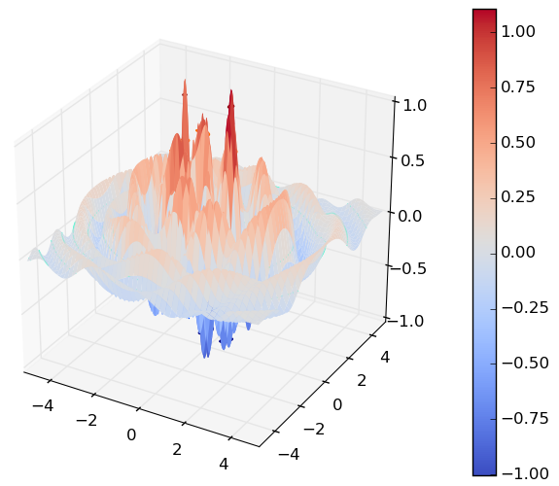
3D surface plot II

Slide 51
References
ColorBrewer 2.0: advice on choosing appropriate color maps http://colorbrewer2.org/
Coblis: color blindness simulator https://www.color-blindness.com/coblis-color-blindness-simulator/
Overview of data visualization types & libraries for Python https://python-graph-gallery.com/

Slide 52
Sympy
https://github.com/gjbex/Scientific-Python/tree/master/source-code/sympy

Slide 53
Introduction
sympy: library for computer algebra
symbolic computations
Features
linear algebra
vectors, matrices, tensors
solving linear sets of equations
eigenvalues/eigenvectors, SVD
…
calculus
computing derivatives, series expansions
limits
integrals (indeterminate/determinate)
…

Slide 54
Defining symbols
import sympy
Defining multiple symbols
Symbol with assumptions
real
rational
integer
positive/negative
Matrices
a, b, c, x = sympy.symbols('a b c x')
y = sympy.Symbol('y', positive=True)
A = sympy.Matrix([[x**2, x*y], [-x*y, y**2]])

Slide 55
Solving equations
Solve
Solve
sympy.solve(a*x**2 + b*x + c, x)
[ (-b + sqrt(-4*a*c + b**2))/(2*a),
-(b + sqrt(-4*a*c + b**2))/(2*a) ]
A = sympy.Matrix([[a, b], [c, d]])
X = sympy.Matrix([x, y])
B = sympy.Matrix([1, 0])
sympy.solve(A*X - B, X)
{ x: d/(a*d - b*c),
y: -c/(a*d - b*c) }

Slide 56
Eigenvalues, eigenvectors
multiplicity
eigen = A.eigenvects()
[(a/2 + d/2 - sqrt(a**2 - 2*a*d + 4*b*c + d**2)/2, 1, [Matrix([
[-b/(a/2 - d/2 + sqrt(a**2 - 2*a*d + 4*b*c + d**2)/2)],
[ 1]])]),
(a/2 + d/2 + sqrt(a**2 - 2*a*d + 4*b*c + d**2)/2, 1, [Matrix([
[-b/(a/2 - d/2 - sqrt(a**2 - 2*a*d + 4*b*c + d**2)/2)],
[ 1]])])]
v1, v2 = eigen[0][2][0], eigen[1][2][0]
sympy.simplify(v1.T*v2)
Matrix([[(-b + c)/c]])
if A is symmetric, eigenvectors are orthogonal

Slide 57
Derivatives
Define function
Derivative with respect to x
Derivative with respect to x and y
def f(x, y):
return a*x**2 + b*x*y + c*y**2 + d
sympy.diff(f(x, y), x)
2*a*x + b*y
sympy.diff(f(x, y), x, y)
b

Slide 58
Integration
Indefinite integral
Definite integral
Multiple integrals
sympy.integrate(f(x, y), x)
a*x**3/3 + b*x**2*y/2 + x*(c*y**2 + d)
from sympy import exp, sqrt, pi, oo
sympy.integrate(exp(-x**2/2)/sqrt(2*pi),
(x, -oo, oo))
1
sympy.integrate(f(x, y), (x, 0, 1), (y, 0, 2))
2*a/3 + b + 8*c/3 + 2*d

Slide 59
Limits and series expansion
Limit
Series expansion
sympy.limit(sin(x)/x, x, 0)
1
sympy.series(sin(x)/x, x, 0, n=6)
1 - x**2/6 + x**4/120 + O(x**6)
Use .removeO() when not required
Use .taylor_term() to get term of specific order

Slide 60
Expression representation
sympy expression = tree
from sympy import Add, Mul, Pow
Add(Mul(a, Pow(x, 2)), Mul(b, x), c)
Add
Mul
Mul
Symbol('c')
Symbol('a')
Pow
Symbol('b')
Symbol('x')
Symbol('x')
Integer(2)

Slide 61
Parts of expressions
Pow
Taking expression apart
Operator
Operands
expr = 1/(a*x + b)
Integer(-1)
Add
expr.func
Symbol('b')
Mul
sympy.core.power.Pow
Symbol('a')
Symbol('x')
expr.args
expr.args[0].args[0]
(a*x + b, -1)
b

Slide 62
Expression manipulation
Substitution
Factor, expand
Simplify
expr = x**2 + 2*a*x + y**2
expr.subs(y, a)
a**2 + 2*a*x + x**2
(x**2 + 2*x*y + y**2).factor()
((x + y)**2).expand()
(x + y)**2
x**2 + 2*x*y + y**2
x, y = symbols('x y', positive=True)
(log(x) + log(y)).simplify()
log(x*y)

Slide 63
Further reading
Sympy: symbolic computing in Python A. Muerer, C.P. Smith, M. Paprocki et al. PeerJ.CompSci

Slide 64
HDF5: PyTables & h5py
https://github.com/gjbex/Scientific-Python/tree/master/source-code/hdf5

Slide 65
HDF5: what is it?
System, OS, programming language independent way of storing data
Hierarchical Data Format
Abstract data model
File
Group
Dataset
Data type
Attribute
Storage model
File system
Directory
File
Metadata
Documentation, comments in data file itself, self contained

Slide 66
HDF5 data
Data stored in dataset as n-dimensional arrays
Dataspace describes layout of data (rank,dimensions)
Datatype describes single data element
Atomic
Integer, float
String, time
Opaque
Composite
Compound
Enumeration
Array
Variable length
Partial read/writes, hyperslab selection
Data layout & type description part of HDF5 file:
self-documenting
discovery!

Slide 67
HDF5 storage
Filtering
Compression
Error detection
Datasets can be extended
Storage drivers
Single file
Multiple files
Multiple files on parallel file system
Memory

Slide 68
HDF5: how to use it?
C/C++
Fortran 90
Java
Python
PyTables, h5py
HDF5 file can be read by program in any language
Not so easy in C/C++/Fortran, fairly trivial in Python

Slide 69
h5py: importing modules
To work with HDF5 files
import h5py
if necessary (almost certainly), import numpy
…
import h5py
import numpy as np
…

Slide 70
h5py: open & close HDF5 file
file name
Create new HDF5 file (w for write)
Open HDF5 file for modification (a for append)
Open HDF5 file for reading (r for read)
Close file
Preferred alternative
h5file = h5py.File('data.h5', mode='w')
h5file = h5py.File('data.h5', mode='a')
h5file = h5py.File('data.h5', mode='r')
h5file.close()
with h5py.File('data.h5', 'w', '…') as h5file:
…

Slide 71
h5py: creating a group
group name
Groups start in root
Creating a subgroup
input_group = h5file.create_group('input')
field_group = input_group.create_group('fields')
≡
field_group = h5file.create_group('/input/fields')

Slide 72
h5py: adding a dataset
Use numpy arrays
Add it to HDF5 file
magn_field = lambda x, y: x**2 + 2*x*y
X, Y = np.meshgrid(np.linspace(-1.0, 1.0, x_dim), np.linspace(-1.0, 1.0, y_dim))
field_values = magn_field(X, Y)
array location in hierarchy
dataset name
field = field_group.create_dataset('magnetic', field_values.shape, field_values.dtype)
field[:, :] = field_values[:, :]
h5file.flush()
dataspace

Slide 73
h5py: adding an 2D array
Create numpy array
Add array
position_values = np.random.normal(scale=10.0, size=(20, 2))
positions = h5file.create_dataset('/coords/positions'
position_values.shape,
dtype=np.float32)
Positions[:, :] = position_values[:, :]
h5file.flush()

Slide 74
h5py: annotations
Adding a unit annotation to array
Adding annotation to a group
attrs behave mostly like Python dictionaries, to set, get, remove an annotation
iterator over attribute names:
field_group.magnetic.attrs['units'] = 'mT'
field_group.attrs['warning'] = 'do not modify'
field_group.attrs.keys()

Slide 75
h5py: reading an array
Read entire dataset, i.e., array
Read slice
Read non-consecutive data
magn_field = h5file['input/fields/magnetic'] print(np.average(magn_field))
pos = h5file['/coords/positions'][3:7, :]
read x- and y-coordinates of 4 particles
indices = [2, 4, 6]
pos = h5file['/c0ords/positions'][indices, :]
read x- and y-coordinates of 3rd, 5th, and 7th particle
Hyperslabs!

Slide 76
HDF5 command line utilities
h5dump
Print a textual representation of HDF5 file
h5ls
Explore structure of HDF5 file
h5copy
Copy data set from one HDF5 file to another
h5mkgrp
Create a group in an HDF5 file
h5cc/h5c++/h5fc
Compile wrappers
With -showconfig shows library features

Slide 77
PyTables: importing modules
To work with HDF5 files
import tables
if necessary (usually not, unless when using compounds), import specific functions, classes
if necessary (almost certainly), import numpy
Fairly slow, nice implementation
…
import tables
from tables import Int32Col, Float64Col
import numpy as np
…

Slide 78
PyTables: open & close HDF5 file
file name
Create new HDF5 file (w for write)
Open HDF5 file for modification (a for append)
Open HDF5 file for reading (r for read)
Close file
Preferred alternative
h5file = tables.open_file('data.h5', mode='w', 'simulation input and results')
title
h5file = tables.open_file('data.h5', mode='a')
h5file = tables.open_file('data.h5', mode='r')
h5file.close()
with tables.open_file('data.h5', 'w', '…') as h5file:
…

Slide 79
PyTables: creating a group
group location in hierarchy
group name
Groups start in root
Creating a subgroup
input_group = h5file.create_group(h5file.root, 'input',
'input data')
≡
comment
input_group = h5file.create_group('/', 'input',
'input data')
field_group = h5file.create_group(input_group, 'fields',
'various fields')
≡
field_group = h5file.create_group('/input', 'fields',
'various fields')

Slide 80
PyTables: adding an array
Use numpy arrays
Add it to HDF5 file
magn_field = lambda x, y: x**2 + 2*x*y
X, Y = np.meshgrid(np.linspace(-1.0, 1.0, x_dim), np.linspace(-1.0, 1.0, y_dim))
field = magn_field(X, Y)
array location in hierarchy
array name
h5file.create_array(field_group, 'magnetic', field,
'static magnetic field')
h5file.flush()
comment
array

Slide 81
PyTables: adding an 2D array
Create numpy array
Add array
positions = np.random.normal(scale=10.0, size=(20, 2))
h5file.create_array('/coords', 'positions', positions,
'particle positions', createparents=True)
h5file.flush()

Slide 82
PyTables: reading an array
Read entire dataset, i.e., array
Read slice
Read non-consecutive data
magn_field = h5file.root.input.fields.magnetic print(np.average(magn_field))
pos = h5file.root.coords.positions[3:7, :]
read x- and y-coordinates of 4 particles
indices = [2, 4, 6]
pos = h5file.root.coords.positions[indices, :]
read x- and y-coordinates of 3rd, 5th, and 7th particle
Hyperslabs!

Slide 83
PyTables: annotations
Adding a unit annotation to array
Adding annotation to a group
attrs, _v_attrs behave mostly like Python dictionaries, to set, get, remove an annotation
list of attributes:
field_group.magnetic.attrs['units'] = 'mT'
field_group._v_attrs['warning'] = 'do not modify'
field_group._f_list('user')

Slide 84
PyTables: objects & tables
Define class
Create table
from tables import IsDescription, Int32Col, Float64Col
class Particle(IsDescription):
particle_id = Int32Col()
mass = Float64Col()
x_pos = Float64Col()
y_pos = Float64Col()
x_vel = Float64Col()
y_vel = Float64Col()
initial_state = h5file.create_table( '/', 'particles', Particle, 'initial state of particles' )

Slide 85
PyTables: populate table
Add new particles
particle = h5file.root.particles.row
for particle_id in range(100):
particle['particle_id'] = particle_id
particle['mass'] = random.gauss(0.0, 1.0)
particle['x_pos'] = random.gauss(0.0, 1.0)
particle['y_pos'] = random.gauss(0.0, 1.0)
particle['x_vel'] = random.gauss(0.0, 1.0)
particle['y_vel'] = random.gauss(0.0, 1.0)
particle.append()
h5file.flush()
append particles one by one, unlimited (except by disk space)

Slide 86
PyTables: reading a table
Compute center of mass
x, y = 0.0, 0.0 mass = 0.0
for particle in h5file.root.particles: mass += particle['mass']
x += particle['mass']*particle['x_pos']
y += particle['mass']*particle['y_pos'] x /= mass y /= mass

Slide 87
Bokeh
https://github.com/gjbex/Scientific-Python/tree/master/source-code/bokeh

Slide 88
What is it?
Plot library
Easy to use
Integrates with Pandas
Interactive demos in jupyter notebooks
Export to HTML pages, interactive plots using Javascript
Reasonable support LaTeX labels
More oriented towards information visualization

Slide 89
Simple plot
import required functions
from bokeh.plotting import figure, output_file, show
…
x = np.linspace(0.0, 20.0, 500)
y = np.exp(-mu*x)*np.cos(2.0*np.pi*x)
y_plus = np.exp(-mu*x)
y_min = -np.exp(-mu*x)
…
output_file('plot.html', title='damped pendulum')
fig = figure(title='damped pendulum',
x_axis_label='t', y_axis_label='theta')
fig.line(x, y)
fig.line(x, y_min, line_color='red', line_width=0.6,
line_dash=(2, 2))
fig.line(x, y_plus, line_color='red', line_width=0.6,
line_dash=(2, 2))
show(fig)
set output file
create figure
plot data
create file

Slide 90
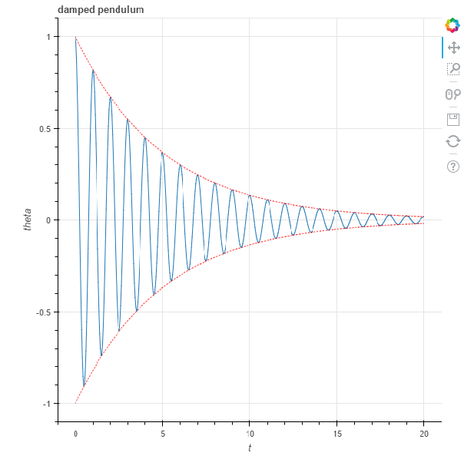
HTML file
pan tool
box zoom
wheel zoom
save image
reset
Interactive in web browser!

Slide 91
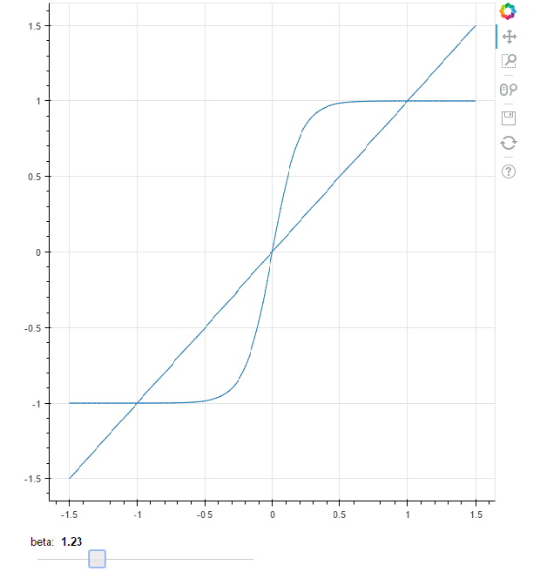
HTML file with widget
Required: callback function
• modifies data
• triggers update
• involves Javascript tinkering
interactive slider

Slide 92
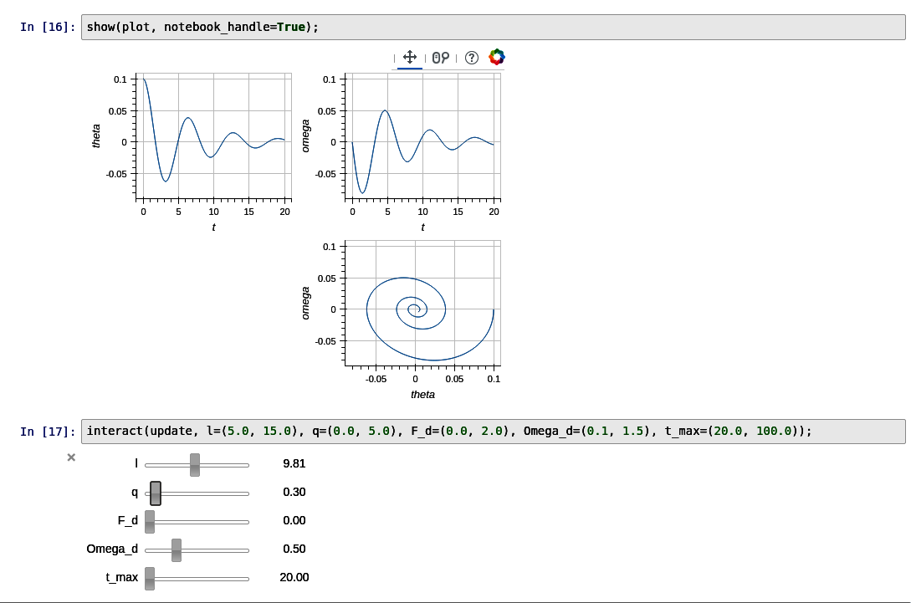
Linked figures
linked figures for
• panning, zooming
• interactive settings

Slide 93
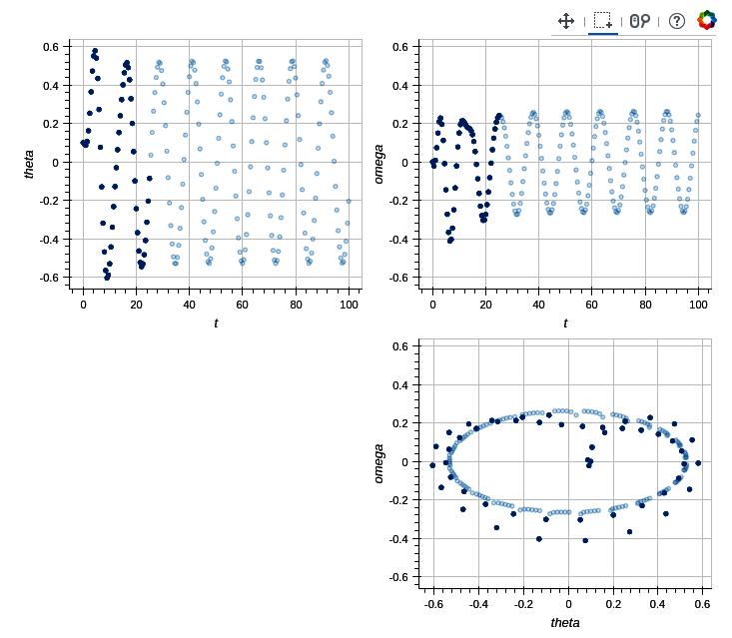
Linked brushing
consistent selection

Slide 94
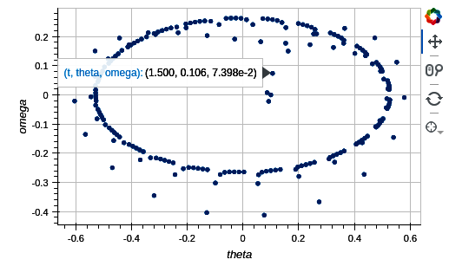
Hover tool
hover for details
Any information can be added

Slide 95
Image & video processing
https://github.com/gjbex/Scientific-Python/tree/master/source-code/image-processing

Slide 96
Image & video processing
Use dedicated software, e.g., GIMP, OpenShot
use Python for plugins
use Python for scripting
Image processing
pillow: basic image processing (successor to PIL)
scikit-image: more sophisticated algorithms
OpenCV: comparable to scikit-image
Video processing
OpenCV: many useful algorithms

Slide 97
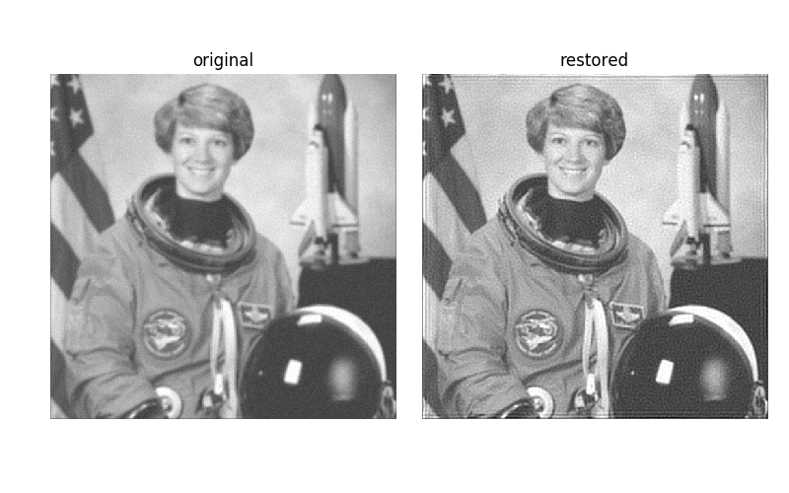
Image restoration
Define point spread function
Perform deconvolution
point_spread_f = np.ones((5, 5))/25.0
from skimage.restoration import unsupervised_wiener
…
denoised, _ = unsupervised_wiener(img, point_spread_f)
3D numpy array, RGB
For image I/O: skimage.io

Slide 98
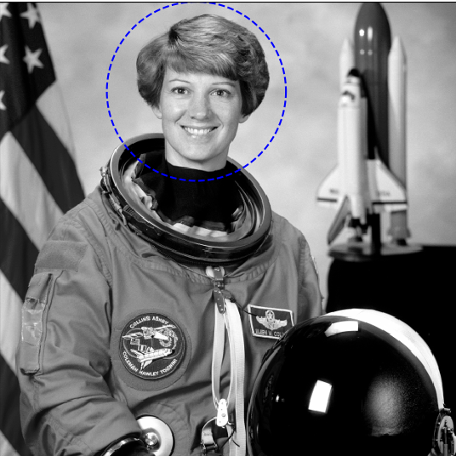
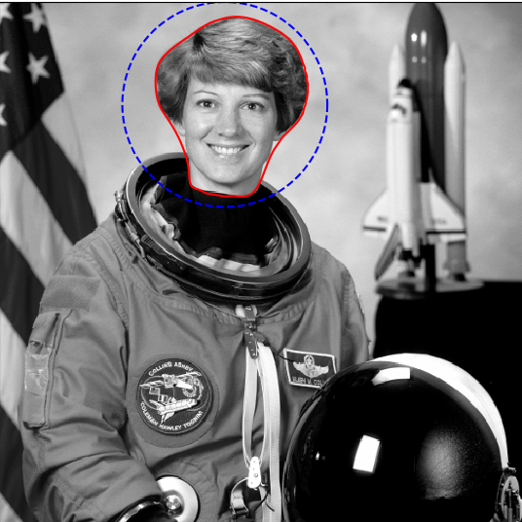
Segmentation
Define initial contour
Compute snake
theta = np.linspace(0, 2*np.pi, n)
x = x0 + radius*np.cos(theta)
y = y0 + radius*np.sin(theta)
initial_snake = np.array([x, y]).T
from skimage.segmentation import active_contour
snake = active_contour(smoothed_image, initial_snake,
alpha=alpha, beta=beta,
gamma=gamma)
from skimage.filters import Gaussian
smoothed_image = gaussian(image, 3)

Slide 99
Capturing video
Capture from camera, show in window
import cv2
capture = cv2.VideoCapture(0)
while True:
status, frame = capture.read()
if not status:
# oops
…
cv2.imshow('frame', frame)
if cv2.waitKey(1) & 0xFF == ord('q'):
break
cv2.destroyAllWindows()
capture.release()
device number
3D numpy array, BGR
quit on 'q'

Slide 100
Reading/writing video
Reading from my_video.avi
Writing to my_video.avi
capture = cv2.VideoCapture('my_video.avi')
video encoding
fourcc = cv2.VideoWriter_fourcc(*'XVID')
writer = cv2.VideoWriter('my_video.avi', fourcc,
frames_per_second,
(width, height))
for frame in frames:
writer.write(frame)
writer.release()

Slide 101
Follow the ball: setup
Hue histogram of ROI (region of interest)
status, frame = capture.read()
track_window = (x, y, width, height)
hsv_frame = cv2.cvtColor(frame, cv2.COLOR_BGR2HSV)
mask = cv2.inRange(hsv_frame,
np.array((min_hue, 50, 50)),
np.array((max_hue, 255, 255)))
roi_hist = cv2.calcHist([hsv_frame], [0],
mask, [max_hue], [0, max_hue])
cv2.normalize(roi_hist, roi_hist, 0, 255, cv2.NORM_MINMAX)
only histogram for hue on ROI
HSV = Hue, Saturation, Value
determines color

Slide 102

Follow the ball
Read frames and update track window
termin_cond = (cv2.TERM_CRITERIA_EPS | cv2.TERM_CRITERIA_COUNT,
iterations, pixels)
while True:
status, frame = capture.read()
hsv = cv2.cvtColor(frame, cv2.COLOR_BGR2HSV)
back_proj = cv2.calcBackProject([hsv], [0], roi_hist, [0, max_hue], 1)
status, track_window = cv2.meanShift(back_proj, track_window,
termin_cond)

Slide 103
Further reading
Success depends on understanding algorithms!
Many things to explore
Check out
https://scikit-image.org/docs/stable/
https://docs.opencv.org/4.x/d6/d00/tutorial_py_root.html

