Slide 1


Workflows for HPC
Geert Jan Bex
(geertjan.bex@uhasselt.be)
License: this presentation is released under the Creative Commons CC BY 4.0, see https://creativecommons.org/licenses/by/4.0/deed.ast

Slide 2

http://bit.ly/33Vx1T9

Slide 3


Slide 4
Typographical conventions I
Inline code fragments and file names are rendered as, e.g., hello_world.py
Longer code fragments are rendered as
Data files are rendered as
#!/usr/bin/env python
…
if __name__ == '__main__':
print('hello world!')
case dim temp
1 1 -0.5
2 1 0.0
3 1 0.5
4 2 -0.5
…
fragment not shown

Slide 5





Typographical conventions II
Shell commands are rendered as
Do not type $, it represents your shell prompt!
Good practice:
Bad practice:
(Potential) hazards/bugs:
Performance issue:
Warning:
$ python –m doctest data_parsing.py

Slide 6
Introduction
Work needs to done at given time(s)
"Computation" consist of (many) steps
Long-running computations
Multiple scenarios based on parameters
Work must be reproducible
Simultaneous tasks with different requirements
Many tools, but what to pick?

Slide 7
Scheduling single tasks

Slide 8
Motivation
Characteristics
Non-interactive
Execute task at specified time once
Locally
As batch job
Use cases
Unattended copy/download
Containers: image generation
Unattended software builds/tests

Slide 9
Run once on local machine/login node
Use at command to execute task (if installed)
Just once
In background
At specified time
$ at 22:00
at> rsync -a \
at> vsc30001@login.hpc.kuleuven.be:/data/leuven/300/vsc30001/results \
at> /home/gjb/work/
at> <crtl-d>
$
$ at -f copy_results.sh 22:00

Slide 10
at times
HH:MM or HHMM
HH:MM YYYY-mm-dd
Special times
now
noon
teatime
midnight
Delta
now + 10 minutes
midnight + 3 days

Slide 11
Run once as batch job
Use --begin for sbatch
Times
HH:MM
YYYY-mm-ddTHH:MM
Special times
now
noon
teatime
midnight
Deltas
now+10minutes
midnight+3days
$ sbatch --begin=now+4hours my_job.slurm
If job is eligible!

Slide 12
More on scheduling single tasks
at https://phoenixnap.com/kb/linux-at-command
sbatch: see Slurm documentation https://slurm.schedmd.com/sbatch.html

Slide 13
Recurring tasks

Slide 14
Motivation
Characteristics
Non-interactive
Execute task at regular intervals
Locally
As batch job
Use cases
Unattended daily copy/download
Containers: image generation
Unattended software builds/tests
Version control repository status check
Process the day's data

Slide 15
Run regularly on local machine/login node
Use crontab command to schedule task
Regularly
In background
At specified intervals
List tasks
Add/modify/remove tasks
Remove all tasks
$ crontab -l
$ crontab -e
$ crontab -r

Slide 16
Crontab tasks
Edit in $EDITOR
Every day at 04:12
crontab -e: edit file
SCRIPT_DIR = /user/leuven/300/vsc30001/scripts
12 04 * * * $SCRIPT_DIR/backup_results.sh
33 03 * * Sun $SCRIPT_DIR/download_data.sh
Every Sunday at 03:33
Day of week (0–7 or names)
Command(s)
Month (1–12 or names)
Day of month (1–31)
* = any value
Hour (0–23)
Minutes (0–59)
No variable expansion in variable definitions!!!

Slide 17
Mail notifications
Define the MAILTO variable
Standard output
Standard error
MAILTO = geertjan.bex@uhasselt.be
31 08 * * * squeue --clusters=all --user=vsc30001
Every day at 08:31

Slide 18
Run regularly as batch job
Use scrontab, similar to crontab
Next job scheduled after completion current job
Cancel job to end sequence
SCRIPT_DIR = /user/leuven/300/vsc30001/scripts
#SCRON --account=lpt2_sysadmin
#SCRON --mem=5G
#SCRON --time=00:15:00
32 22 05 * * /user/leuven/301/vsc30140/jobs/update_hpccm.sh
#SCRON --account=lpt2_sysadmin
#SCRON --mem=5G
#SCRON --time=01:30:00
#SCRON --mail-user=geertjan.bex@uhasselt.be --mail-type=END,FAIL
32 03 06 * * /user/leuven/301/vsc30140/jobs/update_gpu_env.sh
Every 5th day of the month at 22:32
Every 6th day of the month at 03:32
Only works on default cluster (no support for --cluster)

Slide 19
More on recurrent tasks
crontab https://ostechnix.com/a-beginners-guide-to-cron-jobs/
scrontab: see Slurm documentation https://slurm.schedmd.com/scrontab.html

Slide 20
Sequential tasks: job dependencies

Slide 21
Motivation
Characteristics
Non-interactive
Execute tasks with dependencies
Potential inefficient resource usage
Use cases
Preprocess/process/postprocess
Aggregate results

Slide 22
Problem example
resources
Preprocess
process
Wasted resources
Post-preprocess
time

Slide 23
Solution: job dependencies
preprocess.slurm
Dependency types
afterok
afternotok
afterany
Depends on job ID(s)
Combinations of dependencies
Logical and: ,
Logical or: ?
dependency
process.slurm
Determined by exit status
dependency
postprocess.slurm
Jobs accrue priority, start as soon as possible

Slide 24
Submit workflow
$ PRE_ID=$(sbatch preprocess.slurm | grep -oP '\b\d+\b')
$ PROC_ID=$(sbatch --dependency=afterok:$PRE_ID process.slurm | grep -oP '\b\d+\b')
$ sbatch --dependency=afterok:$PROC_ID postprocess.slurm
In shell scripts, use set -e

Slide 25
Aside: exit status
Each command has exit status
0: executed successfully
1–255: something failed
Stored in $?
$ ls bla
ls: cannot access 'bla': No such file or directory
$ echo $?
2
result=$(( $alpha + $beta + $gamma ))
status=$?
# if the computation succeeded, write output
if [[ $status -eq 0 ]]
then
echo "$alpha,$beta,$gamma,$result" > "out-${SLURM_ARRAY_TASK_ID}.txt"
status=$?
fi
…

Slide 26
More sophisticated example
download_db.slurm
copy_backup_db.slurm
503
504
preprocess_1.slurm
preprocess_2.slurm
-d=afternotok:503
stage_db.slurm
501
502
505
process_1.slurm
process_2.slurm
-d=afterok:503?afterok=504
506
507
-d=afterok:501:502
-d=afterany:502,afterok:505
postprocess.slurm
Note: workflow == DAG
-d=afterok:506:507
508

Slide 27
Dangling jobs
download_db.slurm
copy_backup_db.slurm
Job remains queued: pending
√
503
504
-d=afternotok:503
Don't forget to
clean up!
stage_db.slurm
...
√
505
-d=afterok:503?afterok=504

Slide 28
Clean up dangling jobs
$ squeue --cluster=all
CLUSTER: wice
JOBID PARTITION NAME USER ST TIME NODES NODELIST(REASON)
504 batch copy_bac vsc30001 PD 0:00 1 (DependencyNeverSatisfied)
clean_up.sh
#!/usr/bin/env bash
job_ids= $(squeue --cluster=all -t PD | \
grep DependencyNeverSatisfied | \
grep -oP '^\s+(\d+)\b')
for job_id in
do
scancel --cluster=all $job_id
echo job $job_id cancelled
done

Slide 29
More on sequential tasks & job dependencies
See Slurm documentation https://slurm.schedmd.com/sbatch.html

Slide 30
Data staging

Slide 31
Motivation
Characteristics
Data is non-local
Data stage-in or stage-out as part of process
Use cases
Data produced by laboratory equipment
Data in repository/online service

Slide 32
Solutions
Copy data between Linux systems/directories
rsync
Copy data to/from Tier-1 Data
Globus CLI/iRODS
Download data from web
wget
cURL
Use REST API
cURL
Copy data to cloud services
rclone
Data version control
DVC
Make sure you tokens are safe!!!

Slide 33
More on data staging
rsync https://www.tecmint.com/rsync-local-remote-file-synchronization-commands/
Tier-1 Data https://docs.vscentrum.be/data/tier1_data_service.html
cURL https://www.linode.com/docs/guides/curl-for-rest-api/
DVC https://dvc.org/doc
rclone https://rclone.org/docs/
Globus CLI https://docs.globus.org/cli/

Slide 34
Checkpointing

Slide 35
Motivation
Characteristics
Non-interactive
Execute application that exceeds maximum walltime
Use cases
Applications that checkpoint
Non-HPC applications

Slide 36
Problem example
time
Maximum walltime
Computation
Job cancelled
No or partial results!

Slide 37
Solution: checkpointing
Periodically safe application state
Restart from last saved state unless done
Either
Application support (ideal situation)
Distributed MultiThreaded CheckPointing (DMTCP)
time
Maximum walltime
Maximum walltime
Maximum walltime
Computation
Computation
Computation
Job ends
Safe state
Job cancelled
Developers: make your applications checkpoint!

Slide 38
DMTCP checkpointing
All jobs schedule follow-up job
matrix_increment.slurm
…
follow_up_job_id=$( \
sbatch --dependency=afternotok:$SLURM_JOB_ID matrix_increment.slurm \
| grep -oP '\b\d+\b' \
)
if [[ ! -e ./dmtcp_restart_script.sh ]]
then
dmtcp_launch --interval $CKPT_INTERVAL --checkpoint-open-files \
python matrix_increment.py --nr_rows $NR_ROWS \ --nr_cols $NR_COLS --max_iters $MAX_ITERS else
./dmtcp_restart_script.sh
fi
scancel --cluster=$SLURM_CLUSTER_NAME $follow_up_job_id
First job only
All follow-up jobs
Last job only

Slide 39
DMTCP features
Can checkpoint and restart
Single threaded application
Multithreaded applications
MPI applications
Checkpoint can keep track of
Open files
Set a maximum number of restarts

Slide 40
More on checkpointing
See DMTCP documentation https://dmtcp.sourceforge.io/

Slide 41
Parallel tasks

Slide 42
Motivation
Characteristics
Non-interactive
Execute many independent, similar tasks
Potential inefficient resource usage
Use cases
Parameter exploration
Processing many files

Slide 43
Problem example
data_002.dat
result_002.txt
data_001.dat
result_001.txt
data_003.dat
result_003.txt
...
...
data_199.dat
result_199.txt
data_200.dat
result_200.txt
data_*.dat → result_*.txt
Independent tasks!

Slide 44
Solution: GNU parallel in script
create_movie.sh
…
MAX_BETA=50
BETA_FILE=beta.txt
IMG_DIR=images/
mkdir -p $IMG_DIR
parallel --max-procs 4 --arg-file $BETA_FILE \
./create_plot.py --output_dir $IMG_DIR --beta {}
ls $IMG_DIR/*.png | parallel --max-procs 4 \
convert {} {.}.gif
…
Number tasks in parallel
Input from file
Input value
Input via pipe
Input value

Slide 45
GNU parallel substitutions
{}: line of input
{.}: line of input without extension
{/}: line of input basename
{/.}: line of input basename without extension
{//}: line of input dirname
{#}: sequence number
{%}: slot number (cfr. --max-procs)
{= Perl expr =}: evaluate Perl expression on input line ($_)

Slide 46
GNU parallel multiple input sources
Use
::: for list of values
:::+ for list of values linked to previous input
:::: for file (or -a file name)
::::+ for file linked to previous input (or -a file name and --link)
Don't forget to
link!
compute.sh
compute.sh
parallel --max-procs 10 \
python compute.py --x {1} --y {2} \
::::+ arg1.txt \
::::+ arg2.txt \
> result.txt
parallel --max-procs 10 \
-a arg1.txt -a arg2.txt \
--link \
python compute.py --x {1} --y {2} \
> result.txt

Slide 47
GNU parallel multiple values
Values in CSV file: use --colsep
compute_single_column.sh
3,13
5,11
7,7
11,5
13,3
parallel \
--max-procs 2 \
--csv \
python compute.py --x {1} --y {2} \
:::: args.csv \
> result_single_column.txt
args.csv

Slide 48
GNU parallel & failures
Use --joblog file name
Resume unfinished tasks with --resume --joblog file name
Resume failed tasks with --resume-failed --joblog file name
Fix issue first

Slide 49
Solution: run parallel as job arrays
process_batch.slurm
#!/usr/bin/env -S bash -l
#SBATCH --account=lpt2_sysadmin
#SBATCH --cluster=wice
#SBATCH --time=00:05:00
max_id=$(( $SLURM_ARRAY_TASK_ID + $SLURM_ARRAY_TASK_STEP - 1 ))
for id in $(seq $SLURM_ARRAY_TASK_ID $max_id)
do
file_nr=$(printf "%03d" $id)
input_file="input/data_${file_nr}.dat"
output_file="output/result_${file_nr}.txt"
./process.py --input_file "$input_file" --output_file "$output_file"
done
Resources for individual job
$ sbatch --array=1-200:50 process_batch.slurm
SLURM_ARRAY_TASK_COUNT == 4
SLURM_ARRAY_TASK_ID ← 1, 51, 101, 151

Slide 50
Job array execution
data_001.dat
data_050.dat
data_051.dat
data_100.dat
data_151.dat
data_200.dat
...
...
...
Job 523_1
Job 523_51
...
Job 523_151
result_001.txt
result_050.txt
result_051.txt
result_100.txt
result_151.txt
result_200.txt
...
...
...
Can, but need not run at same time!

Slide 51
Job array indices
--array=5-18
SLURM_ARRAY_TASK_MIN == 5
SLURM_ARRAY_TASK_MAX == 18
SLURM_ARRAY_TASK_STEP == 1
SLURM_ARRAY_TASK_COUNT == 14
SLURM_ARRAY_TASK_ID ← 5, ..., 18
--array=5-18:3
SLURM_ARRAY_TASK_MIN == 5
SLURM_ARRAY_TASK_MAX == 17
SLURM_ARRAY_TASK_STEP == 3
SLURM_ARRAY_TASK_COUNT == 5
SLURM_ARRAY_TASK_ID ← 5, 8, .., 17
--array=5,9,14
SLURM_ARRAY_TASK_MIN == 5
SLURM_ARRAY_TASK_MAX == 14
SLURM_ARRAY_TASK_STEP == 1
SLURM_ARRAY_TASK_COUNT == 3
SLURM_ARRAY_TASK_ID ← 5, 9, 14
--array=5,9-18:3
SLURM_ARRAY_TASK_MIN == 5
SLURM_ARRAY_TASK_MAX == 18
SLURM_ARRAY_TASK_STEP == 3
SLURM_ARRAY_TASK_COUNT == 5
SLURM_ARRAY_TASK_ID ← 5, 9, 12,...,18

Slide 52
Limits on parallel array execution
Array size limited by Slurm configuration:
SLURM_ARRAY_TASK_COUNT < MaxArraySize
SLURM_ARRAY_TASK_COUNT < MaxSubmitPU
User limit on running jobs: --array=1-150%5
$ scontrol show config | grep MaxArraySize
MaxArraySize = 1001
$ sacctmgr show qos normal format=Name,MaxSubmitPU
Name MaxSubmitPU
---------- -----------
normal 150
Maximum simultaneous jobs

Slide 53
Job dependencies & arrays
Start after successful completion of all array jobs 553[1-150] --dependency=afterok:553
Chain array job after array jobs 553[1-150] --dependency=aftercorr:553
R
R
Pd
Job 553_1
Job 553_1
Job 554_1
R
Pd
R
Pd
Job 553_2
Job 554_2
R
Job 553_2
Job 554
...
...
...
Job 553_150
Pd
Job 553_150
Pd
Job 554_150
Pd

Slide 54
More on task parallelism
See GNU parallel tutorial https://www.gnu.org/software/parallel/parallel_tutorial.html
See Slurm job array documentation https://slurm.schedmd.com/job_array.html

Slide 55
Parallel tasks simplified: atools

Slide 56
Motivation
Characteristics
Non-interactive
Execute many independent, similar tasks
Potential inefficient resource usage
Potential failures of tasks
Use cases
Parameter exploration
Processing many files
Job arrays: you do the bookkeeping
Parameter exploration?
What succeeded/failed?
Data aggregation?

Slide 57
Problem example
temperature | pressure | humidity
293.0 | 1.0e05 | 87
… | … | …
313.0 | 1.3e05 | 75
#!/bin/bash –l
#SBATCH –-nodes=2 -–ntasks-per-node=36 --time=00:15:00
mpirun weather –p 1.0e05 –t 293.0 –h 87
job_01.slurm
#!/bin/bash –l
#SBATCH –-nodes=2 -–ntasks-per-node=36 --time=00:15:00
mpirun weather –p 1.003e05 –t 293.3 –h 67
job_30.slurm
…
Many multinode computations
#!/bin/bash –l
#SBATCH –-nodes=2 -–ntasks-per-node=36 --time=00:15:00
mpirun weather –p 1.3e05 –t 313.0 –h 75
job_60.slurm
…

Slide 58
Solution: aenv
temperature | pressure | humidity
293.0 | 1.0e05 | 87
… | … | …
313.0 | 1.3e05 | 75
data.csv
#!/bin/bash –l
#SBATCH –-nodes=2 –ntasks=36 -time=00:15:00
module load atools
source <(aenv --data data.csv)
mpirun weather –p $pressure –t $temperature \
–h $humidity
job.slurm
$ module load atools
$ array_ids=$(arange --data data.csv)
$ sbatch –array=${array_ids} job.slurm

Slide 59
Data exploration: steps
Write Slurm script with parameters
add line to initialize parameters: aenv
Create Excel sheet with data
Convert to CSV format
Submit with sbatch --array=… …

Slide 60
And MapReduce?
Supported through scheduler → job dependencies
$ array_ids=$(arange --data data.csv)
$ prolog_id=$(sbatch --parsable prolog.slurm | \
cut –d ‘;’ –f 1)
$ batch_id=$(sbatch --dependency=afterok:${prolog_id} \
--parsable --array=${array_ids} \
job.slurm | \
cut -d ‘;’ –f 1)
$ sbatch --dependency=afterok:${batch_id} epilog.slurm

Slide 61
Job dependencies
data.txt.1
job.slurm
result.txt.1
data.txt.2
job.slurm
result.txt.2
data.txt
result.txt
prolog.slurm
epilog.slurm
…
…
data.txt.7
job.slurm
result.txt.7

Slide 62
Logging
Logging for
bookkeeping: success/failures?
redo failures
performance analysis
Scheduler provides logs
inconvenient
not always user-accessible

Slide 63
Logging: alog
#!/bin/bash –l
#SBATCH –-nodes=2 –ntasks=72
module load atools
source <(aenv --data data.csv)
alog --state start mpirun weather –p $pressure –t $temperature \
–h $humidity
alog --state end --exit $?
job.slurm
1 started by r1i1n3 at 2016-09-02 11:47:45
2 started by r1i1n3 at 2016-09-02 11:47:45
3 started by r1i1n3 at 2016-09-02 11:47:46
2 failed by r1i1n3 at 2016-09-02 11:47:46: 1
3 completed by r1i1n3 at 2016-09-02 11:47:47
…
job.slurm.log145485

Slide 64
Monitoring: arange
For running or finished job
$ arange --data data.csv \
--log job.slurm.log145485 \ --summary

Slide 65
Resuming jobs: arange again
Resume a job that hit the walltime
Redo failed work items
$ array_ids=$(arange --data data.csv \
--log job.slurm.log145485)
$ sbatch --array=${array_ids} --time=5:00:00 \
job.slurm
Fix issue first
$ array_ids=$(arange --data data.csv \
--log job.slurm.log145485 \
--redo)

Slide 66
Adapting Slurm files: acreate
Automatically adapt Slurm file for atools
only logging
logging and using aenv
$ acreate job.slurm > job_atools.slurm
$ acreate --data data.csv \
job.slurm > job_atools.slurm

Slide 67
Simple aggregations: areduce
Almost automatic data aggregation:
Takes care of
missing files (failed items)
incomplete data (failed items), use --t $(arange --data data.csv \ --log job.slurm.log145485 \ --list_completed)
correct order
For CSV, use --mode csv
single column title row
$ areduce --t 1-100 \
--pattern output-{t}.txt \
--output output.txt
SLURM_JOB_ARRAY_TASK_ID

Slide 68
Non-trivial aggregations: areduce
More general data aggregation:
Reductor can be any executable
"appends" new data to existing file
takes two command line arguments
name of file with all output data
name of file to "append"
extra argument using --reduce_args …
$ areduce –-t 1-100 --data data.csv \
--pattern output-{t}.txt \
--empty empty.bin \
--reduce reductor.sh \
--out output.bin

Slide 69
Job statistics: aload
Load balance is mostly taken care of by scheduler, but
do all jobs approximately the same amount of work?
Use aload to analyze runs
report on work items: --list_tasks
report on nodes: --list_slaves
$ aload -–log run.slurm.log445948

Slide 70
CSV formats
atools is flexible
tries to determine CSV dialect by reading part of file & analyzing
default: 1024 bytes
Specify number of bytes to use: --sniff <nr_bytes>
use for CSV files with long lines

Slide 71

More on atools
See documentation http://atools.readthedocs.io/
Each command has help, use -h or --help
http://bit.ly/2qh9kGK

Slide 72
Parallel tasks, one job: worker-ng

Slide 73
Motivation
Characteristics
Non-interactive
Execute even more independent, similar tasks
Potential inefficient resource usage
Potential failures of tasks
Use cases
Parameter exploration
Processing many files
Job arrays: you do the bookkeeping
atools: limited number of task, job start overhead

Slide 74
Problem example
temperature | pressure | humidity
293.0 | 1.0e05 | 87
… | … | …
313.0 | 1.3e05 | 75
#!/bin/bash –l
#SBATCH –-cpus-per-task=2 --time=00:15:00
mpirun weather –p 1.0e05 –t 293.0 –h 87
job_01.slurm
Many multinode computations
#!/bin/bash –l
#SBATCH –-cpus-per-task=2 --time=00:15:00
mpirun weather –p 1.3e05 –t 313.0 –h 75
job_60.slurm
…

Slide 75
Solution: worker-ng
temperature | pressure | humidity
293.0 | 1.0e05 | 87
… | … | …
313.0 | 1.3e05 | 75
data.csv
#!/bin/bash –l
#SBATCH –-cpus-per-task=2 --time=01:00:00
mpirun weather –p $pressure –t $temperature \
–h $humidity
job.slurm
$ module load worker-ng
$ wsub --data=data.csv \
--batch=job.slurm \
--ntasks=15

Slide 76






worker-ng processing: informally
worker
Worker queries for work
/
Server sends work
/
Worker notifies on success/failure, queries
for more work
server
…
Done!
Server sends stop
/
worker
batch.sh.worker

Slide 77
Data exploration: steps
Write Slurm script with parameters
Create Excel sheet with data
Convert to CSV format
Submit with wsub --data=… --batch= … …

Slide 78
Logging
Logging for
bookkeeping: success/failures?
redo failures
performance analysis
Scheduler provides logs
inconvenient
not always user-accessible

Slide 79
Monitoring: wsummarize
For running or finished job
Analizing distribution of walltime/work item
Analyzing load balancing among workers
$ wsummarize --dir=worker_1234
$ wsummarize --dir=worker_1234 \
--show_walltime_stats
$ wsummarize --dir=worker_1234 \
--show_client_stats

Slide 80
Resuming: wresume
Resume job
Resume job with different resources
Redo failed work items
$ wresume --dir=worker_1234
$ wresume --dir=worker_1234 \
--ntasks=2 --time=3:00:00
$ wresume --dir=worker_1234 --redo

Slide 81
Using worker-ng well
Many work items, i.e., #work items/#tasks >> 1
time(work item) > 1 minute
There be dragons
Licensing!
Overloading nodes

Slide 82
More on worker-ng
See documentation https://gjbex.github.io/worker-ng/
Each command has help, use -h or --help

Slide 83
Workflow managers

Slide 84
Motivation
Characteristics
Non-interactive
Execute intricate workflows with dependencies
Execute workflow many times
Potential inefficient resource usage
Potential failure of tasks
Use cases
Preprocess/process/postprocess
Aggregate results
Parameter exploration
Processing many files

Slide 85
Problem example
Create conda environment
Process data
Postprocess data
Preprocess data

Slide 86



Solution(s): workflow managers
Nextflow
Most popular
YAPL: Groovy
Snakemake
Also popular, but less so
Python-based
…
Not quite trivial, use when required

Slide 87
Solution: Nextflow
process
Create conda environment
channel
process
process
Compute distances
Compute distribution
process
channel
Generate points
channel
workflow

Slide 88
Nextflow process: ComputeDistances
…
process ComputeDistances {
input:
val state
path points_file
output:
path "${params.distances_file}"
script:
"""
conda activate ${params.environment_name}
python ${projectDir}/process.py --points_file $points_file \
--nr_processes $task.cpus --batch_size ${params.batch_size} \
--distances_file ${params.distances_file}
"""
}
…
workflow.nf
Channel from CreateEnvironment
Channel from CreatePoints
Channel to ComputeDistribution
Process payload

Slide 89
Nextflow workflow
Create conda environment
Process data
Postprocess data
Preprocess data
…
workflow {
environment_channel = CreateEnvironment()
parameter_channel = channel.of(params.nr_points)
create_points_channel = CreatePoints(parameter_channel)
compute_distances_channel = ComputeDistances(environment_channel,
create_points_channel)
ComputeDistribution(compute_distances_channel).view()
}
workflow.nf

Slide 90
Nextflow configuration
In workflow definition
In configuration file nextflow.config
On command line
// parameters for creating the environment
params.conda_environment_name = 'workflows_for_hpc'
params.conda_init_file = 'conda_init.sh'
…
workflow.nf
conda.enabled = true
…
nextflow.config
$ nextflow run workflow.nf

Slide 91
Nextflow on HPC
Run workflow as job → submits additional jobs for executors
Define resources for executors
process {
withName: 'ComputeDistances' {
executor = 'slurm'
clusterOptions = '--cluster=wice --account=lpt2_sysadmin'
cpus = 4
time = '15min'
beforeScript = "source ${projectDir}/conda_init.sh"
}
…
}
nextflow.config

Slide 92
Nextflow features
Resume interrupted/failed workflows
Many executors: local (default), slurm, awsbatch, ...
Portable workflows: tailor to executor via profiles config file
Support for
Conda environments
Containers (Apptainer, Podman, ...)
Spack
Version control: reproducible
Detailed report: -with-report
HPC systems: build on login node!

Slide 93
Nextflow remote execution
Run nextflow from a GitHub repository directly
Use profiles to tailor executers
Use containers to ensure portability
Pull updates to workflow
$ nextflow run gjbex/Simple-nextflow
$ nextflow run gjbex/Simple-nextflow -profile cluster
$ nextflow pull gjbex/Simple-nextflow

Slide 94
More on Nextflow
Nextflow is sophisticated, this barely scratched the surface!
See documentation https://www.nextflow.io/docs/latest/index.html
See extra examples in repository
Follow a course on Nextflow https://www.vibtrainingandconferences.be/#/

Slide 95
Heterogeneous tasks

Slide 96
Motivation
Characteristics
Non-interactive
Execute multiple dependent tasks with different requirements
Tasks must run side-by-side
Potential inefficient resource usage
Potential failures of tasks
Use cases
Client/server scenarios, e.g., RDBMS
Coupled models

Slide 97
Problem example
cpus-per-task=8 mem=10G
Dask worker 1
Dask worker 2
Dask scheduler
Dask client
cpus-per-task=8 mem=10G
Dask worker 3
cpus-per-task=1 mem=2G
cpus-per-task=8 mem=10G
Dask worker 4
cpus-per-task=8 mem=10G

Slide 98
Solution: heterogeneous jobs
dask_distr_test.slurm
#!/usr/bin/env -S bash -l
#SBATCH --account=lpt2_sysadmin
#SBATCH --cluster=wice
#SBATCH --time=00:10:00
#SBATCH --ntasks=1 --cpus-per-task=1
#SBATCH --mem=2G
#SBATCH hetjob
#SBATCH --ntasks=4 --cpus-per-task=8
#SBATCH --mem=10G
…
All groups
Group 0
Group 1
$ sbatch … --ntasks=1 -–mem=2G : --mem=10G --ntasks=4 …

Slide 99
Heterogeneous jobs: using resources
dask_distr_test.slurm
…
srun --exclusive \
--het-group=0 \
--ntasks=$SLURM_NTASKS_HET_GROUP_0 \
--cpus-per-task=$SLURM_CPUS_PER_TASK_HET_GROUP_0 \
--mem=$SLURM_MEM_PER_NODE_PACK_GROUP_0 \
dask scheduler --scheduler-file $scheduler_file &
…
for i in $(seq $SLURM_NTASKS_HET_GROUP_1); do
echo "launching dask-worker $i"
srun --exclusive \
--het-group=1 \
--ntasks=1 \
--cpus-per-task=$SLURM_CPUS_PER_TASK_HET_GROUP_1 \
--mem=$SLURM_MEM_PER_NODE_PACK_GROUP_1 \
dask worker --scheduler-file $scheduler_file &
done
…
Dask scheduler
Dask workers
Slurm environment variables

Slide 100
More on heterogeneous tasks
See Slurm documentation https://slurm.schedmd.com/heterogeneous_jobs.html

Slide 101
Best practices

Slide 102
Parallelization
How to parallelize?
Parallel applications
GNU parallel
Slurm job arrays
atools
How much to parallelize?
Resource contention: memory capacity, memory bandwidth, I/O
Scheduler limits
Job walltime
Granularity is key!

Slide 103
Do and don't
Do
Benchmark scaling of parallelism
Use appropriate file system
Use appropriate I/O patterns/file formats
Use checkpointing (when possible)
Don't
Many short jobs
Many jobs that do intensive I/O
Training: "Best practices for data science on HPC"

Slide 104
Controlling number of threads
R, most of the time: OMP_NUM_THREADS=1
Matlab
Use maxNumCompThreads(1) function call
Use compiler flag: mcc –singleCompThread …
#!/bin/bash -l
#SBATCH --nodes=5 –ntasks-per-node=36
#SBATCH --time=1:00:00
module load R
export OMP_NUM_THREADS=1
Rscript program $a $b
program_pe.slurm

Slide 105
Dimensions for scaling
Scaling considered in two dimensions
solve same problem faster by using more resources
solve larger problem by using more resources
Strong scaling
Weak scaling

Slide 106
What you hope/expect for…
strong scaling
weak scaling
execution time
nr. processes
Is this going
to happen?
system size
execution time ∼
nr. processes

Slide 107

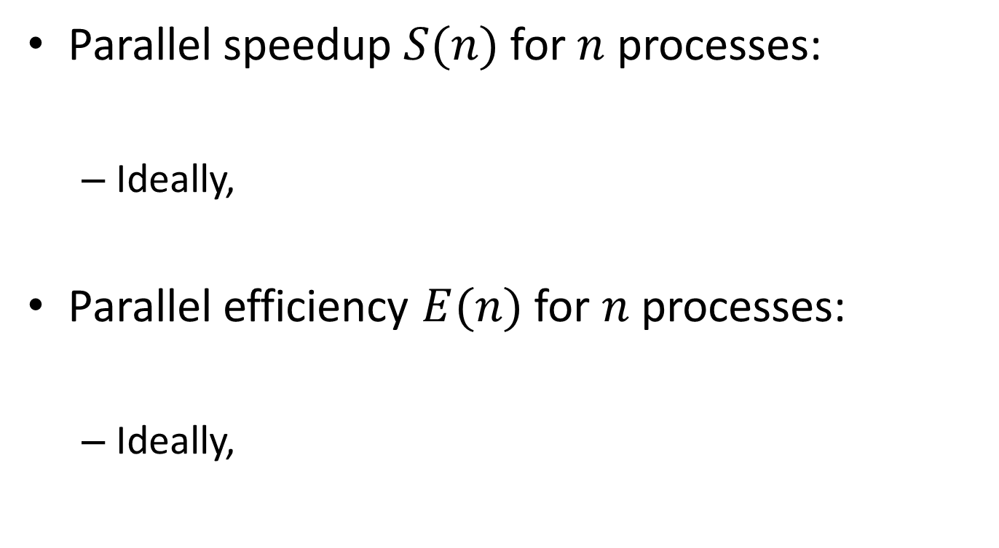



Definitions
$$S(n)=\frac{T_{1}}{T_{n}}$$
Parallel speedup $S(n)$ for $n$ processes:
Ideally,
Parallel efficiency $E(n)$ for $n$ processes:
Ideally,
$$S(n)=n$$
$$E(n)=\frac{T_{1}}{nT_{n}}$$
$$E(n)=1$$

Slide 108
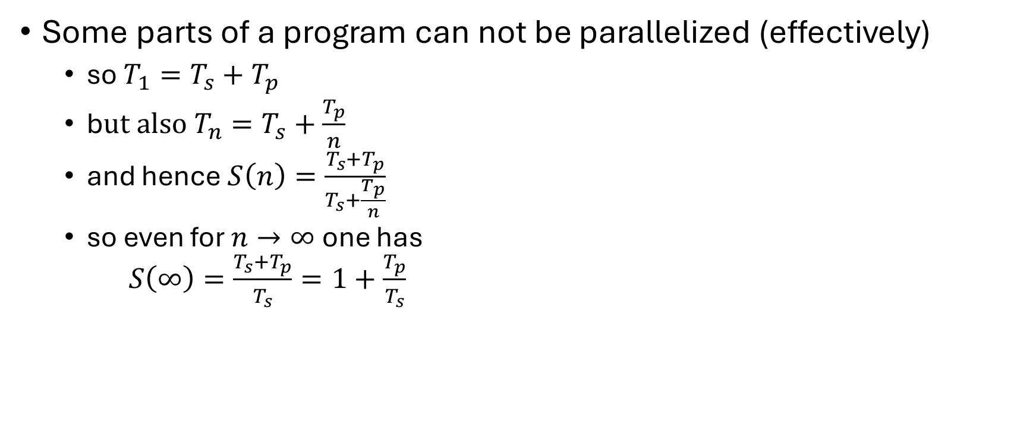
Strong scaling: oops!?!
Some parts of a program can not be parallelized (effectively)
so $T_{1}=T_{s}+T_{p}$
b$ut also T_{n}=T_{s}+\frac{T_{p}}{n}$
and hence $S\left(n\right)=\frac{T_{s}+T_{p}}{T_{s}+\frac{T_{p}}{n}}$
so even for $n→∞$ one has $S\left(∞\right)=\frac{T_{s}+T_{p}}{T_{s}}=1+\frac{T_{p}}{T_{s}}$
Hard limit on speedup due to serial part: Amdahl's law

Slide 109
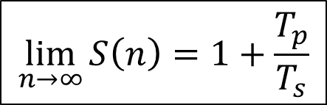

Amdahl's law
speedup
nr. processes
$$\lim_{n→∞}{S\left(n\right)=1+\frac{T_{p}}{T_{s}}}$$
$$\lim_{n→∞}{E\left(n\right)=0}$$

Slide 110
It gets worse…
Overhead!
communication takes time
finite bandwidth
non-zero latency
resource contention
memory subsystem: L3 cache, RAM, QPI
network access
speedup
nr. processes

Slide 111
Picking the sweet spot
sweet spot
speedup
sweet spot
nr. processes
efficiency
nr. processes

Slide 112
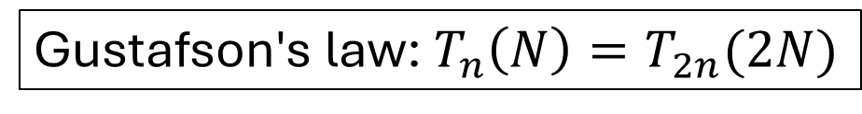
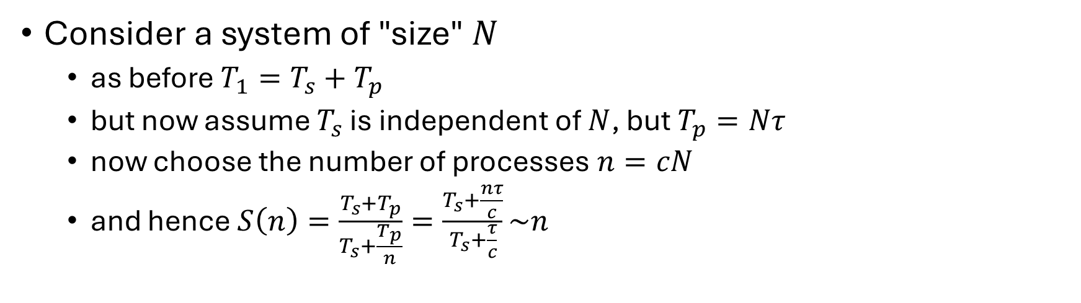
Weak scaling
Consider a system of "size" $N$
as before $T_{1}=T_{s}+T_{p}$
but now assume $T_{s}$ is independent of $N$, but$T_{p}=Nτ$
now choose the number of processes $n=cN$
and hence $S\left(n\right)=\frac{T_{s}+T_{p}}{T_{s}+\frac{T_{p}}{n}}=\frac{T_{s}+\frac{nτ}{c}}{T_{s}+\frac{τ}{c}}\sim n$
Gustafson's law: $T_{n}\left(N\right)=T_{2n}(2N)$
Nice for scientists!

Slide 113
We love Gustafson
Scientist are interested in
studying larger systems/bigger data sets
increasing precision/resolution
more complex phenomena
…

Slide 114
Throughput computing
N independent tasks
Total number of cores n << N
Execution time single task, 1 thread: t₁
Execution time single task, n threads: t_{n}
Multithreading or not?
However: memory?

Slide 115
Conclusions

Slide 116
In closing
Formalize workflow
Easier to map to tools
Reproducible
Benchmark
Single tasks
Parallel tasks
Mind I/O!

