Slide 1
worker & atools training session
Geert Jan Bex (geertjan.bex@uhasselt.be)
License: this presentation is released under the Creative Commons CC BY 4.0, see https://creativecommons.org/licenses/by/4.0/deed.ast

Slide 2

http://bit.ly/2qouLp2

Slide 3
Introduction
Patterns for parallel computing
embarrassingly parallel workloads
…
Happens a lot
many scientific domains
Support for pattern
make it easy to do
do the bookkeeping for you

Slide 4
Scenario: parameter exploration

Slide 5
Use case: parameter exploration
temperature | pressure | humidity
293.0 | 1.0e05 | 87
… | … | …
313.0 | 1.3e05 | 75
job_001.pbs
#!/bin/bash –l
#PBS –l nodes=1:ppn=1 -l walltime=00:10:00
cd $PBS_O_WORKDIR weather –p 1.0e05 –t 293.0 –h 87
Many single core computations
#!/bin/bash –l
#PBS –l nodes=1:ppn=1 -l walltime=00:10:00
cd $PBS_O_WORKDIR weather –p 1.003e05 –t 293.3 –h 67
job_030.pbs
…
#!/bin/bash –l
#PBS –l nodes=1:ppn=1 -l walltime=00:10:00
cd $PBS_O_WORKDIR weather –p 1.3e05 –t 313.0 –h 75
job_600.pbs
…

Slide 6
Solution: worker with -data
temperature | pressure | humidity
293.0 | 1.0e05 | 87
… | … | …
313.0 | 1.3e05 | 75
data.csv
#!/bin/bash –l
#PBS –l nodes=5:ppn=36 -l walltime=01:20:00
cd $PBS_O_WORKDIR weather –p $pressure –t $temperature –h $humidity
job.pbs
$ wsub –data data.csv –batch job.pbs

Slide 7
Data exploration: steps
Write PBS script with parameters
Create Excel sheet with data
Convert to CSV format
Submit with wsub
walltime is time to complete all work items

Slide 8



Example: running R
R is not parallelized
or, not efficiently
However, some usage scenario’s can be done in parallel, e.g.,
parameter exploration
for (a, b) in
{(1.3, 5.7), (2.7, 1.4),
(3.4, 2.1), (4.1, 3.8),
…
}
{
res <- c(a, b, soph_func(a + b))
…
}
program.r
args <- commandArgs(TRUE)
a <- as.double(args[1])
b <- as.double(args[2])
result <- c(a, b, soph_func(a + b))
print(result)
program-pe.r

Slide 9
Example: running R with worker
Run R on your own computer:
On a cluster, create program_pe.pbs and data.csv:
Run the job:
$ Rscript program 1.3 5.7
#!/bin/bash -l
#PBS -N program_pe
#PBS -l walltime=1:00:00,nodes=2:ppn=36
module load R
cd $PBS_O_WORKDIR
export OMP_NUM_THREADS=1
Rscript program $a $b
program_pe.pbs
a, b
1.3, 5.7
2.7, 1.4
3.4, 2.1
4.1, 3.8
…
data.csv
$ module load worker
$ wsub –batch program_pe.pbs –data data.csv

Slide 10
Use case: Torque job arrays
Torque supports job arrays, i.e.,
$ qsub –t 1-100 job_array.pbs
#!/bin/bash –l
#PBS –l nodes=1:ppn=1
cd $PBS_O_WORKDIR cfd-sim –i "params-$PBS_ARRAYID" \
–o "result-$PBS_ARRAYID"
job_array.pbs
#!/bin/bash –l
#PBS –l nodes=1:ppn=1
cd $PBS_O_WORKDIR cfd-sim –i "params-1" \
–o "result-1"
#!/bin/bash –l
#PBS –l nodes=1:ppn=1
cd $PBS_O_WORKDIR cfd-sim –i "params-100" \
–o "result-100"
…

Slide 11
Solution: worker with –t
wsub simulates job arrays, i.e.,
$ wsub –t 1-100 –batch job_array.pbs
#!/bin/bash –l
#PBS –l nodes=1:ppn=36
cd $PBS_O_WORKDIR cfd-simulator –i parameters-$PBS_ARRAYID \
–o result-$PBS_ARRAYID
job_array.pbs

Slide 12
Scenario: MapReduce

Slide 13
Use case: MapReduce
data.txt.1
result.txt.1
data.txt.2
result.txt.2
data.txt
result.txt
result.txt
…
…
data.txt.7
result.txt.7
map
reduce

Slide 14
Solution: -prolog & -epilog
data.txt.1
batch.sh
result.txt.1
data.txt.2
batch.sh
result.txt.2
data.txt
result.txt
prolog.sh
epilog.sh
…
…
data.txt.7
batch.sh
result.txt.7
$ wsub –prolog prolog.sh –batch batch.sh \
–epilog epilog.sh

Slide 15
worker features

Slide 16
Monitoring jobs: wsummarize
Getting a summary of a job
Number of successfully completed items
Number of failed items
Monitoring progress of a running job
$ wsummarize run.pbs.log445948
$ watch -n 60 \
wsummarize run.pbs.log445948

Slide 17
Resuming jobs: wresume
Resuming a job that hit the walltime
Redoing failed work items
$ wresume -l walltime=1:30:00 -jobid 445948
$ wresume -jobid 445948 -retry

Slide 18
Time limits: timedrun
Limit per work item
Avoid spending all walltime on a few work items that (accidentally) run too long
#!/bin/bash -l #PBS -l nodes=5:ppn=36 #PBS -l walltime=04:00:00
module load timedrun
cd $PBS_O_WORKDIR
timedrun -t 00:20:00 cfd-test -t $temperature \
-p $pressure \
-v $volume
time_limitied.pbs

Slide 19
Data aggregation
Sometimes convenient that each work item creates file
Files must be combined later = royal pain
File names are based on values in data
Example for data.csv:
output-1.3-5.7.txt
a, b
1.3, 5.7
2.7, 1.4
3.4, 2.1
4.1, 3.8
…
data.csv
output-2.7-1.4.txt
…
output-4.1-3.8.txt
…

Slide 20
Aggregating text files: wcat
Almost automatic data aggregation:
Preserve data order
Can be done from
worker epilog (-epilog option)
Command line
wcat –data data.csv \
-pattern output-[%a%]-[%b%].txt \
-output output.csv \
-skip_first 1
skip over
headers
a, b
1.3, 5.7
2.7, 1.4
3.4, 2.1
4.1, 3.8
…

Slide 21
Non-trivial aggregation: wreduce
More general data aggregation:
Reductor can be any executable
"appends" new data to existing file
takes two command line arguments
name of file with all output data
name of file to "append"
wreduce –data data.csv \
-pattern output-[%a%]-[%b%].txt \
-reductor reductor.sh \
-output output.txt

Slide 22
Example Python pickle reductor
#!/usr/bin/env python
from argparse import ArgumentParser
import pickle
if __name__ == '__main__':
arg_parser = ArgumentParser(description='create new pickle file from '
'two existing files')
arg_parser.add_argument('old', help='name of aggregation pickle file')
arg_parser.add_argument('new', help='name of pickel file to add to '
'aggregation')
options = arg_parser.parse_args()
with open(options.old, 'rb') as old_file:
old_data = pickle.load(old_file)
with open(options.new, 'rb') as new_file:
new_data = pickle.load(new_file)
for word, count in new_data.iteritems():
if word in old_data:
old_data[word] += count
else:
old_data[word] = count
with open(options.old, 'wb') as old_file:
pickle.dump(old_data, old_file)
redactor.py
read aggregated data
read data to add
add new data to aggregate
write aggregated data

Slide 23
Work load analysis: wload
Load balance is important!
do all workers approximately the same amount of work?
easy if all work items take the same time
Use wload to analyze runs
report on work items: -workitems
report on workers: -workers
$ wload –workers run.pbs.log445948

Slide 24
Load balance
wsub -l nodes=5:ppn=36 …
180 cores
1 master
179 slaves
wsub -l nodes=5:ppn=36 -master …
180 cores
1 master
180 slaves
⇒ executes 179 work items concurrently
⇒ executes 180 work items concurrently
Not default: violates MPI standard!

Slide 25
wsub: multiple data sources
data₁
data₂
data_{n}
-t 1-N
…
batch.pbs
templ.
engine
worker.pbs
batch.pbs.worker

Slide 26
Non-trivial scenario support
worker exposes environment variables to work item shell
WORKER_SIZE: number of worker processes
WORKER_RANK: worker identifier

Slide 27

Help on worker
See documentation http://worker.readthedocs.io/
Each command has help, use -h
http://bit.ly/2WI6ZAP

Slide 28
Hold your horses, my C/C++/Fortran/R
program doesn't do command line
arguments, and I hate programming that!
No worries, there's an app
for that: parameter-weaver

Slide 29
Interlude: parameter-weaver

Slide 30
Motivation
Dealing with command line arguments and configuration files is
boring
error prone
fragile
parameter-weaver
takes parameter description file (CSV)
parameter type/name/default value
generates data structure/functions to easily access
command line arguments
parameters in configuration files
Works for C/C++/Fortran/R
for Python, use argparse/ConfigParser in standard library
Code generation ⇒ no dependencies, no libraries!

Slide 31
C example: code generation
Parameter description file
Code generation
Creates cl_params.c, cl_params.h, cl_params_aux.c, cl_params_aux.h
int rank 2
int max_nr_points 1000
int delta_nr_points 100
int bucket_size 10
int verbose 0
params.txt
$ module load parameter-weaver
$ weave –l C -d params.txt

Slide 32
C example: code use
In C program
…
#include "cl_params.h"
…
int main(int argc, char *argv[]) {
…
Params params;
initCL(&params);
parseCL(&params, &argc, &argv);
if (params.verbose)
dumpCL(stderr, "# ", &params);
tree_spatial_dims_alloc(params, &center, &extent);
…
finalizeCL(&params);
return 0;
}
overhead.c

Slide 33
Features
Supports all basic types
C/C++: int, float, double, char, char*
Fortran: integer, real, double precision, character(len=…), logical
Parameters can be
on command line
in configuration file
Parameters have default values

Slide 34

Help on parameter-weaver
See documentation http://parameter-weaver.readthedocs.io/
Each command has help, use -h
http://bit.ly/2NeoB3Q

Slide 35
worker tuning

Slide 36
How to use worker well?
Many work items, i.e., #work items/#proc >> 1
time(work item) > 1 minute
Work item is not multithreaded
Work item is multithreaded
will work, but user must be careful to request the right resources
Use –threaded <n> flag with wsub, in PBS script, WORKER_NUM_THREADS
There be dragons: licensing!

Slide 37
worker & conflicts
worker module only required for
job submission, i.e., wsub, wresume
data aggregation, …, e.g., wcat, wreduce, …
No need to load in PBS script
use module purge
minimizes conflicts
work items run in own Bash shell
However, MPI may be problematic
e.g., mpi4py

Slide 38
worker & multithreading
Some software uses multithreading automatically, e.g.,
R
Matlab
Will use as many threads as there are cores, regardless of system load
36 cores/node
36 work items/node
36 × 36 threads/node
Oversubscription: very inefficient!!!

Slide 39
Controlling number of threads
R, most of the time: OMP_NUM_THREADS=1
Matlab
Use maxNumCompThreads(1) function call
Use compiler flag: mcc –singleCompThread …
#!/bin/bash -l
#PBS -N my-pe
#PBS -l walltime=1:00:00,nodes=5:ppn=36
module load R
cd $PBS_O_WORKDIR
export OMP_NUM_THREADS=1
Rscript program $a $b
program_pe.pbs

Slide 40
What you hope/expect for…
strong scaling
weak scaling
execution time
nr. processes
Is this going
to happen?
system size
execution time ∼
nr. processes

Slide 41

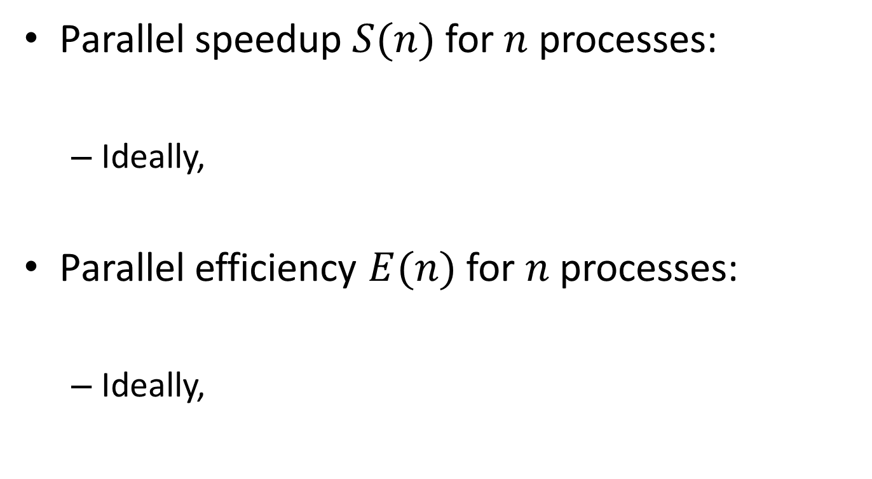



Definitions
Parallel speedup $S(n)$ for $n$ processes:
Ideally,
Parallel efficiency $E(n)$ for $n$ processes:
Ideally,
$$S(n)=\frac{T_{1}}{T_{n}}$$
$$S(n)=n$$
$$E(n)=\frac{T_{1}}{nT_{n}}$$
$$E(n)=1$$

Slide 42
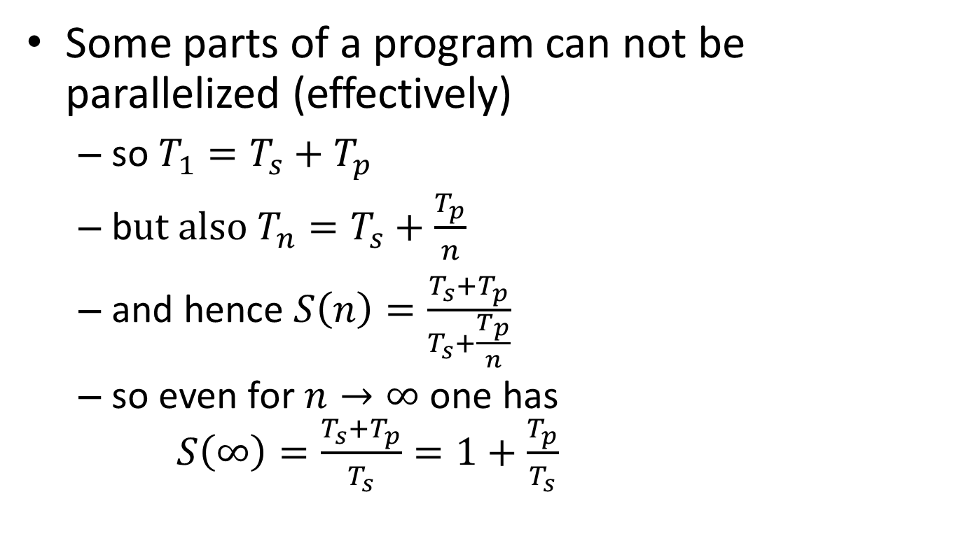
Strong scaling: oops!?!
Some parts of a program can not be parallelized (effectively)
so $T_{1}=T_{s}+T_{p}$
b$ut also T_{n}=T_{s}+\frac{T_{p}}{n}$
and hence $S\left(n\right)=\frac{T_{s}+T_{p}}{T_{s}+\frac{T_{p}}{n}}$
so even for $n→∞$ one has $S\left(∞\right)=\frac{T_{s}+T_{p}}{T_{s}}=1+\frac{T_{p}}{T_{s}}$
Hard limit on speedup due to serial part: Amdahl's law

Slide 43
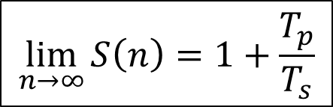

Amdahl's law
speedup
nr. processes
$$\lim_{n→∞}{S\left(n\right)=1+\frac{T_{p}}{T_{s}}}$$
$$\lim_{n→∞}{E\left(n\right)=0}$$

Slide 44
It gets worse…
Overhead!
communication takes time
finite bandwidth
non-zero latency
resource contention
memory subsystem: L3 cache, RAM, QPI
network access
speedup
nr. processes

Slide 45
Picking the sweet spot
sweet spot
speedup
sweet spot
2
4
8
nr. processes
efficiency
2
4
8
nr. processes

Slide 46
Throughput computing
N independent tasks
Total number of cores n << N
Execution time single task, 1 thread: t₁
Execution time single task, n threads: t_{n}
Multithreading or not?
However: memory, total time to solution?

Slide 47
So, what about OpenMP
and MPI work items???
No worries: atools to the rescue!

Slide 48
Scenario revisited: parameter exploration

Slide 49
Use case: parameter exploration
temperature | pressure | humidity
293.0 | 1.0e05 | 87
… | … | …
313.0 | 1.3e05 | 75
#!/bin/bash –l
#PBS –l nodes=2:ppn=36 -l walltime=00:15:00
cd $PBS_O_WORKDIR mpirun weather –p 1.0e05 –t 293.0 –h 87
job_01.pbs
#!/bin/bash –l
#PBS –l nodes=2:ppn=36 -l walltime=00:15:00
cd $PBS_O_WORKDIR mpirun weather –p 1.003e05 –t 293.3 –h 67
job_30.pbs
Many multinode computations
…
#!/bin/bash –l
#PBS –l nodes=2:ppn=36 -l walltime=00:15:00
cd $PBS_O_WORKDIR mpirun weather –p 1.3e05 –t 313.0 –h 75
job_60.pbs
…

Slide 50
Solution: aenv
temperature | pressure | humidity
293.0 | 1.0e05 | 87
… | … | …
313.0 | 1.3e05 | 75
data.csv
#!/bin/bash –l
#PBS –l nodes=2:ppn=36 -l walltime=00:15:00
module load atools/1.4.4
source <(aenv --data data.csv)
cd $PBS_O_WORKDIR mpirun weather –p $pressure –t $temperature \
–h $humidity
job.pbs
$ module load atools/1.4.4
$ array_ids=$(arange --data data.csv)
$ qsub -t ${array_ids} job.pbs

Slide 51
Data exploration: steps
Write PBS script with parameters
add line to initialize parameters: aenv
Create Excel sheet with data
Convert to CSV format
Submit with qsub -t …

Slide 52
Torque job arrays
Torque supports job arrays, i.e.,
$ qsub –t 1-100 job_array.pbs
#!/bin/bash –l
#PBS –l nodes=2:ppn=36
cd $PBS_O_WORKDIR cfd-sim –i "params-$PBS_ARRAYID" \
–o "result-$PBS_ARRAYID"
job_array.pbs
#!/bin/bash –l
#PBS –l nodes=2:ppn=36
cd $PBS_O_WORKDIR cfd-sim –i "params-1" \
–o "result-1"
#!/bin/bash –l
#PBS –l nodes=2:ppn=36
cd $PBS_O_WORKDIR cfd-sim –i "params-100" \
–o "result-100"
…

Slide 53
And MapReduce?
Supported through scheduler → job dependencies
$ array_ids=$(arange --data data.csv)
$ prolog_id=$(qsub prolog.pbs)
$ batch_id=$(qsub -W depend=afterok:${prolog_id} \
-t ${array_ids} job.pbs)
$ qsub -W depend=afterok:${batch_id} epilog.pbs

Slide 54
Job dependencies
data.txt.1
job.pbs
result.txt.1
data.txt.2
job.pbs
result.txt.2
data.txt
result.txt
prolog.pbs
epilog.pbs
…
…
data.txt.7
job.pbs
result.txt.7

Slide 55
atools features

Slide 56
Logging
Logging for
bookkeeping: success/failures?
redo failures
performance analysis
Scheduler provides logs
inconvenient
not always user-accessible

Slide 57
Logging: alog
#!/bin/bash –l
#PBS –l nodes=2:ppn=36
module load atools/1.4.4
source <(aenv --data data.csv)
cd $PBS_O_WORKDIR
alog --state start mpirun weather –p $pressure –t $temperature \
–h $humidity
alog --state end --exit $?
job.pbs
1 started by r1i1n3 at 2016-09-02 11:47:45
2 started by r1i1n3 at 2016-09-02 11:47:45
3 started by r1i1n3 at 2016-09-02 11:47:46
2 failed by r1i1n3 at 2016-09-02 11:47:46: 1
3 completed by r1i1n3 at 2016-09-02 11:47:47
…
job.pbs.log145485

Slide 58
Monitoring: arange
For running or finished job
$ arange --data data.csv \
--log job.pbs.log145485 \ --summary

Slide 59
Resuming jobs: arange again
Resume a job that hit the walltime
Redo failed work items
$ array_ids=$(arange --data data.csv \
--log job.pbs.log145485)
$ qsub -t ${array_ids} -l walltime=5:00:00 \
job.pbs
$ array_ids=$(arange --data data.csv \
--log job.pbs.log145485 \
--redo)

Slide 60
Adapting PBS files: acreate
Automatically adapt PBS file for atools
only logging
logging and using aenv
$ acreate job.pbs > job_atools.pbs
$ acreate --data data.csv \
job.pbs > job_atools.pbs

Slide 61
Simple aggregations: areduce
Almost automatic data aggregation:
Takes care of
missing files (failed items)
incomplete data (failed items), use --t $(arange --data data.csv --list_completed)
correct order
For CSV, use --mode csv
single column row
areduce --t 1-100 --data data.csv \
--pattern output-{t}.txt \
--output output.txt
PBS_ARRAYID

Slide 62
Non-trivial aggregations: areduce
More general data aggregation:
Reductor can be any executable
"appends" new data to existing file
takes two command line arguments
name of file with all output data
name of file to "append"
extra argument using --reduce_args …
areduce –-t 1-100 --data data.csv \
--pattern output-{t}.txt \
--empty empty.bin \
--reduce reductor.sh \
--out output.bin

Slide 63
Job statistics: aload
Load balance is mostly taken care of by scheduler, but
do all jobs approximately the same amount of work?
Use aload to analyze runs
report on work items: --list_tasks
report on nodes: --list_slaves
$ aload -–workers run.pbs.log445948

Slide 64
CSV formats
atools is flexible
tries to determine CSV dialect by reading part of file & analyzing
default: 1024 bytes
Specify number of bytes to use: --sniff <nr_bytes>
use for CSV files with long lines

Slide 65

Help on atools
See documentation http://atools.readthedocs.io/
Each command has help, use -h or --help
http://bit.ly/2qh9kGK

Slide 66
atools tuning

Slide 67
How to use atools well?
Work items may need to use at least a node
no technical reason, just credits/policies
time(work item) > 1 minute
Remember: limits to number of jobs in queue
Limit number of concurrent jobs
e.g., licenses
$ qsub -t ${array_ids}%5 job.pbs
at most 5 tasks concurrently

Slide 68
atools & conflicts
atools module required
in PBS scripts
for submitting jobs
However, conflicts avoided by wrapper scripts

Slide 69
Comparison

Slide 70
worker versus atools
scenario | worker | atools
Single core work items | √ | √, $$$
Multiple multithreaded work items/node | √, $ | √, $$
Single multithreaded work items/node | √, $$ | √
Multi-node work items | x | √
Supports multiple schedulers | x | √
Complimentary
Common feature set
resuming jobs/redoing failed items
data aggregation
job statistics
Design principle: ease of use

Slide 71
How to kill a cluster in one easy step?
… and earn the scorn of you fellow users?
Just do massive I/O!

Slide 72
File system refresher
$VSC_DATA
optimized for reliability
reasonable bandwidth/IOPS
$VSC_SCRATCH
optimized for performance
high bandwidth
reasonable IOPS
$VSC_SCRATCH_NODE
reasonable bandwidth/IOPS
data must be staged in/out
shared file system:
if one users messes
up, everyone suffers

Slide 73
Scenarios for disaster
I/O on many small files
Many small read/write operations
Sophisticated workflows with files as intermediate artefacts
Take I/O into account when planning jobs!
Often implemented via I/O redirection in shell
Meta-data IOPS
Exacerbated by using worker/atools!
…
tool1 < input1 > output1
tool2 --input output1 > output2
tool3 --conf output2 --input output1 > output3
…
job.pbs

Slide 74
Tools to help
datasink
simple to use
based on Bash shell I/O redirection
requires parallel file system
quite fast
mem_io
reasonably easy to use
based on Bash shell I/O redirection
uses redis in-memory database
very fast
Pretty new: contact support!

Slide 75
Conclusions

Slide 76
Conclusions
Lot of tools to support your workflow
Designed to make
simple tasks trivial
somewhat tricky things easy
hard stuff doable
Actively supported
Reasonable attempt at documentation
Suggestions & feature requests welcome!
contact geertjan.bex@uhasselt.be

Slide 77
References
worker
website: https://github.com/gjbex/worker
documentation: http://worker.readthedocs.io/
atools
website: https://github.com/gjbex/atools
documentation: http://atools.readthedocs.io/
datasink
website: https://github.com/gjbex/datasink
documentation: http://datasink.readthedocs.io/
mem_io
website: https://github.com/gjbex/mem_io
documentation: http://mem_io.readthedocs.io/
parameter-weaver
website: https://github.com/gjbex/parameter-weaver/
documentation: http://parameter-weaver.readthedocs.org/

Slide 78
Appendix: worker implementation

Slide 79
worker implementation
Front end: wsub, wresume, wcat, …
Perl 5.x scripts
wsub and wresume generate PBS scripts
Back end: worker application
C + MPI
can be used independently

Slide 80






worker processing: informally
slave₁
slave queries for work
/
master sends work
/
slave notifies on success/failure, queries
for more work
master
…
Done!
master sends stop
/
slave_{S}
batch.sh.worker

Slide 81
worker: initialization & operation
slave₁
master
slave₂
ready
prolog
ready
read
work
jobID, scriptSize
script
read
work
jobID, scriptSize
script
computation
jobID, existStatus
computation
log
read
work
jobID, scriptSize
script
computation

Slide 82
worker: termination
slave₁
master
slave₂
computation
computation
jobID, existStatus
log
read
work
jobID, scriptSize
jobID, existStatus
script
terminate
log
computation
jobID, existStatus
log
terminate
epilog

Slide 83
Appendix: atools implementation

Slide 84
atools implementation
Front end
Bash scripts, wrappers around Python scripts
Bash features in PBS scripts
Back end
Python 2.7.x scripts

Slide 85
Bash feature refresher
Assigning result of command to variable
Creating file handle for command input from command output
$ array_ids=$(arange --data data.csv)
…
source <(aenv --data data.csv)
…
job.pbs

