Slide 1
Climber’s Beta
Gabriel Cabrera

Slide 2
Why?
Climbing, can be an individual sport; If you plan on bouldering or soloing, however, sport(top-rope) and traditional climbing require a partner for belaying and help with beta(route insight).
Maybe you’re solo exploring a new area but need a partner to climb with?
Maybe you spent 2 days driving to a new location and forgot some equipment?
Maybe you just need help from experienced climbers in the area but don’t know anyone or their experience levels?

Slide 3
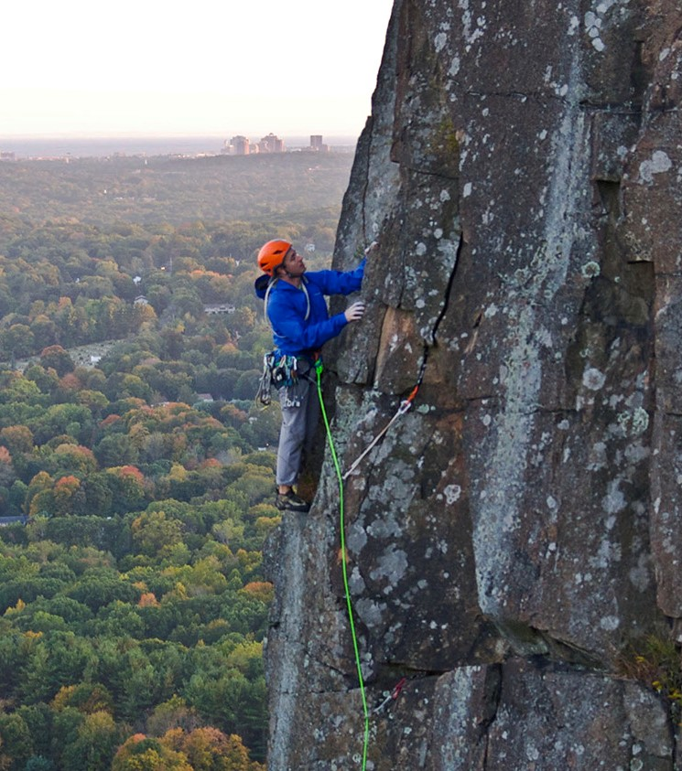
Proposal
An application that organizes and displays information for climbing routes in various locations around the world
A way for climbers to link up and find other climbers that may be in their same climbing grade
A platform for climbers to share their experiences and insight while on the wall(beta, big wall climbing)

Slide 4
App Features
Organizes and displays information regarding locations and routes(route identifying, beta, images, detailed descriptions, ratings, etc)
A classified section for searching for partners or equipment for sale
A Bulletin board for climbers to ask or give advice and warnings(choss[debris], broken anchors, sketchy holds)
Profiles to record the many routes that you send, to show experiences and personal climbing merits

Slide 5
Phone Requirements
Internet connectivity
Camera
Data Storage(depending on how much is downloaded for offline access)

Slide 6
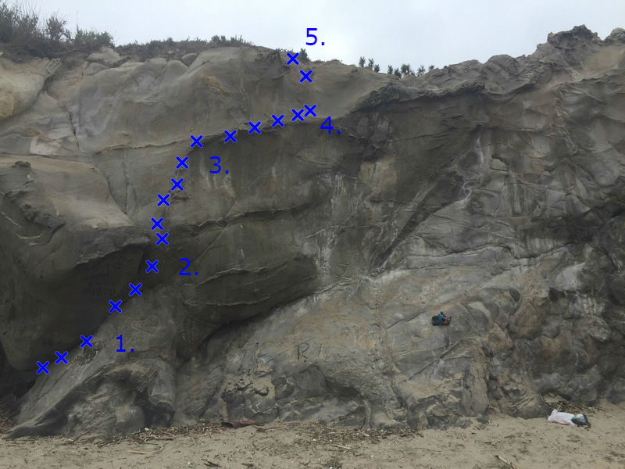
Project Timeline
Design and Finite state
Display of data, account functionality
Messaging board functionality
Testing
Finished product

Slide 7
Deliverables

