Slide 1
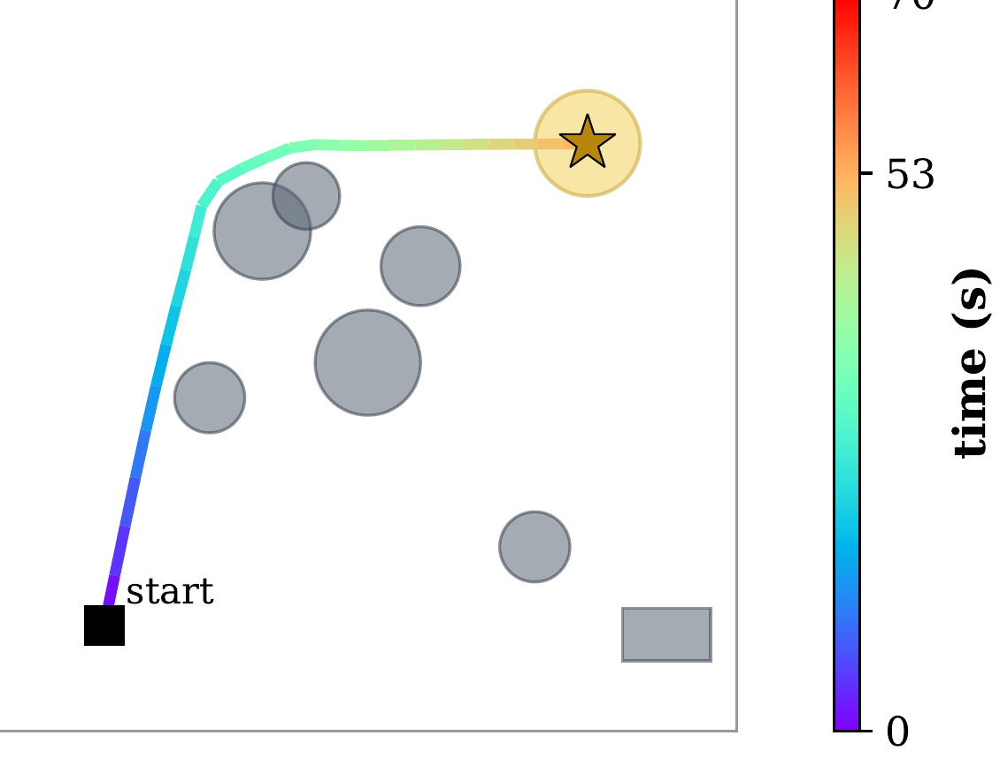


(a) Nested STL spec
(b) Frozen flow-matching planner + robustness guidance
(c) TeLoGraF plan (no A*)
∧
frozen GNN
encoder
xT
xt
⋯
x0
NL: “Reach the goal within
70 seconds while always
keeping safe from every
obstacle.”
F[a,b]
G
G
⇒ conditioning z
differentiable STL robustness ∇ρ (STLCG) steers sampling
¬
¬
reach g
operator normalization
→,↔ ⇒ basis
nested-tree
decomposition
feasibility self-check
→ A* if OOD
avoid o
unsafe
exec 53 s + 4 s plan (in time)
keep-safe = G ¬ unsafe, grounded by sensed disks

