Slide 1


ShineSync
Venture Viability Analysis
Caraga State University, Butuan City Mindanao

Slide 2

ShineSync
We offer a mobile app for easy booking,location tracking,secure payments,enhancing user convenience.
Caraga State University, Butuan City Mindanao PH

Slide 3
Context
At-home car washing dropped from 48% in 1996
to 28.4% in 2021, increasing demand for pro services.
3

Slide 4
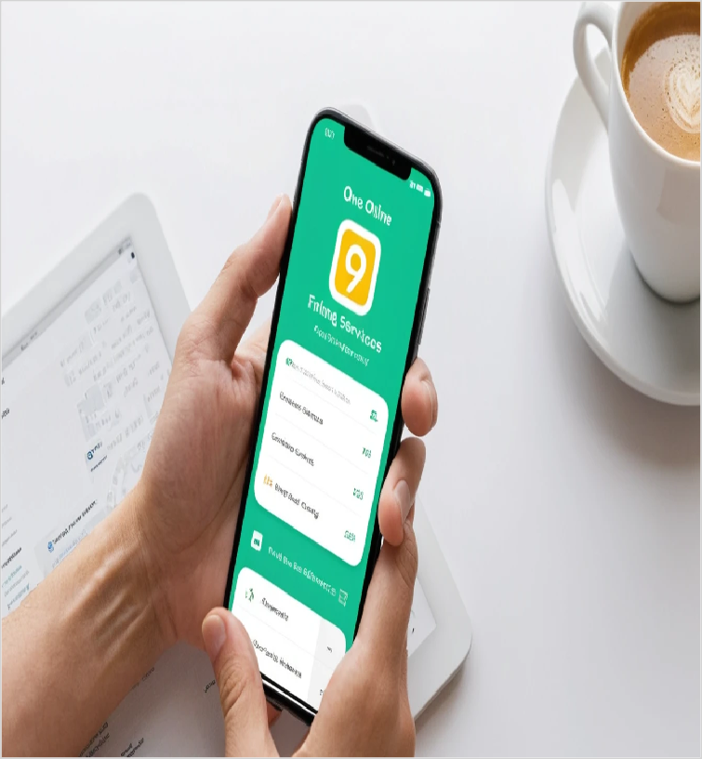
Problem Statement
Problem
Finding reliable car wash services is tough due to poor visibility, scheduling issues, and trust concerns.
Customers face delays, while providers stru
Impact
Finding reliable car wash services is hard due to low visibility,scheduling issues,and trust concerns.Our solution connects userswithefficient service
4

Slide 5

Problem Statement/Industry
Problem Being Solved
Difficulty Finding Reliable Car Wash Providers Clients struggle to find trustworthy home car wash services in their area, often relying on word-of-mouth or limited online listings. Clients and car wash service providers experience difficulties in coordinating appointments, leading to missed bookings, delays, or cancellations
Supporting Data
At-home car washing dropped from 48% in 1996 to 28.4% in 2021, increasing demand for pro services.
Source: At-home car washing fell from 52% in 1996 to 22% in 2022 per the International Carwash Association.
Area
Business Services
Industry
Automotive Services
Domain
Mobile Car Wash & On-Demand Cleaning Services

Slide 6



Problem Analysis
Affected Stakeholders
Consumers struggle to find reliable car wash providers, causing inconvenience and
wasted time. Service
providers face inconsistent bookings, scheduling issues, and cancellations. Fleet operators, rideshare drivers, and local car wash businesses lose
opportunities due to poor coordination.
Environmental agencies
are affected by excessive water use a
Impact on Stakeholders
Car owners struggle with unreliable car wash
services, causing inconvenience and
wasted time. Service
providers face inconsistent bookings, cancellations, and scheduling conflicts, reducing their income.
Fleet operators and rideshare drivers
experience business disruptions. Local car wash businesses lose
customers
Root Causes
Car wash providers lack online presence, making it hard for customers to find reliable services.
Inefficient scheduling
leads to missed bookings and long wait
times.Customers rely on word-of-mouth due to inconsistent service
quality.No standard pricing or guarantees create trust issues.
Excessive water use and improper waste disposal from providers
Personal/Team Connect
We want to solve this problem because finding reliable car wash services is frustrating for many people. Poor scheduling, trust issues, and service inconsistency make it
worse. By creating a seamless and efficient solution, we aim to connect customers with trusted providers,
improve convenience, and promote eco-friendly practices in the car wash

Slide 7
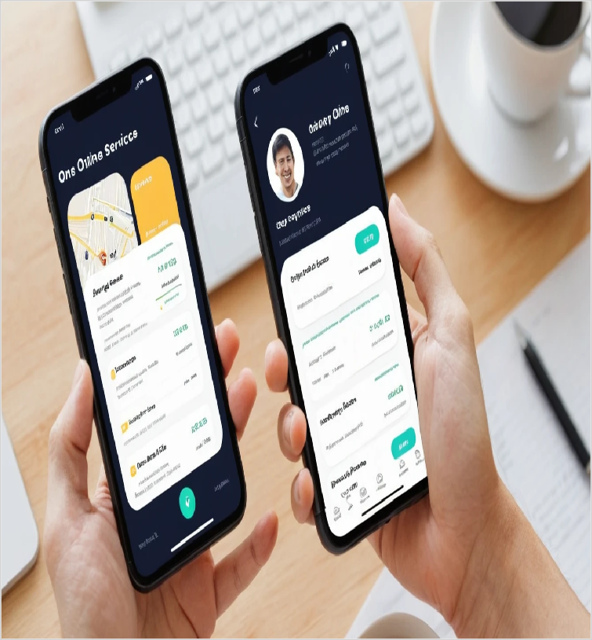
Target Customer Segments
Primary
Urban car owners with busy lifestyles
seeking convenience.
Secondary
Car wash service providers looking to
expand their customer base
through home service
offering
5

Slide 8

Customer Segment & Persona
Primary Segment
Urban car owners with busy
lifestyles seeking convenience.
Persona
Secondary Segment
Car wash service providers looking to expand their
customer base through home
service offering
Liza Cruzâ€‹
Age in years: 38 Location: Metropolitan
Organizational Role:
{Persona's primary role}
(if applicable)

Slide 9

Jobs-to-be-Done
Functional JTBD
Ensure the family vehicle is clean and safe for kids. Book car
washes that fit around family activities and schedules. Find eco- friendly car wash options that
align with family values.
Emotional JTBD
Feel secure knowing the family vehicle is clean and safe for
children. Alleviate guilt about not having enough time for car
maintenance. Experience
satisfaction from supporting eco- friendly services for the family.
Social JTBD
Earn respect from other parents for maintaining a safe and clean family vehicle. Share experiences and recommendations for eco- friendly services with community groups. Foster a sense of belonging by participating in
family-oriented activities and events.

Slide 10


Current Alternatives
Current Alternatives
Books family-friendly car wash services that offer pick-up and drop-off. Utilizes local car wash promotions shared in parent groups on social media. Delegates car maintenance tasks to family members or hires help when needed.
Gaps in Current Alternatives
Many car wash services do not accommodate family schedules, leading to inconvenience. Lack of transparent pricing and hidden fees cause frustration. Limited eco-friendly options that meet both cleanliness and family health standards.

Slide 11
Problem Validation (GOOTB)
Partial List of Potential Customers/Users Interviewed
Problem Validation
Total customers/users interviewed:
In-person: 5 Virtually: 0
Total customers/users for whom this problem is important to
solve: 4
Total customers/users who are dissatisfied with the current alternatives: 3
Name: Ana Reyes
Occupation: Project Manager
Name: Marco Villanueva
Occupation: Sales Executive
Name: Ariel Ramos
Occupation: Business Owner

Slide 12

Solution Design
Our Solution
Mobile App for Car Wash
Services - An app that allows users to book car washes at their convenience, view real- time availability, and read reviews of nearby providers.
Key Features
Our app will feature real-time booking, user reviews, location tracking via Google Maps, secure payment processing
with Stripe, a user-friendly
interface, and notifications for reminders and updates.
Uniqueness
This solution offers rapid deployment with a no-code
approach, cross-platform
functionality via Flutter, and scalable security through
Firebase.â€‹
Solution Format:
Digital service
Core Technologies/ Methodologies:
We will use Flutter for app development, Firebase for database and authentication, GoogleAPI for location services, and Stripe for payment processing.

Slide 13

Solution Benefits
Functional Benefits
Convenience & Time- Saving, Easy Booking & Management, Quality & Reliable Service, Secure & Cashless Transactions, and Customized Car
Care.â€‹
Emotional Benefits
Peace of Mind, Sense of Luxury & Convenience, Satisfaction &
Confidence, Trust & Reliability, and Freedom & Control.â€‹
Social Benefits
Admiration from Peers, Professional Appeal, Eco-Friendly Recognition, and Status & Exclusivity.â€‹
Macro Benefits
ShineSync creates jobs, saves users time,
promotes eco-friendly car care, reduces
emissions, and
enhances urban convenience with on- demand service.â€‹

Slide 14


Competitors
Direct Competitors
Ownwash, CarZippi
Indirect Competitors
Urban Company, Ola Car Wash
Direct Competitors Globally
Washos, Wype
Indirect Competitors Globally
Mister Car Wash, Zips Car Wash

Slide 15
Macro Analysis
Favourable Trends
AREA | DESCRIPTION
Technology | The rise of AI and IoT-enabled automation is making car wash operations more efficient.
Social | Rising demand for eco-friendly car washes drives waterless, biodegradable solutions
Unfavourable Trends
AREA | DESCRIPTION
Technology | The high cost of developing and maintaining app-based platforms, including payment integrations
Social | Growing consumer preference for do-it-yourself (DIY) car washing at home due to economic uncertaint
Data Sources:
McKinsey & Company: Future of Mobility Report (2023)“ Discusses the impact of technology on service-based industries, including automotive care.

