Slide 1
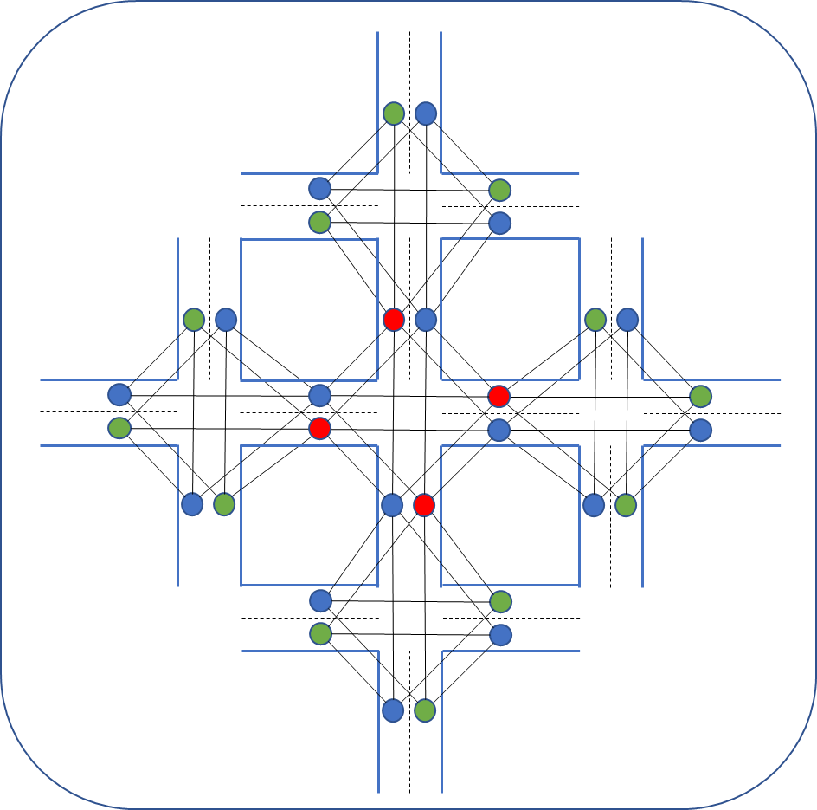
Queue length
B
Traffic volume
环境观察
Current phase
Phase 1
...
Action
Next Queue length
Phase p
节点回归
Next Traffic volume

