Slide 1
Construction for incomplete map matching
MELCO Advanced R&D Center
2022/06/20

Slide 2
A basics of geographical info analysis
To build maps and use these, the following steps are needed.
Uber’s H3 format
Roomba’s Clean Map
Registration
Point clouds
Google Map
Data Format
Coordinate Transformation
Discretization
Mapping
Sensing (Camera, LiDAR etc.)
Data Fusion
Data registration
Data statistics
SLAM
Utilization
Navigation system
Pathfinding
Data size reduction
Object Detection
Simplification
Map matching
In each steps, several technologies are considered and used.
[H3: Uber’s Hexagonal Hierarchical Spatial Index][What is a Clean Map™ Report? (irobot.ca)][Google Maps Platform]

Slide 3
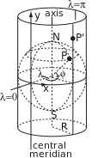

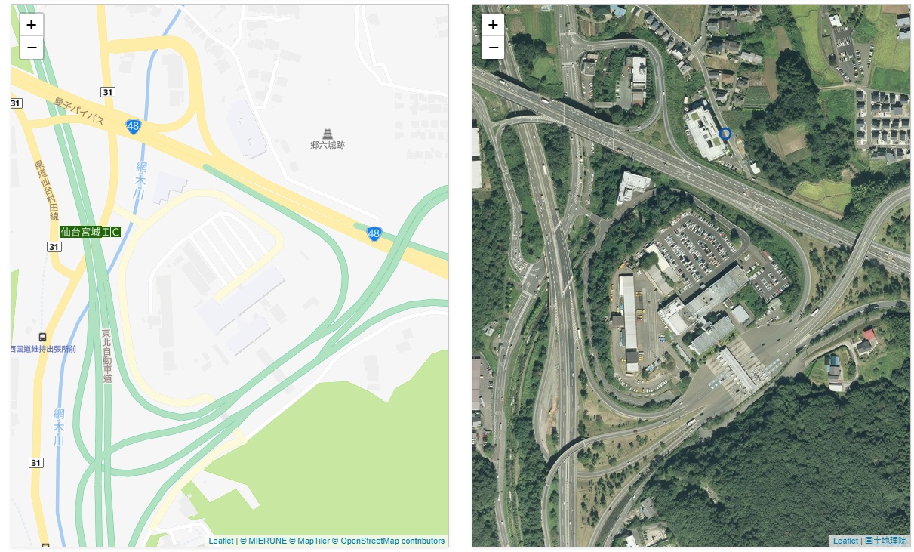
Data Format
The digital geographical data need to
Discretize geometry
Transform coordinates
Simplify the information
for data processing.
There are several geographical
data format like
LAS file format: 3D sampled data format,
Shapefile format: Geospatial vector data format (points, lines, and polygons),
and so on.
[H3: Uber’s Hexagonal Hierarchical Spatial Index] [Mercator projection – Wikipedia]

Slide 4

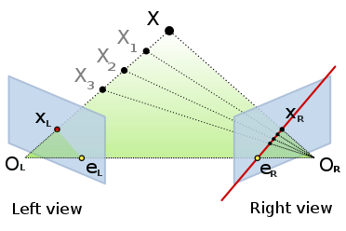
Mapping
To obtain map data, mapping systems are needed.
The typical algorithm SLAM (Simultaneous Localization and Mapping) is
Using sensors (Camera, GPS, IMU LiDAR, and so on),
Doing localization,
Building maps.
Moreover, we need to
Simplify the map data (extracting while lines, …),
Detect objects (walls, poles, …),
Complement maps.
[Epipolar geometry – Wikipedia][アイサンテクノロジー – 建設・測量生産性向上展 (cspi-expo.com)]

Slide 5
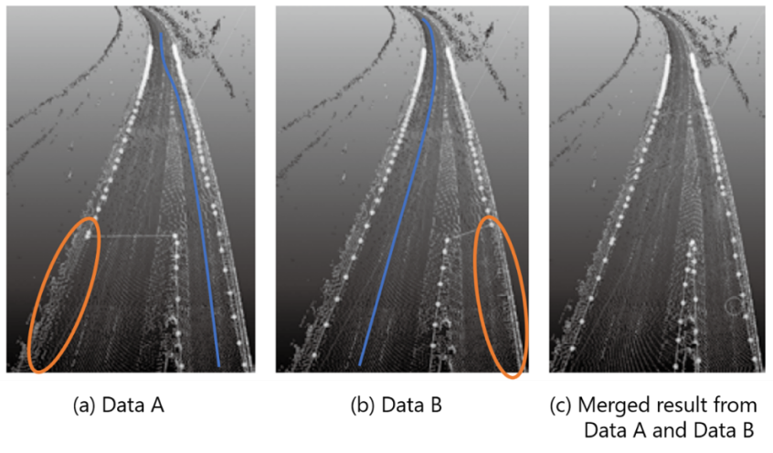
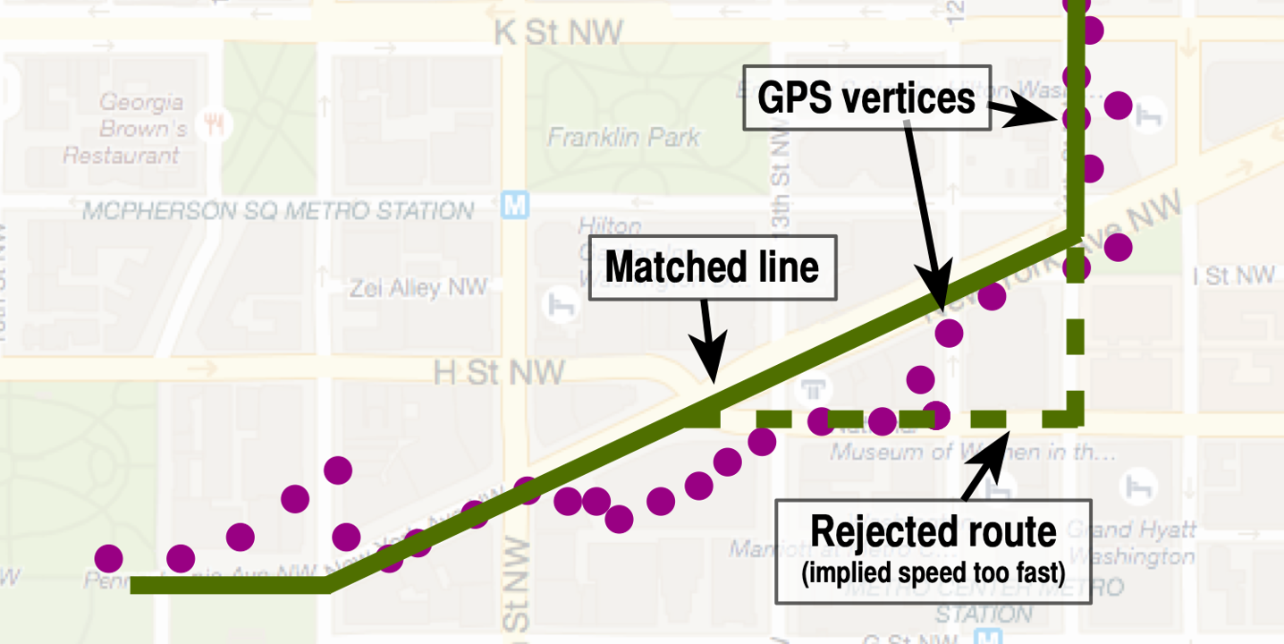
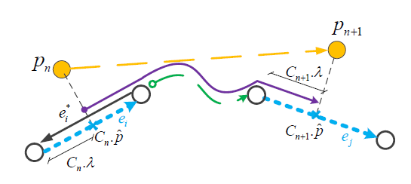
Data fusion
In general, the outputs from mapping system are incomplete.
We need to complement these by uniting incomplete maps.
The typical steps are
Convert these data in unified format (coordinates),
Matching their parts,
Unite matched parts.
The demand for incomplete map unification is increasing for
Building high-definition map (increasing data amount)
Updating maps frequently (increasing times)
[H3: Uber’s Hexagonal Hierarchical Spatial Index] [Mercator projection – Wikipedia]

Slide 6
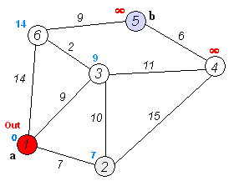
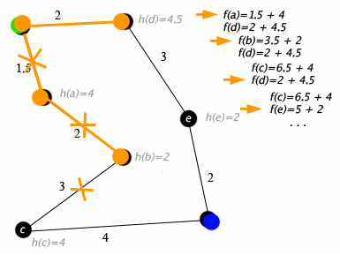
Utilization
There are a lot of service utilizing maps.
Navigation system is
Localizing itself by sensors,
Finding positions on maps by map matching algorithms.
Pathfinding is done by
Building graph base on maps,
Optimization with respect to loss functions.
[A* search algorithm – Wikipedia][cyang-kth/fmm][[amillb/pgMapMatch]

Slide 7
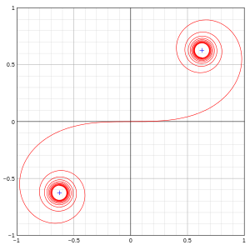
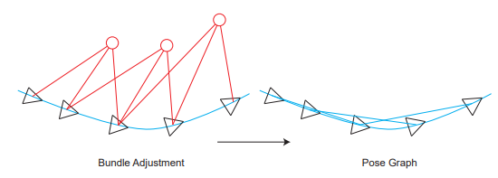
Math for geographical info analysis
Elementary geometry
and Manifold
Graph theory
and Optimization
Mercator projection
Euler spiral and curve fitting
Map matching
A* search algorithm
Epipolar geometry and Triangulation of visual SLAM
Graph optimization of visual SLAM
[gaoxiang12/slambook-en][Euler spiral – Wikipedia]

Slide 8
Main Theme: Construction
Construction of something (“loss function”, “map representation”, “fusion algorithm” and so on) for incomplete map matching
An example of project planning
Title: Construction of loss function for incomplete map matching
Contents: For incomplete map, we try to build new loss function considering - local geometry information (distance, metric and so on) - global geometry information (graph, topology and so on) for optimization.
A simple example of
incomplete maps unification
It is not necessary to include elements about map matching.
We expect interesting problem settings about geographical information!

