Slide 1
C-H Film Productions
Recommendations for Entry into the Film Industry
Miles Cumiskey
Mike Hanson
September 13, 2024

Slide 2
Agenda
Business Problem
Methodology
Analysis
Conclusions

Slide 3
BLUF – Do this in the morning

Slide 4
Business Objective
Enter into the Movie Production Space
What kinds of films should we endeavor to make to maximize our chance of success when entering this industry?

Slide 5
methodology
Explored these datasets to drive decisions
as we are new to the industry Focus on smaller budget films in Specific Genres
Focus on Quality (Critical Reception)
Movie Industry Datasets
Internet Movie Database (IMDB)
Box Office Mojo (BOM)
The Numbers (TN)
The Movie Database (TMDB)
The Academy Award Database (OSCAR)

Slide 6
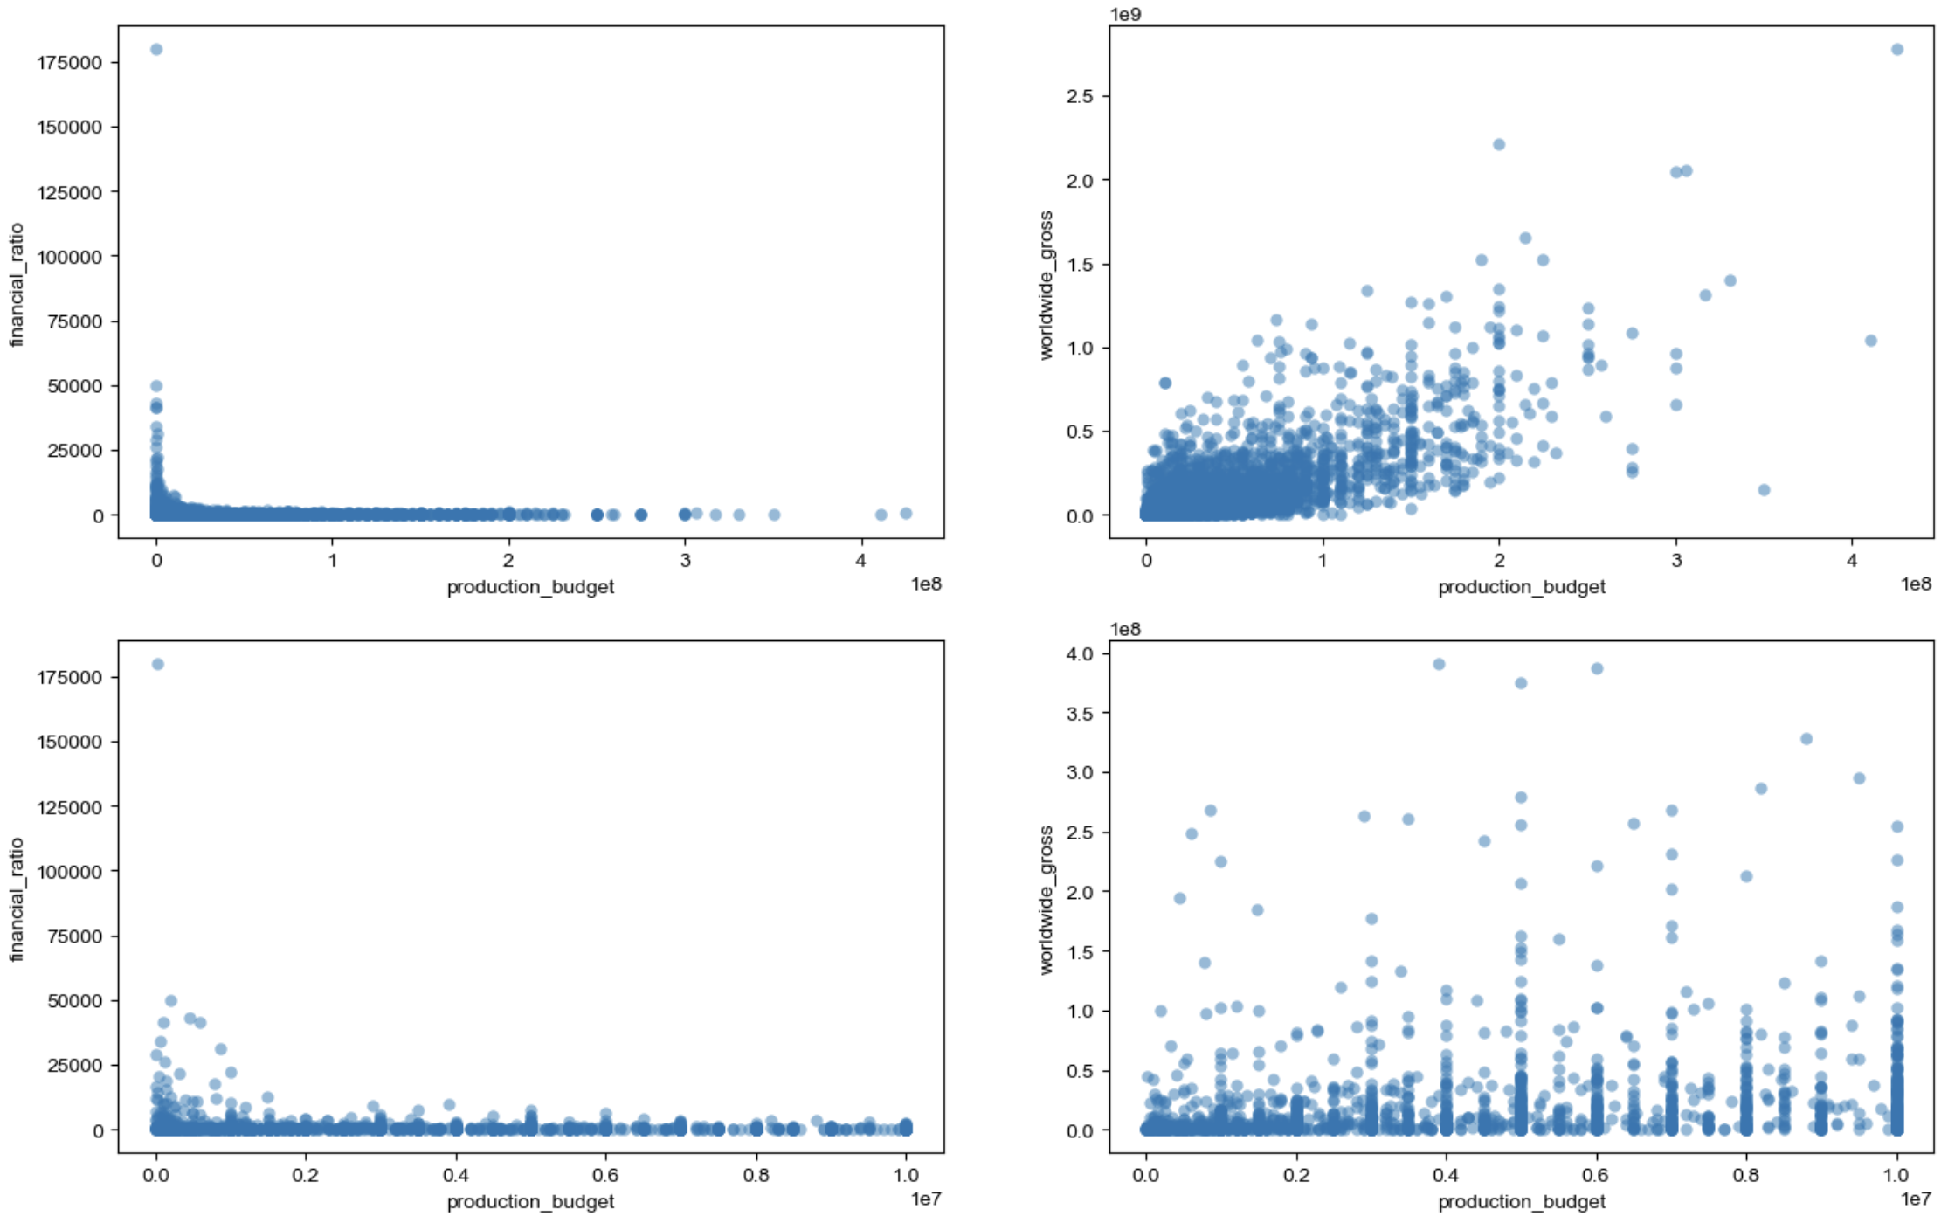

Slide 7
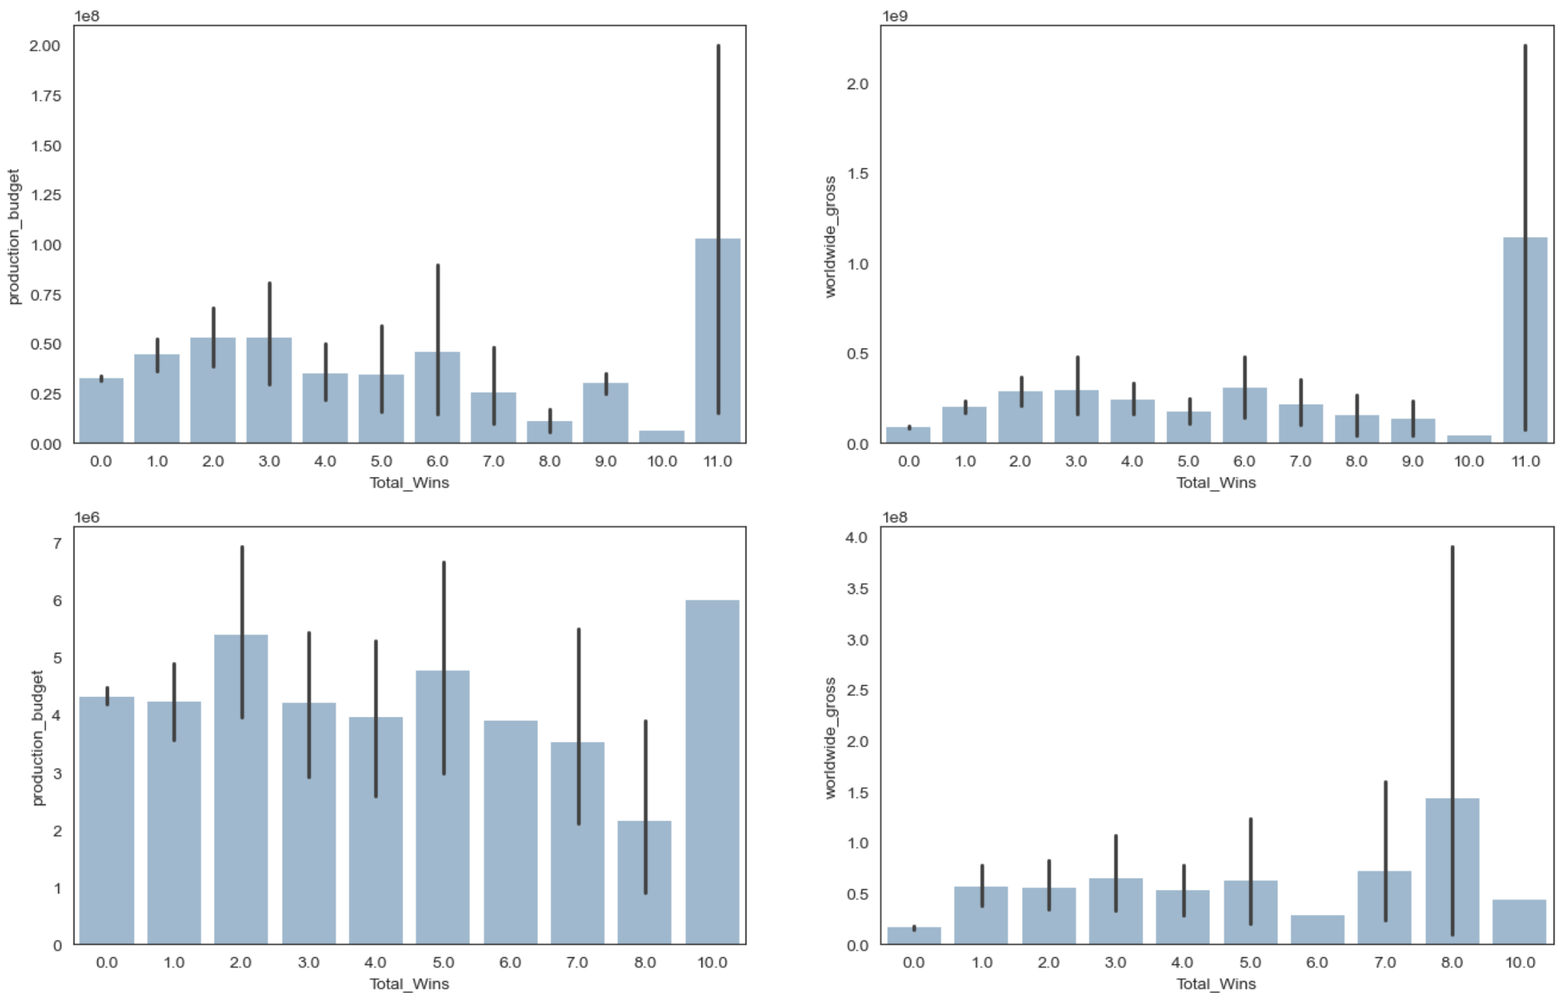

Slide 8
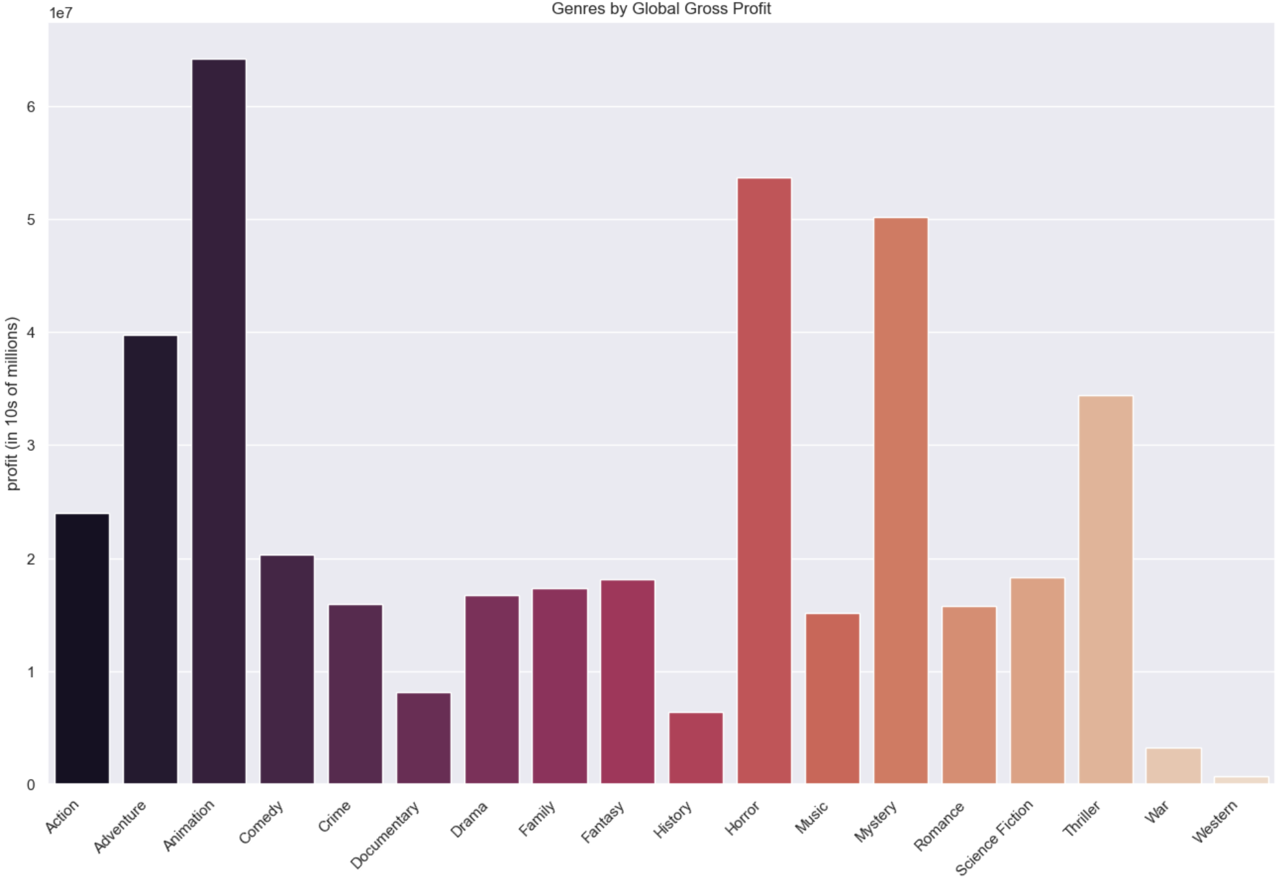

Slide 9

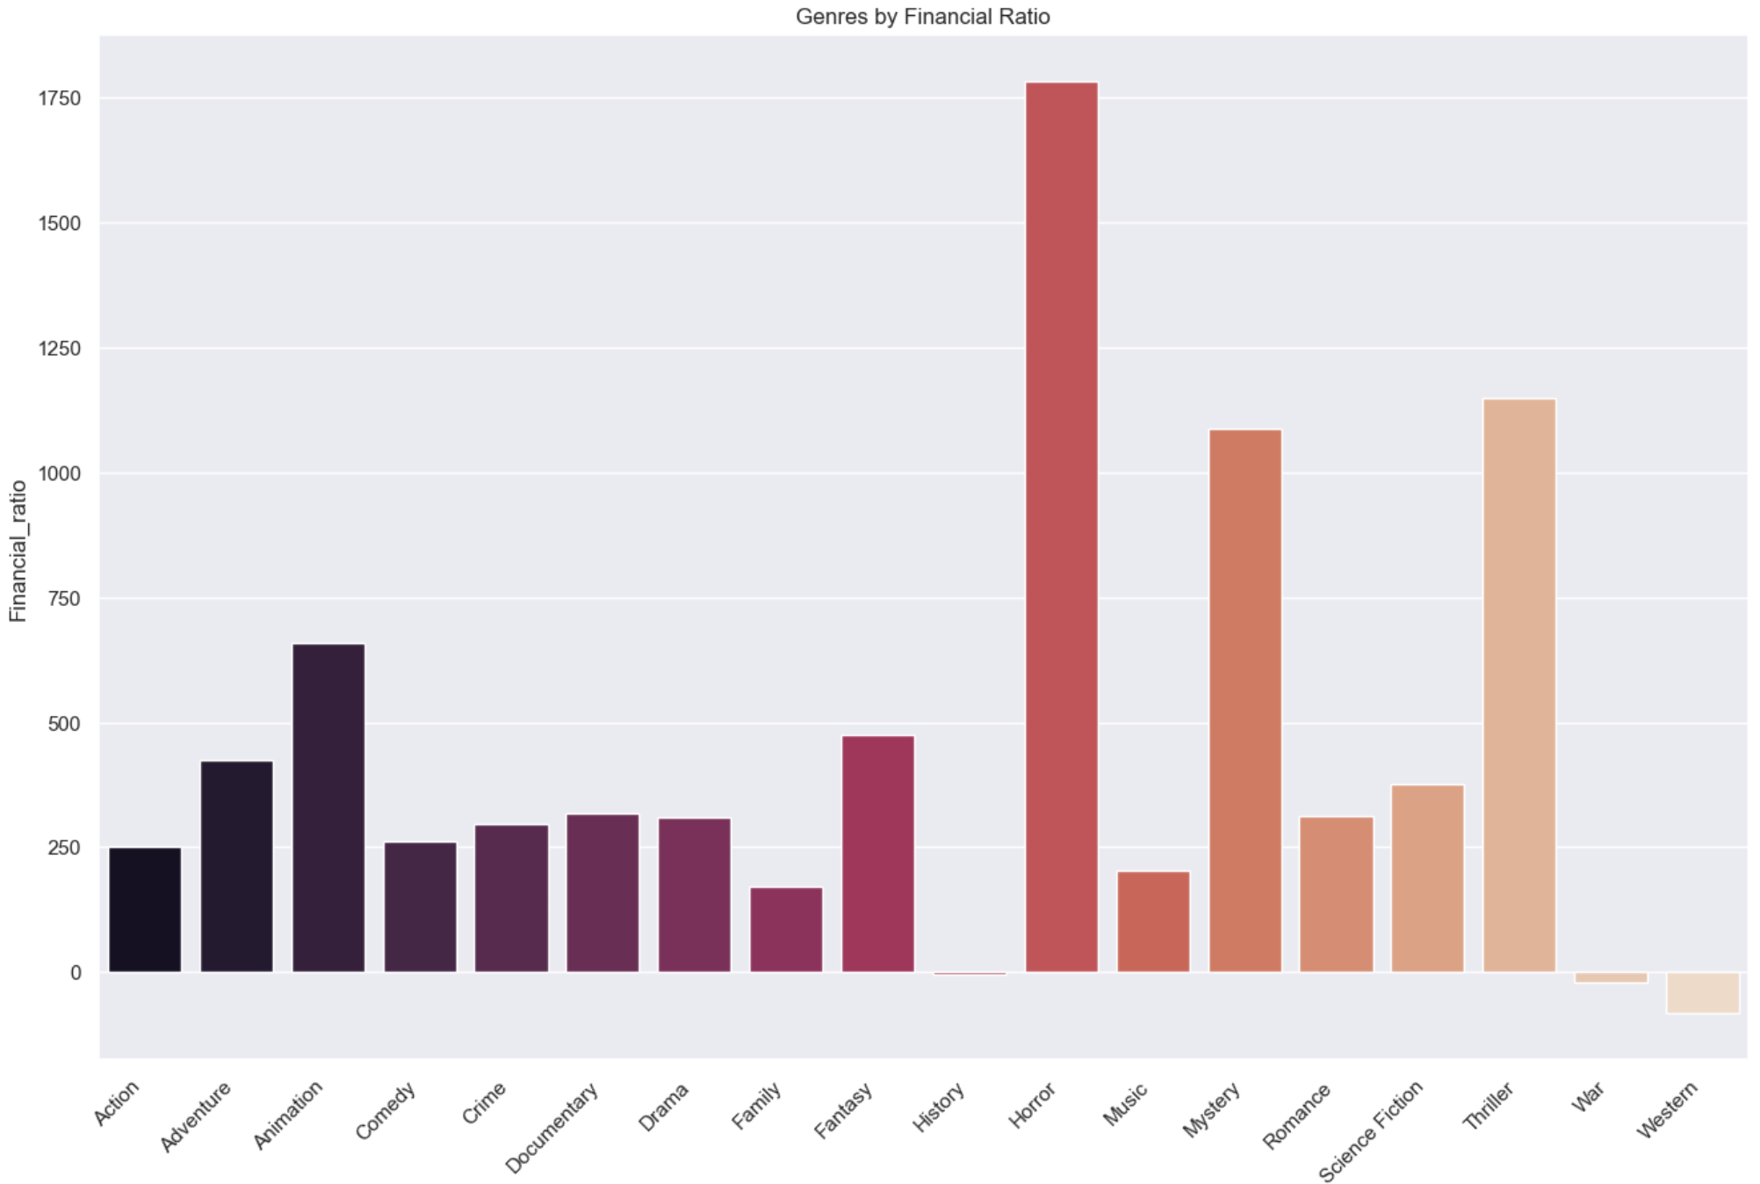

Title
Financial Ratio = $\frac{\left(Worldwide Gross −Budget\right) × 100}{Budget}$

Slide 10
