Slide 1

Hurricane Harvey Flood Forecaster
Watershed-level flood forecasting for Harris County, TX
A zone-conditioned LSTM trained on Hurricane Harvey (Aug 2017)
Deep Learning Project | Data: USGS NWIS + NHC HURDAT2

Slide 2



The Problem
Rainfall during Harvey was roughly county-wide.
Flood outcomes were not.
Flashy urban bayous
Buffalo & Brays Bayou — fast rise, fast fall
Given rainfall + wind over the past 36 hours, forecast a gage's water level for the next 12 hours, and flag whether it crosses flood stage — conditioned on which Harris County watershed you're looking at.
Extreme rural rainfall
Cypress Creek — highest totals, prolonged rise
Human-controlled release
Addicks Reservoir — slow, policy-driven recession
The real question Harris County faces every storm: rainfall is county-wide, but flood risk is hyper-local.

Slide 3
Dataset: 4 Watersheds, 1 Storm
Zone | USGS Site | Watershed character
Buffalo Bayou at Houston | 08074500 | Urban bayou — fast, flashy response
Brays Bayou at Houston | 08075000 | Urban bayou — repeated residential flooding (Meyerland)
Cypress Creek near Westfield | 08068500 | Rural/suburban — Harvey's most extreme rainfall totals
Addicks Reservoir near Addicks | 08073000 | Flood-control reservoir — slow, human-controlled release
Signals pulled for each zone (storm window Aug 23 – Sep 2, 2017):
Gage height & discharge
Precipitation
Wind speed
USGS NWIS instantaneous values service
USGS NWIS, parameter 00045 (co-located gages)
NHC HURDAT2 best track for Harvey (AL092017)

Slide 4
Model: One Encoder, Conditioned on Zone
Shared LSTM across all 4 gages — a zone embedding specializes the response per watershed
Regression Head
water level, next 12h
Rainfall + Wind
Zone Embedding
Shared LSTM Encoder
36h lookback window
learned, per watershed
2 layers, hidden=64
Classification Head
flood-stage probability
Why share one encoder instead of 4 separate models? Each gage only has ~10 days of storm data — too little for a model to learn alone. Sharing lets the encoder learn general storm dynamics from all 4 gages, while the zone embedding specializes the shape per watershed.
This is also the exact mechanism the demo exploits: swap the zone embedding, hold rainfall/wind fixed, isolate the effect of location.

Slide 5
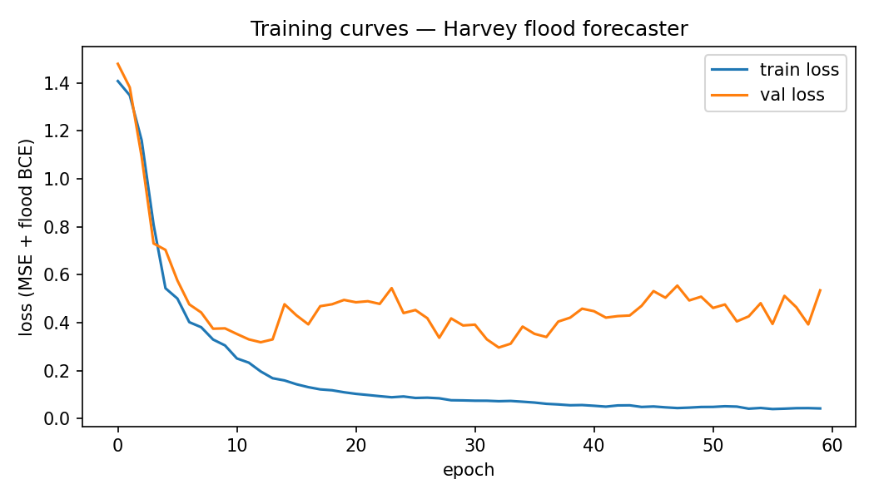
Training
Multi-task loss
MSE on water level + weighted BCE on flood-stage exceedance
Time-based split
Train on rise, validate/test on recession — never shuffle across time
Adam optimizer
lr = 1e-3, weight decay = 1e-5, 60 epochs
Checkpoint bundling
Model weights + config + normalizer saved together — no refitting needed downstream
outputs/training_curves.png — train vs. val loss over 60 epochs

Slide 6
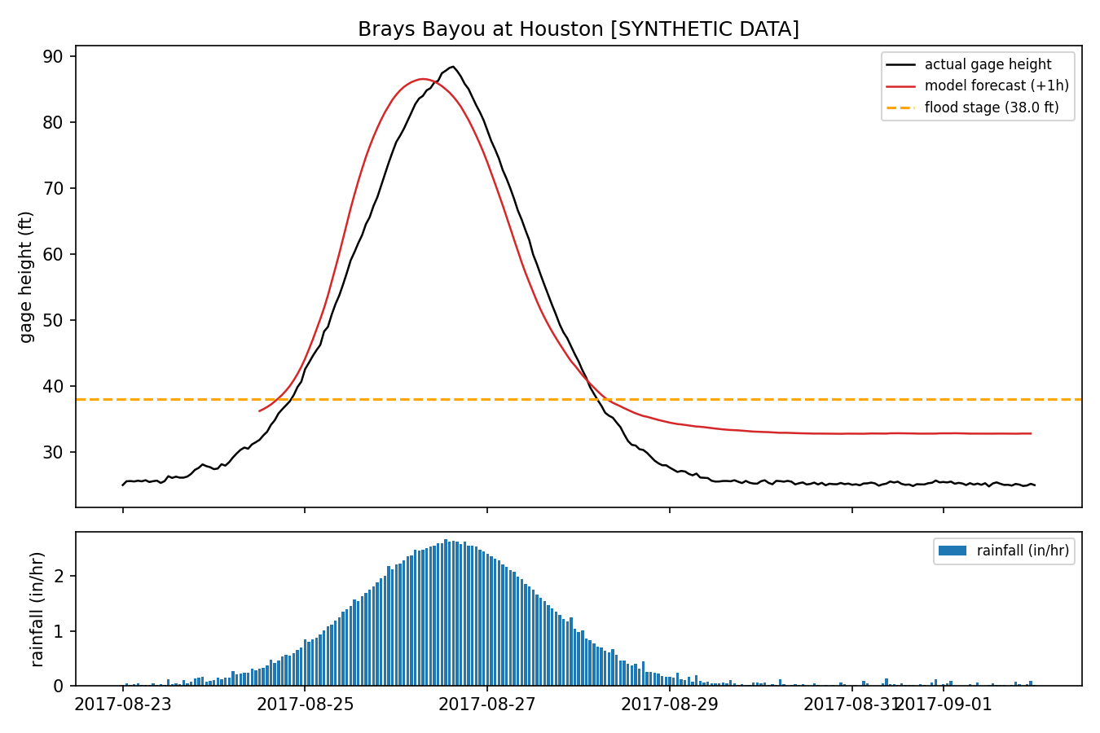
Results
Zone | RMSE (ft) | MAE (ft)
Buffalo Bayou | 10.9 | 10.6
Brays Bayou | 12.0 | 11.7
Cypress Creek | 20.2 | 19.4
Addicks Reservoir | 13.9 | 13.2
Model tracks the rise and peak well across all 4 zones. Cypress Creek has the highest error — its rainfall-driven response is the most volatile of the four. Addicks' slow, policy-driven recession is visibly under-predicted (see report).
outputs/hydrograph_brays_bayou.png — predicted (+1h) vs actual

Slide 7
Demo: Same Storm, Different Zone
Hold rainfall (0.4 in/hr) and wind (20 mph) fixed across all 4 zones — only the zone embedding changes
Buffalo Bayou
⚠ exceeds flood stage
Brays Bayou
⚠ exceeds flood stage
Cypress Creek
⚠ exceeds flood stage
Addicks Reservoir
✓ stays below flood stage

Slide 8



Lessons Learned & Limitations
Single-event data is genuinely limiting
With one storm, a zone's held-out window can contain zero flood crossings — pooling metrics across zones helps, but multi-storm training is the real fix.
Reservoirs aren't pure hydrology
Addicks' release is an Army Corps policy decision, not just rainfall response — the model visibly under-predicts its slow recession.
Zone-conditioning punches above its weight
One small shared LSTM + an 8-dim embedding captured 4 distinctly different watershed personalities from ~10 days of data each.
Build for graceful degradation
A synthetic-data fallback meant the whole pipeline stayed testable even when live USGS/NHC access wasn't available.

Slide 9
Future Work
Train across more storms (Imelda 2019, Beta 2020, Nicholas 2021) for cross-event generalization
Per-zone wind via distance-weighted interpolation from the HURDAT2 track, not one county-wide series
Spatial flood-extent mapping (Sentinel-1 SAR + DEM, U-Net) as a richer visual extension
Leave-one-zone-out evaluation — train on 3 watersheds, test entirely on the 4th
github.com/gjjohnson/harvey-flood-dl

