Slide 1
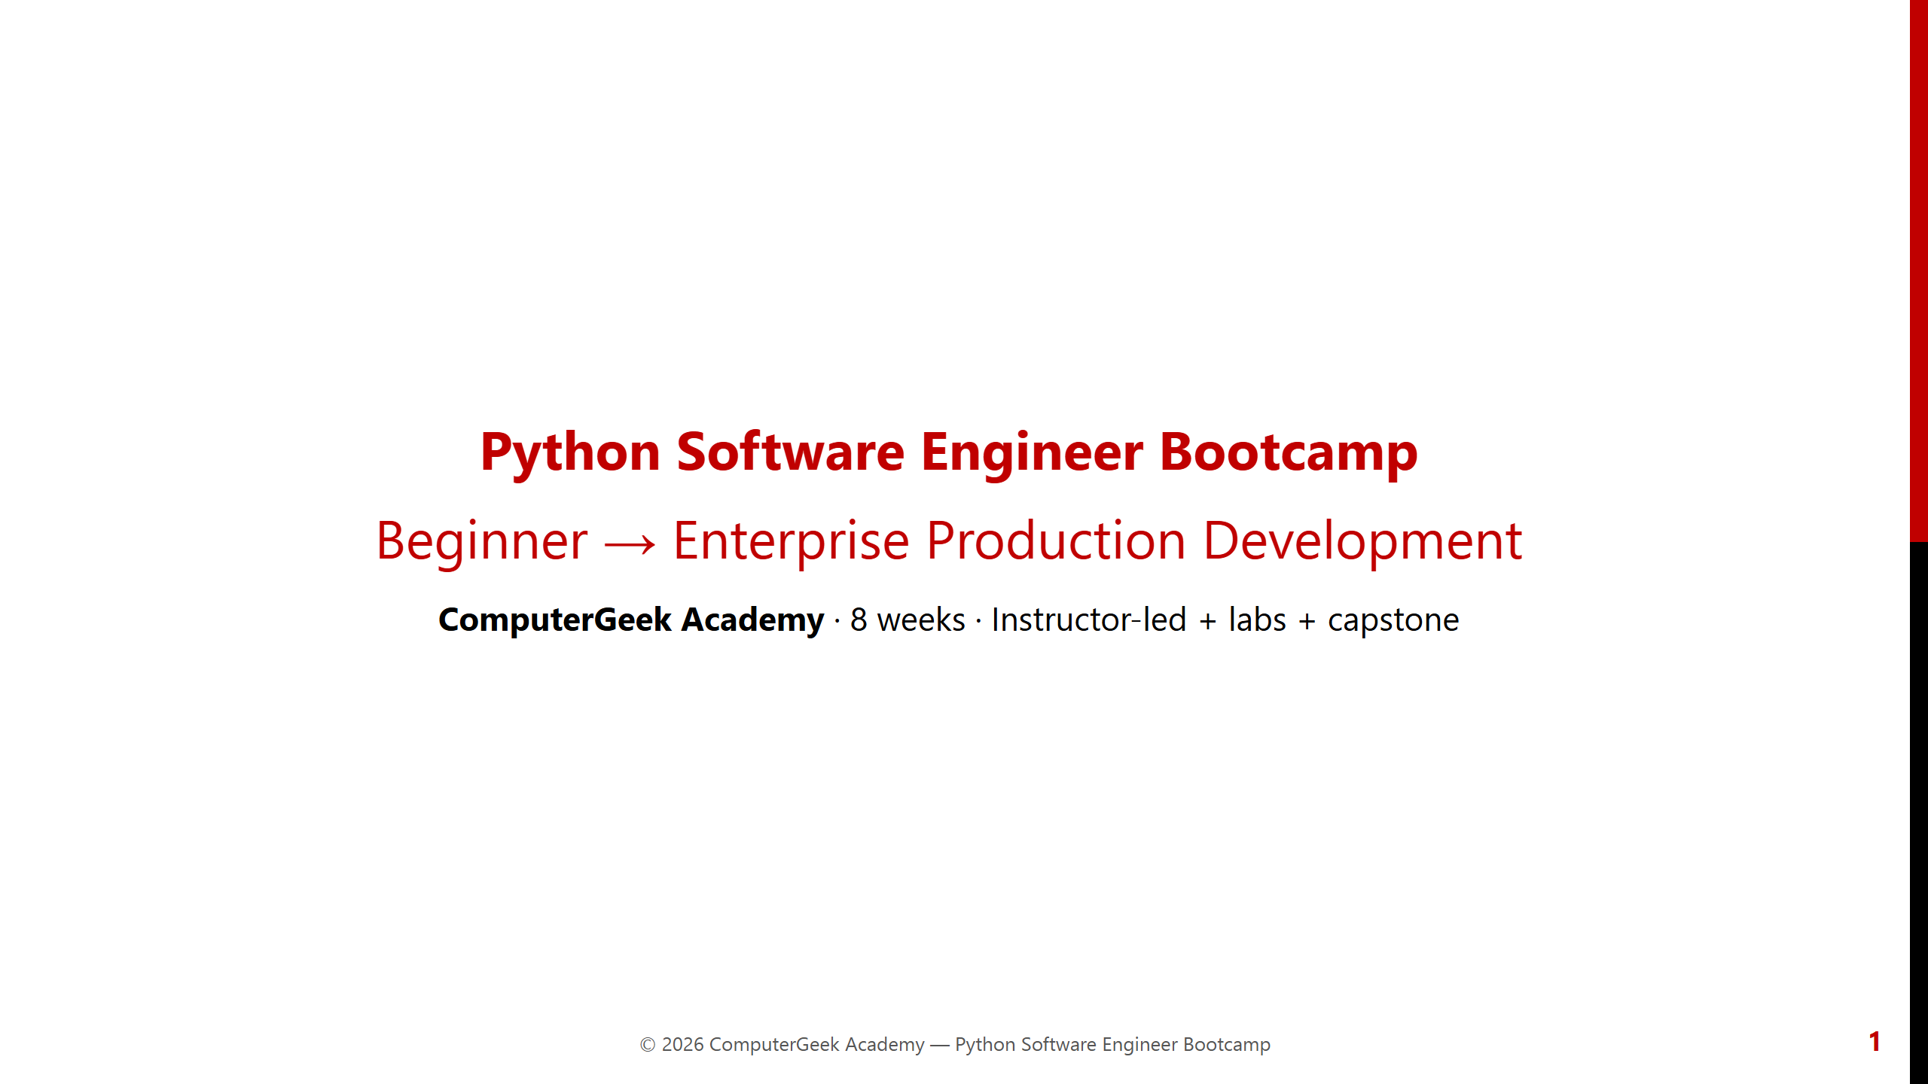
Notes:
Welcome learners. This deck focuses on the Python bootcamp only. Point them to the free Python Code Lab for Week 1 dry-runs.

Slide 2
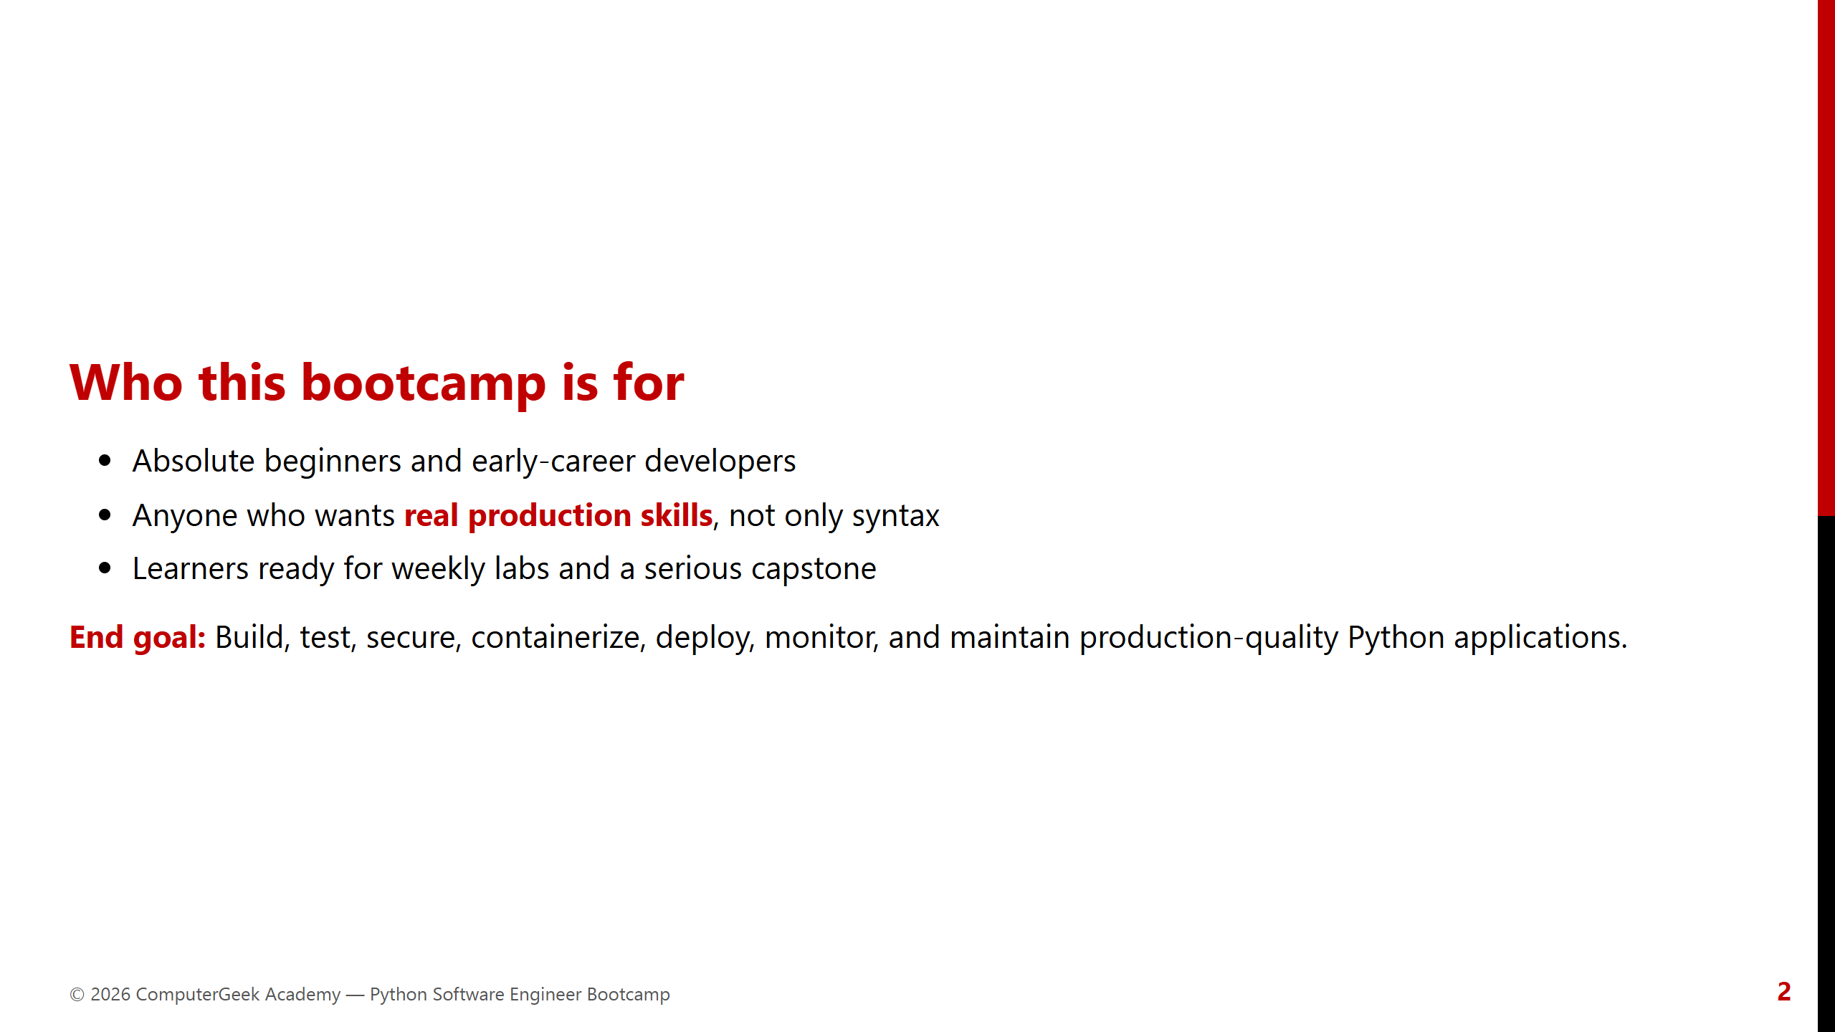
Notes:
Emphasize: syntax alone is not enough — we go to production engineering.

Slide 3
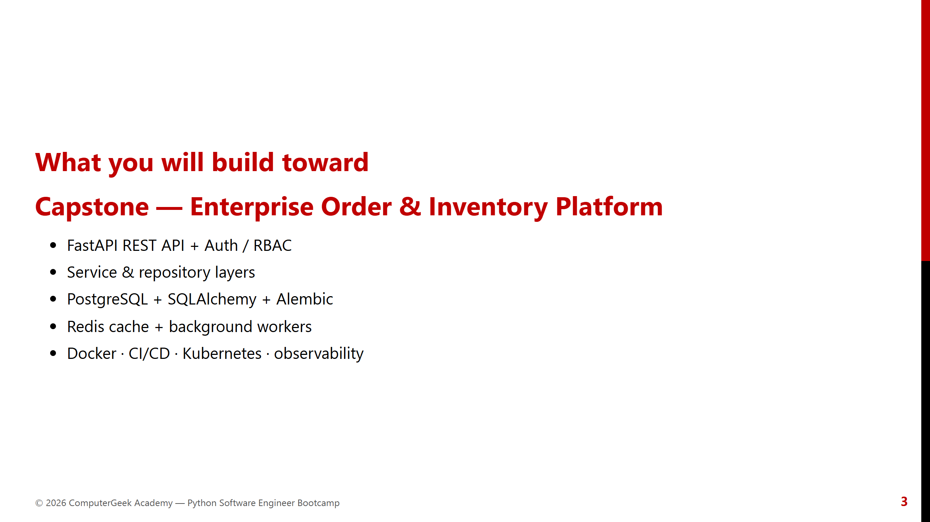
Notes:
Show the big picture early so Week 1 foundations feel purposeful.

Slide 4
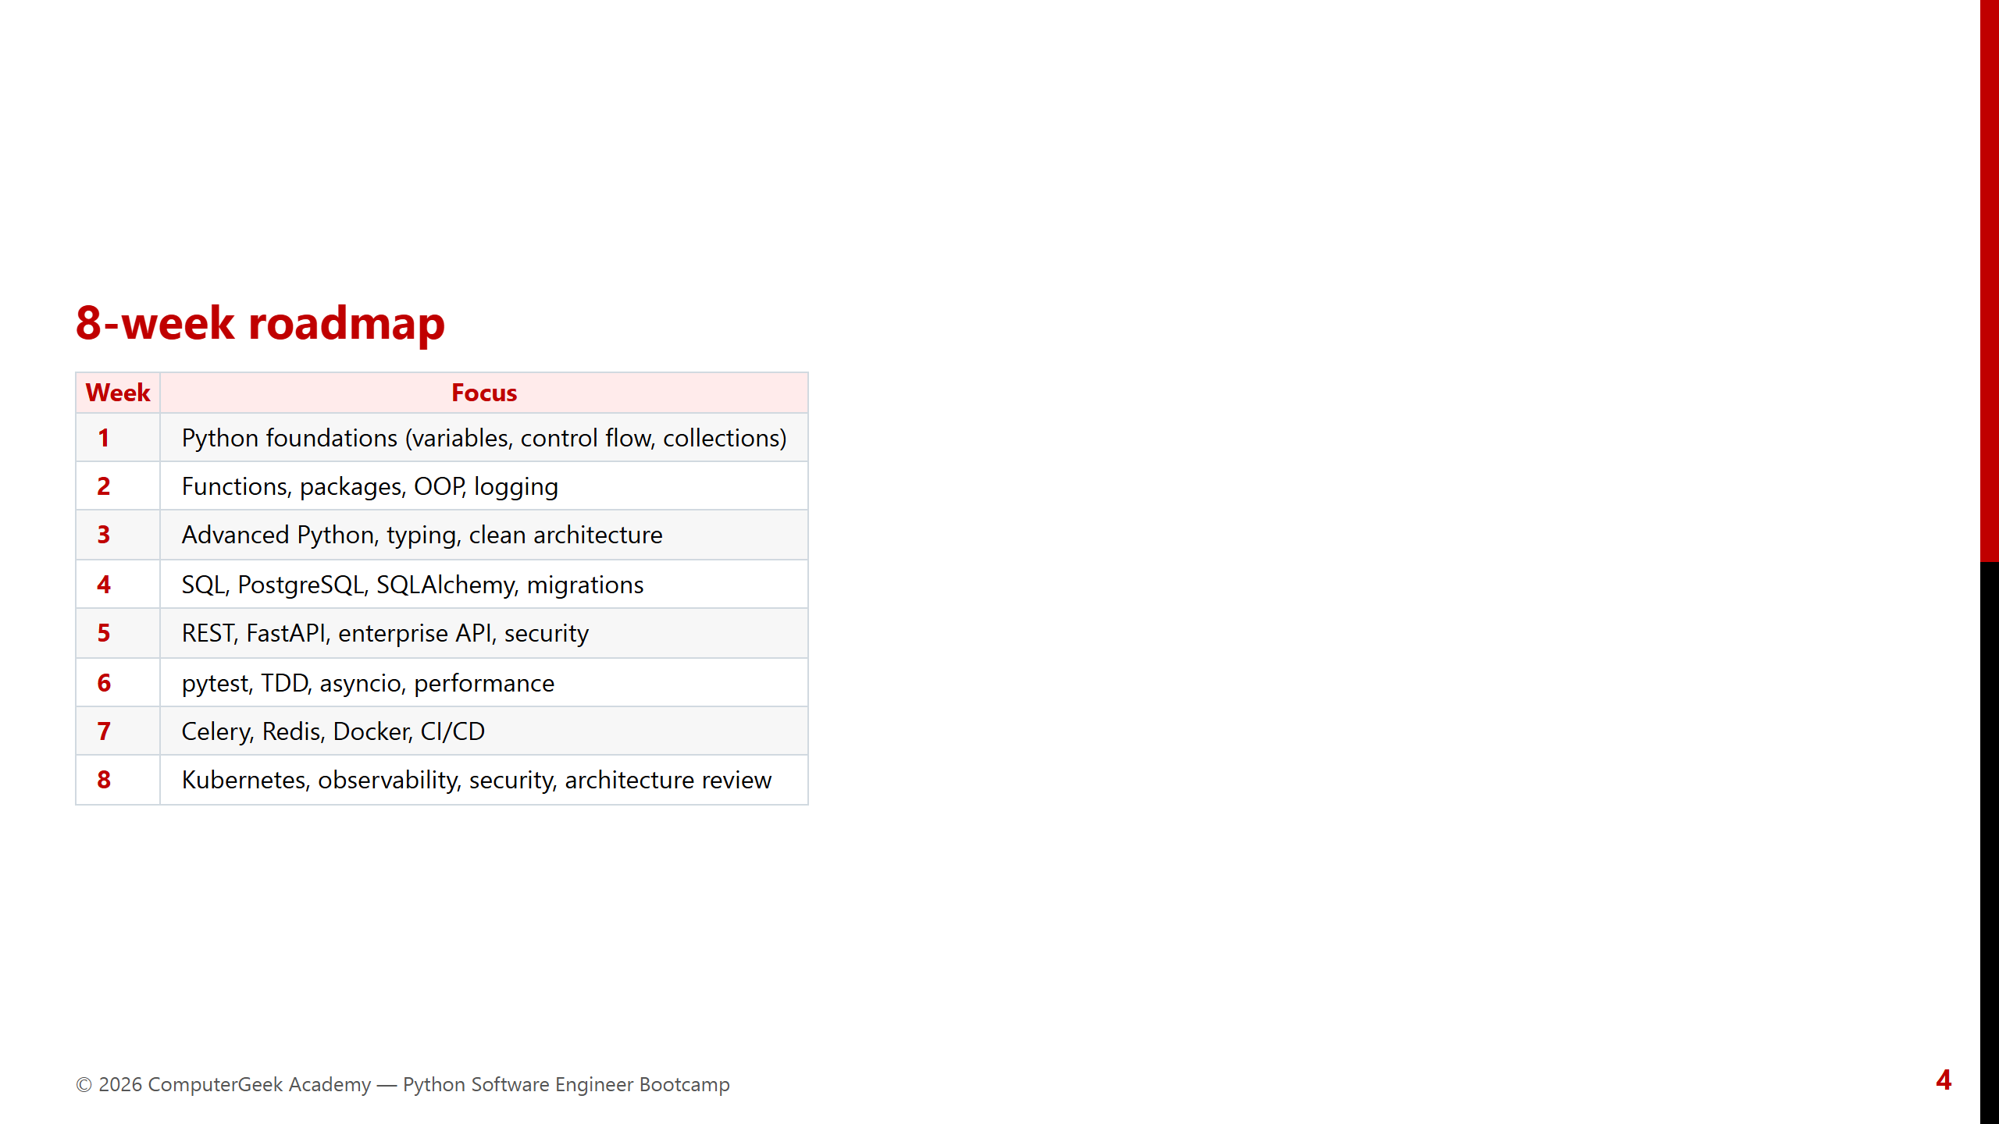
Notes:
This PPT focuses deep content on Week 1 for now. Later weeks = roadmap slides.

Slide 5
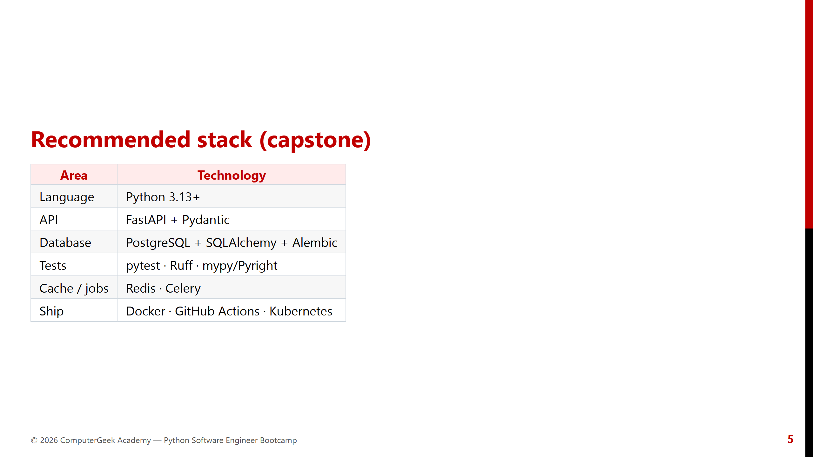
Notes:
Do not overwhelm beginners — say “you will grow into this stack.”

Slide 6
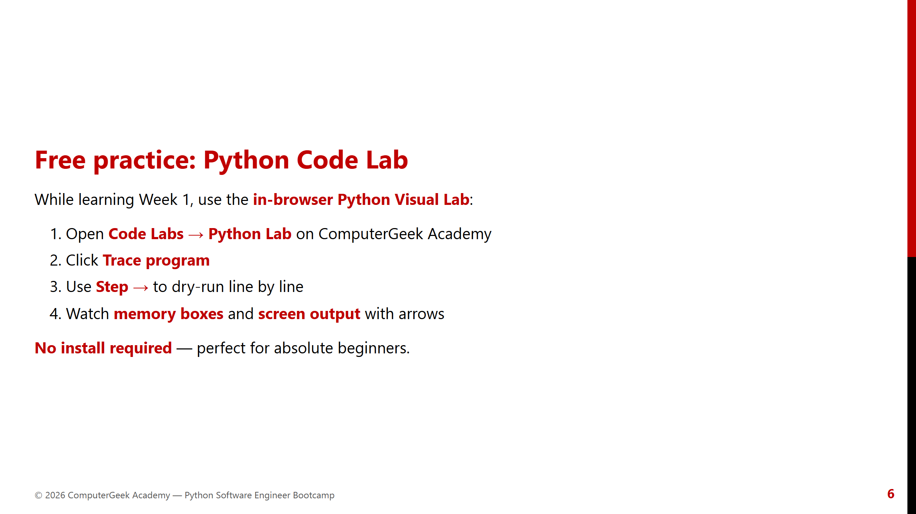
Notes:
Demo the lab live if possible in the first session.

Slide 7
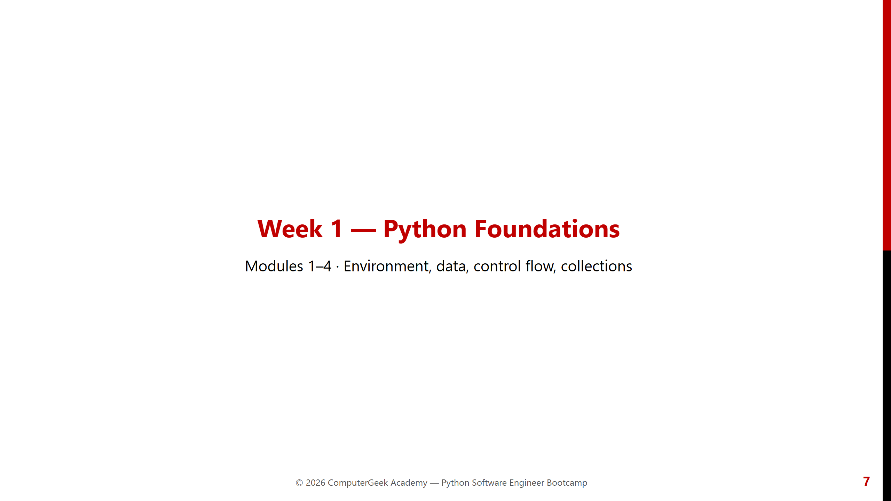
Notes:
Week 1 opener. Labs every module. Use Code Lab for variables & loops.

Slide 8
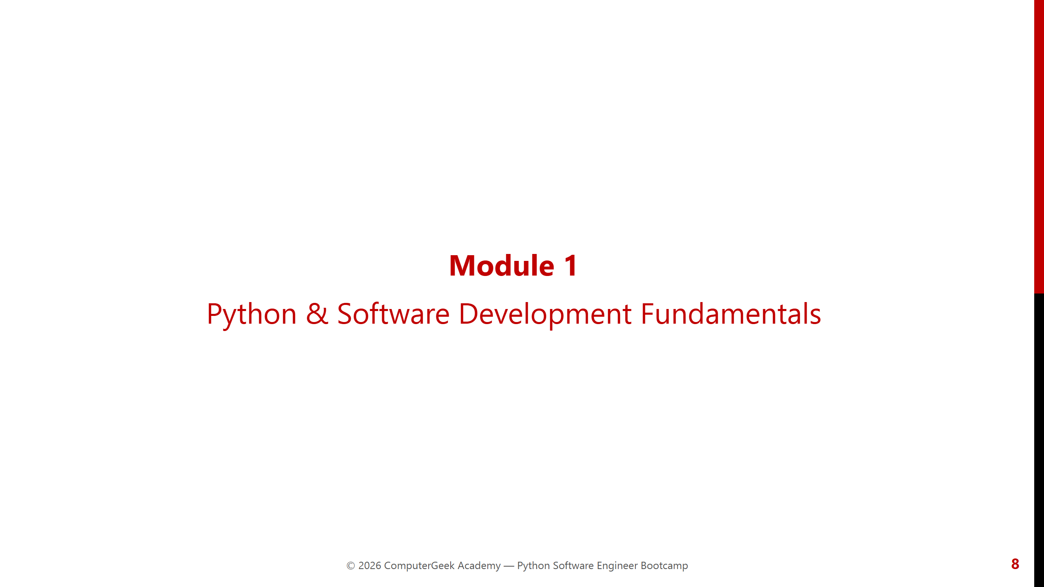
Notes:
Module 1 opener.

Slide 9
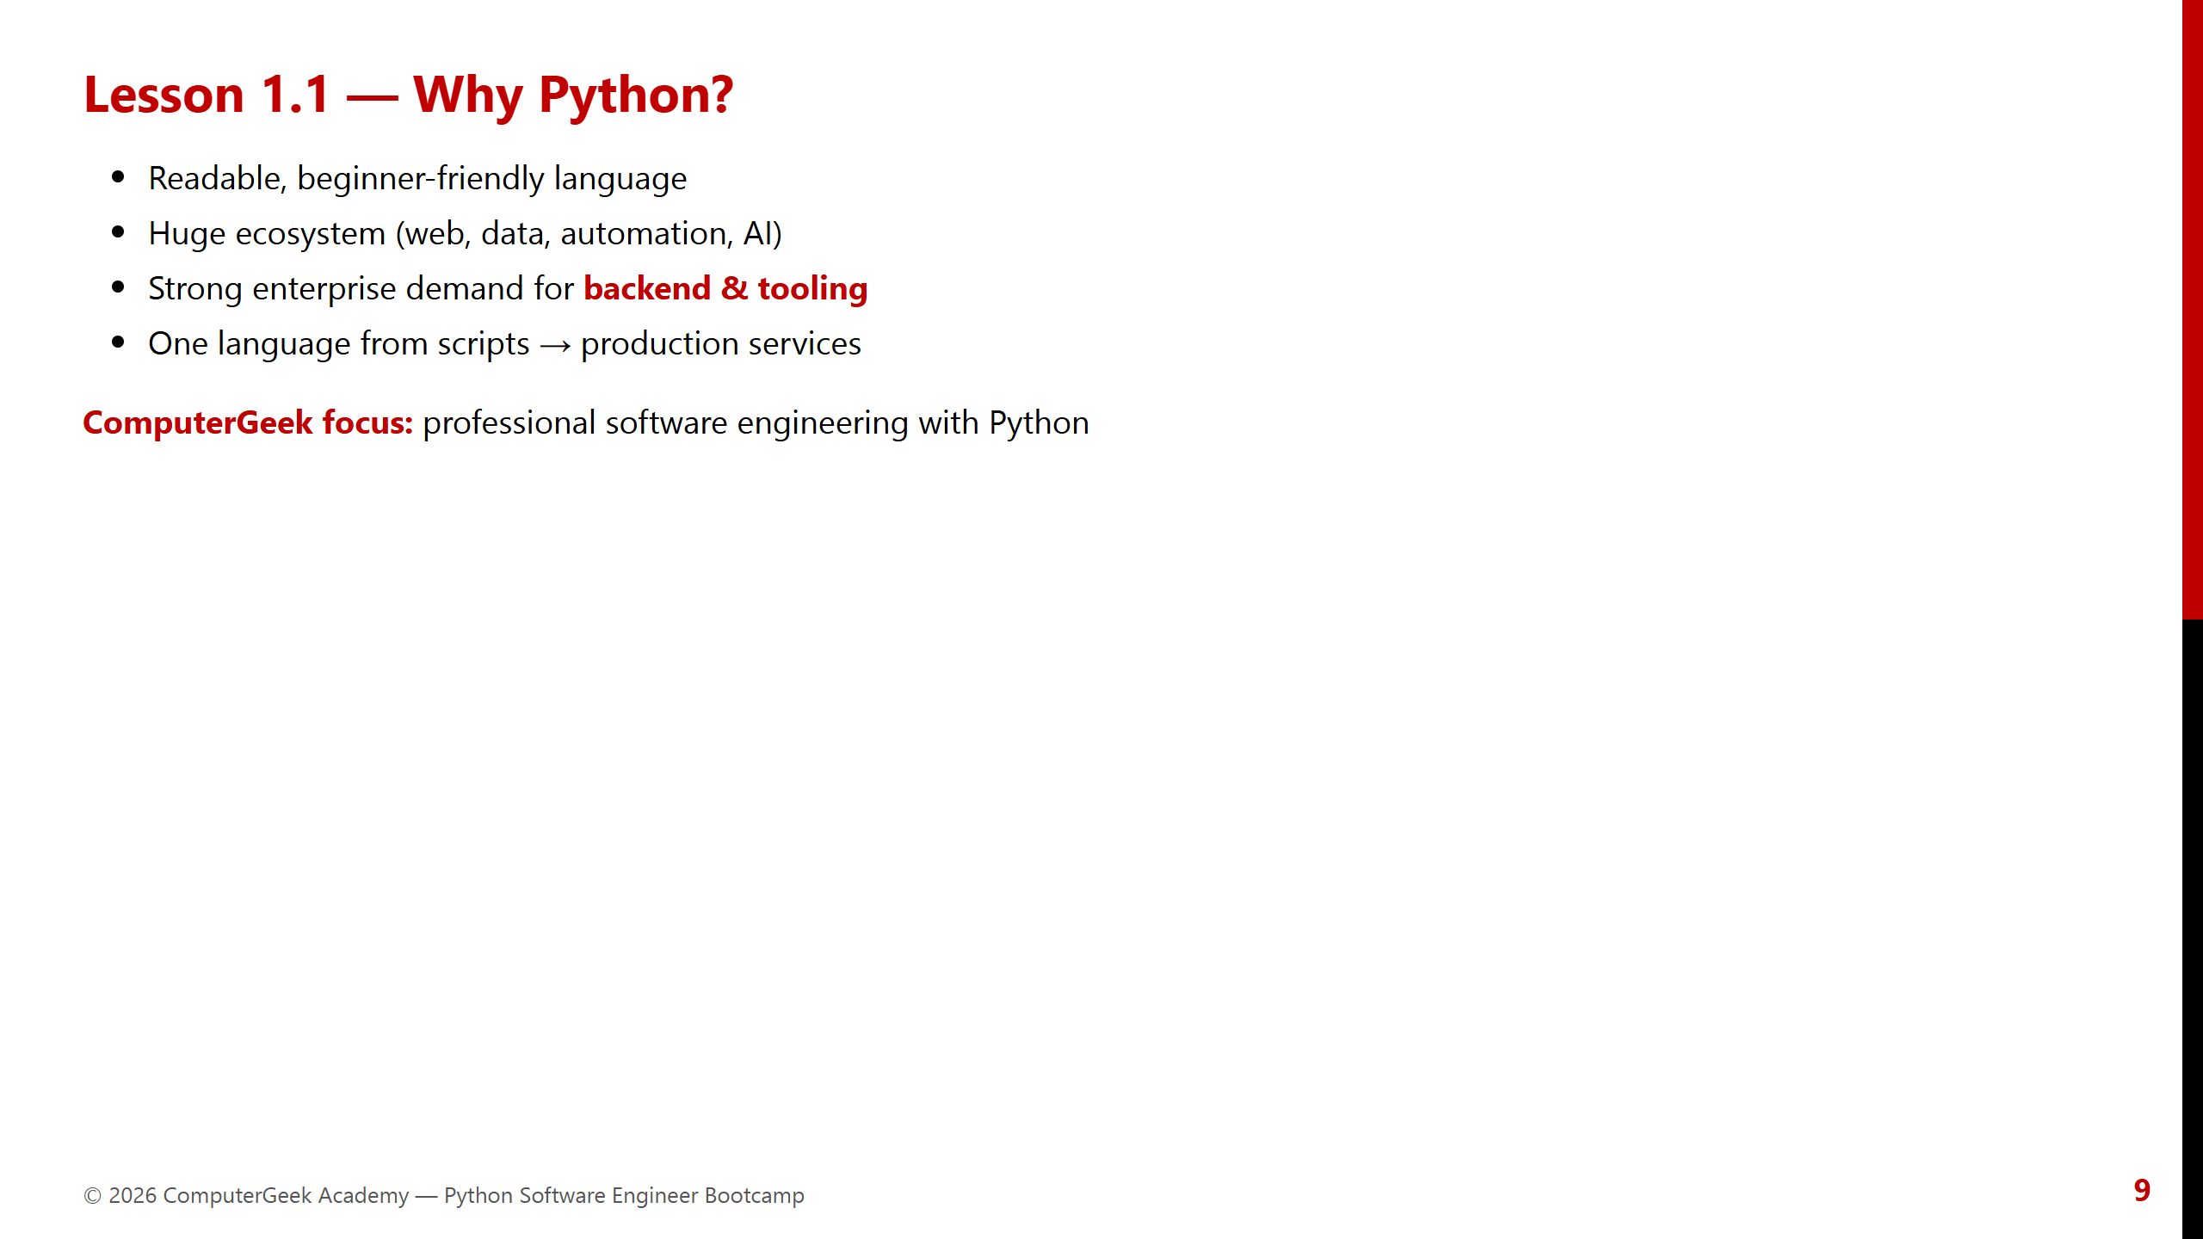
Notes:
Connect motivation to careers, not just “Python is popular.”

Slide 10
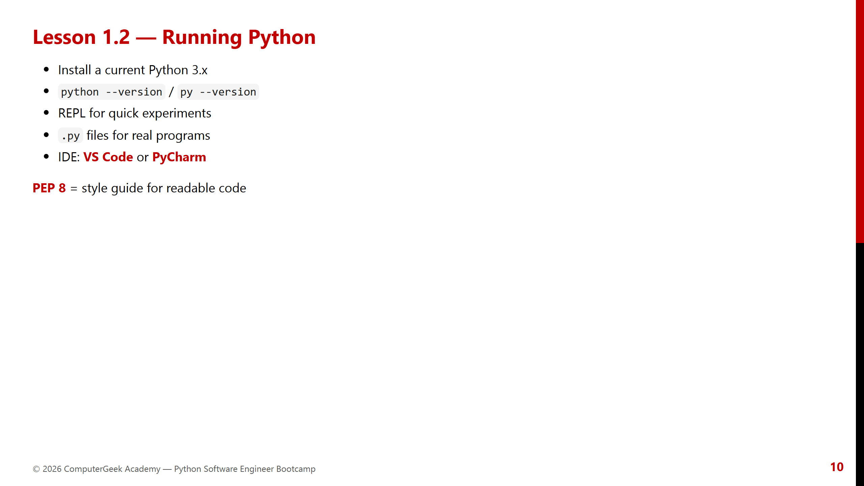
Notes:
Have learners verify install together. Fix PATH issues early.

Slide 11
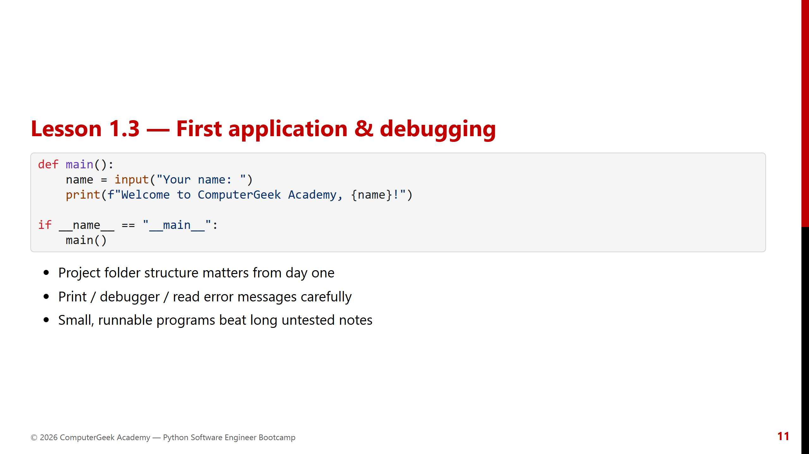
Notes:
Walk through a deliberate bug and how to read the traceback.

Slide 12
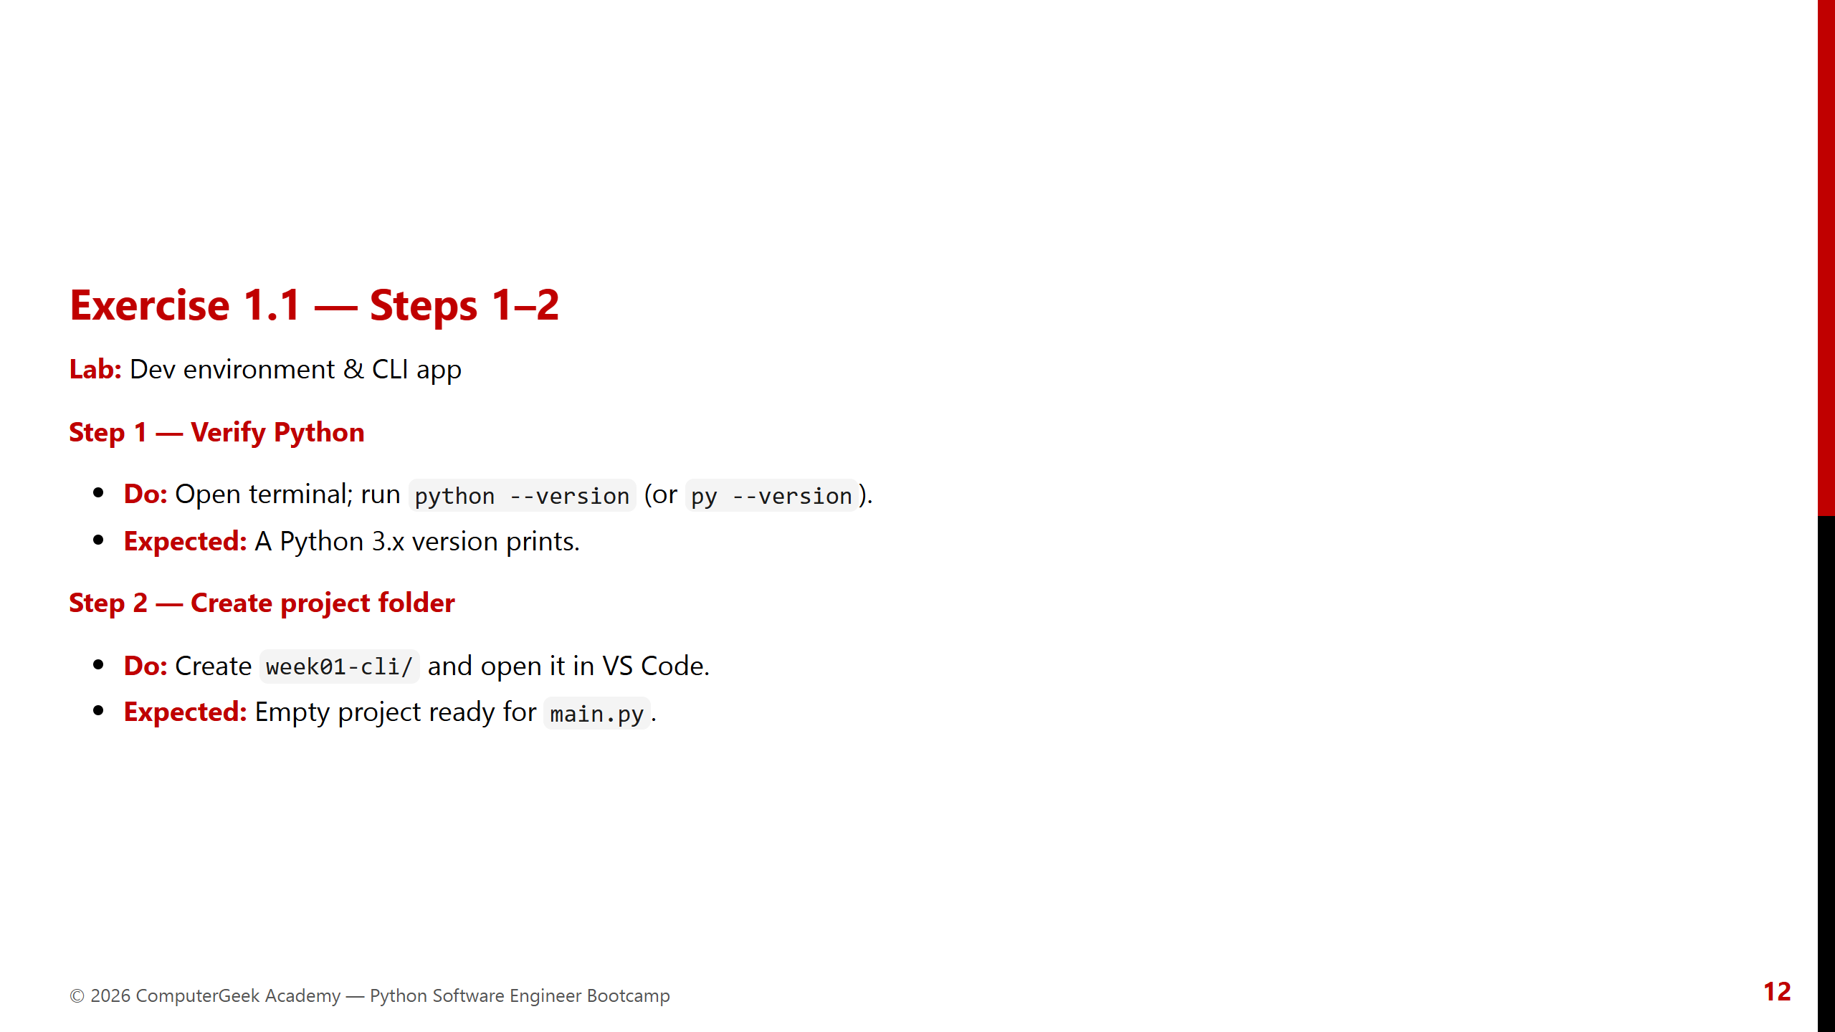
Notes:
Time-box tightly. Help anyone stuck on install immediately.

Slide 13
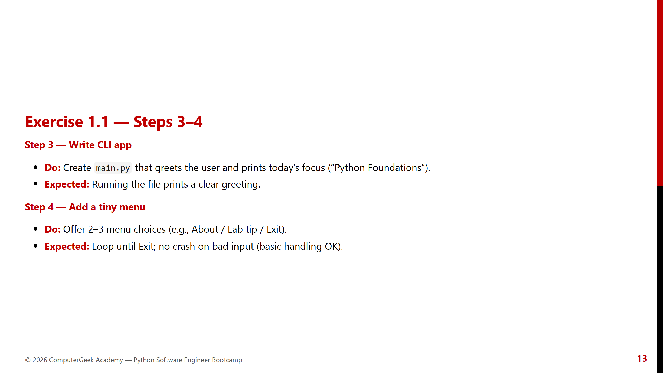
Notes:
Collect 2–3 demos. Praise clean structure over cleverness.

Slide 14
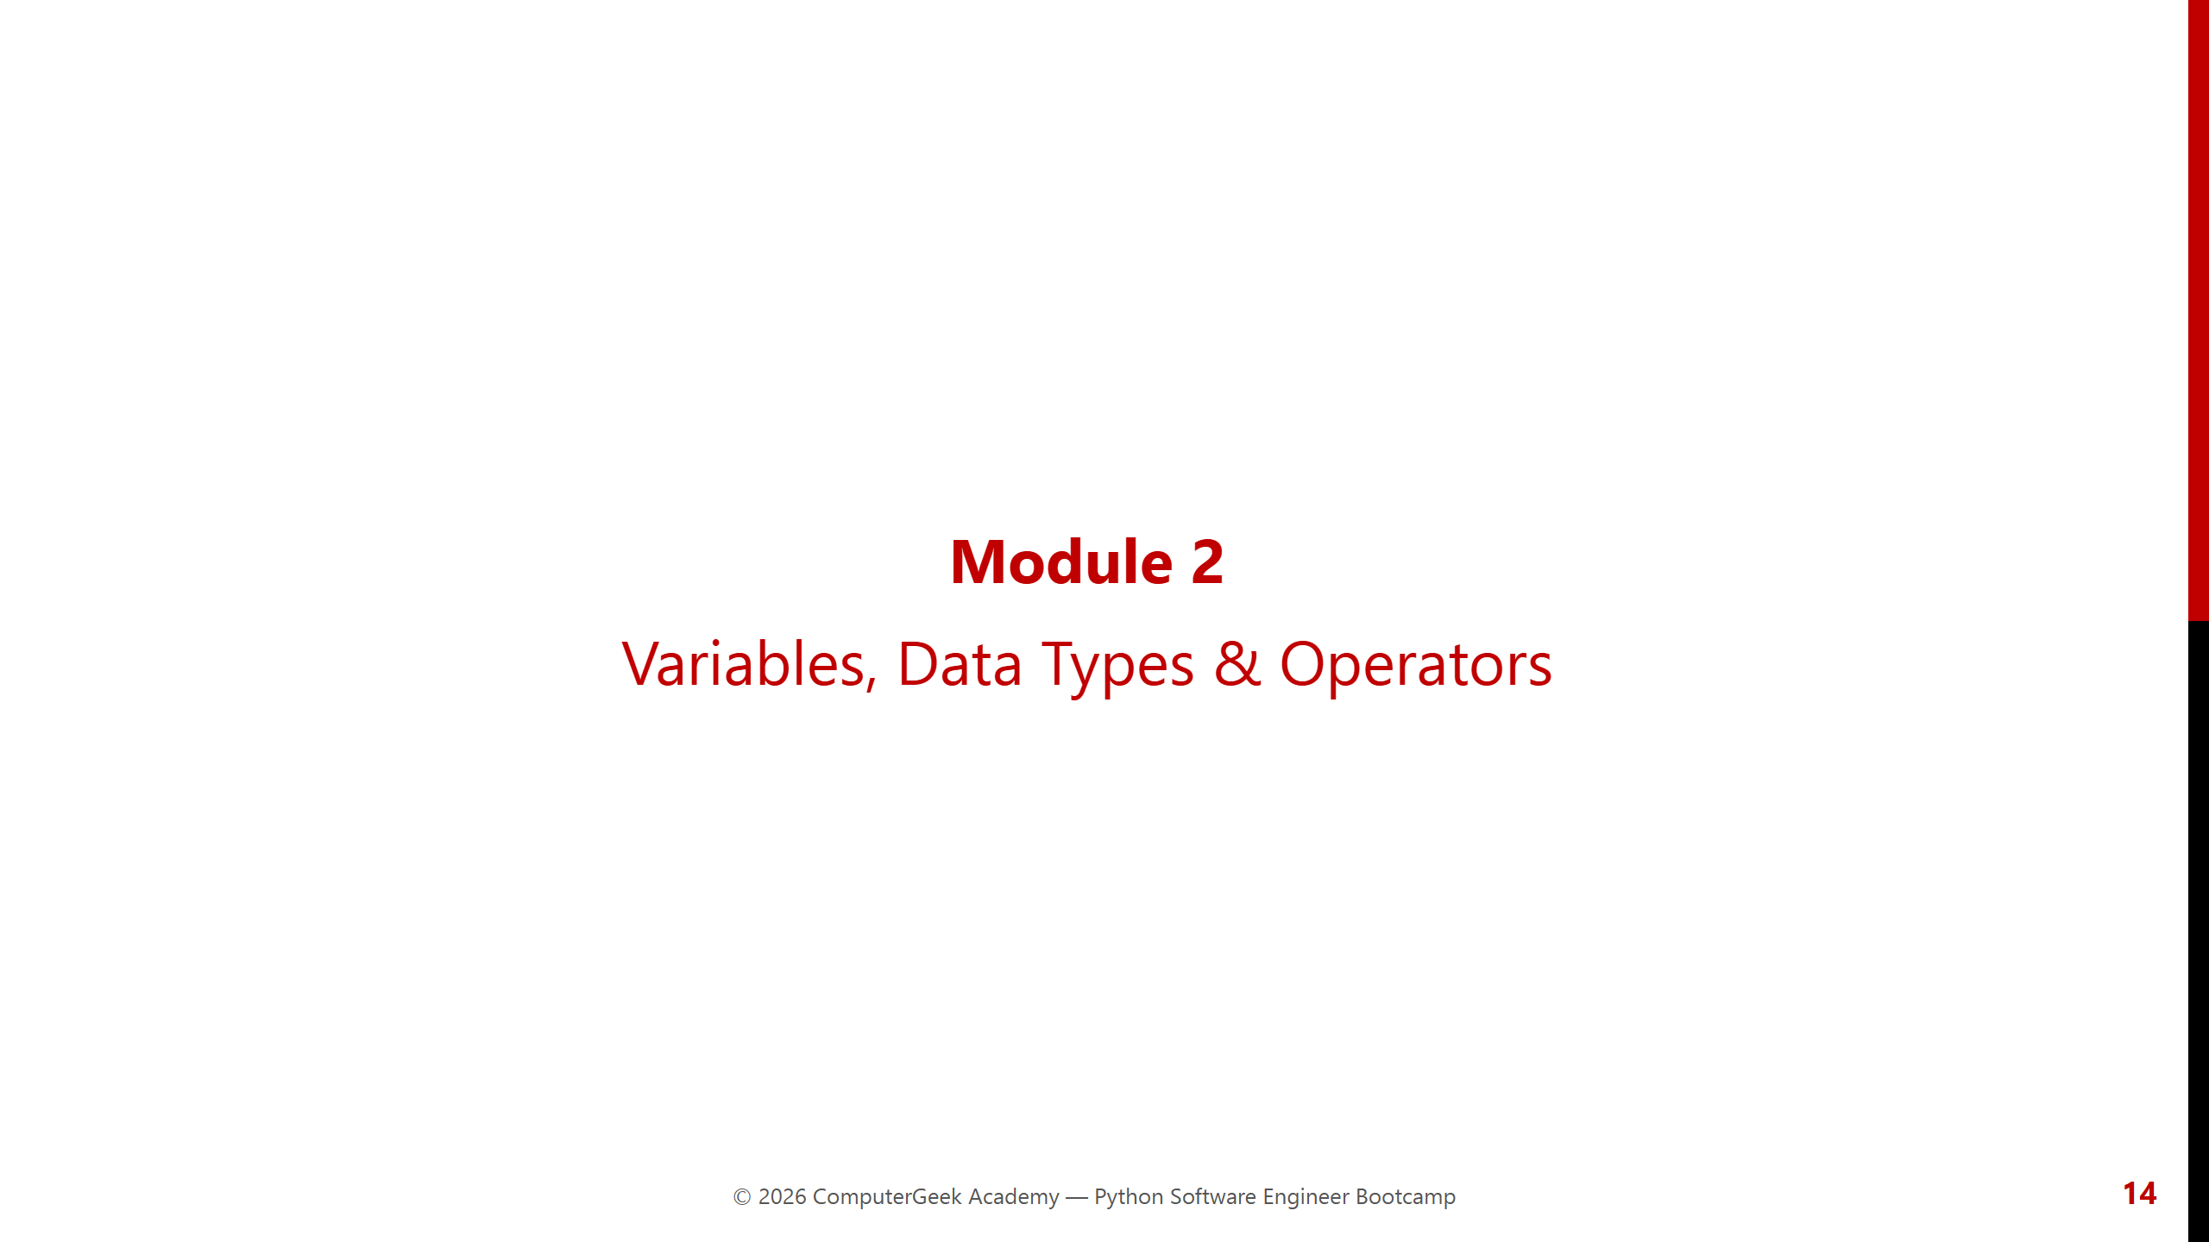
Notes:
Module 2 opener. Pair with Code Lab memory boxes.

Slide 15
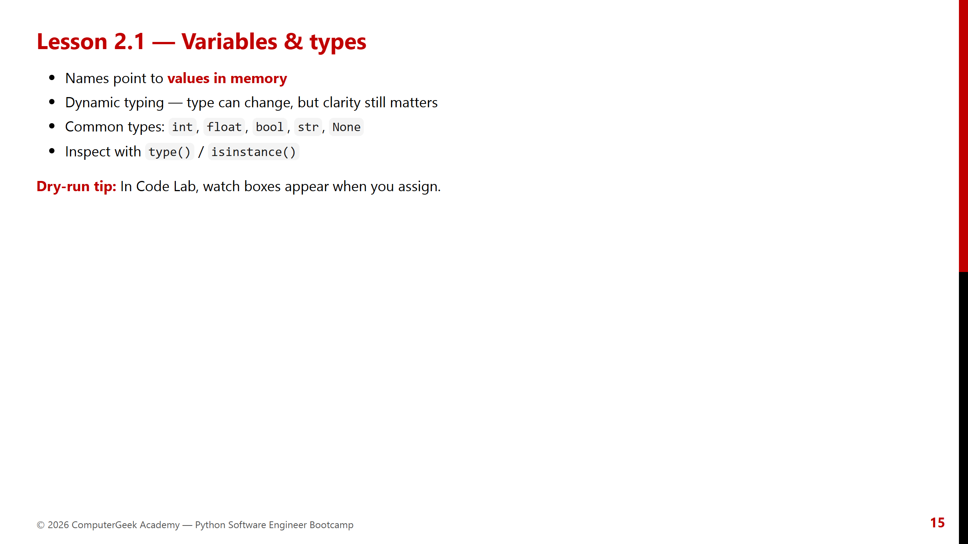
Notes:
Draw name → value boxes on whiteboard if teaching in person.

Slide 16
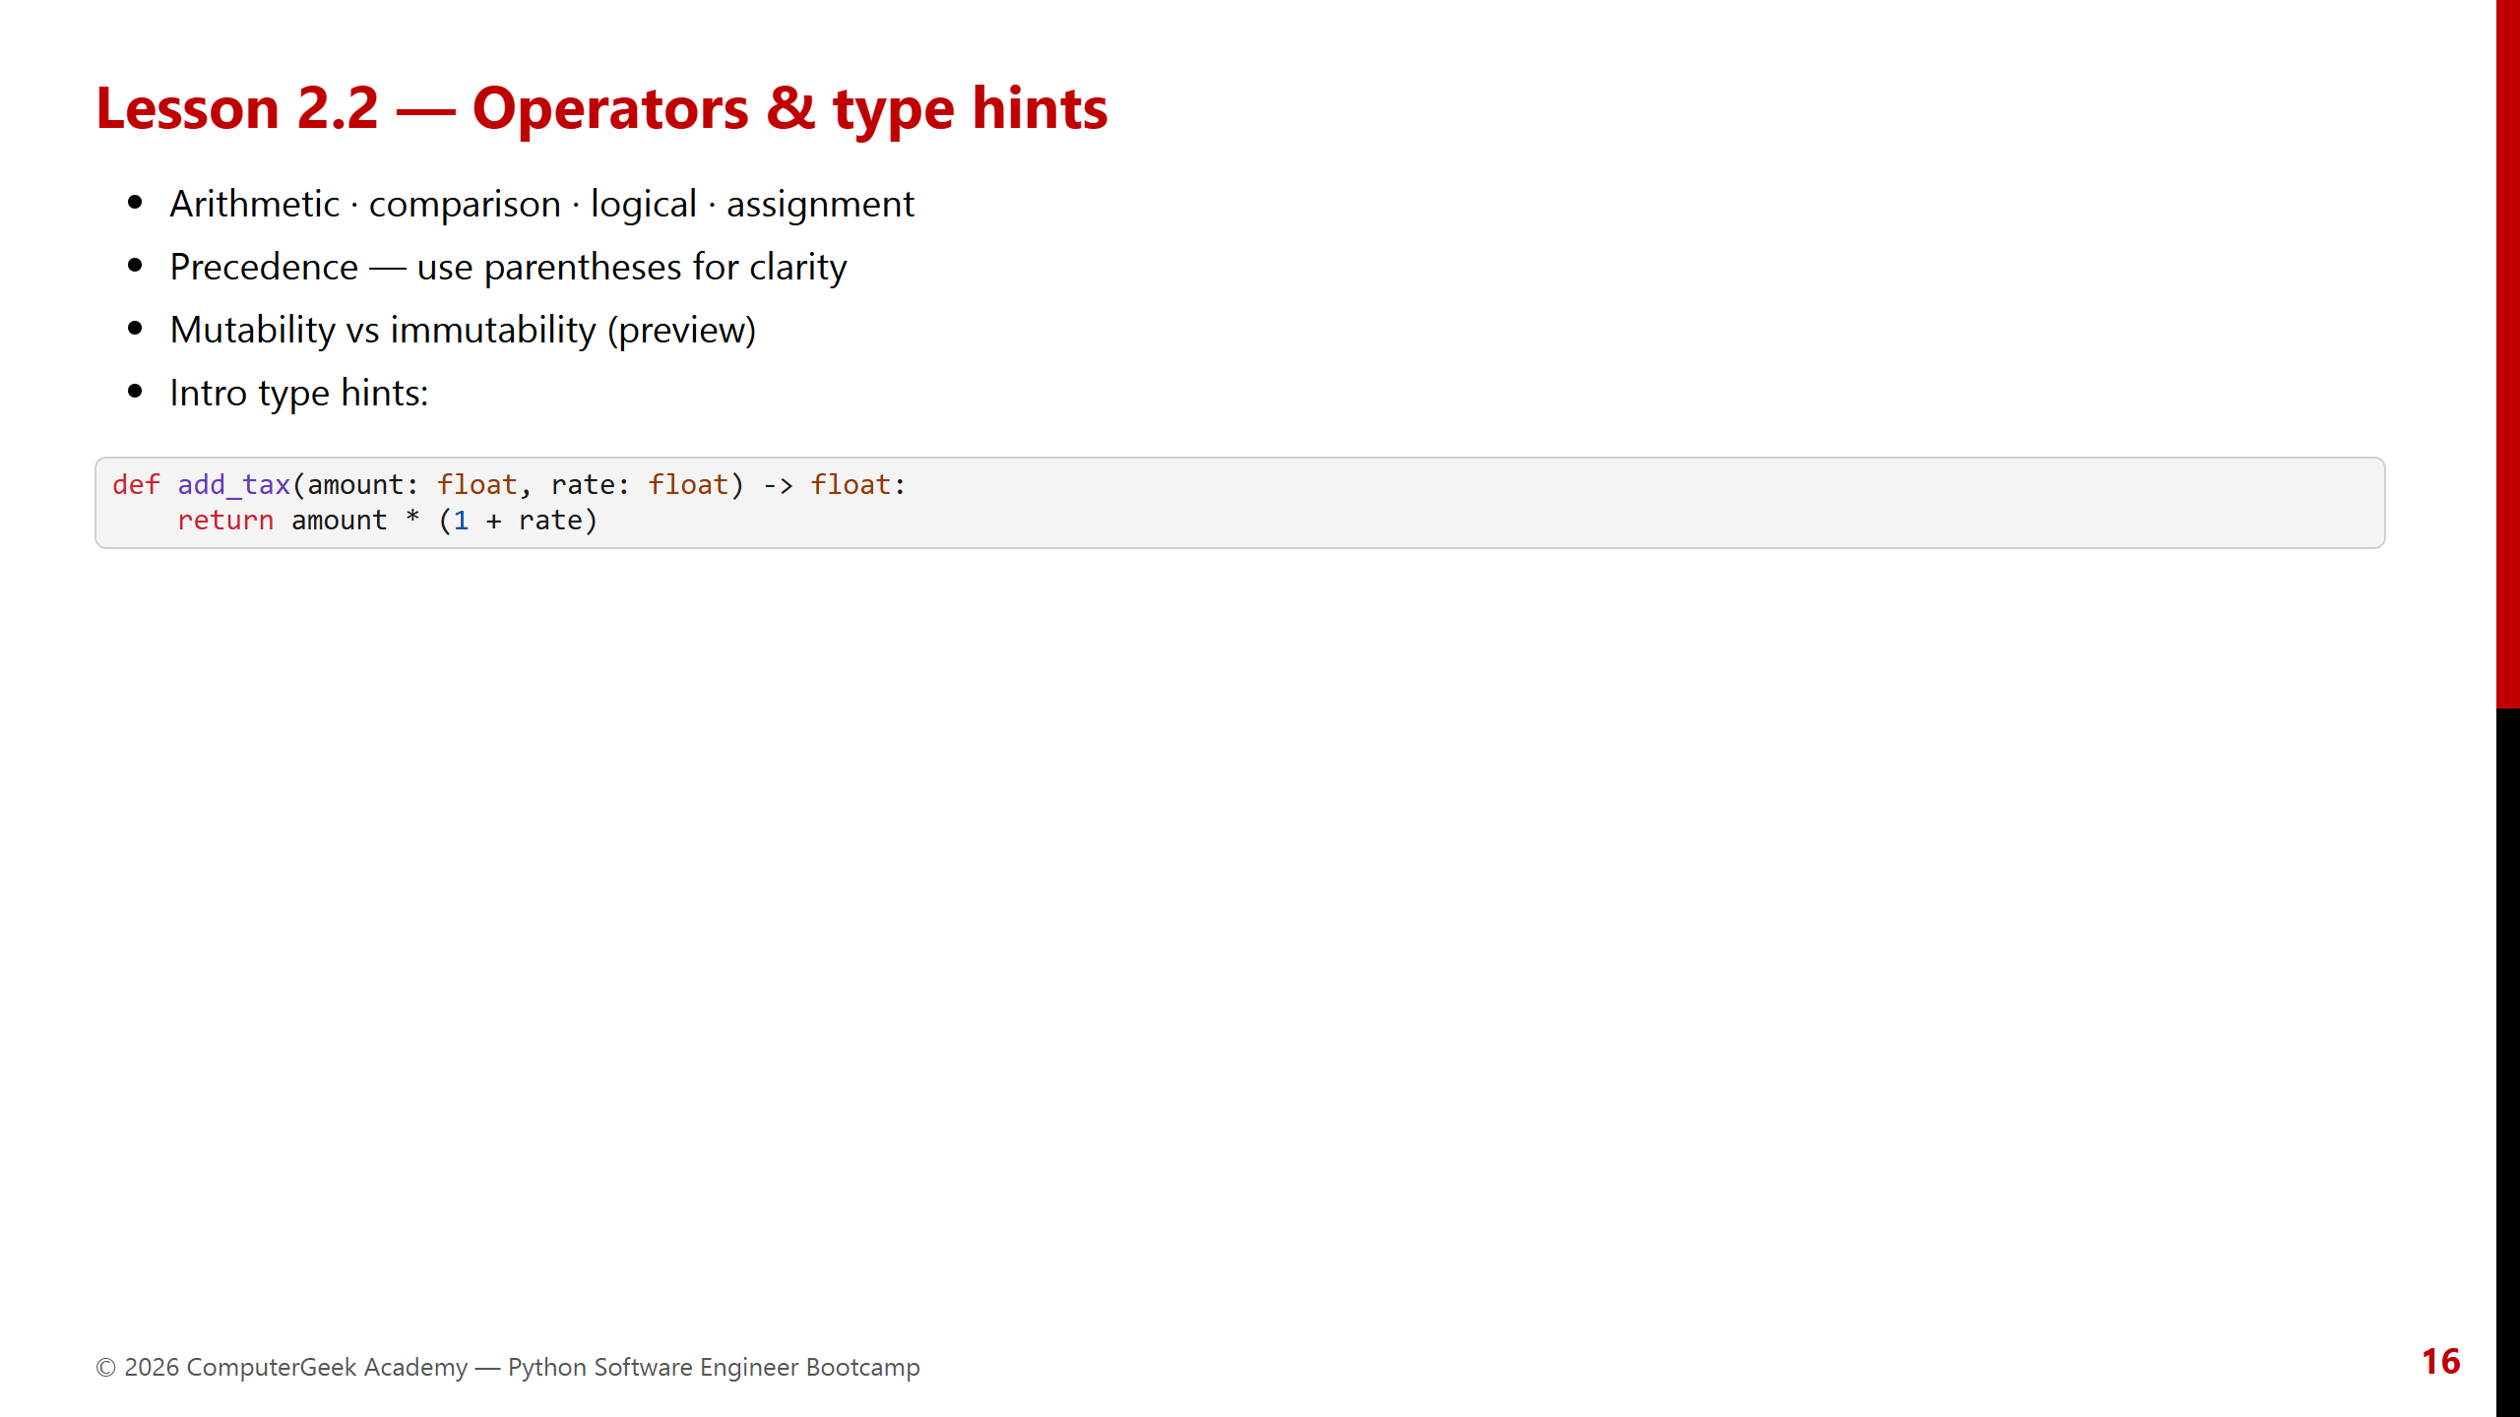
Notes:
Type hints are documentation + future tooling — keep gentle in Week 1.

Slide 17
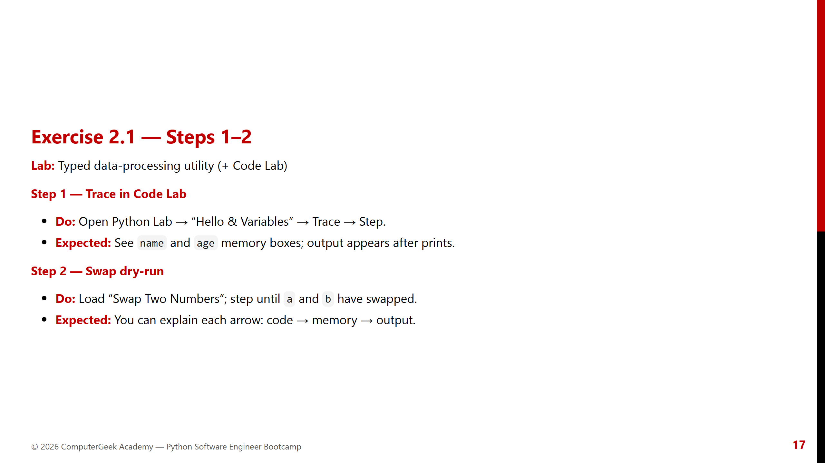
Notes:
This is the “aha” moment for beginners — don’t rush.

Slide 18
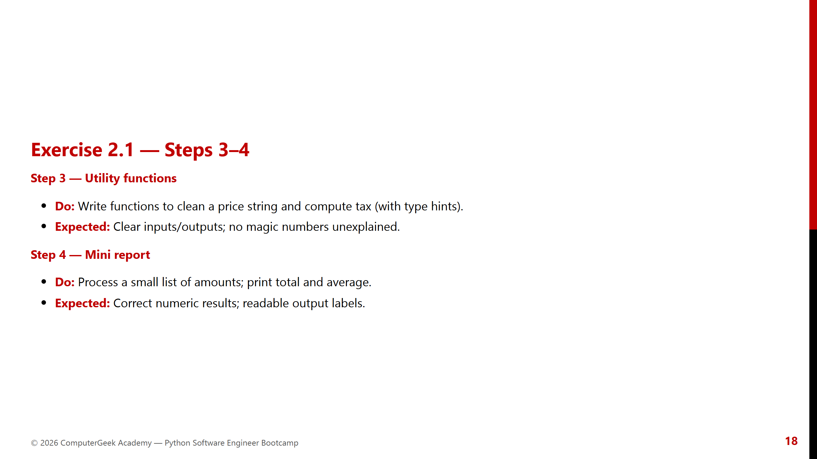
Notes:
Check type hints are present even if checker isn’t set up yet.

Slide 19
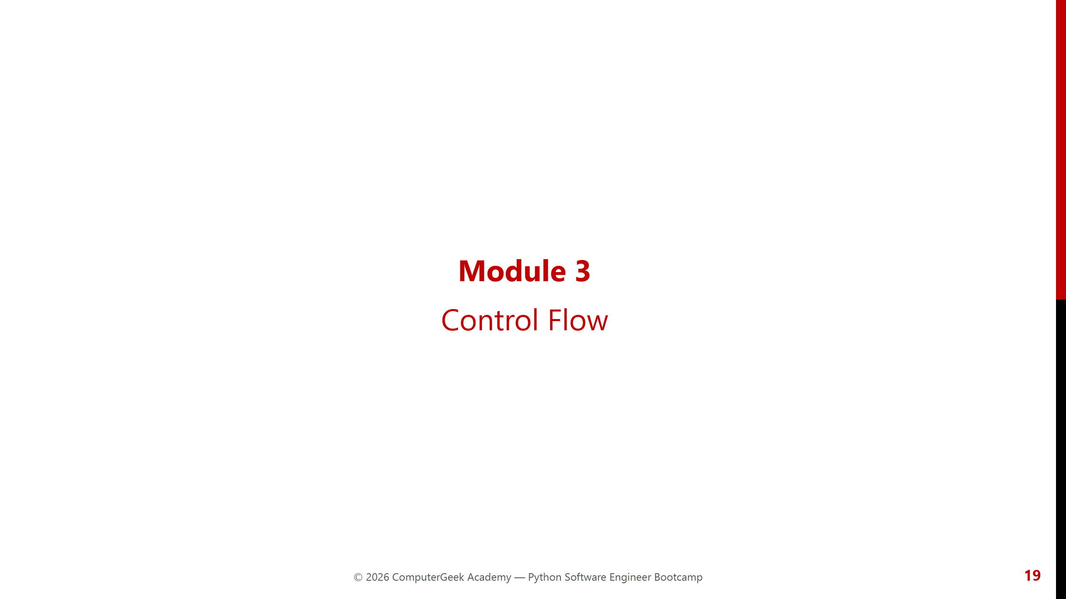
Notes:
Module 3 opener.

Slide 20
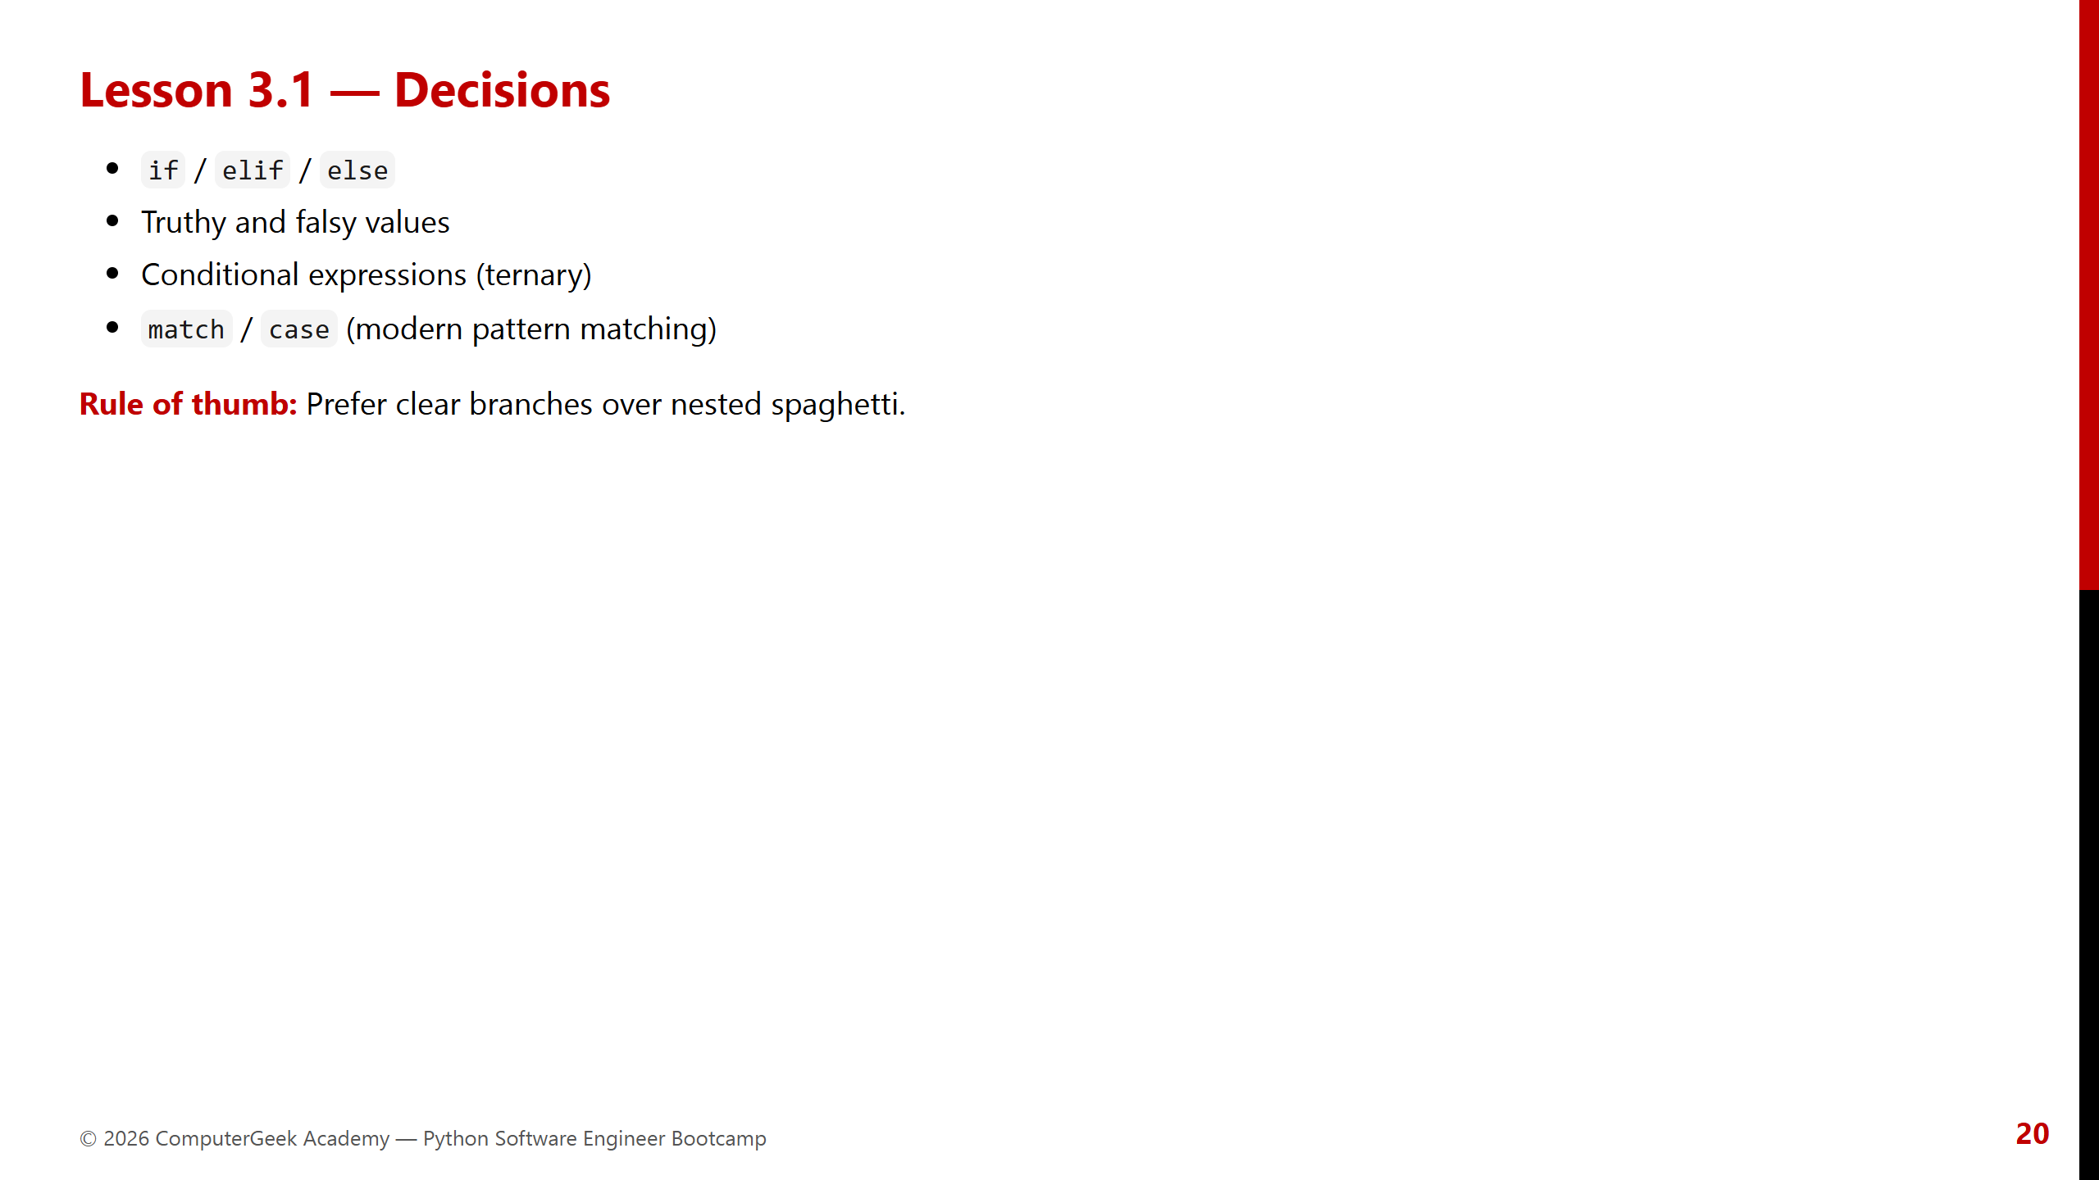
Notes:
Show one messy nested if, then a cleaner rewrite.

Slide 21
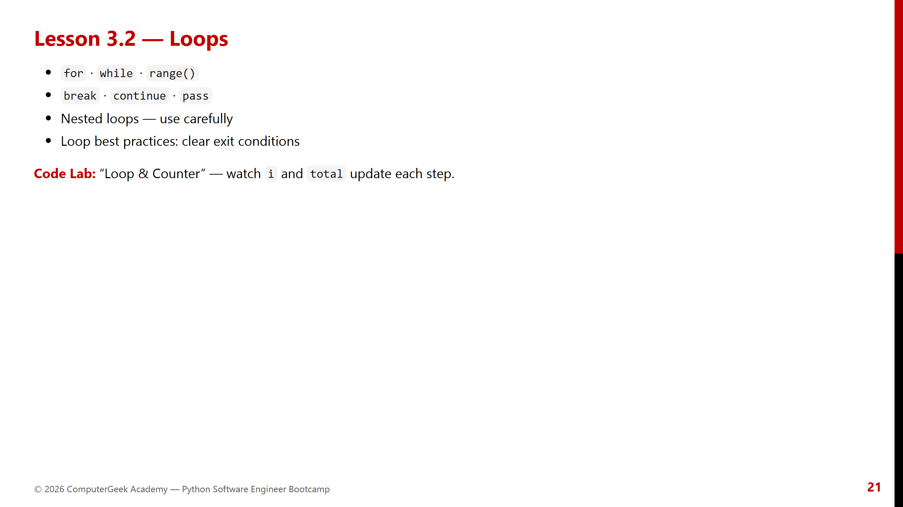
Notes:
Connect loops to memory visualization explicitly.

Slide 22
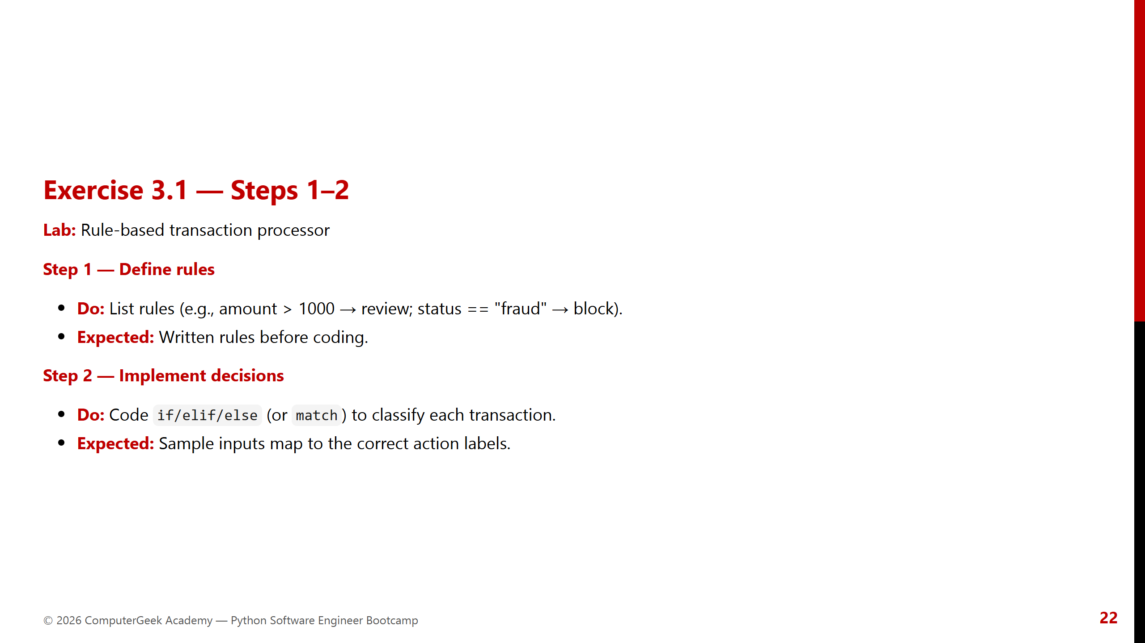
Notes:
Emphasize designing rules first — software engineering habit.

Slide 23
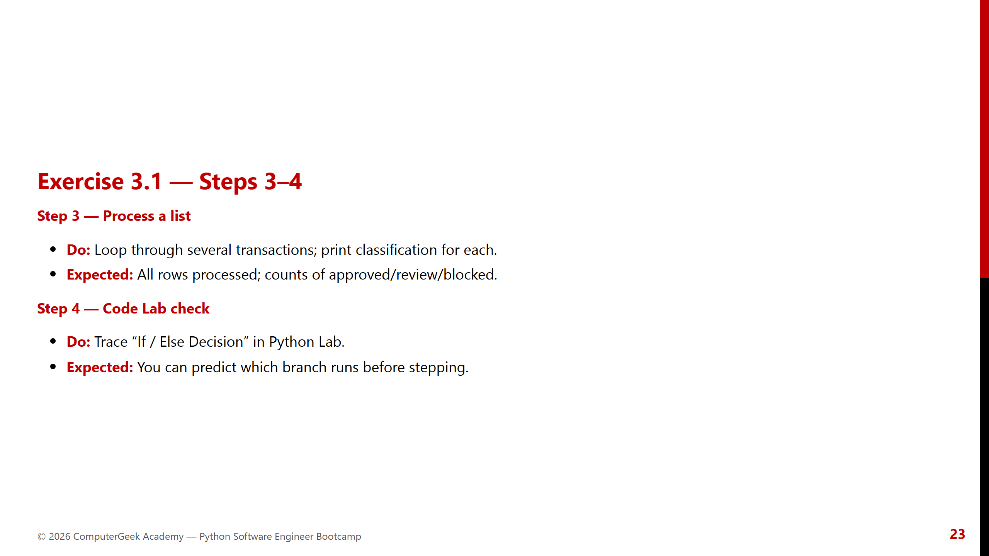
Notes:
Ask learners to predict before Step — builds dry-run skill.

Slide 24
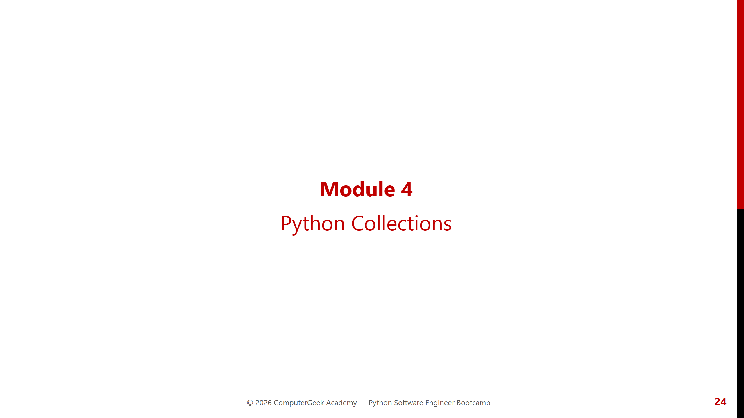
Notes:
Module 4 opener — closes Week 1 foundations.

Slide 25
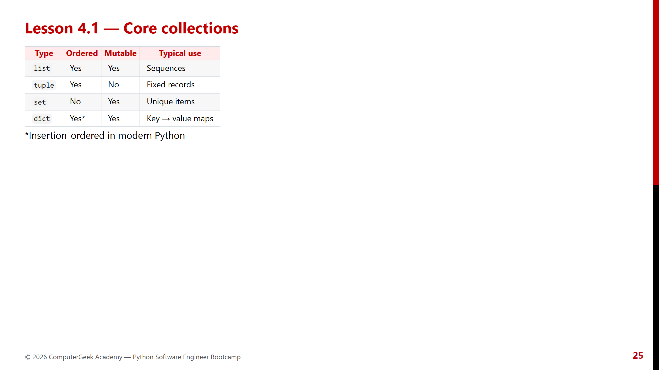
Notes:
Choosing the right structure is an engineering decision.

Slide 26
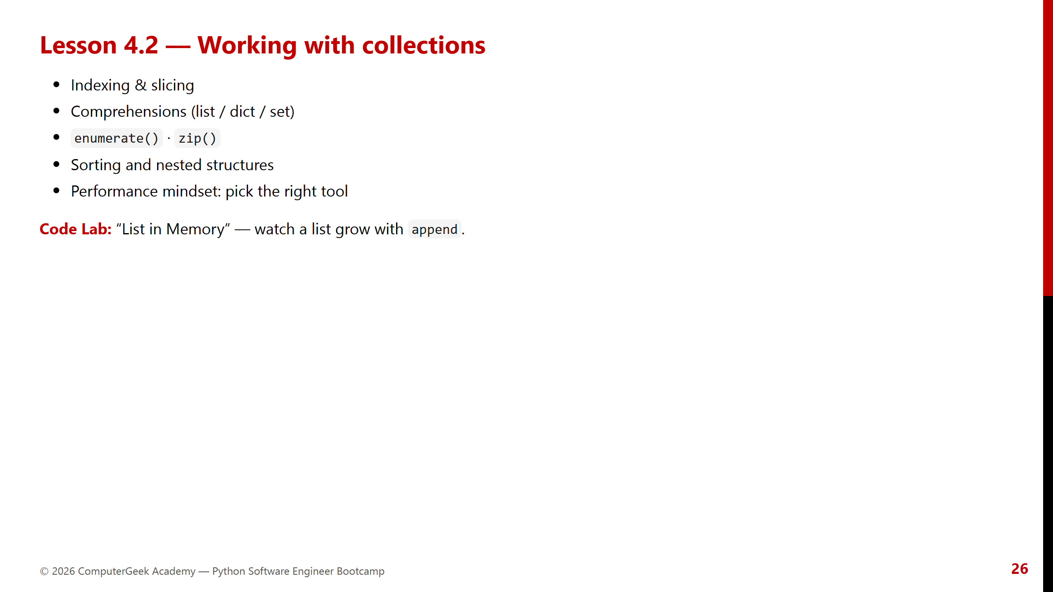
Notes:
Warn that nested dict/list debugging needs dry-runs.

Slide 27
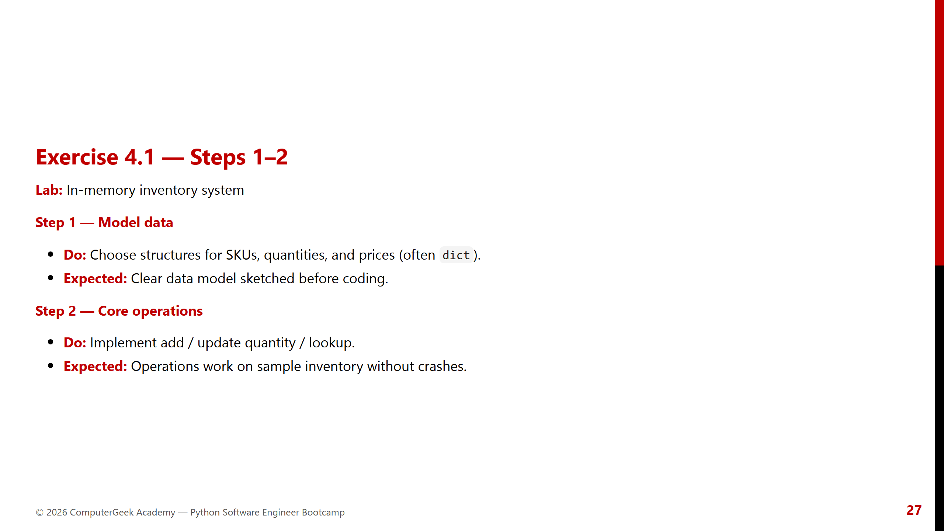
Notes:
Reject over-engineering — Week 1 dicts are enough.

Slide 28
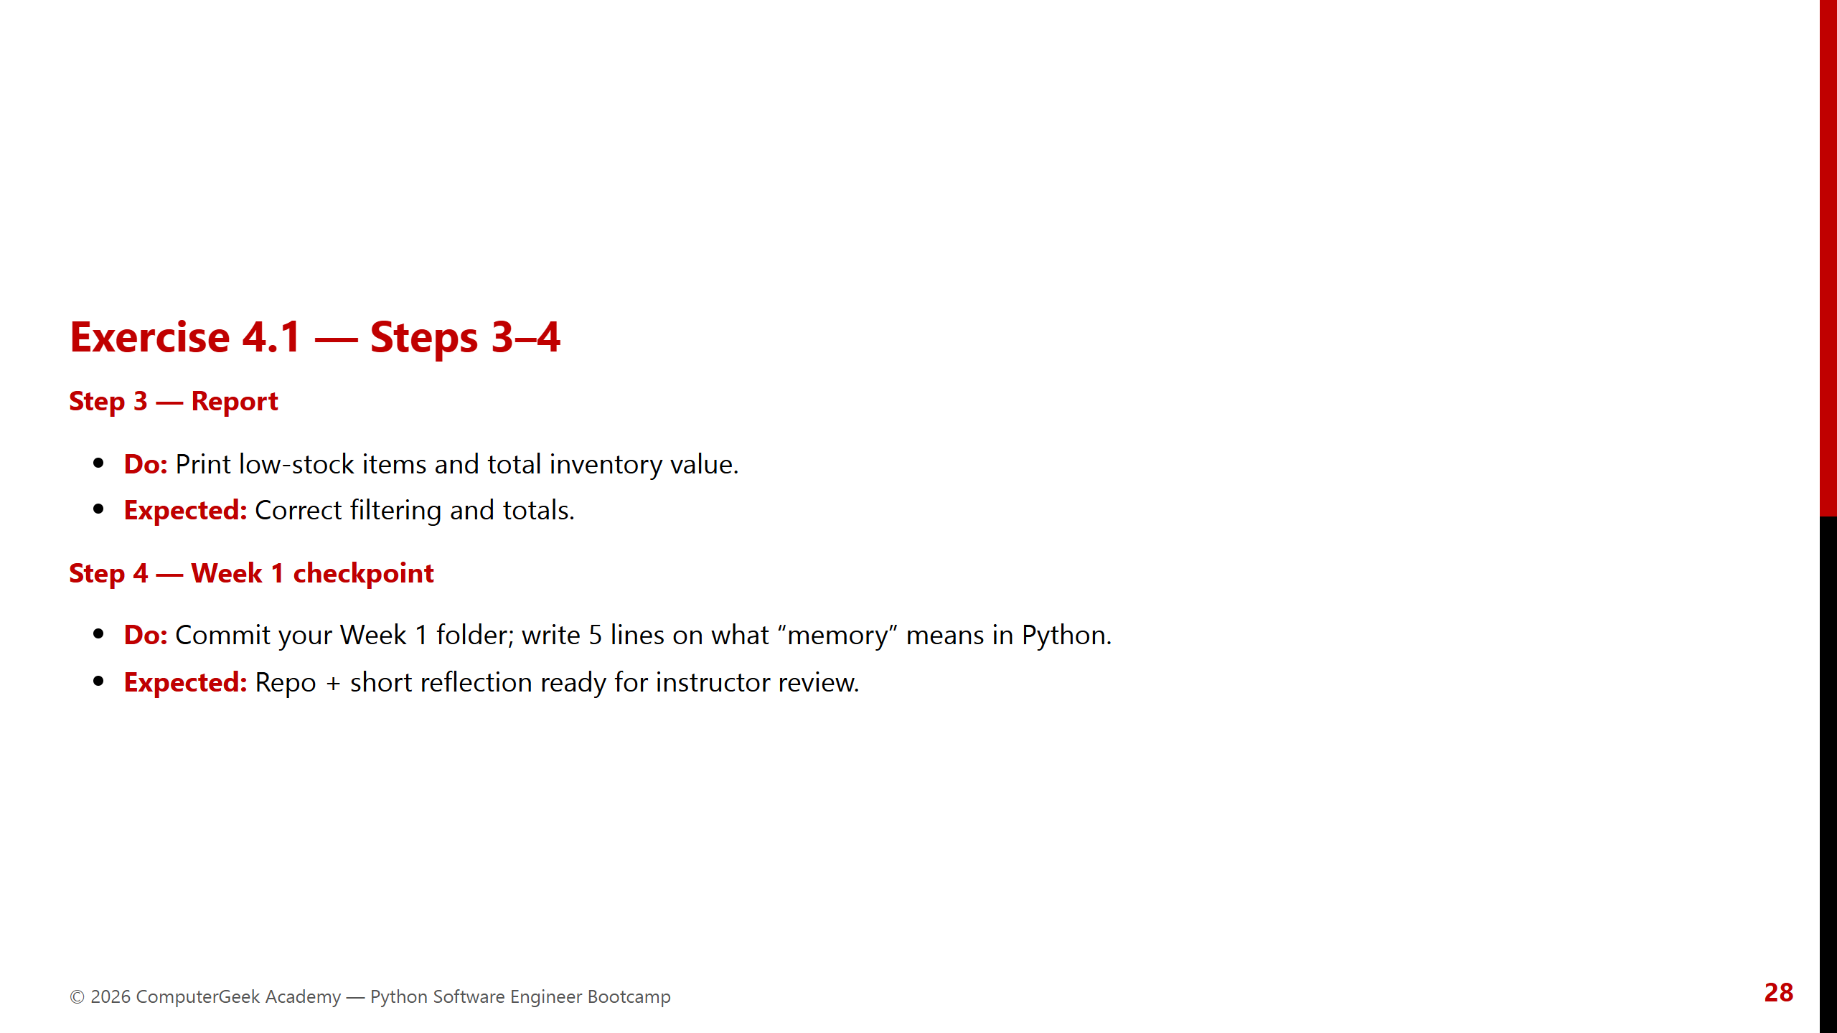
Notes:
Celebrate finishing Week 1 foundations.

Slide 29
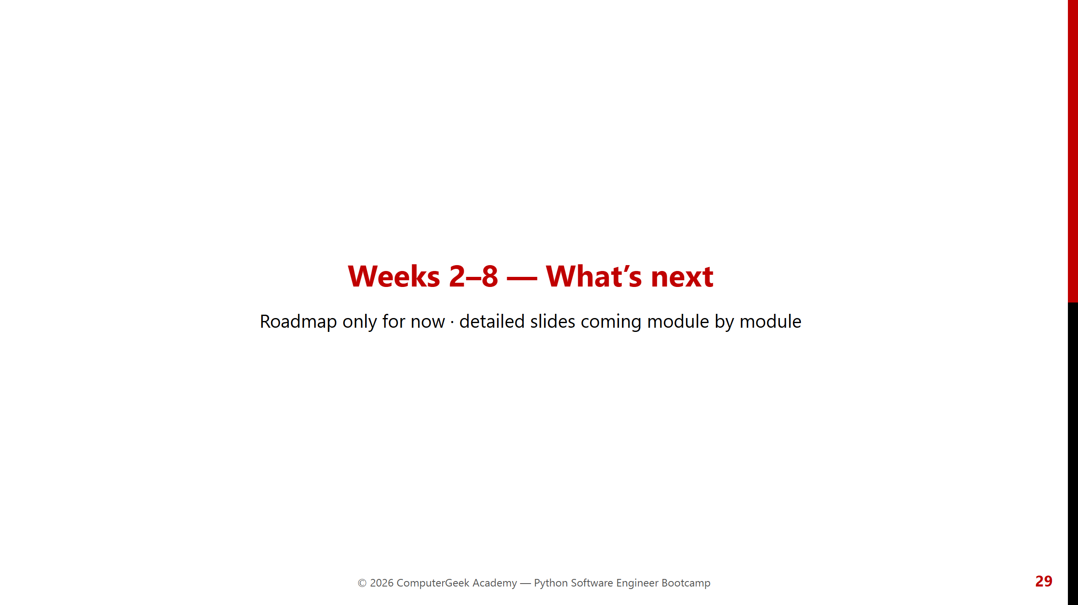
Notes:
Set expectations: this PPT is Python bootcamp focus; deep slides expand over time.

Slide 30
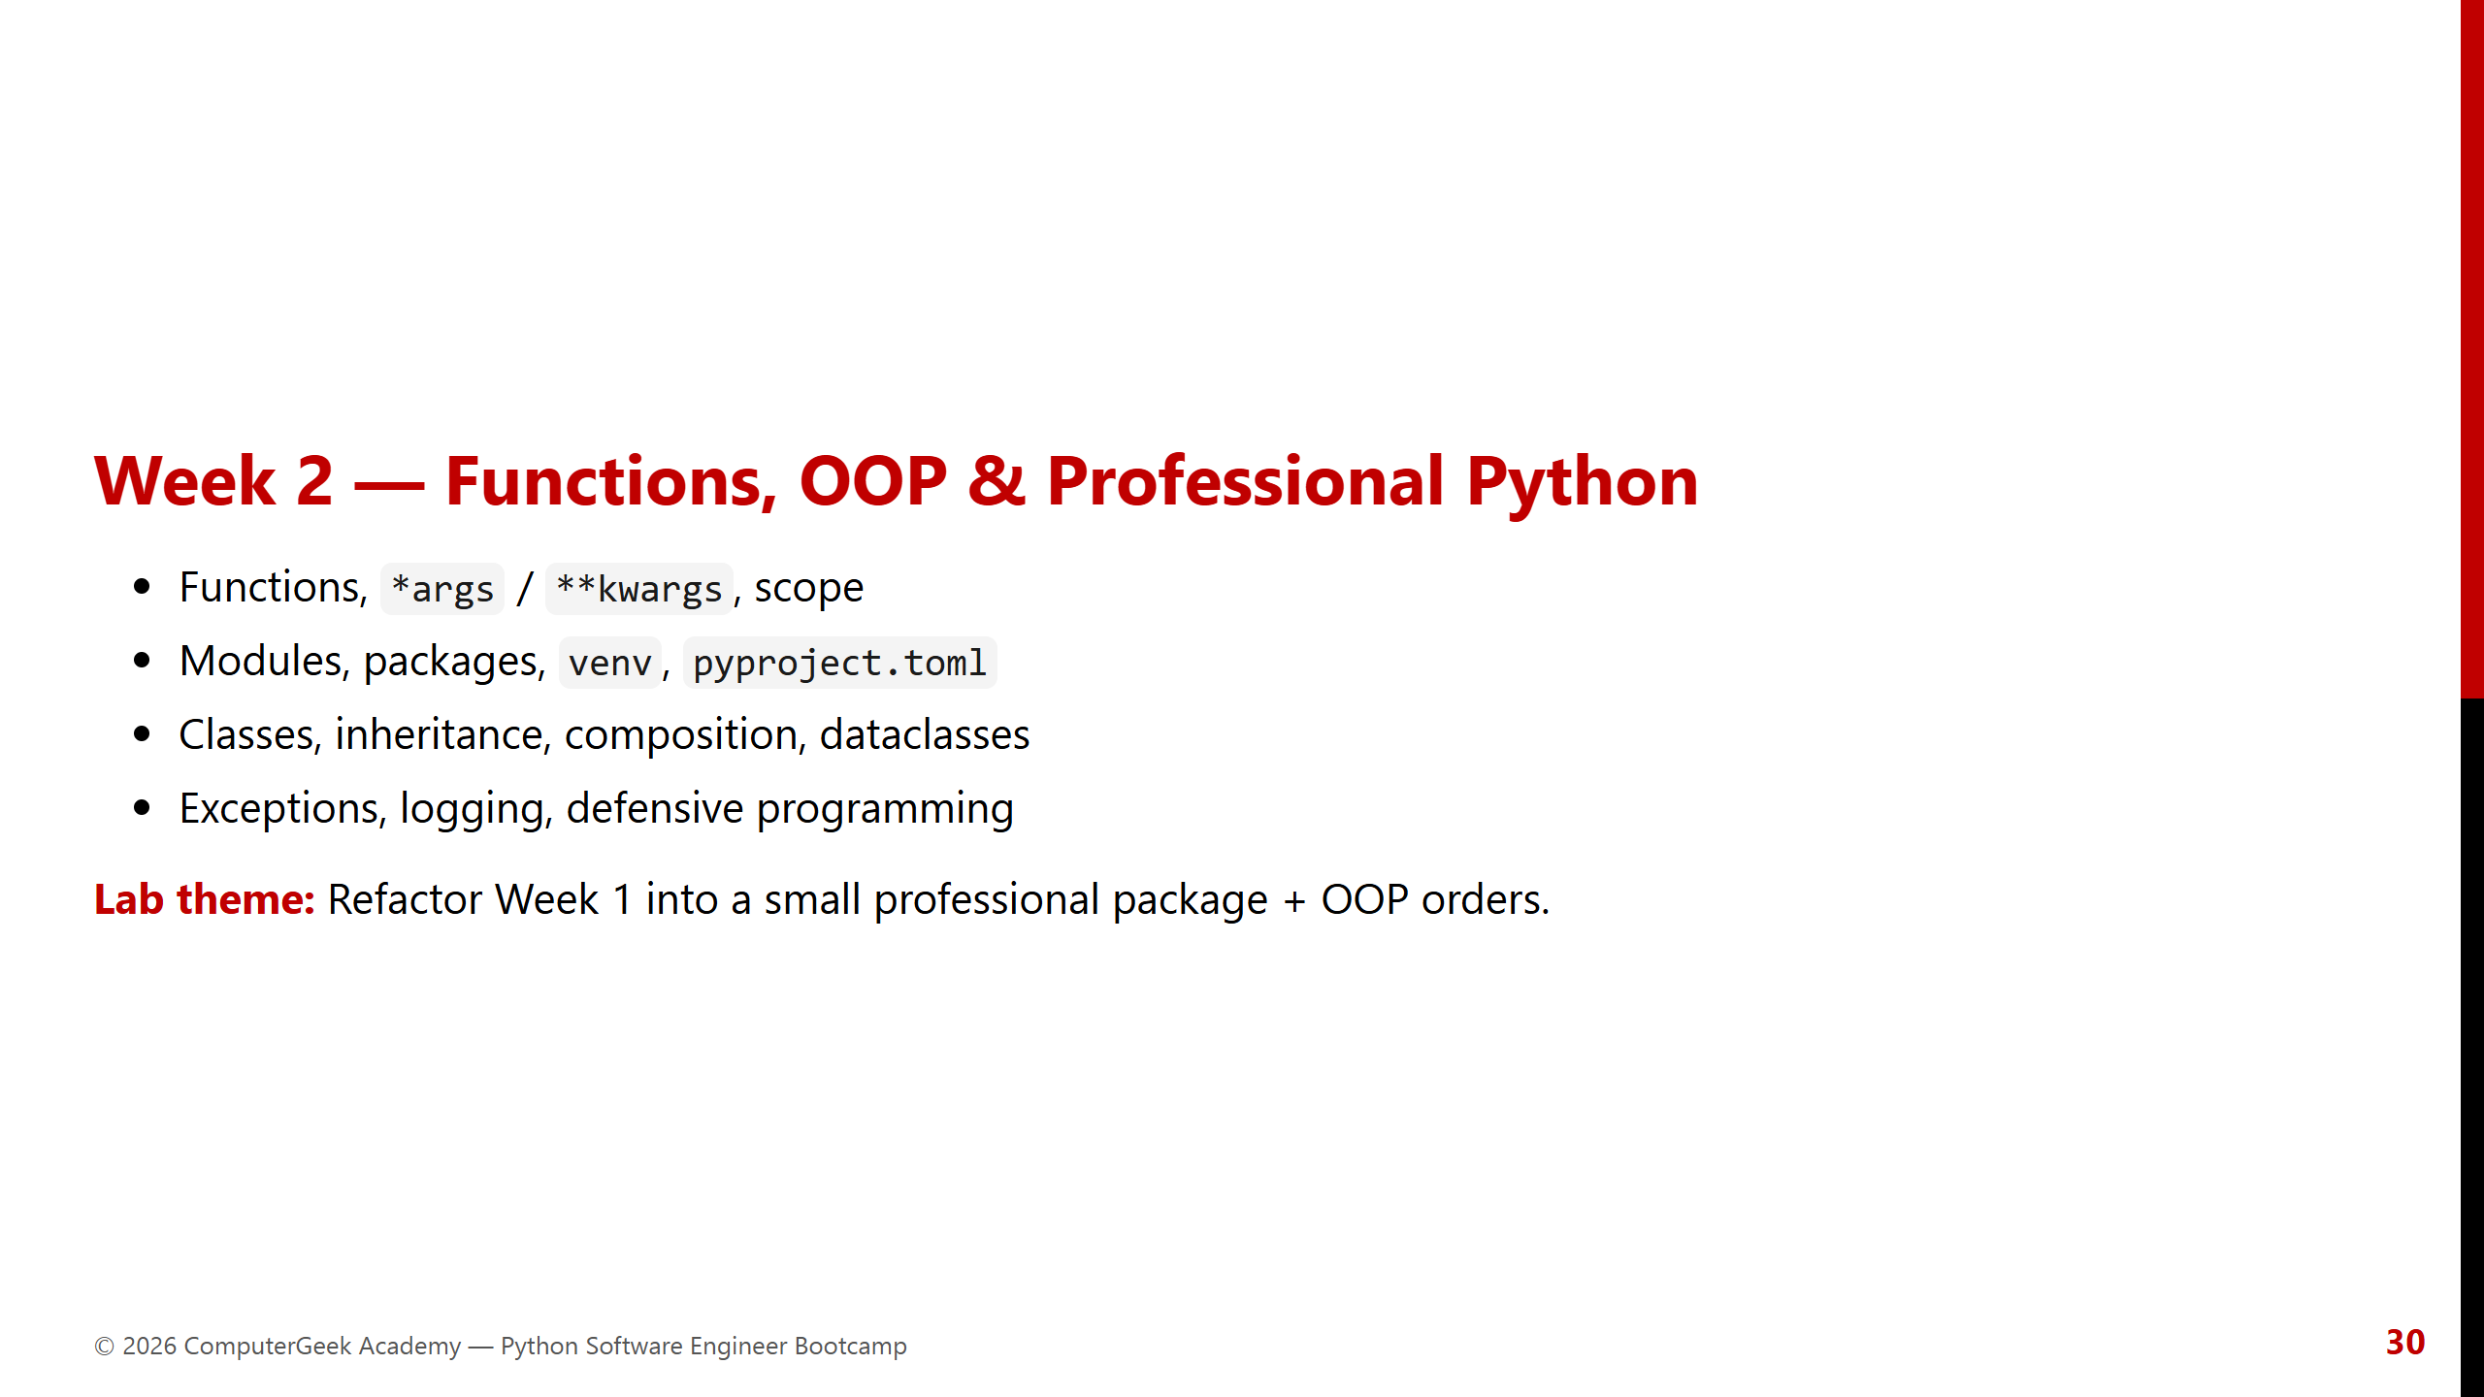

Slide 31
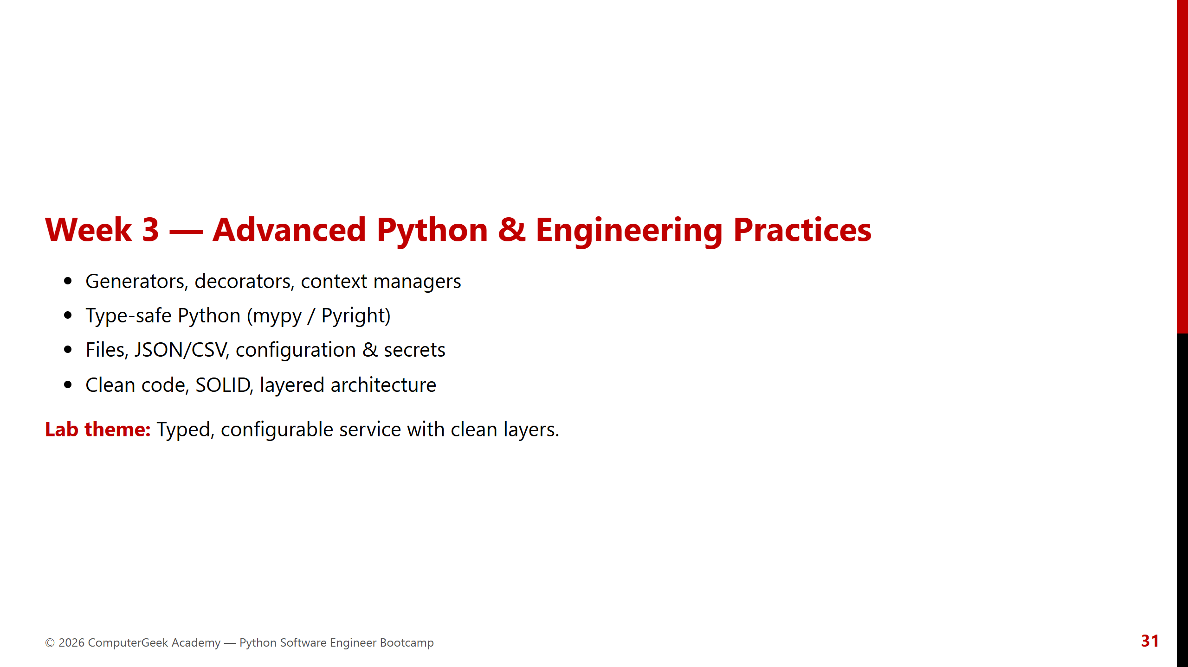

Slide 32
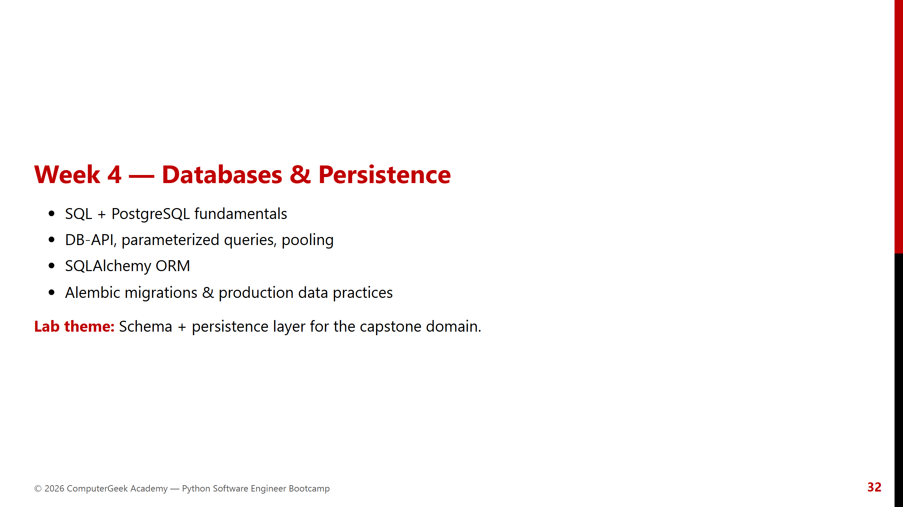

Slide 33
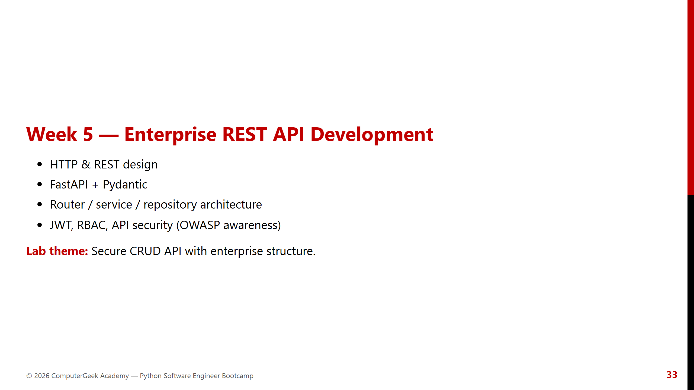

Slide 34
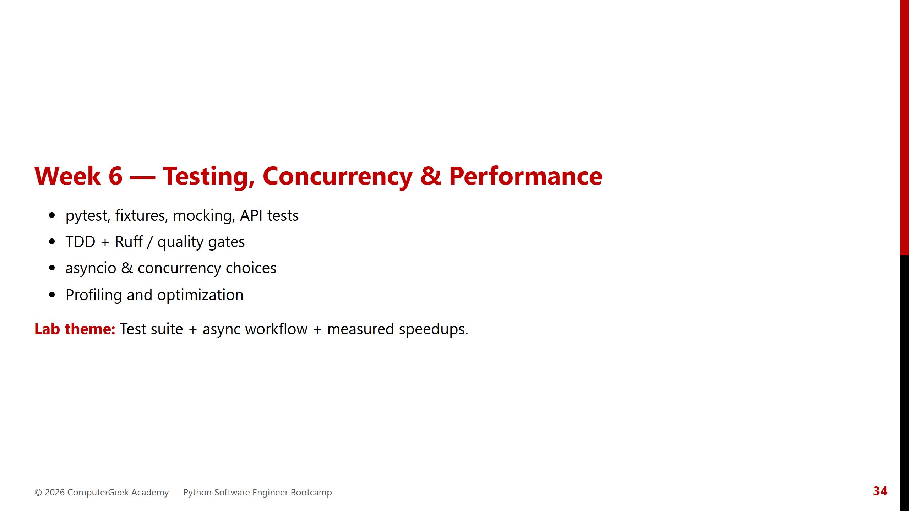

Slide 35


Slide 36
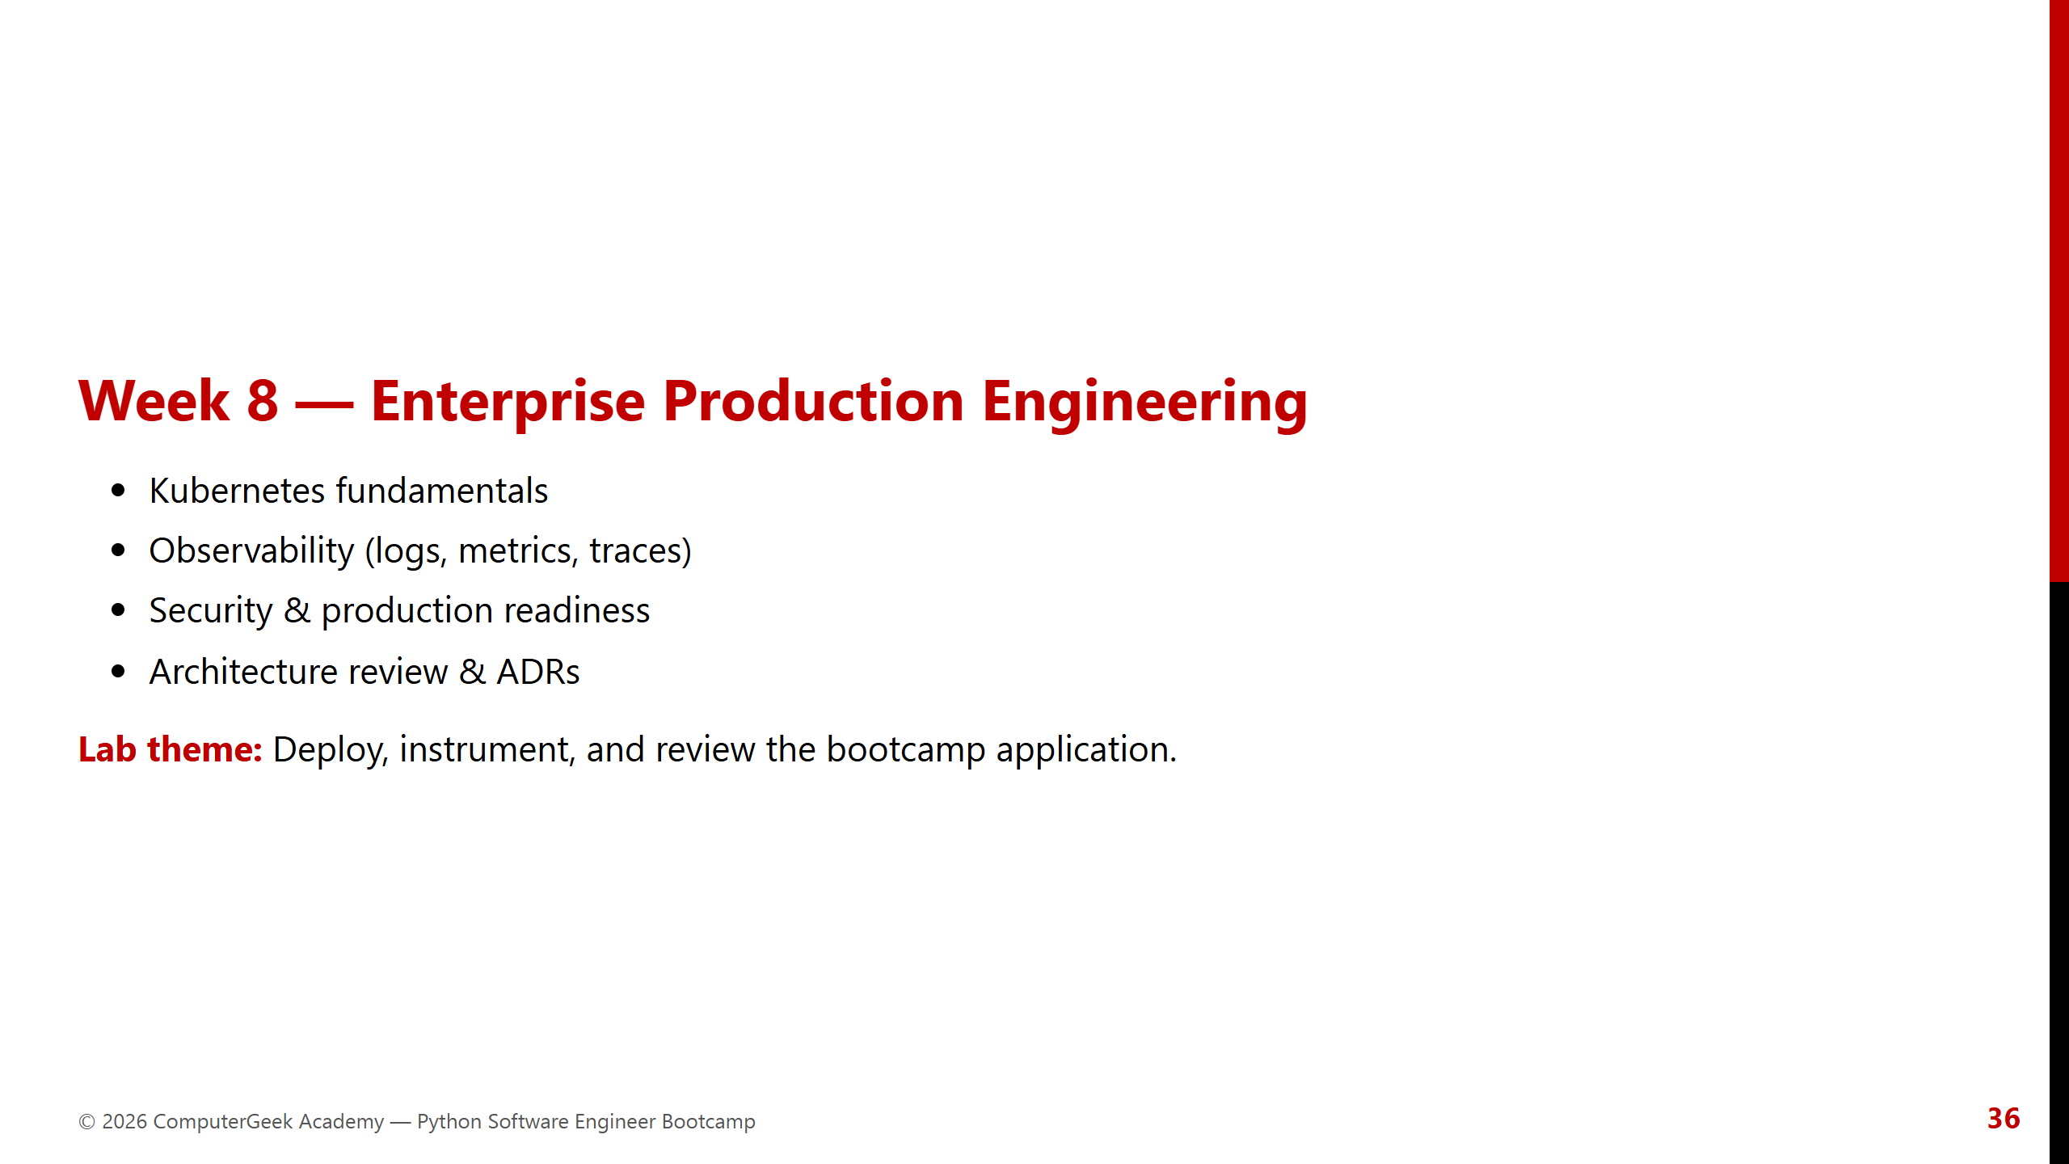

Slide 37
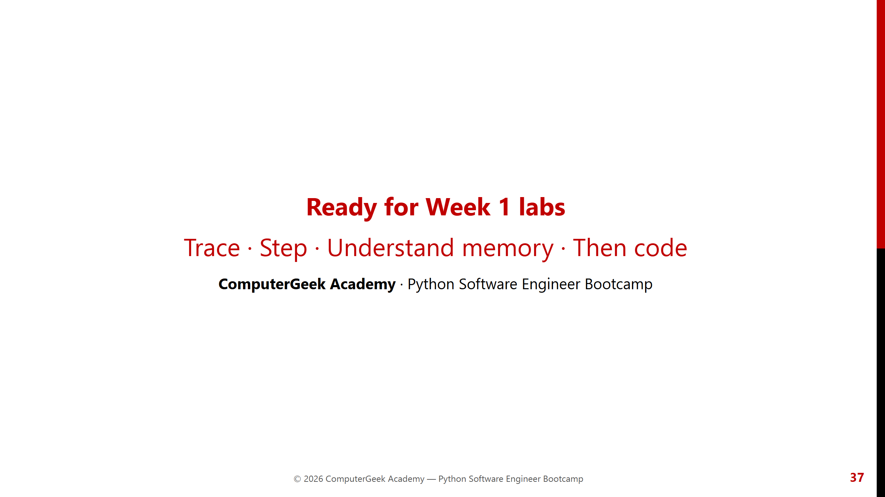
Notes:
Close with Code Lab demo reminder and next meeting logistics.

