Slide 1
Basic idea
Strengthen the visual motion over stationary vestibular sense such that it dominates over
Note one possible way might be to strengthen the visual motion itself (e.g. amount of visual motion)
We know indirectly this might not work because if you compare small FOV and large FOV visual motion, the latter which has visual motion strengthened, it causes even more sickness (more mismatch)
But we need to test this too!
We can posit that it is not the amount necessarily but perhaps the number of other “consistent” modality information
E.g. Usual mismatch occurs by the vestibular against the visual
But if we increase “number” of other modality information that supports the visual, this might work?
(Visual + Sound + Haptic + Proprio.) + Vest. → 3 support < (Visual + Sound + Haptic) + Vest. → 2 support < (Visual + Sound) + Vest. → 1 support < (Visual) + Vest. → 0 support

Slide 2
Bonus: Walk-in-place?
Explain effect of WIP in terms of this “Dominance” theory
WIP as one modality support
WIP gives not only one but two/three modalities
Haptic/Tactile and Indirect/Proprioceptive
Thus WIP alone might then be more effective than just adding single modality support!
Use test contents that necessitate WIP like interface
Roller coaster, Racing and Space navigation might be unnatural to employ WIP like interface

Slide 3
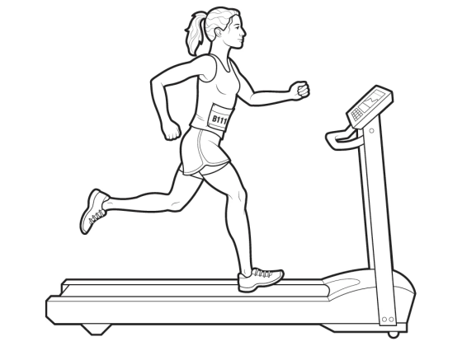
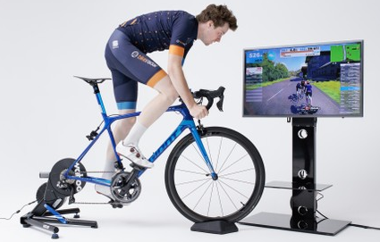
Hypothesis Test 1
Increasing “number” of different modality and consistent information supporting visual motion will increase the reduction of sickness
Motion information is overall strengthened by dominance over “lone” vestibular
Sensory mismatch is relatively reduced, and likewise the sickness
Two contents:
Running
Less speed
Less continuous
Run-in-place
Cycling
Higher speed
More continuous
Pedal-in-place

Slide 4
Possible experiment set-up
Default
Visual motion – Cycling / Running
(Vestibular) – no gross whole body motion
Factors
2 Contents (2 levels)
Sound – Sound synched to steps/pedaling vs. None (2 levels)
Proprioception/Indirect: RIP/PIP vs. Controller/None (2 levels)
Haptic/Tactile: Foot vibration/Handle vibration vs. None (2 levels)
Haptic and tactile can be separated but then too many factors …
User intent: User driven vs. Fixed navigation (2 levels)
Cognitive modality?/effect where as others are more physiogical
Self body visualization: Yes vs. None (2 Levels)
Too many factors and combinations ㅠㅠ

Slide 5
Test only partial combinations (Cycling)
 | Baseline | +S | +S+H | +S+WIP |  | +I | +I+S | +I+S+H | +I+S+WIP
 | 0 | 1 | 2 | 4 |  | 1 | 2 | 3 | 5
Visual
Vestibular
Sound | None | Pedaling, wind, … (indicate motion) | Pedaling, wind, … (indicate motion) | Pedaling, wind, … (indicate motion) |  | None | Pedaling, wind, … (indicate motion) | Pedaling, wind, … (indicate motion) | Pedaling, wind, … (indicate motion)
Haptic/ Tactile | None | None | Handle for direction, vibration for bumps, … | None |  | None | None | Handle for direction, vibration for bumps, … | None
WIP like | None | None | None | Pedal in place |  | None | None |  | Pedal in place
User Intent* | None | None | None | None |  | Direction by handle | Direction by handle | Direction by handle | Direction by handle
Exclude self body visualization …

Slide 6
What about?
H alone, WIP alone, ….
Too many combinations then
We are not interested which modality is more effective …
At least we have:
S+H vs. S+WIP
S vs. I
H+WIP 의 경우는? See later …

Slide 7
Test only partial combinations (Running)
 | Baseline | +S | +S+H | +S+WIP |  | +I | +I+S | +I+S+H | +I+S+WIP
 | 0 | 1 | 2 | 4 |  | 1 | 2 | 3 | 5
Visual
Vestibular
Sound | None | Steps, wind, … (indicate motion) | Steps, wind, … (indicate motion) | Steps, wind, … (indicate motion) |  | None | Steps, wind, … (indicate motion) | Steps, wind, … (indicate motion) | Steps, wind, … (indicate motion)
Haptic/ Tactile | None | None | Wind, foot vibration for bumps, … | None |  | None | None | Wind, foot vibration for bumps, … | None
WIP like | None | None | None | Run in place |  | None | None | None | Run in place
User Intent* | None | None | None | None |  | Direction by body | Direction by body | Direction by body | Direction by body
Exclude self body visualization …

Slide 8
Hypothesis Test 2
Increasing amount of one modality information (for attempting dominance) is not effective
One indirect evidence: Increasing visual motion only exacerbates sickness
More testing is needed – Compare other cases
+S vs. + Enriched S
+I vs. + Enriched I
+H vs. + Enriched H (= H+WIP)
+weak WIP (Head bobbing only or arm swing only) vs. Enriched WIP (= H+WIP)
Enriched case is worse or no difference?

Slide 9
Running
 | Baseline | +S | +ES | +I | +EI | +H | +EH | +weak WIP | +Enriched WIP
Visual
Vestibular
Sound | None | Steps, wind, … (indicate motion) | Steps, wind, … (indicate motion) In 3D | None | None | None |  | None | None
Haptic/ Tactile | None | None | None | None | None | Wind, foot vibration for bumps, … | Wind, foot vibration for bumps, … | None | Wind, foot vibration for bumps, …
WIP like | None | None | None | None | None | None | Run in place | Head bob only | Run in place
User Intent* | None | None | None | Direction by body | Direction by body +Guidance | None | None | None | None

Slide 10
More validation?
The other way around:
How about adding inconsistent modality information?
Should worsen the sickness (by even more mismatch … !)
E.g. Visual (forward) + Vestibular (stationary) + Reverse wind + side way sound ???

