Slide 1
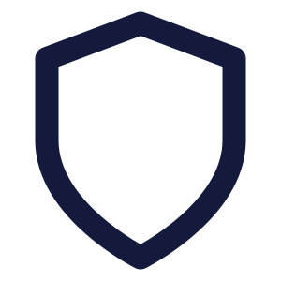

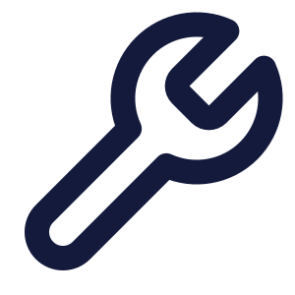
CYBERSECURITY ASSET MANAGEMENT · TOOLING EVALUATION
Axonius vs. ManageEngine
A comprehensive capability comparison — where Axonius outperforms ManageEngine, what it does that ManageEngine cannot, and how the two fit together.
AXONIUS
MANAGEENGINE
Cyber asset intelligence (CAASM) — security-first, agentless, aggregates every tool.
IT asset management + endpoint & service management — operations-first, scan/agent based.
Prepared for internal tooling evaluation · sources: vendor documentation & independent analyst reviews, 2026

Slide 2

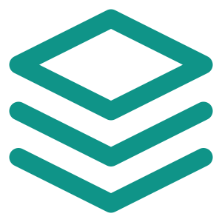






CONTENTS
What this deck covers
1
Where each tool fits
2
How they work
The question each tool was built to answer
Agentless aggregation vs. scan-and-agent
3
Coverage & integrations
4
Capability comparison
Asset-type scope and 1,400+ integrations
Side-by-side table and the Axonius advantage
5
Exposure & automation
6
Deployment & compliance
Vulnerability prioritization & response
Time-to-value & SAMA / NCA / NDMO alignment
7
The cost of blind spots
8
Decision & rollout
Why reconciled visibility changes outcomes
Scorecard, recommendation and rollout

Slide 3

EXECUTIVE SUMMARY
Bottom line up front
Axonius and ManageEngine solve different problems. ManageEngine is a strong IT-operations toolset. Axonius is a security-grade asset intelligence platform that sits above your existing tools — including ManageEngine — to reveal the coverage gaps and exposures no single scanner can see.
One reconciled source of truth
It finds what is missing
Best used together
Axonius aggregates, de-duplicates and reconciles data from 1,400+ tools into a single asset model — not just the assets one scanner happens to reach.
Only Axonius answers “which assets have no EDR, no vuln scan, or aren’t in AD?” — the security coverage gaps ManageEngine structurally can’t surface.
Keep ManageEngine for endpoint ops, licensing and service desk. Feed it into Axonius as the security system of record. Different jobs, complementary.

Slide 4
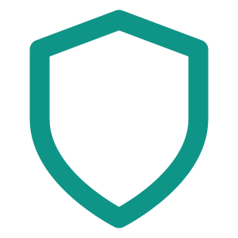


CATEGORY
Two tools, two different jobs
Comparing them head-to-head only makes sense once you see they were built to answer different questions.
Axonius
ManageEngine
CAASM / cyber asset intelligence — a security tool
ITAM + UEM + ITSM — an IT operations suite
“Are all my assets covered by the controls they should be?”
“What hardware and software do we own, and how do we run it?”
Aggregates existing tools; owns no agents of its own
Discovers via its own agents + network/SNMP scans
Devices, identities, SaaS, cloud, software, IoT/OT, controls
Hardware, software, network devices — IT assets
Surfaces coverage gaps, rogue assets and exposure
Lifecycle, licensing, procurement, warranty, CMDB
Drives automated, cross-tool response and enforcement
Patching, software deployment, remote control, help desk

Slide 5


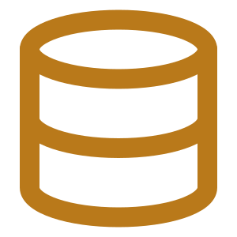

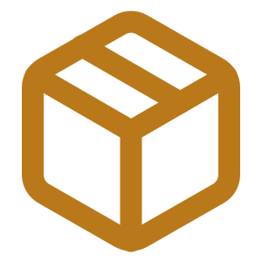
ARCHITECTURE
How they work: aggregate vs. scan
AXONIUS — AGENTLESS AGGREGATION
MANAGEENGINE — SCAN & AGENT BASED
EDR / AV
Cloud (AWS·Azure·GCP)
Deploy agents + run network / SNMP / WMI scans
Vuln scanners
AD / Identity
↓
MDM / UEM
SaaS apps
Discover the endpoints & devices it can directly reach
Network / DHCP
ManageEngine
↓
Build a hardware / software inventory & CMDB
Normalize · de-duplicate · reconcile
↓
↓ One unified, always-current asset model
Manage lifecycle: patch, license, procure, retire
No new agents to deploy — it reads the tools you already own.
Sees what it scans — not what other security tools see.

Slide 6
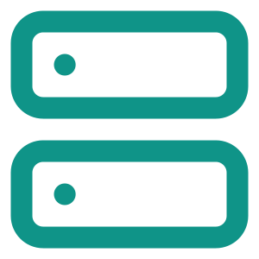

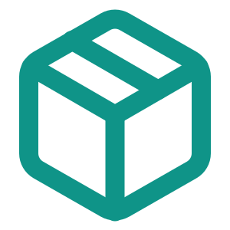


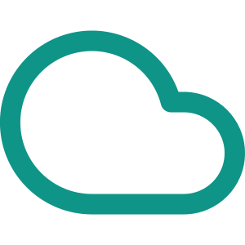


COVERAGE
What counts as an “asset”
Axonius reconciles far more than IT hardware — 45 asset types across seven domains in one model.
AXONIUS — UNIFIED ASSET FABRIC
MANAGEENGINE — IT ASSET SCOPE
Workstations & servers
Devices
Identities
SaaS apps
Software
Network devices (SNMP)
Installed software & licenses
Cloud
IoT
OT
Controls
CMDB configuration items
45 asset types, one reconciled record each
No identities, SaaS or control-coverage view.

Slide 7
INTEGRATIONS
The integration ecosystem
1,400+ bi-directional integrations — not just fetching data, but pushing fixes and enforcing policy across your stack.
Endpoint & EDR
Cloud & virtualization
Vulnerability & patch
CrowdStrike, SentinelOne, Carbon Black, Defender
AWS, Azure, GCP, VMware
Qualys, Tenable, Rapid7, Kenna
Identity & IAM
Network & firewall
MDM / UEM / ITAM
Active Directory, Okta, Google Workspace
Cisco, Fortinet, Palo Alto, Aruba
Intune, Jamf, SCCM — and ManageEngine
ManageEngine integrates mainly within its own product family and a set of connectors — it is a data source, not an aggregation layer.

Slide 8

AT A GLANCE
Side-by-side capabilities
Capability
Axonius
ManageEngine
Primary purpose
Security visibility
IT operations
Discovery approach
Agentless API aggregation
Agent + network scan
Unified view across all your tools
Own scans only
Security control gap analysis
Identity, SaaS & cloud posture
Limited
Exposure prioritization (beyond CVE)
Automated cross-tool response
Endpoint-scoped
Patch, deploy & remote control
Licensing, procurement & help desk
Strong / native
Not offered / limited

Slide 9
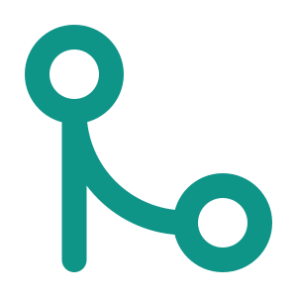
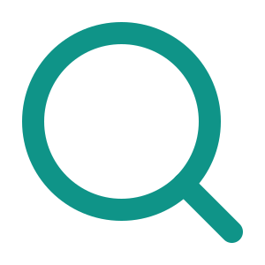

THE CASE FOR AXONIUS
Why Axonius, for a security program
One reconciled inventory
Coverage-gap detection
Unmanaged & rogue asset discovery
Merges and de-duplicates every source into a single trustworthy record — no more three tools disagreeing on asset counts.
Instantly flags assets missing EDR, unscanned for vulnerabilities, or absent from AD — the blind spots that become incidents.
Correlates across cloud, network and identity to find devices no agent ever touched.
Beyond hardware
Automated cross-tool action
Audit & compliance readiness
Brings identities, SaaS, cloud and OT/IoT into scope — not just IT endpoints.
Policy-driven playbooks push fixes and enforce controls across your whole stack.
Continuously validates control coverage and evidences it against regulatory frameworks.

Slide 10





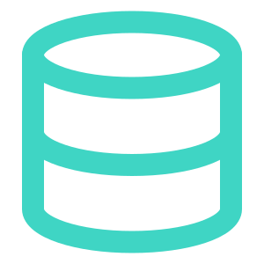
THE DIFFERENTIATORS
What Axonius can do that ManageEngine cannot
These aren’t “nice-to-haves” — they are structural: they require aggregating and reconciling the whole security stack, which ManageEngine is not built to do.
Validate security-control coverage
Reconcile the same asset across tools
Tell you exactly which assets are missing or have a broken EDR, DLP or vuln-scan agent — because Axonius ingests and correlates those tools.
Collapse the ten records ten tools hold on one machine into a single authoritative asset. ManageEngine only knows what it scanned.
Expose the gaps between tools
Cover identity, SaaS & shadow IT
Find assets that exist in one system but not another — the rogue and unmanaged devices that live in the seams.
Map user accounts, SaaS apps and shadow SaaS (SSPM) — an attack surface ITAM never sees.
Orchestrate response across your stack
Sit above ManageEngine itself
Trigger enforcement in other security tools from policy — not just act on its own endpoints.
Consume ManageEngine as one data source among many — Axonius is the layer over your tools, including it.

Slide 11


DEEP DIVE · 1
Exposure & vulnerability management
Axonius turns scattered findings into a ranked, owned, actionable list — not another dashboard.
1
Aggregate findings
BEYOND CVEs
Pull vulnerabilities & security findings from every scanner into one place
Identity hygiene gaps
↓
2
Score with context
SaaS misconfigurations
Axonius Vulnerability Score + asset criticality + threat-intel on active exploitation
Certificate & TLS issues
↓
Policy violations & drift
3
Prioritize by real risk
Attack-path analysis ranks by exploitability & blast radius, not raw CVSS
↓
ManageEngine
4
Remediate & assign
Can deploy patches to its own endpoints — but doesn’t correlate or prioritize exposure across scanners.
AI-recommended fixes, auto-assigned ownership, tracked to closure

Slide 12

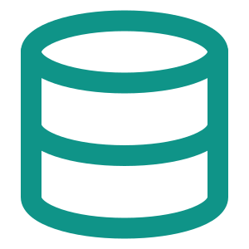
DEEP DIVE · 2
Automation & response
The Enforcement Center turns a query result into action — bi-directionally, across the tools you already run.
Isolate or block a device
Disable or manage accounts
Open & track tickets
Push firewall / EDR containment on risky or rogue assets
Act on identities directly in AD / IdP
Create tracked ITSM tickets with full asset context
Enrich CMDB & SIEM
Deploy or verify agents
Notify owners & escalate
Write reconciled asset data back into downstream systems
Detect and remediate missing security agents
Route findings to the right owner automatically
Policy-driven and triggered automatically — ManageEngine automates within the endpoints it manages; Axonius acts across your entire stack.

Slide 13

IN PRACTICE
What this unlocks day to day
“Which laptops have no EDR?”
“What’s on the network we don’t manage?”
Axonius cross-checks your endpoint inventory against your EDR console and lists every device the agent never reported — in one query.
Correlating DHCP, cloud, identity and scan data surfaces rogue and unmanaged assets that no single agent covers.
ManageEngine can’t: it doesn’t ingest your EDR.
ManageEngine sees only what it scans.
“Is every critical asset being scanned?”
“Prove control coverage for the audit.”
Validate that vuln-scan, logging and control coverage actually reaches every asset that matters — and auto-remediate the gaps.
Continuously evidence which assets meet policy and map it to regulatory frameworks — audit-ready, not a spreadsheet scramble.
Beyond ITAM’s remit.
ManageEngine reports on inventory, not control posture.

Slide 14
WHY IT MATTERS
The cost of blind spots
The industry’s problem isn’t collecting data — it’s turning it into action. A reconciled asset model is what closes that gap.
45%
55%
23%
~50%
consolidate assets & exposures into a single view
still track remediation in spreadsheets
always apply exploitability & business impact
consistently assign remediation ownership
the other 55% work from fragmented reality
manual, error-prone, impossible to audit
most prioritize on raw severity alone
findings stall with no clear owner
Source: Axonius 2026 Actionability Report (Ponemon Institute; 662 IT & security professionals).

Slide 15

ROLLOUT
Deployment & time-to-value
Axonius — connect, don’t deploy
ManageEngine — install & scan
Agentless — nothing to install on endpoints
Roll out agents / configure scans across the estate
Connect adapters over API to tools you already own
Coverage limited to what agents & scans reach
Value in hours to days, not an agent-rollout project
Server + database sizing for large estates
Deploy as SaaS (Axonius-hosted) or on-prem
On-prem or cloud editions available
Widens automatically as you connect more sources
Strong once deployed — but a heavier rollout
Honest note: on a large estate, planning the Axonius integrations still takes design effort — the payoff is no endpoint-agent rollout.

Slide 16

REGULATORY ALIGNMENT
Compliance in the Saudi financial sector
Asset inventory, control coverage and continuous monitoring are foundational requirements — exactly what Axonius evidences.
SAMA CSF
NCA ECC
NDMO
Cyber Security Framework — mandatory for banks, insurers and credit bureaus in KSA.
Essential Cybersecurity Controls (114 controls) — Domain 2 covers asset & inventory management.
National Data Management & governance standards for data assets.
Complete asset inventory & ownership
Asset & inventory management (2-1)
Data-asset cataloguing & ownership
Control coverage & monitoring
Vulnerability & patch management
Classification-aware inventory
Risk-based vulnerability management
Evidence controls are operating
Auditable, current records
Axonius supports these control objectives and produces audit evidence; it does not by itself confer certification.

Slide 17
DECISION
Weighted scorecard
Rated through a security-program lens — weight the criteria to your own mandate.
Criterion
Axonius
ManageEngine
Security visibility & coverage
Exposure prioritization & remediation
Third-party integration breadth
Automation & cross-tool response
Compliance evidence & audit
Deployment speed to visibility
Endpoint management & patching
Licensing, procurement & ITSM
More filled = stronger fit. Ratings reflect a security-team priority set; a pure IT-ops mandate shifts the weighting toward ManageEngine.

Slide 18

A FAIR VIEW
Where ManageEngine is the right tool
Axonius doesn’t replace ManageEngine — there are jobs it does that Axonius deliberately doesn’t.
Endpoint management
IT service management
Patching, software deployment and remote control via Endpoint Central.
Help desk, tickets and workflows through ServiceDesk Plus.
Licensing & procurement
ITAM lifecycle & CMDB
License compliance, purchase orders, contracts, vendor & warranty tracking.
Cradle-to-grave IT asset lifecycle and a configuration database for operations.
And to be fair about Axonius
Subscription cost scales with asset count · integration design takes planning on large estates · it’s a security layer, not an endpoint-management or ITSM replacement.

Slide 19

RECOMMENDATION
Choose by the job to be done
Lead with Axonius when…
Lead with ManageEngine when…
the goal is security visibility & attack-surface reduction
the goal is IT asset lifecycle & inventory
you need control-coverage validation and gap detection
you need patching, deployment or remote control
you must evidence compliance across the environment
you run a help desk, licensing and procurement
The verdict
For a security-led program, Axonius delivers capabilities ManageEngine structurally cannot — and it can consume ManageEngine as a source. Ideal end state: both, with Axonius as the security system of record.

Slide 20




GETTING STARTED
A pragmatic adoption path
You don’t rip anything out — you layer Axonius over what you already run, ManageEngine included.
1
2
3
4
Connect
Reconcile
Automate
Evidence
Integrate Axonius with your existing tools over API — EDR, cloud, identity, vuln scanners and ManageEngine.
Establish the single reconciled inventory and let coverage gaps, rogue assets and exposures surface automatically.
Turn on policy-driven enforcement and remediation ownership across the stack; retire the spreadsheets.
Report control coverage continuously and map it to SAMA / NCA / NDMO for audit-ready assurance.
Start with your highest-risk domain (endpoints or identities), prove the coverage gap it surfaces, then expand.

