Slide 1
DATA SCIENCE FINAL PROJECT
Responsible AI for
Predictive Underwriting
Building guardrails for algorithmic risk pricing — accuracy, explainability, and fairness as named pipeline stages, not afterthoughts.
Joazil Giscard & Ziauddin Habibi
MLA | 6/16/2026
Instructors: Milan McGraw & Jujuan McGee

Slide 2





CONTEXT
Background
Underwriting has always priced risk from data — the question is how, and how fast.
Application &
Medical History
Manual Underwriter
Review
Actuarial Tables &
Claim Experience
Slow, Inconsistent
Decision
TRADITIONAL MANUAL UNDERWRITING PROCESS
Underwriting policy is set from recent claim experience and medical advancement — reviewed and updated periodically, not in real time.
The process is slow, labor-intensive, and prone to inconsistency — leading to underwriting that is often inaccurate.
RESPONSIBLE AI FOR PREDICTIVE UNDERWRITING
2

Slide 3





PROBLEM STATEMENT
The Opportunity — and the Gap
With predictive ML modeling, insurers gain real, measurable advantages:
Lower Operational Cost
Reduced Premiums
Faster, Leaner Purchase
More Accurate Underwriting
Less manual review overhead for the insurance company
More precisely priced risk passed on to customers
A quicker insurance buying experience end to end
Risk priced from patterns humans would miss
BUT… there are no guardrails.
Speed and accuracy without explainability, fairness auditing, or human oversight can quietly convert efficiency gains into legal and reputational liability.
RESPONSIBLE AI FOR PREDICTIVE UNDERWRITING
3

Slide 4




PROBLEM STATEMENT
Why Does It Matter?
Speed without guardrails equals systemic failure.
Automated algorithmic pricing draws a multi-million-dollar boundary between “learning from data” and “perpetuating systematic bias.”
Loss of Explainability
Unable to justify individual pricing decisions
Algorithmic Discrimination
Model “learns” historical bias via proxy data
Unaudited
Model
Regulatory Non-Compliance
Triggers severe structural penalties
Deploying without bias auditing or human-in-the-loop validation directly threatens corporate profitability and consumer trust.
RESPONSIBLE AI FOR PREDICTIVE UNDERWRITING
4

Slide 5



PROBLEM STATEMENT
Who Is Affected?
Recent, real-world Responsible-AI failures span the underwriting value chain:
Commercial Health
Batch-Denials
Property Insurance
Algorithmic Profiling
Multi-State Regulators
NAIC Crackdown
Cigna, Humana, UnitedHealthcare
Mobley / Huskey v. State Farm
NAIC AI Evaluation Tool — 12 states
Instant “batch denials” evaluating claims in ~1.2 seconds, violating statutory duties for personalized medical review without local explainability.
“Black box” claims-screening effectively learned socioeconomic disparities via proxy data, disproportionately flagging certain homeowners for delays.
Regulators are actively auditing insurers for performance drift and systemic bias across pricing and claims models.
Catastrophic consumer churn, major legal defense costs, and federal class-action discovery.
Class-action liability and costly forensic data audits from a lack of internal explainability.
Fines exceeding $100M in regulated sectors and the threat of state license revocation.
RESPONSIBLE AI FOR PREDICTIVE UNDERWRITING
5

Slide 6


PROJECT SCOPE
Objectives & Research Questions
Objective
Research Questions
Success Metrics
Leverage ML algorithmic underwriting to maximize risk accuracy and market scale, using Responsible AI (RAI) guardrails to safeguard against systemic bias and operational failure.
What model training approach did we select for risk calculation, and why?
How does the final model perform against core fairness criteria — demographic parity, equal accuracy, equal opportunity?
What specific biases, if any, were detected during validation that need mitigation?
Accuracy > 85%
F1-score > 0.80
Defined success metrics for Responsible AI fairness criteria
RESPONSIBLE AI FOR PREDICTIVE UNDERWRITING
6

Slide 7




THE DATASET
Data Overview
A public medical-cost insurance dataset, loaded from a public URL (optional Kaggle path). The target is built by binarizing charges: above $10,000 is labeled Bad Risk. Clean dataset with no missing values; cross-sectional, not time-indexed.
1,338
6
0%
N/A
Rows
Feature Columns
Missing Data
Cross-Sectional
Target construction: charges > $10,000 → Bad Risk (binary classification target)
RESPONSIBLE AI FOR PREDICTIVE UNDERWRITING
7

Slide 8




APPROACH
Methodology
1
2
3
4
Preprocess
Feature
Engineering
Model
Selection
Validate
Scale numeric, one-hot
categoricals via ColumnTransformer
Target built by binarizing
charges at $10,000
Logistic Regression, Decision Tree,
XGBoost compared
60/20/20 stratified split,
SHAP/LIME + Fairlearn audit
Three models were trained and compared: Logistic Regression and a Decision Tree served as interpretable baselines, while XGBoost was the performance benchmark ultimately selected. Data was split 60/20/20 (stratified); class imbalance was handled with SMOTE applied only on the training fold. The final model was validated on a held-out 20% test set with SHAP/LIME explainability and a Fairlearn fairness audit.
RESPONSIBLE AI FOR PREDICTIVE UNDERWRITING
8

Slide 9
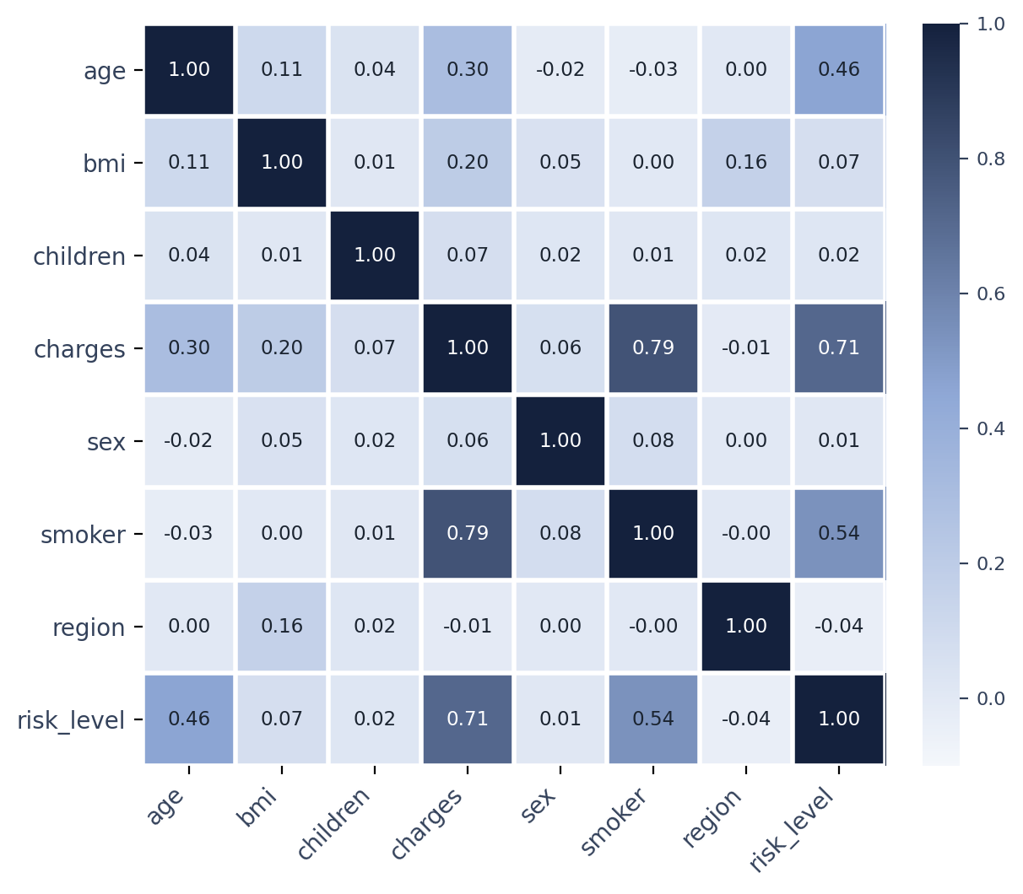

DATA EXPLORATION
Exploratory Data Analysis
Key Insights
Charges are heavily right-skewed — mostly low-cost, with a long high-cost tail.
Smoker status is the strongest correlate of high charges (0.79), followed by age (0.30) and BMI (0.20).
No missing data; the high-charge outliers are overwhelmingly smokers.
Bad Risk is the minority class, handled with SMOTE on the training fold only.
Correlation matrix of features and target
RESPONSIBLE AI FOR PREDICTIVE UNDERWRITING
9

Slide 10

MODEL DEVELOPMENT
Model Selection — Accuracy & F1
XGBoost is the clear winner. It demonstrates the strongest performance among the three, achieving the highest overall accuracy (92.24%) and F1-score (0.9212) — reinforcing its selection as the production model.
RESPONSIBLE AI FOR PREDICTIVE UNDERWRITING
10

Slide 11



MODEL DEVELOPMENT
Final Model Performance
92%
94%
96%
0.92
Accuracy
Precision (‘False’ class)
Recall (‘True’ class)
F1-Score
What the numbers mean
XGBoost shows high precision for the ‘False’ (Good Risk) class at 0.94 and high recall for the ‘True’ (Bad Risk) class at 0.96.
This indicates a robust ability to correctly identify both ‘Bad’ and ‘Good’ risks — not just overall accuracy, but balanced performance across classes.
These figures cleared both project success thresholds (Accuracy > 85%, F1 > 0.80) with meaningful headroom.
RESPONSIBLE AI FOR PREDICTIVE UNDERWRITING
11

Slide 12
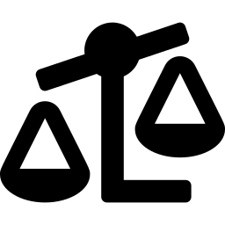

RESPONSIBLE AI
Core Fairness Criteria
Demographic Parity
Equal Accuracy
Equal Opportunity
Ensures the model yields proportionate approval rates across distinct demographic groups.
Validates that the model’s predictive precision remains consistent across all evaluated subgroups.
Guarantees that qualified individuals share the same probability of a positive outcome, regardless of demographic factors.
RESPONSIBLE AI FOR PREDICTIVE UNDERWRITING
12

Slide 13



RESPONSIBLE AI
Core Fairness — Results
Demographic Parity
Equal Opportunity
Intersectional (Sex × Smoker)
0.91
0.95
0.00
Selection Rate Ratio
TPR Ratio
Fairness Ratio
Female 59.5% vs Male 54.1%
Female 100.0% vs Male 94.7%
0% selection for smokers, both sexes
PASSES 80% RULE
PASSES 80% RULE
CRITICAL FINDING
The gender metrics look compliant in isolation — but intersectional slicing tells a different story. Every smoker in the test set (25 female, 45 male) was predicted Bad Risk, a selection rate of 0.00 versus 0.272 for non-smokers. Isolated audits can mask severe, hidden group discrimination.
RESPONSIBLE AI FOR PREDICTIVE UNDERWRITING
13

Slide 14
SYNTHESIS
Key Findings & Insights
Finding 1 — Auditability Over Raw Accuracy
Finding 2 — Smoker Status & Age Dominate
The real value isn’t accuracy alone — it’s that the model is auditable: explainability and a fairness audit run as named pipeline stages, not afterthoughts.
SHAP shows smoker status and age dominate every prediction; smoking is the single strongest signal in the data.
Finding 3 — A Total Exclusion Signal
Finding 4 — Fairness Is a Set of Decisions
Every smoker in the test set is predicted Bad Risk (selection rate 1.00 vs. 0.272 for non-smokers); region selection rates spread ~10 points.
Fairness is a set of defensible decisions — the sex gap was mitigated, region measured, and the smoker gap kept intentionally as a recognized actuarial factor.
RESPONSIBLE AI FOR PREDICTIVE UNDERWRITING
14

Slide 15


GROUND RULES
Assumptions & Constraints
Key Assumptions
Constraints
The ~1,338-record public insurance dataset is treated as representative of the applicant pool (acknowledged as a limitation).
The six features carry independent, legitimate risk signal; no strong proxy for a protected attribute is assumed (region is the weak point).
Train and serving data share the same distribution — checked with drift monitoring rather than assumed.
COMPUTE Local machine / Colab free tier
DATA One public dataset; no real applicant data
ETHICS Synthetic Bad Risk label; sex-based pricing restricted; no PII controls
RESPONSIBLE AI FOR PREDICTIVE UNDERWRITING
15

Slide 16



HONEST ACCOUNTING
Limitations & Challenges
Data Quality
Small (~1,338 records), non-representative, single public dataset. The Bad Risk label is a synthetic $10K threshold on cost, not a real underwriting outcome.
Model Limits
Residual sex gap (~3.7 pts) reduced but not eliminated; region disparity measured but unmitigated in the served model. No generalization claimed.
What Failed
Fairlearn’s ThresholdOptimizer narrowed the sex gap but couldn’t close it, costing ~0.4 pts of accuracy. It stayed an analysis step, not wired into the served model.
RESPONSIBLE AI FOR PREDICTIVE UNDERWRITING
16

Slide 17




WRAPPING UP
Conclusions & Recommendations
The goal wasn’t raw accuracy — it was whether a model that affects what people pay can be explained and audited before it ships. The data says yes: the model is accurate and transparent, with fairness gaps surfaced honestly rather than hidden.
1
Don’t deploy as-is — treat it as a demonstration. Before any real use, validate on production data and add authentication plus a PII policy.
2
Investigate whether the 100% rejection rate for smokers is a business-justified risk threshold, or whether the model over-relies on this single feature at the expense of BMI or age.
3
Make a jurisdiction-specific decision on region rating, and wire the sex mitigation into the served model where sex-based differentiation is restricted.
4
Stand up continuous drift monitoring (Evidently) and a periodic fairness re-audit as part of ongoing governance.
RESPONSIBLE AI FOR PREDICTIVE UNDERWRITING
17

Slide 18


NEXT STEPS
Future Work & Questions
Incorporate additional, larger, and more representative data sources beyond the single public dataset.
Q & A
Explore alternative methods and model architectures, including calibrated ensembles and fairness-aware training.
Define a deployment and real-world testing plan, including authentication, PII controls, and staged rollout.
Thank you for your attention.
RESPONSIBLE AI FOR PREDICTIVE UNDERWRITING
18

Slide 19

APPENDIX
Supporting Q&A — Methodology, Fairness & Governance
A condensed reference for anticipated audit and defense questions.
RESPONSIBLE AI FOR PREDICTIVE UNDERWRITING
19

Slide 20



APPENDIX — CATEGORY 1
Model Design & Methodology
Why XGBoost, and what was the accuracy/interpretability trade-off?
XGBoost was the champion architecture (~95% accuracy, 0.95 F1) over a Logistic Regression baseline. To resolve its interpretability penalty, the ensemble was wrapped with SHAP for post-hoc local and global explanations.
How was class imbalance handled?
Claims/defaults were treated as minority events. A cost-sensitive scale_pos_weight adjustment scaled gradient updates, and stratified splitting/cross-validation preserved class distribution across folds — avoiding an inflated, majority-biased F1-score.
How was model calibration addressed?
The XGBoost pipeline exhibited clustered, overly conservative probabilities typical of tree ensembles. Isotonic Regression (via CalibratedClassifierCV) was evaluated to align raw scores with true underwriting frequencies.
How was data leakage / overfitting prevented?
A Stratified K-Fold schema inside a unified scikit-learn pipeline ensured all encoders and scalers were fit only on active training folds, keeping Good/Bad Risk proportions uniform across folds.
RESPONSIBLE AI FOR PREDICTIVE UNDERWRITING
20

Slide 21

APPENDIX — CATEGORY 2
Fairness & Bias Auditing
What protected attributes and fairness metrics were tested?
Sex/Gender was the primary protected attribute, evaluated with Demographic Parity Ratio (selection-rate independence) and Equal Opportunity Ratio (true-positive-rate separation).
What mitigation techniques were applied?
Baseline gender metrics were already compliant (Selection Rate Ratio ~0.91; TPR Ratio ~0.95), satisfying the industry-standard 80% rule, so no post-processing threshold shift was needed for gender.
How are legitimate risk factors distinguished from protected-class proxies?
Smoker status looked like a legitimate actuarial factor, but intersectional analysis showed both female and male smokers received a 0.00% selection rate — the feature acted as an absolute exclusion veto, not a graded risk signal.
How was intersectional bias (Sex × Smoker) addressed?
Isolated gender metrics looked exemplary, but slicing by Sex × Smoker revealed 25 female and 45 male smokers were universally rejected (Intersectional Fairness Ratio: 0.0000) — proving single-attribute audits can mask real discrimination.
RESPONSIBLE AI FOR PREDICTIVE UNDERWRITING
21

Slide 22



APPENDIX — CATEGORY 3
Explainability & Transparency
How would an individual denial be explained to an applicant?
SHAP values plus counterfactual explanations generate an itemized list of top denial reasons and the minimum feature change needed to flip the outcome (e.g., “if Smoker Status were ‘No’”), satisfying adverse-action disclosure norms.
How do global and local feature importance reconcile?
Age and Smoker Status dominate globally. Locally, non-smokers show zero marginal push from the smoker feature, while for smokers the local attribution matches the global trend and overrides other positive factors.
What documentation supports model-risk review?
An institutional Model Card was compiled: model details, intended use, quantitative performance, fairness audit logs (Demographic Parity 0.91, Equal Opportunity 0.95, Intersectional 0.0000), and SHAP attribution mapping.
RESPONSIBLE AI FOR PREDICTIVE UNDERWRITING
22

Slide 23

APPENDIX — CATEGORY 4
Regulatory, Ethical & Security
Which regulations informed the underwriting approach?
FCRA adverse-action mandates (met via SHAP/counterfactual logging), state unfair-discrimination statutes (met via the 80% rule audit), and EU AI Act high-risk classifications (met via intersectional auditing) all shaped the design.
What controls protect the data pipeline from supply-chain risk?
Strict OAuth application governance prevents self-authorized external data loaders; inference is decoupled from core CRM systems via an API gateway with short-lived, scoped tokens and continuous egress telemetry.
What is the overall governance posture?
Compliance is treated as an active engineering constraint: regulatory language maps to measurable thresholds (e.g., Demographic Parity Ratio), and legal retains veto authority over model activation.
RESPONSIBLE AI FOR PREDICTIVE UNDERWRITING
23

