Slide 1
2024-3-28
Lab Meeting

Slide 2
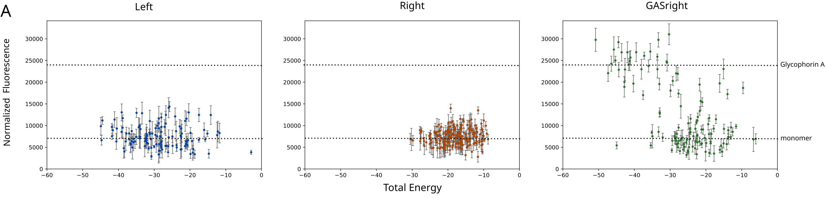
Finalized sort-seq data

Slide 3
All designs have at least 1 S, T, or Y
Determine if left and right designs are associating by hydrogen bonding or solely packing

Slide 4
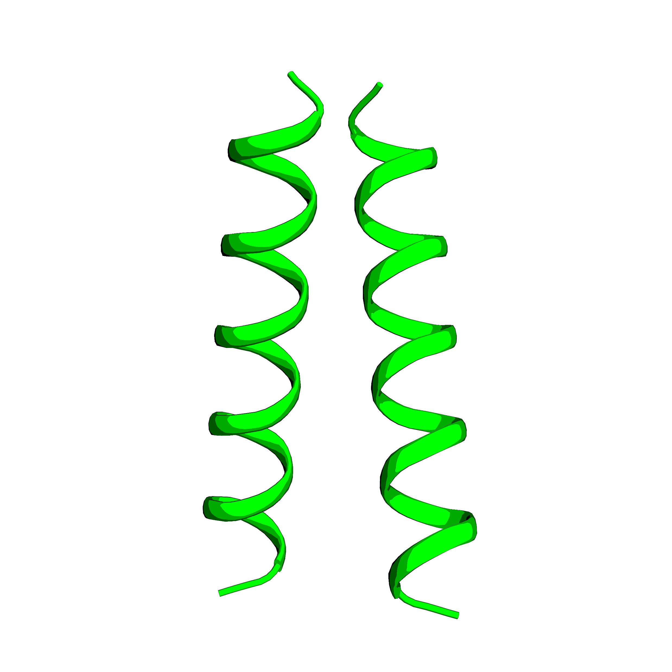
Identifying hydrogen bonds
Take predicted structure

Slide 5
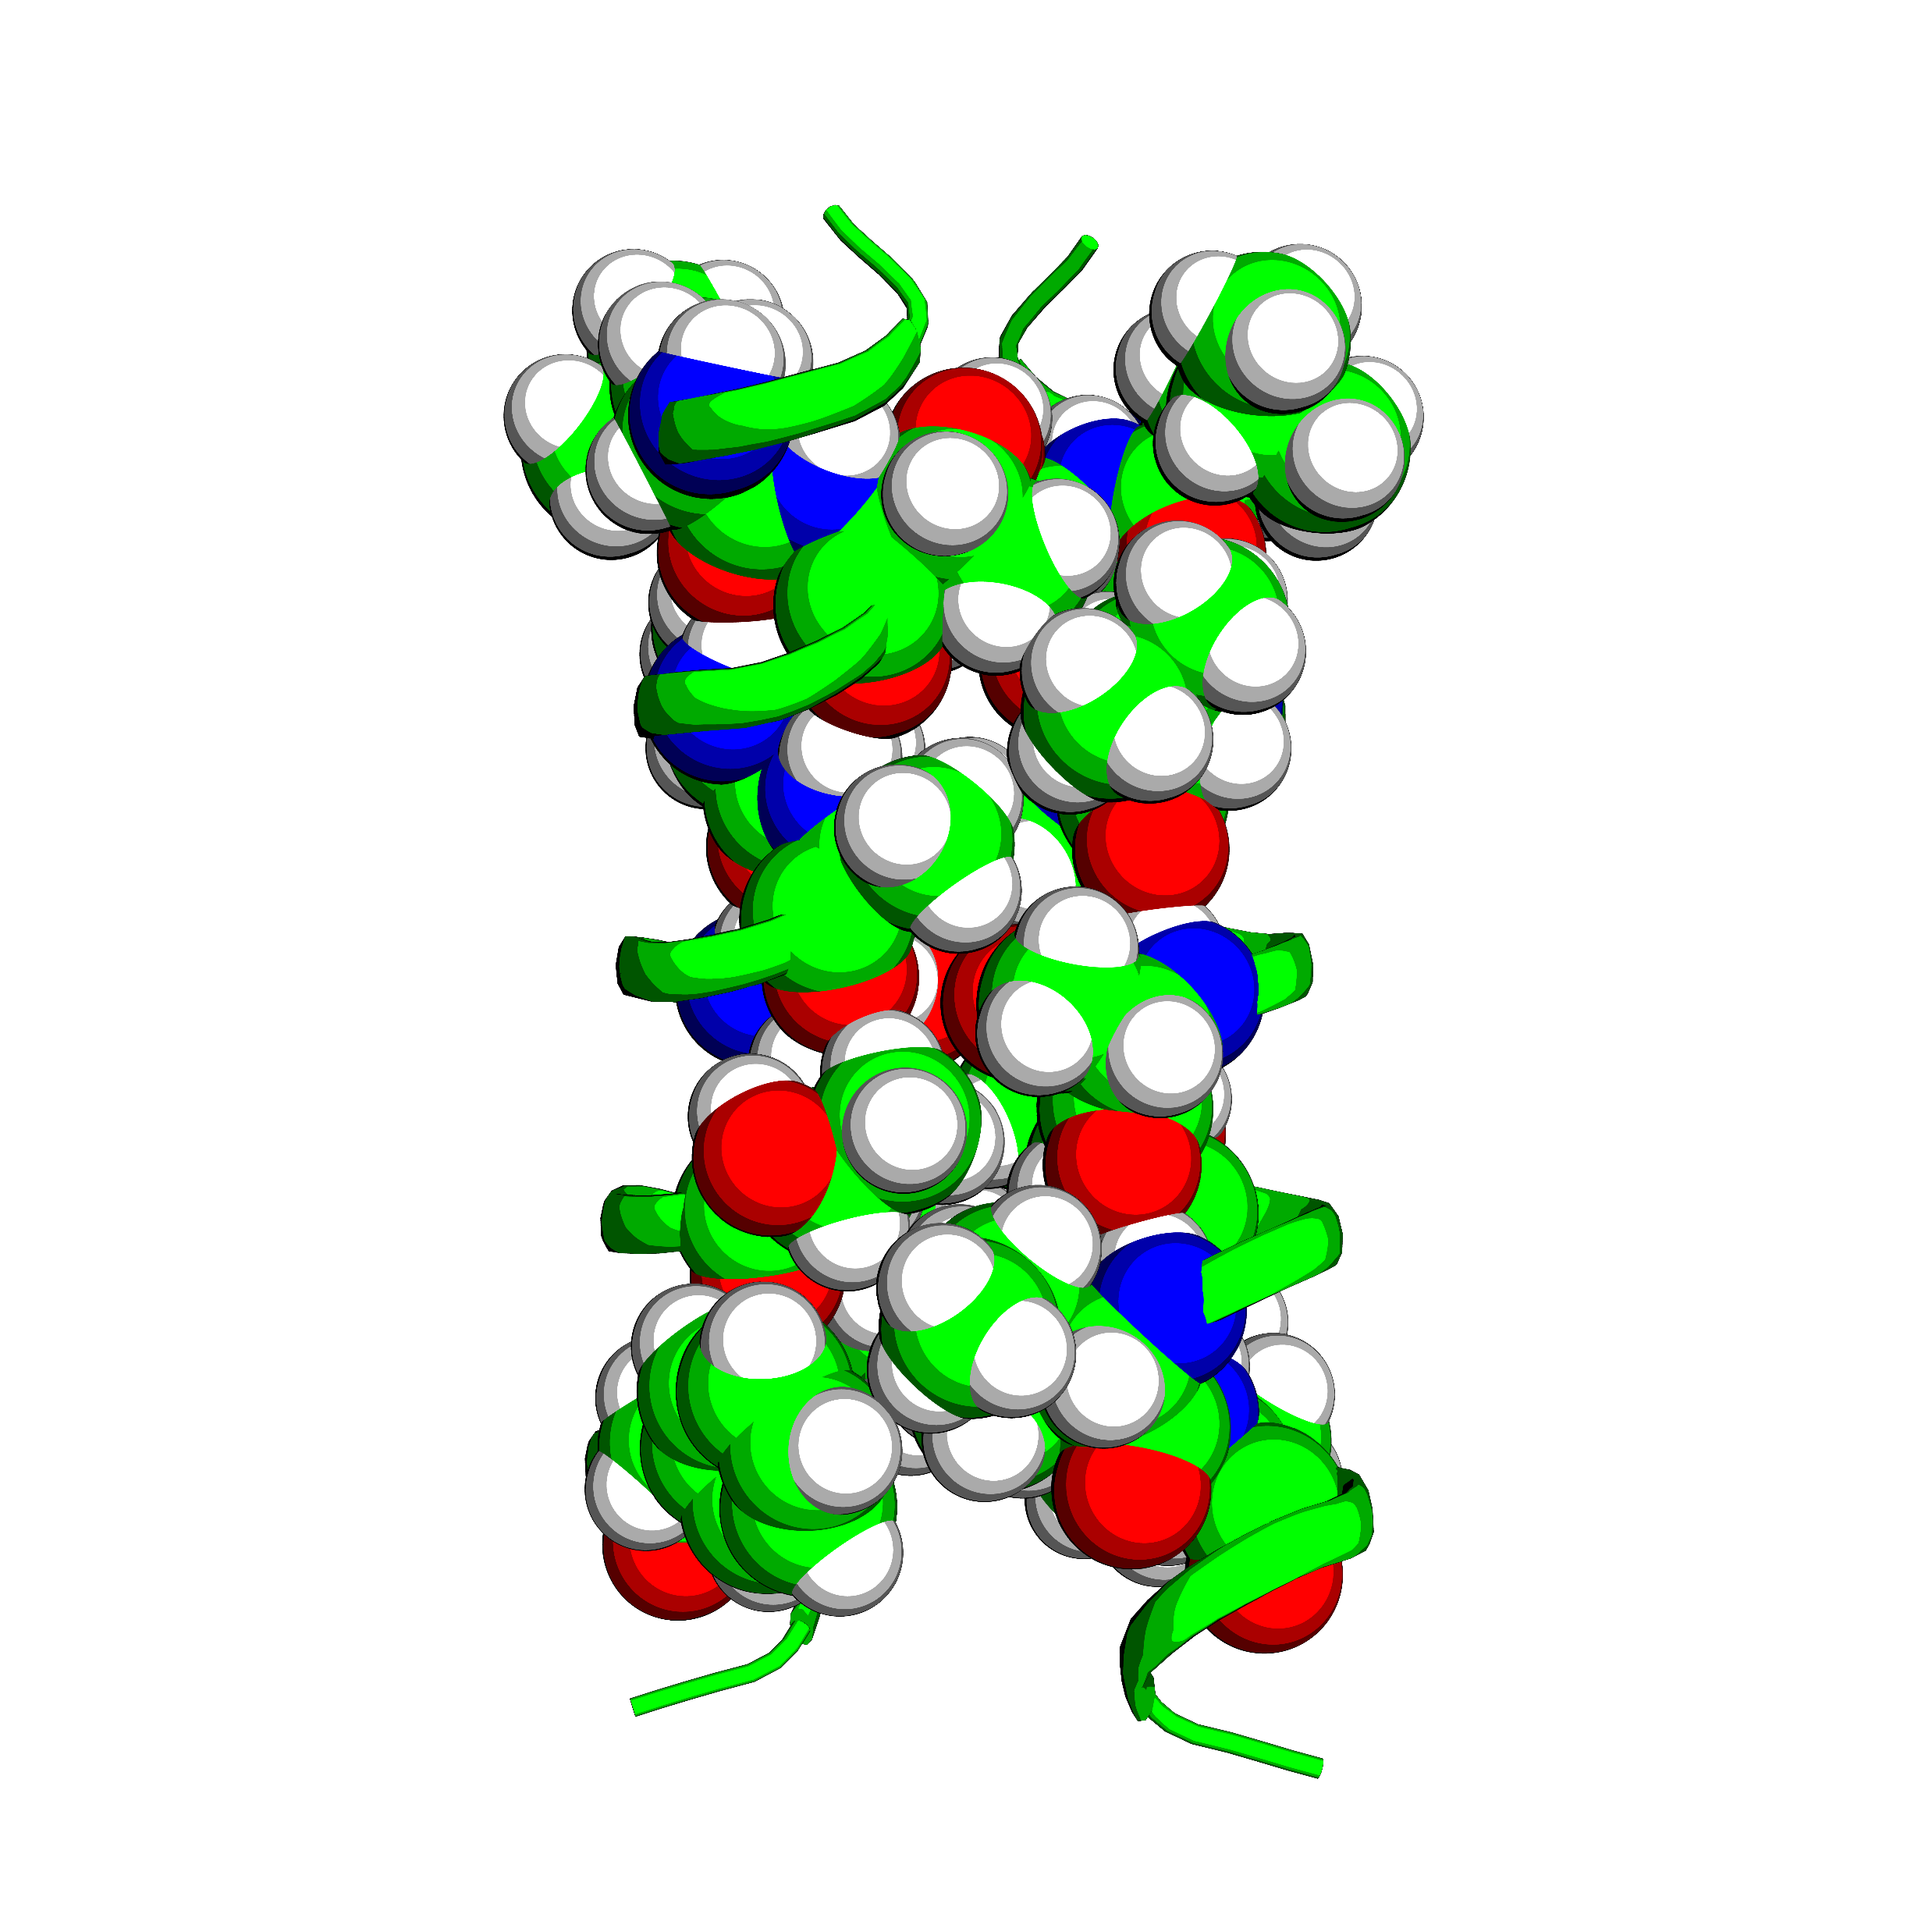
Identifying hydrogen bonds
Identify interfacial positions
Get all Ser, Thr, and Tyr
Identify any O within 3Å (including backbone carbonyl O)

Slide 6
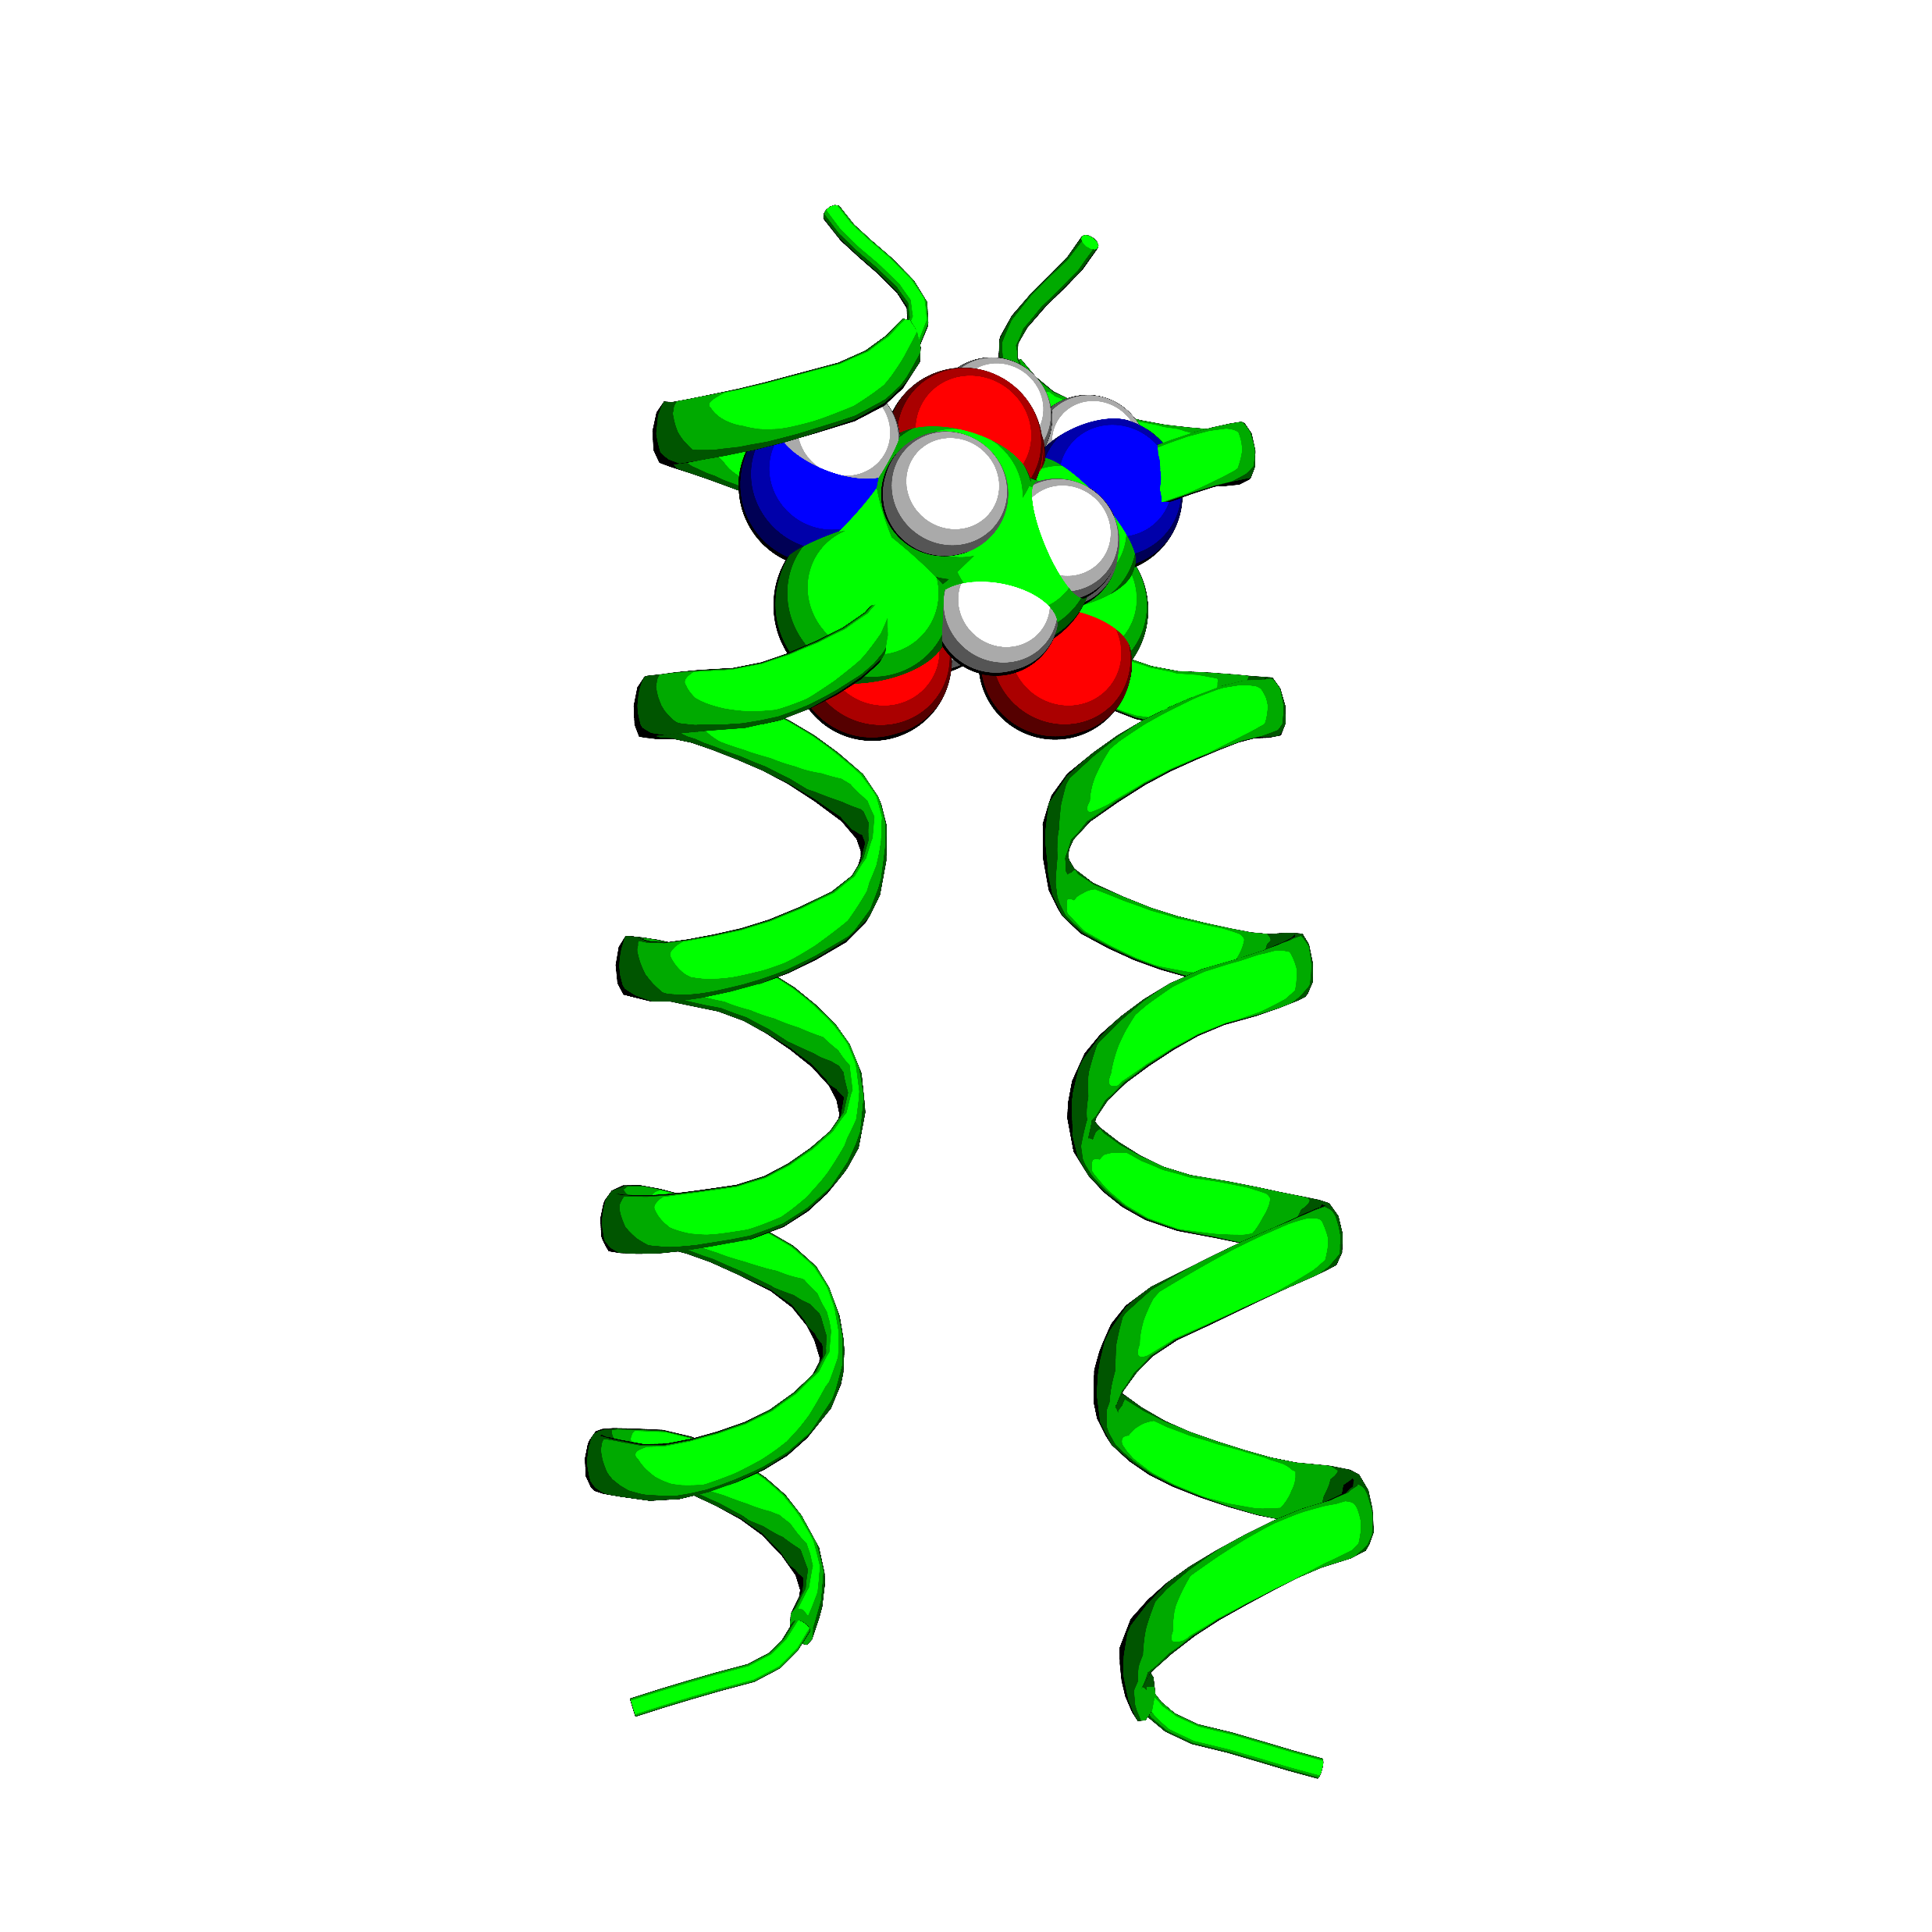
Identifying hydrogen bonds
Count the number of hbond contacts

Slide 7
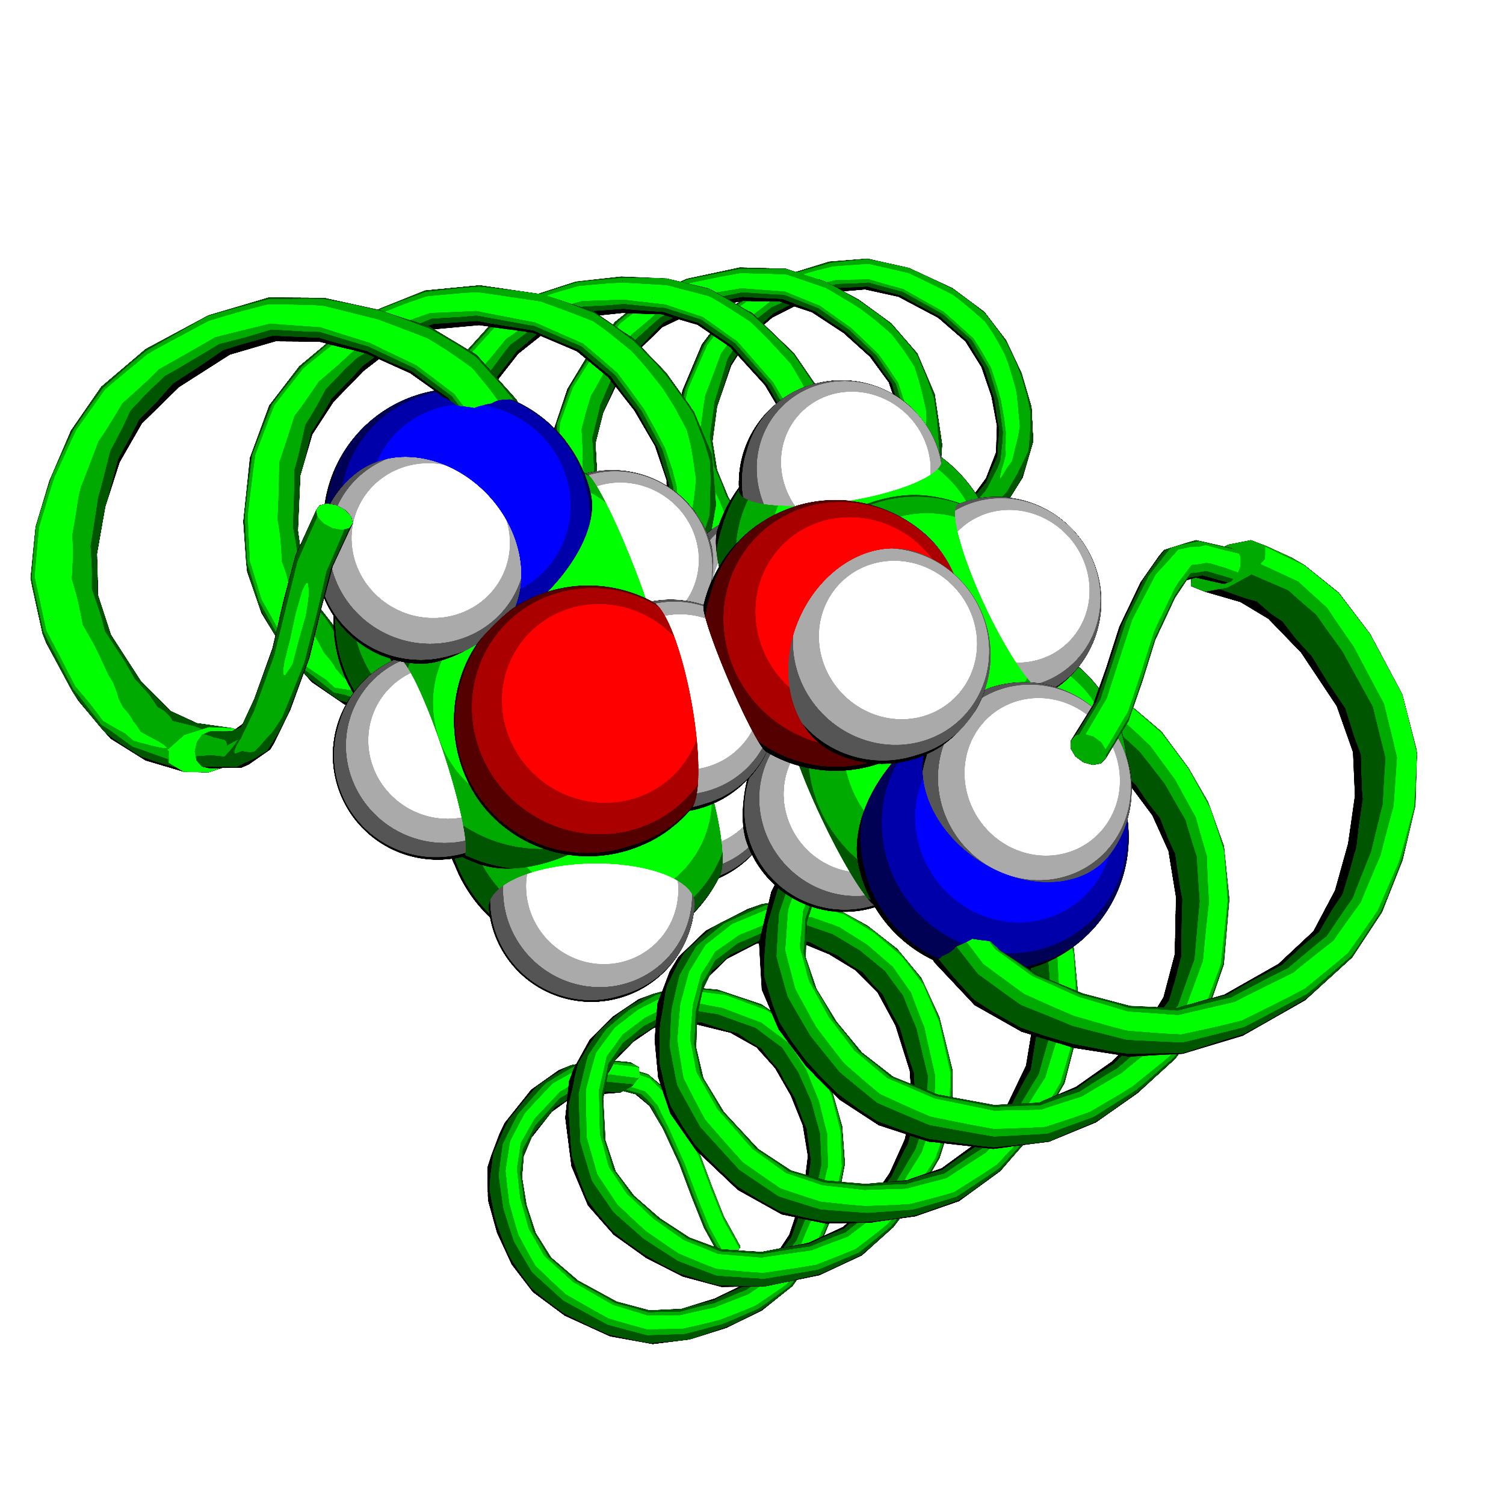
Identifying hydrogen bonds

Slide 8
Compare designs above and below 40% GpA

Slide 9
20-40% of Right and Left designs have potential hydrogen bonds

Slide 10
Past few weeks
7 left and 10 right designs with at least 1 hbond
Order gblocks with point mutants for Ser, Thr, and Tyr
Clone and run toxgreen

Slide 11
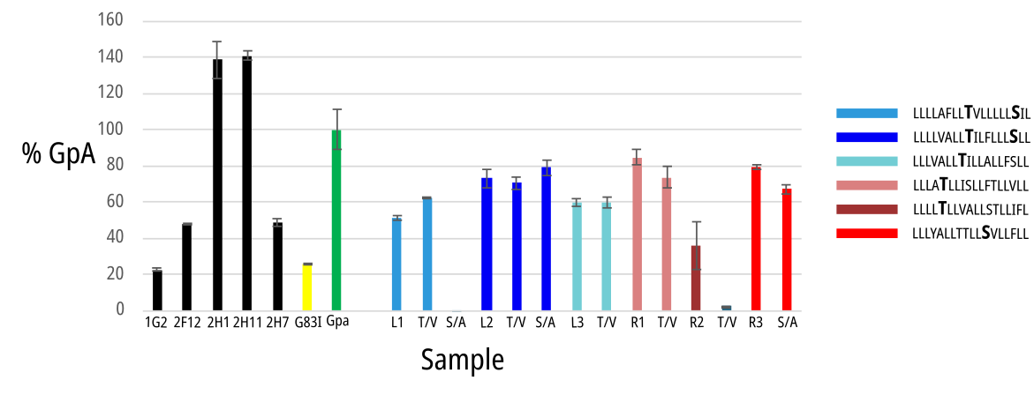
TOXGREEN

Slide 12
TOXGREEN

Slide 13
TOXGREEN

Slide 14
TOXGREEN

Slide 15
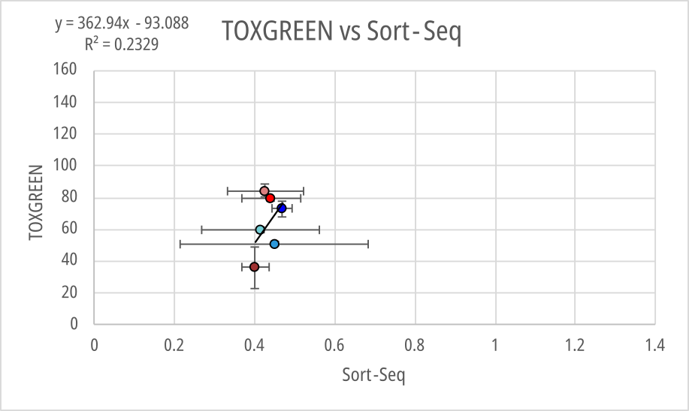

Slide 16
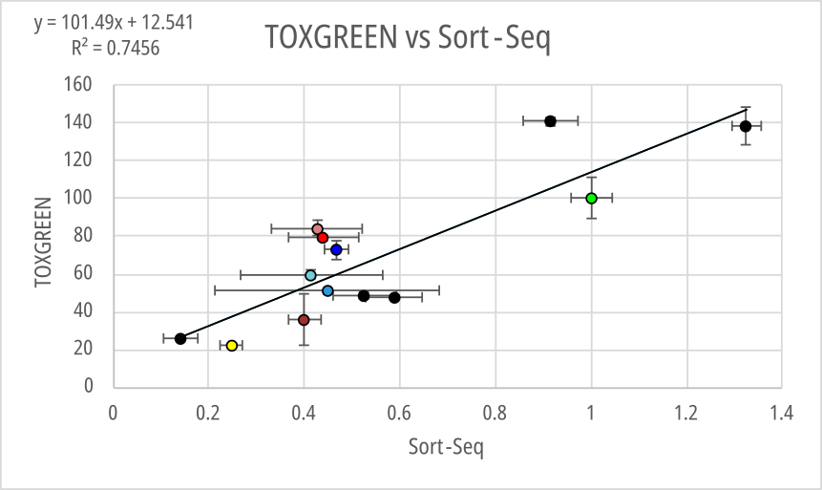
Scatter

Slide 17
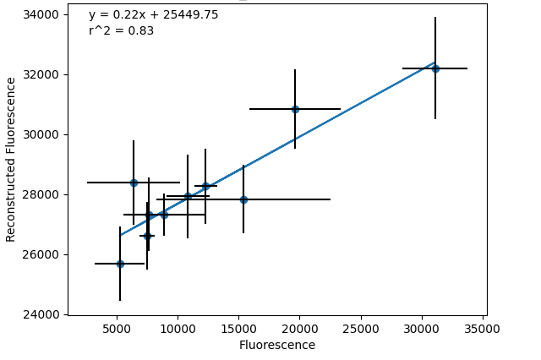

Slide 18
More to do!
Ordered gblocks w/ double mutants to ensure association is reliant on switching to other hbond AA
Clone, run TOXGREEN, and finish writing paper

