Slide 2
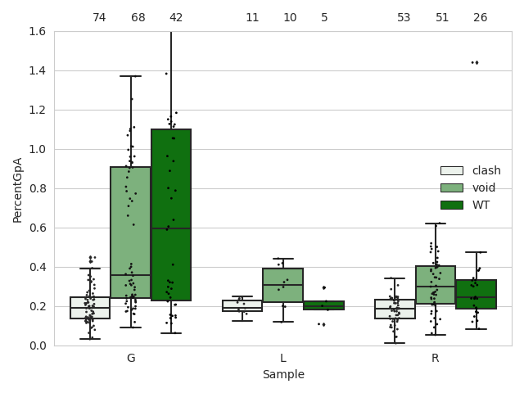
2 mutants < 25% OR < 50% WT

Slide 3
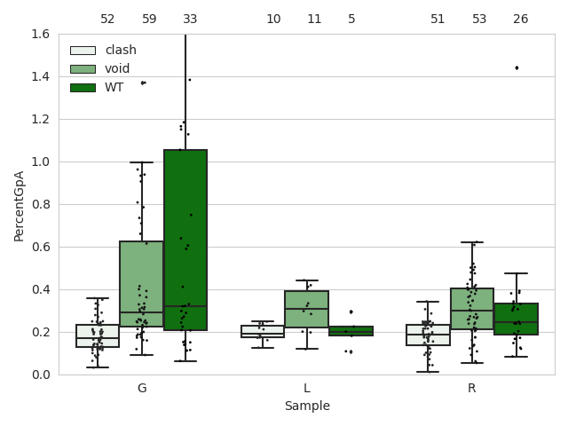
2 mutants < 25% OR < 75% WT

Slide 4
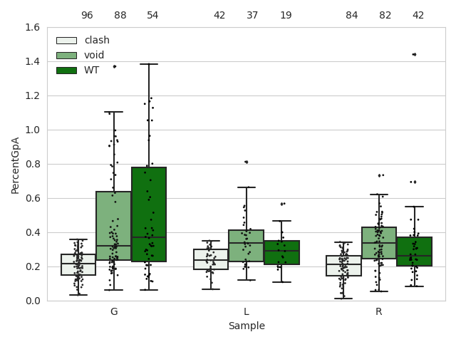
2 mutants < 35% OR < 75% WT

Slide 5
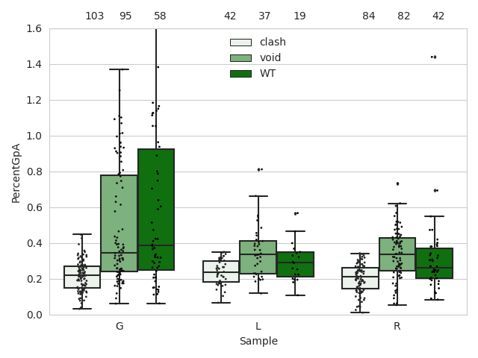
2 mutants < 35% OR < 50% WT

Slide 6
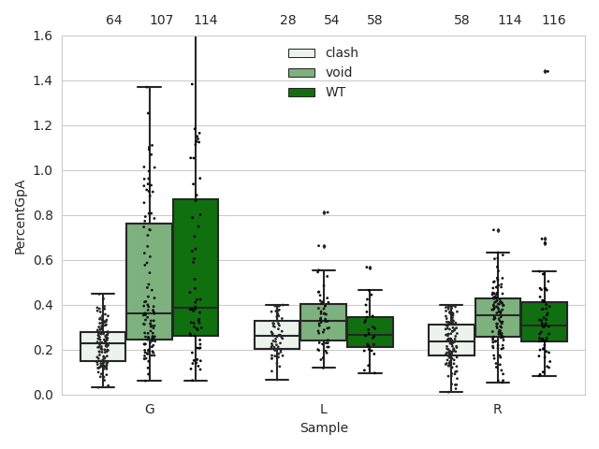
2 mutants < 40% OR < 50% WT

Slide 7
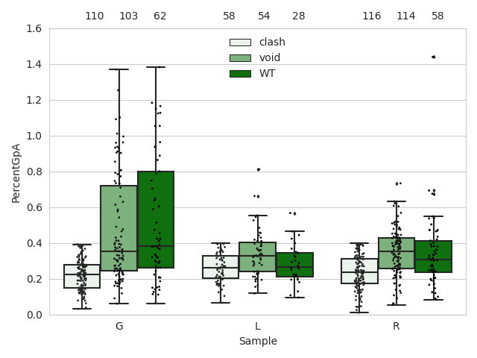
2 mutants < 40% OR < 75% WT

