Slide 1
westerns

Slide 2
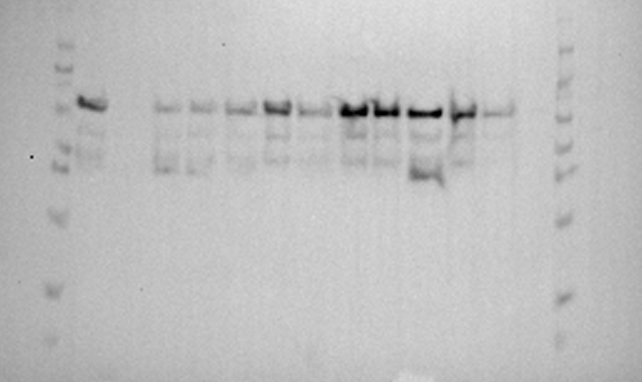
2025-5-13
Ladder, +C, -C, RWT, RD, RC, RY→F, LWT, LD, LC, LWT, LD, LC, blank, Ladder

Slide 3
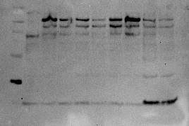
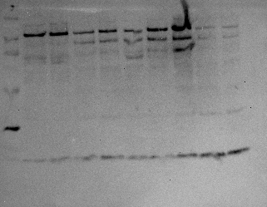
2024-1-1: duplicate
Ladder, 5-4, G8, L3, L7, L5, L19, L6, 1G2, 2H7

Slide 4
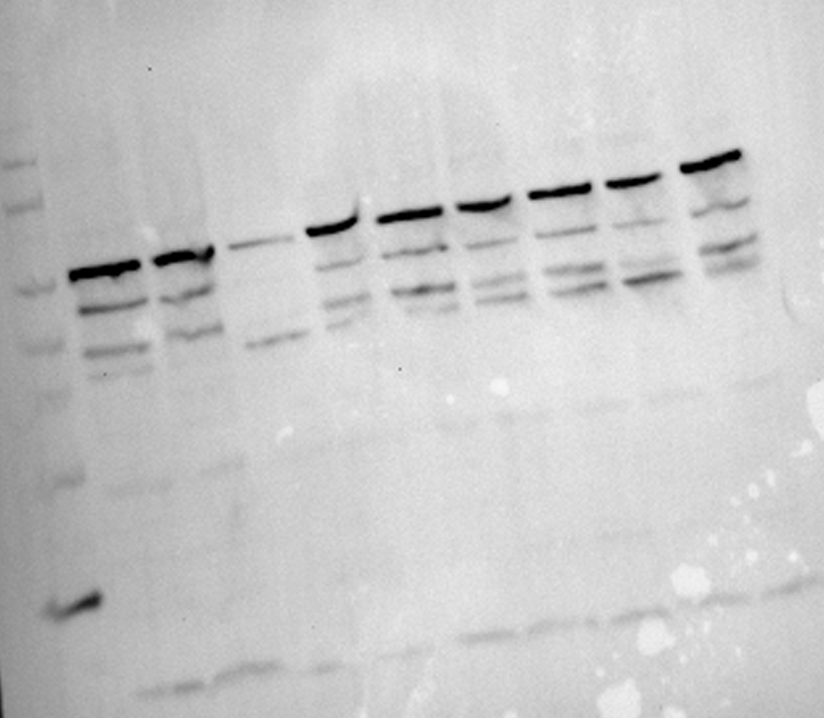
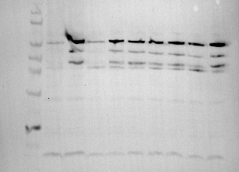
2023-10-31: duplicate
Ladder, +C, +C, R20, L19, R19, G5, G9, L13, L18

Slide 5
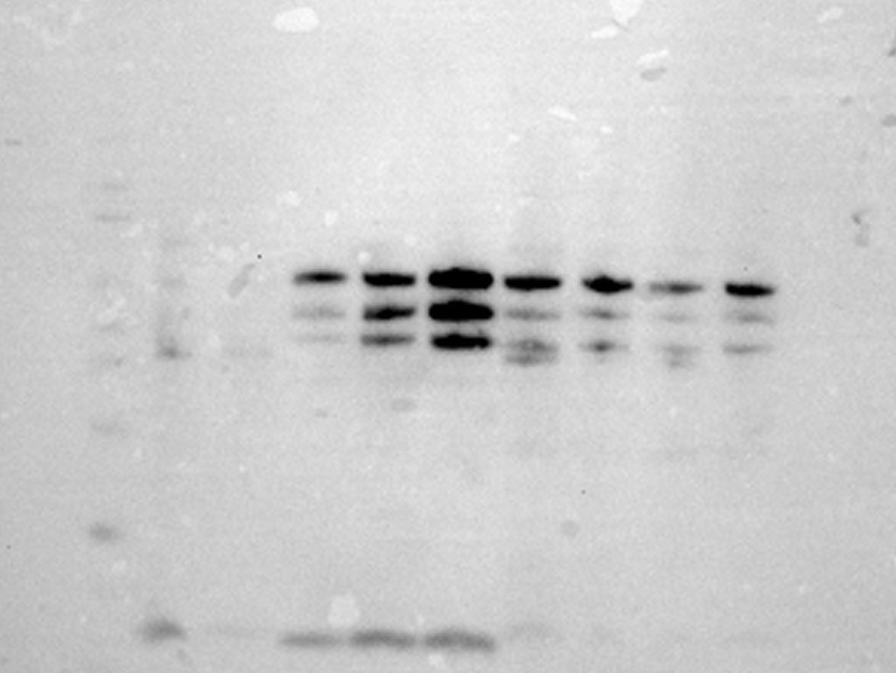
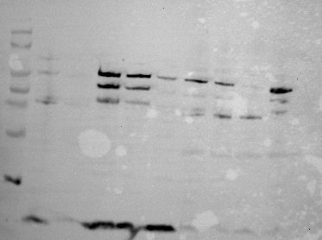
2023-10-10
Ladder, +C, -C, RWT, RD, RC, RY→F, LWT, LD, LC, LWT, LD, LC, blank, Ladder

