Slide 1

Portfolio presentation
Grey Joyner
Friday the 13th! November 2020

Slide 2
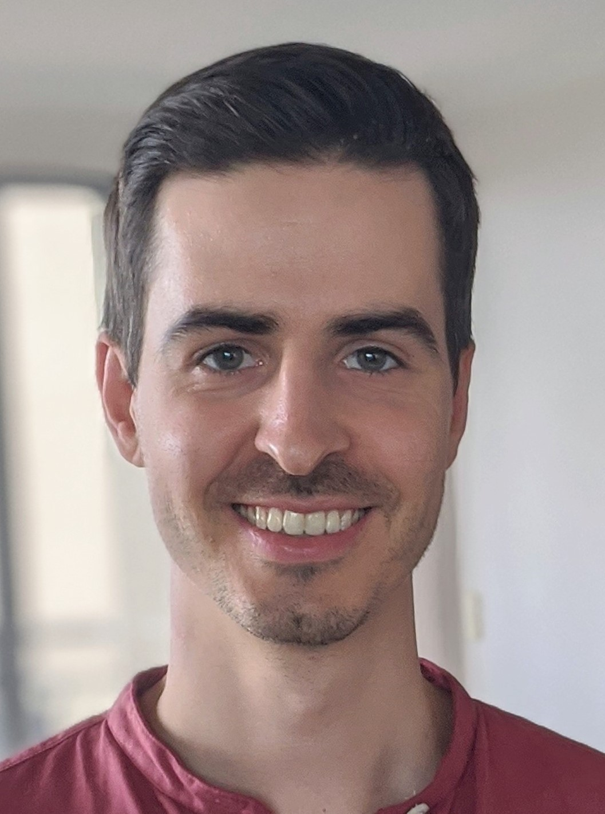
Agenda
Portfolio Overview
Sitemap
Wireframes
Static demo: features & design decisions
Favourite parts and challenges
Dynamic demo

Slide 3
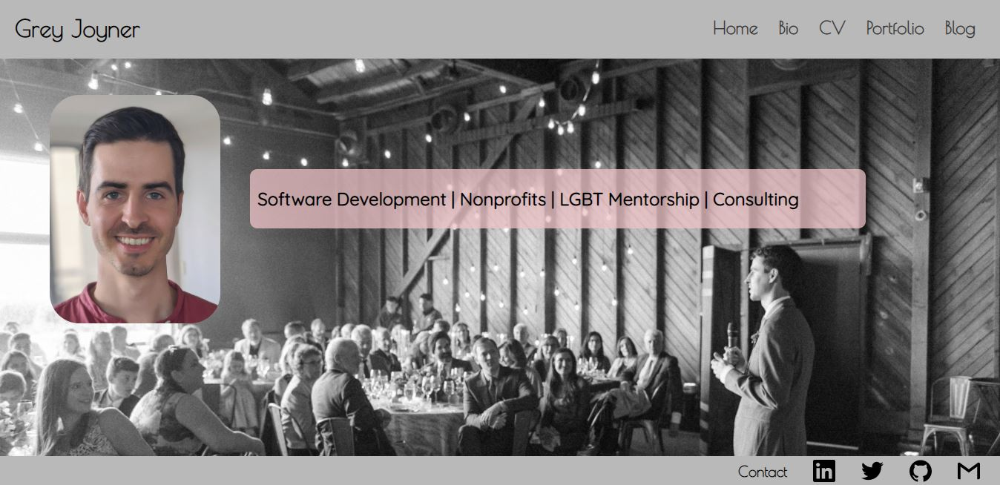
Grey Joyner’s Portfolio
Purpose:
Provide overview of myself, my background and my skills to potential employers

Slide 4





Tech stack

Slide 5
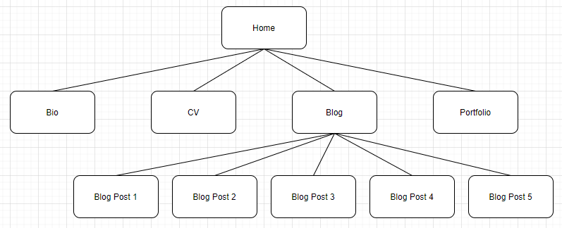
Sitemap

Slide 6
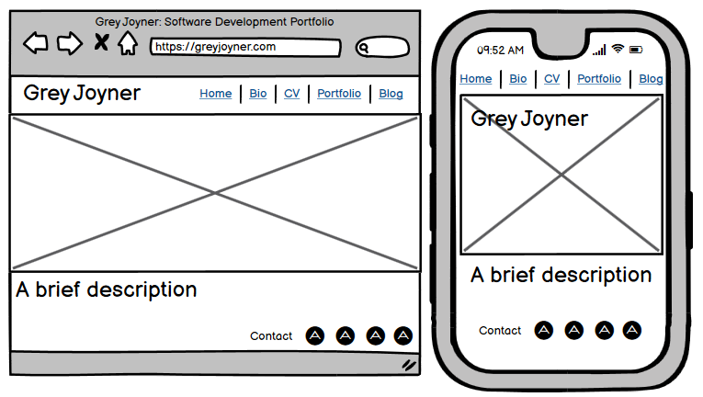
Wireframes

Slide 7
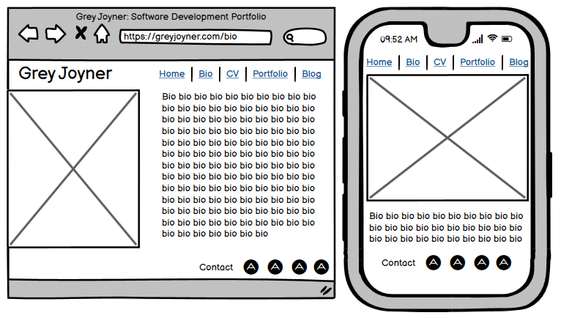
Wireframes

Slide 8
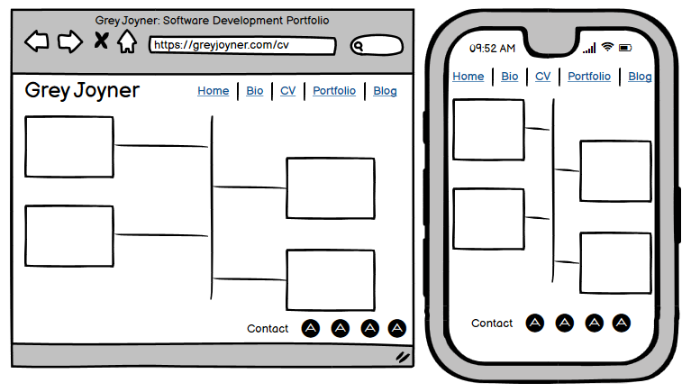
Wireframes

Slide 9
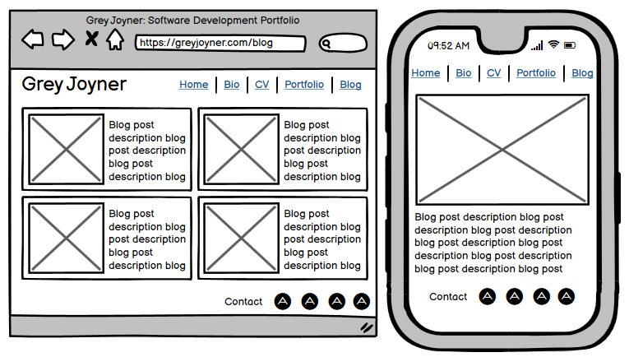
Wireframes

Slide 10
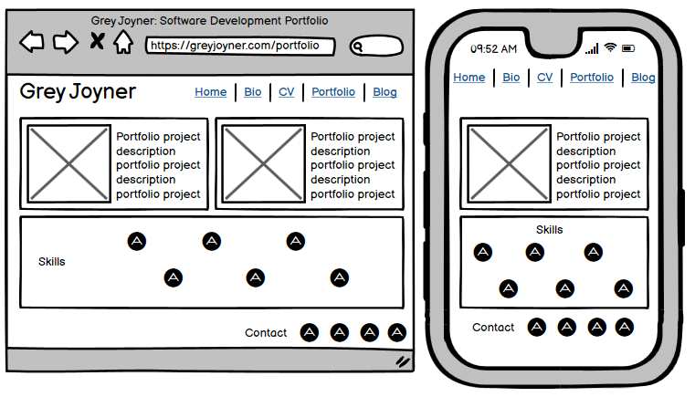
Wireframes

Slide 11
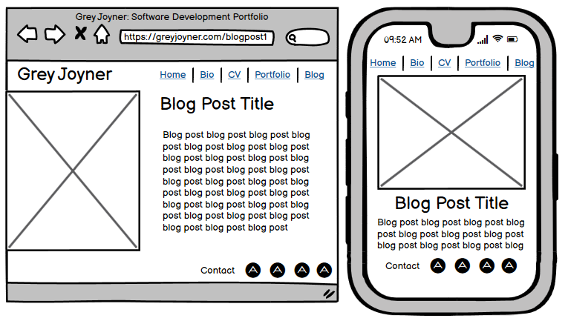
Wireframes

Slide 12
Static demo
Static header with scrolling links
Picture and bio with transition
Greyscale theme
Static contact footer

Slide 13
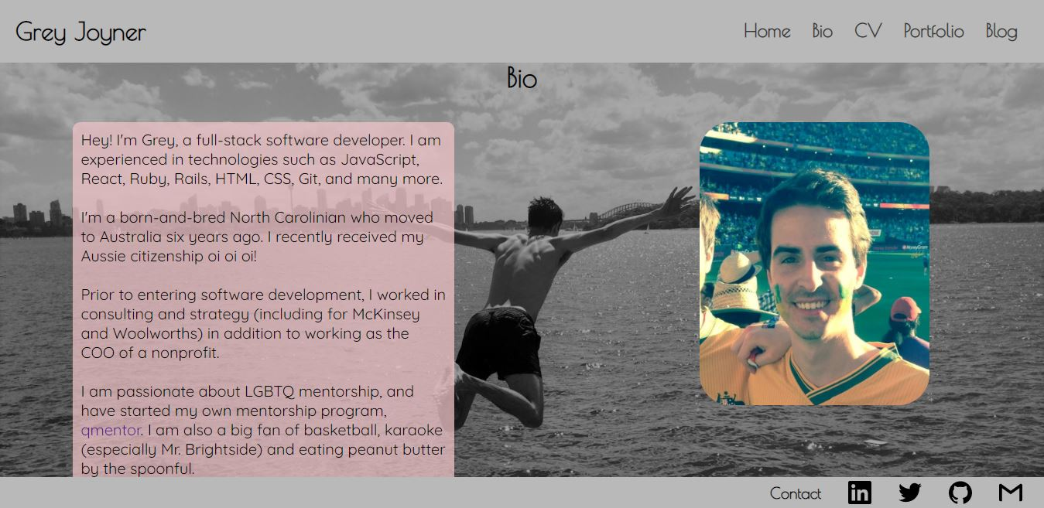
Static demo
Bio and picture

Slide 14
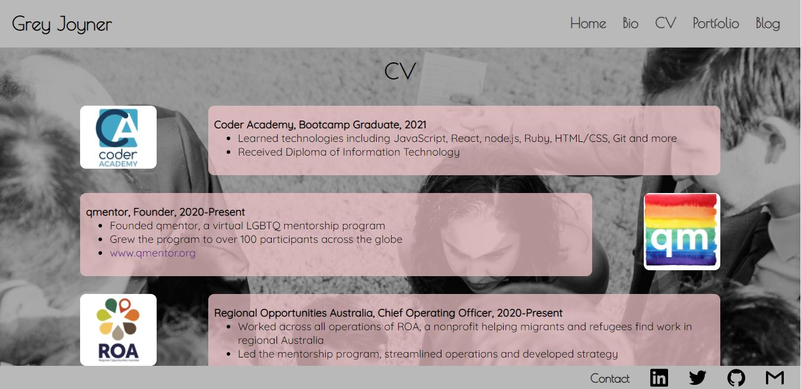
Static demo
CV timeline and download link

Slide 15
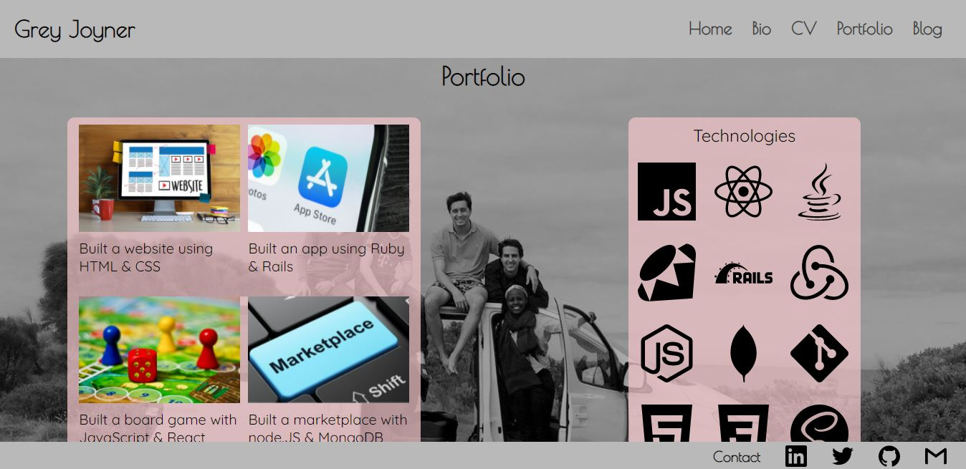
Static demo
Portfolio examples
Tech stack

Slide 16
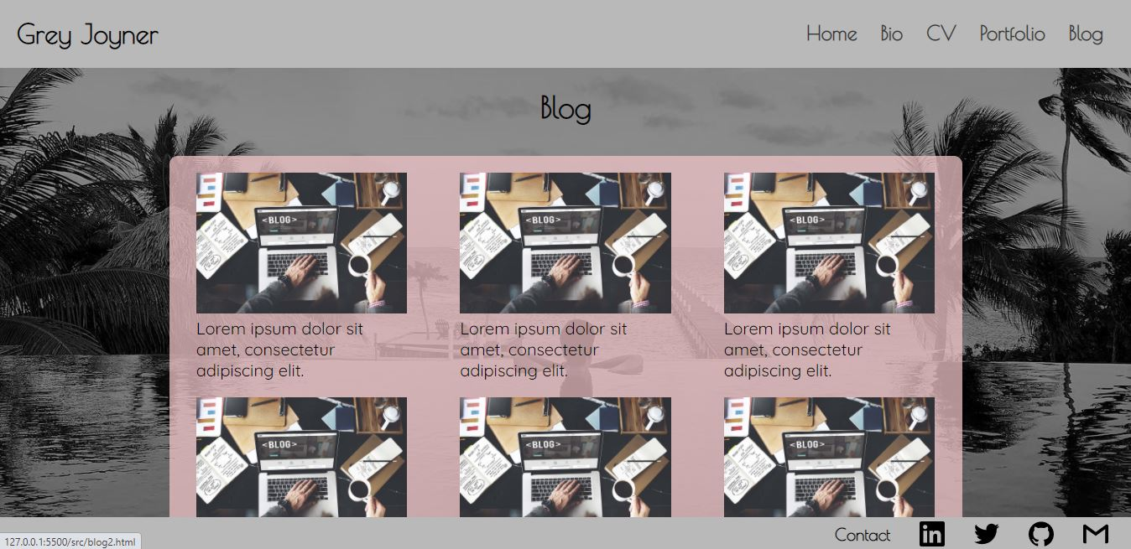
Static demo
Blog posts

Slide 17
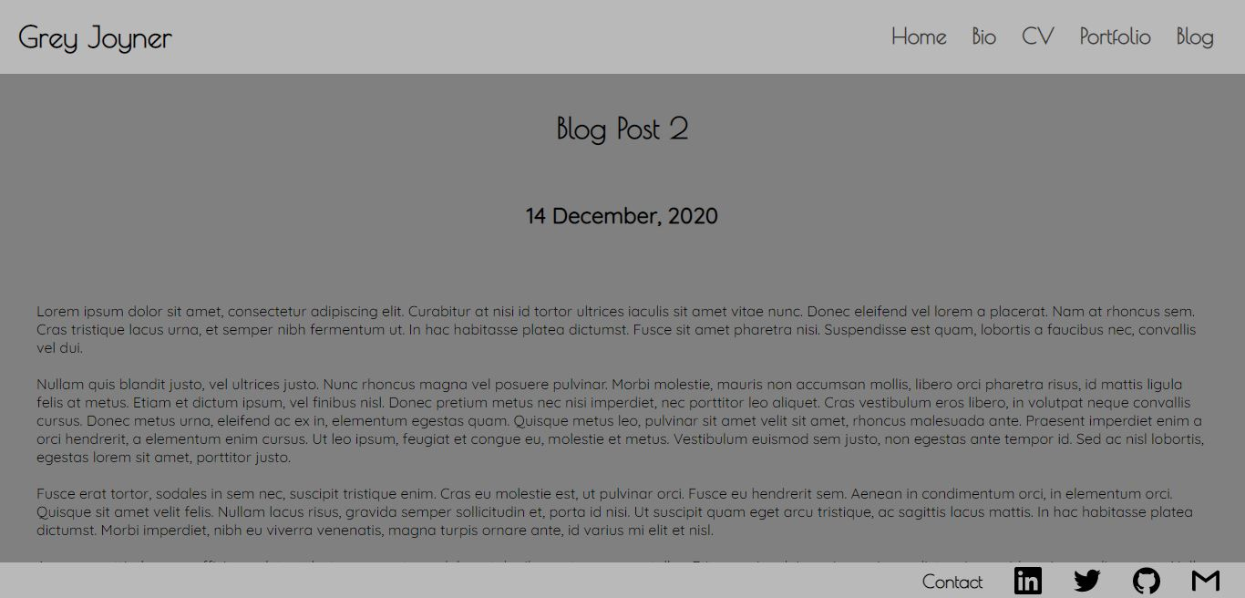
Static demo
Blog post
Next step: improve look and feel

Slide 18
Favourite parts and challenges
Favourite parts
Challenges
Look and feel
Sliding links
Getting to build something
Media queries
Learning better ways to do things
Blog post pages

Slide 19
Live demo
(Pending available time)
https://grey-joyner.netlify.app/

Slide 20
Thank you!

