Slide 1

Battleship
Grey Joyner
Coder Academy, December 2020

Slide 2

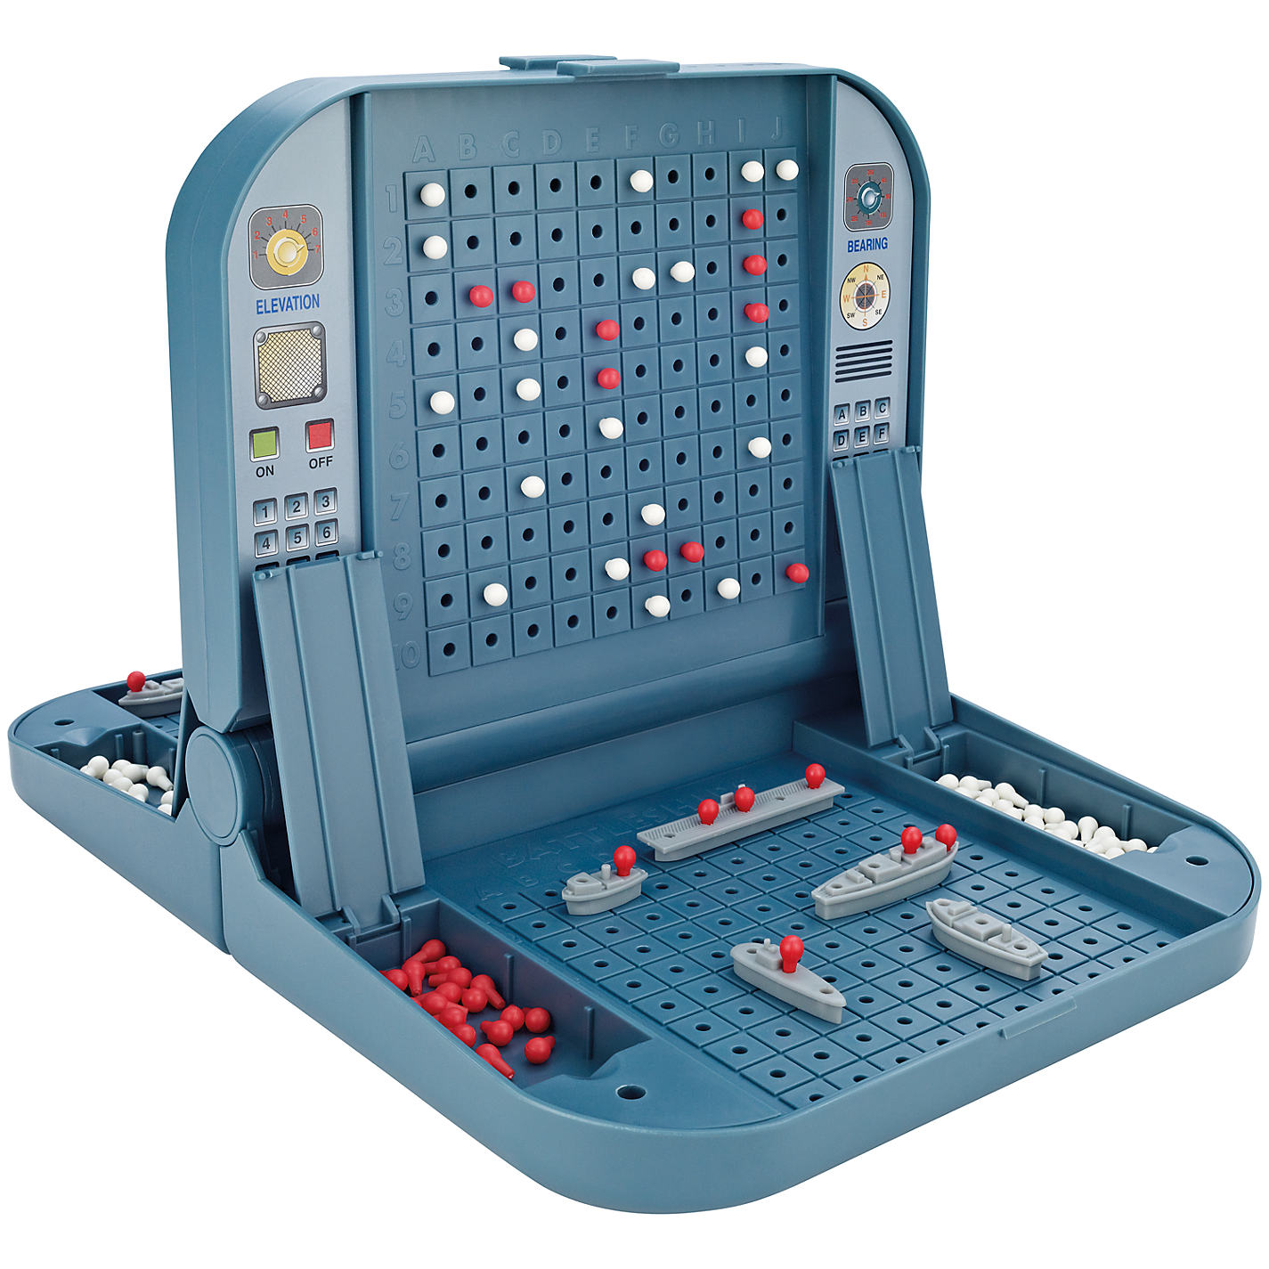
The program

Slide 3
The flow (simple overview)
Intro and instructions
User places boats
User turn
Computer turn
End result
No
Game over?
Yes
Game over?
Yes
No

Slide 4
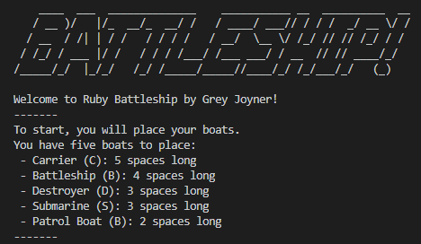
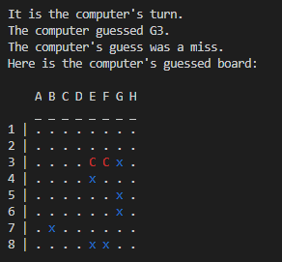
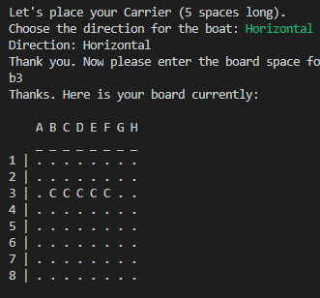
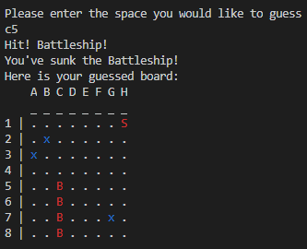
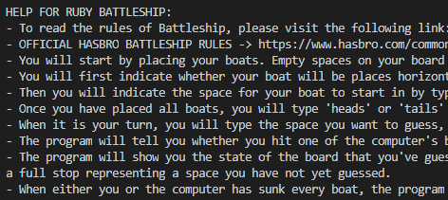

Features
Intro, instructions, help
Place boats
User turn
Results from computer turn and game

Slide 5
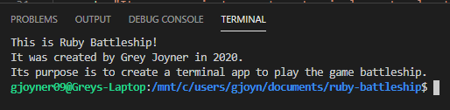
Command line options
Help
About
Speed
Default: slow
Time in between turns, instructions, etc.
Option: fast
No time in between
Difficulty
Default: normal
AI has decent but not perfect strategy
Option: easy
AI always guesses randomly

Slide 6
AI logic – normal mode
Guess around that space
One space guessed?
Yes
Unsunk boat?
Guess in the same direction
No
Guess randomly
Note: computer will never guess the same space twice

Slide 7
Code structure - files
ruby_battleship.rb
Main file which runs the program
board.rb
Creates the Board class and all associated methods
welcome.rb
Prints the welcome message and initial instructions
user_turn.rb
Method for the user’s turn
computer_turn.rb
Method for the computer’s turn
print_board.rb
Method to print the board
game_over.rb
Checks to see if the game is over
ruby_battleship_spec
Tests the program; located in the Spec folder
Note: also contains a README, Gemfile and Bash script file

Slide 8
Process review
Challenges
AI logic
Gems
Program structure and variable scoping
Ethical issues
Copyrighted game?
Favourite parts
AI logic
Learning new things: bash script, gems, testing, etc.

Slide 9
THANK YOU!

