Slide 1
Mach-Zehnder Interferometry
20233789 Gyu Huh

Slide 2
SETUP - Component
[ 3-Mirror System ]
[ 4F System ]
f1
f1
f2
f2
Beam Expansion & Collimation
Synchronize phase information before/after the system.
Make Gaussian to Plane wave
Determine the propagation of light
(One mirror only can decide one direction, while we need handle two)

Slide 3
SETUP – Mach Zehnder Interferometry
Aperture
(Airy Disk Filter)
3-Mirror
System
.
5x Objective
NA: 0.12
f2: 200mm
R
O
Pinhole
(Spatial Filter)
f1: 100mm
f2: 300mm
4F
10x Objective
NA: 0.25
f1: 17.7mm
f2: 200mm
Camera
Sample
WD = 17.7mm
200mm

Slide 4

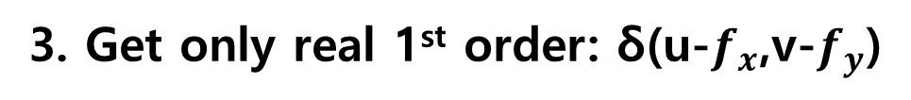

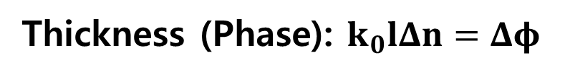
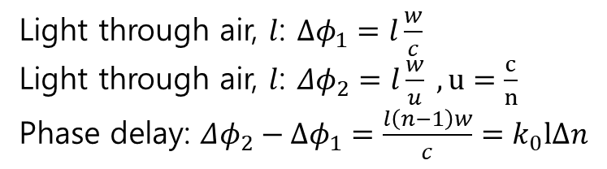
OFF-AXIS HOLOGRAPHY
1. Intensity on Camera:
I = |O+R|^2 = |O|^2 + |R|^2 + O*R+ R*O
2. Fourier Transform of I: FFT(I(x,y)) = 2δ(u,v) + δ(u-$f_{x}$,v-$f_{y}$) + δ(u+$f_{x}$,v+$f_{y}$)
3. Get only real 1st order: δ(u-$f_{x}$,v-$f_{y}$)
4. Frequency shift: δ(u,v) , Inverser FFT: IFFT(δ(u,v)) = $I_{recon}$(x,y)
$$n$$
Amplitude Reconstruction: abs($I_{recon}$(x,y))
RBC
$$l$$
Light through air, $l$: $Δφ_{1}=l\frac{w}{c}$
Light through air, $l$: $Δφ_{2}=l\frac{w}{u} , u=\frac{c}{n}$
Phase delay: $Δφ_{2}−Δφ_{1}=\frac{l\left(n−1\right)w}{c}=k_{0}lΔn$
Thickness (Phase): $k_{0}lΔn=Δφ$

Slide 5
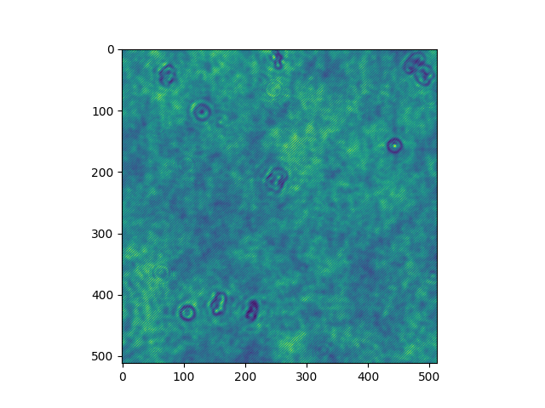
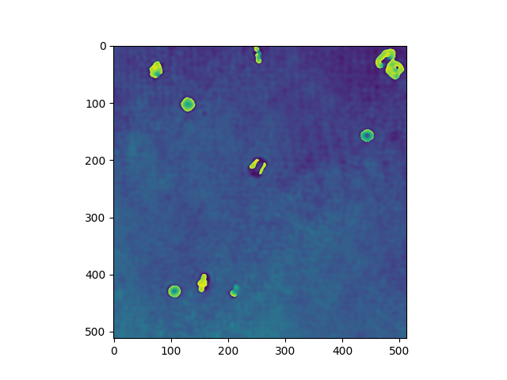
OFF-AXIS HOLOGRAPHY : Result
Original Image
Thickness (Phase) Reconstructed

Slide 6
Angular Spectrum Method (ASM)
1. Intensity on Camera:
I = |O+R|^2 = |O|^2 + |R|^2 + O*R+ R*O
2. Fourier Transform of I: FFT(I(x,y)) = 2δ(u,v) + δ(u-$f_{x}$,v-$f_{y}$) + δ(u+$f_{x}$,v+$f_{y}$)
3. Get only real 1st order: δ(u-$f_{x}$,v-$f_{y}$)
4. Frequency shift: δ(u,v) , Inverser FFT: IFFT(δ(u,v)) = $I_{recon}$(x,y)
$$n$$
Amplitude Reconstruction: abs($I_{recon}$(x,y))
RBC
$$l$$
Light through air, $l$: $Δφ_{1}=l\frac{w}{c}$
Light through air, $l$: $Δφ_{2}=l\frac{w}{u} , u=\frac{c}{n}$
Phase delay: $Δφ_{2}−Δφ_{1}=\frac{l\left(n−1\right)w}{c}=k_{0}lΔn$
Thickness (Phase): $k_{0}lΔn=Δφ$

