Slide 1
SUPER PARSER BROS
Team_2_log_file_parser_Makefile

Slide 2



TEAM_WORK_GREAT
Mario (Github id: CodingChimpanzee) – 20175003_Sunghyun Kang
1. makefile.l lexical analysis tokenizing.
2. makefile.y parsing part and error handling focused on the target line.
3. makefile.y C main function debugging.
4. Makefile parser frontend.
Luigi (Github id: gjrb0324) – 20195191_Gyu Huh
1. Made a basis of the whole team project structure.
2. Makefile line decomposition and preprocessing for the parsing.
3. Makefile command line error handling & authentication.
4. Macro handling with system environment function.
5. Lexical analysis, syntactic analysis debugging.
Github: https://github.com/gjrb0324/Super_Parser_Bros

Slide 3
TABLE OF CONTENTS
1. DESIGN
2. CODE INTRODUCTION
3. RESULTS & DEMO
4. REAL MAKEFILE
Made by Super_Parser_Bros
Total flow
What our system can handle
Makefile.l
Makefile.y
Correct Makefile demo
Makefile error handling demo
Difference between real makefile <make> and our makefile parser

Slide 4


01
DESIGN
Total Flow
What our system can handle

Slide 5
TOTAL FLOW
Get an arbitrary File
Prints
Error and goes back
Macro variable defined in above (i.e., target line)
maco
Makefile name string compare + analyze the target line
Go back to the original step
maci
mac
: Means if macro (like Logisim)
maci
maco
Command line substitution based on the rules
Current Makefile
Parser blueprint
maci
yyparse() based on specific rules defined in the rules section
Command line execution check
EOF
RUNS “make” AND TERMINATE

Slide 6
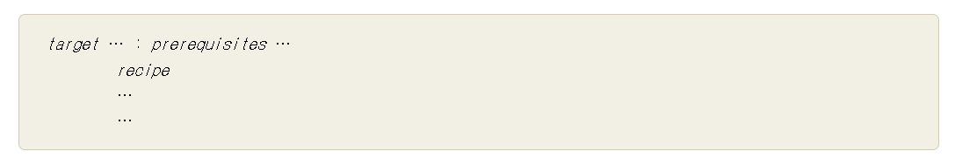
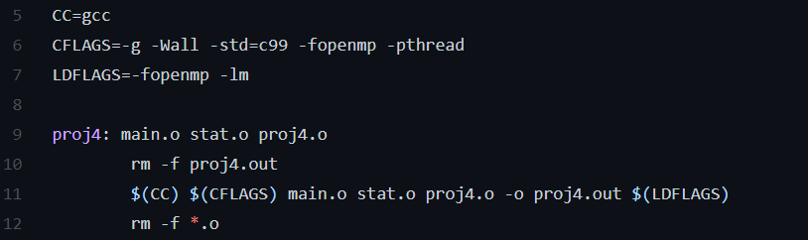
MAKEFILE COMPOSITION
Makefile Basic Structure
Makefile Macro
Command line (Recipe)
Reference: https://www.gnu.org/software/make/manual/make.html

Slide 7
ERROR HANDLING
Invalid makefile name
Eightspace VS TAB
No rule or negelcted space to make target
Invalid rule to make target (“XXX”)
Non-executable command line
No targets
Invalid macros
Missing Separator

Slide 8
02
CODE INTRODUCTION
Makefile.l
Makefile.y

Slide 9
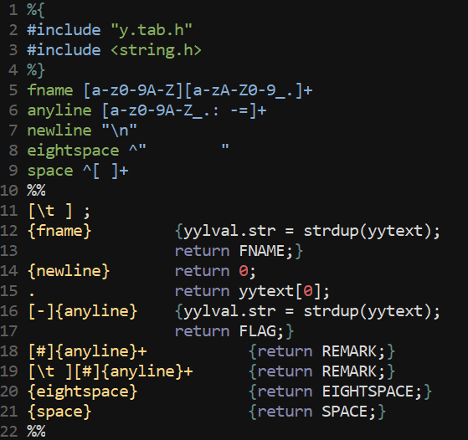
Makefile.l
1. [\t ], {newline}: ignores the tabbed space and “\n”.
2. FNAME: Mainly used in the filename parsing.
3. FLAG: In the macro parsing, it detects the flags.
4. REMARK: detects remark and tokenize.
5. EIGHTSPACE/SPACE: detects space which may be undesirable.

Slide 10
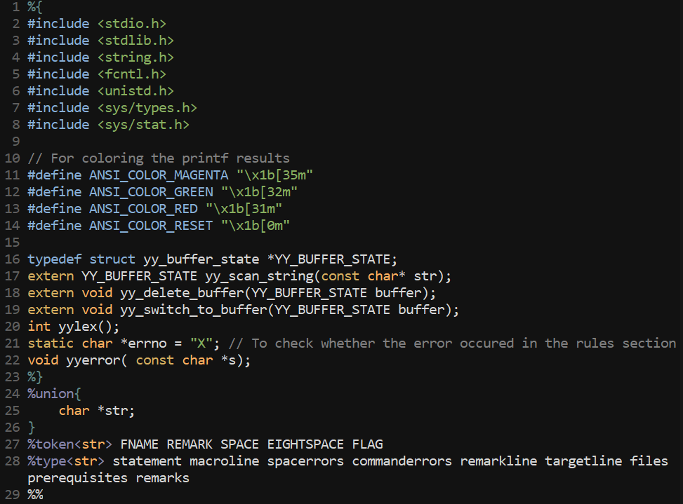
Makefile.y
YY_BUFFER_STATE: struct to use yy_scan_string.
yy_scan_string : scan(parse) line by line.
yy_switch_to_buffer: give string to buffer.
yy_delete_buffer: delete buffer(string).
yylex(): lexical analyzer
errno: used in error handling in yyerror().
yyerror(): error handling function.
token<str>: tokens(symbols) from makefile.l
type<str>: CFG variable definition.
HEADER

Slide 11
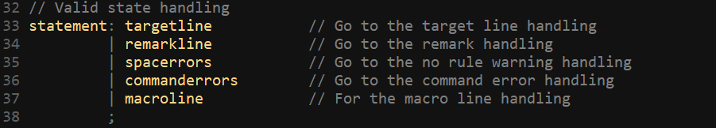
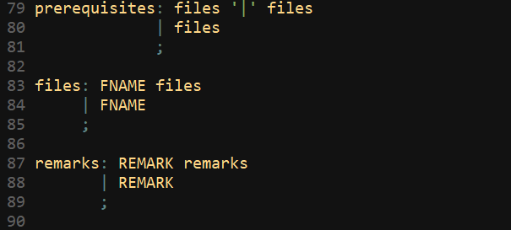
Makefile.y
Starts by taking a line in the statement. It will be separated by several lines
targetline: go to the target line handling.
remarkline: go to the remak line handling.
spacerrors: go to the undesirable space warning handling.
commanderrors: go to the possible command error handling.
macroline: goes to the macro line handling.
2. Also, we generates some of the CFG variables in here.
Prerequisites: makes a CFG variable for target line prerequisites.
Files: makes a CFG variable for actual file name.
Remakrs: makes a CFG variable for actual remarks.
Production Rule

Slide 12
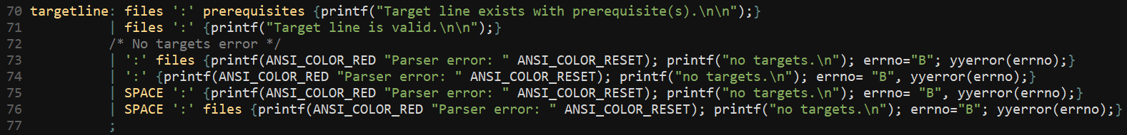
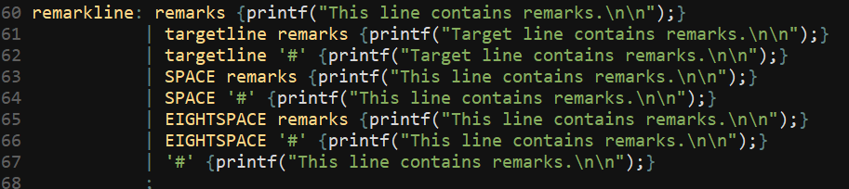
Makefile.y
3. In the target line parsing, if it has a valid rule then prints out the “Target line is valid” or “Target line exists with prerequisites(s). If the targetline has no targets, then it prints out no targets error.
4. If the parser detects remarks, then prints out “This line contains remarks”. If the remark is in the target line, then prints out “Target line contains remarks.
Production Rule

Slide 13
Makefile.y
5. If there are the possibility of command error (i.e. the command starts without \t), then it prints out invalid rule to make target “XXX” error.
6. If the parser detects space that can be negligible, then prints out the warning about it. If the commands starts using 8 spaces instead of using ‘\t’, then prints out 8 space error.
7. If the parser detects line including the macro, then stores that macro variable as mapping with the FNAME.
Production Rule

Slide 14
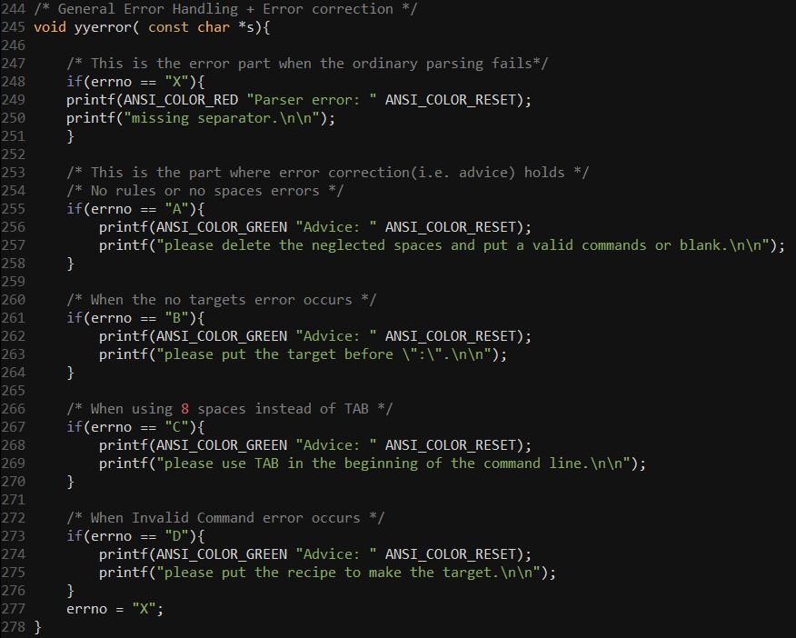
Makefile.y
8. Now in the error handling and advice part.
errno == “X”: This is the errno default value, thus prints out “missing separator” error as same as real Makefile.
errno == “A”: This is the case which error happened in the “spacerror”. Hence it prints out the advice about deleting the space or putting valid commands.
errno == “B”: This is the case which error happened in the “targetline”. Hence it prints out the advice to put a target.
errno == “C”: This is the case which error happened in the “spacerror”. Hence it prints out the advice to put a TAB instead of 8 spaces.
errno = “D”: This is the case which error happened in the “commanderror”. Hence it prints out the advice to put a recipe.
Production Rule

Slide 15
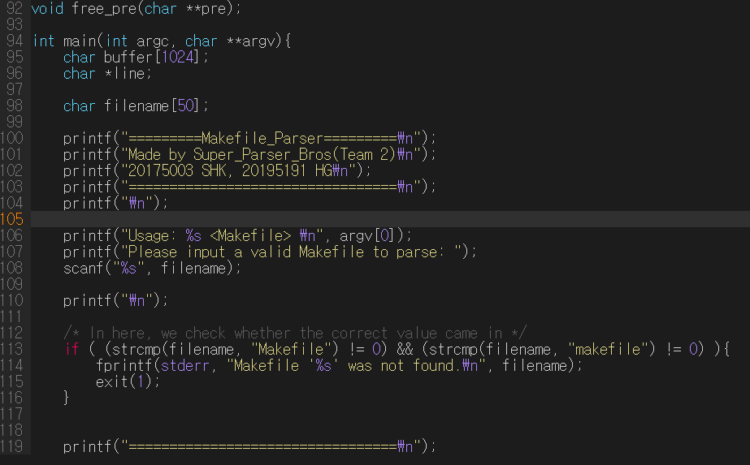
Makefile.y
C main() function
Print some lines, and scan file name.
Then check if the file name is as same as ‘Makefile’ or ‘makefile’

Slide 16
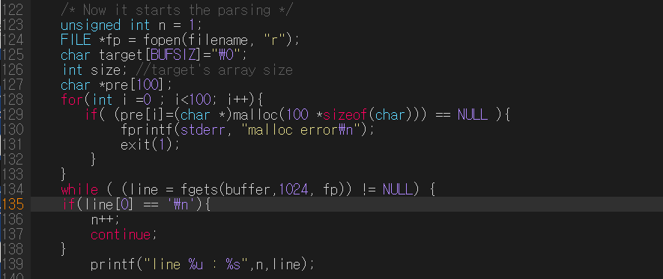
Makefile.y
C main() function
Print some lines, and scan file name.
Then check if the file name is as same as ‘Makefile’ or ‘makefile’
If success, open file.
Memory allocation for prerequisite file name array(pre).
Then, get line by lline from file.

Slide 17
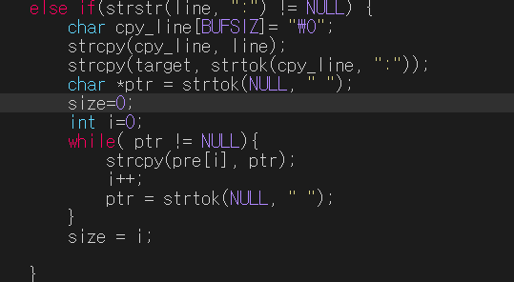
Makefile.y
C main() function
Check whether the line is target using strstr function
If target, tokenize with delimiter ‘:’ first to identify target file name, then tokenize the line with delimiter ‘ ‘ to identify and store prerequisite fil names to array pre.
Those will use when we met special macros $@ $^… to replace them to real file names.

Slide 18
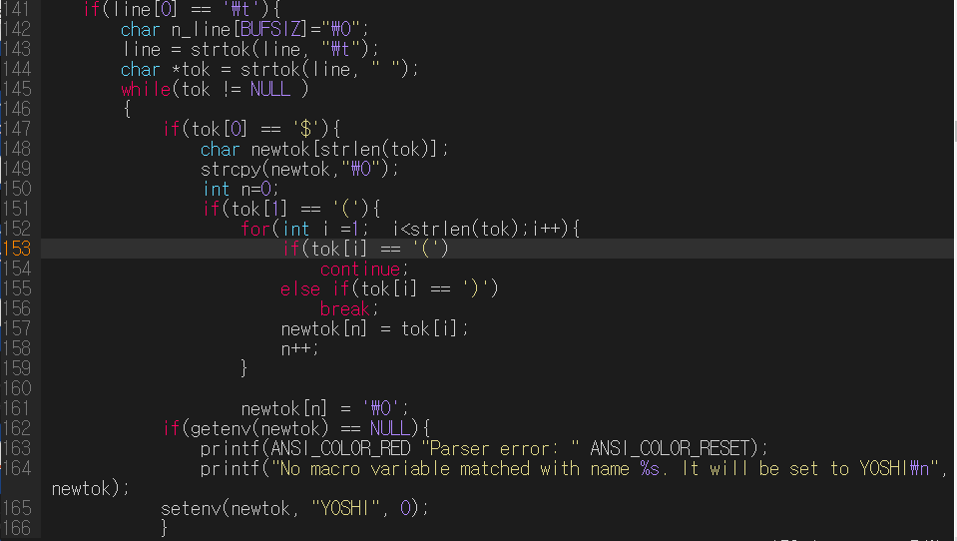
Makefile.l
C main() function
If line is command, we initialize new line (n_line in this code) that stores real value of the macros.
For example, for the string ‘\t$(HI) professor’, and $(HI)=“hello”, n_line will be store ‘hello professor.’
First case is regular macro. The program take off parentheses and get value of the macro with getenv() function, which we stored with setenv() at parser step.

Slide 19
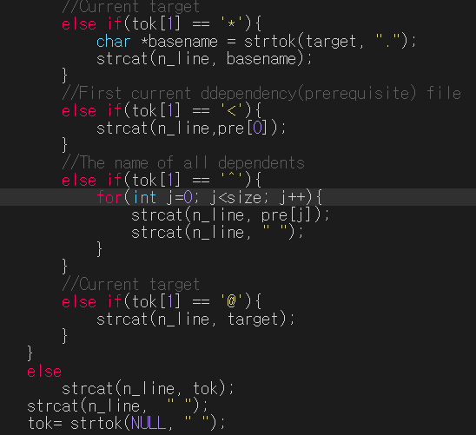
Makefile.l
C main() function
Next case is special macros.
$* should get basename of the target,
$< should get first current prerequisite file
$^ should get the name of all prerequisite files.
$@ should get current target file name

Slide 20
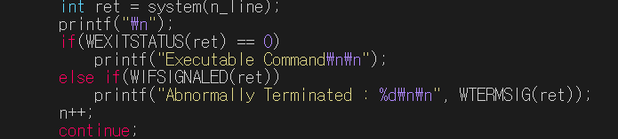
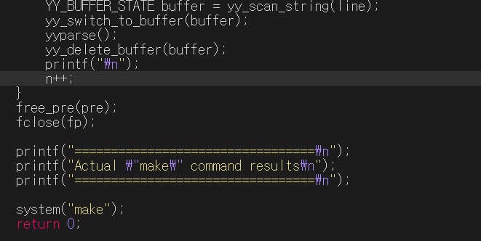
Makefile.l
C main() function
Run n_line with system function, it will returns several linux command errors those we cannot handle simply.
If executable, print success line, else, print report line.
Give line to buffer with yy_scan_string function and yy_switch_to_buffer function.
Then do parse.
When the parsing finished, delete line from parsing buffer and go to next loop(line).

Slide 21
03
RESULTS & DEMO
Correct Makefile Demo
Incorrect Makefile Demo and print

Slide 22
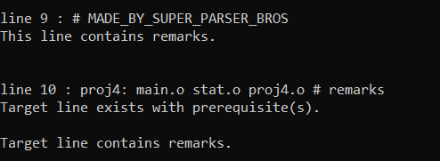
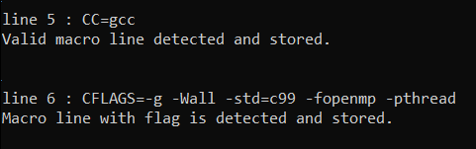
CORRECT MAKEFILE
Valid Remarks
Valid Macro line

Slide 23



CORRECT MAKEFILE
Valid target line
Valid command line

Slide 24
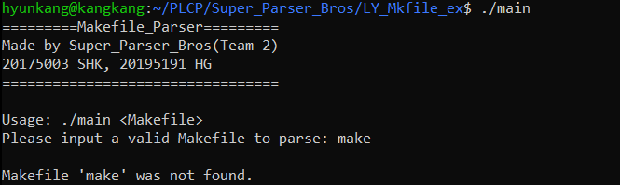
INCORRECT MAKEFILE
Invalid makefile
Then prints out Makefile ‘xxx’ was not found and exit.

Slide 25

INCORRECT MAKEFILE
Invalid macro token detected
Invalid rule to make target “XXX”

Slide 26


INCORRECT MAKEFILE
Missing separator (8 spaces)
Warning: neglected spaces

Slide 27



INCORRECT MAKEFILE
No targets
Missing separator (Default)
Command line error

Slide 28
04
REAL MAKEFILE
Difference between real makefile <make> and our makefile parser

Slide 29
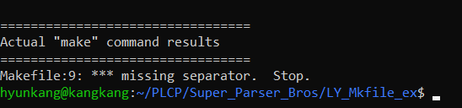

BETTER THAN…
Better Parsing
We can handle more errors compared to original Makefile
Also, we can do some advice or error correction (e.g., YOSHI) in the parsing phase, and continues (while the original “make” command stops).

Slide 30
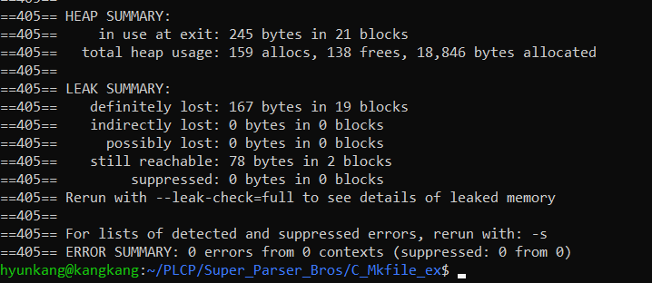
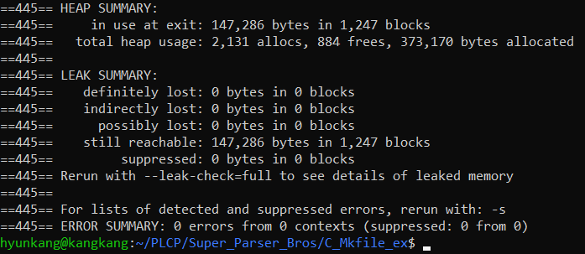
WORSE THAN…
MEMORY LEAK
Our Parser
There is a memory leak compared to original “make” command.
“make” command

Slide 31
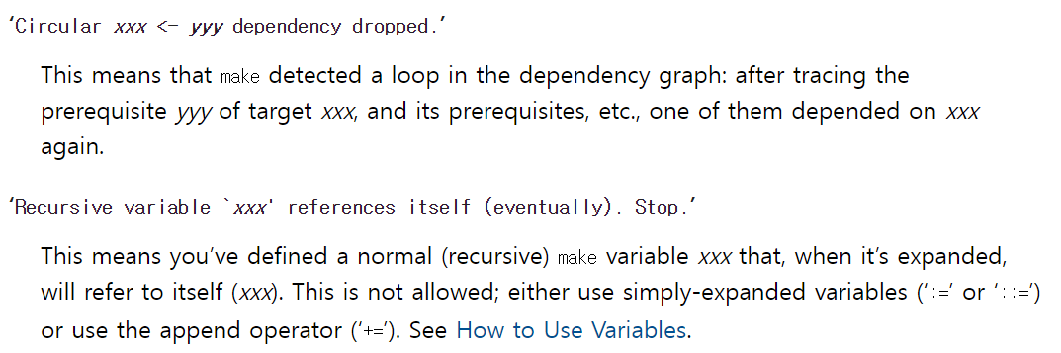
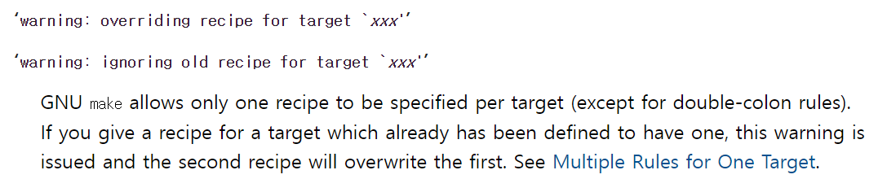
WORSE THAN…
Lack of some specific error handling
The errors which cannot be handled in the parsing phase are not considered in here.
We did not consider the circular dependency.
It was hard to call old target line to compare its target.

Slide 32
THANKS!
Please keep this slide for attribution.

