Slide 1



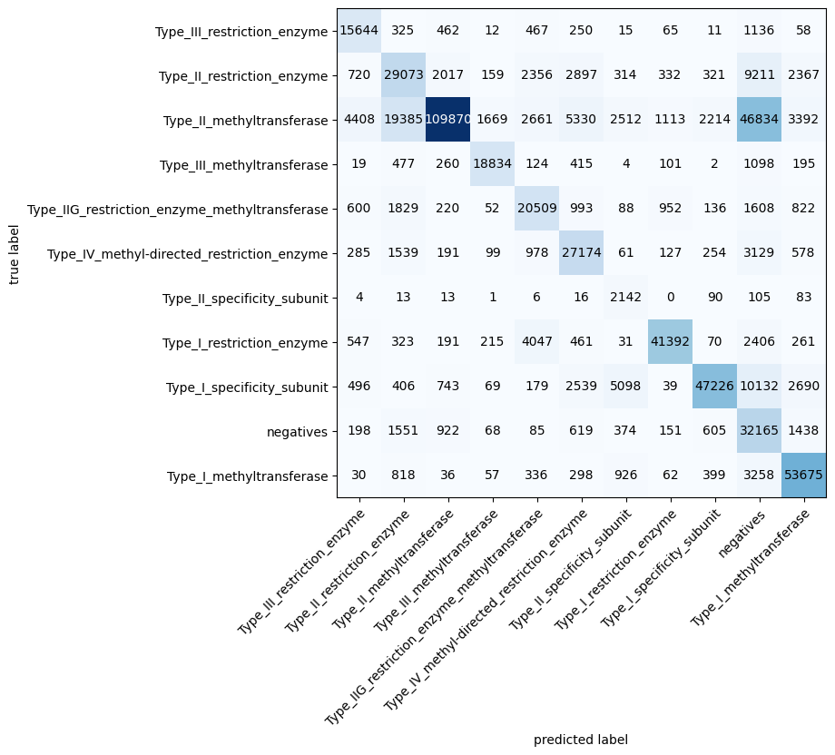




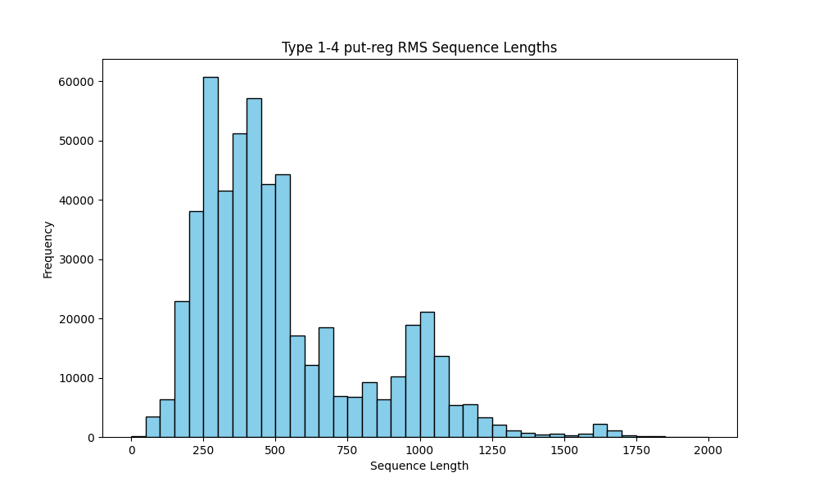
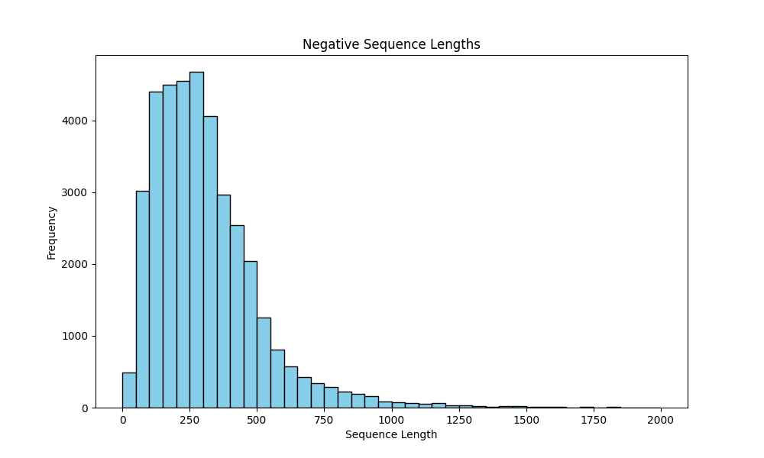
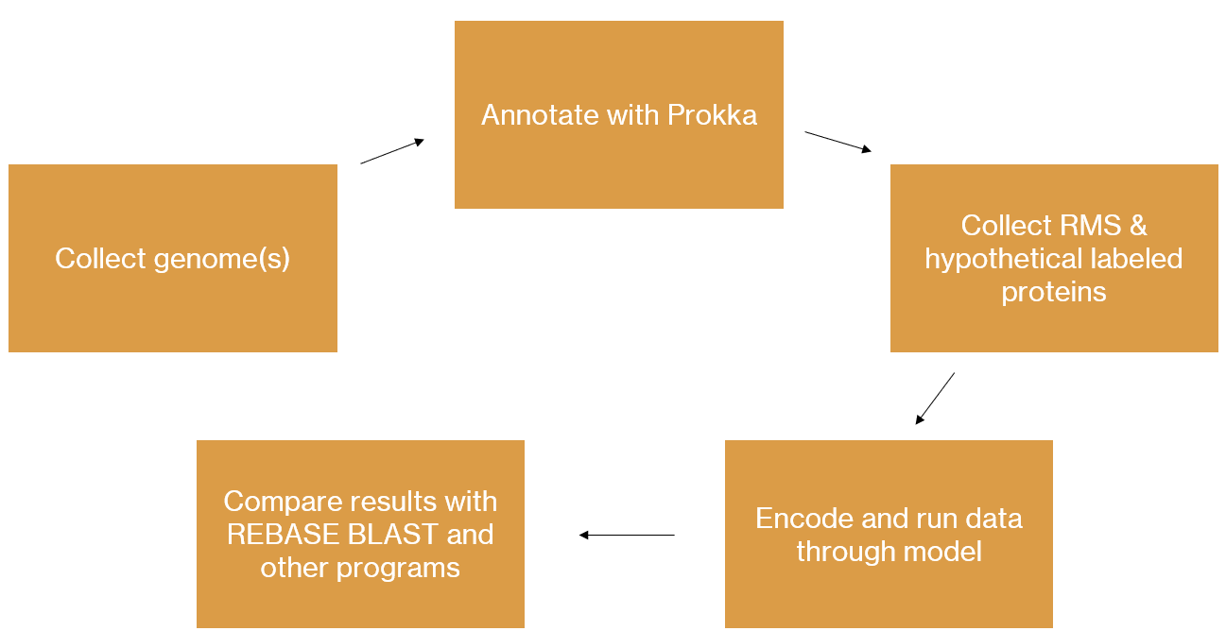
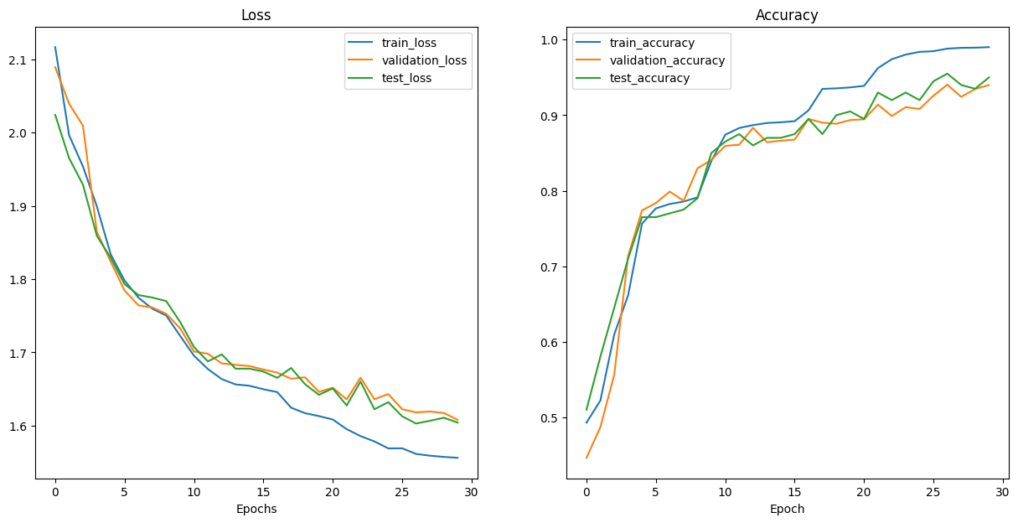
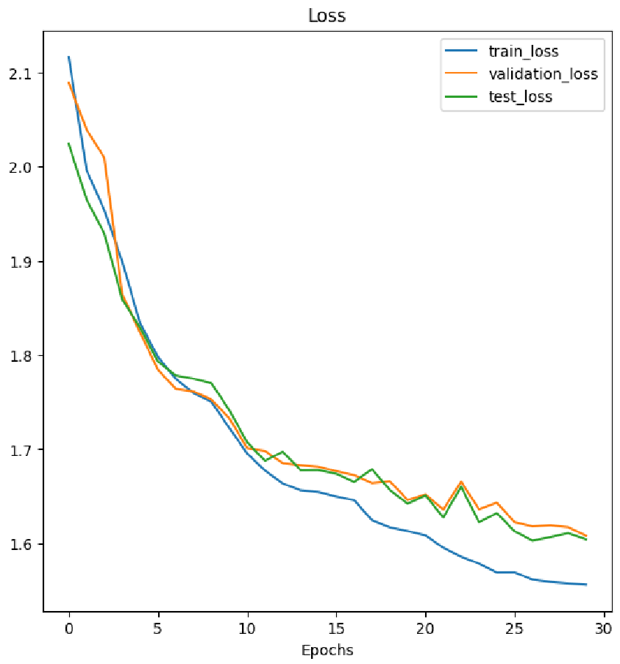
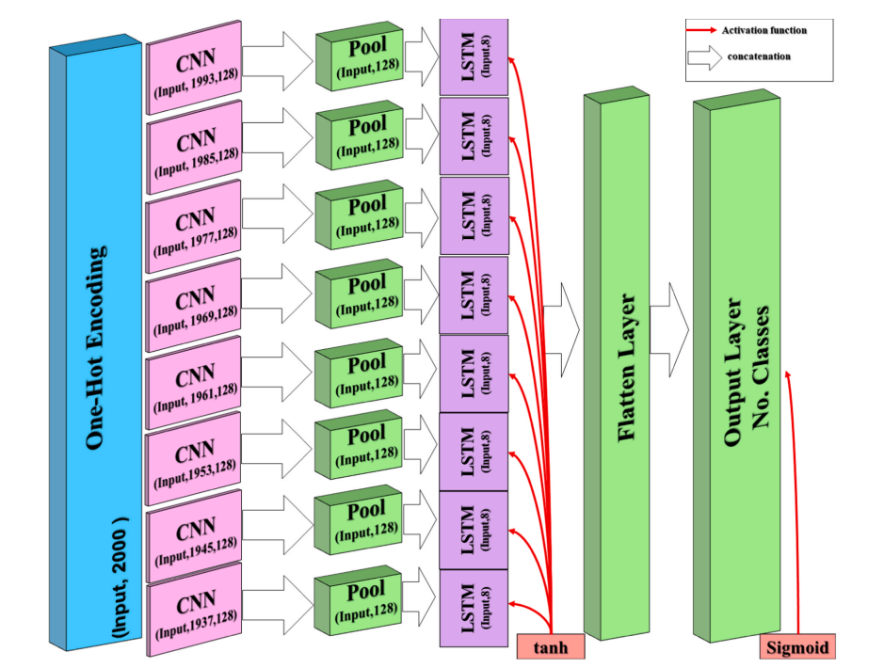
RM System Protein Identification with Deep Learning
Greyson Walker¹, Nathan Crook²
¹ Kansas State University, ² North Carolina State University
Introduction
RM System proteins act as bacteria defensive systems against foreign DNA. Being able to identify RM Systems in bacteria reliably would serve great purpose in the understanding these proteins, help fight antibiotic resistance, assist in biotechnology applications, and more.
Deep learning is rapidly becoming a major tool used in bioinformatics, especially in the area of identifying protein types. It employs neural network with many layers to understand complex relationships in data.
Our approach was to use a combination of existing bacterial genome annotation software Prokka to get possible RM proteins from genomes, then confirm these reads with a deep learning model. The model could then be turned into a command line tool that could intake multiple amino acid sequences and predict if they are an RM system protein or not.
Results
Models were then evaluated on their performance on the test set, and their prediction of the entire REBASE dataset with the addition of ~40,000 negatives. Training, validation, and testing accuracy were plotted, and a confusion matrix was used to evaluate the model's effectiveness. Models were most effective when trained with a 1:1 ratio between the positive and negative set.
(Below) Each row of the confusion matrix represents the actual class of a protein, and each column being the model’s prediction of the class. A strong model performance will have the actual class and predicted class line up diagonally from top left to bottom right, with predictions grouped in this line.
5ca1d4
001957
006e3a
fdb826
cc0000
cfe0ea
cacfda
d1e2d1
f2e8d3
f2d1d1
(Above) Data profiling for both positive and negative sets revealed that nearly all amino acid sequences (>99.99%) were below 2000 amino acids in length. The negative set, taken from annotated genomes of random organisms, revealed a similar trend.
(Below) Accuracy and loss calculation graphs display a high model performance on all datasets, with training, validation, and test accuracy all increasing over 30 epochs. Loss calculation additionally decreased over the same period, showing that the model can distinguish classes from others well.
Methods
For the most successful model, data consisted of 10 different classes of RM system proteins with 1,000 sequences in each class were randomly gathered off REBASE. Another 10,000 proteins were gathered randomly from annotated bacteria genomes with no RM Systems predicted.
The model was trained on sequences up to 2,000 amino acids long that were one-hot encoded.
Deep learning models were all based off Deep CNN LSTM GO, with hyperparameters being based on experimentation.
The model was trained on Google Colaboratory, with later models trained on the BRC Cluster. Time taking anywhere from 1-5 hours.
Conclusions
We discovered that a deep learning models can be reasonably effective at identifying RM System proteins from non-RM System proteins.
Along with Prokka, this model could be used to find new RM Systems in bacteria, or possibly help reclassify putative RM proteins.
Future & Improvement
Effectiveness could be increased by increasing the number of classes, gathering better negative datasets, and modifying model architecture.
Better data profiling of REBASE data could yield insights that could lead to better model development
Future work includes increasing the effectiveness and turning it into a usable command line tool.
(Right) Results revealed an overall F1 Score of 0.83. Analysis shows class-specific performance disparities: classes 0, 7, and 10 demonstrated impressive precision and recall, often surpassing the 90% mark. Class 9 (negatives) presented a unique challenge with a recall of 95%, however, its precision stood at just 35%. This suggests that while the model is efficient at identifying true positives for non-RM proteins, it also misclassifies a significant number of RM proteins as non-RM’s. This disproportionally high false-positive rate for negatives impacts the model's overall precision.
On entirety of REBASE + all negatives:
precision recall f1-score support
0 0.91 0.94 0.93 18445
1 0.70 0.71 0.71 49767
2 0.99 0.67 0.80 199388
3 0.96 0.95 0.95 21529
4 0.83 0.87 0.85 27809
5 0.80 0.87 0.84 34415
6 0.57 0.94 0.71 2473
7 0.98 0.95 0.97 49944
8 0.98 0.86 0.91 69617
9 0.35 0.95 0.51 38176
10 0.93 0.96 0.94 59895
accuracy 0.81 571458
macro avg 0.82 0.88 0.83 571458
weighted avg 0.89 0.81 0.83 571458
Acknowledgments
Special thanks to John van Schaik, and thanks to the rest of the Crook Lab at NC State.
Literature cited
Elhaj-Abdou, M. E. M., El-Dib, H., El-Helw, A., & El-Habrouk, M. (2021). Deep_CNN_LSTM_GO: Protein function prediction from amino-acid sequences. Computational Biology and Chemistry, 95(107584), 107584. https://doi.org/10.1016/j.compbiolchem.2021.107584
(Elhaj-Abdou et al., 2021, p. 4)
This work was supported primarily by the Engineering Research Centers Program of the National Science Foundation under NSF Cooperative Agreement No. EEC-2133504. Any opinions, findings, and conclusions or recommendations expressed in this material are those of the author(s) and do not necessarily reflect those of the National Science Foundation.
(Elhaj-Abdou et al., 2021, p. 4)
Use this space to present your project, 1 or 2 columns: Some things to make sure you include and highlight (if applicable):
Any current data you have, good looking and easy-to-understand figures are the best way to present them
Attractive and colorful pictures or figures that have relevance to your work
to PreMiEr colors or muted versions of those colors (see color swatches on right; use eyedropper or color codes to match)

