Slide 1
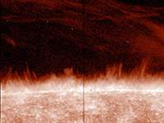
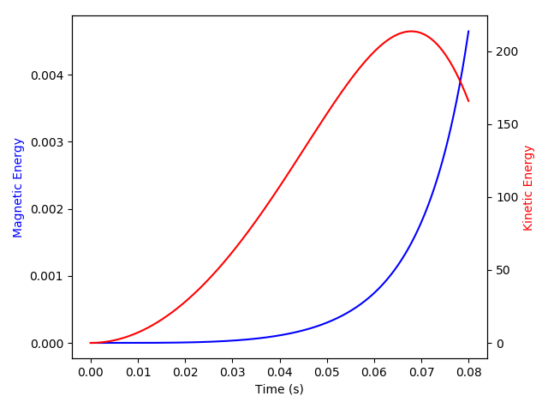
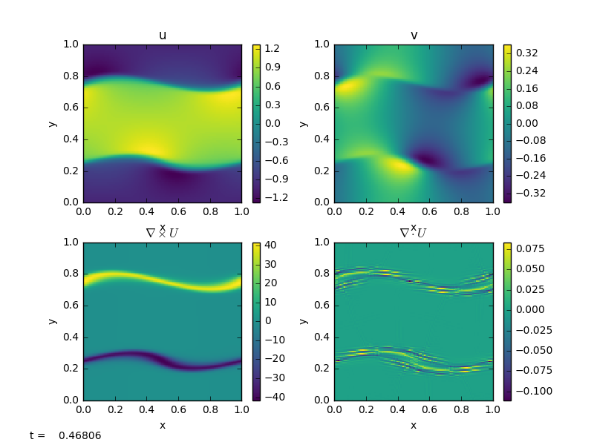
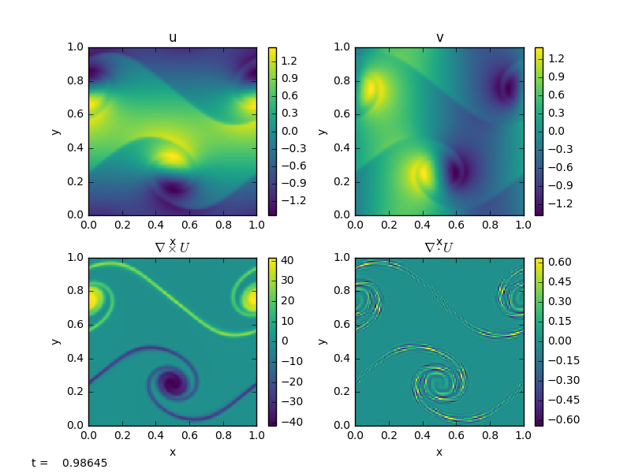
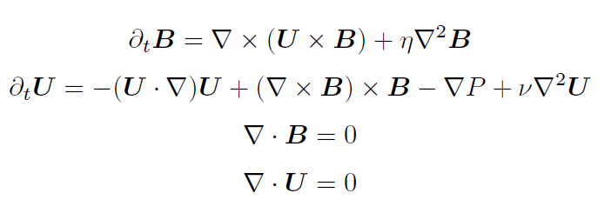
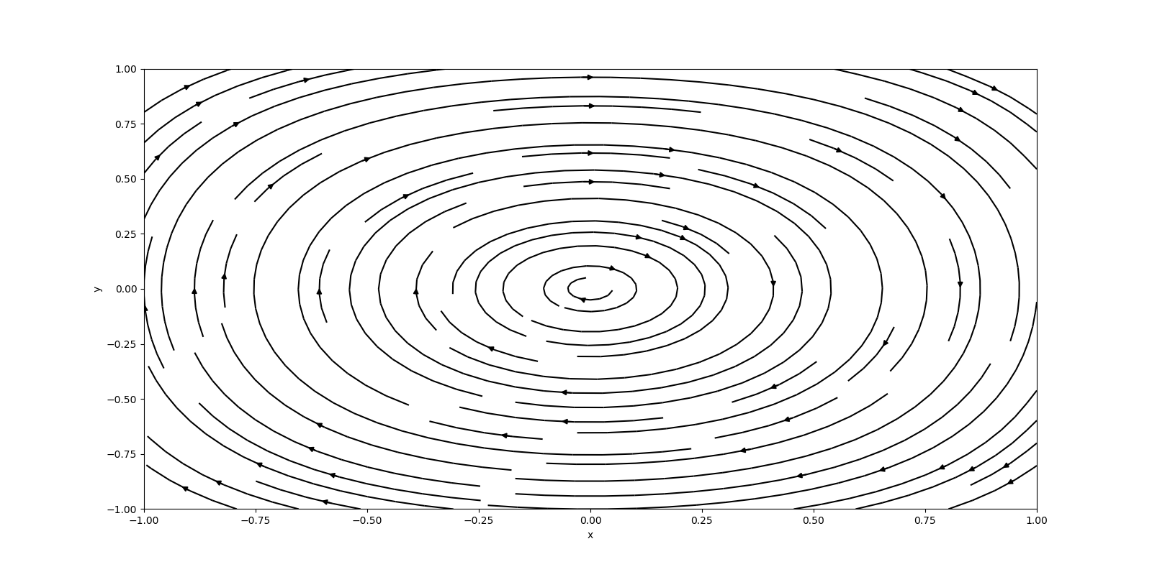
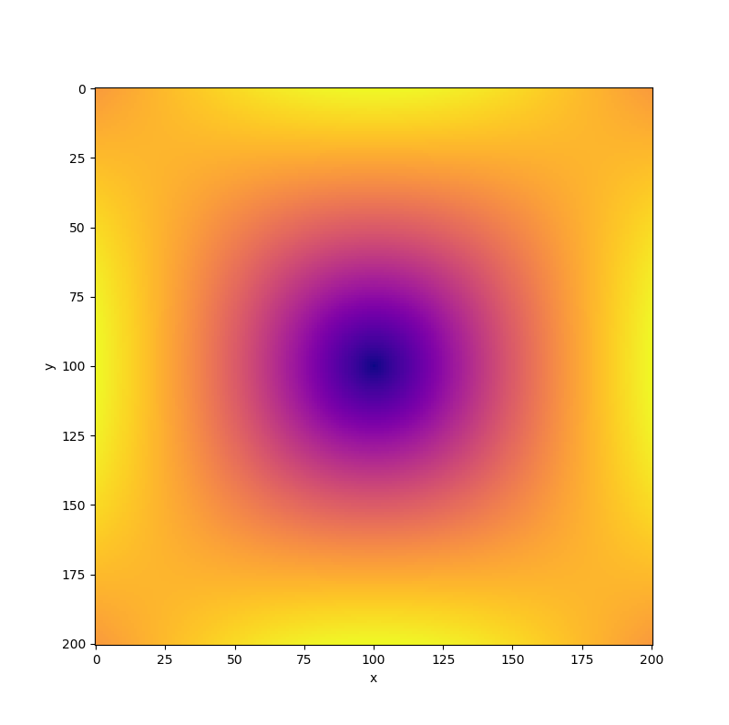
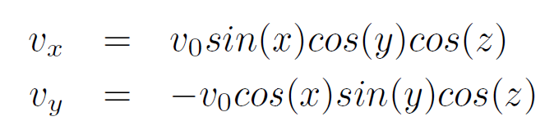
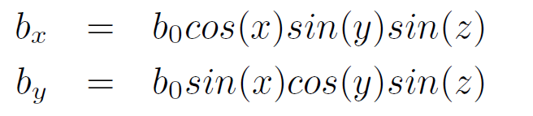
Introduction
Magnetohydrodynamics (MHD) is a theoretical framework to describe the macroscopic dynamics of plasmas. Assuming the flows of the fluids are incompressible, MHD can be formulated as a set of four equations[1]:
Where B is the magnetic field, U is the velocity field, and P is the pressure. Decaying dynamos are important MHD objects to understand because of their connections with astrophysics and energetics. The decaying dynamo gives rise to a magnetic field and converts kinetic energy to magnetic energy. The evolution of these dynamos could let us understand the temporal evolution of the solar and terrestrial magnetic fields[2]. Dynamo action has been shown to arise from forced Taylor-Green votices[3]. The equations for the velocity field of these dynamos are[2,5]:
The goal of this study was to understand how the magnetic field and plasma dynamics are interconnected and if we could model the temporal evolution of one of these magnetic fields. The initial conditions on the Alfven velocity, given by the magnetic field over the density of the plasma, are:
Study of Computational Magnetohydrodynamics
3. Results
Figure 1: An image of the Sun’s corona from [5]. MHD Calculations can give model the solar magnetic field and jets in its corona.
Figure 3: Results from out first code showing the changes in kinetic and magnetic energy over time. The equations were stiff and prevented long runs with our method.
Figure 4: An example output from pyro. This shows the evolution of the velocity field of an incompressible plasma using shear force initial conditions. This module comes preloaded with pyro.
a)
b)
4. Conclusions
The MHD equations resulted in a set of stiff equations that could not be solved with the numerical methods that we were familiar with. After searching other methods to solve these equations numerically, we realized the best course of action would be to write a module for an existing solver. This project taught us about the complexity of solving physical problems numerically in addition to providing an opportunity to study an interesting physical phenomenon.
Figure 2: The Taylor-Green Initial Conditions for the velocity (a) and magnetic (b) fields. Kinetic energy from the decaying vortex will turn into magnetic energy. The magnetic field will evolve in time, as well, obeying the MHD equations.
2. Methods
To approach this problem, we began by looking at the methods we knew to numerically solve differential equations. Our first approach used the method of finite differences to compute the spatial derivatives and a Euler step to compute how B and U changed in time. This proved impractical, as the equation required very small time steps to keep the error small. With this being computationally expensive, we looked into other ways to implement Taylor-Green dynamos in MHD. We turned to pyro [6,7] a learning code for MHD. This code has a solver built in and is a teaching code that requires students to write their own modules for the specific flows they want to study. We knew we could create the Taylor-Green initial conditions, as shown in Figure 2. For this reason, our next method was to try to make a module that could work with pyro’s solver to give the desired outputs.
5. References
[1]
[2]
[3]
[4]
[5]
[6]
[7]

