Slide 1
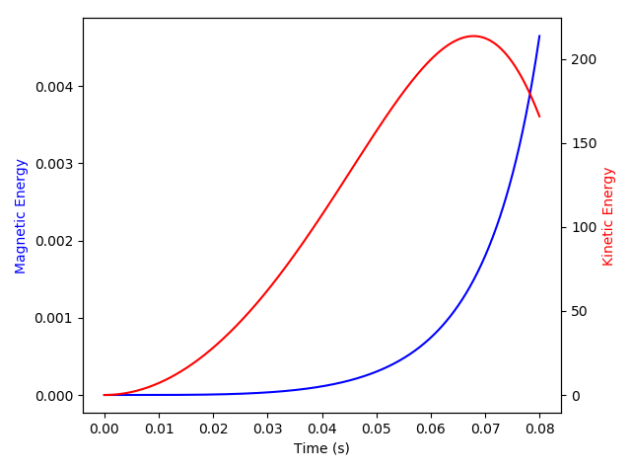
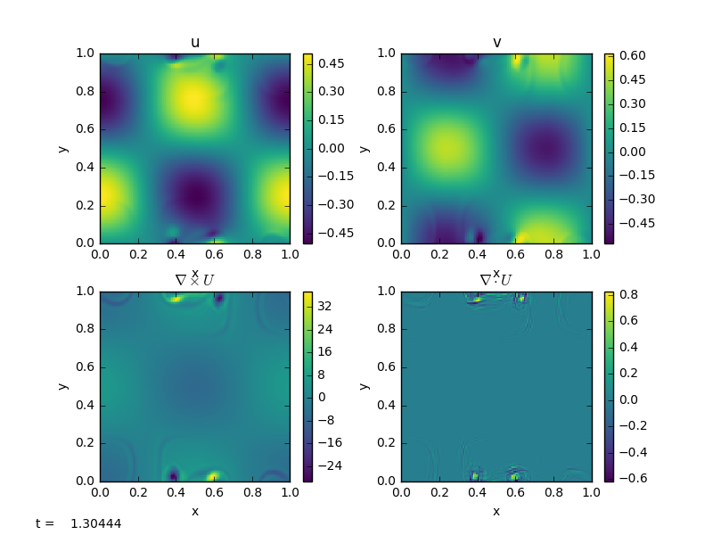
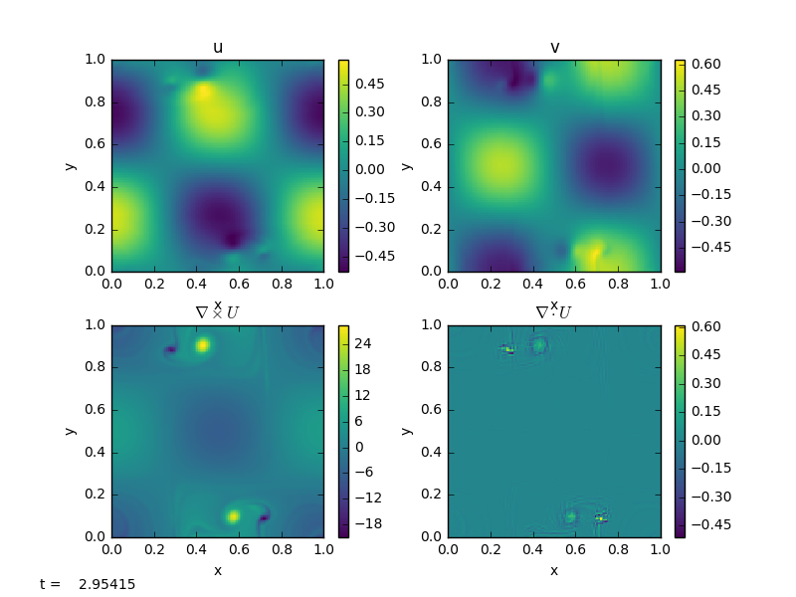
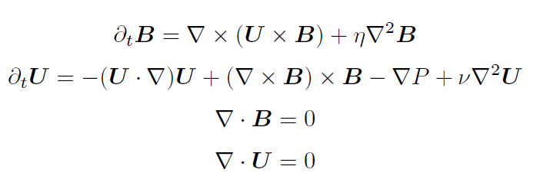
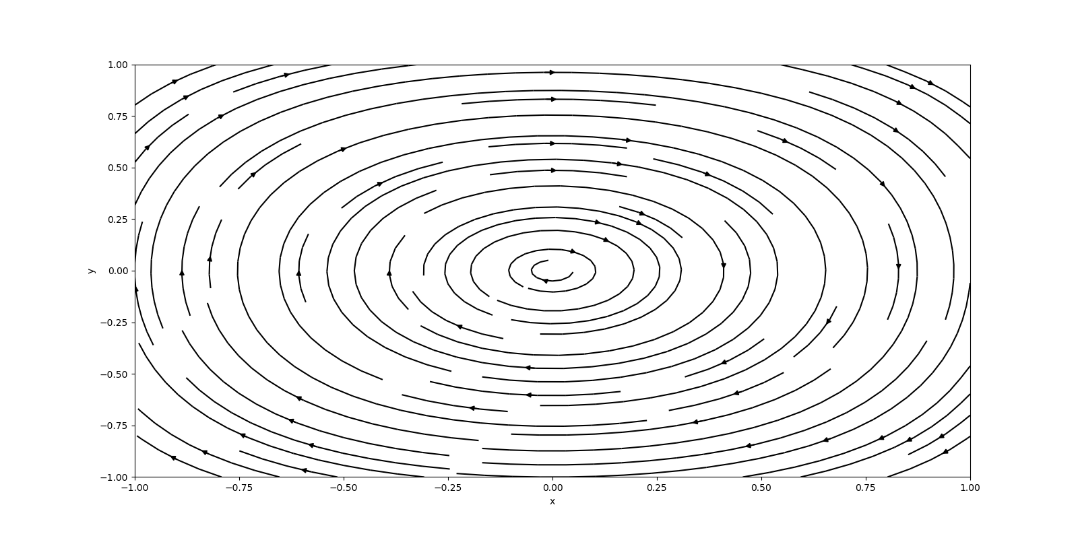
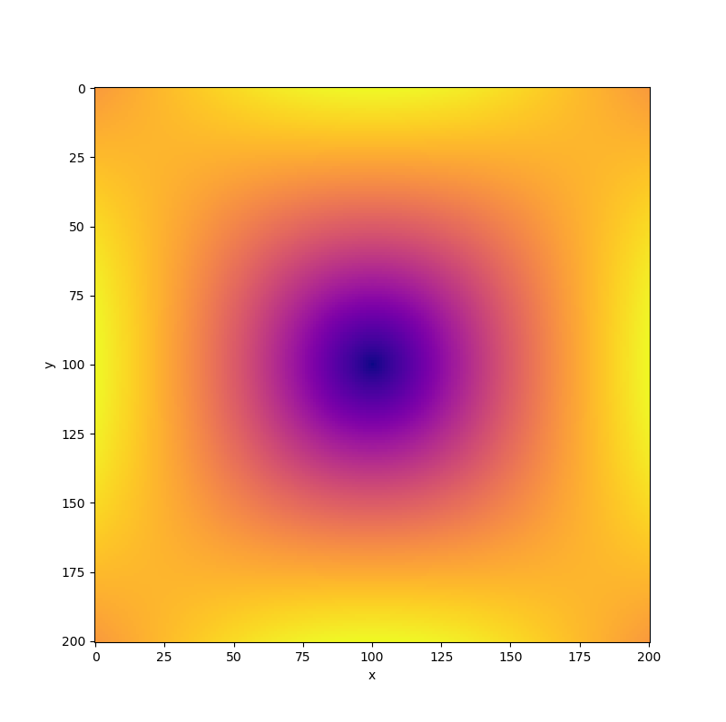
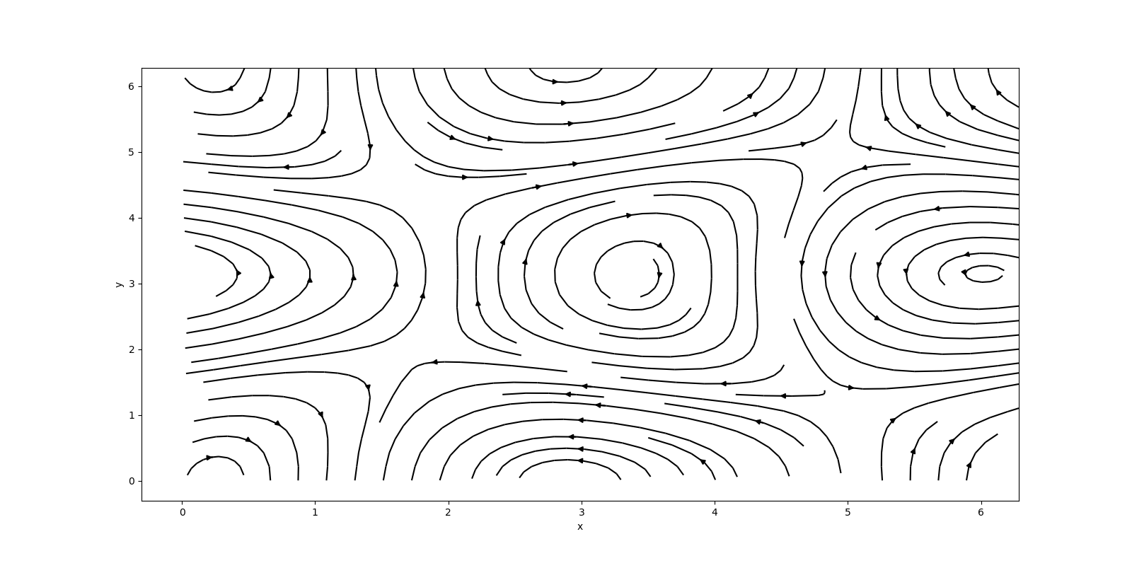
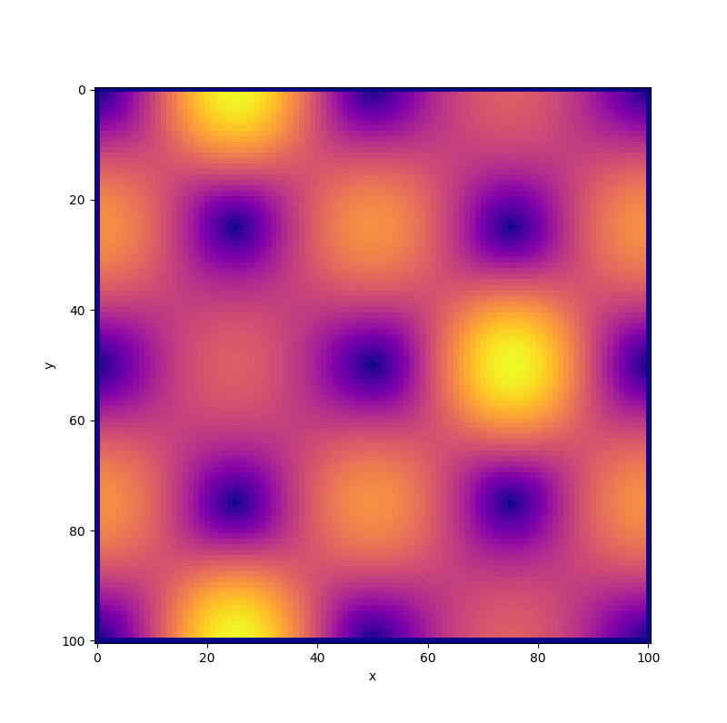
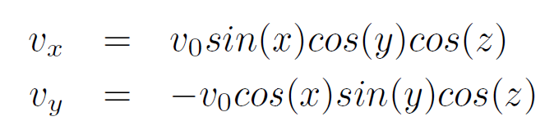
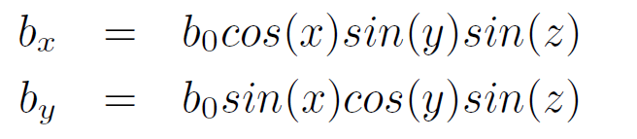
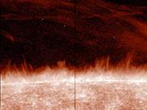
Study of Computational Magnetohydrodynamics
Garrett King and Katie Schram
Introduction
Magnetohydrodynamics (MHD) is a theoretical framework to describe the macroscopic dynamics of plasmas.
Assuming incompressible flow, MHD can be formulated as [1]:
Decaying dynamos are important MHD objects with connections with astrophysics and energetics[2]
The currents in the plasma give rise to a magnetic field
The evolution of these dynamos could let us understand the evolution of magnetic fields of different bodies[2].
Dynamo action has been shown to arise from forced Taylor-Green (TG) vortices[3].
The equations for the velocity field of these dynamos are[2,4]:
3. Results
Figure 2: Results from out first code showing the changes in kinetic and magnetic energy over time. Kinetic energy starts to decay around where magnetic energy starts to build up.
Figure 4: Decaying TG vortices near the end of one of our pyro module. A small perturbation was introduced at the bottom left corner of the grid and led to the decay. As in Figures 2 and 3, this decay will lead to the build up of a magnetic field.
a)
b)
4. Conclusions
MHD equations result in stiff equation and require advanced numerical methods
TG vortices require some perturbation to start decaying and build up magnetic field
With the symmetry broken, there is turbulent flow and decaying dynamos
The decay leads to the build up of a magnetic field
Our perturbation was a simple bump to demonstrate how this works
Outlook: Look at different types/sizes of perturbations, physical considerations to see how it impacts growth of B field.
c)
d)
Figure 3: Up close view of the TG Initial Conditions for the velocity (a) and magnetic (b) fields. Without any perturbation, this vortex will stay as it is. With a perturbation, the vortex will decay and give rise to a new velocity field and magnetic field. (c) and (d) show how these vortices in a grid decay and change the magnetic field.
5. References
[1] D. Gόmez, P. Minni, P. Dmitruk, MHD simulations and astrophysical applications, Advances in Space Research, 35, (2005).
[2] A. Pouquet et. Al, The dynamics of unforced turbulence at high Reynolds number for Taylor-Green vortices generalized to MHD, Geophysical & Astrophysical Fluid Dynamics, 104(2-3), (2010).
[3] C.Nore, M. Brachet, H. Politano, and A. Pouquet, Dynamo action in the Taylor-Green vortex near threshold, Physics of Plasma, 4(1), (1997).
[4] G. Taylor and A. Green, Mechanism of the Production of Small Eddies from Large Ones, Proceedings of the Royal Society A, 158, (1936).
[5] M. Zingale, pyro: A teaching code for computational astrophysical hydrodynamics, arXiv: 1306.6883v3 [astro-ph.IM], (2014). Code available from https://github.com/zingale/pyro2
[6] T. Pereira and J.M. Sykora, Uncovering the Sun’s Swirling Jets, NASA@SC17, https://www.nasa.gov/SC17/demos/demo17.htm
2. Methods
First attempt: Finite Differences for spatial derivatives and Euler Step for time
Stiff equation resulted in large errors
Learning code for MHD, pyro [5], had an incompressible solver already developed
Used our initial conditions to make our own module
Figure 1: An image of the Sun’s corona from [6]. MHD Calculations can model the solar magnetic field and jets in its corona.

