Slide 1



716: Cricket Score Prediction Using Machine Learning
Presenter Name: Gautam Kumar
Affiliation: School of Computer Engineering, KIIT-DU
3rd International Conference on Advancements in Smart, Secure
and Intelligent Computing
KIIT-DU, Bhubaneswar, India
(16th - 18th May , 2025)

Slide 2
Introduction
Cricket is no longer just a sport— it has become a rich domain for data analytics and predictive modelli.
With the growing availability of real-time and historical match data, Machine Learning (ML) has emerged as a powerful tool to predict:
Match outcomes
Player performances
Final scores (our focus)
This project explores how ML algorithms can be applied to predict cricket scores more accurately, making the process more scientific and data-driven rather than guesswork.

Slide 3
Objectives
To develop a machine learning model for accurately predicting cricket scores using ball-by-ball data.
To perform feature engineering on real-world datasets for identifying key match variables.
To compare multiple ML algorithms (e.g., Random Forest, XGBoost, SVM) and evaluate their performance.
To identify the most suitable model for handling the dynamic nature of cricket data.
To contribute toward data-driven decision-making in cricket through predictive analytics.

Slide 4
Literature Survey
Shristi et al.
Used Random Forest and other classifiers on IPL data (2008–2020); achieved 74% accuracy, highlighted venue data as a critical feature.
Aryan et al.
Applied XGBoost and Random Forest on ball-by-ball data from CricSheet; achieved 99.99% win prediction accuracy using effective feature selection.
Pritpal et al.
Used ensemble models (Random Forest, Decision Trees) on IPL datasets; found weather and player performance key to improving accuracy.
Qamaruz Zaman et al.
Used K-means clustering to categorize T20 all-rounders by performance metrics (e.g., economy rate, strike rate).
Singhvi et al.
Explored ensemble models and ELO rating system for match winner prediction using over 5,000 match records.

Slide 5
Problem Statement
Cricket score prediction is inherently complex due to dynamic match conditions and multiple influencing factors (e.g., player form, pitch, weather).
Traditional statistical methods cannot model nonlinear patterns and adapt to real-time game dynamics.
There is a need for a robust, data-driven machine learning approach that utilises historical and in-game data for accurate and reliable score prediction.

Slide 6
Methodology (Data Collection and Integration)
Data Sources:
Reliable sources like Cricinfo and Kaggle were used to ensure data accuracy.
These sources provide comprehensive historical match data, which is crucial for training machine learning models.
Data Description:
Ball-by-ball match data: This granular data captures the dynamics of each delivery, allowing for detailed feature engineering.
Player and team statistics: Includes information like player scores, batting averages, bowling figures, and team performance, which are important for predicting outcomes.
Venue details: Ground-specific information, as pitch conditions and stadium characteristics can significantly influence match scores.
Importance:
High-quality, comprehensive data is essential for building accurate and reliable predictive models.
Combining data from multiple sources ensures a more complete representation of the factors affecting cricket scores.

Slide 7
Methodology (Data Preprocessing and Feature Engineering)
Data Preprocessing:
Irrelevant rows were eliminated: Removing data points that are not relevant to the analysis (e.g., incomplete or erroneous records).
Missing values were handled: Techniques like imputation (filling in missing values) or elimination were used to address incomplete data.
Numerical features were scaled/normalized: Scaling ensures that all features contribute equally to the model, preventing bias due to differences in magnitude.
Categorical features were encoded: Converting non-numerical data (e.g., team names, venue names) into a numerical format that machine learning models can understand.

Slide 8
Methodology (Data Preprocessing and Feature Engineering)
Feature Engineering:
Key variables:
Batsman strike rate: Measures how quickly a batsman scores runs.
Batsman average: The average number of runs a batsman scores per match.
Bowler economy rate: Measures how many runs a bowler concedes per over.
Bowler average wickets: The average number of wickets a bowler takes per match.
Performance metrics: Runs and wickets in the last 5 overs - captures the recent momentum of the game.
Custom metrics like average runs and wickets: Additional calculated features to provide more context to the model.
Objective:
To construct a best-fit dataset for accurate predictions. Preprocessing ensures data quality, while feature engineering extracts the most relevant information for the model.

Slide 9
Results and Discussion
Model Performance:
Train Score: 99.05%
Test Score: 99.73% – indicating excellent generalisation to unseen data.
Error Metrics:
MSE: 4.42
MAE: 55.76
RMSE: 7.46
→ All values suggest high prediction accuracy with minimal deviation.
Model Comparison:
Random Forest outperformed other models (e.g., SVM, XGBoost) in terms of both accuracy and robustness.

Slide 10
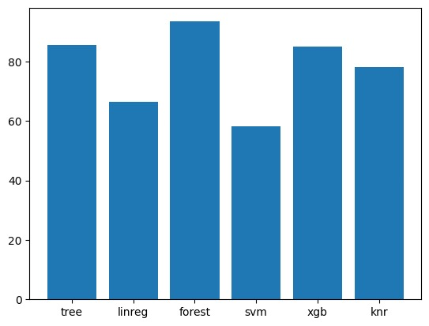
Fig1.1: Accuracy Score of different models

Slide 11
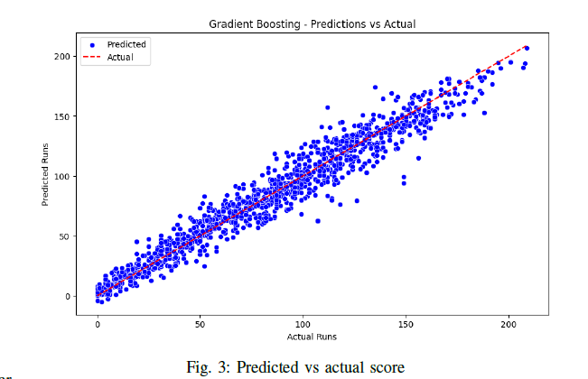

Slide 12
IMPACT OF VENUE AND MOMENTUM ON RESULTS;
Impact of venue:
Some stadiums are naturally high or low scoring due to pitch, boundary size, altitude, etc.
Examples:
Chinnaswamy Stadium (Bangalore): Known for high scores, small boundaries, batting-friendly.
Chepauk (Chennai): Slower pitch, favors spinners, low average scores.
What We Did:
Encoded venue as a categorical variable.
Observed strong correlation between venue and predicted score.
Helped models adjust expectations based on location.

Slide 13
Impact of momentum:
Momentum Shifts:
Scoring rates and wicket falls can change rapidly, impacting the final score significantly.
Modelling Challenge:
Traditional models often fail to capture these dynamic changes effectively.
Our Approach:
Included features like run rate trends and recent over performance
Engineered inputs such as runs in last 2–3 overs, wickets in last 5 overs
Helped the model understand match acceleration or slowdown patterns
Example:
Team score: 70/2 after 10 overs
Scored 120 runs in last 10 overs, ending at 190
Model predicted a high finish based on stable wickets and rising run rate from overs 8–10

Slide 14
Conclusion
• The project successfully demonstrated how machine learning models, especially Random Forest, can be used to predict final scores in IPL T20 matches with high accuracy.
• Effective data preprocessing, thoughtful feature selection, and comparative model analysis were key to our results.
• The model provides valuable insights into the flow of a cricket match and the impact of factors like wickets, venue, and overs.
• Although models like KNR and SVM showed potential, ensemble methods like Random Forest offered superior consistency and performance.

Slide 15
Why Random Forest Performed best?
Handles Complex, Non-linear Patterns Well-
T20 scores are influenced by many interacting factors (run rate, wickets, venue, etc.).
Random Forest captures these relationships effectively by building multiple decision trees.
Reduces Overfitting with Ensemble Learning-
Unlike single decision trees that overfit easily, Random Forest averages multiple trees to reduce variance and generalize better on unseen match data.
Performs Well Without Extensive Hyperparameter Tuning-
Even with default settings, the model gave reliable results, making it suitable under time constraints.
Insensitivity to Outliers and Noise
T20 cricket is full of unpredictable scenarios. Random Forest is robust to such irregularities and gives stable predictions.

Slide 16
Future Works
• Implement deep learning models like LSTM to capture temporal dynamics in overs.
• Improve prediction robustness by incorporating weather conditions and ground dimensions.
• Develop a real-time prediction web app with interactive dashboards.
• Expand the scope to include match outcome prediction, win probability, and player-level forecasting (e.g., projected runs/wickets).
• Enhance prediction logic using contextual factors such as batting partnerships and bowler fatigue.

Slide 17
References
[1] S. Sanjaykumar, K. Udaichi, G. Rajendiran, M. Cretu, and Z. Kozina, “Cricket performance predictions: a comparative analysis of machine learning models for predicting cricket player’s performance in the one day international (odi) world cup 2023,” Health, sport, rehabilitation, vol. 10, no. 1, pp. 6–19, 2024.
[2] S. Syed and E. M. Albalawi, “Optimizing cloud resource allocation with machine learning: A comprehensive approach to efficiency and performance,” 2024.
[3] S. Priya, A. K. Gupta, A. Dwivedi, and A. Prabhakar, “Analysis and winning prediction in t20 cricket using machine learning,” in 2022 Second International Conference on Advances in Electrical, Computing, Communication and Sustainable Technologies (ICAECT), pp. 1–4, 2022.
[4] A. Satwani, K. Coutinho, N. John, and J. A. Arul Jothi, “Live cricket predictions for runs and win using machine learning,” in 2024 IEEE 12th International Conference on Intelligent Systems (IS), pp. 1–6, 2024.
[5] P. Singh, J. Kaur, and L. Singh, “Predicting ipl victories: An ensemble modeling approach using comprehensive dataset analysis,” in 2024 2nd International Conference on Artificial Intelligence and Machine Learning Applications Theme: Healthcare and Internet of Things (AIMLA), pp. 1–6, 2024.
[6] Q. Zaman, M. I. Khattak, S. Nawaz, M. U. Khan, and G. Sahib, “A cluster analysis of the performance of allrounders in t-20 international cricket,” Dialogue Social Science Review (DSSR), vol. 3, no. 1, pp. 520– 544, 2025.

Slide 18
Thank You

