Slide 1
Foundations of Data Science & Analytics DSCI 633
Lecture 11
Nidhi Rastogi
Assistant Professor, GCCIS, RIT

Slide 2
Lecture Agenda
Random Forests

Slide 3
Review: Decision Trees
To learn a decision tree model, we take a greedy approach:
Start with an empty decision tree (undivided feature space)
Choose the ‘optimal’ predictor on which to split and choose the ‘optimal’ threshold value for splitting by applying a splitting criterion, purity of the regions for classification, and MSE for regression.
Recurse on each new node until the stopping condition is met
For classification, we label each region in the model with the label of the class to which the plurality of the points within the region belong
For regression, we predict with the average of the output values of the training points contained in the region.

Slide 4
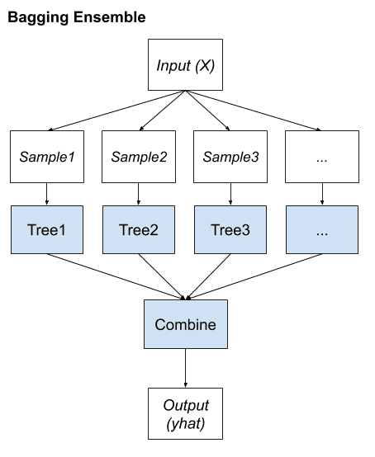
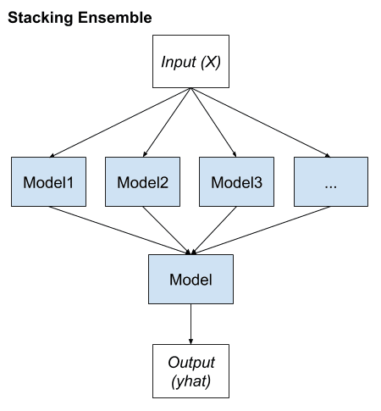
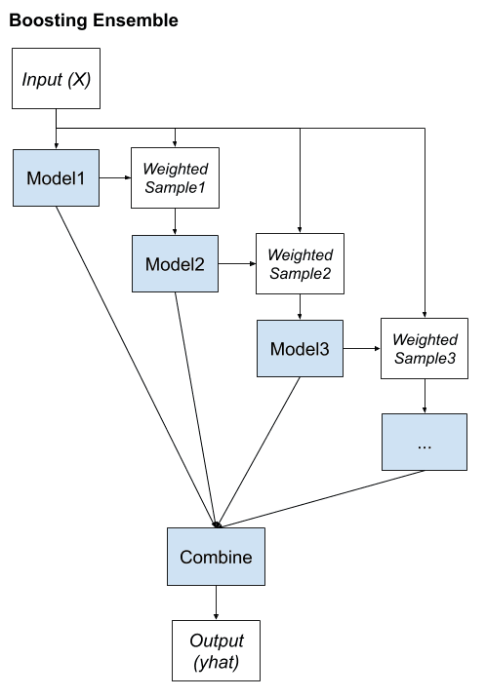
Review: Bagging vs Stacking vs Boosting

Slide 5
Random Forests
RF is an ensemble of Decision Trees, generally trained via the bagging method, typically with max_samples set to the size of the training set.
BaggingClassifier and passing it a DecisionTreeClassifier
is the same as
using RandomForestClassifier class
more convenient and optimized for Decision Trees
Similarly, RandomForestRegressor class for regression

Slide 6
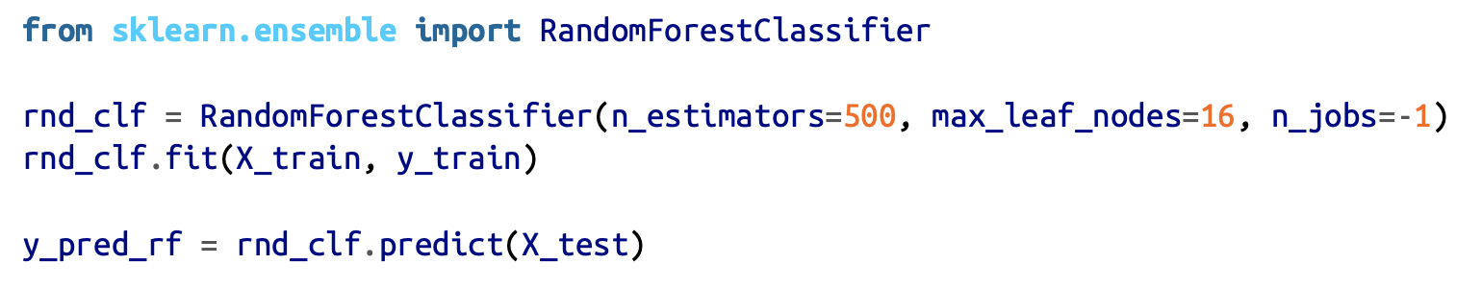
Random Forests
Following code trains a Random Forest classifier with 500 trees (each limited to maximum of 16 nodes), using all available CPU cores:

Slide 7
Random Forests
class sklearn.ensemble.RandomForestRegressor(n_estimators=10, criterion=’mse’, max_depth=None, min_samples_split=2, min_samples_leaf=1, min_weight_fraction_leaf=0.0, max_features=’auto’, max_leaf_nodes=None, min_impurity_decrease=0.0, min_impurity_split=None, bootstrap=True, oob_score=False, n_jobs=1, random_state=None, verbose=0, warm_start=False
Need to remember:
n_estimators, max_depth, min_samples_leaf, and max_features
n_estimators is simply the number of trees. The more uncorrelated trees in our forest, the closer their errors get to average.
max_depth is how many splits deep you want each tree to go. max_depth = 50, for example, would limit trees to at most 50 splits down any given branch.
min_samples_leaf= 10 tells each tree to stop splitting if doing so would result in the end node of any resulting branch having less than 10 leaves.
max_features tells each tree how many features to check when looking for the best split to make

Slide 8
Random Forests
Introduces extra randomness when growing trees;
Instead of searching for the very best feature when splitting a node, it searches for the best feature among a random subset of features.
this results in a greater tree diversity
this trades a higher bias for a lower variance
generally yielding an overall better model
Notes:
We say our model is biased if it systematically under or over-predicts the target variable. In machine learning, this is often the result of either the statistical assumptions made by our model of choice or of bias in the training data.
Variance, on the other hand, in some sense captures the generalizability of the model. Put more precisely. It measures how much our prediction would change if we trained it on different data. High variance typically means we are overfitting our training data, finding patterns and complexity that are a product of randomness instead of some real trend. Generally, a more complex or flexible model will tend to have high variance due to overfitting. Still, lower bias because by averaging over several predictions, our model more accurately predicts the target variable.
On the other hand, an underfit or oversimplified model, while having a lower variance, will likely be more biased since it lacks the tools to capture trends in the data fully.

Slide 9
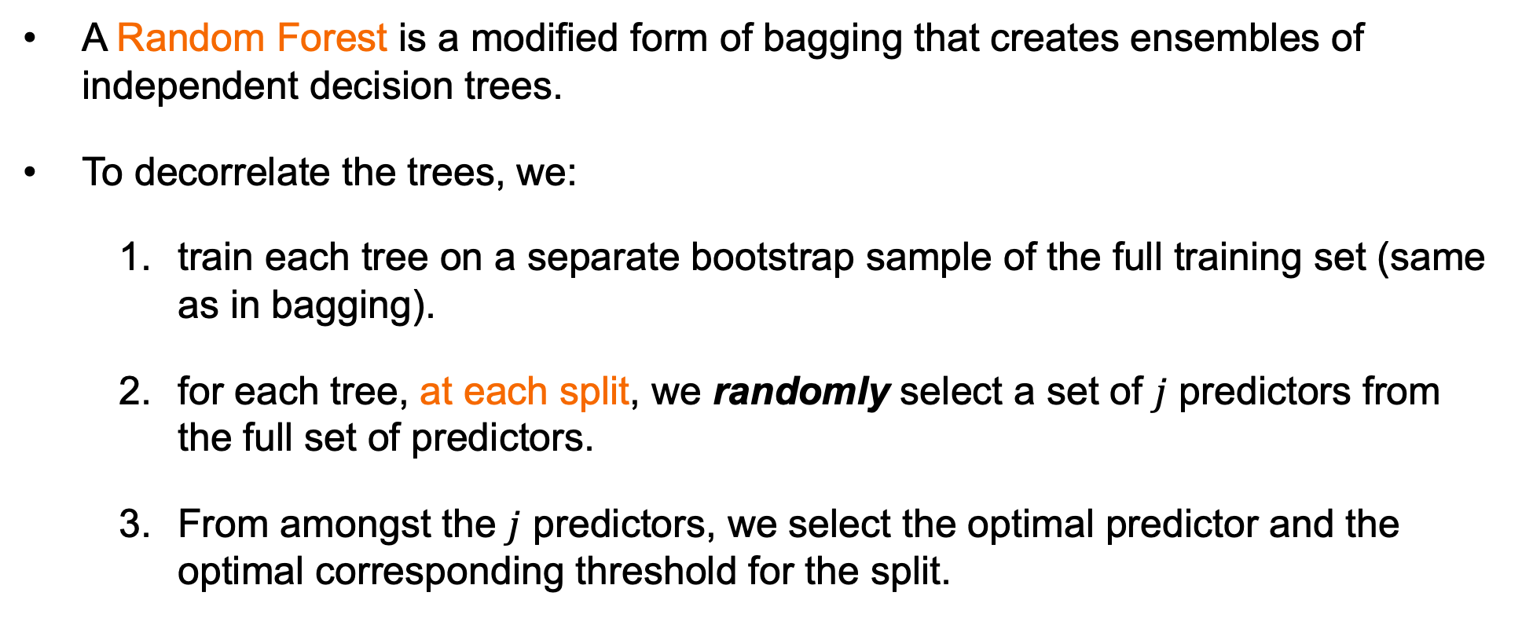
Random Forests
A Random Forest is a modified form of bagging that creates ensembles of independent decision trees.
To decorrelate the trees, we:
train each tree on a separate bootstrap sample of the full training set (same as in bagging).
for each tree, at each split, we randomly select a set of $j$ predictors from the full set of predictors.
From amongst the $j$ predictors, we select the optimal predictor and the optimal corresponding threshold for the split.

Slide 10
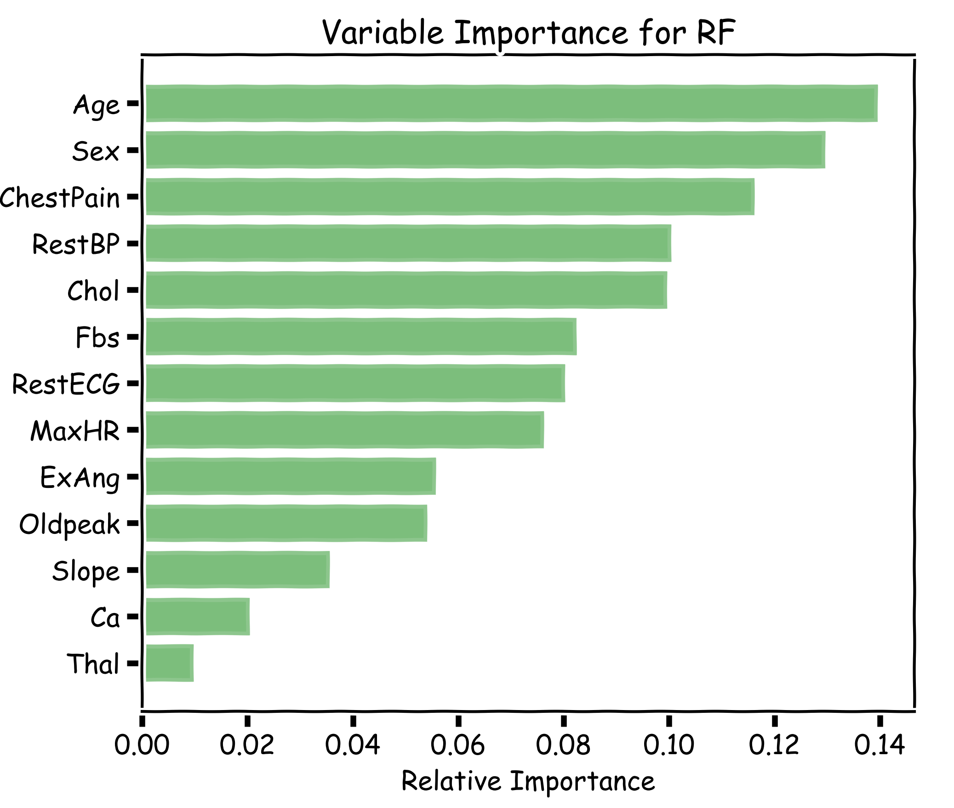
Explanations using Random Forests
Explaining predictions from tree models is always desired; the patterns uncovered by a model are, in some applications, more important than the model’s prediction performance.
A drawback of RF, Bagging, and other ensemble methods, is that the averaged model is no longer easily interpretable - i.e. one can no longer trace the logic of an output through a series of decisions based on predictor values!

Slide 11
Attributions
Some of these slides are based on material from HandsOn machine learning 2nd edition, slides prepared by Pavlos Protopapas et al.

