Slide 1
Adaptive Neural Interface System for ALS and Parkinson's Disease Patients
Action-Oriented Research Project
Author: Artem Kuvaev
Scientific Advisor: Valeria Boldyreva, Physics Teacher

Slide 2
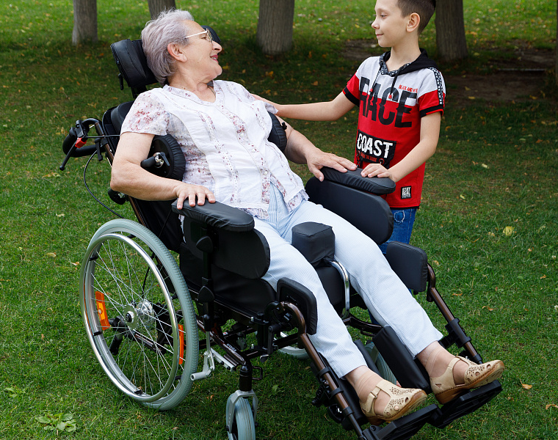
Relevance & Objectives
• ALS and Parkinson's disease severely limit movement and speech, while cognitive Current brain-computer interfaces (BCIs) struggle to process damaged or noisy neural signals.
• Project Goal: Develop an algorithm prototype achieving ≥ 85% accuracy on synthetic datasets.
• Solution: An adaptive system tailored to the individual neurophysiological characteristics of each patient.
functions remain fully intact.

Slide 3
Chapter 1: Algorithm Architecture
• Signal Preprocessing: Butterworth, notch, and bandpass filtering.
• Feature Extraction: Spectral analysis and data normalization.
• Machine Learning Models: Deep learning integration using CNN and LSTM architectures.
• Loss Functions: Optimized via MSE, Cross-Entropy, and Dice Loss.
• Modular Pipeline: Comprises attention mechanism, signal reconstruction, and intent decoder blocks.

Slide 4
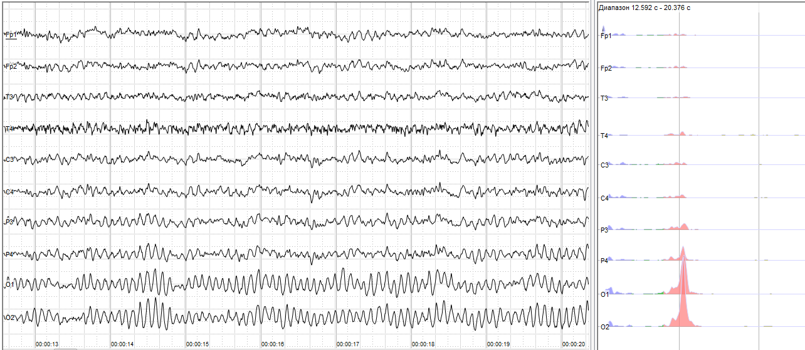
Chapter 2: Synthetic Data Testing
• Framework validated on synthetic datasets matching Neuralink specifications (30 kHz, 1024 channels).
• ALS Models: Reached 92.2% signal restoration accuracy in early-stage simulations.
• Parkinson's Models: Demonstrated stable tremor suppression over long-duration records.
• Multi-stage evaluation conducted across early, intermediate, and critical phases of neurodegeneration.

Slide 5
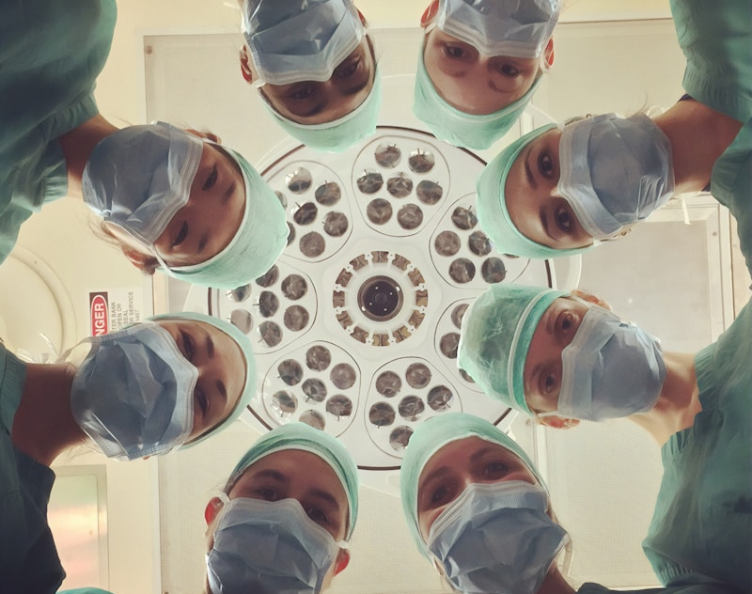
Chapter 3: External Hardware Unit
• Advanced BCIs require heavy computing power, necessitating an external wearable processing unit.
• Hardware Components: High-performance deployment using GPU and FPGA architectures.
• Real-time data processing and signal decoding.
• Seamless integration with the Neuralink Box environment.
• Customized algorithmic pipelines designed specifically for Parkinson's tremor filtering.

Slide 6

Chapter 4: Expert Consultation
• Academic Review: Mentored by Aleksandr Terekhov, Department of Normal Physiology at SZGMU named after I.I. Mechnikov.
• Project conceptualization evaluated as highly promising and practically feasible.
• The external wearable device approach was confirmed as a realistic engineering solution.
• Critical physiological constraints addressed: electrode glial scarring and periodic software recalibration.

Slide 7
Conclusion
Successfully developed a functional prototype of an adaptive neural interface system.
Benchmark results on synthetic data confirm that all primary target metrics have been met.
Academic consultation fully validated the scientific viability of the chosen technical approach.
Practical Impact: Promising foundation to assist ALS and Parkinson's patients with communication and device control.

Slide 8
References
Оппенгейм А. В., Шафер Р. В. Цифровая обработка сигналов. Учебник по ДВС, фильтрация, спектр, дискретное преобразование Фурье.
Welch P. D. The use of fast Fourier transform for the estimation of power spectra: a method based on time averaging over short, modified periodograms. IEEE Trans. Audio Electroacoust., 1967 (метод Уэлча).
Гайтон А. К., Холл Дж. Э. Медицинская физиология (разделы о нервной системе, двигательных нарушениях).
Обзорные материалы по нейроинтерфейсам и декодированию моторных команд по многоканальным записям активности мозга.
Goodfellow I., Bengio Y., Courville A. Deep Learning / Гудфеллоу И. и др. Глубокое обучение (главы по нейросетям и последовательностям).
Gramfort A. et al. MEG and EEG data analysis with MNE-Python. Frontiers in Neuroscience, 2013 (экосистема MNE-Python).
Документация и руководства пользователя: NumPy, SciPy, scikit-learn; TensorFlow и Keras (описание API моделей).

