Slide 1
PROBLEM
We need a simple way of “drilling down” on images within a e-book.
SOLUTION
Allow expandable images to open a sub-book with more information.
IMPLEMENTATION
Using the inline-recursive style, we provide the user with an intuitive drill-down experience. Sub-books contain their own expandable sub-books, so the reading experience never loses consistency.
DESIGNER
Graham Kaemmer

Slide 2
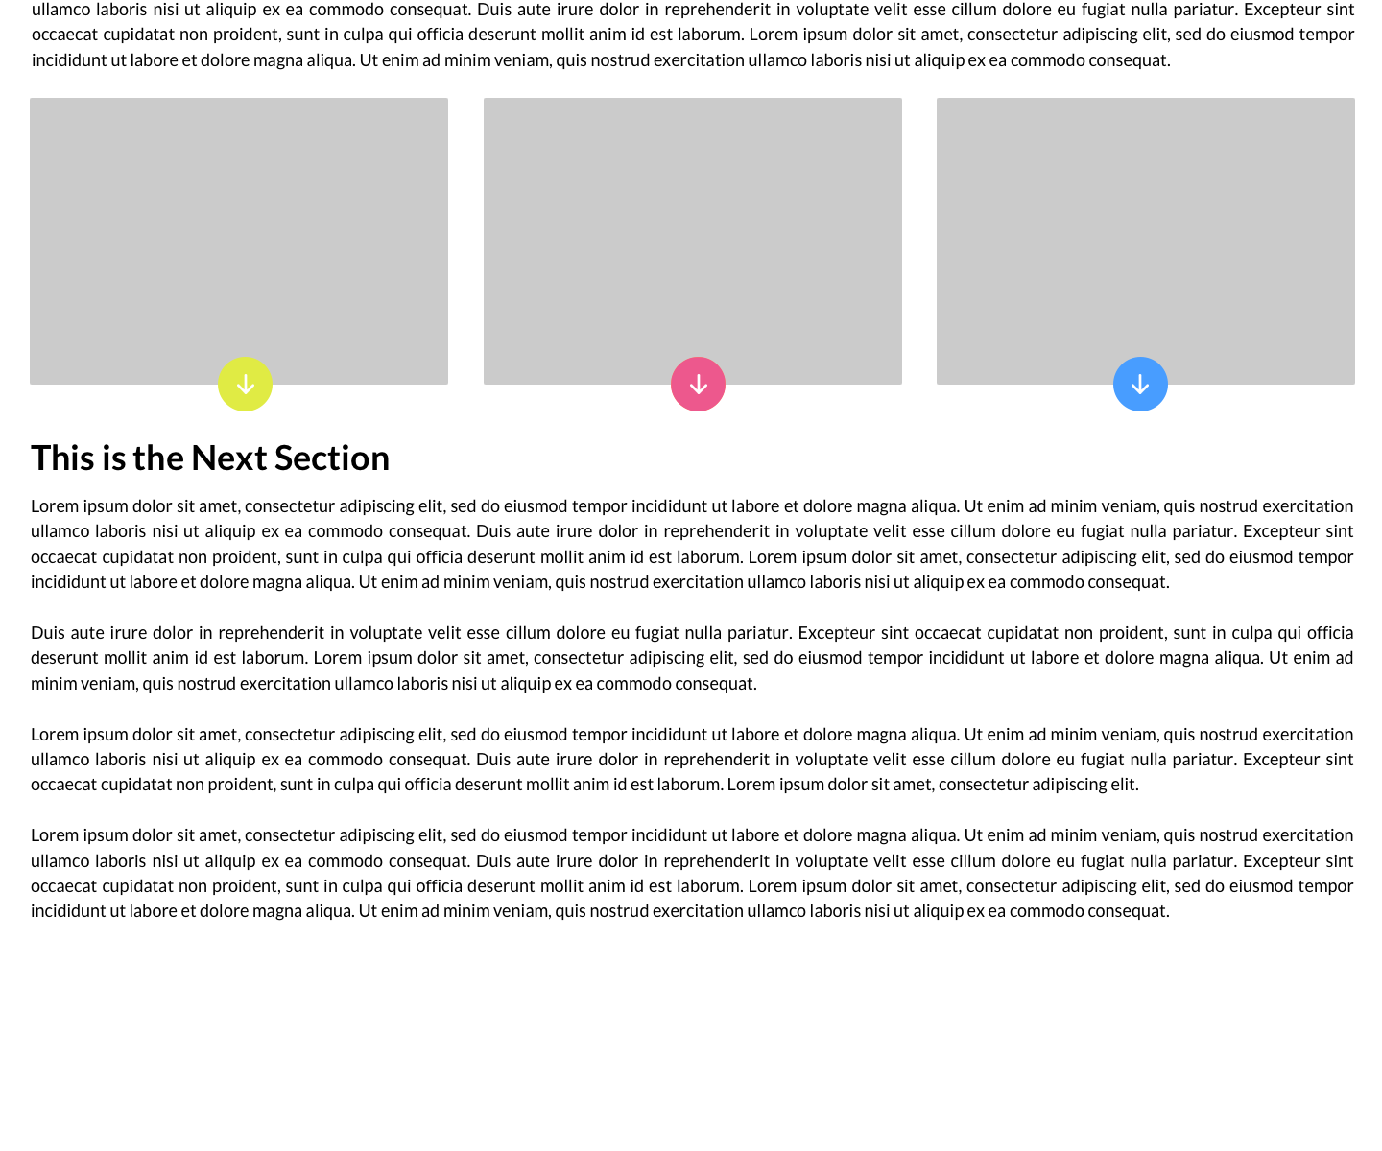
Each of these three images are expandable, indicated by their colored down-arrows.

Slide 3
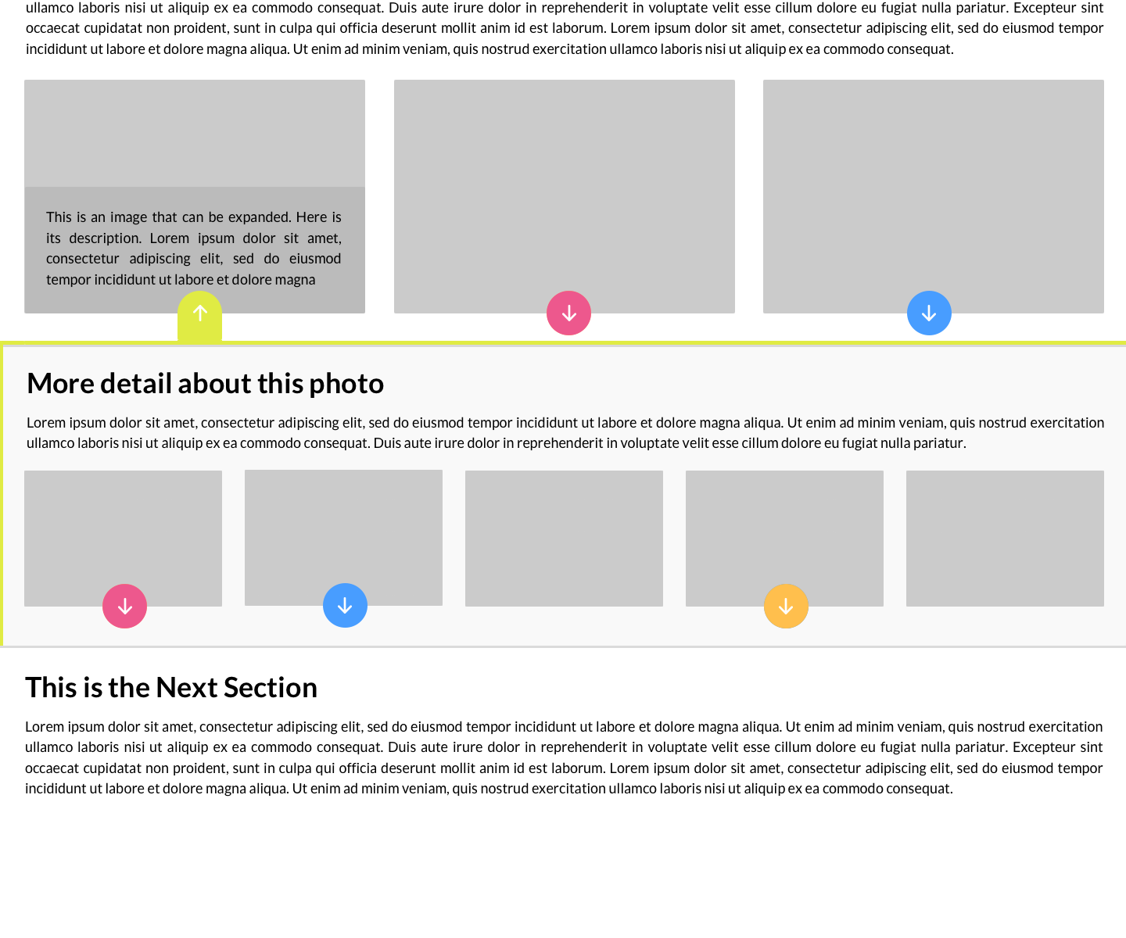
When hovered over or expanded, the image displays its caption.
A small inner shadow, along with a slightly darker background, imply that this sub-book lies beneath its parent.
The color of the button represents the book, wrapping it with both a top and left border. Taking advantage of this color, the button expands to connect to its sub-book.
More images can appear in the sub-book, and those that are expandable have their own buttons.

Slide 4
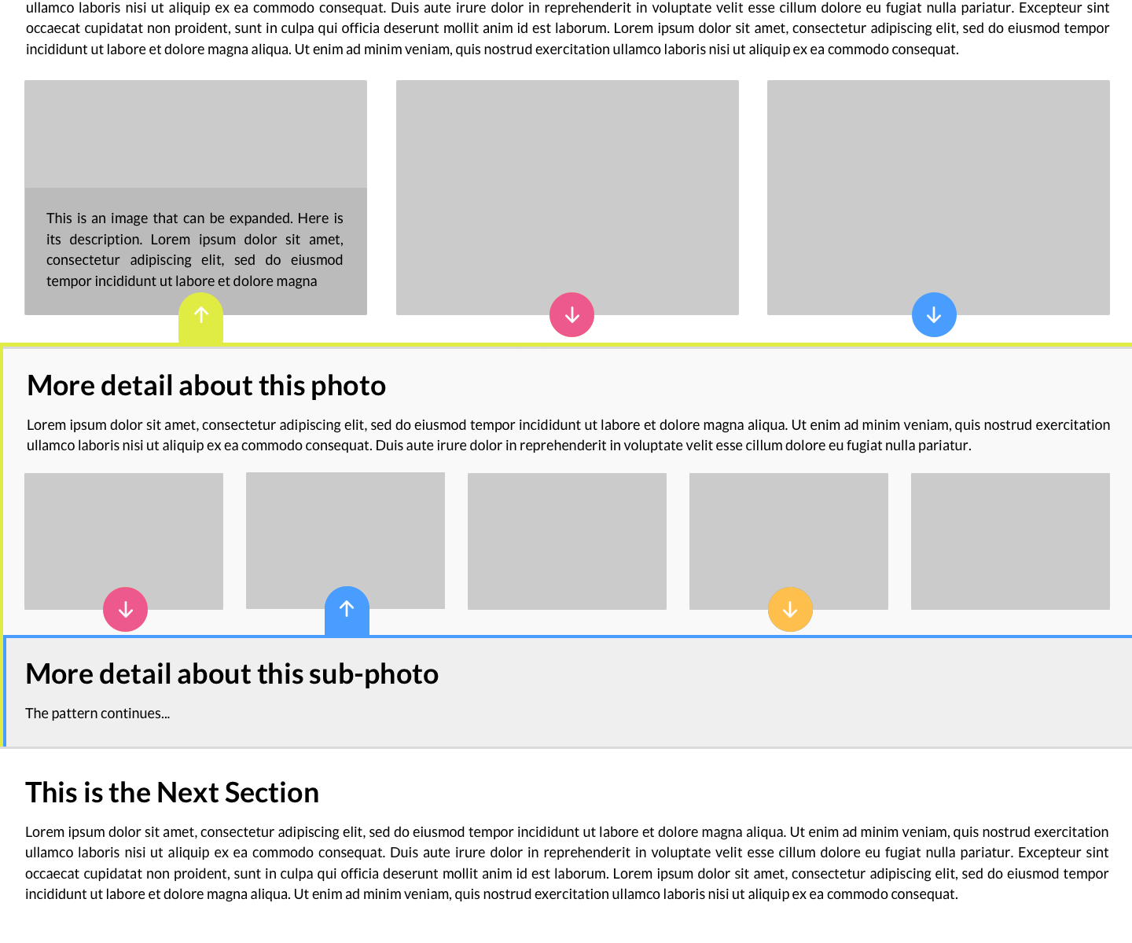
Consistent with the top level, the next sub-book also is uniquely identified by its button’s color.
Another corresponding border appears within the other, indicating how many books are open. The background color also darkens further.

Slide 5
LIMITATIONS
Clearly, this system can only accommodate a depth of perhaps 10, before the left border grows too wide or the background grows too dark.
The colors, which should all be unique within a single path of sub-books, should match each other so as not to distract the user with their ugliness. With colored images, perhaps subtler colors should be used.

