Slide 1
Efficient clustering algorithm to segregate tests on their execution behavior
Ganesh K
Intern R&D GS & Tools

Slide 2
Agenda
Why this project?
What is this project about?
What did I learn in PTC?

Slide 3
BY the Numbers
1
Product
1
Project
172677
Tests
48295
Useful Tests
4
months

Slide 4
Why this project?
I’m curious about
Artificial Intelligence
Data Science
Machine Learning
Next generation job opportunities
Artificial Intelligence
Bio-technology
Nano-technology

Slide 5
What did I learnt
18 – relative path
>get values from string
>split that string
>pass split string to the web()
19 – compared the version values dictionary
20 – compared two keys
>cleaned old code
>removed confirmationMsg()

Slide 6
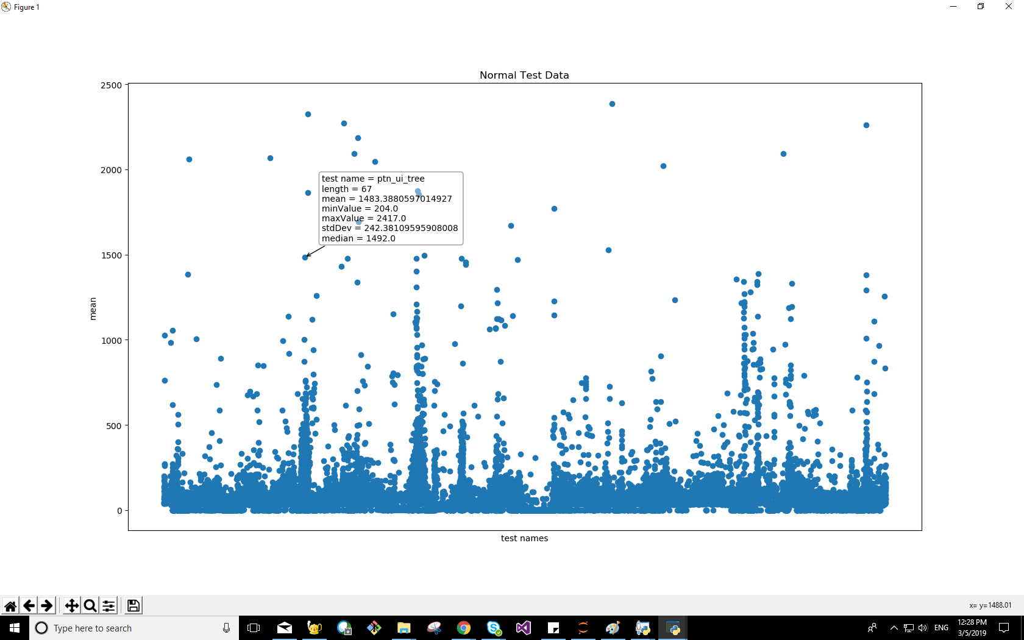
Output – (48,295)

Slide 7
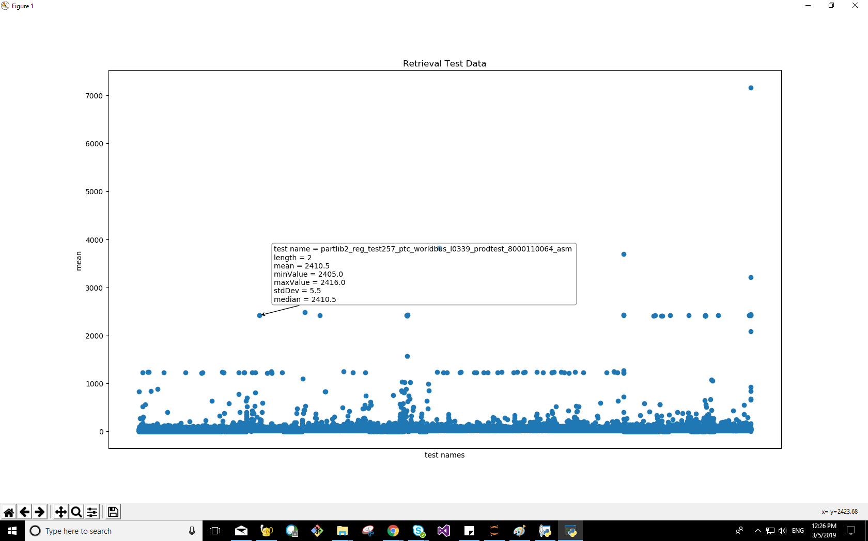
Output – (124,382)

Slide 8
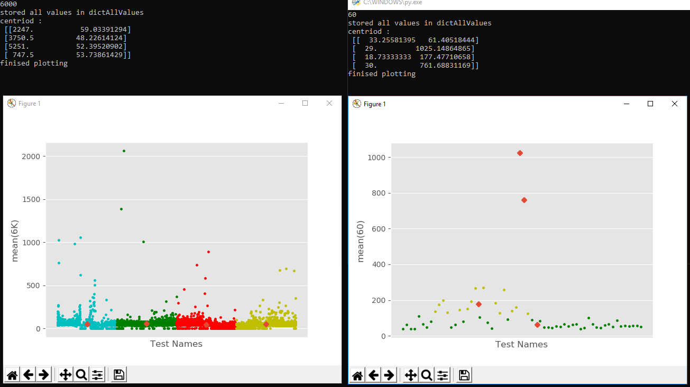
Output

Slide 9
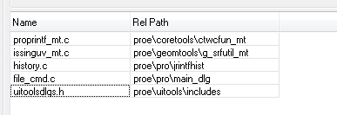
Why do build this way
Solution
“Integration” pre-builds libraries and executables
Developers relink the executable, using as many pre-built binaries as possible
Usually, the resulting xtop.exe is 99.8% pre-built
Objects built in project | System Pre-built Objects
4 | 2674

Slide 10
How do we build
Platform used - Windows
Command line tools – you can invoke directly from the shell
Compiler – transform C/C++ code to machine code (*.obj)
Linker – mashes together object files to an executable or dll
The tools and concept work in similar ways on Sun, Linux and Mac OS X
All commands in this presentation are for Microsoft Visual Studio, on Windows

Slide 11
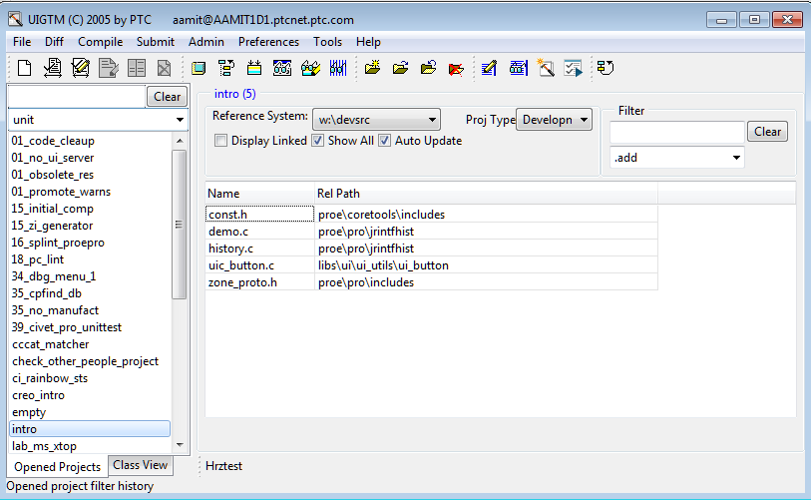
UiGtm

Slide 12
How it all works together

Slide 13
Using your Header File
Fetch a header file to your project
Update the makefile
The include search path will be modified – to first look at your project files
Whenever you write an #include inside a header file, make sure you use <> (and not “” )
(Self learning) – why?
Use /showIncludes compiler flag to research this

Slide 14
Summary- compilation
We compile all the source file in one directory at once
‘gmk’ tweaks the include search path so the project files override the system files
Always do “Update&Make” after fetching a file (either .c or .h)

Slide 15
The linker treats .OBJ and .LIB differentlYof libraries
f:\tmp\LL\shipsrcp20\spg\system_1\x86e_win64\libs\lightning\uitk_integ\obj\uitk_integ.lib f:\tmp\LL\shipsrcp20\spg\system_1\x86e_win64\proe\solvertools\objmd\solvertools_md.lib d:\home\aamit\proj\hrztestp20\x86e_win64\proe\geomtools\objmd\g_uv2dcntr_mt.obj f:\tmp\LL\shipsrcp20\spg\system_1\x86e_win64\proe\geomtools\objmd\geomtools_md.lib f:\tmp\LL\shipsrcp20\spg\system_1\x86e_win64\proe\unitmgr\objmd\unitmgr_md.lib
The linker won't include any stuff from an OBJ inside a library unless there's a reference to at least one symbol from that OBJ.
In other words,
Explicitly named OBJs on the linker command line fly first class, and are always included in the executable.
OBJs from LIB files fly standby, and are only included in the executable if referenced.
http://www.microsoft.com/msj/0797/hood0797.aspx

Slide 16
Example
main.c : int main() { display(); }
f1.c : void display() {printf(“from f1\n”);}
f2.c : void display() {printf(“from f2\n”);}
% lib /out:mylib.lib f1.obj
% link /out:f1.exe main.obj mylib.lib
% link /out:f2.exe main.obj f2.obj mylib.lib
First Class
Standby
Compare /verbose output

Slide 17
Gotchas

Slide 18
Solution
Use Build Archives
The “Build Archives” option, tells gmk to generate a makefile that re-packages all the libraries
The makefile generated by ‘gmk’, calls ‘lib’ to generate library
combining your objects and the system’s objects
It could be used all the time. It is presumed to slow the build a bit
Always do ‘Build Archives’ at least once for your project before submission

Slide 19
Supporting Slides

Slide 20
Where to get more info
github.com/gkalidas/Python/tree/master/MCS_project_sem_III

Slide 21



Submission
A developer can make changes and run his project and see the result
Submission
Integration Build
System Update
Updated $PTCSYS

