Slide 1


Shree Chanakya Education Society’s
Indira College of Commerce & Science, Wakad, Pune
Project Presentation
“Efficient clustering algorithm
to segregate tests
on their execution behavior”
By,
Ganesh Londhe
M.Sc.(CS)-II

Slide 2
AGENDA
What is this project about?
Why this project is needed?
H/W & S/W Requirements
UML Diagrams
Output
Future Enhancements
References

Slide 3
What is this project about?
Regretion tests
Automation
Machine Learning

Slide 4
Why this project needed ?
Related to my work
- Existing system
- Limitations
- Manual work
I’m Curious about
- Artificial Intelligence
- Data Science
- Machine Learning
Next generation’s job opportunities
- AI
- Bio-technology
- Nano-technology

Slide 5
H/W & S/W Requirements
Hardware Requirements :
8 GB RAM
Intel 4th generation or above processor
Software Requirements :
Windows/Linux
Tools:
Jupitor notebook
matplotlib
Technology:
Python 3.6 or grater

Slide 6
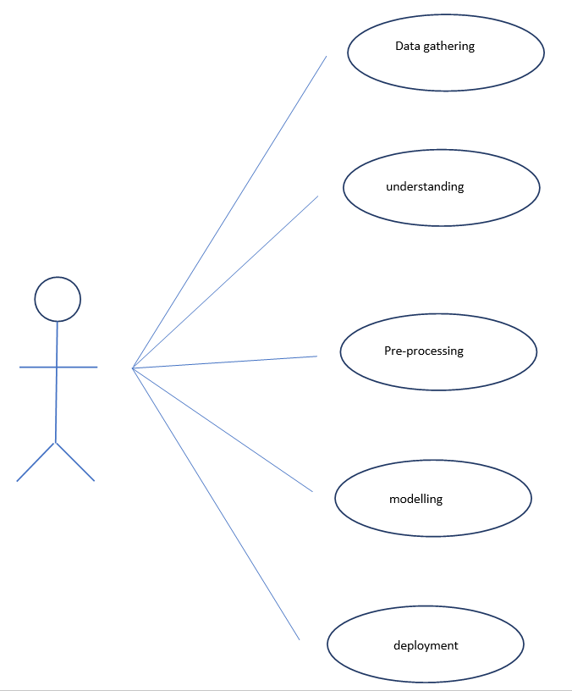
UML Diagrams
Use Case Diagram

Slide 7
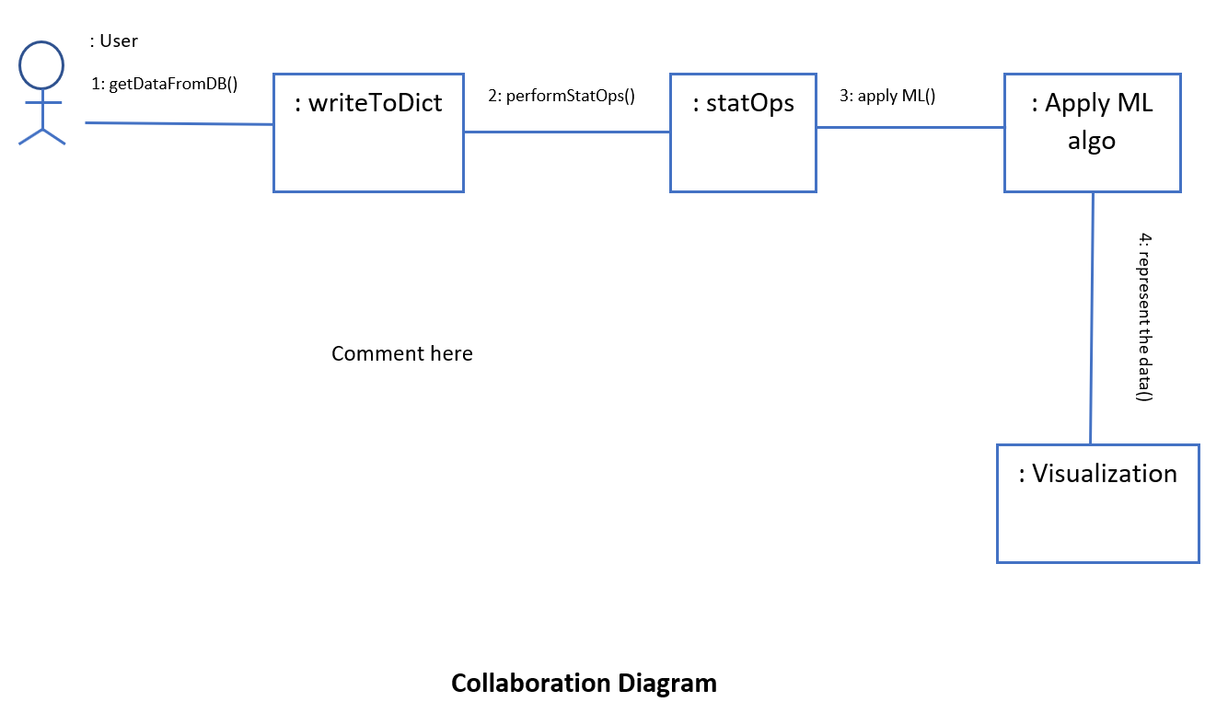
UML Diagrams - Collaboration
Collaboration Diagram :
: User
1. Start the Application 2.Enter values
: System
3. Calculate and show results
4.Save results
6. Response
5. Request for previous data
: Database

Slide 8
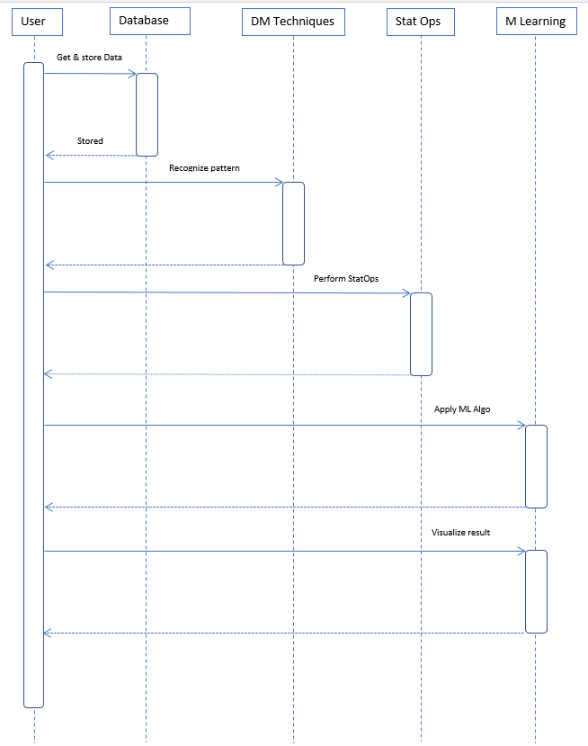
UML Diagrams
Sequence

Slide 9
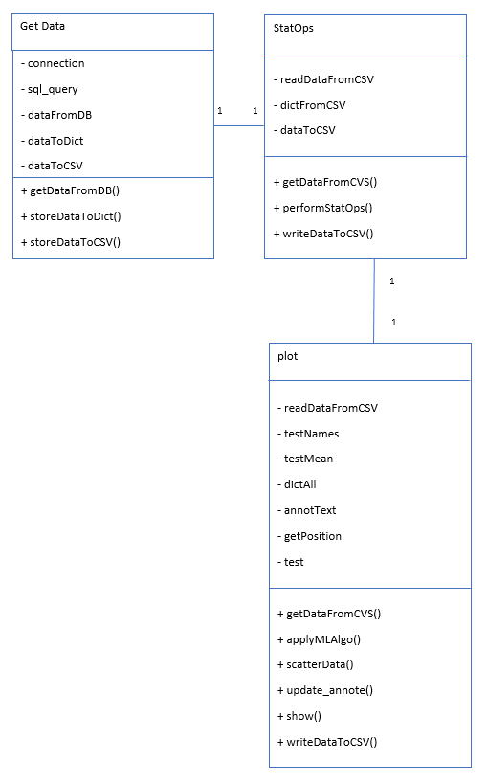
UML Diagrams
Class Diagram

Slide 10
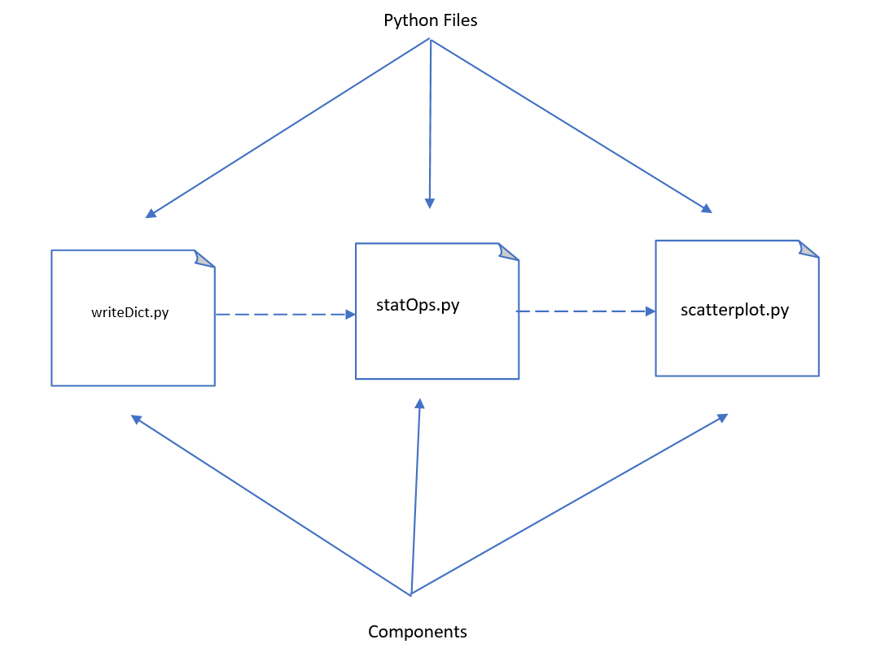
UML Diagrams – Component

Slide 11
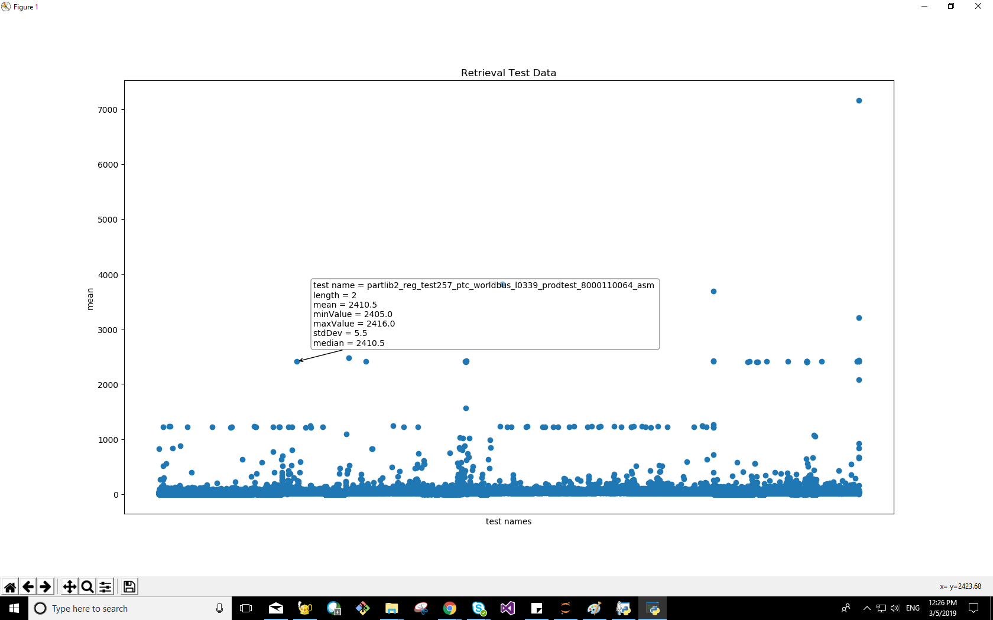
Output – (124,383)

Slide 12
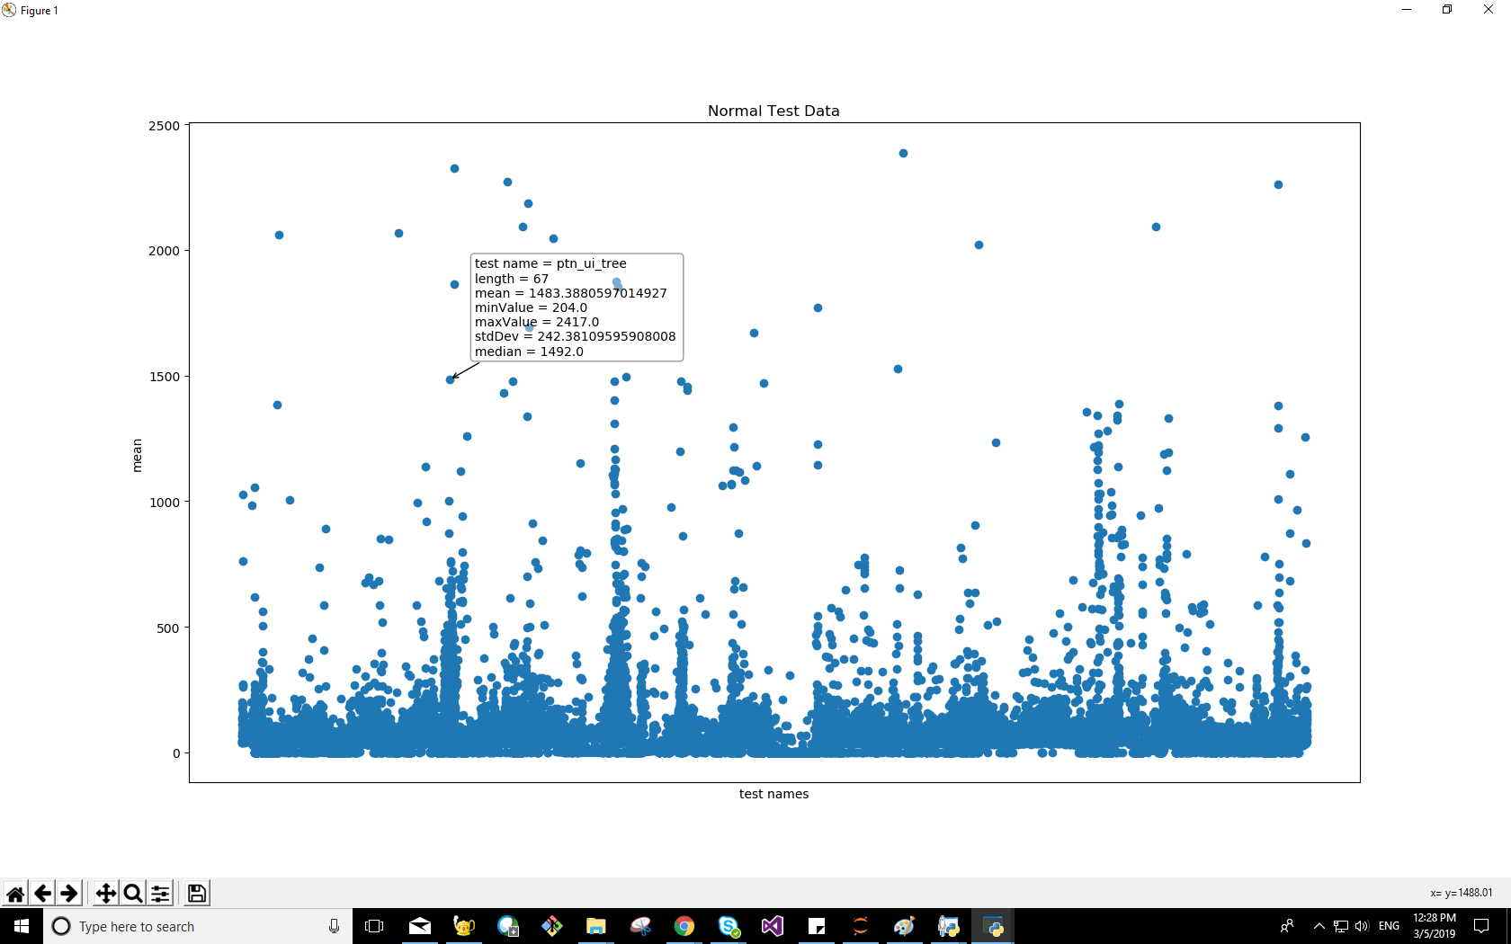
Output – (48,295)

Slide 13
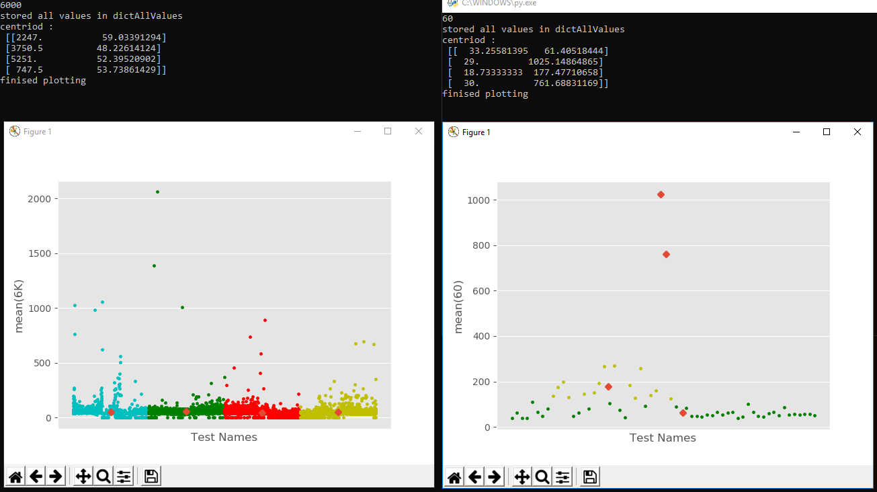
Output – (48,295)

Slide 14
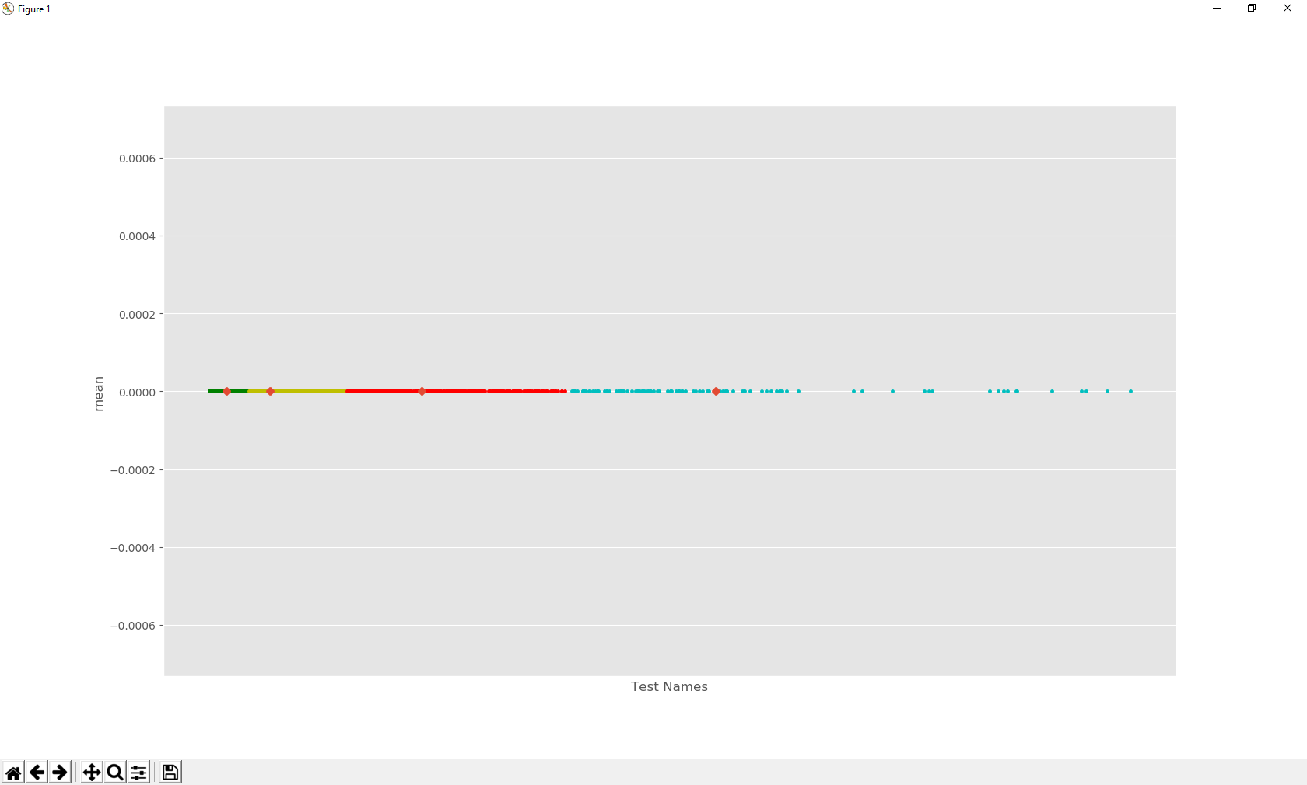
Output – (48,295)

Slide 15
Future Enhancements and References
Prediction of the test
Daily, weekly, monthly and yearly report
can be generated
Python.com
Youtube.com
Scikit-learn.com
Wikipedia.com
Youtube.com/sentdex

Slide 16
Where to get more info
github.com/gkalidas/Python/tree/master/MCS_project_sem_III

Slide 17
?

Slide 18
Thank You!

